Slide 1
The Discipline of
Scientific Presentations
- Workshop I
For Post Docs / Graduate Students
Delivered by:
Karen Ramorino Ed.D.

Slide 2
Introduction
There are three primary learning objectives for the course…
To identify and articulate the differences between strong and weak presentations
To gain a better understanding of how to develop and prepare for a presentation
To learn how to give better presentations
Notes:
Michael Alley’s background: technical editor at Sandia Laboratories. Now a professor in technical communication at Virginia Tech. Researched stories of Nobel prize winners and their speaking and lecture capabilities.
My background.
Also, Joe Kwan and Spencer Klein provided conceptual assistance and edited presentation

Slide 3
Introduction
What’s needed for participation
in the course…
Participant Resource
Copy of a recent presentation you delivered
Course Material
Presentation Planning Worksheet
Notes:
Michael Alley’s background: technical editor at Sandia Laboratories. Now a professor in technical communication at Virginia Tech. Researched stories of Nobel prize winners and their speaking and lecture capabilities.
My background.

Slide 4
Introduction
    To convey an idea
    To transfer information
    Communicate your contribution
What is the purpose of presentations?

Slide 5
Introduction
What is the purpose of presentations?
Speaker has an opportunity to provide more in depth information about an aspect of a topic or particular research and to answer questions on the spot for the audience.
Poorly organized presentations or poorly presented
visuals at lectures or conferences can result in
misunderstandings about the significance of
the research or findings.
Notes:
Advantages: can have interaction with audience. More options with presentations than with document: more visuals, more audience interaction, and information is current to date.
Disadvantage: no chance for audience to look up background information; success dependent on speaker’s ability to deliver speech

Slide 6
Introduction
Why are presentations important?
Effective scientific presentations communicate highly complex hypotheses, methodologies and results…
to colleagues and managers, and often to legislators and other key public administrators who do not have in-depth training in sciences…
but who are making critical decisions about appropriations for research projects and determining industry and national priorities.
Notes:
For post docs, future in future may have these implications.
While most presentations are given orally, the message is often discussed by others after lecture is over, may even make important decisions from it.
Job interviews. Most universities hire people partly to teach. I fyour presentation is poor, they will think you can’t teach.

Slide 7
Introduction
Sometimes there are consequences to poor presentations…
1986 explosion of the Challenger
spacecraft shortly after takeoff.
Morton Thiokol engineers made a weak and unsuccessful presentation to convince NASA to delay the launch. The result was an explosion shortly after lift-off that killed all seven crew members on board.
Notes:
One of the missing links in the chain of events leading to the explosion shortly after the 1986 takeoff of the Challenger spacecraft was an ineffective oral presentation by Morton Thiokol engineers to NASA administrators on the preceding night. The engineers knew that the lower the launch temperature, the more likely that explosive gases from the solid booster rockets would escape. Engineers succeeded in convincing Morton Thiokol’s management to request a delay, but they met a lot of resistance when they tried to convince NASA.
Investigations into the actions leading up to the explosion identified a teleconference between Morton Thiokol engineers and NASA administrators on the preceding night of takeoff failed in part because the engineers didn’t target the audience and didn’t understand the strong bias that NASA had against delaying the launch. It was easier to convince their own management because the bias against delay was not as strong.
They also didn’t create visuals that were clear and succinct in their message and didn’t consider carefully the occasion of the presentation.

Slide 8
Introduction
Sometimes there are consequences to poor presentations…
J. Robert Oppenheimer
In his first semester at UC Berkeley in 1929
he encountered a big problem - by mid-semester
all but one student had dropped out. Students
complained to the head of the Department that they couldn’t understand what Oppenheimer was saying.
Notes:
“Father of the atomic bomb”, first director of Los Alamos National Lab, and head of the Manhatten Project – the development of the first nuclear weapon.
In his early lectures given at UCB in 1929 during his first semester of teaching, he was already well known for this work on quantum theory. Halfway through the semester the number of students registered for his course had dropped to one. One of his former student said of him: “Since we couldn’t understand what he was saying we watched his cigarette. We were always expecting him to write on the board with it and smoke the chalk, but I don’t think he ever did.”
Principal reason was that he did not target his speech to students. His pace was too fast for them; he felt it was too slow. He made seemingly obscure references to the classics of literature and philosophy, students didn’t understand it. Students complained to the head of the department. He didn’t match what he said to the audience, purpose and occasion.

Slide 9
Introduction
The ability to give good
presentations is a craft
that can be learned.

Slide 10
Introduction
There are different types of presentations…
Scientific colloquium
Conference
Seminar
Class lecture
Notes:
Times vary. Conference presentation may be up to 20 minutes. Seminar may be an hour. Class lecture may be an hour or more and is part of a structured class for learning

Slide 11
Introduction
There are different types of presentations…
Informational
Inspirational (e.g. association meetings or conferences, after dinner speech)
Proposal for funding
To management
Notes:
Information is usually short. Inspirational – less technical detail and more emotional appeal.
QUESTION: What kind do you anticipate doing?

Slide 12
Introduction
Different kinds of presentations require different approaches to preparation, production and delivery…
Different presentations are needed for different audiences
For example:
A class lecture might be an appropriate opportunity to pass around models and objects, but for a presentation at a large scientific conference it probably is not
An inspirational presentation is effective for a keynote address or a talk to new students, but not for a university colloquium

Slide 13
Introduction
Four considerations for the presentation…
Speech
Structure
Visual Aids
Delivery
Notes:
Speech – what is the message we want to say to the particular audience we are speaking to?
Structure – how will it be organized, how will it flow for the audience, the message you want to convey?
Visual aids – how will you make visual examples that support your key points?
Deliver – how will you help the audience to understand my key message? They don’t have to agree with you, but at least they walk away informed and understand the key points you wanted to get across.

Slide 14
Speech
Considerations
A speech targeted to the audience is essential for a presentation’s success

Slide 15
Speech
Considerations
Know your audience…
What are their roles in relation to your topic?
  Scientific expert in sub-field - Scientists from other fields
  Senior scientists - Graduate students / post docs
  Decision-maker - General interest in topic
  Collaborators
What will the audience do with the information?
What are their expectations from presentation?
How much do they know about your area of science?

Slide 16
Speech
Considerations
Know your purpose…
Inform: with facts, findings, opinions
Persuade: change understanding about your findings or area of expertise; recommend a particular course of action
Occasional: entertainment on general topic, inspire others to your project
Instructive: explain a process or problem solution, or teach a skill, or define terms
Notes:
QUESTIONS: When would you want to inform, persuade, occasional, and instruct.
Morton Thiokol – what should they have done to NASA?
Oppenheimer – what should he have done for his student lecture?

Slide 17
Speech
Considerations
Convey your purpose to a
specific audience…
Continually ask two questions:
- Will the audience understand these points?
- Will the audience be interested in these points?
Depending on the audience, you may need to tailor:
- the examples
- the depth
- the background information
Notes:
Know want they want to hear, your work verses an overview of the field.
Ok to ask the inviter to ensure you are very clear and deliver what they want to hear.
Dan Hartley, a former VP of Sandia National Laboratories was adept at targeting audiences. He was continually giving tours of Combustion Research Facility in Livermore to DOE officials, visiting scientists from abroad, to politicians, and other visitors.
Author of the book saw him give three tours in one day, all different because audiences were different.
As he spoke, Hartley constantly watched the expressions of the audiences to gather whether what he was saying registered with them.

Slide 18
Speech
Considerations
Convey your purpose to
multiple audiences…
Speak to the different audiences at different times in the presentation
  Begin at a shallow depth that orients everyone in the room to the subject, show the importance of the subject
  Then take a deeper dive into scientific information
  Just make sure you start shallow again when beginning next sections
What if the audience includes an expert in your area of research?
  Mention the expert by name and possibly admit this person could explain the topic better, but that you will try.
  Gains respect of expert

Slide 19
Speech
Considerations
Convey your purpose to
multiple audiences…
First
Major
Topic
Second
Major
Topic
Intro
Ending
Non-technical
time
General
Technical
Specialist
depth

Slide 20
Speech
Considerations
Summary of speech considerations…
Know your audience
  What are their expectations?
  Who are they?
  Is it a target audience or multiple audience?
Know your purpose
  Identify your supporting arguments
  Identify supporting stories, analogies, and examples
Know how you will deliver the presentation given the situation
Notes:
Review Speech Considerations section in Planning Sheet. Is there anything you would change in your recent presentation based on what we just learned?
Complete the Presentation Planning Worksheet to start planning for new presentation.

Slide 21
Structure
Considerations
The success of a
presentation hinges
on its structure.
Notes:
QUESTION: What is the structure of a presentation?

Slide 22
Structure
Considerations
A presentation needs structure…
the organization of the major points
the transitions between those points
the depth that the presenter achieves
and the emphasis of details
Notes:
Aspects of the structure of a presentation are similar to that of a document, but three aspects are not.
The necessity of the speaker to begin at a depth that orients the entire audience. In a document, readers have the opportunity to look up the background. IN a presentation they don’t.
Speaker needs to map the presentation for the audience. Mapping is important in document, but is crucial for presentation because listeners don’t have a change to thumb through document to see what’s coming up.
Speaker needs to signal transitions between topics. In a document, reader can see transitions through headings and subheadings, and end of chapters. Speakers need to signal transitions with phrases.
QUESTION: How did I signal the end of Speech Considerations and a switch to Structure Considerations?

Slide 23
Structure
Considerations
A presentation needs structure…
The beginning – show the big picture
  focus audience attention on the particular topic
  introduction: summary of theory, experimental apparatus, data, analysis, conclusions
The middle – discuss the topic in a logical fashion
  typically use subcategories or supporting points
The end – analyzes work from an overall perspective
  contains a summary of the most important details of the work,
  recommendations
  how work affects big picture presented in the beginning
  Conclusion: 1 slide on conclusion, 1 slide on future work

Slide 24
Structure
Considerations
A presentation needs a
message or theme…
Highlight the structure of the presentation at the beginning so audience knows what to expect
  State theme and purpose of presentation
  Make sure themes are of interest to audience
Decide the single main point or message of presentation
  The evidence suggests that…but…
  If we solve this, then we should be able to…
  Why theory x is better than y….
  It is urgent that we….

Slide 25
Structure
Considerations
A presentation needs a
message or theme…
Identify a problem, show how it might be tackled through your research
  Review the significance of what has been done in your research
Define some distinguishing aspect of your work, such as a system, device or process, and describe its fundamental purpose
  Helps to locate technical details within an appropriate frame of reference
  Make sure reference is understood by the audience
Highlight cause-effect relationships
  Point to some effect or action that may affect the work or lives of the audience
Notes:
My Jamaica research. Women talked about the significance of their work to the development of their country, and their findings to improving living conditions to the elderly, ghetto youth, youth in classrooms and for educators.
Sylvia called fort public and private institutions to collaborate to realize the new industry from medicinal plants. She made the link to economic development.

Slide 26
Structure
Considerations
A presentation needs to be planned…
Develop an outline of the structure: purpose, introduction, body of the presentation and conclusion
  Define your purpose, attendees want to know why you are speaking
  Start with an audience hook (e.g. a question, an anecdote, a dilemma, a statistic)
Plan where graphics should go early on
Plan presentation transitions from one theme to another to the conclusion
  Should flow like a story – audience should be able to follow the story you are telling

Slide 27
Structure
Considerations
A presentation needs transitions…
Helps audience remain on track with main topics of presentation.
One level of transitions:
  between the beginning and the middle – allows audience to assign details to each of the major divisions of the presentation
  between the middle and the ending - signals the ending is near, gets audience attention

Slide 28
Structure
Considerations
A presentation needs transitions…
Second level of transitions:
  between each segment of the middle
  middle is typically divided into two, three or four divisions
  Speaker needs to make these middle transitions clear

Slide 29
Structure
Considerations
A presentation needs transitions…
1st level transition
1st level transition
Beginning
Middle
End
Point 1
Point 2
Point 3
2nd level transitions

Slide 30
Structure
Considerations
A presentation needs transitions…
In speech:
  In the middle section, moving from first point to the second point,
    “…That concludes what I wanted to say about building stages of volcanoes. Now I will consider the declining stages…”
  In moving from the middle section to the end,
    “…in summary” or “to conclude this presentation….”

Slide 31
Structure
Considerations
A presentation needs transitions…
In presentation slides:
  At the beginning, use a mapping slide that includes key images for each of the three topics in the middle.
    As make transition, show that image from the mapping slide
    Or show mapping slide again with new topic circled or highlighted
In presentation delivery:
  A pause allows for sorting, synthesis, and analysis to occur
  Holding up fingers, gesture one, two or three
  Raise or lower voice as make the transition
  Return to the podium, pause and glance at notes
Notes:
QUESTION: what was my mapping slide for this course? Slide 10

Slide 32
Structure
Considerations
Watch out for too much content…
Select details that allow the audience to understand the work and leave out details that the audience does not need or will not understand
  Give a hierarchy of details so the audience knows which details to hang onto and which to let go of in case they are overwhelmed
Audiences remember lists of two, threes and fours
  To have more is overwhelming for listeners
  If have long list, break into smaller lists with two or three overarching topics
Create a hierarchy of details
  At the beginning, show summary of essentials points
  Repetition indicates essential points
  Place key results/images onto slides, leave less important details to speech
  Pause before an important point, raise/lower the voice, step closer to audience
Notes:
This slide is a good example of too much content….
QUESTION: how could I convey this information differently?

Slide 33
Structure
Considerations
Summary of Structure Considerations…
Organization of Presentation
  Beginning, middle and end
  Identify single main point or message
Planning the Content
  Define some distinguishing aspect of your work
  Develop outline, transitions, graphic locations
Ask yourself…are you drowning the audience with details?
Notes:
Review Structure Considerations section in Planning Sheet. Is there anything you would change in your recent presentation based on what we just learned?
Complete the Presentation Planning Worksheet to start planning for new presentation.

Slide 34
Visual Aids
Most scientific presentations use “powerpoint”
as the visual support
Notes:
Most audiences expect this now days, even in class lectures.
Powerpoints are often emailed around so need to stand alone.
Power point presentation can help emphasize key points to audience.
Emphasis should remain however on speaker, not powerpoint presentation.
What will makes a memorable speech is the speaker not the powerpoint presentation.

Slide 35
Visual Aids
There are advantages and pitfalls to watch out for with powerpoint …
+ Audiences expect it
+ Can effectively show images
+ Can effectively emphasize key details
- Can be boring if no images are included
- Can be overwhelming if have too many details
- Speaker can become irrelevant if doesn’t add value
Notes:
Most audiences expect this now days, even in class lectures.
Powerpoints are often emailed around so need to stand alone.
Power point presentation can help emphasize key points to audience.
Emphasis should remain however on speaker, not powerpoint presentation.
What will makes a memorable speech is the speaker not the powerpoint presentation.

Slide 36
Visual Aids
Presentations can include other visual aids…
Types Advantages (+) and Disadvantages (-)
Models | + are effective for showing three dimensions are ineffective unless large enough for audience to see
Demonstrations | + are effective for engaging the audience + are effective for incorporating sounds and smells - can fail
Writing Boards | + more common in classrooms and brainstorming - force presenter to turn away from audience are slow for detailed drawings and difficult to read if handwriting is poor
Handouts | + ensure that audience leaves with the message - Can be distracting if distributed too early

Slide 37
Visual Aids
Slides need to be readable and clear…
Typography
Use a sans serif typeface such as Arial
Use boldface (Arial)
Use type sizes at least 18 points (14 points okay for references)
Avoid presenting text in all capital letters – too hard to read
Don’t use too many typefaces on one slide (or in one talk)
Color
Use contrasting background and type color
Test to make sure it prints out well
Be consistent in color use on all slides (e.g. data = blue, simulation = red)
Avoid red-green combinations (many people can’t distinguish and often
doesn’t project well)

Slide 38
Visual Aids
Slides need to be readable and clear…
Layout
Use a sentence headline for every slide, but the title slide
Left justify the headline in the slide’s upper left corner
Keep lists to two, three, or four items; make listed items parallel; avoid
sub-lists
Be generous with the white space, keep number of words to a minimum
Don’t overuse “special effects”
Style
Try to include an image on every slide
Make the mapping slide memorable; for instance, couple each section of the
talk with an image that is repeated in that section
Limit the number of items on each slide
Limit the number of slides - dedicate at least one minute to each

Slide 39
Visual Aids
Slides should be memorable…
Showing the presentation’s organization
makes it easy for audience to understand the message
title slide contains key information:
  - title of presentation
  speaker’s name and affiliation
  key image from the work
  and icon for the affiliation
Slides indicating transitions in presentation
mapping slide – need one slide outlining structure of presentation
first slide for each different part in the middle section - establish transitions
concluding slide – summary of key points, place for repetition

Slide 40
Visual Aids
Slides should be memorable…
Show key plots / equations / numbers of presentation
title slide and ending slide are more memorable when a key plot is
included
the brain processes visual information more quickly than text
audiences remember key plot or image longer
Show key results
Place the most important results of the presentation on your slides –
increased recall from audience
Don’t use too many numerical results

Slide 41
Weak Example
Temperature
Concern on SRM Joints
27 Jan 1986
Does not convey
main message…
delay the launch
of the Challenger
Does not identify
sending entity
and therefore
the authority
of the message
Notes:
This is first of thirteen slides from Morton Thiokol that were faxed to NASA in their failed attempt to postpone the launch of the space shuttle Challenger on January 28, 1986.
QUESTIONS: What’s wrong with this slide?
It did not reflect the ultimate purpose of the presetation: to delay the shuttle launch.
Slide also did not include Morton Thiokol’s logo, or any reference to who sent it, so it didn’t carry the authority that it should have.

Slide 42
Weak Example
New prototype for high powered laser module…
Electrical feed-through pin
Copper base
Elastomeric thermal pad
Kovar optical bench
LD Submount
AWG
Kovar lid
Uninteresting way to
present information
Notes:
This is an uninteresting way to present this information. These are the parts for a new prototype for a high powered laser module.

Slide 43
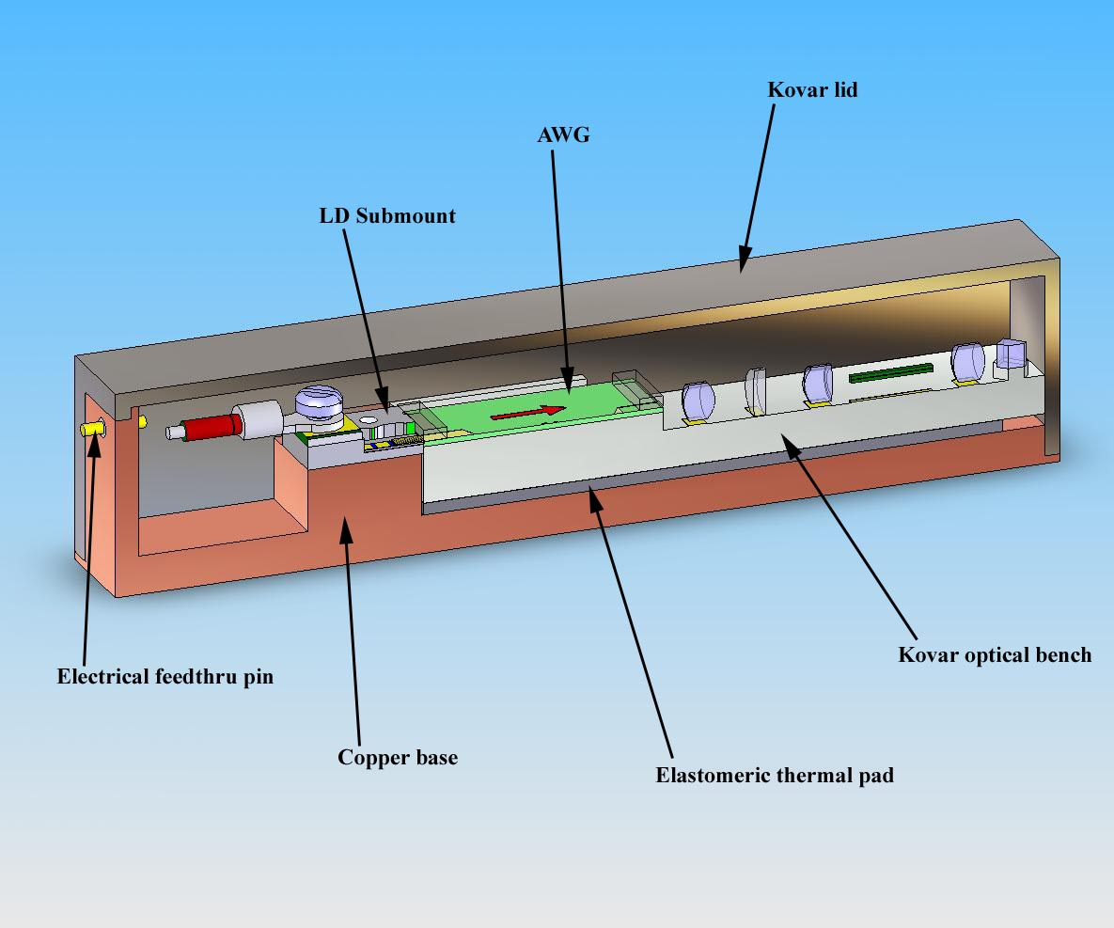
Better Example
CAD drawing
can provide more
interesting visual
Part labels
need to be
larger
Notes:
A graphic explains it much better. These are the parts for a new prototype for a high powered laser module.
What’s better about it?
What could be improved.

Slide 44
Visual Aids
Graphic plots are useful in getting complex scientific points across, but they can confuse people…
label the axes on graphs
label the curves
labels must be big enough to be easily legible
define your symbols

Slide 45
Visual Aids
Graphs are the dominant form of conveying numerical information…
But make sure they’re understandable
  Label all axes in large type
  Label all curves in large type
  No more than ~3 curves/plot
  Use colors
    Green does not display well on many projectors
    Don’t get garish

Slide 46
Visual Aids
Numbers and equations are useful for conveying quantitative relationships…
  Best way to show data
  1 or 2 numbers can be used to make a point
  However, they have pitfalls

Slide 47
Visual Aids
Equations are useful for conveying relationships if the audience can understand them…
  Keep them simple
    - Maximum of 1 line
  Clearly define all of the variables
  For complex equations, where possible, consider using a graph instead

Slide 48
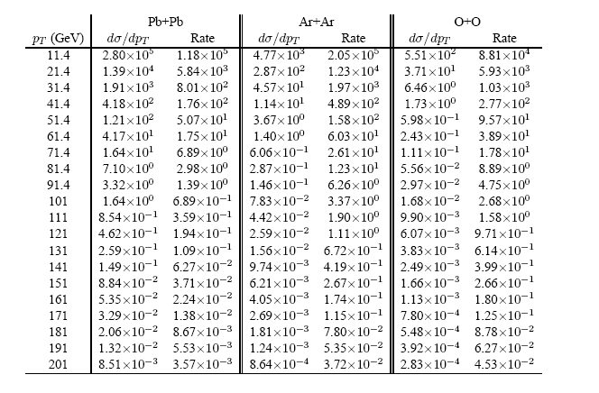
Weak Example
Don’t present large tables of numbers…
  Audiences can’t assimilate them
  Use graphs instead

Slide 49
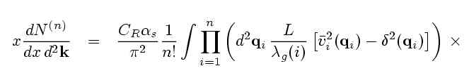
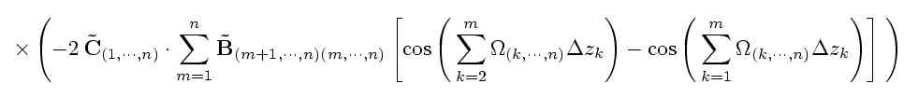
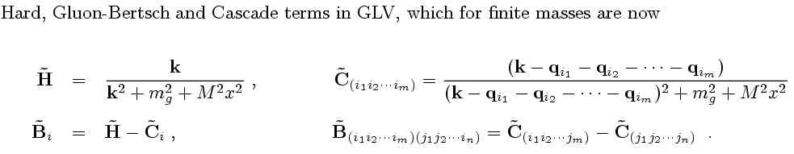

Weak Example
We generalized GLV Opacity Series (NPB594(01)) to
M_{Q} and m_{g} > 0 (DG, Nucl.Phys.A 733, 265 (04))
Hard, Gunion-Bertsch, and Cascade ampl. in GLV generalized to finite M
Notes:
Too many equations for one page…too much to digest in one slide

Slide 50
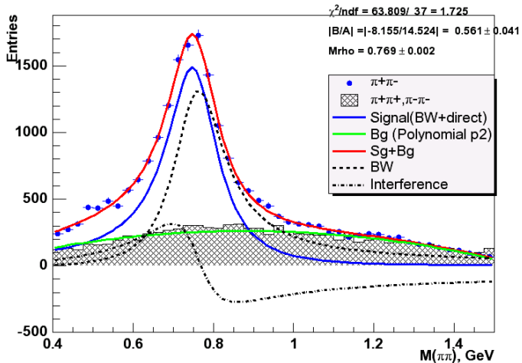
Weak Example
Points and labels are small
What looks good in a publication may not look on screen
This probably
can be fixed
γd --> ρ⁰ pn
(neutron detected in ZDC)
Preliminary
M_{ππ} (GeV)
Notes:
If you copy a plot from a paper, the labels will usually be too small.
If needed, relabel in powerpoint, as with the axis here

Slide 51
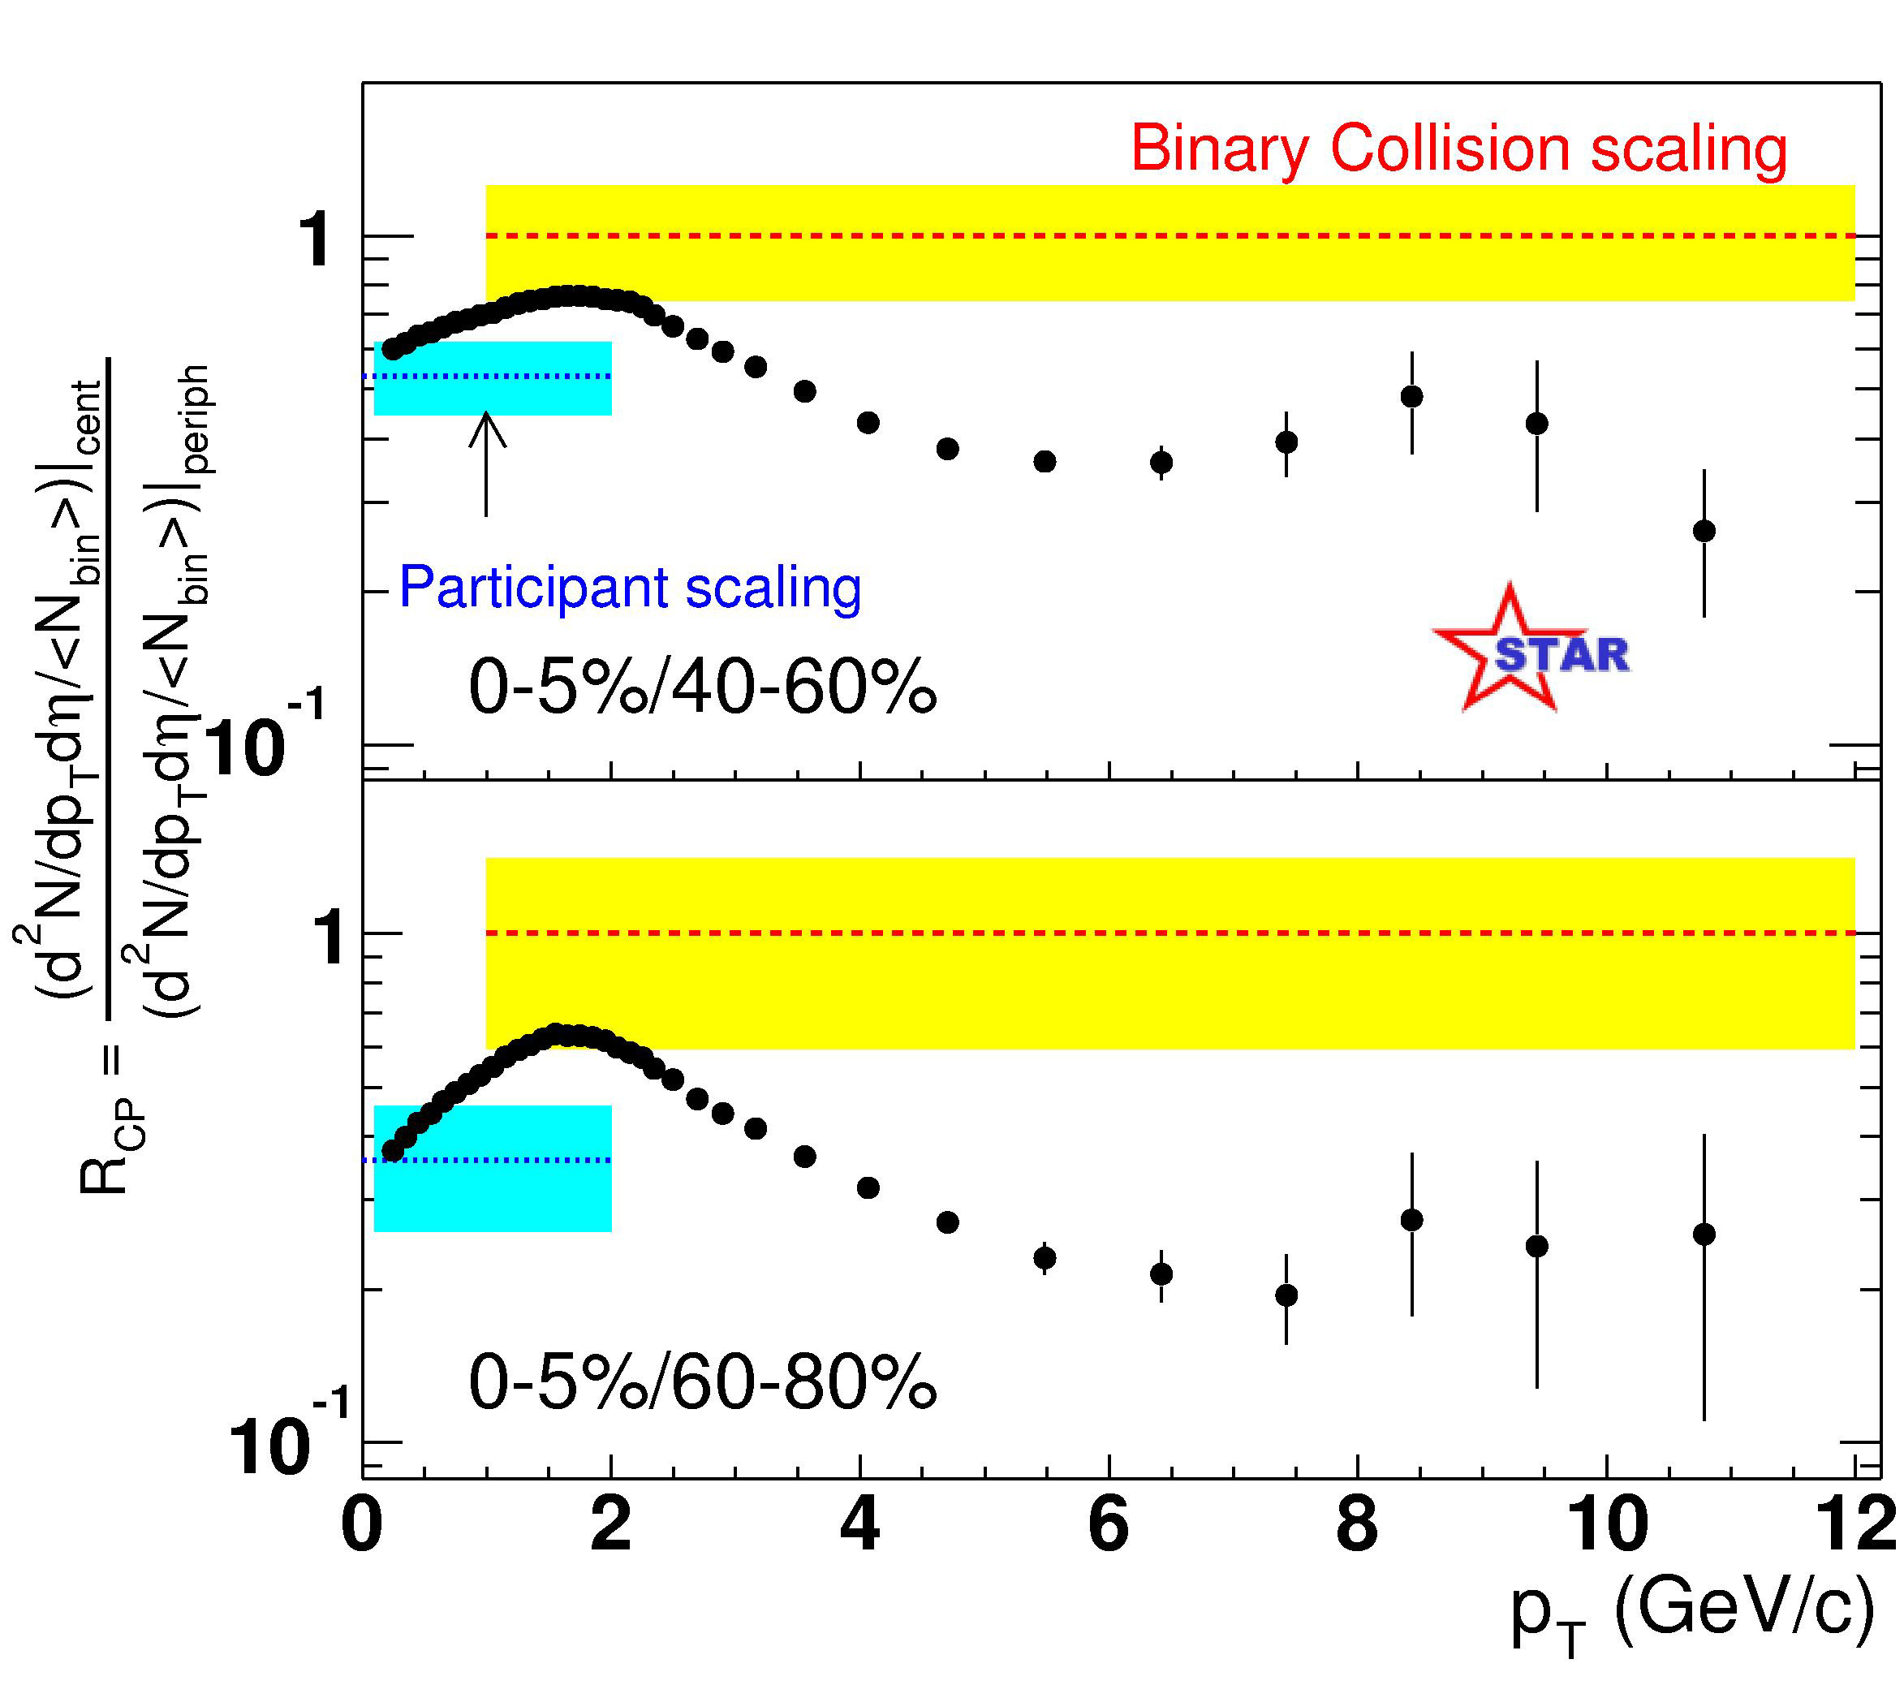
Better Example
Curves
mostly labeled
Mostly
readable
Axis label a
bit hard to
read
Notes:
Comparing collisions of two nuclei (composed of many nucleons) with individual nucleon-nucleon collisions
R_CP = 1 would mean that nucleus-nucleus collisions act like collisions of independent nucleons
Axes and curves mostly labeled. Mostly readable; axis label hard to read.
Good use of color

Slide 52
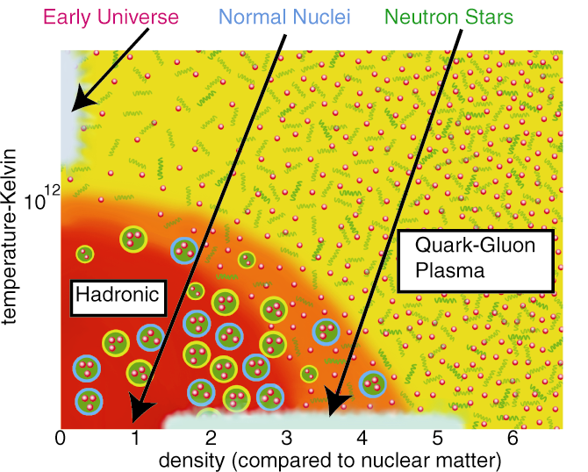
Better Example
Clearly conveys
information
Visually
appealing
Overly
complex graphics
may detract from
the physics message
Notes:
Nuclear phase diagram

Slide 53


Better Example
Easy to read
diagram
Single line equation
Big Bang
200
Quak-Gluon Plasma
150
Temperature (MeV)
100
Mixed Phase?
Hadron
Gas
50
Color Superconductor?
HL
Neutron Stars
2 4 6 8
Baryon Density (ρ/ρ₀) [relative to cold nuclei] r₀ = 1/6 baryon/ fm ³
Notes:
Nuclear matter phase diagram

Slide 54
Visual Aids
Summary of visual aids…
Create a powerpoint presentation to support
the speech and the message
Select types of visual aids
Select visual aspects of slides
Create slides that the audience remembers
Simplify the complexity of graph plots, numbers and
diagrams
Notes:
Types of visual aids: projected slides, posters, films, demonstrations, models, handouts, passed object, writing boards
Visual aspects of slides: color, size and type of type, headlines, layout and style
Slides that audience remembers: show key images that audience will remember; show key results on important results
NOTE: article in packet on “A Case for Sentence Headlines and Visual Evidence.” Gives good examples of old paradigm of thinking on powerpoint slides verses more visual presentation.
Review Visual Aids section in Planning Sheet. Is there anything you would change in your recent presentation based on what we just learned?
Complete the Presentation Planning Worksheet to start planning for new presentation.

Slide 55
Delivery
Delivery is your interaction with the audience and with the room.
Voice, gestures, eye contact, stance, movement – all contribute to the delivery.

Slide 56
Delivery
What part should presentation style play
in different presentations…
If you are not
enthusiastic about your subject, how can
you expect anyone else to be.
Content without some style may go unnoticed.
Style with no content has no meaning.
Notes:
QUESTION: can you be objective and enthusiastic? What are some techniques you could do to show enthusiasm within being objective?

Slide 57
Delivery
Building credibility is a technique …
Be objective, open-minded and fair, and present evidence and arguments in an unbiased manner
Use carefully documented evidence, cite prestigious and the most relevant sources, and cite accurately
Present both sides of the problem or issue, avoid false reasoning
Acknowledge the status and knowledge of audience
Have a highly credible person introduce you
Notes:
Important if audience doesn’t know you

Slide 58
Delivery
Preparation is critical…
Rehearse
  You learn the pitfalls
  Particularly if doing demonstrations or using equipment
  Speak to the slides not read them
Arrive early
  If something doesn’t work, you have time to fix it
  Audiences get irritated if presenter is late
  Test computer with projector before the talk
Always prepare for the worst
  Imagine the nightmare scenario and what you would do
  What if the projector bulb burns out, can you give presentation from notes, can audience follow with handouts
  If a failure occurs, turn it into an advantage

Slide 59
Delivery
Preparation is critical…
Continual self critique and revise
  Ask for feedback
  Have a colleague critique your presentation
Don’t become too orchestrated
  Don’t determine every individual part of delivery – posture, stance, hand gestures, body movements, facial expressions, eye contact, loudness of voice
  Will be too stiff and self-conscious; can happen if give the same talk too many times
Study the delivery of others
  Observe classroom techniques verses conference lectures
  Imagine what a good delivery of your presentation would look like

Slide 60
Delivery
Preparation is critical…
Take the time to prepare
  Time is needed to understand the content well enough to organize it in a fashion that is readily comprehended by the audience
  Time is needed to gather the important images
  Time is needed to rehearse
Preparing time to speak
  Most people need some time alone before they speak to gather thoughts
  Practice helps transition from one point to the next better
Notes:
Richard Feynman, after his work at Los Alamos and when he began teaching at Cornell, he was depressed because of the time it took to prepare for his two lectures a week. He didn’t have much time for his research. He worked from 8 to 16 hours per day each day of the week for these two weekly lectures thinking through his own outline and planning how each lecture fit with the other parts.
Marie Curie required the entire afternoon to prepare herself for her 5:00pm lecture to her graduate students.

Slide 61
Delivery
Take charge where you can…
You control the room set-up
  Lights
  Arrangement of your speaking space
  Sometimes, the arrangement of the seating for the audience
Take charge of what you can control – what to look for
  Are you set up on the wrong side of the overhead projector?
  Are you boxed in by furniture, so you can’t move around freely?
  Does the room lighting make your slides look washed out?
  Are distracting noises coming in from an open door?
  If you don’t have control, make sure you come early enough so you are aware of the constraints

Slide 62
Delivery
Take charge of yourself…
Attire
  First impressions are made within initial few minutes
  Give impression that you take your work and findings seriously
Voice
  Can’t do much about pitch or accent, but can with inflection and loudness
  If no change in inflection or loudness, makes it hard to listen to attentively
  Change the speed and loudness helps to emphasize key points
Eye Contact
- Make direct eye contact with individuals for up to five seconds
- Make direct eye contact with individuals throughout the room
Notes:
Attire. Einstein was known for showing up to his first teaching assignment “in shabby attire, wearing pants that were too short.”
James Watson, 1962 nobel prize winner for RNA involvement in synthesis of proteins, once wore clothes purchased at an army surplus to give a presentation at a conference in France, his clothes had been stolen on a train in Italy.
Voice: Feynman and Linus Pauling were known for dramatically changing loudness and speed throughout presentation.

Slide 63
Delivery
Take charge of yourself…
Movements
  Best presenters move around with purpose; get out from podium…
  Find a stance that conveys confidence
    Hand relaxed at your side or in hip range
    If at podium, placing hands lightly on podium is ok, clinching it isn’t
    Hand in the pocket is ok, as long as don’t move it around
Avoid
  Both hands in pockets
  Hands folded across the chest
  Fig-leaf position – hands locked in front
  Reverse fig-leave – hands locked in back
  Leaning against the podium
  Over-use of pointer

Slide 64
Delivery
Take charge of yourself…
Nervousness
  Is sometimes a sign of not enough preparation
  Often subsides when presentation begins and focus is on content
  Often occurs when important people are in the audience
Don’t overreact
  You can control how you react to distractions
    If people walk out during presentation
    If bulb burns out in projector

Slide 65
Delivery
Pay attention to time…
If allowed to speak without interruption of questions
  Preparation helps meet the deadline
  If too long, redefine scope, avoid talking faster
  For example, don’t show 20 slides in a 15 minute speech
  Complex slides require more time
  Glance at the clock periodically to gauge time
When audience can interrupt with questions
  Ok to say you will address that point later in the presentation
  If persist too long, ok to exercise your authority to keep things moving
  Read the situation, if person interrupting is the expert in the field, you may let him/her continue on
Notes:
In 1841, William Henry Harrison gave a two hour presidential inaugural address in a freezing rainstorm. Shortly after the address, he caught a cold and developed pneumonia. Two moths later he died.

Slide 66
Delivery
Pay attention to questions…
If you don’t understand the question, ask for clarification
  If don’t know the answer, don’t bluff it, your credibility will diminish
If a questioner challenges you
  Answer confidently
  Ok to counter the attack with points mentioned in the presentation, or suggest a further discussion at a later date
  Counter with credible sources and data, will show you’ve done your homework
If you realize you are wrong, admit it
Notes:
If it is out of the scope of presentation, say so.
If its something you should know but have forgotten at the moment, offer to get back to the questioner after the presentation.
Lowering your voice can be effective as long as stay confident and avoid um’s and uh’s
Einstein was once fielding a question from a young, unknown Russaon whose broken German conveyed something along the lines that Eistein had said was not so stupid. The Russian turned out to be Lev Landau, who become one of the Soviet Union’s greatest theoretical physicists. In the question, Landau pointed out an error in one of Einstein’s equations.
Einstein studied the blackboard and turned back to the audience and quietly said that the point the young man had raised was correct and that what had been presented today beyond a certain step was incorrect.
Such character earns admiration and is a good sign of one’s security.

Slide 67
Delivery
Summary of delivery…
Tips to improve credibility
  Present evidence and arguments in unbiased manner
  Acknowledge status and knowledge of audience
Tips to improve delivery
  Rehearse, rehearse, rehearse, arrive early, plan for the worst
  Self critique and revise
  Study the delivery of others
Tips to prepare for delivery
  Take time to prepare, control room set-up
  Pay attention to yourself and the audience
Notes:
Review Delivery section in Planning Sheet. Is there anything you would change in your recent presentation based on what we just learned?
Complete the Presentation Planning Worksheet to start planning for new presentation.

Slide 68
Concluding
Remarks
Summary of audience considerations…
Speech: know your
audience and purpose
Structure: organize
and plan the content
Visual Aids: create visual
aids and slides that the
audience remembers
Delivery: rehearse,
pay attention to audience,
room and yourself

Slide 69
Concluding
Remarks
Aim high.
Strive to craft a presentation that is truly worthy of your audience’s time and one they will not forget.
Notes:
Aim high. Don’t be content to present in the staid fashion that many presenters resign themselves. If you discovered some things you would do differently in your recent presentation now that you have reflected on it, then make sure you make those changed in your next presentation.
Do you know professors who delivery exciting and interesting lectures….do you know some who don’t deliver lectures in organized fashion? Have you ever seen a compelling speaker or one who is so dull you don’t care what their message is….Which one do you want to be like? Make your presentation truly worthy of your audience’s time and one they will not forget.

Slide 70
Example
Director Steve Chu
Speech on the Energy Crisis
At Lab’s 2005 Summer Lecture Series
Notes:
Sort of like a home movie. But we’ll watch about 7 minutes of the speech.
Things to look for:
Keep in mind his audience is mixed – scientists and non-scientific staff
Analogy of horses that he uses in beginning to describe his message – makes a more descriptive graphic point to his message, one that everyone is the audience can grasp
Very specific on his key points to cover in his talk – what’s the problem, energy solution, and how the Lab could contribute to finding solutions
Describes history in comparison to new data that indicates we’re entering into an atmospheric situation that we’ve never experienced before
Note his graphs – unfortunately don’t view them for a long time, but get a sense of it
Clear graphs, one of two defining sentences
One has a catchy title – Can we predict the past?
Used a Yogi Beara quote to make his point
Room for improvement:
Was a bit too casual at beginning, looked like he was eating something. As he got going he was casual but more of a presentation style that says he wants to make a point

Slide 71
Sources
Sources used for course development…
Primary Source
Alley, Michael
2003. The Craft of Scientific Presentations: Critical Steps to Succeed and Critical Errors to Avoid in Technical Communication. New York: Springer
Science+Business Media Inc.
Secondary Sources
Alley, Michael and Kathryn A. Neeley
2005. “Rethinking the Design of Presentation Slides: A Case for Sentence Headlines and Visual Evidence” in Technical Communication.
Volume 52, Number 4. November 2005. 417-426.
Zwickel, Steven B. and William Sanborn Pfeiffer
  2006. Pocket Guide to Technical Presentations and Professional
  Speaking. Columbus, Ohio: Pearson Prentice Hall.
Notes:
With a lot of input from Joe Kwan, Spencer Klein and Jim Siegrist

Slide 72
Source
To download this presentation go to:
www.lbl.gov/BLI
BLI Resources
BLI Courses on powerpoint
Notes:
Sort of like a home movie. But we’ll watch about 7 minutes of the speech.
Things to look for:
Keep in mind his audience is mixed – scientists and non-scientific staff
Analogy of horses that he uses in beginning to describe his message – makes a more descriptive graphic point to his message, one that everyone is the audience can grasp
Very specific on his key points to cover in his talk – what’s the problem, energy solution, and how the Lab could contribute to finding solutions
Describes history in comparison to new data that indicates we’re entering into an atmospheric situation that we’ve never experienced before
Note his graphs – unfortunately don’t view them for a long time, but get a sense of it
Clear graphs, one of two defining sentences
One has a catchy title – Can we predict the past?
Used a Yogi Beara quote to make his point
Room for improvement:
Was a bit too casual at beginning, looked like he was eating something. As he got going he was casual but more of a presentation style that says he wants to make a point

