Slide 1
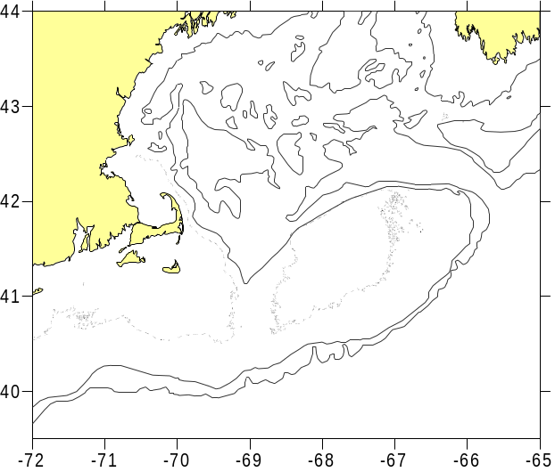
Wind-Driven Transport Indices for Cod and Haddock Recruitment on Georges Bank
David Mountain, Jim Manning, Jon Brodziak, Loretta O’Brien

Slide 2
Wind-Driven Transport Indices for Cod and Haddock Recruitment on Georges Bank
David Mountain, Jim Manning, Jon Brodziak, Loretta O’Brien
Outline:
1. Background (why we even thought of doing this)
2. What we did
3. Results
4. Why it doesn’t work
5. What we learned (that may be even better!)

Slide 3
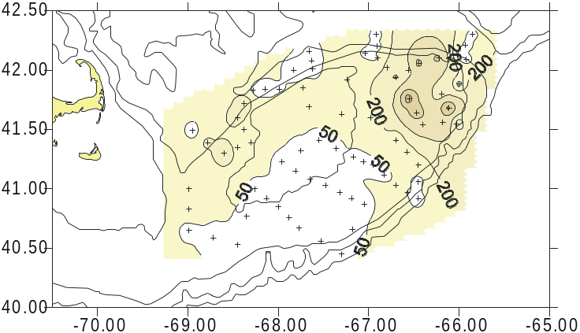
GLOBEC Georges Bank Program
1. GLOBEC Monthly Surveys
Jan – June, 1995-1999
2. Cod and Haddock eggs staged
Annual estimates of
a) eggs spawned
b) egg hatched
c) egg mortality
Cod early stage eggs, February 1997
Egg Hatching to Recruitment
Cod: R² = 0.8 (p<0.04)
Haddock: R² = 0.5 (p<0.18)

Slide 4
Seasonal Egg Mortality Rate (%/day)
Variation in hatching due mainly to variation in egg mortality
 | Cod | Haddock
1995 | 13.7 | 12.0
1996 | 12.2 | 11.3
1997 | 20.4 | 13.4
1998 | 9.9 | 7.8
1999 | 15.4 | 9.9
So….. what determines egg mortality?

Slide 5
Wind driven transport off Georges Bank!
Simple transport model:
climatological flow field
(from hydrodynamic model)
+
time-dependent Ekman current
For each year:
1. Use early egg distributions (10 day periods over the season)
2. Track egg particles for 17 days (time to hatching)
3. If cross 200m isobath on southern flank of the bank, assumed lost
4. Sum for the season and determine the mortality (loss) rate.

Slide 6
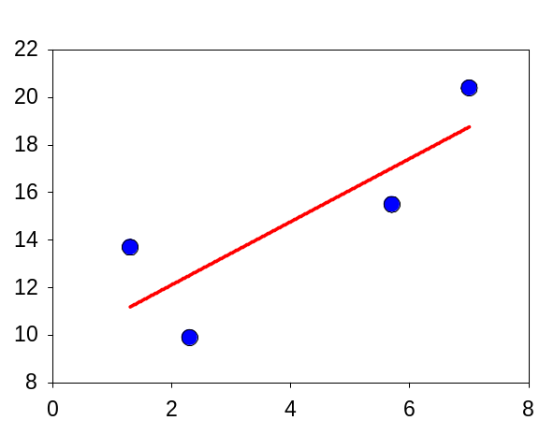
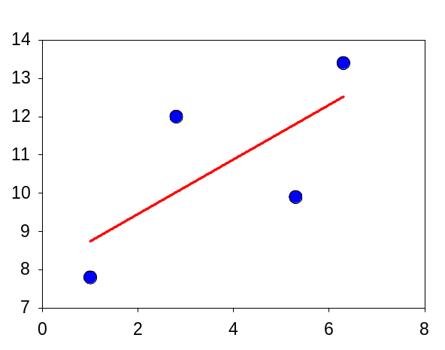
Run the model
Modeled mortality similar to observed
Regression slopes ~1
Cod
R² = 0.7 (p < 0.18)
Observed Mortality (ppd)
Haddock
[ Chase did this for haddock
(1931 – 1950) using SE winds
with R² ~ 0.5 for recruitment ]
R² = 0.5 (p < 0.30)
Model Mortality (ppd)

Slide 7
The proposed project:
SSB spawning egg mortality hatching recruitment
SSB Wind recruitment
Take longer time series and see if index for recruitment could be developed:
Assumes:
SSB is a proxy for egg production (fecundity is constant)
Spatial/temporal egg distribution constant (use GLOBEC distribution)
Egg mortality represented by wind-driven model
Hatching is a proxy for recruitment (larval/juvenile survival is constant)
Basically, to give a ‘heads up’ for higher or lower R than expected

Slide 8
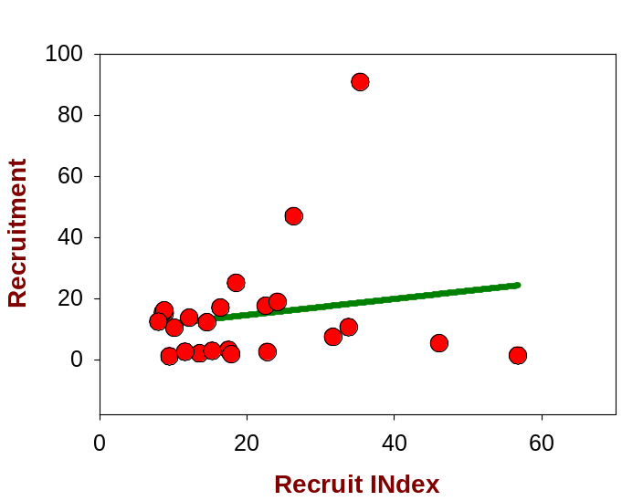
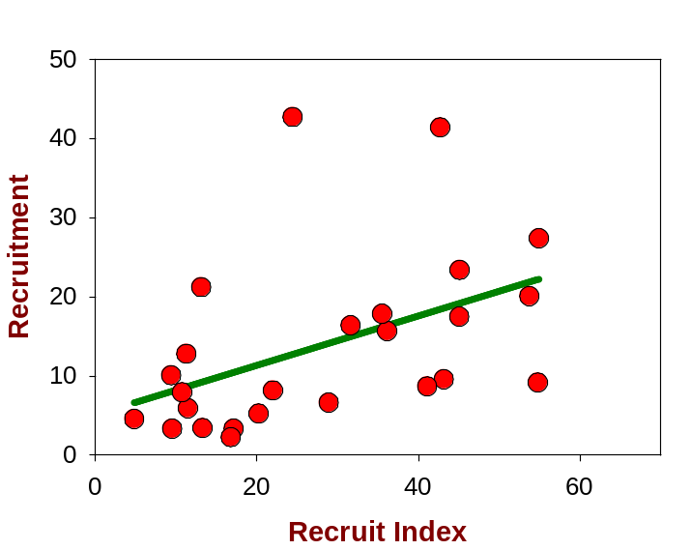
So, run the model, 1979 to 2003:
(SSB wind-driven transport egg survival)
Compare Recruit Index vs actual Recruitment
Not very good….!!
Haddock
(2003, 788)
Cod

Slide 9
Why?
Using years with egg data (spawn, mortality, hatch):
SSB spawning not so good
Obs mortality model mortality not so good
Hatching recruitment …interesting!
(Have egg spawning, hatching and mortality estimates for 1979-1987 & 1995-1999)

Slide 10
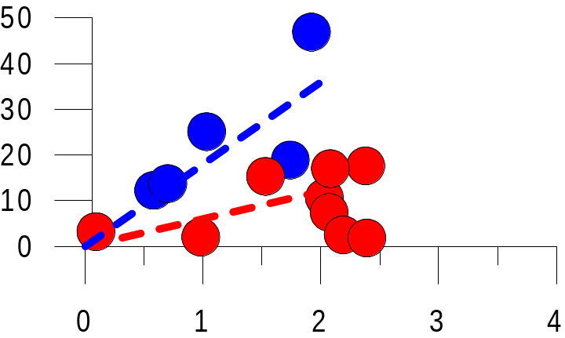
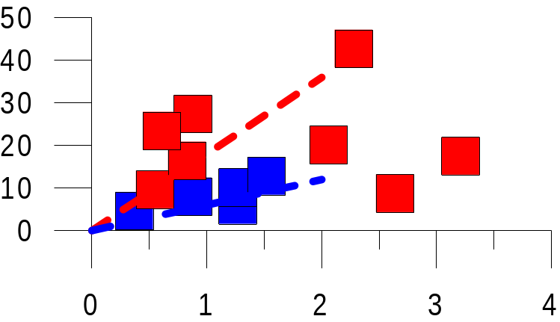
Egg hatching to Recruitment
Haddock
MARMAP (1980’s)
GLOBEC (1995-1999)
Recruitment (x10⁻⁶)
Haddock:
About 3 times recruits/egg
in 1990’s as in 1980’s
Cod:
Just the reverse
Cod
Hatching (x10⁻¹²)

Slide 11
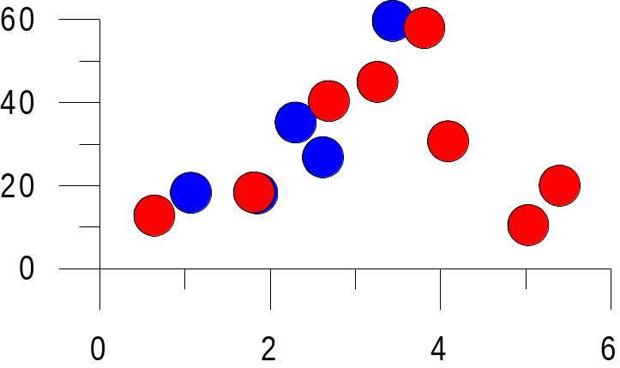
Combining Cod and Haddock
Consistent pattern
for both periods
‘order’ vs ‘scatter’
Densty dependence?
Consistent ‘Egg to R’,
Just shift between species
In the different periods.
Recruitment (x10⁻⁶)
Hatching (x10⁻¹²)

Slide 12
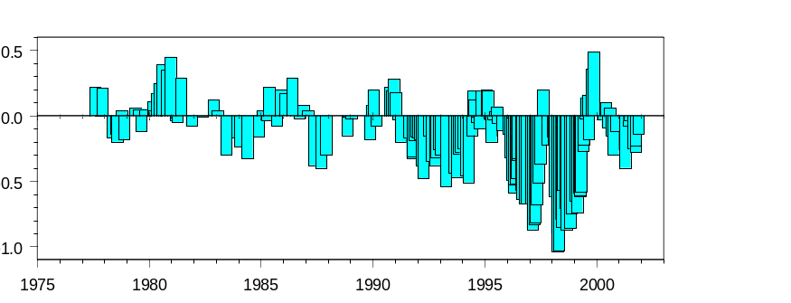
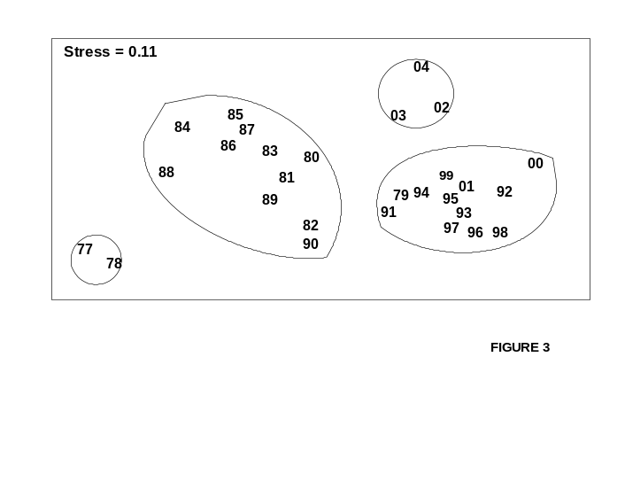
So, what else was going on?
Salinity Anomaly on Georges Bank
Low salinity in 1990’s
Change in zoo community
Zoo Community Structure
(Kane 2007)

Slide 13
So, what else was going on?
Salinity Anomaly on Georges Bank
1990’s:
- Low salinity
- Smaller copepods
- Haddock favored over cod
Zoo Community Structure
(Kane 2007)

Slide 14
So, what else was going on?
Salinity Anomaly on Georges Bank
1990’s:
- Low salinity
- Smaller copepods
- Haddock favored over cod
Zoo Community Structure
(Kane 2007)
A ‘FATE’ connection?

Slide 15
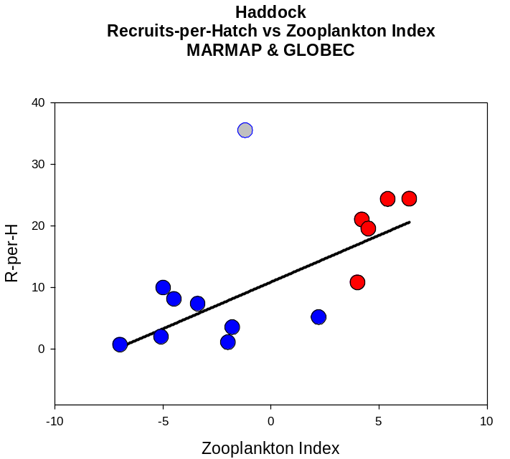
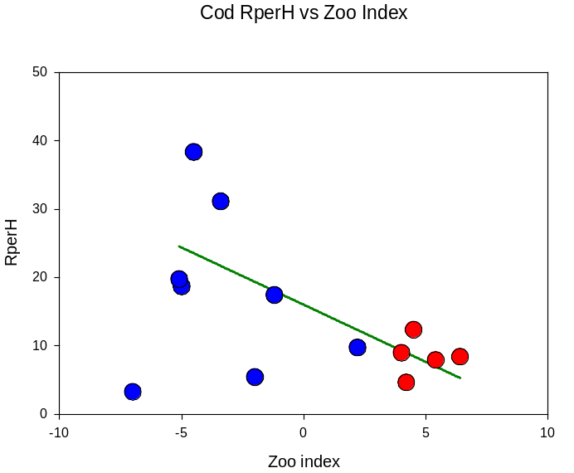
Not just decade – to – decade
Create ‘Zoo index’
Relationship over the whole period
Recruits/hatched egg vs Zoo Index
Haddock
Cod

Slide 16
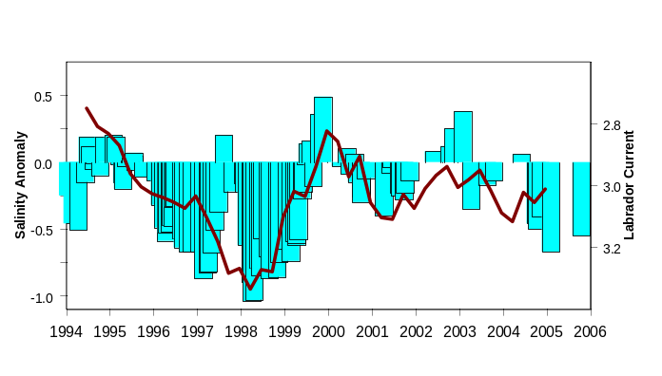
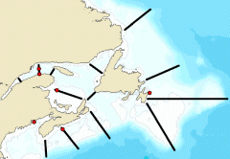
So, where did the low salinity come from?
Salinity Anomaly &
Labrador Current Transport
High latitude
The Arctic?
A ‘Climate Change’ connection?

Slide 17
So ……
Initial project didn’t work – too much variability at all steps
But …..
Have a new, FATE related, issue to pursue!
Session at 2008 Ocean Sciences:
074 “Influence of Recent Changes in the Arctic
on Sub-arctic and Mid-latitude Marine Ecosystems”

Slide 19
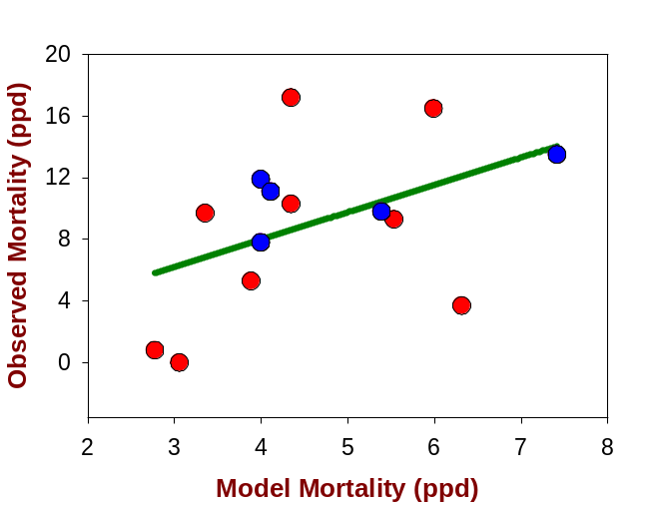
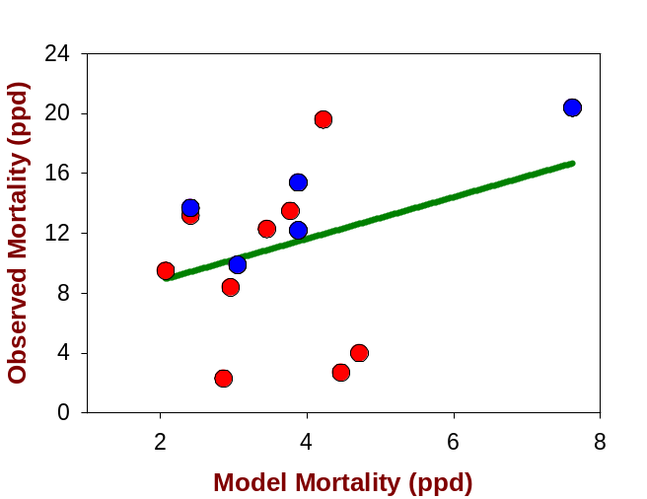

Slide 20
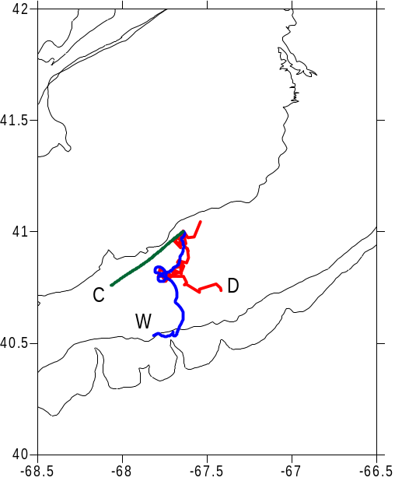
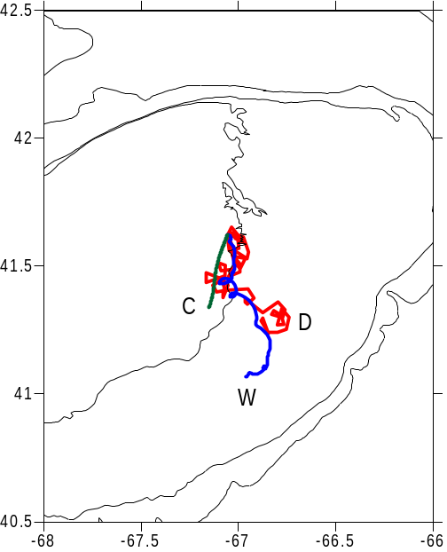
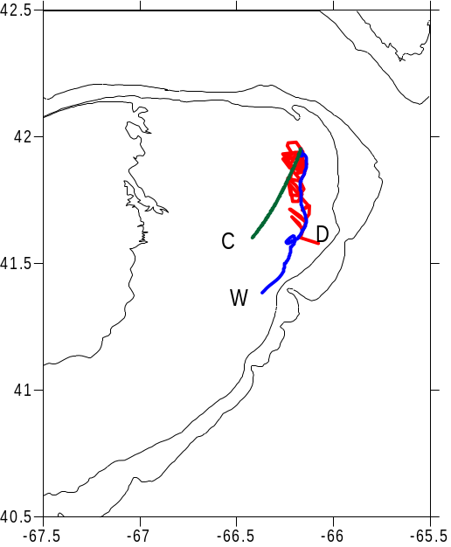
Test of the Ekman current approach
Using satellite tracked drifters, drogued at 10m depth
Three examples where drift track changed direction with a major wind event.
Red (‘D’) is drifter; Green (‘C’) is climatology; Blue (‘W’) is climatology + Ekman

Slide 22
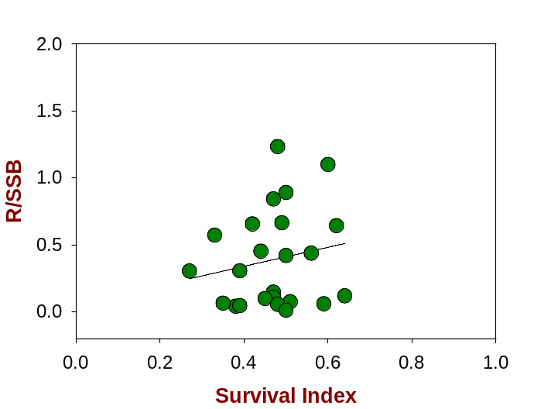
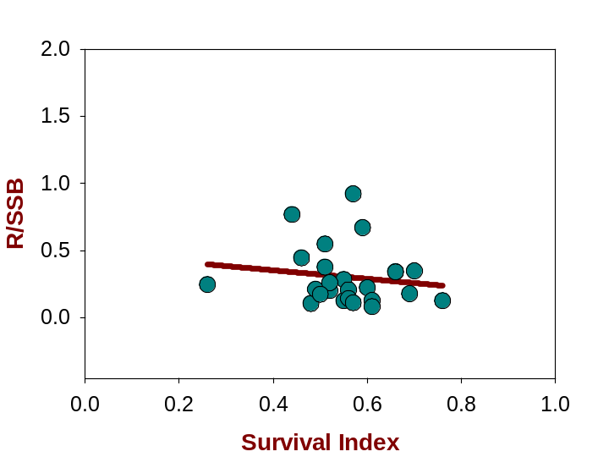
(2003, 6)

Slide 23
For an operational index, can only use parameters that will be available
The proposed index depends on:
SSB - which can be estimated
Wind measurements - which are available
To test this:
Have SSB and R from VPA’s
Have egg spawning, hatching and mortality estimates for 1979-1987
Have wind data from NDBC buoys and from NCEP
Use mean early egg distributions (10-day cohorts) from GLOBEC
Basically, to give a ‘heads up’ for higher or lower R than expected

