Slide 1


PRESENTS

Slide 2

INSTRUCTIONS FOR CONTINUED AIRWORTHINESS
OR
MORE @#//**+# PAPER WORK FROM THE FRIENDLY PEOPLE FROM THE FAA

Slide 3

Your Instructor
BILL O’BRIEN
NATIONAL RESOURCE SPECIALIST (NRS)
WORK: 202 267-3796
FAX: 202 267-5115
william.o’brien@faa.gov

Slide 4
OVERVIEW
THE REASONS BEHIND ICA POLICY
FSAW 98-03
HBAW 98-18
CHECKLIST REVIEW

Slide 5
GOAL:
CONVINCE MECHANICS THAT ICA ARE FOR THEIR BENEFIT, AND WILL SOLVE MORE PROBLEMS THEN THEY CREATE.

Slide 6

QUESTION:
WHAT ARE:
INSTRUCTIONS FOR
CONTINUED
AIRWORTHINESS (ICA)?

Slide 7

ANSWER:
INSTRUCTIONS FOR CONTINUED AIRWORTHINESS ARE:
PROCEDURES FOR MAINTENANCE,
INSPECTIONS, ALLOWABLE WEAR,
TOLERANCES, TROUBLE SHOOTING,
REPAIRS, ETC., ESSENTIAL TO THE
CONTINUED AIRWORTHINESS OF THE AIRCRAFT

Slide 8

INSTRUCTIONS FOR CONTINUED AIRWORTHINESS
ARE FOUND IN:
21.50 23.1529
25.1529 27.1529
29.1529 31.82
33.4 35.4
APPENDIX G OF PART 23
APPENDIX H OF PART 25

Slide 9
INSTRUCTIONS FOR CONTINUED AIRWORTHINESS
ARE ALSO FOUND IN THE FAR:
43.13(a) PERFORMANCE RULES
43.15 ADDITIONAL PERF. RULES
43.16 A/W LIMITATIONS
91.403(c) GENERAL

Slide 10

HEY FAA!! HOW COME WE NEVER HEARD ABOUT ICA BEFORE?

Slide 11

ANSWER:
FOR THE LONGEST TIME “ICA” WAS A LOT LIKE THE ELECTORAL COLLEGE, IT SEEM TO WORK OK IF WE DIDN’T THINK ABOUT IT TOO MUCH.

Slide 12

ANSWER:
BUT WE DID HAVE TO START THINKING ABOUT ICA DURING THE RULE MAKING PROCESS FOR THE NEW PART 135, SINGLE ENGINE, IFR, PASSENGER CARRYING RULE (REF: 135.421(d))

Slide 13

PART 135 SEIFR RULE REQUIRES:
ALTERNATIVE SOURCE OF ELECTRICAL POWER
STAND-BY VACUUM SYSTEM
SO
MANY OF THESE ALTERATIONS WOULD BE PERFORMED UNDER A FIELD APPROVAL.

Slide 14
PART 135 RULEMAKING FOUND:
THAT NO POLICY OR REQUIREMENTS FOR ICA EXISTED FOR FIELD APPROVED MAJOR ALTERATIONS REQUIRED BY FAR 135.421 (d) ADDITIONAL MAINTENANCE REQUIREMENTS.
SO WE HAD TO DEVELOP ICA POLICY FOR FIELD APPROVALS OR THE FAA WOULD CANCEL FIELD APPROVALS FOR MAJOR ALTERATIONS.

Slide 15
PROBLEM:
WITHOUT “ICA” THE MECHANIC WHO HAS TO MAINTAIN THE MAJOR ALTERATION (CHANGE TO THE TYPE DESIGN) WITH NO MAINTENANCE INSTRUCTIONS IS FORCED TO STRETCH THE TRUTH IN THE LOG BOOK ENTRY

Slide 16

THE SOLUTION

Slide 17
SOLUTION:
SINCE THE RULES WERE ALREADY IN PLACE REQUIRING “ICA” WE DEVELOPED NEW POLICY.
FSAW 98-03 FLIGHT STANDARDS BULLETIN (AIRWORTHINESS) CHANGED THE FAA INSPECTOR’S POLICY ON FIELD APPROVALS TO REQUIRE “ICA.”(dated: 1-30-98)

Slide 18
HBAW 98-03 REQUIRES:
“ICA” FOR FIELD APPROVED MAJOR ALTERATIONS ONLY.
“ICA” MUST BE ATTACHED TO THE FORM 337.
“ICA” BECOMES PART OF THE AIRCRAFT’S INSPECTION PROGRAM.
LOG BOOK ENTRY FOR THE MAJOR ALTERATION MENTIONS “ICA.”

Slide 19
ICA FACTS:
“ICA” ARE FOR FIELD APPROVED MAJOR ALTERATIONS ONLY
“ICA IS CONSIDERED “ACCEPTABLE” DATA ONLY JUST LIKE ANY OTHER MAINTENANCE MANUAL.
“ICA” ARE ATTACHED TO FORM 337 TO ENSURE THE “ICA” ARE NOT LOST OR MISPLACED.
MECHANICS CAN DEVELOP AN ICA AND HAVE THE FAA ACCEPT THEM.

Slide 20

PROBLEM:
INITIALLY BOTH THE FAA INSPECTORS AND INDUSTRY DID NOT LIKE THE NEW POLICY.

Slide 21
SOLUTION:
SINCE THE MAJOR PROBLEM WAS IN THE DEVELOPMENT OF “ICA” A CHECK LIST WAS THE SOLUTION.
FLIGHT STANDARDS HANDBOOK BULLETIN FOR AIRWORTHINESS (HBAW) 98-18 INCLUDED A CHECK LIST FOR “ICA.”(dated 10-07-98)

Slide 22
HBAW 98-18
STANDARDIZED THE FIELD APPROVAL PROCESS FOR “ICA”
SUPPORTS FSAW 98-03
FORMALIZES FAA POLICY BY CHANGING THE FAA INSPECTOR’S HANDBOOK FAA ORDER 8300.10 CHANGE 15 (OCT. 30,2002).
DOES A FEW OTHER “NEAT” THINGS.

Slide 23

LIKE WHAT?

Slide 24
NEAT THINGS:
THE CHECKLIST MEETS THE REGULATIONS.
THE CHECKLIST HAS 18 ITEMS BUT IN MOST ALTERATIONS YOU WILL ONLY FILL OUT BETWEEN 5 TO 8 CHECKLIST ITEMS.
ICA CAN REFERENCE MANUFACTURER’S INSTRUCTIONS.

Slide 25
NEAT THINGS:
RECORD KEEPING INFORMATION.
INSTRUCTIONS ON REPLACEMENT
OF PARTS.
INSTRUCTIONS ON HOW TO REVISE
THE “ICA.”
LIST THE NAME OF FAA RESOURCES
FOR FAA FIELD INSPECTORS TO
CONTACT FOR ADDITIONAL HELP.

Slide 26

“ICA” CHECK LIST REVIEW

Slide 27

“ICA” CHECKLIST:
THE CHECK LIST MUST ADDRESS
THE FIRST 16 ITEMS
“ICA” MUST BE MENTIONED ON
BLOCK 8 OF THE FORM 337 AND
ATTACHED TO THE 337
IF A CHECKLIST ITEM DOES NOT
APPLY WRITE “N/A” AFTER THE
ITEM.

Slide 28
ITEM #1: INTRODUCTION
BRIEF DESCRIPTION OF THE COMPONENT BEING ALTERED
PURPOSE OF THE ALTERATION.
DISTRIBUTION OF THE “ICA” IF APPLICABLE.

Slide 29
ITEM #2: DESCRIPTION
DESCRIPTION OF THE MAJOR ALTERATION, ITS FUNCTIONS AND INTERFACE WITH OTHER SYSTEMS IF ANY.

Slide 30
ITEM #3: CONTROL
DESCRIBE HOW THE NEW COMPONENT IS CONTROLLED, OR OPERATED.

Slide 31
ITEM #4: SERVICE
INFORMATION
LIST TYPES OF FLUIDS USED, SERVICING POINTS, AND LOCATION OF ACCESS PANELS AS APPROPRIATE.

Slide 32
ITEM #5: MAINTENANCE
INSTRUCTIONS
LIST RECOMMENDED
INSPECTION/MAINTENANCE
PERIODS.
REFER TO MFG... INSTRUCTIONS.
SPECIAL NOTES OR CAUTIONS
FUNCTIONAL CHECKS ETC.

Slide 33
ITEM #6: TROUBLESHOOTING
INFORMATION DESCRIBING PROBABLE MALFUNCTIONS, HOW TO RECOGNIZE THOSE PROBLEMS AND HOW TO FIX THEM.

Slide 34
ITEM #7: REMOVAL AND REPLACEMENT INFORMATION
THIS SECTION DESCRIBE THE ORDER AND METHOD OF REMOVAL AND REPLACEMENT OF PRODUCTS AND PARTS.
MAY REFERENCE MFG... PROCEDURES FOR TESTS, ALIGNMENT, CALIBRATE, ETC.

Slide 35
ITEM #8: DIAGRAMS
SHOW WERE ACCESS PLATES ARE LOCATED, INCLUDING INSTRUCTIONS ON HOW TO GAIN ACCESS TO THE COMPONENT(S)

Slide 36

ITEM # 9: SPECIAL
INSPECTIONS
LIST ANY SPECIAL INSPECTIONS SUCH AS X-RAY, ULTRASONIC TESTING, EDDY CURRENT, MAGNETIC PARTICLE OR ANY OTHER SPECIAL INSPECTION REQUIREMENTS.

Slide 37
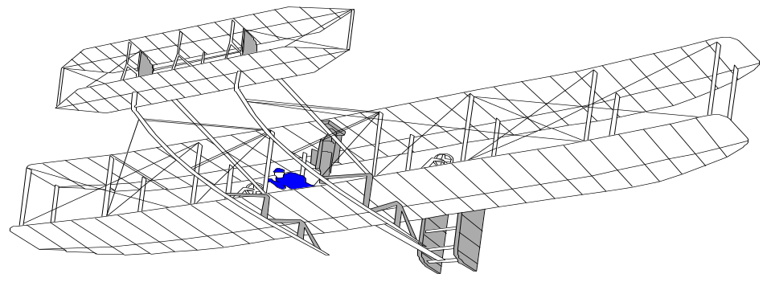
ITEM #10: SPECIAL PROTECTIVE TREATMENTS
LIST SPECIAL COATINGS, PAINT, LUBRICANTS, OR CORROSION PROOFING THE ALTERATION OR SURROUNDING STRUCTURE MAY REQUIRE.

Slide 38

ITEM #11: DATA
RELATIVE TO FASTENERS, SUCH AS TYPE OF FASTENERS, TORQUE REQUIREMENTS, SPECIAL INSTALLATION REQUIREMENTS IF ANY.

Slide 39
ITEM #12: SPECIAL TOOLS
SPECIAL TOOLS USED TO MAINTAIN THE ALTERATION SUCH AS A NUCLEAR POWERED TORQUE WRENCH OR A WIND DRIVEN SAFETY WIRE TWISTER.

Slide 40
ITEM #13: COMMUTER
AIRCRAFT REQUIREMENTS
ELECTRICAL LOADS
METHODS OF BALANCING FLIGHT CONTROLS.
IDENTIFICATION OF PRIMARY AND SECONDARY STRUCTURE AFFECTED
SPECIAL REPAIRS METHODS

Slide 41
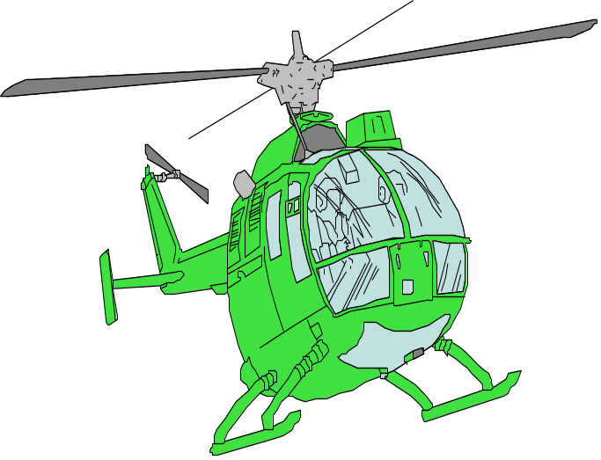
ITEM #14: RECOMMENDED
OVERHAUL PERIODS
REQUIRED IF THE OVERHAUL PERIOD IS LISTED BY THE COMPONENT OR EQUIPMENT MFG...

Slide 42
ITEM #15: AIRWORTHINESS
LIMITATION SECTION
INCLUDES ANY “APPROVED” AIRWORTHINESS LIMITATIONS SUCH AS ONE WOULD FIND IN AN STC THAT IS BEING INCORPORATED WITH OTHER WORK APPROVED UNDER A FAA FIELD APPROVAL.

Slide 43
ITEM #16: REVISION
INCLUDES INFORMATION ON HOW TO REVISE THE ICA. FOR EXAMPLE SEND A LETTER AND A COPY OF THE REVISED FORM 337 TO THE FSDO REQUESTING A REVISION.
FAA INSPECTOR ACCEPTS THE CHANGE BY SIGNING BLOCK 3 OF THE FORM 337

Slide 44

RECORDKEEPING

Slide 45

RECORDKEEPING
PART 91 OPERATIONS REQUIRE A LOG BOOK ENTRY (SECTION 43.9)
ENTRY RECORDS THE MAJOR ALTERATION AND IDENTIFIES THE ORIGINAL ICA LOCATION (FAA FORM 337 DATED 3/15/99)
STATEMENT THAT “ICA” IS PART OF THE INSPECTION PROGRAM

Slide 46

RECORDKEEPING
AIR CARRIER IS RESPONSIBLE FOR CHANGING HIS MAINTENANCE PROGRAM. (REVISION SENT TO THE PMI)
PART 135 OPERATORS WITH AAIP MUST SUBMIT A CHANGE IN ACCORDANCE WITH SECTION 135.419(b)

Slide 47

RECORDKEEPING
PART 135, 9 OR LESS USING ANNUAL, 100 HOUR INSPECTION PROGRAMS MUST:
MAKE A LOG BOOK ENTRY
STATEMENT THAT ICA IS NOW PART OF THE INSPECTION PROGRAM
IDENTIFY WHERE THE “ICA” ARE LOCATED. (FORM 337, DATED 3/15/99)

Slide 48

SUMMARY

Slide 49
SUMMARY:
“ICA” IS FOR MAJOR ALTERATIONS PERFORMED UNDER A FIELD APPROVAL.
“ICA” IS “ACCEPTABLE DATA.”
“ICA” IS ATTACHED TO THE FORM 337 SO IT IS WILL PART OF A REQUIRED RECORD UNDER 91.417.

Slide 50
SUMMARY:
“ICA” POLICY PRESERVES THE FIELD APPROVAL PROCESS FOR MAJOR ALTERATIONS BY MEETING THE SAME REQUIREMENTS FOR STC UNDER SECTION 21.50.

Slide 51
SUMMARY:
OF THE 16 ITEMS A MAXIMUM OF 8 WILL BE FILLED OUT COMPLETELY.
“ICA” CAN REFER TO THE MFG. INSTRUCTIONS.
REPLACEMENT PARTS CAN BE IDENTIFIED.
“ICA” CAN BE REVISED AND SO CAN OLDER FIELD APPROVALS.

Slide 52

ANY QUESTIONS

Slide 53

WE HAVE ONE
DID WE MEET OUR
GOALS AND
OBJECTIVES?
Notes:
WE HAVE A QUESTION
DID WE MEET OUR GOALS AND OBJECTIVES FOR THIS MEETING??

Slide 54
GOAL:
CONVINCE MECHANICS THAT ICA ARE FOR THEIR BENEFIT, AND WILL SOLVE MORE PROBLEMS THEN THEY CREATE.

Slide 55

THE END

