Slide 1

Electron cooling of 8 GeV antiprotons at Fermilab’s Recycler:
Results and operational implications
June 5th, 2006
L. Prost, Recycler Dpt. personnel
Fermi National Accelerator Laboratory

Slide 2
Outline
Context of electron cooling at FNAL
Electron cooling
Electron beam properties
Cooling of antiprotons
  Cooling force measurements
  Electron cooling in operation
Conclusion

Slide 3
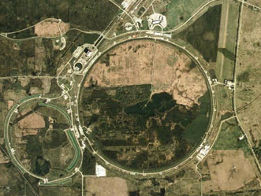
Fermilab complex
The Fermilab Collider is a Antiproton-Proton Collider operating at 980 GeV
Proton source
CDF
Tevatron
Main Injector\
Recycler
Antiproton
source
D0

Slide 4
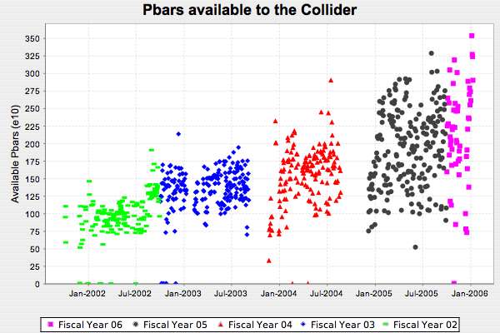
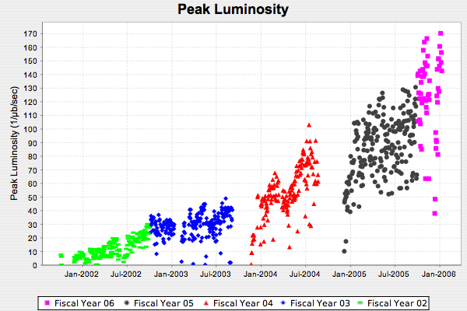
Antiprotons and Luminosity
The strategy for increasing luminosity in the Tevatron is mostly to increase the number of antiprotons
  Provide a third stage of antiproton cooling with the Recycler

Slide 5
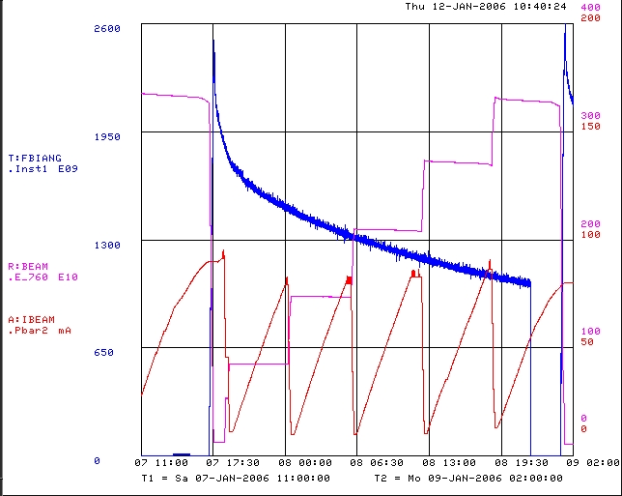
Antiprotons flow (Recycler only shot)
Transfer from Accumulator to Recycler
Shot to TeV
Tevatron
Recycler
100 mA
Accumulator
2600e9
400 e10
200 mA
Keep Accumulator stack <100 mA ⇒ Increase stacking rate

Slide 6
Beam Cooling in the Recycler
The missions for cooling systems in the Recycler are:
The multiple Coulomb scattering (IBS and residual gas) needs to be neutralized
The emittances of stacked antiprotons need to be reduced between transfers from the Accumulator to the Recycler
The effects of heating because of the Main Injector ramping (stray magnetic fields) need to be neutralized

Slide 7
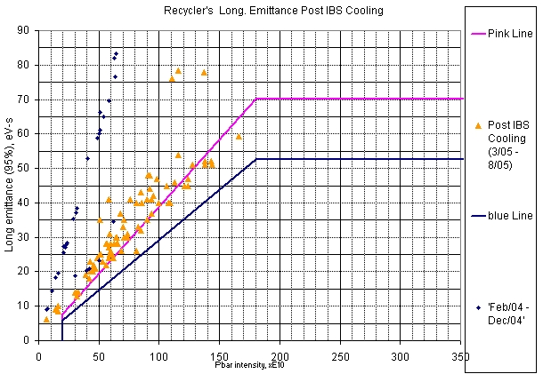
Performance goal for the long. equilibrium emittance: 54 eV-s
Stochastic cooling limit
MAX
36 bunches
at 2 eVs per bunch
GOAL
36 bunches
at 1.5 eVs per bunch
20% lower

Slide 8
Recycler Electron Cooling
The maximum antiproton stack size in the Recycler is limited by
  Stacking rate in the Debuncher-Accumulator at large stacks
  Longitudinal cooling in the Recycler
    Stochastic cooling only
      ~140×10¹⁰ for 1.5 eVs bunches (36)
      ~180×10¹⁰ for 2eVs bunches (36)
Longitudinal stochastic cooling has been complemented by Electron cooling

Slide 9
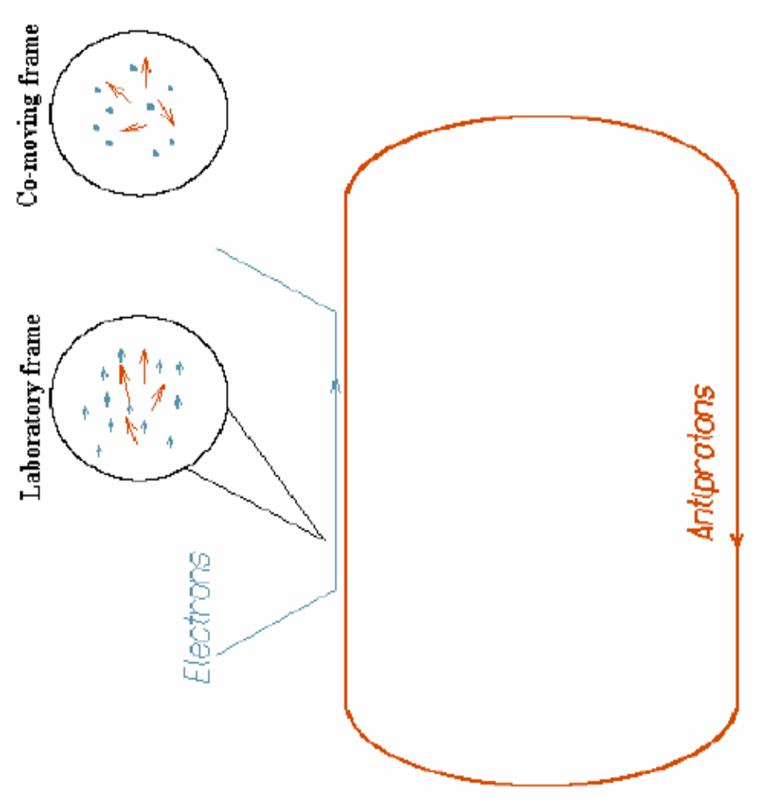
How does electron cooling work?
In the moving frame we have a mixture of gases of “hot” antiprotons and “cold” electrons.
Transfer of energy through Coulomb interactions

Slide 10
How does electron cooling work? (cont’)
At electron energies up to ~300 keV:
  Direct electrostatic acceleration of electrons with energy recovery.
  A strong longitudinal magnetic field accompanies electrons from the cathode to the exit of the cooling section. Magnetic field assures the transport of the electron beam while retaining low temperature of the electrons.
Typical parameters of all existing low-energy electron coolers:
  electron kinetic energy: 2-300 keV
  electron beam current: up to 5 A
  Cooler length: 1-3 m
  Magnetic field: 0.1-0.5 T
Electron
Gun
Electron
Collector
Electron beam
Storage ring
Ion beam
1-5% of the ring
circumference

Slide 11
What makes the Fermilab system unique?
It requires a 4.36 MV DC power supply. We have chosen a commercially available electrostatic accelerator. As a consequence we had to develop several truly new beamline, cooling, and solenoid technologies:
  Interrupted solenoidal field: there is a magnetic field at the gun cathode and in the cooling section, but no field in between. It is an angular-momentum-dominated transport line;
  Low magnetic field in the cooling section: 50-150 G. Unlike low-energy coolers, this will result in non-magnetized cooling – something that had never been tested;
  A 20-m long, 100-G solenoid with high field quality

Slide 12
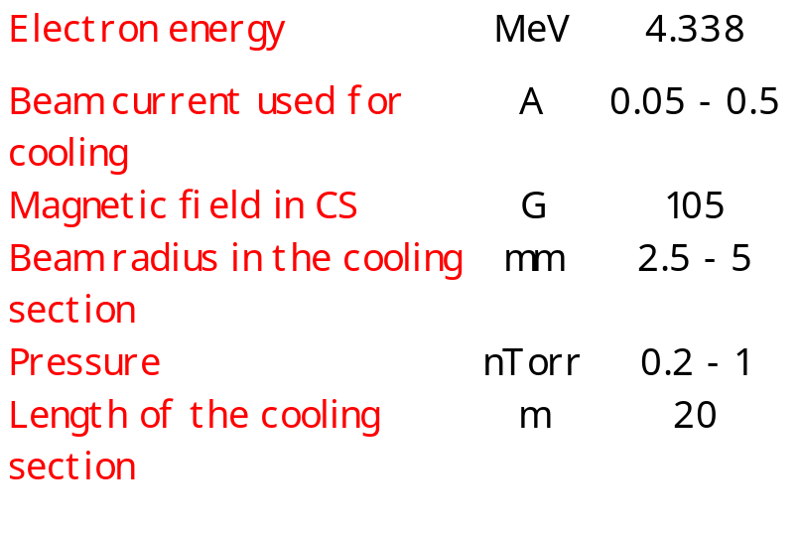
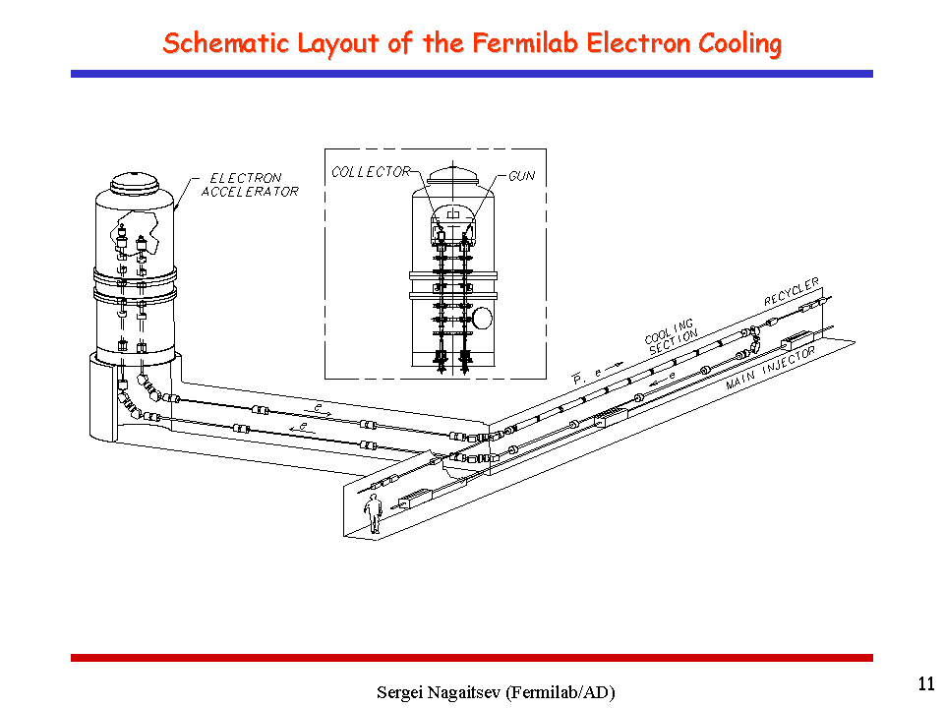
Fermilab cooler – main features
Electrostatic accelerator (Pelletron) working in the energy recovery mode
DC electron beam
100 G longitudinal magnetic field in the cooling section
Lumped focusing outside the cooling section

Slide 13
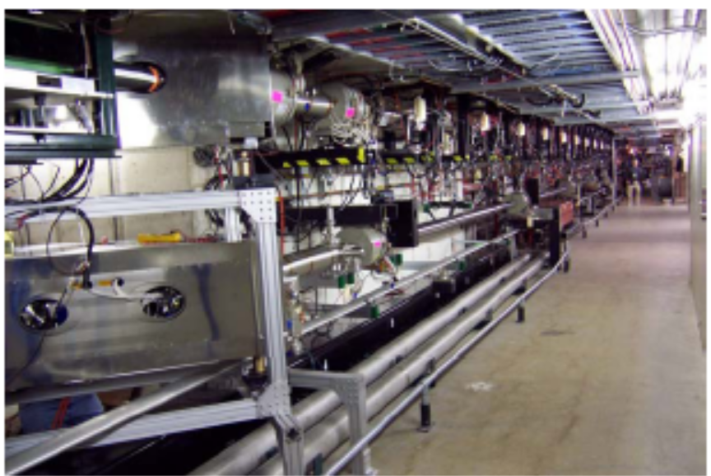
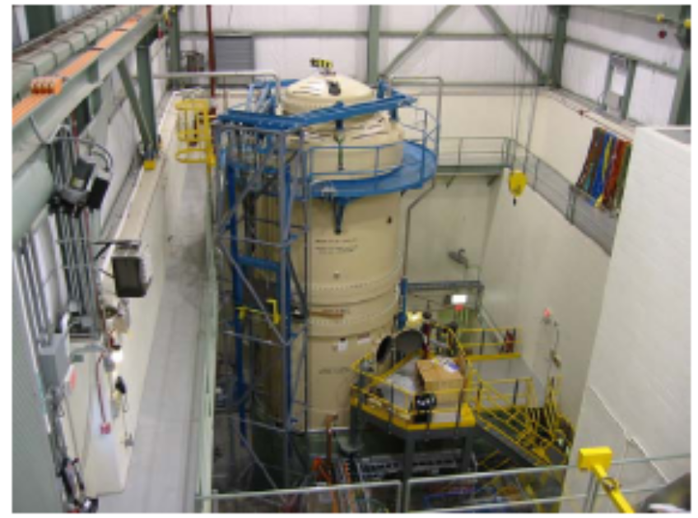
Electron cooling system setup at MI-30/31
Pelletron
(MI-31 building)
Cooling section solenoids
(MI-30 straight section)

Slide 14
Commissioning Milestones Highlights (2005)
Feb, 25th – Installation Complete
Mar, 7th – All systems ready for commissioning
  Charging system, gun, pulser work
Mar, 17th – 4.3 MeV, 0.5 A pulsed beam to collector (U-Bend mode, low losses)
  Regulation system works properly
Apr, 20th – First DC beam (few mA) in Recycler beam line
Jun, 3rd – 4.3 MeV, 0.2 A DC recirculating in the full line.
Jul, 9th – First observation of electron beam interacting with antiproton beam
Jul, 15th – Electron Cooling of 8 GeV antiprotons has been demonstrated
Jul, 16th – Electron cooling is used for a collider shot
Jul, 26th – 0.5 A DC in the full line. All commissioning milestones are met.

Slide 15
Beam quality: Longitudinal temperature
The cooling process is determined by an effective energy spread consisting primarily of two components, the electron energy spread at a fixed time and the Pelletron voltage ripple
  The energy spread is determined by IBS (the main contributor) and by density fluctuations at the cathode. According to simulations, at currents 0.1 – 0.5 A the energy spread is 70 – 150 eV.
  The Pelletron voltage ripple is 200 - 300V r.m.s. (probably, fluctuates from day to day). The main frequency is 1.8 Hz, which is much shorter than a cooling time.
  Hence, the effective energy spread is equal to these two effects added in quadratures.

Slide 16
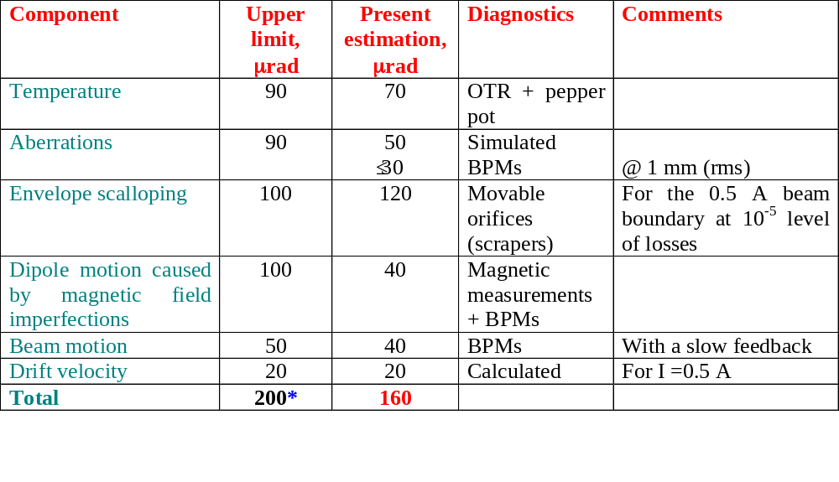
Beam quality: Electron angles in the cooling section
*Angles are added in quadrature

Slide 17
Back one year ago… July 05 electron beam status
Goal for the rms angular spread (<0.2 mrad) had not been met
0.5 A DC beam was not stable
  200 mA only
Reliability, reproducibility were still a problem
BUT…
… (first) cooling attempt was successful !

Slide 18
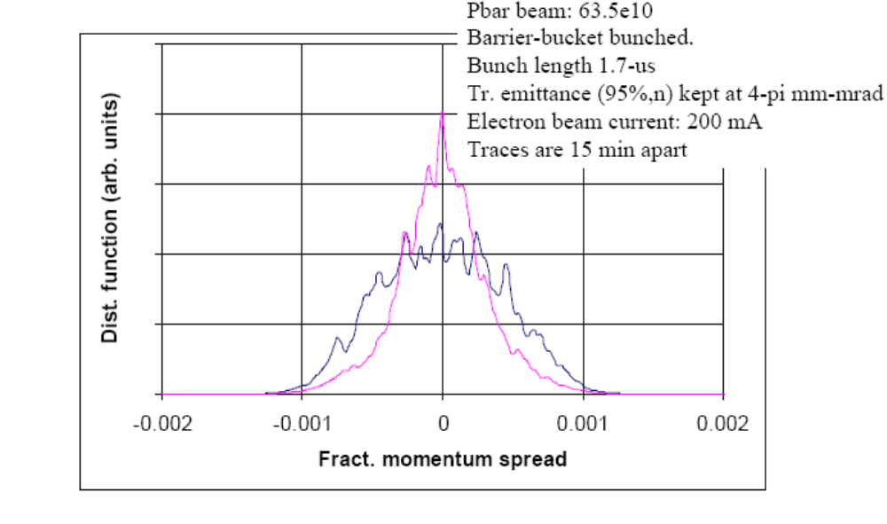
First e-cooling demonstration – 07/15/05

Slide 19
Cooling force – Experimental measurement methods
Two experimental techniques, both requiring small amount of pbars (1-5 × 10¹⁰), coasting (i.e. no RF) with narrow momentum distribution (< 0.2 MeV/c) and small transverse emittances (< 3 π mm mrad, 95%, normalized)
  ‘Diffusion’ measurement
    For small deviation cooling force (linear part)
    Reach equilibrium with ecool
    Turn off ecool and measure diffusion rate
  Voltage jump measurement
    For momentum deviation > 2 MeV/c
    Reach equilibrium with ecool
    Instantaneously change electron beam energy
    Follow pbar momentum distribution evolution
Both methods characterize the effectiveness of electron cooling (hence, the electron beam quality) quite locally and not necessarily the cooling efficiency/rate for large stashes

Slide 20
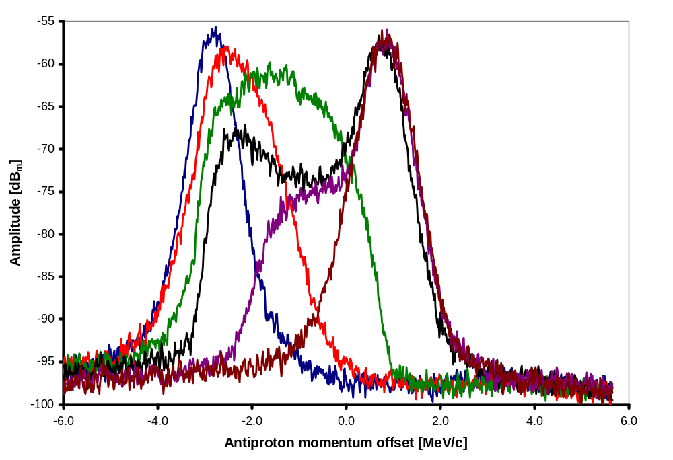
Example: 500 mA, nominal settings, +2 kV jump (i.e. 3.67 MeV/c momentum offset), on axis
~3.7 MeV/c
2.8 × 10¹⁰ pbar
3-6 π mm mrad
Traces (from left to right) are taken 0, 2, 5, 18, 96 and 202 minutes after the energy jump.

Slide 21
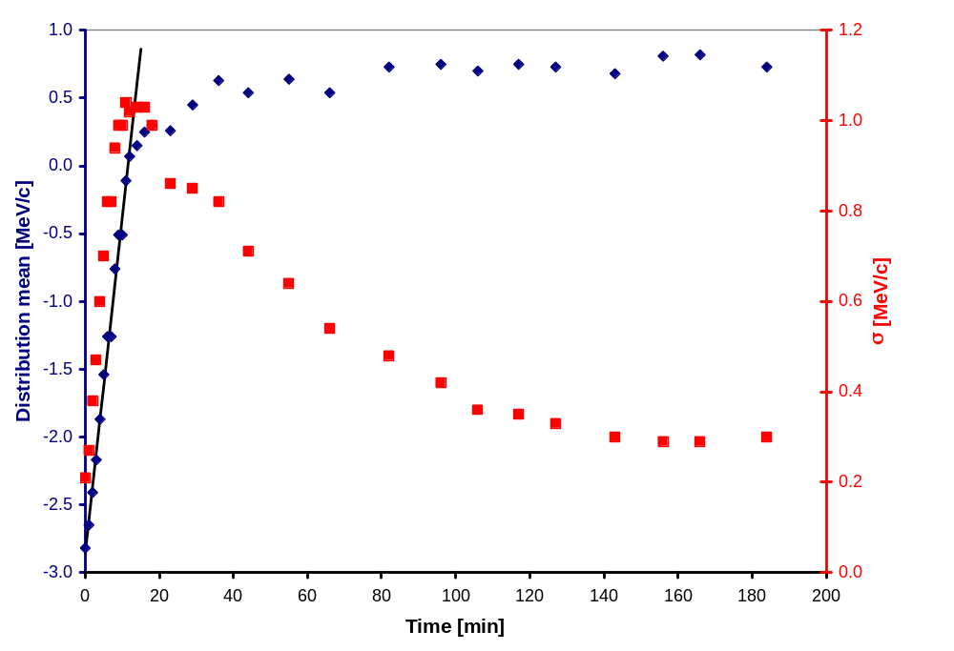
Extracting the cooling (drag) force
Evolution of the weighted average and RMS momentum spread of the pbar momentum distribution function
15 MeV/c per hour

Slide 22
Cooling force measurements carried out
Three types of measurements:
  Various electron energy jumps
    Description of the drag rate as a function of the antiproton momentum deviation
    For various electron beam positions
  Various electron beam positions (w.r.t. antiproton beam)
    Mostly at 100 mA
  Various electron beam current
    On axis (mostly) i.e. electron beam and antiproton beam are centered
‘By-product’
  Drag rate as a function of the transverse emittance
    Keeping the transverse emittance low throughout the measurement has been sometimes challenging
    Difficulties measuring the ‘real’ emittance at very low Δp/p and low number of particles

Slide 23
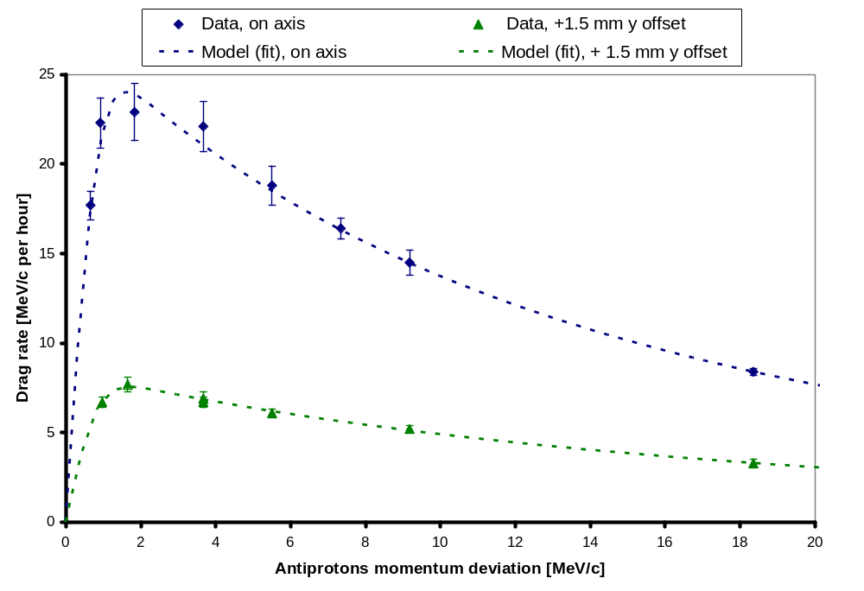
Drag Force as a function of the antiproton momentum deviation
100 mA, nominal cooling settings
Error bars ≡ statistical error from the slope determination

Slide 24
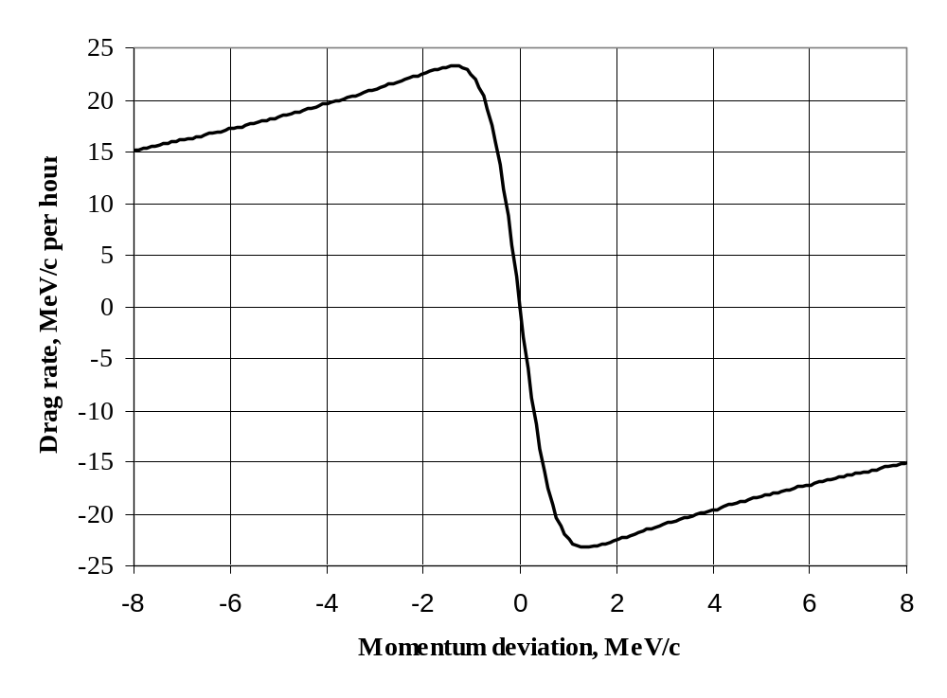
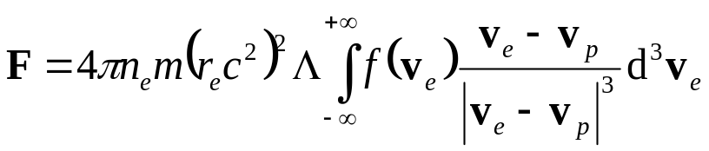
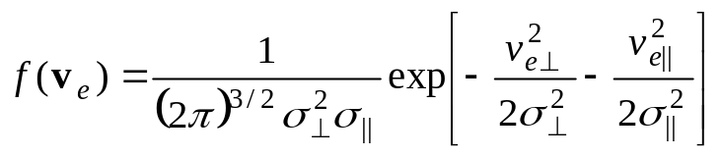

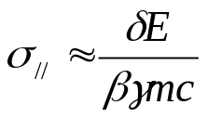
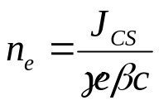
Electron cooling drag rate - Theory
For an antiproton with zero transverse velocity, electron beam: 500 mA, 3.5-mm radius, 200 eV rms energy spread and 200 μrad rms angular spread
Non-magnetized cooling
force model
Lab frame quantities

Slide 25
Comparison to a non-magnetized model
Constant:
Coulomb log, Λ = 10
Fitting parameters:
Electron beam current density, J_{cs}
Lab frame RMS energy spread, δE
Lab frame RMS angular spread, θ_{e}
100 mA, nominal cooling settings (both data sets)

Slide 26
Comparison to a non-magnetized model (cont’)
Results from the fits
 | Electron beam vertical offset, mm
 | 0 | 1.5 | 2
J_{CS,} A cm⁻² | 1.2 | 0.7 | 0.3
θ_{e}, mrad | 0.19 | 0.25 | 0.25
δE, eV | 370 | 370 | 370
RMS energy ripple, RMS angular spread
  ‘Best’ estimations (250 eV, 160 μrad) from measurements
Beam current density
  Factor of ~5 higher than best estimate (assuming uniform current density)

Slide 27
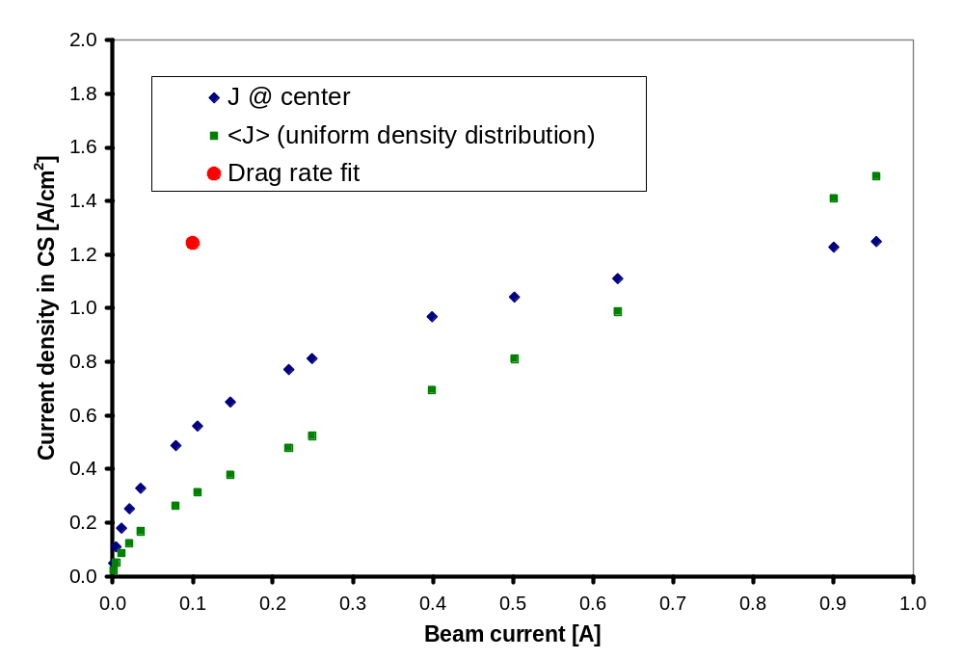
Better model for determining the current density in the cooling section ?
For 100 mA, the beam current density distribution is NOT uniform
Use SuperSAM gun simulations to estimate on-axis current density
  Electron beam is quite uniform and linear (in phase space) over a limited emitter surface
This ‘model’ reduces the discrepancy between ‘measured’ and expected current density in CS by a factor of ~2

Slide 28
Electron cooling in operation
In the present scheme, electron cooling is typically not used for stacks < 200e10
  Allows for periods of electron beam/cooling force studies
Over 200e10 stored
  Electron cooling used to ‘help’ stochastic cooling maintain a certain longitudinal emittance (i.e. low cooling from electron beam) between transfers or shot to the TeV
  ~1 hour before setup for incoming transfer or shot to the TeV, electron beam adjusted to provide strong cooling (progressively)
This procedure is intended to maximize lifetime

Slide 29
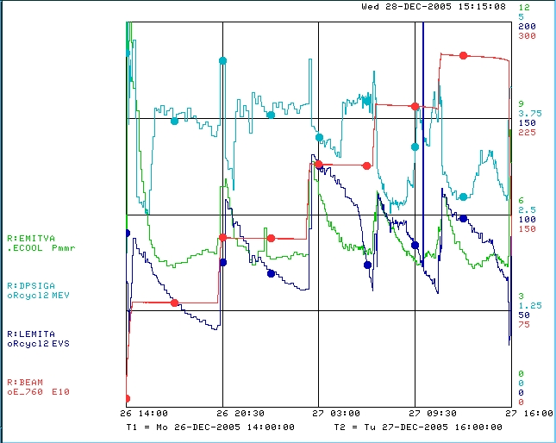
Electron cooling in operation (cont’)
Electron cooling between transfers
Transverse emittance
3 π mm mrad/div
Momentum spread
1.25 MeV/c /div
Longitudinal emittance
50 eVs/div
Pbar intensity
75e10/div
Electron cooling
prior to extraction
Stochastic cooling only

Slide 30
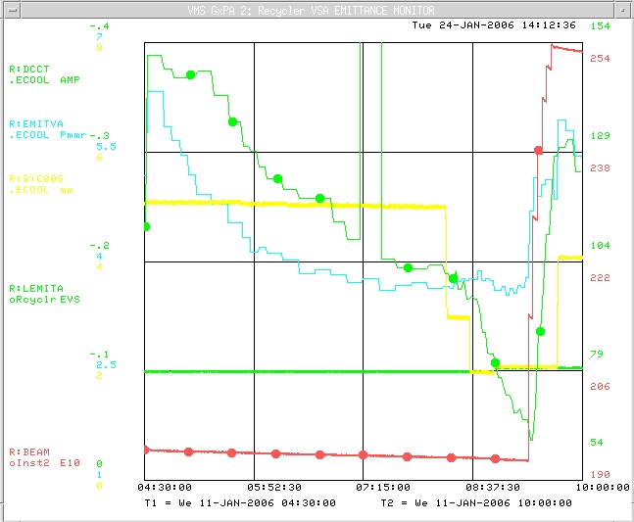
Electron cooling between transfers/extraction
Electron beam ‘out’ (5 mm offset)
Electron beam current
0.1 A/div
Transverse emittance
1.5 π mm mrad/div
Electron beam position
1 mm/div
Longitudinal emittance (circle)
25 eVs/div
Pbar intensity
(circle)
16e10/div
Electron beam is moved ‘in’
Stochastic cooling
after injection
100 mA
~60 eVs
~1 hour
195e10

Slide 31
Adjusting the cooling rate
Two ‘knobs”
  Electron beam current
    Beam stays on axis
    Dynamics of the gun varies between low and high currents
    Hence, changing the beam current also changes the beam size and envelope in the cooling section
  Electron beam position
    ‘Adjustments’ are obtained by bringing the pbar bunch in an area of the beam where the angles are low
Area of good cooling
5 mm offset
2 mm offset

Slide 32
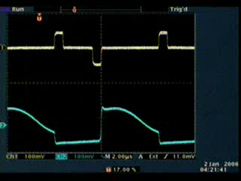
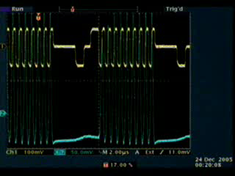
Issues related to electron cooling and large stacks
Since started to use the electron beam for cooling, we have dealt with two main problems
  Transverse emittance growth
    During mining
  Lifetime degradation
    When the beam is turned on and/or moved towards the axis (i.e. strong cooling)
MINING

Slide 33
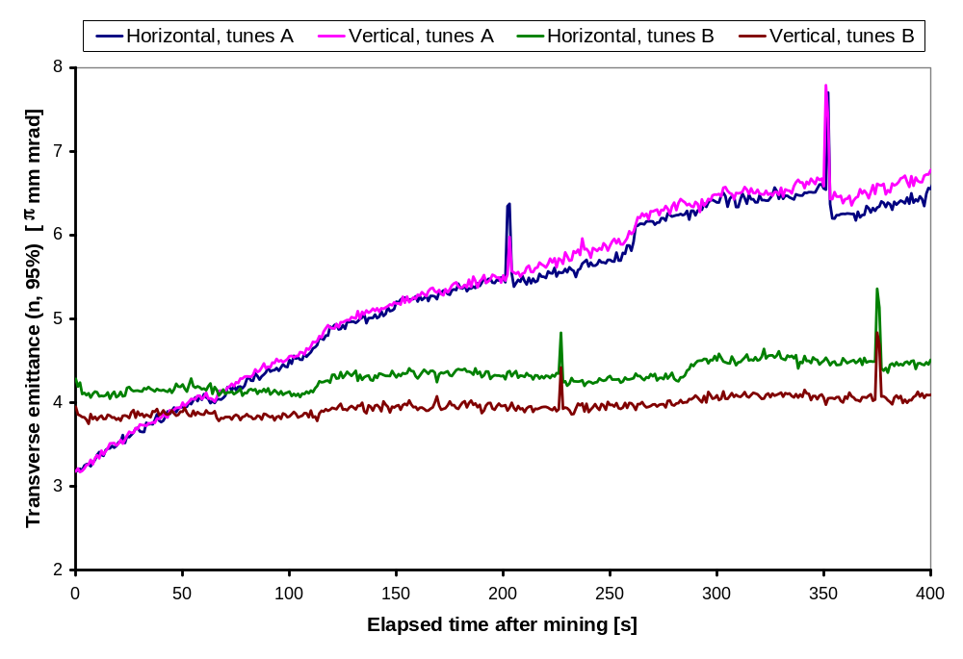
Emittance growth during mining
0.414/0.418 (H/V)
0.451/0.468 (H/V)
(A)
(B)
Initial growth rate:
(A) 36 π mm mrad per hour
(B) 3 π mm mrad per hour
/ ~10
Emittance growth likely due to a quadrupole instability (Burov et al. )
  Growth rate ∝ κ_{xy} I_{e} I_{p} , (κ_{xy} coupling parameter)
  Increase tune split to reduce κ_{xy}

Slide 34
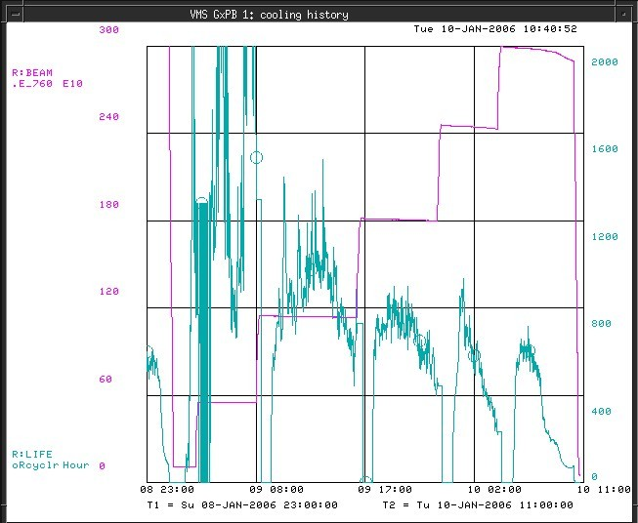
Lifetime degradation throughout a store
60 × 10¹⁰
400 hours
Pbar intensity
Lifetime
(1 hour running average)
500 hours

Slide 35
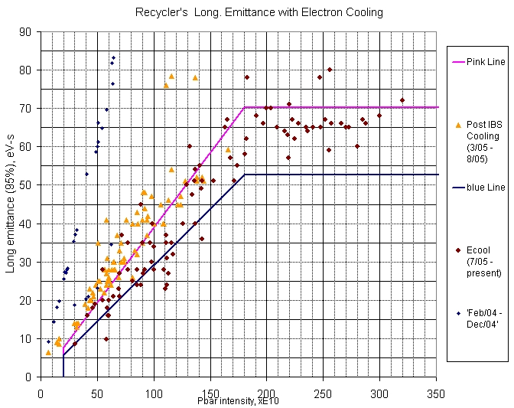
Present Recycler performance with electron cooling

Slide 36
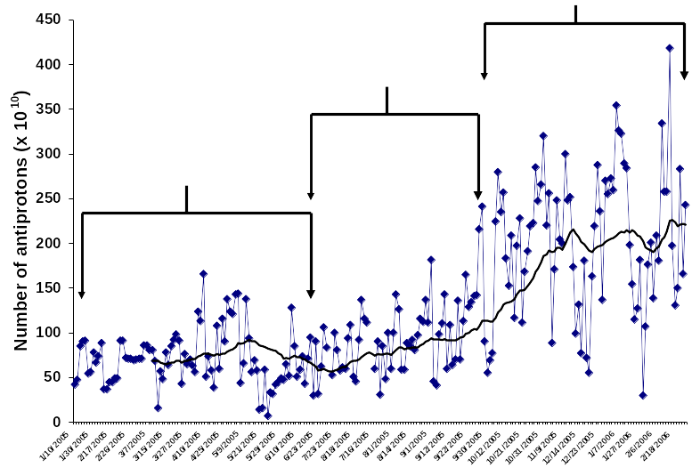
Evolution of the number of antiprotons available from the Recycler (~1 year period)
Recycler only shots
Ecool implementation
Mixed mode operation

Slide 37
Conclusion (I)
Fermilab has a unique operational electron cooling system for cooling of 8.9 GeV/c antiprotons
  Since the end of August 2005, electron cooling is being used on (almost) every Tevatron shot
  Increases of stash sizes are a direct consequence of the ability to cool the beam efficiently
  Electron cooling allowed for the latest advances in the TeV peak luminosity
Emittance growth during the mining process has been almost completely eliminated by changing our operating point (tune space)
  Theoretical model prediction
  More tune space investigations in the near future
Lifetime degradation is mitigated by a progressive cooling procedure
  Focus of upcoming studies

Slide 38
Conclusion (II)
Cooling force has been measured and compared to a non-magnetized model
  Reasonable agreement with expectations
    Uncertainties in the electron beam properties make this agreement no better than within a factor of 2-3

Slide 39
People of Ecool
Recycler department head:
  Paul Derwent
Recycler deputy department head:
  Cons Gattuso*
Ecool Safety officer:
  Mike Gerardi
Recycler department personnel:
  Valeri Balbekov
  Dan Broemmelsiek*
  Alexey Burov†
  Kermit Carlson‡
  Jim Crisp
  Martin Hu*
  Dave Neuffer
  Bill Ng
  Lionel Prost*
  Stan Pruss*
Recycler department personnel (cont’):
  Sasha Shemyakin (GL)*
  Mary Sutherland*
  Arden Warner*
  Meiqin Xio
Other AD departments:
  Brian Chase
  Paul Joireman
  Ron Kellett
  Brian Kramper
  Valeri Lebedev
  Mike McGee
  Sergei Nagaitsev
  Jerry Nelson
  Greg Saewert
  Chuck Schmidt
  Alexei Semenov
  Sergey Seletskiy
  Jeff Simmons
  Karl Williams
* Main experimentalists (experimental studies, data analyses,…); † Primary ecool theorist (theoretical analyses); ‡ Primary technical support (tech support coordination,…)

Slide 40
EXTRAS

Slide 41
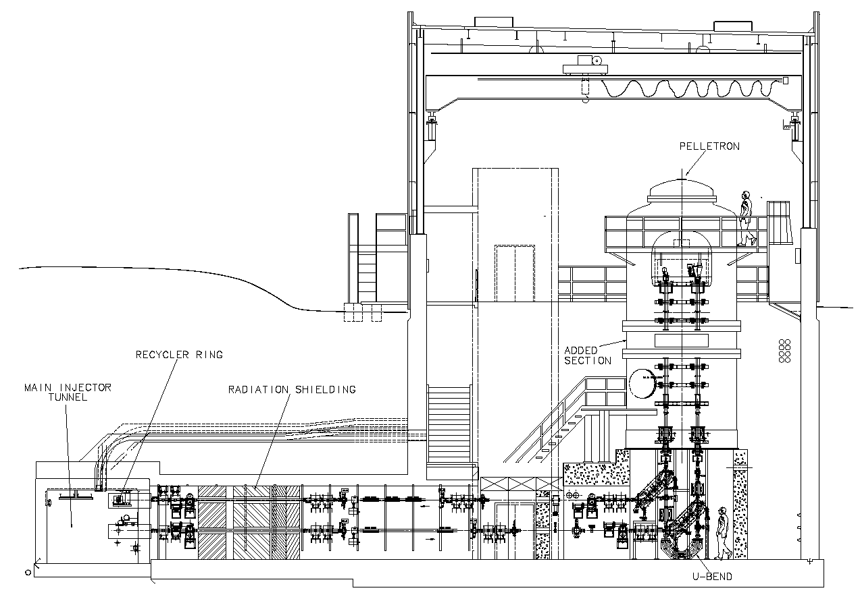
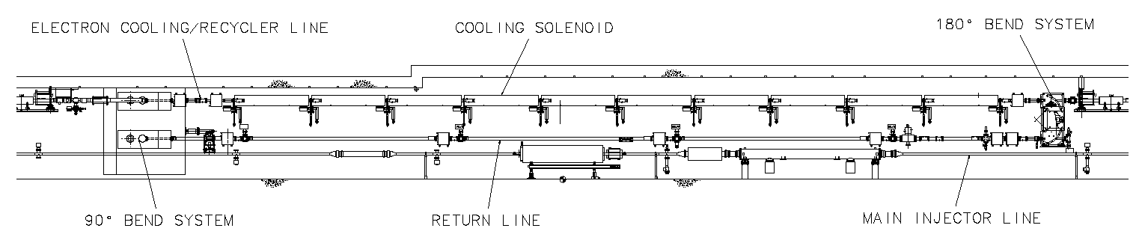
Setup of Fermilab’s Electron Cooler

Slide 42
Electron beam parameters (for cooling)
Electron kinetic energy 4.34 MeV
Uncertainty in electron beam energy ≤ 0.3 %
Energy ripple 250 V rms
Beam current 0.1 A DC
Duty factor (averaged over 8 h) >95 %
Electron angles in the cooling section
(averaged over time, beam cross section,
and cooling section length), rms ≤0.2 mrad

Slide 43
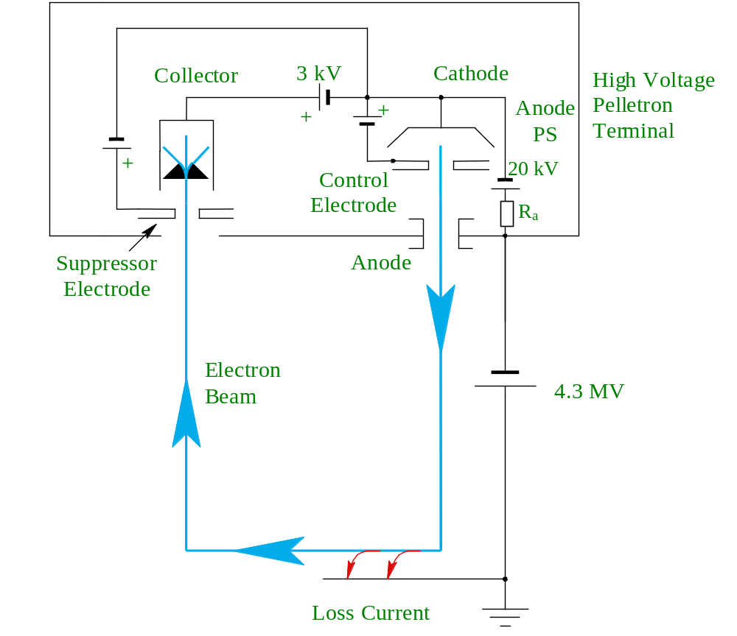
Simplified electrical schematic of the electron beam recirculation system
For I= 0.5 A, ΔI= 5 μA:
Beam power 2.15 MW
Current loss power 21.5 W
Power dissipated in collector 1.6 kW
The beam power of 2 MW requires the energy recovery (recirculation) scheme

Slide 44
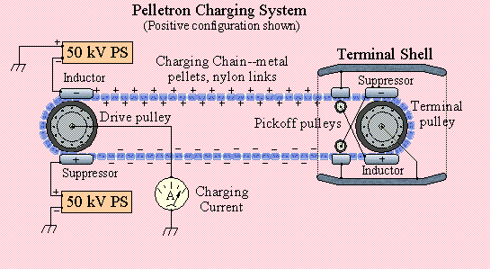
Electrostatic generator: the Pelletron (developed by NEC)
‘Improved’ Van de Graaff generator
  Charge carried by a chain (metal cylinders joined by nylon links) instead of a rubber belt
  Induction system to charge the chain (instead of rubbing contacts or corona discharges)

Slide 45
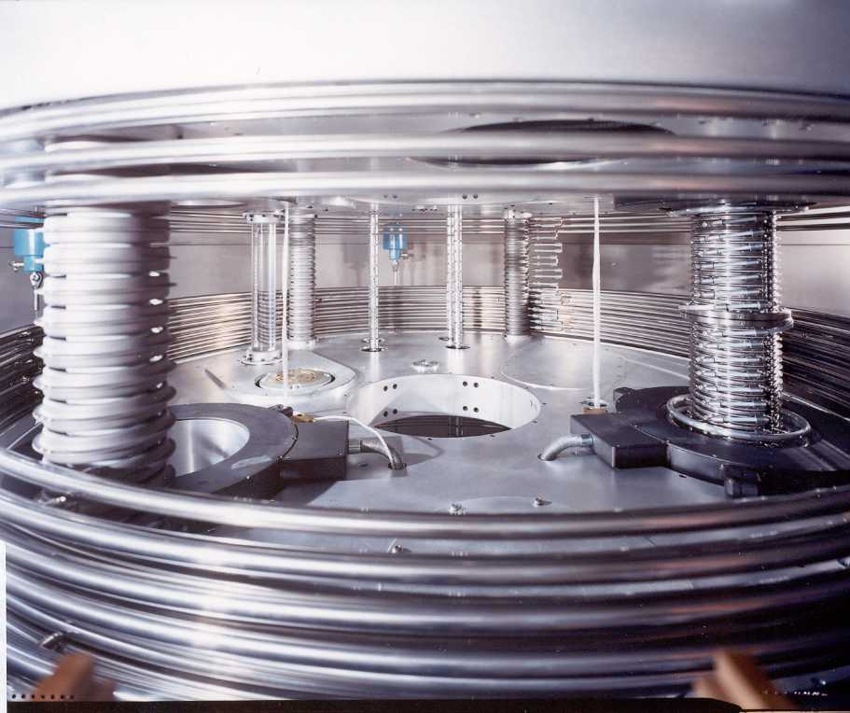
Preview of what’s inside the pressure vessel
High-voltage column with grading hoops partially removed to show the accelerating tube (right) and the charging chains (far center).

Slide 46
Diagnostics
YAG crystal, OTR monitors throughout the beam line
  Beam size (shape), distribution
  Used to compare to optics models
1 multi-wire scanner
  Beam size and shape after 180° bend
Removable apertures in the cooling section
  Between each of the ten cooling section solenoid
  Beam size and angle
BPMs
  Between each of the ten cooling section solenoid + 16 in other beam lines (accel, supply, return, transfer, decel)
  Can measure both pulsed and DC beam
  Capable of monitoring both electrons AND pbars

Slide 47
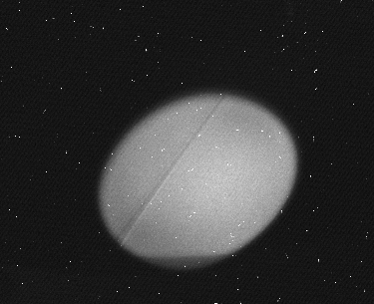
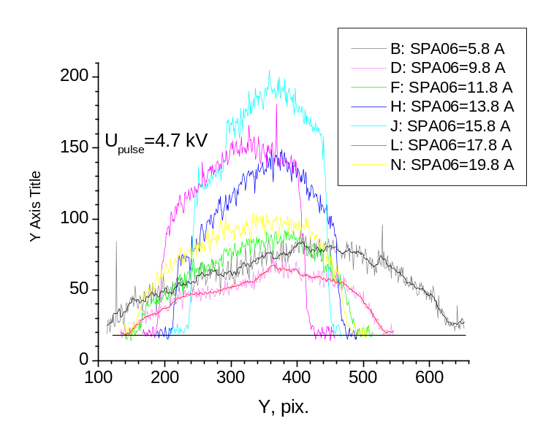
OTR Detectors for the Medium Energy Electron Cooler
Detector characteristics
  5 µm foil
  Lower current limit 20mA
  Resolution 50 µm
Applications
  Real-time charge density distribution and beam size measurements
  Measurement of beam initial conditions in the acceleration section
  Beam ellipticity measurements
  Beam temperature measurements with pepper-pot
Beam Image from OTR at full current (acceleration tube exit)
Beam profile versus Lens current on acceleration side

Slide 48
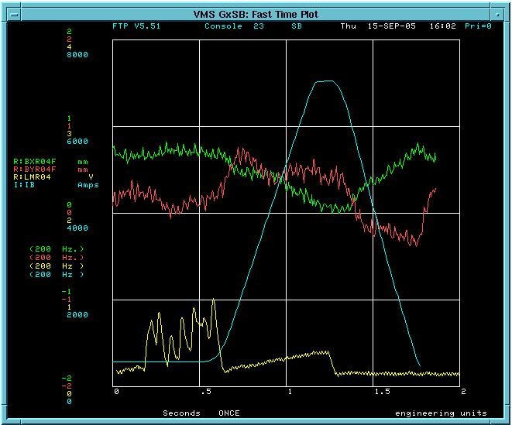
Neighborhood with the Main Injector
Magnetic fields of busses and MI magnets in the time of ramping causes an extensive motion of the electron beam (up to 0.2 mm in the cooling section and up to 2 mm in the return line)
MI radiation losses sometimes result in false trips of the ECool protection system
MI bus current
1mm
X
Y
MI loss
2 sec
Electron beam motion and MI losses at R04 location in the time of MI ramping. 0.55 Hz oscillation is due to 250 V (rms) energy ripple.

Slide 49
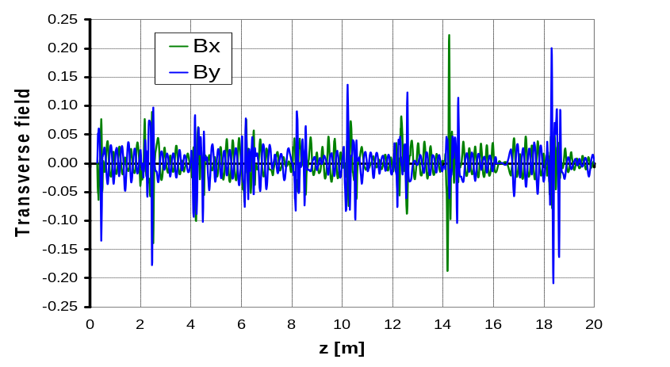
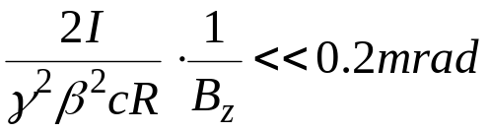
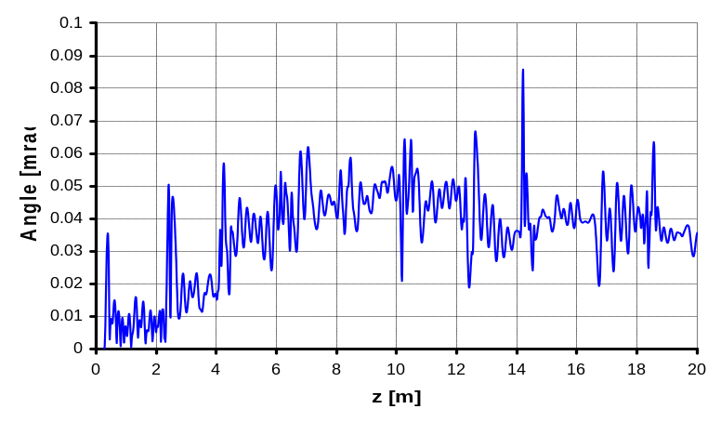

Low magnetic field in the cooling section
Cooling is not magnetized
The role of the magnetic field in the cooling section is to preserve low electron angles,
Transverse magnetic field map after compensation (B_{z} = 105 G).
A typical length of B⊥ perturbation, ~20 cm, is much shorter than the electron Larmor length, 10 m. Electron angles are sensitive to , not to B⊥ .
Simulated angle of an 4.34 MeV electron in this field. RMS angle is < 40 μrad.

Slide 50
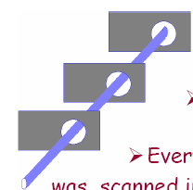



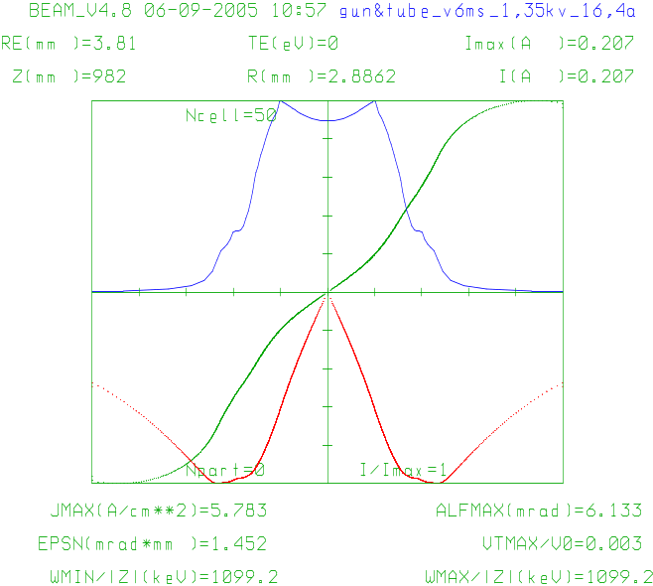
Beam size measurements in the Cooling Section
11 movable orifices (not in phase) in the cooling section
The scrapers are diaphragms of 15 mm diameter, located every 2 m.
While only one of them is in place, the beam is shifted in some direction until it touches the scraper. The bpm data for the beam center is taken at this point.
The beam is shifted in other direction, and the center coordinates at touch are detected again; usually 8 directions are used. Then, the entire procedure is repeated for other scrapers.
From these data, the beam ellipse and the scraper offsets are found for every scraper involved.
Initial conditions for the beam envelope are fitted for these ellipses.
A cylindrical boundary might not guarantee low angles in the middle of the beam because of aberrations
density
radial angle
tangential angle

Slide 51
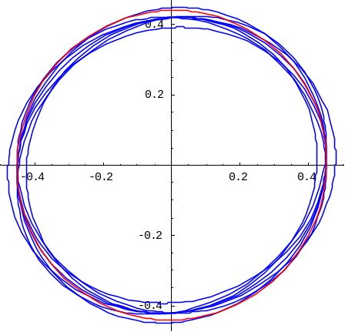
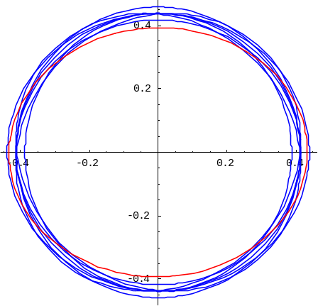
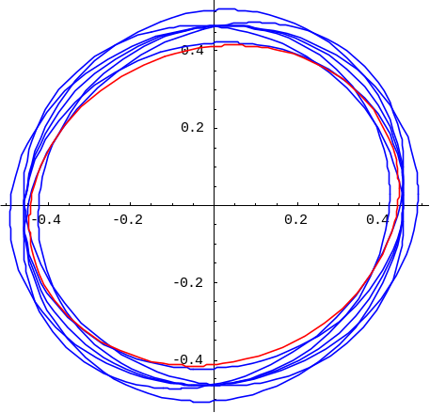
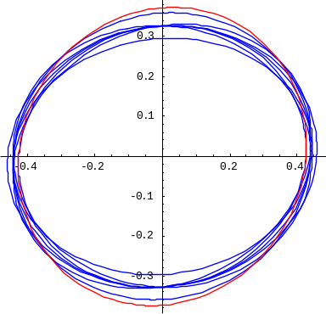
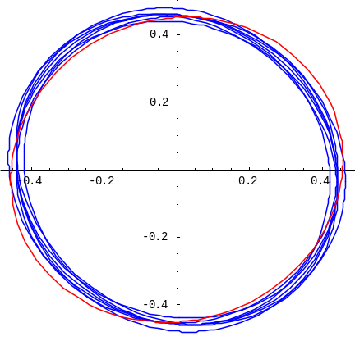
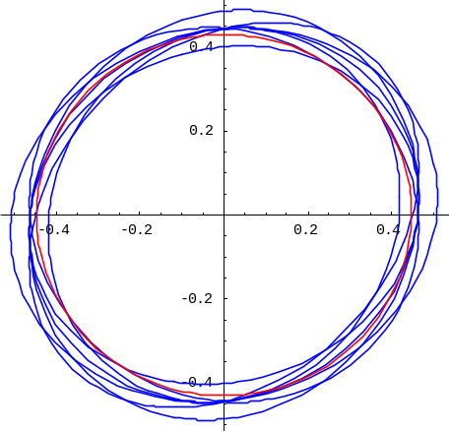
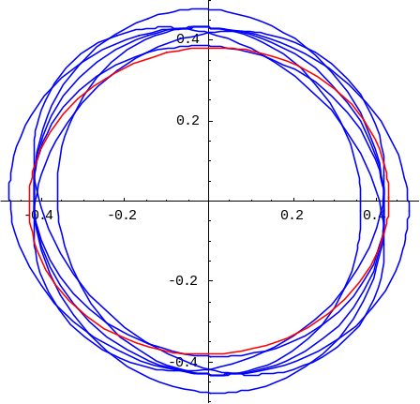
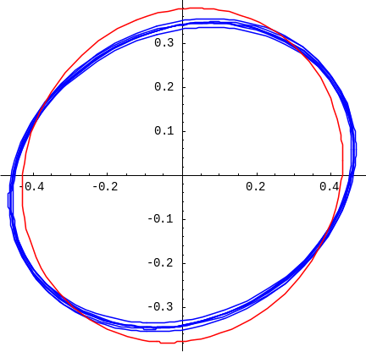



Scraper Measurements Dec 1 (nominal settings, 500 mA)
SCC00
SCC10
SCC20
SCC30
SCC40
SCC50
SCC60
SCC70
Beam radius ~ 4.5 mm
Averaged rms angle <0.2 mrad
SCC80
SCC90
SCQ01

Slide 52


Comparison of two focusing settings
Nominal
Average rms envelope angle is 0.2 mrad
One lens changed by 2 A
Average rms envelope angle is 0.5 mrad
Envelope (fit) along the scrapers 0-5

Slide 53
Why sudden new interest in high energy cooling?
The existing stochastic cooling technology is band-width limited (10 GHz or so).
The lack of progress in bunched-beam stochastic cooling
The advance in electron gun and collector technology (experience of low energy e-cooling), and in recirculation of DC beams.
The advance in recirculating linac technologies.
The advance in linear optics on beams with a large angular momentum.

Slide 54

Simulation of cooling demonstration
Without cooling -- the momentum distribution remains flat over 0.3% span for 30 minutes
Coasting beam, IBS+ECOOL simulation, εn = 2 mm mrad, Ie=0.1 A, rms angular spread = 0.5 mrad

Slide 55

Recycler measured momentum distribution using Schottky
1.5e11 pbars, ε_{n} = 2 mm mrad
Momentum acceptance (flat central part): about 0.5% (+/- 22 MeV/c)

Slide 56

Drag rate as a function of the electron beam current
3.67 MeV/c momentum deviation, on axis, nominal cooling settings
Not a real fit
Drag force on axis appears to be independent of the electron beam current
→ Quite consistent with equilibrium longitudinal emittance measurements
The drag force is nearly constant at 0.1 – 0.5 A, while in simulations the current density at the axis is twice higher at 0.5 A than at 0.1 A.

Slide 57

Drag rate as a function of the transverse emittance
1.84 and 3.67 MeV/c momentum offsets, 100 - 500 mA e-beam, on axis
Scattered in the data likely dominated by the difficulties in getting similar machine conditions

Slide 58

Emittance growth during mining
e-beam: 500 mA, +3 mm offset
pbars: 180e10
Initial rate:
17 π mm mrad/hour
Stochastic cooling system was turned off when mining, e-beam (when used) remained on
e-beam: 500 mA, +3.5 mm offset
pbars: 180e10
Dampers are on for all measurements
pbars: 114e10
Instrumentation problem

Slide 59

Emittance growth during mining reduced by ~10
Changed working point for the tunes (in order to split them more), from 0.414/0.418 (H/V) to 0.453/0.473 (H/V)
Electron beam current
Horizontal emittance
Electron beam position
Longitudinal emittance (circle)
Vertical emittance (circle)
Pbar intensity
(circle)
Phase density when mining = 0.9
227e10
Mining
Stochastic cooling system is turned off before mining
100 mA
~2 π mm mrad/hour

Slide 60

Correlation with presence of electron beam & cooling ?
158 × 10¹⁰
Pbar intensity
(1 × 10¹⁰/div)
Longitudinal emittance
(20 eV s/div)
Vertical emittance
(2 π mm mrad/div)
Electron beam current
(0.1 A/div)
Lifetime
(1 hour running average) [circle]
(500 h/div)
2000 h
Lifetime drops and recovers ~1 hour later
But phase density has increased by ~2 !
68 eV s
3.8 π mm mrad
40 minutes of electron cooling on axis at 300 mA
0 h

Slide 61


Comparison with cooling force measured at low-energy coolers
  Comparison with data for normalized longitudinal cooling force measured at low energy coolers adapted from
  I.N. Meshkov, Phys. Part. Nucl., 25 (6), p. 631 (1994).
eV/m
  Red triangles represent Fermilab’s data measured at 0.1 A. The current density is estimated in the model with secondary electrons.
Vp, cm/s

