Slide 1
Electron Cooling in RHIC at Low Energies
Alexei Fedotov
Collider-Accelerator Department, BNL
(March 10, 2006)

Slide 2
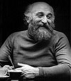

Electron cooling
was invented by
G.I. Budker
(INP, Novosibirsk, 1966)
First experimental
cooling. NAP-M storage
ring (Novosibirsk, 1974)
Principles of electron cooling:
Produce a beam of cold (low emittance) electrons.
Move these electrons with a velocity of the heavy particles to be cooled.
Heavy particles scatter off the electrons and energy is transferred to electrons. This energy transfer appears as a friction force acting on the ions. The ions are “cooled”.
The electrons are renewed.

Slide 3
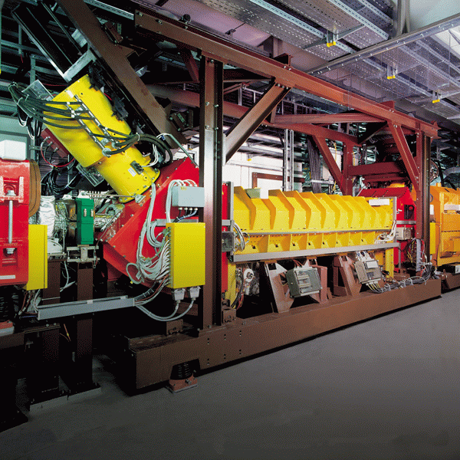
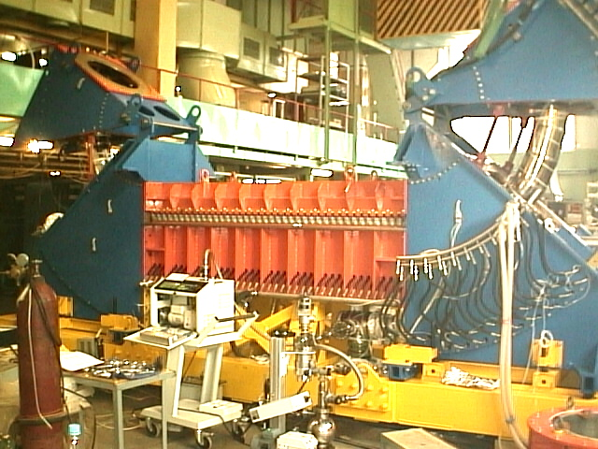
Low-energy (3-400 KeV electrons) cooling ( < 1 GeV/u ions): 10’s of coolers were constructed: 1975-2005

Slide 4
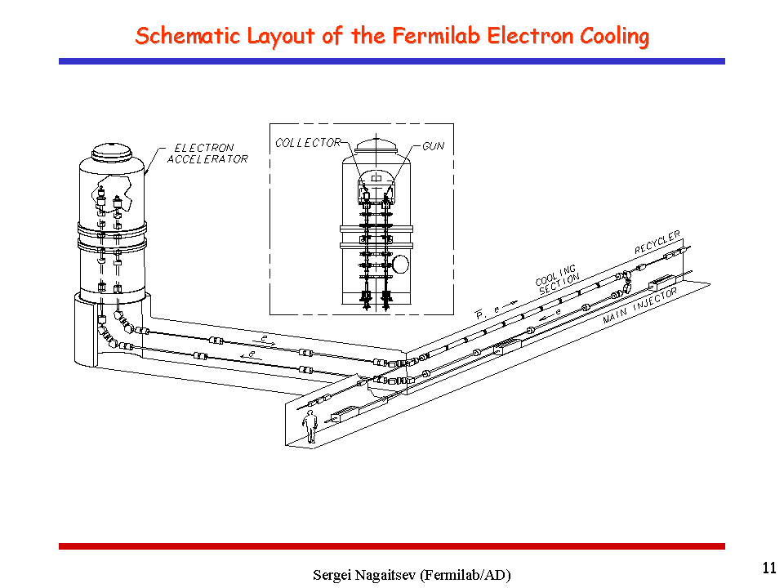
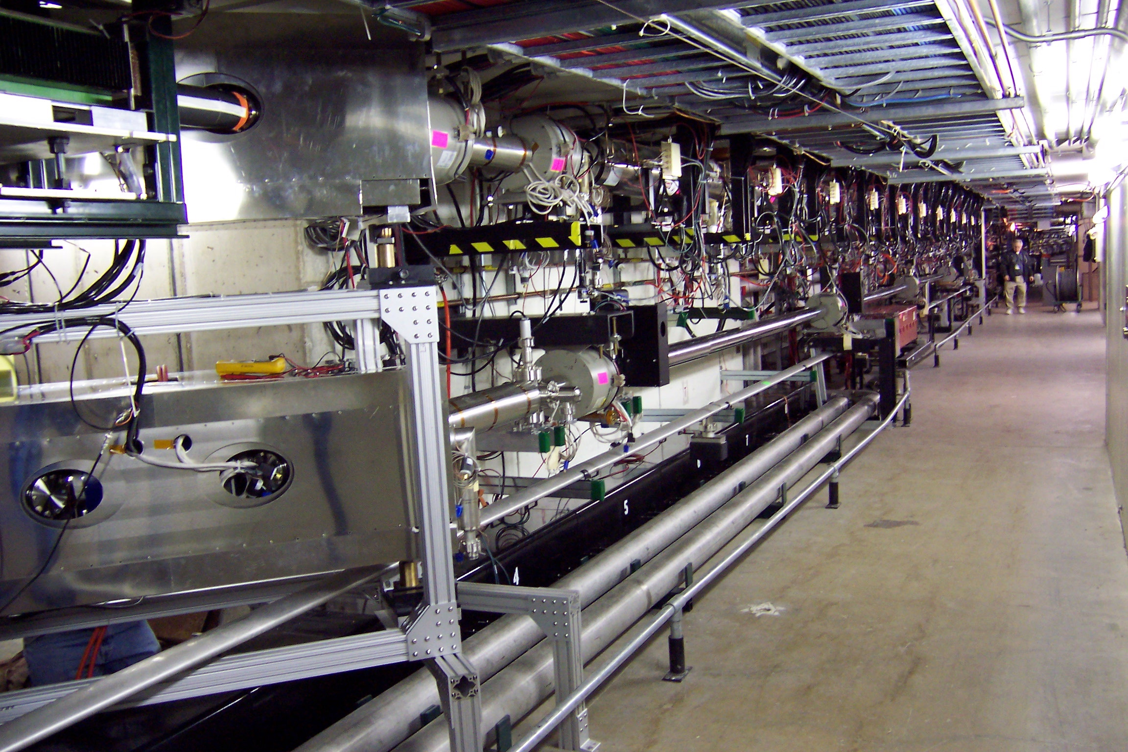
Medium-energy (4 MeV electrons) cooling at FNAL – to cool 8 GeV pbars – successfully operating since July 2005

Slide 5
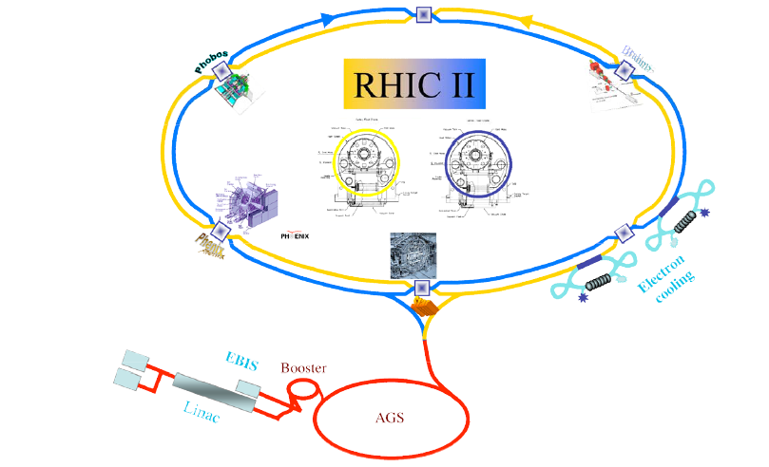
High-energy (54 MeV electrons) cooling - to cool Au ions at 100 GeV/u energies – RHIC-II upgrade
54 MeV electrons
delivered by
Energy Recovery Linac (ERL)

Slide 6
Magnetized and Non-magnetized cooling
1. All low-energy (3-400KeV electrons) coolers 1975-2005 are based on “magnetized cooling” – electron beam transport and alignment of electron and ion beam is done with continuous magnetic field. Strong magnetic field completely suppresses transverse temperature of electron beam, so that effectiveness of cooling is determined by a very low longitudinal temperature of electrons.
2. “Non-magnetized cooling” – relies on the fact that rms velocity spread of electrons is comparable or smaller than the one of ions which need to be cooled.

Slide 7
Practical implementation of e-cooling for low energy in RHIC
Magnetized cooling: 2 MeV electrons is considered as COSY upgrade. 4.3 (8) MeV electrons 8 (15) GeV pbars is planned for HESR GSI (FAIR project) – both are technically challenging projects.
Non-magnetized cooler at FNAL 4.3 MeV electron energy - can cover ion energies up to (E_{k}=8 GeV).
RHIC-II cooler 54 MeV electrons (100 GeV/u ions) is based on RF SC gun.
Two guns are presently being designed:
3.1 Prototype ERL gun (1/2 cell): designed energy of electrons at gun exit 2.5 MeV – ( E_{k}= 4.6 GeV ions)
3.2 RHIC-II cooler gun (1.5 cell): designed energy of electrons at gun exit 4.5 MeV – ( E_{k}= 8.3 GeV ions)

Slide 8
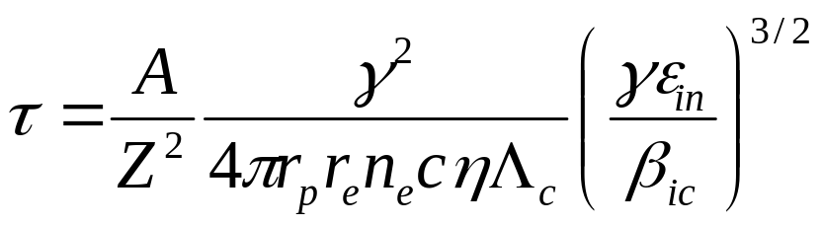
Cooling at different energies
Cooling times for relativistic energies are much longer than for typical low-energy coolers (γ=1).
In approximation of cold electron beam one gets cooling time:
When rms velocity spread of electron beam is significant compared to the ion beam, dependence of cooling time on relativistic factor γ is less pronounced.
Very fast for low energies
Very fast for heavy ions

Slide 9
Present design of high-energy electron cooler for RHIC-II is based on the non-magnetized approach.
For non-magnetized cooling – the challenging requirement is to get small electron emittance for high charge of electron beam.
For 100 GeV/u, γ=108 cooling, we need
electron beam with Q=5nC and rms normalized emittance ε_{e,n} < 4 μm
Present simulations (Chang, Kayran) for 1.5 cell gun give ε_{e,n}=3-5 μm
For ½ cell gun (ERL prototype under construction at BNL):
expected rms normalized emittance for Q=5nC: ε_{e,n} < 10 μm

Slide 10
Cooling times at low energies in RHIC will slightly depend on:
Emittance of ion beam at such low energy
Emittance of electron beam
Simulations results (using BETACOOL) are shown for the followings emittances of electron beam (electron charge Q=5nC):
E_{k}=1.5 GeV/u (c.m. 5 GeV) – electron rms normalized emittance 15 μm.
E_{k}=5.0 GeV/u (c.m. 12 GeV) – electron rms normalized emittance 10 μm
E_{k}=9.0 GeV/u (c.m. 20 GeV) – electron rms normalized emittance 10 μm.
Technical aspects such as electron beam transport at low energy, emittance preservation for such a beam, alignment of electron and ion beams require careful consideration and are not discussed here.

Slide 11
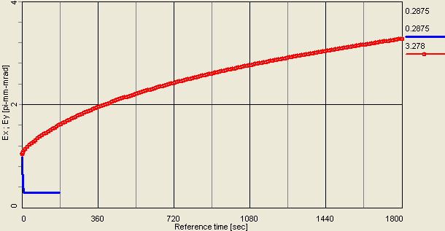
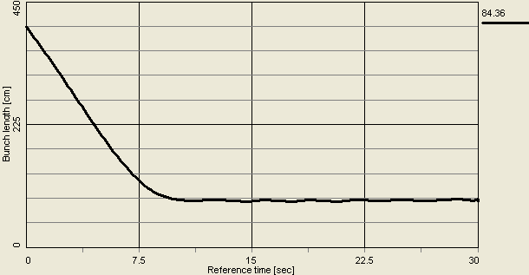
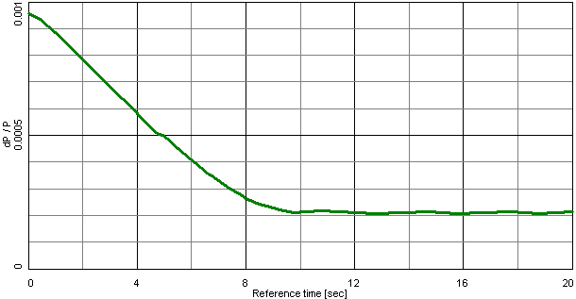
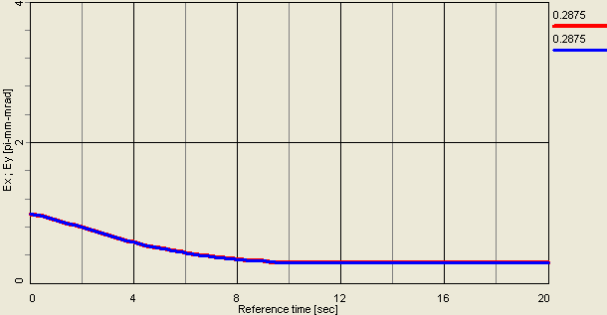
Cooling Au ions at E_{k}=1.5 GeV/u (γ=2.61)
Electron beam: q=5nC, rms ε_{e,n}=15μm, σ_{p}=1e-3, L=80m
(Figs: plotted emittance is rms unnormalized)
rms bunch length due to cooling:
400 cm -> 84 cm in 10 sec
emittance growth
(95% normalized) due to IBS:
ε_{i,n,95%}: 15 π μm -> 48 π μm in 30 min
Cooling of transverse emittance
(95% normalized):
ε_{i,n,95%}: 15 π μm -> 4 π μm in 10 sec
rms momentum spread:
0.001 -> 0.0002
Cooling section length: L=80m

Slide 12
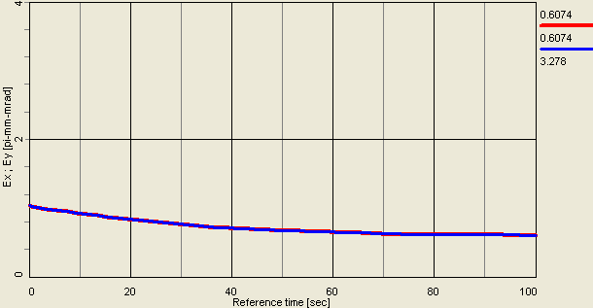
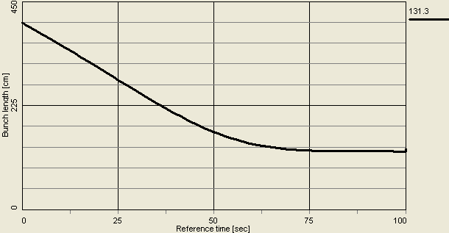
Cooling Au ions at E_{k}=1.5 GeV/u (γ=2.61)
Electron beam: q=5nC, rms ε_{e,n}=15μm, σ_{p}=1e-3, L=10m
(Figs: plotted emittance is rms unnormalized)
Cooling of transverse emittance
(95% normalized):
ε_{i,n,95%}: 15 π -> 8.6 π in 80 sec
rms bunch length due to cooling:
400 cm -> 130 cm in 80 sec
Cooling section length: L=10m

Slide 13
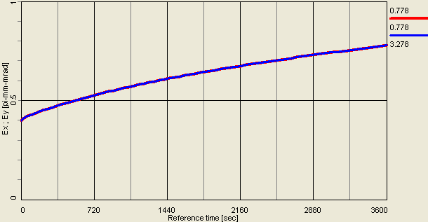
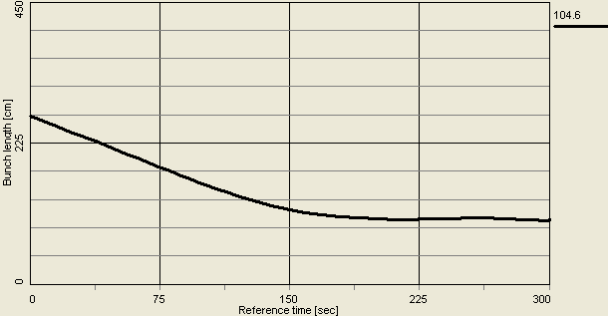
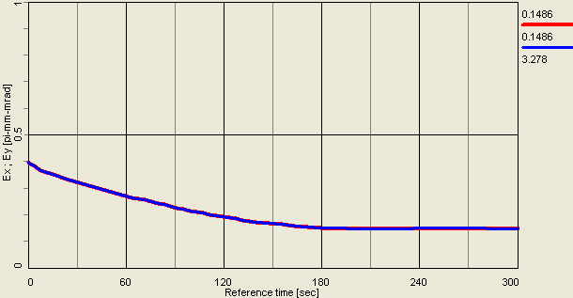
Cooling Au ions at E_{k}=5 GeV/u (γ=6.37)
Electron beam: q=5nC, rms ε_{e,n}=10μm, σ_{p}=1e-3, L=10m
(Figs: plotted emittance is rms unnormalized)
rms bunch length due to cooling:
268 cm -> 105 cm in 200 sec
Emittance growth
(95% normalized) due to IBS:
ε_{i,n,95%}: 15 π -> 30 π in 60 min
Cooling of transverse emittance
(95% normalized):
ε_{i,n,95%}: 15 π -> 5.6 π in 200 sec
Cooling section length: L=10m

Slide 14
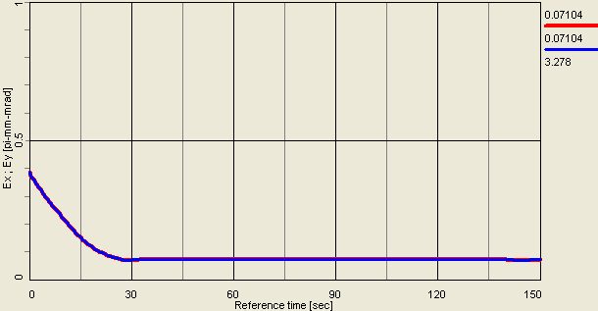
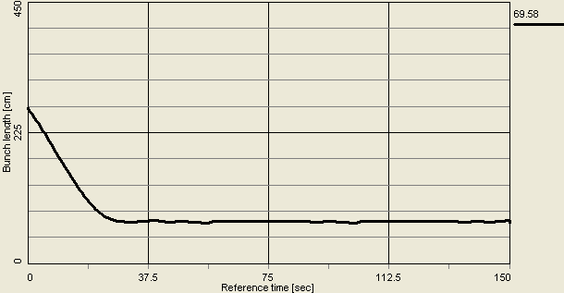
Cooling Au ions at E_{k}=5 GeV/u (γ=6.37)
Electron beam: q=5nC, rms ε_{e,n}=10μm, σ_{p}=1e-3, L=80m
(Figs: plotted emittance is rms unnormalized)
Cooling of transverse emittance
(95% normalized):
ε_{i,n,95%}: 15 π -> 3 π in 35 sec
Cooling of rms bunch length:
268 cm -> 70 cm in 35 sec
Cooling section length: L=80m

Slide 15
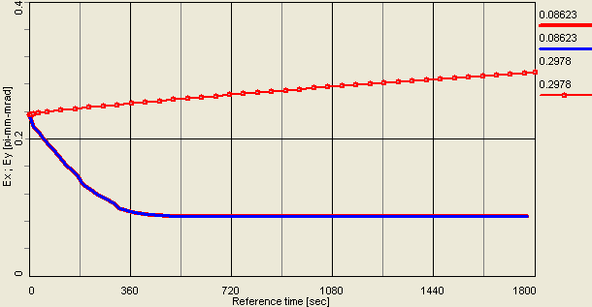
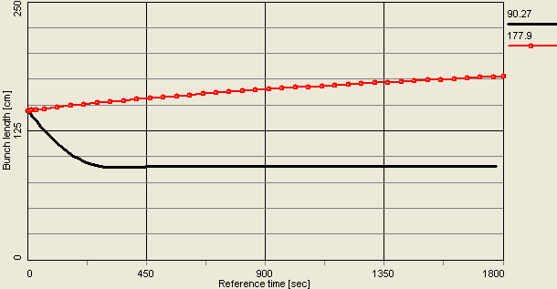
Cooling of Au ions at E_{k}=9 GeV/u (γ=10.66)
Electron beam: q=5nC, rms ε_{e,n}=10μm, σ_{p}=1e-3, L=10m
(Figs: plotted emittance is rms unnormalized)
emittance growth due to IBS:
ε_{i,n,95%}: 15 π -> 20 π in 30 min
rms bunch length growth due to IBS:
144 cm -> 177 cm in 30 min
cooling of rms bunch length:
144 cm -> 90 cm in 6 min
cooling: ε_{i,n,95%}: 15 π -> 5.5 π in 6 min
cooling at present RHIC injection
energy just with L=10 m cooling section

Slide 16
Summary
Cooling times at low-energies in RHIC are very short.
It seems feasible to employ RF gun which is developed for ERL project at BNL (presently under construction at Collider-Accelerator Department) to provide such a low-energy cooling.
Actual technical aspects of electron beam transport will need to be addressed when the energy of interest or a range of energies will be defined.

