Slide 1
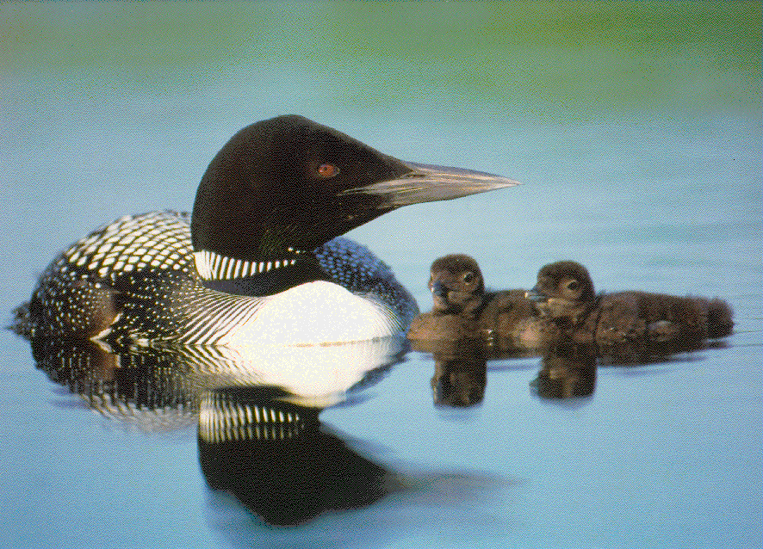
Mercury, Mercury Everywhere! What’s a critter to eat? Development of a mercury Wildlife Criterion for Maine
David Evers and Oksana Lane,
BioDiversity Research Institute
&
Barry Mower,
Maine Department of Env. Protection
&
Robert Taylor,
Texas A&M Trace Element Res. Lab
&
Robert Poppenga
University of Penn., Animal Health Diagnostics Lab

Slide 2
Presentation Outline
Risk Assessment Approach for developing a Wildlife Criterion Value (WCV) for Hg
  Defining parameters
Using the Common Loon as an initial standard
  Why use the loon?
3. Risk Characterization (weight of evidence approach)
  Exposure profile results (spatially explicit)
  Hazard profile results (individual & population level)
WCV Hg Model
  Preliminary results

Slide 3
What is a WCV
A procedure to estimate surface Hg water concentrations that will protect the viability of wildlife populations associated with aquatic resources
  First developed and used in 1995 for the Great Lakes Water Quality Initiative (GLI)
  An independently directed U.S. Congressional request in 1990 for a WCV (as mandated by the Clean Air Act) was developed by the U.S. EPA in a 1997 Report to Congress.
  Parts of this report were published by Nichols and Bradbury as “Derivations of wildlife values for mercury” in the J. Toxicology and Environ. Health, 1999.

Slide 4
Why use the Common Loon as our initial standard
Documented individual and, potentially, population level impacts from MeHg ingestion;
High trophic level obligate piscivore (biomagnification);
“K-selected” life history strategy (bioaccumulation);
Complex and coordinated behaviors within pair;
Moderate to high sensitivity to stressors;
Logistically feasible (easily observed and individually identified over entire breeding period);
Some matrices (i.e., blood and eggs) represent a target area (i.e., a lake);
High profile to public and therefore policymakers;
Demographic models based on >3,000 banded loons.

Slide 5
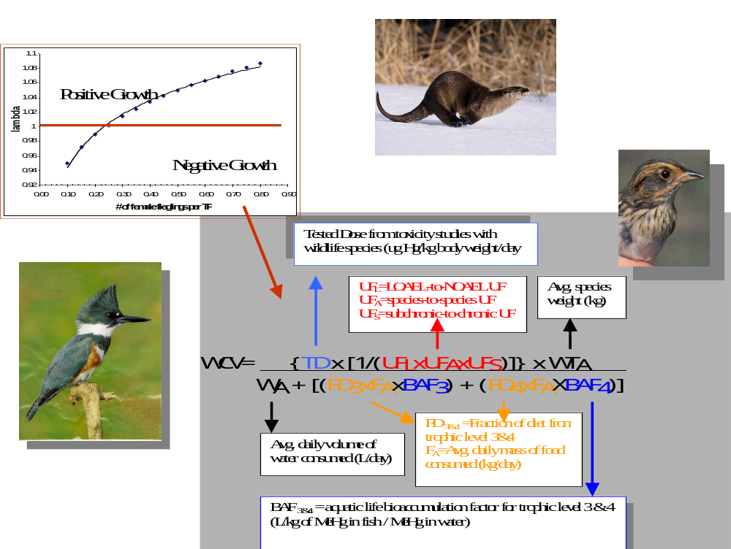

Slide 6

Test Dose
EPA WCV limitations
  Test dose is:
    Based on mallards, non-piscivorous birds that are more sensitive to Hg toxicity because of evolutionary reasons;
    Based on laboratory studies;
    Based on impacts to individuals.
  Ingestion rates and BAF are quite generic and are not based on empirical data.
BRI WCV for Maine (response to limitations in EPA model)
  Test dose is:
    based on a species that is sensitive to Hg toxicity and is exposed to Hg levels that are significantly higher than historical levels on freshwater lakes;
    Based on in-field studies:
    Based on impacts to populations.
  Ingestion rates and BAF are empirically measured parameters.

Slide 7
Developing an Exposure Profile
Matrix type and meaning:
  Blood: reflects current dietary uptake (based on strong relationship between breeding adult blood Hg and fish prey Hg collected from the same lake).
  Feather: reflects body burden and if input > output will show increase of MeHg related to age.
  Egg: reflects primarily breeding lake dietary uptake (i.e., 79% of the egg Hg can be explained by female blood Hg)*
Results of effort:
  Adults sampled: >1,800
  Juveniles sampled: >1,400
  Eggs sampled: >900
* Evers et al. 2003. Common Loon eggs as indicators of methylmercury availability in North America. Ecotoxicology 12:69-81.

Slide 8
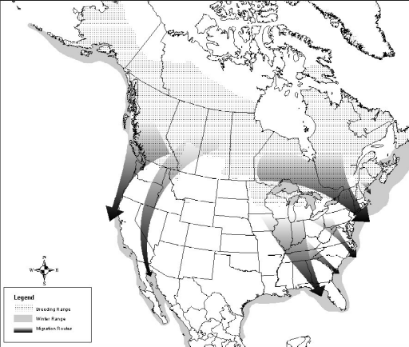
Geographic Context: Sampling from 1989-2002
North Slope
Mat-Su Valley
KEY FOR STUDY SITES
Breeding
Winter
Migration
Tetlin NWR
Kenai NWR
Pinchi Lake area
La Maurice NP
Isle Royale NP
Lepreau area
Voyageurs NP
Northwest
Seney NWR
Kejimkujik NP
Grand Rapids Area
Rangeley Lakes
North-cent. WI
Tomalas Bay
Ottawa NF
Adirondacks
Walker Lake
Topaz Lake
Chesapeake Bay
Florida

Slide 9
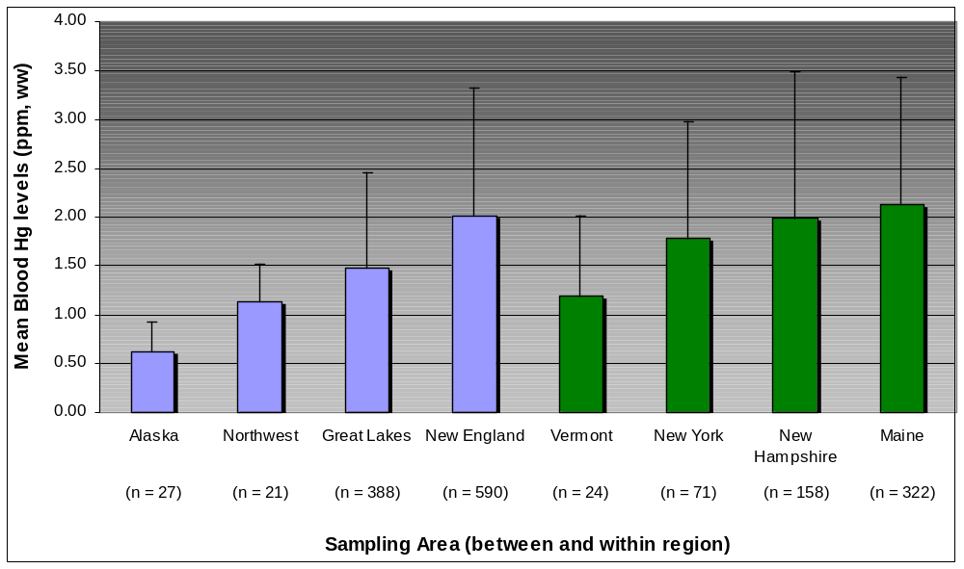
Geographic context for MeHg availability
  Significant increase from western to eastern North America*
  New England has some of the highest levels of MeHg availability
Between
Within
* Evers et al. 1998. Geographic trend in mercury measured in Common Loon feathers and blood. Environ. Tox. Chem. 17:173-183.

Slide 10
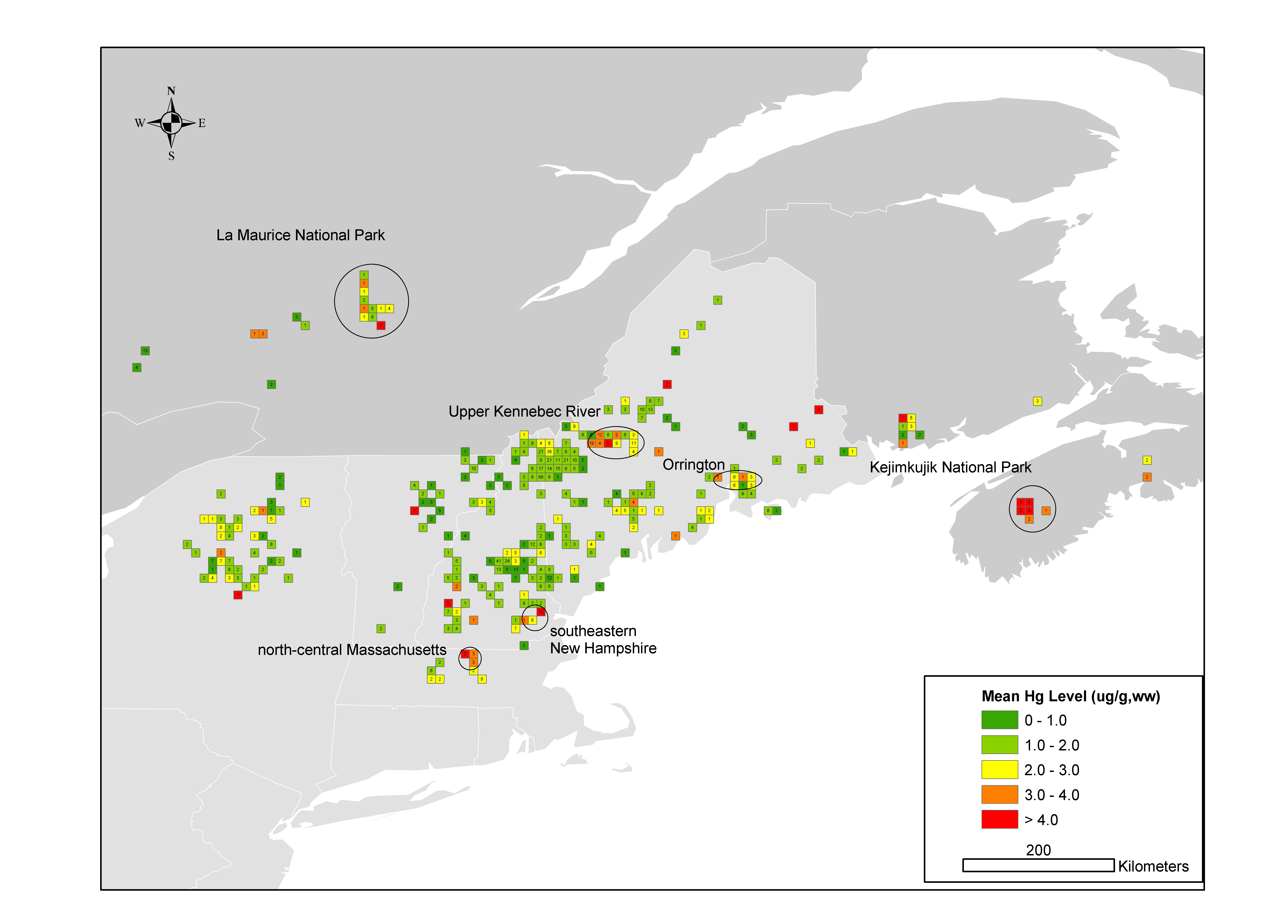
Lakes With Representative Loon Tissue Hg Levels
(N>400 terr, >250 Lakes)

Slide 11
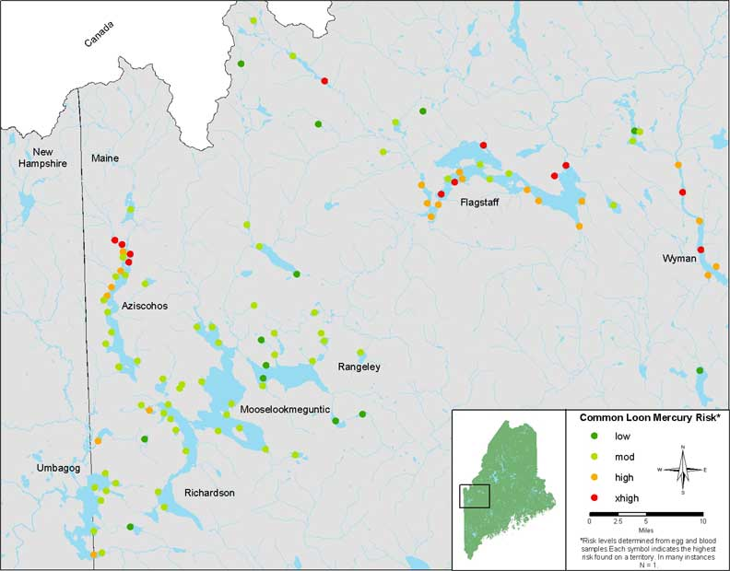
Rangeley Lakes Focal Study Site (44 lakes with 181 Loon Territories)

Slide 12
Hazard Assessment for individuals; Does Hg impact individual loons? YES
Physiological:
    Significant relationship with increasing corticosterone stress hormones & MeHg levels
Behavioral (>2,500 hours of observation)
    Higher Hg levels sig. reduce time incubating
    Higher Hg levels cause adults to become lethargic (i.e., they spend sig. more time in low energy behaviors)
Pharmacokinetics:
    Recaptured adults have 9% (males) and 5.6% (females) annual increase in feather Hg levels
    Recaptured juveniles have increasing (1-3%/day) Hg levels during the summer

Slide 13
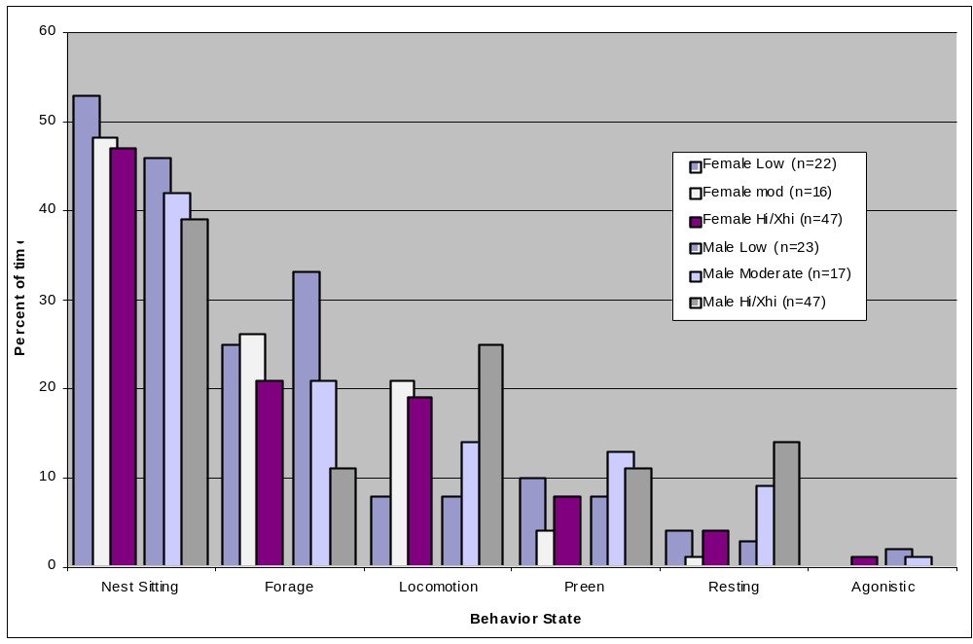
Behavioral impacts
90%
80%
R
2
= 0.230
70%
p = 0.037
Percent time adults (M&F) spent
60%
50%
in High* energybehaviors
40%
Low Hg incubation time=99% of time
High Hg incubation time=85% of time
30%
20%
10%
0%
0.00
1.00
2.00
3.00
4.00
5.00
6.00
7.00
Blood Hg (ppm, ww)
Male foraging time for
high Hg risk loons
is one-third that of
low Hg risk ones

Slide 14
Population-level impacts from Hg; Is Hg harming loon populations? Likely
Condition/Fitness:
  Measurements indicate a decline related to increasing Hg levels.
    Flight feather asymmetry is significant in Maine’s breeding population – the 3.5% mean may result in 15% less flight efficiency
    Recaptured high/xhigh adults show a sig. (p=0.03) body weight decline vs. low/mod (n=21).
    Egg weights have a sig. (p=0.02) decline as Hg levels increase
Reproductive Success:
  - Compared to low risk loon pairs, high risk pairs;
    Significantly initiate 7% fewer nests
    Significantly hatch 31% fewer eggs
    Significantly fledge 40% fewer young

Slide 15
Impacts to reproductive success
1.4
Low Risk (n=30 territories, 149 territory-years )
1.2
Moderate Risk (n=58 territories, 330 territory-years)
1.22
High Risk (n=46 territories, 394 territory-years)
1.0
0.99
0.8
0.84
Loon Productivity Rates
0.76
0.76
0.74
0.6
0.71
0.68
0.68
0.65
0.4
0.49
0.41
0.2
0
Nest (NP/TP)
Hatch (SY/NP)
Chick Survival (LY/SY)
Overall Productivity (LY/TP)
Productivity Parameters

Slide 16
Hazard Assessment - Results
NOAEL
LOAEL
Matrix* Low Mod High Xhigh Reference
Fish** 0-0.1 0.1-0.2 0.2-0.4 >0.4 Barr 1986, This Study
Eggs 0-0.5 0.5-1.3 1.3-2.0 >2.0 Evers et al. 2003
Blood-J 0-0.1 0.1-0.3 0.3-0.4 >0.4 Meyer et al. 1998***
Blood-A0-1.0 1.0-3.0 3.0-4.0 >4.0 This Study, Nocera 1999
Feather 0-9 9-20 20-30 >30 Thompson 1998
* Total Hg levels in ug/g, blood and eggs are ww and feathers are fw
** Represents 10-15 cm Yellow Perch, ww, whole body analysis
***Applies to 3-5 week old chicks only

Slide 17
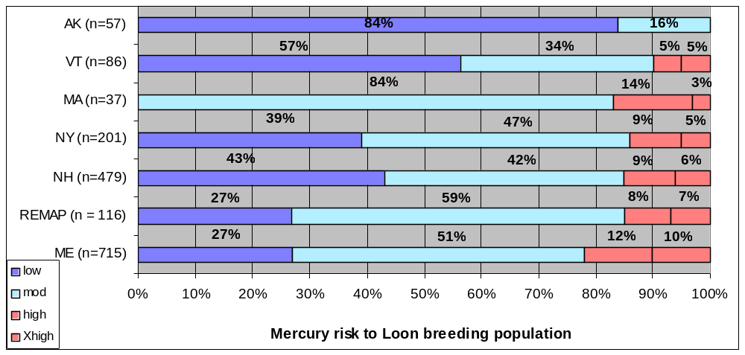
New England risk characterization
Opportunistic and Random Sampling Design

Slide 18
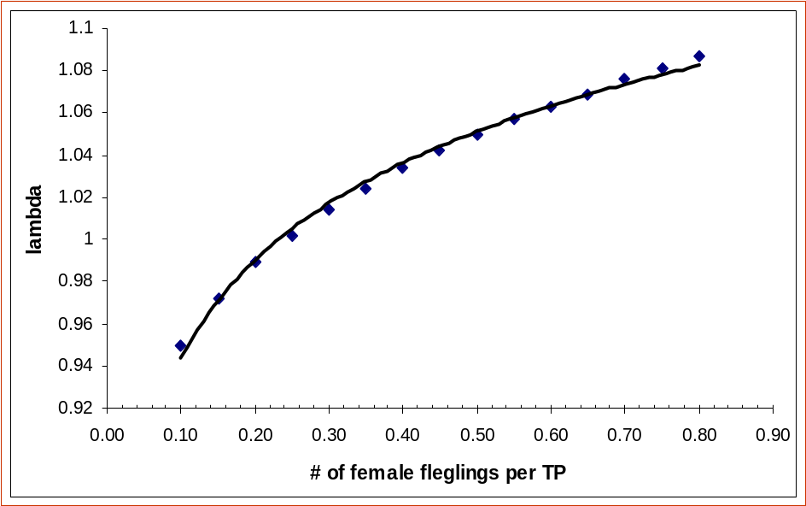
Common Loon Population Model
Under construction
  Demographic parameters mostly known
  Needs to be spatially explicit
Will provide a test dose for Hg that is based on:
  Wild populations
  Population level
Results to date
  Lamda = 0.48 fledged
  young/territorial pair
  Validated through NH
  and VT long-term
  datasets
Positive Growth
Negative Growth

Slide 19
Uncertainty Factors
Interspecies Uncertainty
  Measurements of various species in same areas (comparative exposure profile)
  Develop hazard assessments
LOAEL to NOAEL Uncertainty
  Use dose-response curve
  Conservative because impacts in the moderate category not used
Subchronic to Chronic Uncertainty
  Uncertainty factor is minimal if using sublethal

Slide 20
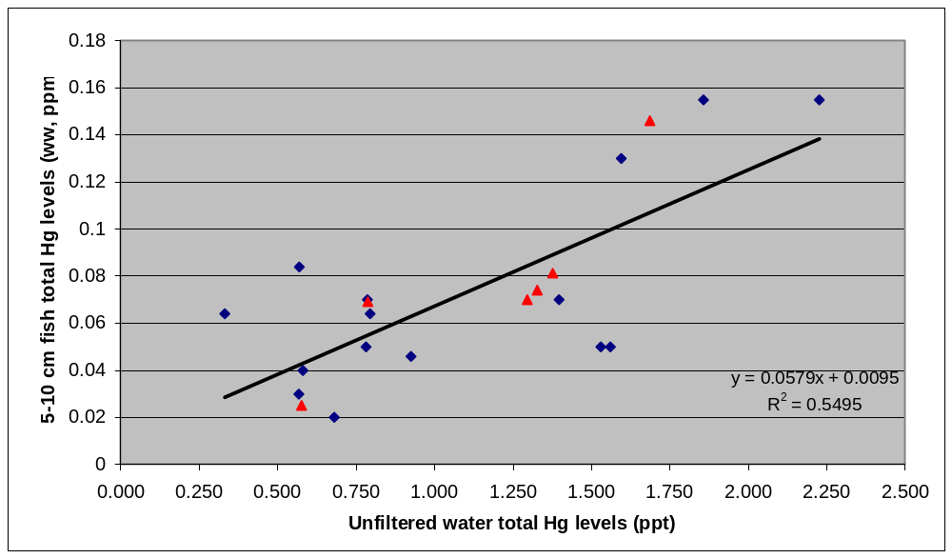
Bioaccumulation Factor
Total Hg in unfiltered water related to yellow perch Hg (whole body, ww)
  BAF for Trophic Level 3 fish (5-15 cm) = 86,250
  BAF for Trophic Level 4 fish (15-25 cm) = 156,330
Total Hg in unfiltered water related to perch or perch equivalents
  Best relationship with 5-10 cm size class (explains 55% of variation)
  Species-to-species conversion is 1.15 for centrarchids, golden shiner, trout
Water-fish MeHg relationship is being investigated in New York

Slide 21
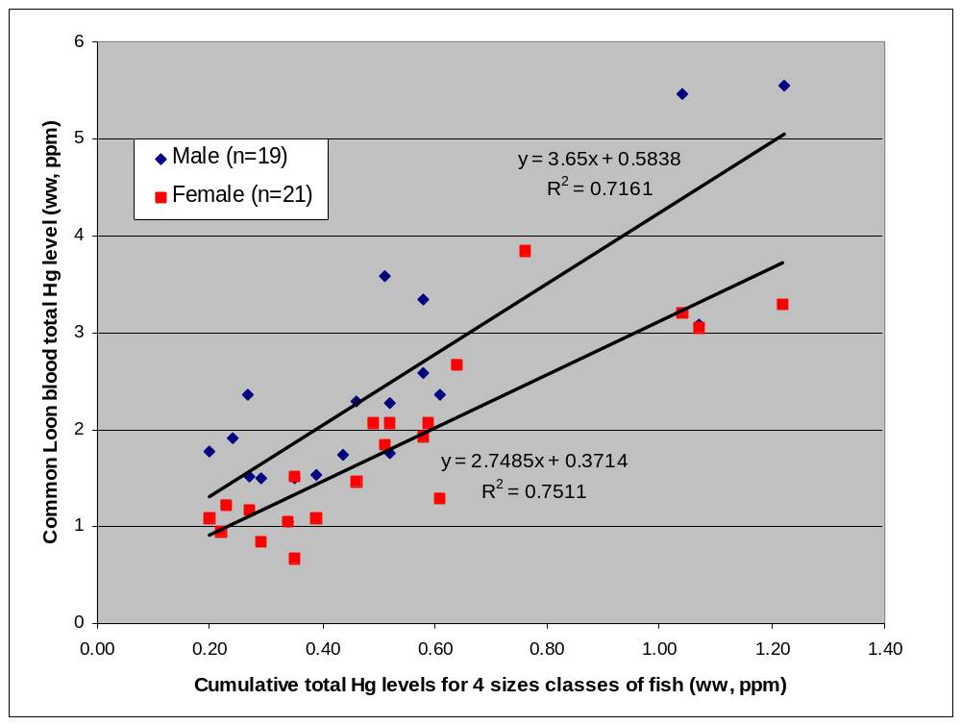
Cumulative perch Hg levels compared to adult loon blood Hg levels

Slide 22
Additional parameters required in WCV (Loon)
Body Weight (WT_{A}) g
  Sexual dimorphism is 21%
  Mean female weight of 4,714 +/- 302g (n=157, range=4,000 to 4,800)
  Mean male weight of 5,953 +/-412g (n=153, range=4,600 to 7,550)
Ingestion Rate (FA) g/day
  20% of weight (Barr 1996)
  1,190 +/- 82 g for males
  943 +/- 60 g for females
Percent of diet at each trophic level
  Trophic Level 3 and 4….Male = 73% and 27%
  Trophic Level 3 and 4….Female = 83% and 17%
Test Dose:
  Based on weight of evidence impacts of a chronic MeHg dose of ~0.20 ug/g
  Male = 179 ug Hg/kg bw/day
  Female = 142 ug Hg/kg bw/day
Reference Dose:
  Test Dose/Uncertainty Factors

Slide 23
Test Dose
Based on multiple lines of evidence
Dietary uptake of 0.20 ug/g of MeHg is equivalent to approximately
    3.0 ug/g in blood,
    1.3 ug/g in eggs,
    9% annual increase in feathers
    Smaller eggs, weight loss
    Significantly less time on nest and foraging
    40% fewer fledged young

Slide 24
WCV for Hg based on population levels of the Common Loon
WCV _{Male Loon} = 0.179 mg/kg/d x [1/3 x 1 x 2)]) x 5.95 kg
0.012 L/d + [(0.73) (1.19 kg/d x 72,000) + (0.27) (1.19 kg/d x 142,000)
WCV _{Male Loon} = 1.65 ng/L
WCV _{Female Loon} = 0.142 mg/kg/d x [1/3 x 1 x 2)]) x 4.71 kg
0.012 L/d + [(0.83) (0.943 kg/d x 72,000) + (0.17) (0.943 kg/d x 142,000)
WCV _{Female Loon} = 1.41 ng/L

Slide 25
WCV for Hg for mink and river otter
WCV _{Mink} = 0.055 mg/kg/d x [1/1 x 1 x 3)]) x 0.8 kg
0.012 L/d + [(0.73) (1.78 kg/d x 72,000)
WCV _{Mink} = 1.14 ng/L
WCV _{River Otter} = 0.055 mg/kg/d x [1/1 x 1 x 3)]) x 7.40 kg
0.012 L/d + [(0.80) (1.22 kg/d x 72,000) + (0.20) (1.22 kg/d x 142,000)
WCV _{River Otter} = 1.29 ng/L

Slide 26
Comparison of WCVs (ng/L)
Species GLWQI EPA MDEP
Belted Kingfisher 1.04 0.60 NA
Bald Eagle 1.92 1.82 NA
Mink 2.88 1.04 1.14
River Otter 1.93 0.76 1.29
Loon – female NA 0.82 1.41
Loon – male NA NA 1.65

Slide 27
Next steps
Test WCV methods in another geographic area.
  A 3-year randomized study in New York is nearly final.
Reduce uncertainty factors including species-to-species.
Include gamefish species at trophic 4 level
Finalize spatially explicit population model and water-fish-loon relationships.
  Collaboration on a modeling effort “MERGANSER” by USEPA AND USGS will provide a standard loon unit
  Publications are in preparation.

Slide 28
Collaborators
Spearheaded by the Maine Dept. of Environmental Protection
FEDERAL GOVERNMENT
U.S. Fish and Wildlife Service – New England Field Office and Office of Migratory Bird Mgmt.
U.S. EPA – ORD Narragansett Office – Atlantic Ecological Div. & the New England Field Office
U.S.D.A. – Northeastern Ecosystem Research Cooperative
Canadian Wildlife Service
STATE GOVERNMENT
Maine Dept. of Environ. Protection & Inland Fish and Wildlife
Mass. Metropolitan Dist. Comm.
NH Dept. of Environ. Service
NY State Dept. of Environ. Cons.
Vermont Dept. of Environ. Cons.
NON-PROFIT ORGANIZATIONS
Loon Preservation Committee
Maine Audubon Society
Vermont Inst. Of Natural Science
Adirondack Coop. Loon Program
New England Forestry Foundation
Wildlife Conservation Society
University of Pennsylvania
Texas A&M Trace Element Res. Lab
Tufts University
Univ. of Southern Maine
INDUSTRY
FPL Energy Maine Hydro
New York State Energy Research and Development Authority

