Slide 1
SPCC Rule Amendments
Streamlined Requirements for Regulated Facilities
U.S. Environmental Protection Agency
Office of Emergency Management
December 2006

Slide 2
Agenda
Overview of SPCC Rule
December 2006 Amendments (SPCC I)
  Smaller Capacity Oil Storage Facilities
  Oil-Filled Operational Equipment
  Other Regulatory Revisions
Compliance Dates & Extension Proposal
Oil Discharge Reporting
Questions and Answers
Additional Rulemaking (SPCC II)

Slide 3
SPCC Rule Overview
Oil Pollution Prevention and Response regulation (40 CFR 112)
  Outlines requirements for prevention of, preparedness for, and response to oil discharges
  Prevention requirements called the “SPCC rule”
  Includes requirements for Facility Response Plans (FRPs)
Requirements help prevent oil discharges from reaching navigable waters or adjoining shorelines
Requires specific facilities to develop SPCC Plans
  Details equipment, workforce, procedures, and training to prevent, control, and provide adequate countermeasures to a discharge of oil

Slide 4
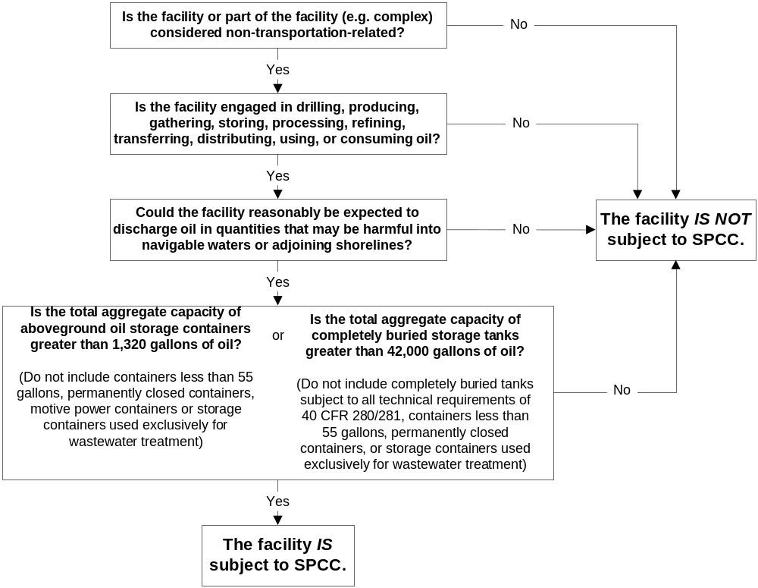
Applicability Flow Chart
Source: SPCC Guidance for Regional Inspectors, www.epa.gov/oilspill

Slide 5
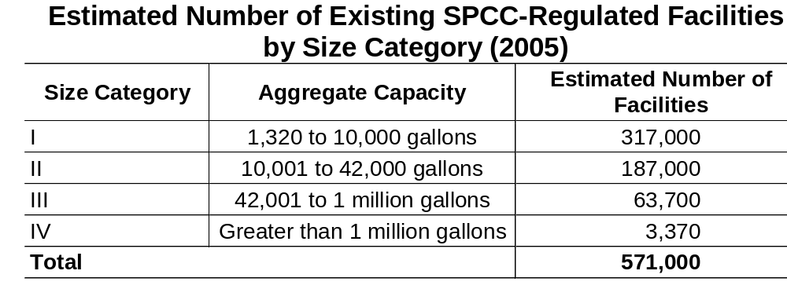
Estimate of the Universe of Facilities Affected by the Final Rule

Slide 6
December 2006 Amendments
Final Rule published December 2006
Final Rule effective 60 days after publication
Rule proposal was published December 12, 2005
Provides streamlined, alternative methods for compliance with oil spill prevention requirements

Slide 7
New Streamlined Requirements for…
Facilities with an oil storage capacity of 10,000 gallons or less (“qualified facilities”)
Oil-filled operational equipment
Mobile refuelers

Slide 8
The rule also…
Exempts motive power containers
Eliminates certain requirements for animal fats and vegetable oils
Provides compliance date extension for farms

Slide 9
Summary of Estimated Cost Savings for 2006 Final Rule Amendments (per year)
Total savings: $127 million
  (Range $95 - $163 million)
Qualified Facilities: $38 million
Qualified OFOE: ($39-$67 million)
Motive Power: ($1-$5 million)
Mobile Refuelers: ($17-$51 million)

Slide 10
Estimating Compliance Cost Savings
1. Estimate the universe of facilities affected by the final rule
2. Estimate the difference in compliance costs between the SPCC rule as amended in 2002 and the 2006 final rule
3. Estimate the total reduction in compliance costs to potentially affected facilities

Slide 11
Qualified Facilities
Must meet eligibility criteria to use alternative option
Streamlined regulatory requirements
  Self-certified SPCC Plan instead of one reviewed and certified by a Professional Engineer
  Streamlined integrity testing requirements
  Streamlined facility security requirements
May also use qualified oil-filled operational equipment option since an impracticability determination by a PE is not necessary

Slide 12
Qualified Facilities Eligibility Criteria
Facility must have 10,000 gallons or less in aggregate aboveground oil storage capacity
For the 3 years prior to Plan certification, or since becoming subject to the rule if it has operated for less than 3 years, the facility must not have had:
  A single discharge of oil to navigable waters exceeding 1,000 U.S. gallons, or
  Two discharges of oil to navigable waters each exceeding 42 U.S. gallons within any 12-month period

Slide 13
Reportable Discharge History
When determining the applicability of this criterion, the gallon amount(s) specified (either 1,000 or 42) refers to the amount of oil that actually reaches navigable waters or adjoining shorelines, not the total amount of oil spilled.
Oil discharges that result from natural disasters, acts of war, or terrorism are not included
Facilities that have a reportable oil discharge after self-certifying the SPCC Plan do not automatically lose eligibility
  However, the Regional Administrator has the authority to require a Plan amendment

Slide 14
Self-Certification
Owner/operator attests that he/she is familiar with the rule and has visited and examined the facility
Owner/operator also certifies that:
  The Plan has been prepared in accordance with accepted and sound industry practices and standards and with the rule requirements
  Procedures for required inspections and testing have been established
  The Plan is being fully implemented
  The facility meets the qualifying criteria
  The Plan does not deviate from rule requirements except as allowed and as certified by a PE
  Management approves the Plan and has committed resources to implement it
Notes:
Owner/operator must also ensure that plan is developed in accordance with good engineering practice

Slide 15
Alternative Measures
May use environmentally equivalent measures and make impracticability determinations
  if reviewed and certified by a PE
Rule provides alternative requirements for integrity testing and security
  do not need to be reviewed and certified by a PE

Slide 16
Technical Amendments
May self-certify technical amendments as long as a PE has not certified the portion being changed
If a PE certified the affected portion of the Plan, then a PE must certify the technical amendment

Slide 17
Alternative Integrity Testing Requirements for Qualified Facilities
Test and inspect each aboveground container for integrity on a regular schedule and whenever material repairs are made
Flexibility to determine, in accordance with industry standards:
  Appropriate qualifications for personnel performing tests and inspections
  Frequency and type of testing and inspections that take into account container size, configuration, and design
  No longer specifically requires both visual inspection and another testing method

Slide 18
Alternative Facility Security Requirements for Qualified Facilities
To prevent acts of vandalism and assist in the discovery of oil discharges, owners/operators of qualified facilities may describe how they:
  Control access to the oil handling, processing and storage areas
  Secure master flow and drain valves and out-of-service and loading/unloading connections of oil pipelines
  Prevent unauthorized access to starter controls on oil pumps
  Address the appropriateness of security lighting

Slide 19
Qualified Facilities - Summary
If a facility… | And the facility… | Then the owner/operator of the facility…
…has 10,000 gallons or less in aggregate aboveground oil storage capacity | …meets the oil discharge history criteria described below | …may prepare a self-certified SPCC Plan instead of one reviewed and certified by a Professional Engineer (PE) …may meet tailored facility security and tank integrity inspection requirements without PE certification …may prepare a plan which includes PE-certified environmentally equivalent measures or impracticability determinations that would require PE certification for only the portions dealing with environmental equivalence and impracticability determinations. The remaining portions of the plan could be self-certified by the facility owner/operator.
To use these alternatives a facility must meet requirements for its reportable discharge history. The facility must not have had (1) a single discharge of oil to navigable waters exceeding 1,000 U.S. gallons or (2) two discharges of oil to navigable waters each exceeding 42 U.S. gallons within any twelve-month period, in the three years prior to the SPCC Plan certification date, or since becoming subject to 40 CFR part 112 if operating for less than three years.

Slide 20
Oil-Filled Operational Equipment: Definition
Equipment that includes an oil storage container (or multiple containers) in which the oil is present solely to support the function of the apparatus or the device
Not considered a bulk storage container
Does not include oil-filled manufacturing equipment (flow-through process)
Piping might be considered a component of oil-filled operational equipment:
  Yes, if it is inherent to the equipment and used solely to facilitate operation of the device
  No, if it is not intrinsic to the equipment (i.e., flowlines, transfer piping or piping associated with a process)
Notes:
From preamble: When piping is intrinsic to the oil-filled operational equipment in a closed loop system, i.e., inherent to the equipment and used solely to facilitate operation of the device, (e.g., for lubrication) then EPA will consider the piping to be a component of the oil-filled operational equipment. However, piping not intrinsic to the operational equipment (i.e., flowlines, transfer piping or piping associated with a process) will not be considered to be part of the oil-filled operational equipment.

Slide 21
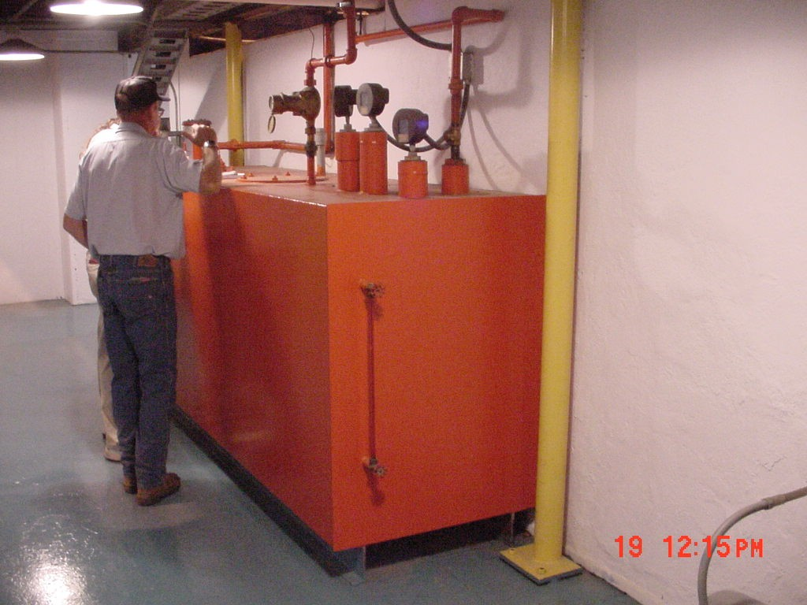
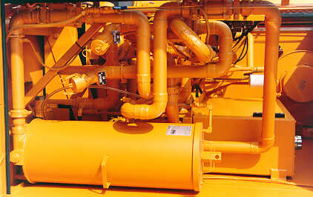
Oil-Filled Operational Equipment
Examples: hydraulic systems, lubricating systems, gear boxes, machining coolant systems, heat transfer systems, transformers, circuit breakers, electrical switches, other systems containing oil solely to enable the operation of the device

Slide 22
Oil-Filled Operational Equipment
Alternative to the general secondary containment requirements for qualified oil-filled operational equipment:
  Prepare an oil spill contingency plan and a written commitment of manpower, equipment, and materials
  Have an inspection or monitoring program to detect equipment failure and/or a discharge
Individual impracticability determination for each piece of equipment is not required

Slide 23
Oil-Filled Operational Equipment Eligibility Criteria
For the 3 years prior to Plan certification, or since becoming subject to the rule if it has operated for less than 3 years, the facility must not have had:
  A single discharge of oil from any oil-filled operational equipment to navigable waters exceeding 1,000 U.S. gallons, or
  Two discharges of oil from any oil-filled operational equipment to navigable waters each exceeding 42 U.S. gallons within any 12-month period
Eligibility determined by the reportable discharge history from the equipment, not the entire facility

Slide 24
Contingency Plan
Detailed oil spill response and removal plan to control, contain, and recover an oil discharge in quantities that may be harmful to navigable waters/adjoining shorelines
Elements outlined in 40 CFR 109.5:
  Authorities, responsibilities, and duties of all persons, organizations, or agencies involved in oil removal operations
  Notification procedures for the purpose of early detection and timely notification of an oil discharge
  Provisions to ensure that full resource capability is known and can be committed during an oil discharge
  Provisions for well-defined and specific actions to be taken after discovery and notification of an oil discharge
  Procedures to facilitate recovery of damages and enforcement measures
A sample contingency plan is available in the SPCC Guidance for Regional Inspectors available at www.epa.gov/oilspill

Slide 25
Written Commitment
Facilities must be able to implement the contingency plan
Owner/operator must provide a written commitment of manpower, equipment, and materials to expeditiously control and remove any quantity of oil discharged that may be harmful
Elements also included in 40 CFR 109.5

Slide 26
Inspections and Monitoring Program Requirements
Develop an appropriate set of procedures for inspections or a monitoring program for equipment
Written description of the inspection or monitoring program included in SPCC Plan
Keep a record of inspections and tests, signed by the appropriate supervisor or inspector, for three years

Slide 27
Oil-Filled Operational Equipment - Summary
If the facility… | And the equipment… | Then the owner/operator of the facility…
…has oil-filled operational equipment | …meets the oil discharge history criteria described below | …may implement an inspection and monitoring program, develop an oil spill contingency plan, and provide a written commitment of resources to control and remove oil discharged, for qualified equipment in lieu of secondary containment for the oil-filled operational equipment …does not need to make an impracticability determination for each piece of equipment
To use this alternative, a facility’s oil-filled operational equipment must meet requirements for its reportable discharge history. The facility’s oil-filled operational equipment must not have had (1) a single discharge of oil to navigable waters exceeding 1,000 U.S. gallons or (2) two discharges of oil to navigable waters each exceeding 42 U.S. gallons within any twelve-month period, in the three years prior to the SPCC Plan certification date, or since becoming subject to 40 CFR part 112 if operating for less than three years.

Slide 28
Mobile Refuelers: Definition
Bulk storage container onboard a vehicle or towed, that is designed or used solely to store and transport fuel for transfer into or from an aircraft, motor vehicle, locomotive, vessel, ground service equipment, or other oil storage container
Include vehicles of various sizes equipped with a bulk storage container that is used to fuel or defuel aircraft, motor vehicles, locomotives, tanks, vessels, or other oil storage containers

Slide 29
Mobile Refuelers
Owners and operators of mobile refuelers at a non-transportation-related facility will no longer need to provide sized secondary containment
  Sufficient to contain the capacity of the largest single compartment or container with enough volume to contain precipitation
Does not apply to vehicles that are used primarily to store oil in a stationary location
General secondary containment requirements still apply!

Slide 30
General Secondary Containment Requirements
General secondary containment should be designed to address the most likely discharge from the container
  Requires appropriate containment and/or diversionary structures or equipment to prevent a discharge to navigable waters or adjoining shorelines
  Allows for the use of certain types of active containment measures that prevent a discharge to navigable waters or adjoining shorelines.

Slide 31
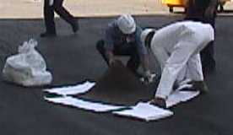

Active Measures
Active containment measures require deployment or other specific action by the owner or operator
May be appropriate for discharges that occur during manned activities if it:
  Can contain the volume and rate of oil
  Is properly constructed
  Is deployed in a timely manner

Slide 32
Motive Power Container: Definition
Any onboard bulk storage container used primarily to power the movement of a motor vehicle, or ancillary onboard oil-filled operational equipment
Examples: automotive, airplane, or truck fuel tanks
An onboard bulk storage container which is used to store or transfer oil for further distribution is not a motive power container
Definition does not include oil drilling or workover equipment, including rigs
  But fuel tanks on trucks, automobiles, bulldozers, seismic exploration vehicles, or other earth-moving equipment at drilling or workover facilities are considered to be “motive power” containers

Slide 33
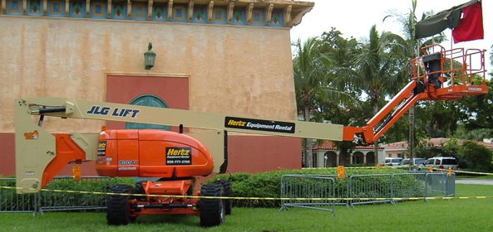
Motive Power Containers
Motive power containers exempted from SPCC rule
Oil transfer activities occurring within an SPCC-regulated facility continue to be regulated
  Transfer of oil from an otherwise SPCC regulated facility’s AST gas pump into an automobile
  Transfer of oil from an otherwise SPCC regulated facility’s airport mobile refueler into an airplane

Slide 34
Animal Fats and Vegetable Oils
Removed sections for facilities with animal fats and vegetable oils that are not appropriate:
  Onshore oil production (§112.13)
  Onshore oil drilling and workover facilities (§112.14)
  Offshore oil drilling, production, or workover facilities (§112.15)
EPA examining if differentiated SPCC requirements for animal fats and vegetable oils are appropriate

Slide 35
Compliance Dates – Farms
Farm: A facility on a tract of land devoted to the production of crops or raising of animals, including fish, which produced and sold, or normally would have produced and sold, $1,000 or more of agricultural products during a year
There is no capacity limitation associated with eligibility for the extension
The compliance date is delayed until the effective date of a rule addressing farms
EPA will announce the new compliance date in the Federal Register
Farms subject to SPCC requirements on or before August 16, 2002 must maintain their Plans

Slide 36
Compliance Dates – Facilities other than Farms (Current)
Extension for facilities (other than farms) published February 2006
A facility (other than a farm) starting operation… | Must...
On or before 8/16/02 | Maintain existing Plan. Amend and implement Plan no later than 10/31/07.
After 8/16/02 through 10/31/07 | Prepare and implement Plan no later than 10/31/07.
After 10/31/07 | Prepare and implement Plan before beginning operations.

Slide 37
Compliance Dates – Proposed Extension
EPA proposed an extension to the compliance dates December 2006
This proposed rule would extend the dates in §112.3(a), (b), and (c) by which a facility must prepare or amend and implement its SPCC Plan:
A facility (other than a farm) starting operation… | Would…
On or before 8/16/02 | Maintain existing Plan. Amend and implement Plan no later than 7/1/09.
After 8/16/02 through 7/1/09 | Prepare and implement Plan no later than 7/1/09.
After 7/1/09 | Prepare and implement Plan before beginning operations.

Slide 38
Compliance Dates – Reasons for Proposed Extension
EPA is proposing to extend the compliance dates because it will provide the time for the regulated community to:
  Make changes to their facilities and to their SPCC Plans necessary to comply with the revised requirements that EPA expects to propose in 2007
  Fully understand the regulatory relief offered by revisions to the SPCC rule as finalized in 2006.
  Understand the material presented in the SPCC Guidance for Regional Inspectors, which will be updated to address both the December 2006 revisions and the upcoming revisions expected to be proposed in 2007, before preparing or amending their SPCC Plans.

Slide 39
Oil Discharge Reporting
Facilities that discharge oil to navigable waters or adjoining shorelines subject to certain federal reporting requirements
40 CFR 110, Discharge of Oil regulation
  Framework for determining whether an oil discharge to inland and coastal waters or adjoining shorelines should be reported to the National Response Center
40 CFR 112, Oil Pollution Prevention regulation
  Identifies certain types of discharges from regulated facilities that also need to be reported to EPA

Slide 40
Discharge of Oil – “Sheen Rule”
Any facility or vessel is subject to these reporting requirements if it discharges a harmful quantity of oil to U.S. navigable waters, adjoining shorelines, or the contiguous zone
Harmful quantity of discharged oil
  Violates state water quality standards
  Causes a film or sheen on the water’s surface
  Leaves sludge or emulsion beneath the surface.
Not based on amount of oil discharged, but instead on the presence of a sheen, sludge, or emulsion

Slide 41
National Response Center (NRC)
Report discharges to NRC at 1-800-424-8802
Federal government's centralized reporting center, which is staffed 24 hours a day by U.S. Coast Guard personnel
Any person in charge of a vessel or an onshore or offshore facility must notify NRC immediately after he or she has knowledge of the discharge
NRC relays information to EPA or U.S. Coast Guard depending on the location of the incident
An On-Scene Coordinator evaluates the situation and decides if federal emergency response action is necessary

Slide 42
SPCC Reporting Requirements
Some discharges must also be reported to EPA
  Requirements found in §112.4(a)
  Applies to facilities subject to the SPCC rule
Report to the EPA Regional Administrator (RA) when there is a discharge of:
  More than 1,000 U.S. gallons of oil in a single discharge to navigable waters or adjoining shorelines
  More than 42 U.S. gallons of oil in each of two discharges to navigable waters or adjoining shorelines within a 12-month period
  When making this determination it is the amount of oil in gallons that reached the navigable waters
An owner/operator must report the discharge(s) to the EPA Regional Administrator within 60 days

Slide 43
For More Information
SPCC rule amendment (71 FR 77266)
  http://www.gpoaccess.gov/fr/
Oil Pollution Prevention regulation (40 CFR part 112)
  http://www.gpoaccess.gov/cfr/
EPA Office of Emergency Management Web site
  www.epa.gov/emergencies
  www.epa.gov/oilspill
Superfund, TRI, EPCRA, RMP, and Oil Information Center
  (800) 424-9346 or (703) 412-9810
  TDD (800) 553-7672 or (703) 412-3323
  www.epa.gov/superfund/resources/infocenter

Slide 44

Questions and Answers

Slide 45
Upcoming Actions
Considering additional streamlined and tailored regulatory modifications or guidance for certain types of facilities and equipment
Exploring potential options
  Subset of qualified facilities
  Facilities handling animal fats and vegetable oils
  Issues relating to farms
  Specific issues relating to the exploration and production industry
  Definition of loading rack

