Slide 1
Example 8
GIS Applications
Convert trajectory endpoints into ESRI Shapefile format for use in free ArcExplorer GIS PC software.
Convert trajectory endpoints into Google Earth (kmz) files for use in the PC 3D software.

Slide 2
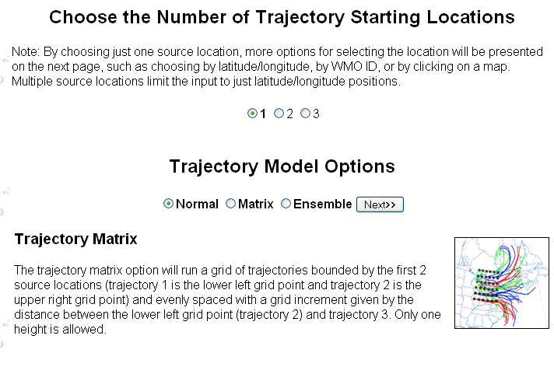
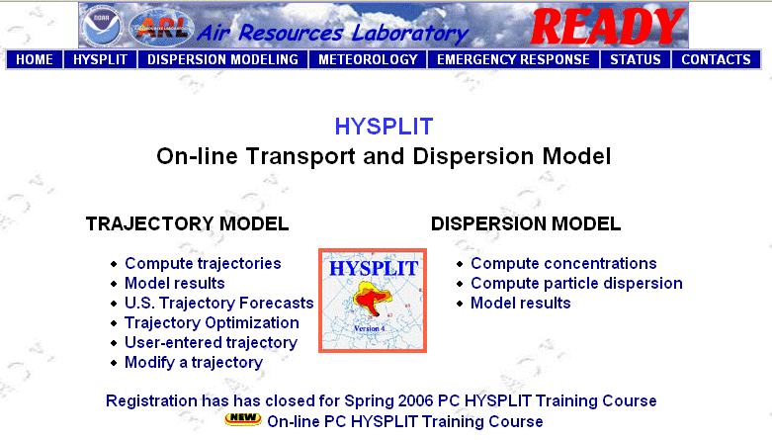
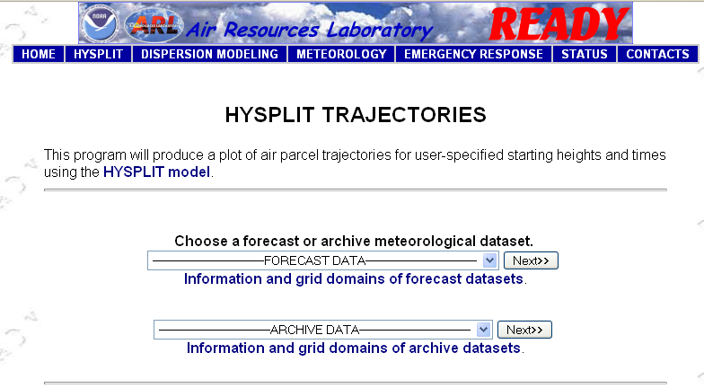
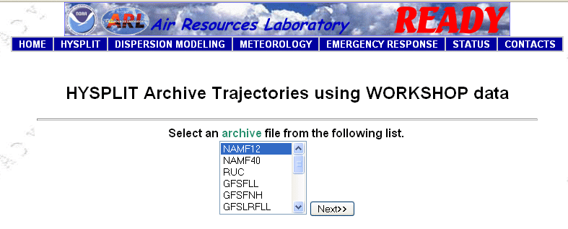
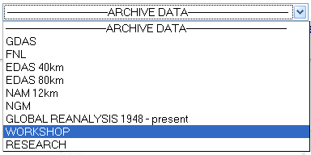
Run a forward trajectory with NAMF12 forecast data from the Workshop archive.

Slide 3
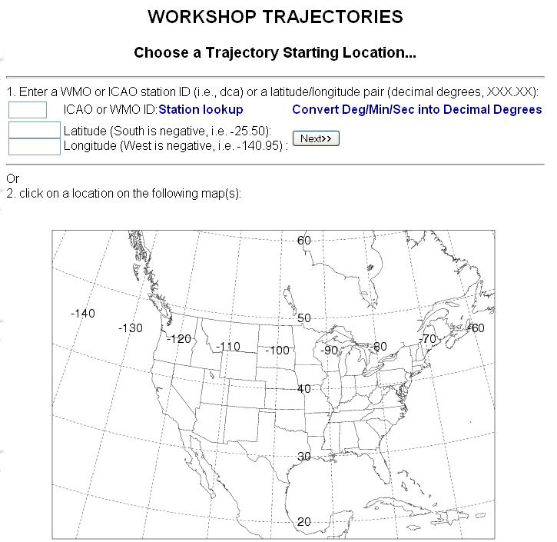

Choose Source Location
Enter a starting location at: 28.608N and 80.604W

Slide 4
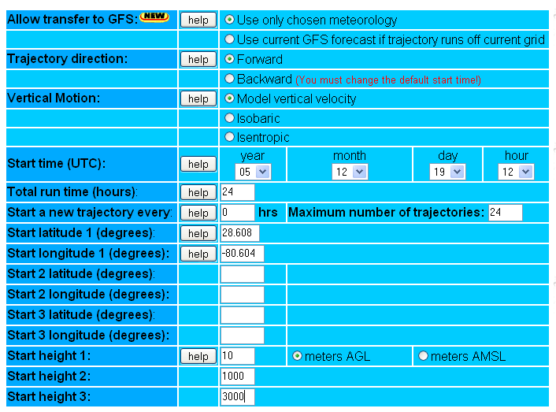
Model Runtime Options
Total run time: 24 hours
Starting heights: 10 m AGL, 1000 m AGL, 3000 m AGL

Slide 5
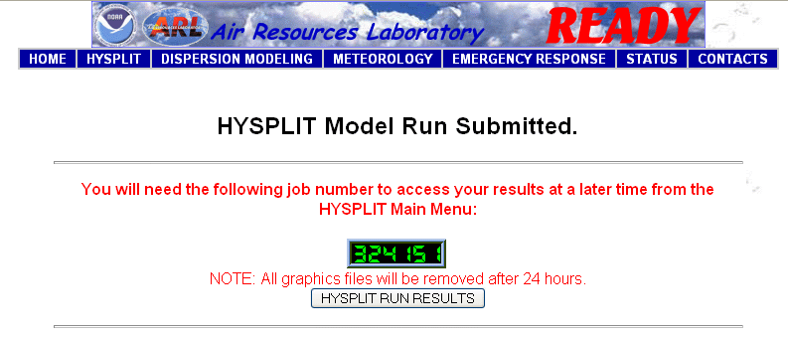
Submit the job and view the results

Slide 6
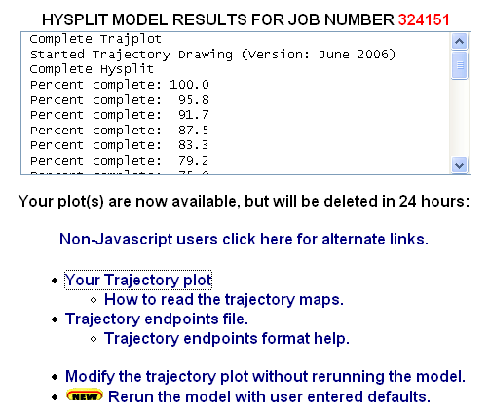
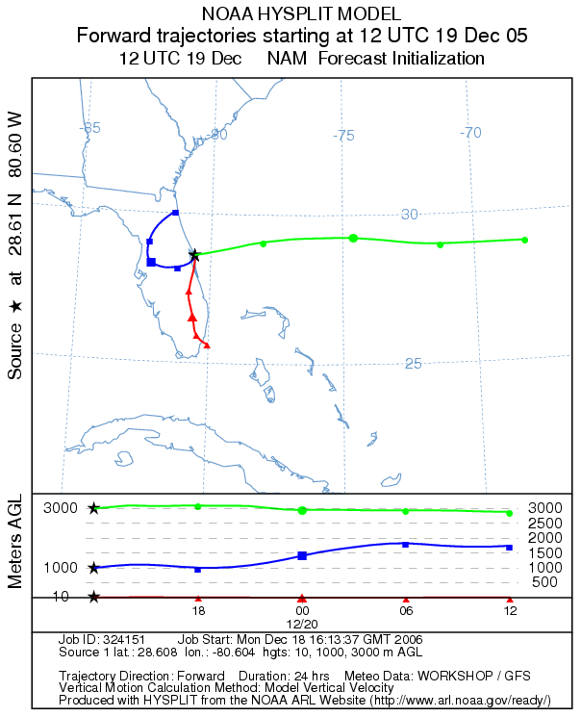
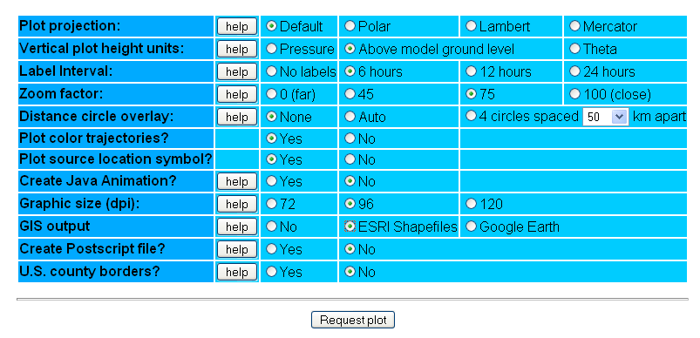
The result shows a very complex wind pattern over Florida with all 3 trajectories moving off in different directions, however none varied much with height over the calculational period.
HYSPLIT Trajectory Graphic Setup
Now click on “Modify the trajectory plot without rerunning the model” from the results page.
GIS output: ESRI Shapefiles
Click “Request plot.”

Slide 7
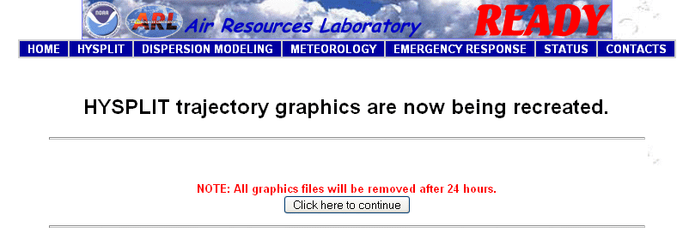
Submit the plot job and view the results

Slide 8
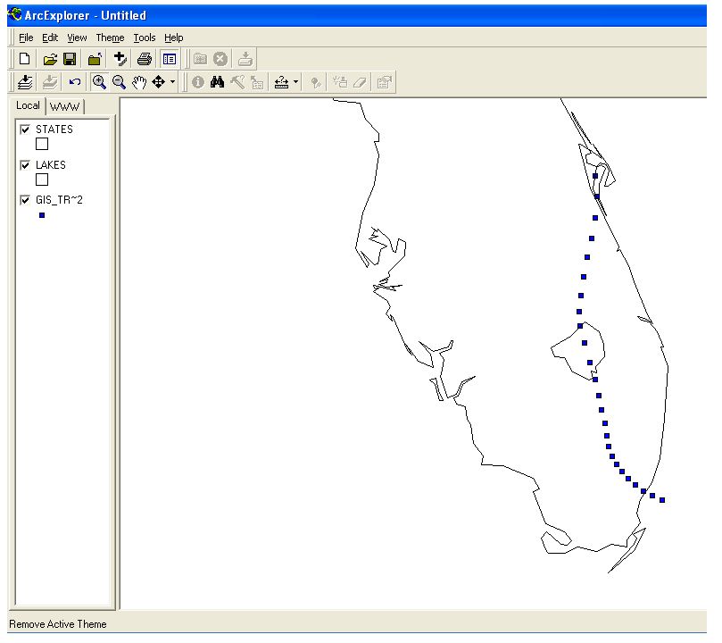
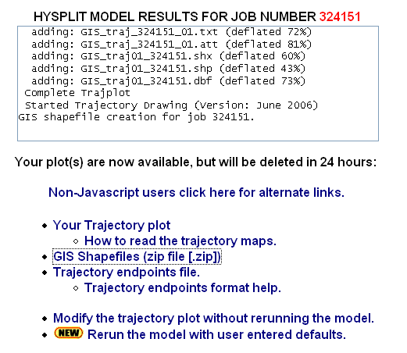
ESRI Shapefile Link
When complete, the model results page will include a link to the zipped GIS shapefile. Click on it, extract it to a folder, and open it with ArcExplorer.
The first trajectory displayed using ArcExplorer.

Slide 9
Google Earth Output

Slide 10
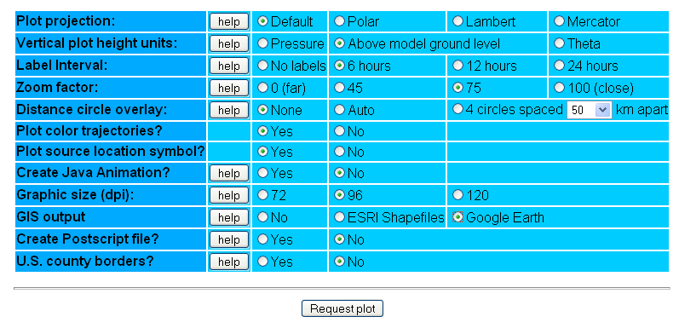
HYSPLIT Trajectory Graphic Setup
Click on “Modify the trajectory plot without rerunning the model” from the results page.
Make sure the vertical plot height units are “Above model ground level” for proper Google Earth display.
GIS output: Google Earth
Click “Request plot.”

Slide 11
Submit the plot job and view the results

Slide 12
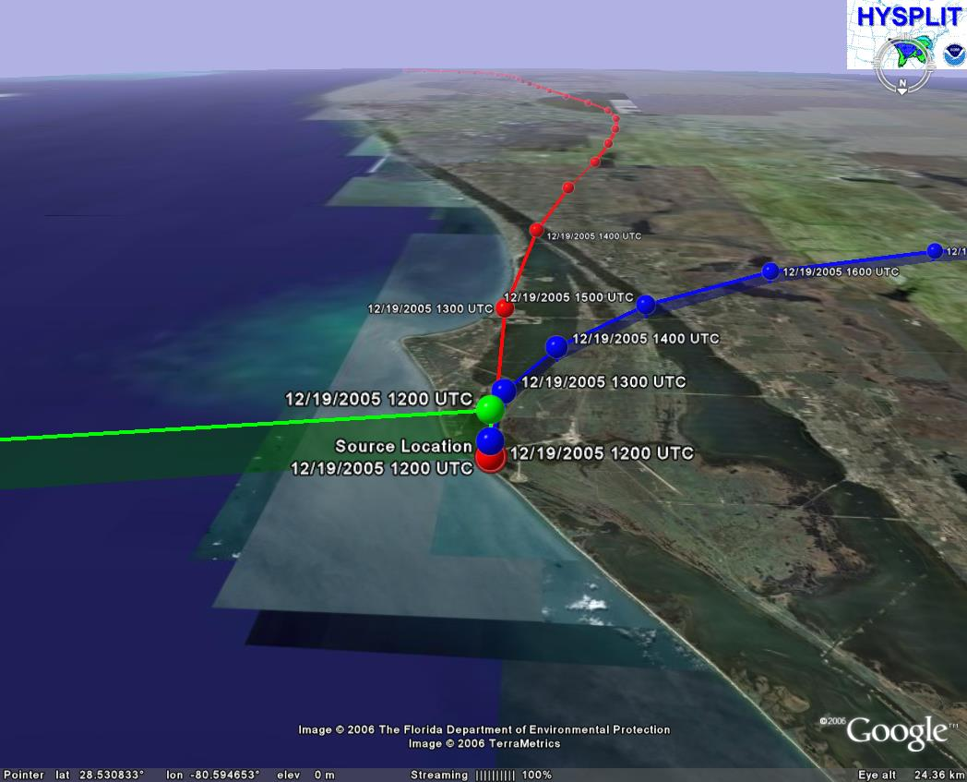
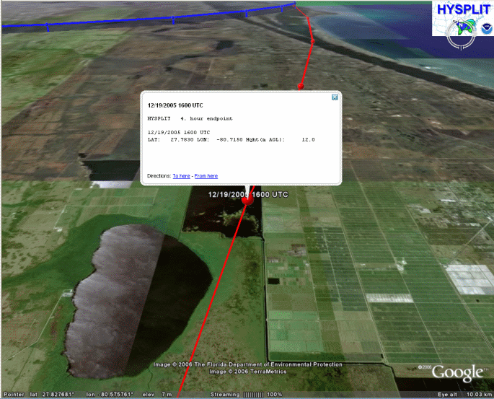
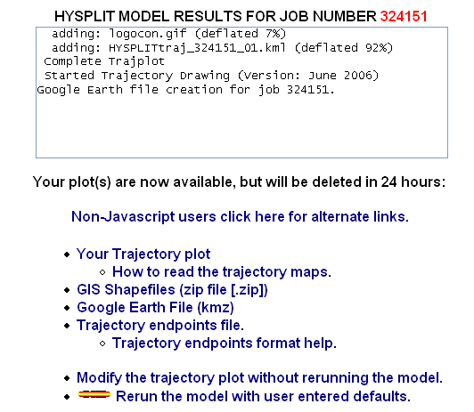
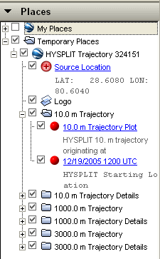
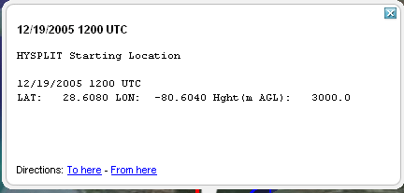
Google Earth Link
HYSPLITtraj.kmz
Users can turn on/off the trajectories, terrain, and other features within Google Earth.
When complete, the model results page will include a link to the zipped Google Earth kmz file. Click on it and if Google Earth is installed on the PC, it will open it automatically.
Clicking once on any of the trajectory endpoints will cause an information box to appear giving the height and lat/lon location of the endpoint.
Double clicking on an endpoint or any other feature will cause the program to zoom to that location.
Expanding the menu along the left side of the display will reveal the different layers associated with the trajectory display.

