Slide 1
Exoplanet Task Force
Worlds Beyond: A Strategy for the Detection and Characterization of Exoplanets
Final Report Briefing by
Jonathan I. Lunine, Chair
“Better is the end of the thing than the beginning thereof.”
-Ecclesiastes

Slide 2
Task Force Membership
Jonathan Lunine (chair) - LPL/University of Arizona
Debra Fischer San Francisco State | Gary Melnick CFA
Heidi Hammel Space Science Institute | David Monet USNO
Lynne Hillenbrand Cal Tech | Charley Noecker Ball
James Kasting Penn State | Stan Peale UCSB
Greg Laughlin UCSC | Andreas Quirrenbach Landessternwarte Heidelberg
Bruce Macintosh Lawrence Livermore | Sara Seager MIT
Mark Marley NASA Ames | Josh Winn MIT
Thomas Henning - MPI (ESA liaison)

Slide 3
Task Force Process
Five Task Force meetings in 2007
Public Input
  18 external presentations
  84 exoplanet white papers contributed from the community
  Open sessions during the first 4 meetings
  7 external readers
Report was reviewed by seven experts 12/07
Report revised in response to the readers & submitted to AAAC 2/4/08.
Final presentation to AAAC 2/11/08.

Slide 4
Compelling Questions Identified by the Task Force
What are the characteristics of Earth-mass/Earth-size planets in the habitable zone around nearby, bright stars?
What is the architecture of planetary systems?
How do planets and planetary systems form?

Slide 5
Strategic Goals by end of time horizon
To a high degree of statistical significance, η⊕ should be determined around a broad range of main sequence stellar types.
The architectures of planetary systems, both in the nearby solar neighborhood of order 10⁶ cubic pc, and in the larger galactic bulge, should be constrained down to sub-Earth masses for semi-major axes out to several AU (for G-dwarfs)
Provided η⊕ is large (at least 0.1), and exo-zodiacal emission typically low (< 10 zodis), at least one Earth-sized planet should have its mass and basic atmospheric composition characterized

Slide 6
Recommendations: Towards Earths
Intensify RV studies to reach down to (several) Earth-mass planets around bright stars
  More telescope time/higher precision
  Invest in IR spectrograph development for late M stars
Search for transiting terrestrial-size exoplanets around nearby M dwarfs and characterize with Warm Spitzer and JWST

Slide 7
Recommendations: Towards Earths
Develop a space-borne astrometric planet search mission
  Mass and orbits are required to understand habitability
  Find the Earth-mass exoplanets in habitable zones of nearby sun-like stars and get their orbits
  Sub microarcsecond astrometric signatures on order of 100 stars
  Study planetary architectures whether or not Earth-mass planets are common, whether or not zodi is large
Prepare for space-based direct imaging characterization mission
  Ongoing development to be ready for launch after some targets are known
  Exozodi measurements down to 10 zodi around nearby stars

Slide 8
Recommendations: Planetary Architectures/Formation
Microlensing for planetary masses and separations
  Augment ground-based facilities
  Space-based mission if possible at Discovery level or below, if does not affect the astrometric and direct imaging missions
Ground-based direct imaging
  Develop and implement extreme AO
  Support construction of a 30-m telescope with extreme AO

Slide 9
Recommendations: Planetary Architectures/Formation
Circumstellar Disk Science
  Maintain US involvement in Herschel and ALMA
  Archival analysis for relevant Spitzer, Chandra, Hubble, and ground-based data
  Invest in appropriate instrumentation on large-aperture telescopes
Support for activities that maximize the knowledge return from data and train new scientists in the field
  Theoretical studies
  Stellar property surveys
  Competitive fellowships for young researchers

Slide 10
Two-Pronged Strategy
Prong 1: M dwarfs
Fast-track
ground-based, and existing space assets
1-5 yrs
5-10 yrs
10-15 yrs
Prong 2: F, G, K dwarfs
Requires technology investments
And new space-based facilities

Slide 11

If η⊕ is > 0.1
,masses, addresses Density, detectability Characterize for habitability
M dwarfs
RV + Transit surveys--> Spitzer-->JWST
1-5 yrs
5-10 yrs
10-15 yrs
Exo-zodi studies
F, G, K dwarfs
Corot/ Kepler --> Astrometry+RV --> Space Direct Imaging
Density, addresses Characterize for habitability

Slide 12
If η⊕ is < 0.1
,masses, addresses Density, detectability
M dwarfs
RV + Transit surveys
1-5 yrs
5-10 yrs
10-15 yrs
Exo-zodi studies
Ground-based EXAO on ELT for giant planets
F, G, K dwarfs
Corot/Kepler Astrometry
Microlensing
Larger space-based system
Planetary Architecture

Slide 13
If Exozodi > 10 Earth Zodi
,masses, addresses Density, detectability Characterize for habitability
M dwarfs
RV + Transit surveys--> Spitzer-->JWST
1-5 yrs
5-10 yrs
10-15 yrs
Exo-zodi studies
Ground-based EXAO on ELT for giant planets
F, G, K dwarfs
Corot/ Kepler Astrometry
Microlensing
Planetary architecture
Notes:
A
We always 14
A 37

Slide 14
Recommended Programs, Missions and Activities
Technology development
IR Characterization
Visible Characterization
Proposed Missions
Astrometric mission
Discovery Microlensing Mission
Spitzer transit followup
Existing Missions
JWST transit followup
Kepler
Advanced and intensive RV studies - Kepler followup
Advanced ground-based microlensing
Advanced ground-based transit searches
ELT advanced imaging (extreme AO)
Ground-based
Exozodi characterization, lab, theory, fellowships, other supporting data
1-5 yrs
5-10 yrs
10-15 yrs

Slide 15
Strategy Summary
Two-pronged approach
  Potential for early results on Earth-sized planets orbiting M stars
  Astrometric search is insensitive to zodi and background objects; ensures significant results on planetary architectures and Earth-mass planets
  Known targets simplify the space-based direct detection mission
Flexibility
  Decision points occur early enough in the strategy to shift focus toward the end, contingent on η⊕ and zodi
  Individual elements can be delayed or stretched out while the overall program still provides exciting discoveries

Slide 16
Reader comments & responses I
N.B. No reader challenged the fundamental strategy.
Hinging the strategy on a space-borne astrometric mission requiring 0.2 μarcsec is risky
  The TF reviewed this very carefully and we conclude that the astrometric goal is challenging but achievable. Our recommendations include early non-advocate, expert review of spaceborne astrometric technology.
  A modified approach could proceed without astrometry, but it is much riskier and leaves us without knowledge of the mass and orbit data.
Completeness figures should be plotted in universal axes.
  Done

Slide 17
Reader comments & responses II
The detailed discussion of techniques is too lengthy for the report’s readership
  We have relegated this discussion to an appendix, while moving its key material up front to a beefed-up summary of techniques.
There was a bias in favor of coronagraphy as pposd to interferometry as the first direct detection mission,
  The Task Force believes that coronagraphy or the external occulter are more mature than interferometry for this application. However, we have rebalanced the discussion and added a recommendation that more effort be put into determining the technical maturity of each.

Slide 18
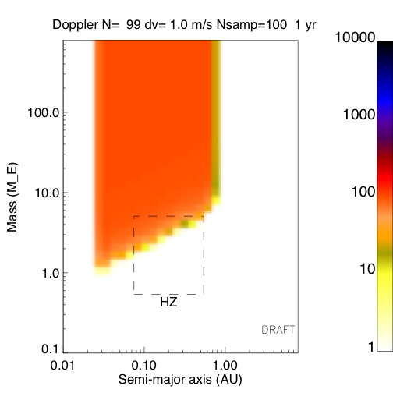
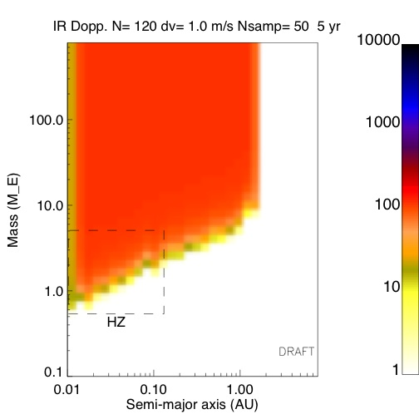
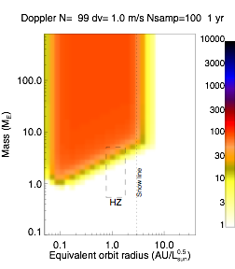

Slide 19
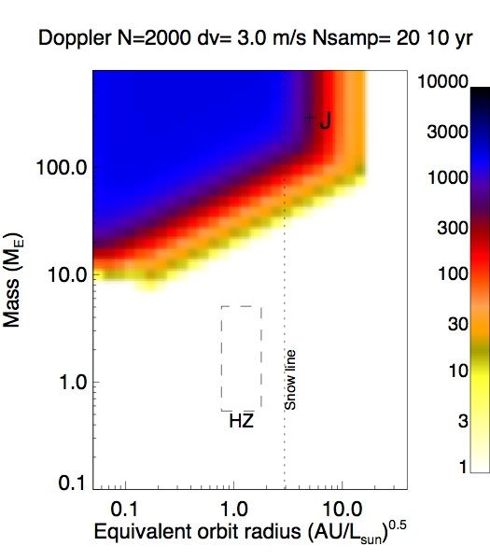
Depth of Search Figures
The number of detectable planets assuming every star to be examined has a planet of the given mass and semi-major axis
No assumptions need be made about planet distributions
No imposed mission lifetime
Scaled x-axis allows all star types on the same plot
Both x- and y-axes are on a log scale

Slide 20
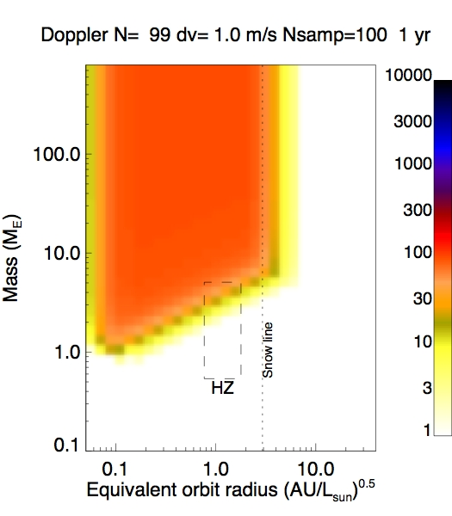
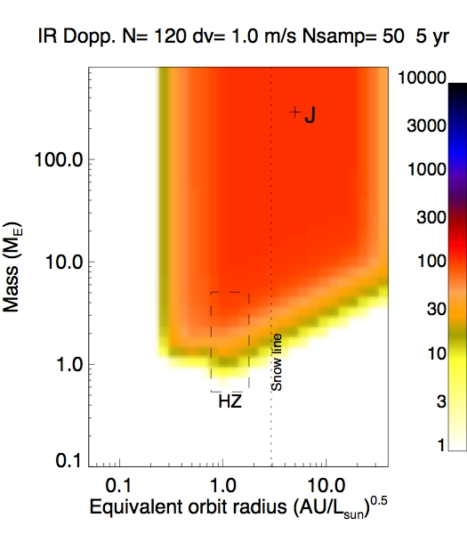
RV Studies
Optical
Near IR

Slide 21
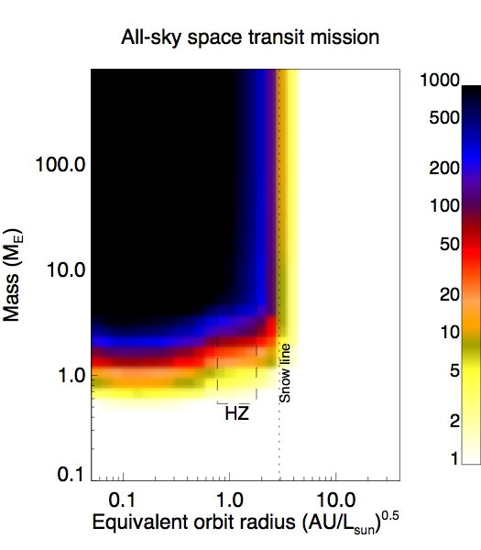
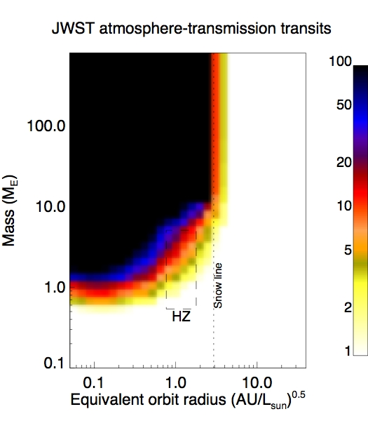
Terrestrial Transits for Characterization
Transits from space
Atmospheres with JWST

Slide 22
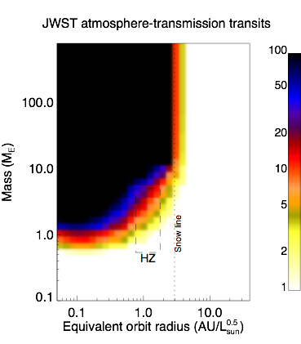
JWST transit studies (M -dwarfs only)

Slide 23
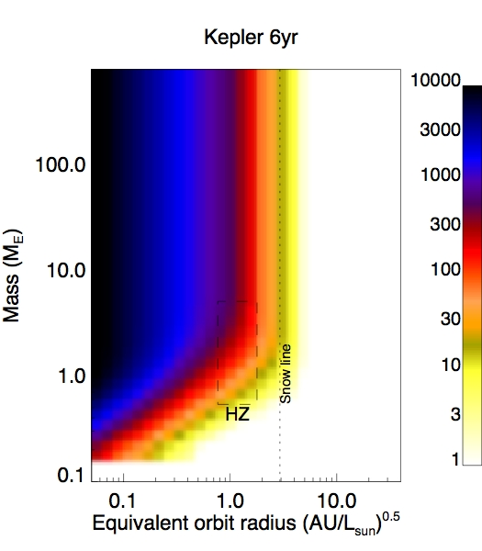
Kepler

Slide 24
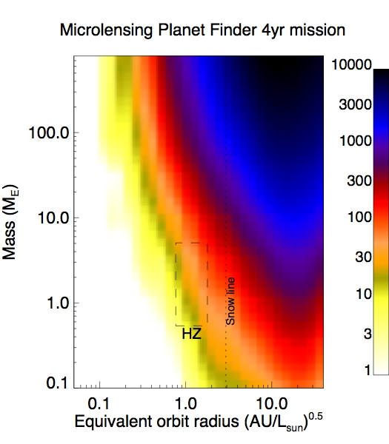
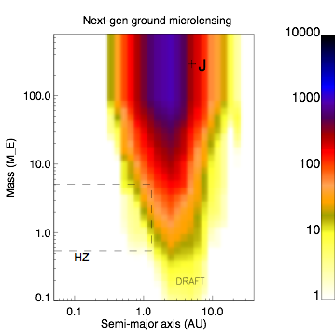
Space-Based Microlensing

Slide 25
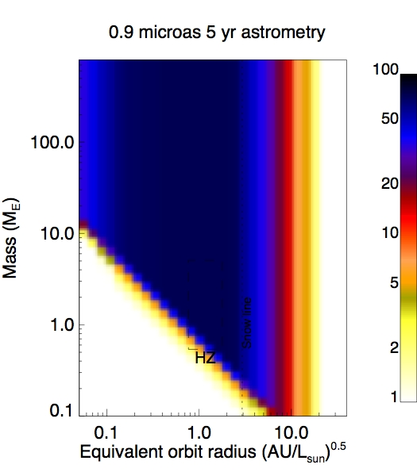
Space-based microlensing

Slide 26
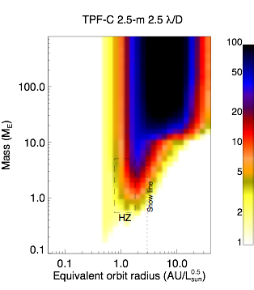
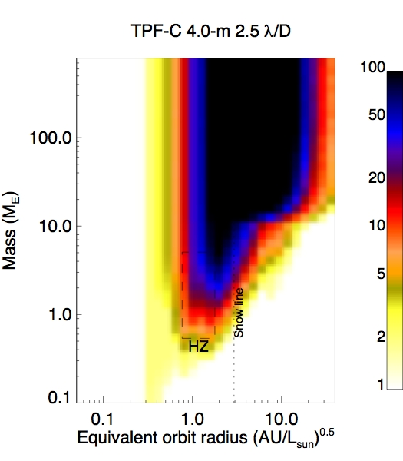
Space -based
Direct Imaging

Slide 27
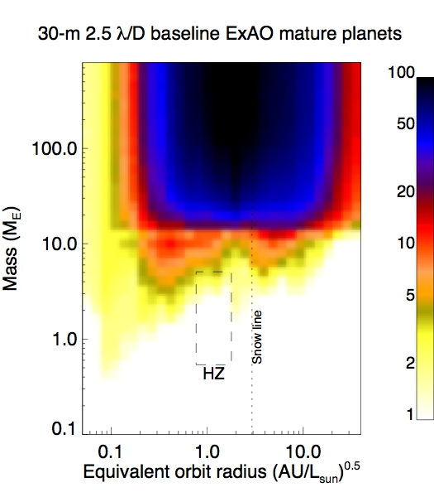
Ground-Based Direct Imaging

Slide 28
Issue of cost
The plan utilizes existing/under development/planned capabilities where possible
There are three new missions within the 15 year time horizon, two of which are essential (of which one can be stretched out).
Key to costing is early, intense technology studies and blue ribbon reviews on cost, risk.

Slide 29
Recommended Programs, Missions and Activities
Technology development
IR Characterization
Visible Characterization
Proposed Missions
Astrometric mission
Discovery Microlensing Mission
Spitzer transit followup
Existing Missions
JWST transit followup
Kepler
Advanced and intensive RV studies - Kepler followup
Advanced ground-based microlensing
Advanced ground-based transit searches
ELT advanced imaging (extreme AO)
Ground-based
Exozodi characterization, lab, theory, fellowships, other supporting data
1-5 yrs
5-10 yrs
10-15 yrs

Slide 30
Conclusions
The plan addresses the key questions in exoplanet research:
Are there habitable planets around other stars?
What is the architecture of planetary systems?
How do planets fit in to the process of star formation?
2. The plan provides the opportunity for early discoveries and risk reduction; spaceborne direct imaging is significantly simplified
3. Plan depends on a balance of ground and space; existing and future assets
4. Plan is flexible to surprises, failures and new discoveries
5. Plan is already streamlined in cost but can be stretched out

Slide 31
I personally want to thank
The Task Force
The AAAC
The Readers
All of our NASA and NSF experts
The community
but especially....
Dana Lehr
Stephen Ridgeway
Garth Illingworth

