Slide 1


The Chief Architects Forum and The Federal Enterprise Architecture Glossary Of Terms
Ira Grossman
National Oceanic and Atmospheric Administration
Chairman, CAF
May 3, 2005

Slide 2

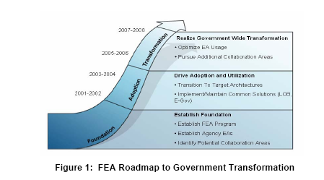
The Federal Enterprise Architecture
Ref: Enabling Citizen-Centered Electronic Government 2005 - 2006 FEA PMO Action Plan, March 2005

Slide 3

The Chief Architects Forum and EA Glossary of Terms Are About Communications

Slide 4
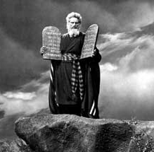
Words Are Very Powerful

Slide 5

What Are We Talking About?
Constituencies within the EA Community
Executive Branch of the Federal Government
Legislative Branch including Congress and the GAO;
State and Local Governments
International Governments, Organizations and Companies
IT Research, Advisory Services, and Strategic Consulting Community
EA Vendors
EA Advisory and Professional Organizations
EA Support Consultants and Contractors
EA Conference Community
Universities
EA Continuing Education/Certification Community
News Media
Citizens/Public

Slide 6
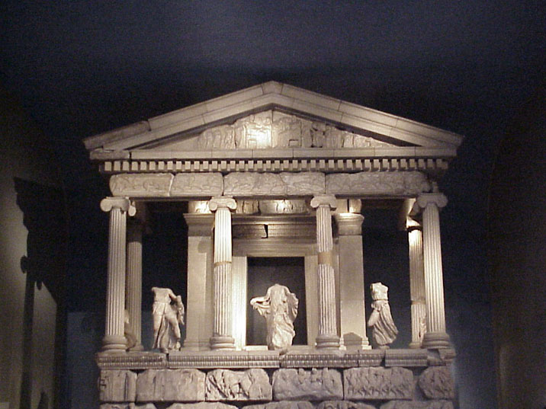
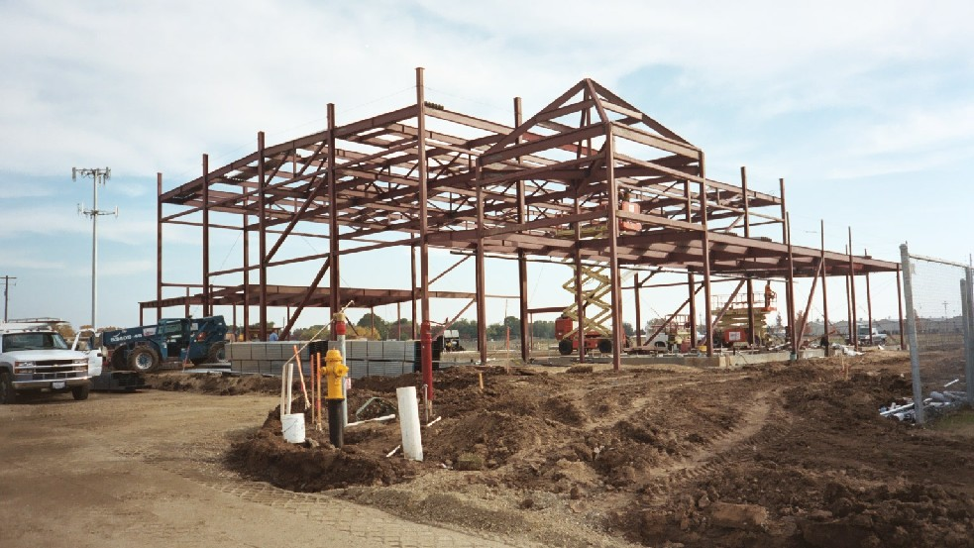
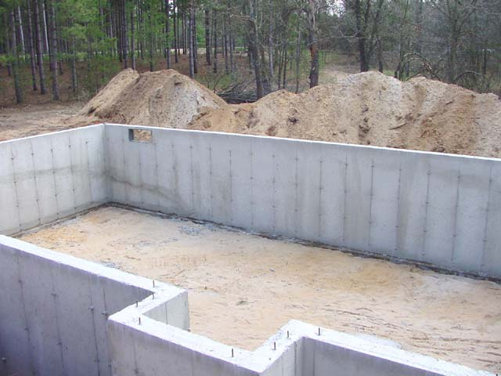
What Are We Talking About?
Federal Enterprise Architecture (FEA) is a business-based framework for government-wide improvement.
Technical Reference Model (TRM) is a foundation to describe the standards, specifications, and technologies supporting the delivery, exchange, and construction of business (or Service) components and E-Gov solutions.
Architecture
framework
foundation

Slide 7

We Do Not Want to Wait Until
The Day the Earth Stood Still

Slide 8

Nor We Do Not Want to End Up Feeling Like We Are on a Forbidden Planet

Slide 9
What Is the Chief Architects Forum
(CAF)?
  “I have laid out an aggressive agenda in this action plan, and I am confident we will be successful.” - Richard R. Burk Chief Architect, Office of E-Government and Information Technology
  It will take the entire architecture community – Federal agency architects, the Architecture and Infrastructure Committee (AIC) of the CIO Council, the Chief Architects Forum (CAF), our partners in State and local government, the private sector and others committed to a citizen-centered and results-oriented government.
  Together, we will provide leadership to our organizations by using the FEA as the cornerstone for achieving innovative efficient design and implementation of information resources government-wide while reducing costs for the taxpayer.
Ref: Enabling Citizen-Centered Electronic Government 2005 - 2006 FEA PMO Action Plan, March 2005

Slide 10
CAF in Reference to the CIO Council
CIO Council
FEA - PMO
ILLUSTRATIVE
AIC Partners
Industry Advisory Council
FEAC Institute
National Defense University
Syracuse University
AFCEA
Workforce Committee
Architecture and Infrastructure Committee (AIC)
Best Practices Committee
Governance Subcommittee
Components Subcommittee
Emerging Technology Subcommittee
Chief Architects Forum (CAF)
XML Community of Practice (COP)

Slide 11
What Is the Chief Architects Forum
(CAF)?
3.3.4 Support the Integration of the E-Government and LoB Initiative Architectures
The FEA PMO will play a key role in ensuring the E-Government and LoB initiatives develop their architectures in a common and consistent manner.
Architectures from identified E-Government initiatives will serve to inform the development and refinement of the LoB architectures at both the business and technical levels.
In addition, the FEA PMO, in conjunction with the Chief Architects Forum (CAF) and the CIO Council, will work with the LoB taskforces to ensure adherence to approved segment (LoB) architectures and to confirm touch points between LoBs are identified and incorporated into the common solutions.
Ref: Enabling Citizen-Centered Electronic Government 2005 - 2006 FEA PMO Action Plan, March 2005

Slide 12
Federal Enterprise Architecture
Glossary of Terms
3.2.9 Develop an Enterprise Architecture Glossary of Terms
The FEAPMO, in collaboration with the CIO Council AIC and the IAC, will develop a comprehensive glossary of EA terms and their respective meanings to facilitate communication throughout the FEA Practice.
Agencies will not only be able to use the glossary as a basic reference for understanding EA-related documents, but also to ensure consistency in communication and establish a common understanding with OMB and other agencies regarding EA information.
Using a shared set of common terminology to describe the elements of their enterprise architectures, agencies will reap greater value from their EA efforts through a better understanding of the state of the FEA Practice and more effective communication across the government.
Ref: Enabling Citizen-Centered Electronic Government 2005 - 2006 FEA PMO Action Plan, March 2005

Slide 13
What Is the Chief Architects Forum
(CAF)?
  Comprised of Chief Architects and their staffs from federal, state, and local government agencies.
  Provides an opportunity for Chief Architects to get together to share real world experiences and identify specific issues to promote EA successes.
  Serves as a formal mechanism as the voice of the Chief Architect Community to be heard by the AIC Leadership, CIO Council, and OMB FEAPMO.

Slide 14
CAF Purpose
Voice of the Community: The CAF represents the shared voice of the EA community through a cooperative forum.
Collaborative Organizing Environment: The CAF is a conducive environment for collaborative organizing around shared EA challenges.
Clearinghouse: The CAF is a clearinghouse for all EA Efforts. It invites representatives from the community to discuss potential opportunities and ideas with its planning committee.
Initiative Incubator: The CAF exists as an incubator for new initiatives and ideas to develop and to be discussed.
Clearinghouse
Initiative Incubator
Collaborative Organizing Environment
Voice of the Community
Notes:
The most frequent themes that emerged as CAF agenda items/objectives for the coming year are:
Interoperability
EA Value Proposition
EA Registry/Repository
EA Guidance
EA Human Capital

Slide 15
What Does the CAF Do?
The CAF meets quarterly and focuses on topics that are relevant to advancing the practice of EA.
During the meetings, participants are facilitated in small group breakout sessions on various EA topics.
A discussion summary of the meeting is prepared, which includes analysis, and is disseminated to the CAF community via the CAF list serve.
The summary is sent to the AIC Leadership.

Slide 16
CAF Involvement in FEA Activities
Refine the FEA Value Proposition
Gather and Share EA Case Studies
Establish and Implement a Governance Framework
Align EA To Agency Strategic Planning
Develop an EA Glossary of Terms
Guide Agency Transition Planning Towards Common Solutions
Measuring EA Value with the EA Assessment Program

Slide 17
Schedule of CAF Quarterly Meetings
All meetings will be held at the NOAA Science Center in Silver Spring, MD from 1 – 4 pm
Wednesday May 11, 2005
Thursday July 7, 2005
Thursday October 27, 2005
Notes:
The most frequent themes that emerged as CAF agenda items/objectives for the coming year are:
Interoperability
EA Value Proposition
EA Registry/Repository
EA Guidance
EA Human Capital

Slide 18
Progress To Date
This meeting identified themes that shaped the CAF’s annual strategic agenda
Date | Title | Purpose | Outcome
April 5, 2004 | CAF Kick-Off Meeting | * To congregate and introduce the CAF and identify a schedule for the upcoming year | Future meetings were scheduled for 2004 as a result
July 30, 2004 | Federal Lines of Business (LoB) Initiative | *Identify “best practice” architecture work that is leveraging the tenets of the LoB initiative and discuss how agencies can better use the LoB initiative to support agency EA development. | Developed a LoB Summary that was a successful goal to set. A weight was given certain initiatives to follow for the future.
September 22, 2004 | CAF Agenda Setting Meeting | *To listen to what architects had to say with respect to EA topics to completing their mission, prioritize them and identify the issues CAF should focus on throughout the upcoming fiscal year. | CAF has taken the prioritized issues and started to arrange them into the 2005 meeting schedule.
January 6, 2005 | EA Definition Session | *Develop a draft taxonomy that streamlines processes and definitions for enterprise architecture among agencies. | CAF has joined efforts with the DRM Working Group Glossary initiative
 |  | *Participate in a Strawman session to begin collaboration among agencies terminology use for enterprise architecture processes.

Slide 19
Agenda Setting Meeting
This Theme resulted in the CAF’s EA Glossary effort and subsequent meeting
Theme | Activity and Desired Outcome
Interoperability | *Improve collaboration and communication across various enterprises through the principle and practice of semantic interoperability.
 | *Provide guidance on interoperability before LoB solutions are implemented.
 | *Provide assistance in defining components that can be used across agencies.
 | *Provide data interoperability guidance and standardized data, tools, etc.
 | *Identify opportunities for leveraging EA tool buying power and the possibility of sharing of information included in existing EA tools.
EA Value Proposition | *Demonstrate EA value proposition.
 | *Develop EA communication campaign directed at multiple stakeholders to generate enthusiasm and energy.
EA Registry/ Repository | *Provide a registry and repository for sharing services and components across agencies that is well known, populated, and used to promote replication.
 | *Address naming convention issues associated with various registry indexes.
EA Guidance | *Define how EA is to be financed and what the resources are for the development and maturation of EA.
 | *Provide comprehensive guidance on what needs to be done for the next EA maturity assessment (e.g. who will score it; how often will agencies be able to re-assess themselves; and, what will the information be used for.)
EA Human Capital | *Define what constitutes a successful EA team.

Slide 20
Enterprise Architecture Glossary of Terms
3.2.9 Develop an Enterprise Architecture Glossary of Terms
The FEAPMO, in collaboration with the CIO Council AIC and the IAC, will develop a comprehensive glossary of EA terms and their respective meanings to facilitate communication throughout the FEA Practice.
Agencies will not only be able to use the glossary as a basic reference for understanding EA-related documents, but also to ensure consistency in communication and establish a common understanding with OMB and other agencies regarding EA information.
Using a shared set of common terminology to describe the elements of their enterprise architectures, agencies will reap greater value from their EA efforts through a better understanding of the state of the FEA Practice and more effective communication across the government.
Ref: Enabling Citizen-Centered Electronic Government 2005 - 2006 FEA PMO Action Plan, March 2005

Slide 21
CAF and the Internet
Collaborative Site
  Wiki: (http://colab.cim3.net/cgi-bin/wiki.pl?WikiHomePage): The Wiki is the COLAB Community Wiki, and is a community for collaborative documentation. CAF documents and announcements are posted to the Wiki.
Registries and Repositories
  Core.gov: (https://www.core.gov/): Core.gov is a government site that hosts a section for the CAF. CAF information such as announcements and reports are posted here.
  ET.gov: Will be launched in April 2005 and potentially interface with Core.gov
  Solutions Exchange: The Solutions Exchange (TSE) was created by the CIO Council's Best Practices Committee as a clearing house for reusable IT investments from across government.

Slide 22
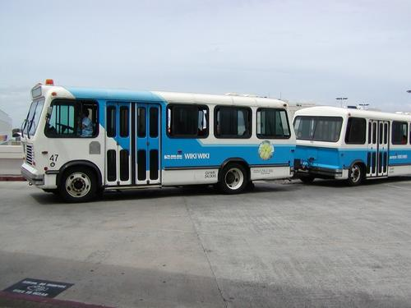

What Is a Wiki?
wiki¹
Wiki-wiki is the Hawaiian word for quick.
Wiki Web sites are sites designed for users to be able to make additions or edit any page of the site. They often have a common vocabulary, and consider themselves a "Wiki" community.
Ref: ¹http://www.answers.com/main/ntquery?s=wiki&method=2&gwp=13 © 1999-2005 by GuruNet. All rights reserved.

Slide 23
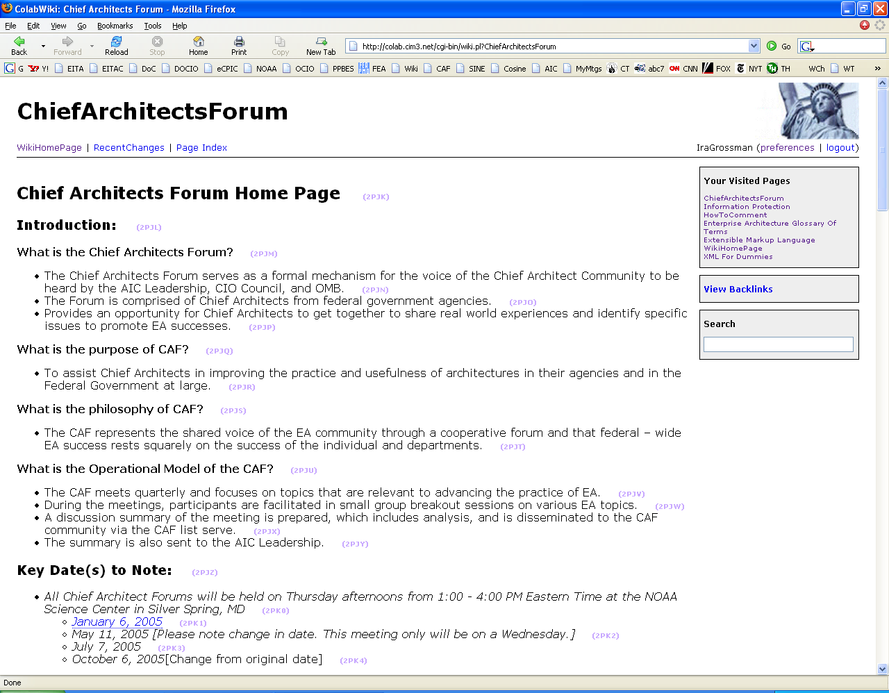
Chief Architects Forum Wiki Page http://colab.cim3.net/cgi-bin/wiki.pl?ChiefArchitectsForum

Slide 24
Draft EA Glossary of Terms
The Industry Advisory Council prepared a strawman draft EA Glossary of Terms and introduced it at the last CAF Meeting.
  The glossary contained an edited set of definitions and terms
  This glossary was reviewed in small group break-outs and is being refined.
The draft EA Glossary of Terms Version 1.0 is undergoing the collaboration process within the EA Community that was instigated by the CAF

Slide 25
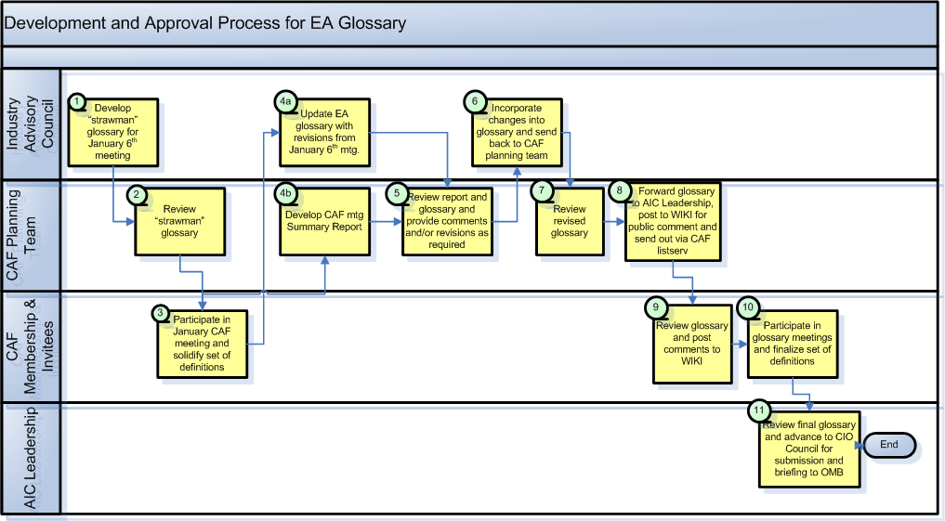
EA Glossary Development Process

Slide 26
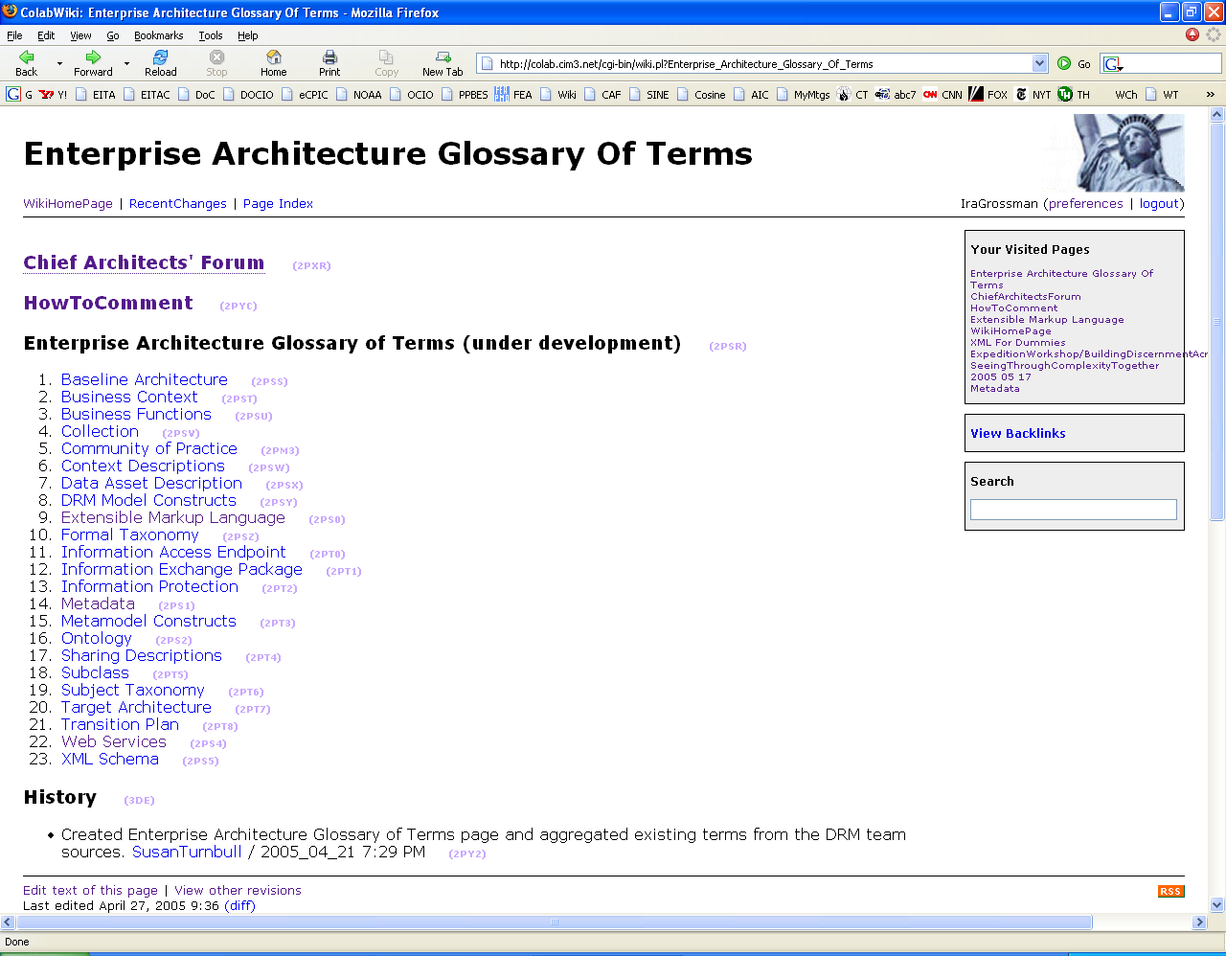
Enterprise Architecture Glossary Of Terms http://colab.cim3.net/cgi-bin/wiki.pl?Enterprise_Architecture_Glossary_Of_Terms

Slide 27
Enterprise Architecture Glossary of Terms
(under development)
Baseline Architecture
Business Context
Business Functions
Collection
Community of Practice
Context Descriptions
Data Asset Description
DRM Model Constructs
Extensible Markup Language
Formal Taxonomy
Information Access Endpoint
Information Exchange Package
Information Protection)
Metadata
Metamodel Constructs
Ontology
Sharing Descriptions
Subclass
Subject Taxonomy (2PT6)
Target Architecture
Transition Plan
Web Services
XML Schema

Slide 28
Sources for EA Glossary of Terms, Version 1.0
Five FEA Reference Models
  Data
  Business
  Performance
  Service Component
  Technical
OMB Circular No. A-11, Section 53, Information Technology and E-Government
OMB Federal Enterprise Architecture Program Management Office
Federal CIO Council Architecture and Infrastructure Committee

Slide 29
Definition Construct
Business Definition
  Non-technical definition (“Dummies” Definition)
  Intended for the business community
  Most general definition
Technical Definition
  Intended for the IT community
  Provides technical specificity
  In conformance with Business Definition
Context Definitions
  Intended for specific Department or organization
  Provides greater detail or clarity than Technical Definition
  In conformance with Business and Technical Definition
  Cannot conflict with Business and Technical Definition
  Can have multiple Context Definitions

Slide 30
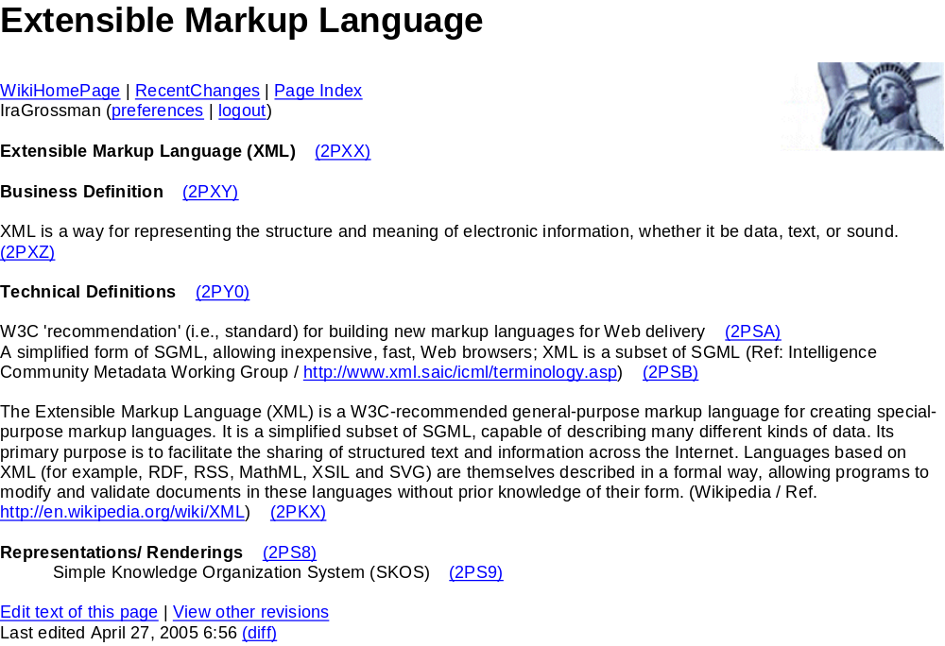

Slide 31
How to Comment
Use purple number method to anchor your comments to the relevant paragraph
  Right click on the "purple number" following the section identified for comment like the "2J0U" at the end of this line (2J0U)
  Select copy shortcut
  Paste into your email message with subject line - Comments
  Follow the example of comments provided below; "purple number" is pasted in after ref: (for reference)
  Add your name, date and time in parentheses
  Subscribe to the appropriate discussion forum for your comments:
    Subscribe to the DRM public site Discussion Forum
    Subscribe to the Chief Architects' Discussion Forum
  Send your message to the appropriate public site:
    For DRM comments: drm-public@colab.cim3.net
    For Chief Architects' Forum EA glossary of terms: caf-forum@colab.cim3.net

Slide 32
Example: Comment
ref: http://colab.cim3.net/cgi-bin/wiki.pl?Extensible_Markup_Language#nid2PXX (2PY9)
  suggest changing business definition of Extensible Markup Language to read: XML is a notation system for representing the underlying structure and meaning of electronic information, whether it be data, text, or sound. (2J11)
    (--SusanTurnbull / 2005.05.27 12:30pm EST) (2J13)
Comments received for the Data Reference Model (DRM) Public Forum will be added to the bottom of the relevant page with the corresponding "purple number" link. (2J1A)
Comments received on the Enterprise Architecture Glossary of Terms will be reconciled by the Chief Architects' Forum. (2PYB)

Slide 33
EA Glossary Development Timeline
(Tentative)
EA Glossary of Terms, 1st draft - June 30th
CAF Planning Committee Review - July 15th
Public Comment of Glossary on WIKI – Aug. 1st
Issue Draft Glossary to AIC/FEAPMO for Review – Aug. 15th
Issue Draft Glossary to Public – Sept. 15th

Slide 34
How You Can Help the CAF Develop FEA Glossary of Terms
Volunteers Needed
  Writers (Maximum 10 words to define)
  Reviewers (Maximum 10 words to review for clarity and understandability)
  Editors (Maximum 20 words to edit)
  Senior Editors (CAF Planning Committee)

Slide 35
CAF Efforts Moving Forward
Continued EA Glossary Development: The CAF is currently collaborating with other federal efforts in order to develop a preliminary glossary that stems from the Strawman developed at the last Quarterly Meeting.
DRM Working Group: The Architecture and Infrastructure Committee (AIC) is evolving an interagency collaborative working group to develop the next version of the Federal Enterprise Architecture Data Reference Model and associated implementation guidelines. The CAF is collaborating with this effort.
Geospatial: The AIC and the Federal Geographic Data Committee (FGDC) are developing a partnership that will support the President's Geospatial One-Stop Initiative in creating a single point of access to geospatial information. Through this partnership, the AIC will help develop a National Geospatial Enterprise Architecture and the FEA Geospatial profile.
Cyber Security Line of Business (LoB): OMB established the IT Security LoB that focuses on agencies’ vulnerabilities, defense against threats and management of resulting risks. Consequently the FEA PMO has taken responsibility for guiding this LoB through development, as outlined in the FEA PMO Strategic Plan. The Cyber Security LoB is an important topic and will potentially be the next CAF Quarterly Meeting in May.
LEAD (Leadership in Enterprise Architecture Deployment Update): LEAD presented at the CAF Planning Committee this Spring. It is an Intelligence Community project focused on establishing a dialogue between public and private Enterprise Architecture counterparts, identifying best practices that will improve information sharing, and providing leadership in the area of EA within the IC, the federal government, and the commercial community.

Slide 36
How the CAF can assist in your work
Communicate with other agencies
Enhance networking in the EA Community
Collaborate with other EA initiatives and projects
Become educated on latest EA efforts
Enlighten yourself through sharing of knowledge
Use as a forum to develop your own EA efforts
+
Collaborative and Efficient Results

Slide 37
Contact Information
Ira Grossman
NOAA OCIO
(301) 713-3345 x140
ira.m.grossman@noaa.gov

Slide 38


Questions and Hopefully Answers

