Slide 1
Flux Data Server User Tutorial
Deb Agarwal, Catharine van Ingen, Susan Holladay, and Misha Krassovski
Berkeley Water Center (UCB, LBL),
ORNL, and Microsoft

Slide 2


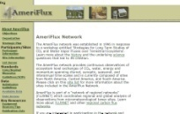


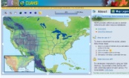


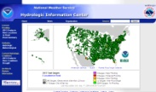




Typical Data Storage Today
Data retrieved by each investigator individually
Data corrections and updates applied individually
Data are often scattered, across a wide array of locations
Provenance is often not tracked
“Everybody knows” yet no one is sure
Internet Data
Archives
Large
Models
Local
Measurements
Legacy
Sources

Slide 3
Target Data Analysis Flow
Scientific Data Server
Validate & Quality Check data
Perform Analysis
Identify Data Issues & Obtain Missing Data
Obtain Data from Source
Track versions,
results, and
provenance

Slide 4
Scientific Data Server - Overview
Data Cubes
Databases
Data Ingest
User Interfaces

Slide 5
Database Role
All descriptive metadata and data held in relational databases
Metadata is important too!
Data versioning enables tracking of changes
Data reorganization easy
Allows complex questions to be posed
Data may be exported to flat file, copied to a private MyDb database, directly accessed programmatically, or ?

Slide 6
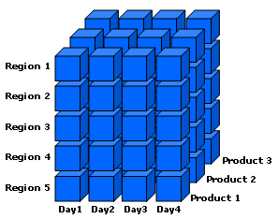
Data Cubes
A data cube is a database specifically designed for data mining
Simple aggregations (sum, min, or max) can be pre-computed for speed
Additional calculations can be computed dynamically or pre-computed (e.g. daily calc, par day)
Both operate along dimensions such as time, site, or datumtype
Constructed from a relational database
Client tool integration is evolving
Excel PivotTables allow simple data viewing
More powerful analysis and plotting using Matlab and statistics software

Slide 7
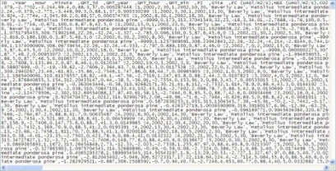
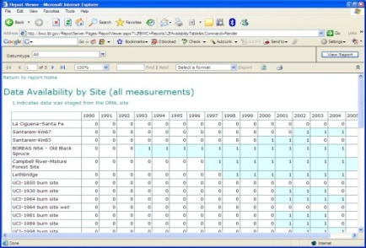
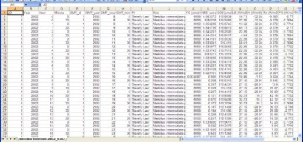
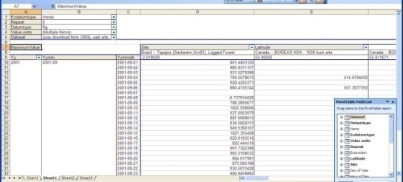
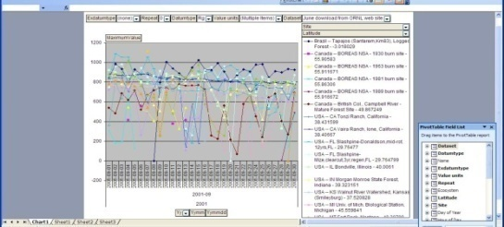
Overview of Data Server Flow
CSV Files
Reports and Excel Pivot
Tables and Charts
ORNL Ameriflux
Web Site
BWC SQL Server
Database
Data Cube

Slide 8
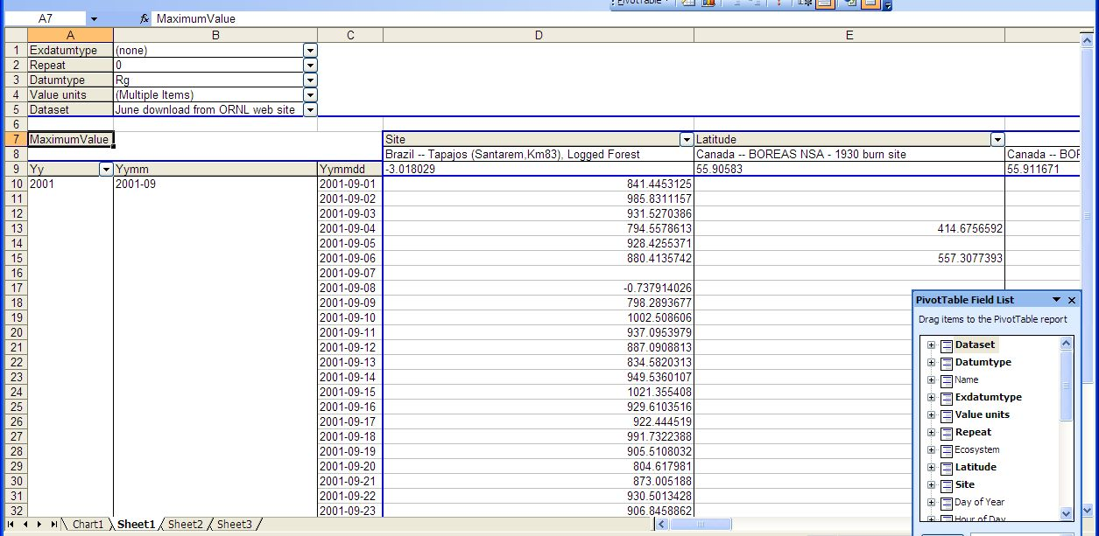
Pivot Tables

Slide 9
Switch to Live demo of Pivot Tables
Connect up a cube and view data in 2003 and 2007
Display pivot chart and links to table

Slide 10
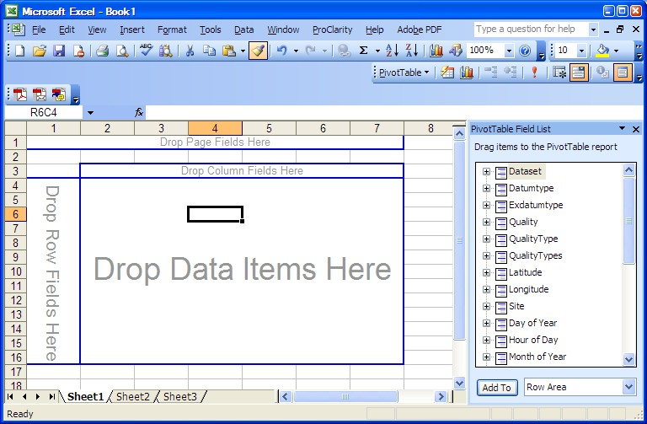
Pivot Table Regions 2003
Page Filters
Field List
Column Fields
Row Fields

Slide 11
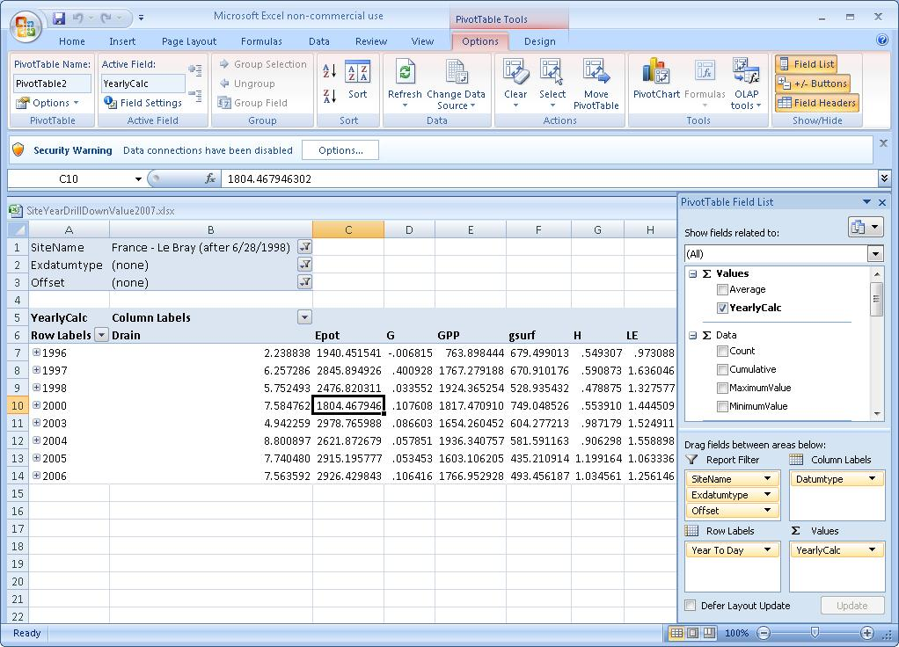
Pivot Table Regions 2007
Data Connections
Pivot Tools
Pivot Field List and Filtering
Pivot Layout and Field Optioons

Slide 12
Pivot Table Regions
Page Filters
Applied to all data before it goes into the pivot table
Columns and rows
Layout the table
Select all or individual items
Data
Calculated values – average, sum, etc

Slide 13
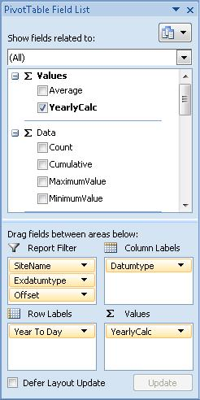
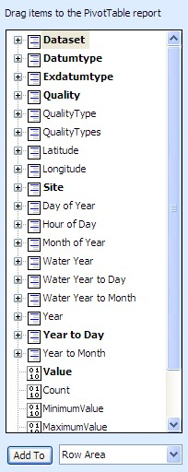
Pivot Table Field List
Organizing Dimensions of the Pivot Table

Slide 14
Dimension Hierarchies
Year to Day
Initially displays years
Opening a year gives days
In contrast – Day of Year is a flat dimension giving days
Year to Month
Initially displays years
Opening a year gives months
Opening a month gives days
VegType to Site

Slide 15
Exdatumtype and Offset
Column heading | Datumtype | Offset | Repeat | Exdatumtype
TA_7_6 (deg C) | TA | 7.6 | None | None
FC_WPL_H_25 (umol/m2/s) | FC | None | None | _WPL_H_25
TA5_F1 | TA | None | 5 | _F1
RH_FRAC_5_8 (FRACTION) | RH | 5.8 | None | _FRAC
PAR_ALB (umol/m2/s) | PAR | None | None | _ALB
NEEC_396 (umol/m2/s) | None | 396 | None | NEEC

Slide 16
Calculated Measures
Science variables
Statistics

Slide 17
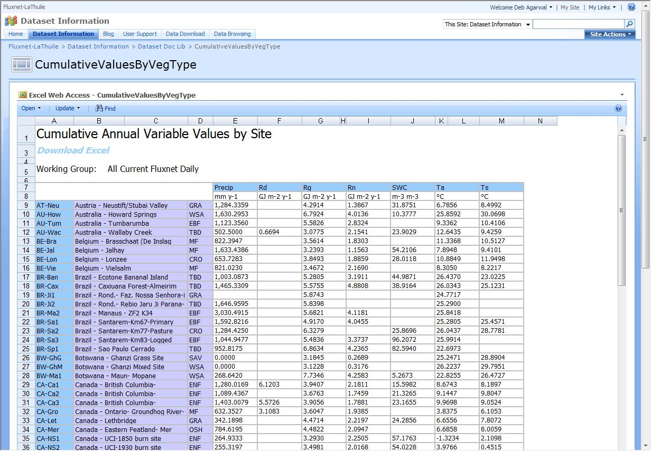
Data Reports

Slide 18
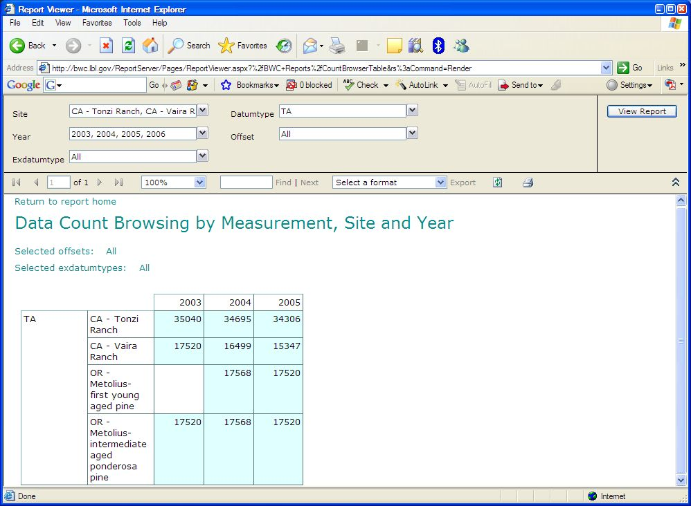
Live demo of data reports

Slide 19
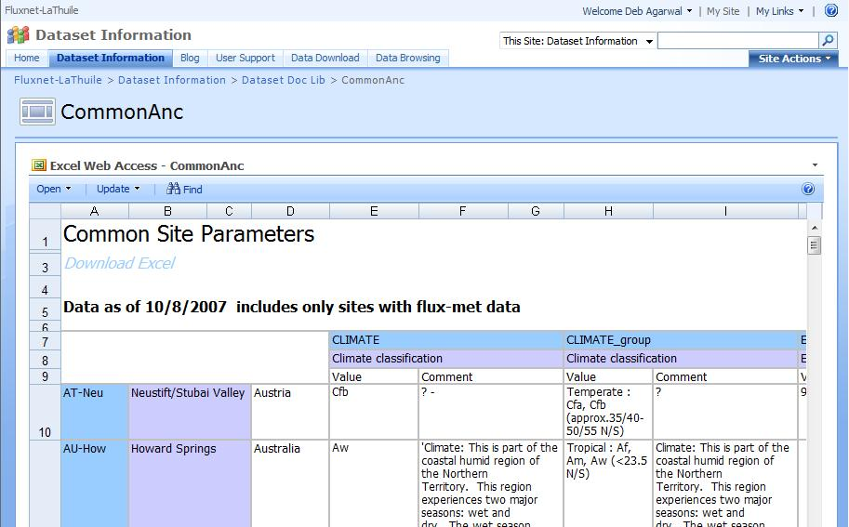
Ancillary Data Reports
Live demo

Slide 20
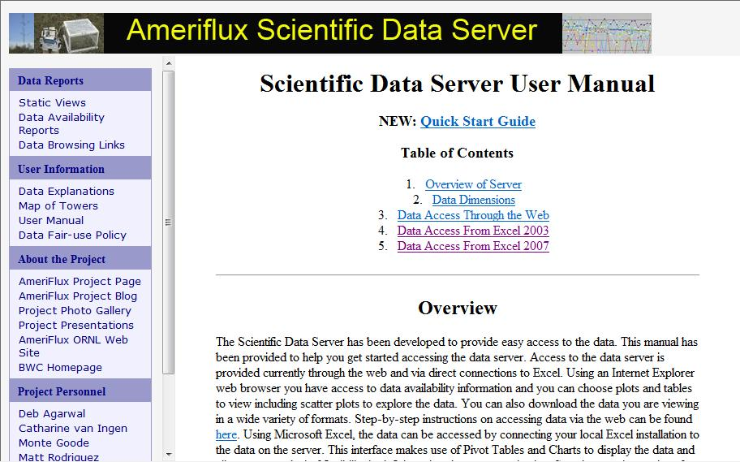
User Manual
Live Demo

Slide 21
Tips and Tricks
Saving connection information
Grand totals
Field totals
Embedded connection in table

Slide 22
The End

Slide 23
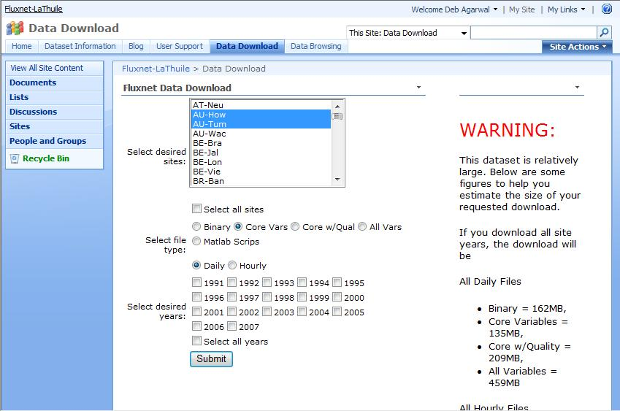
Downloading Data

