Slide 1
A Unified Relational Approach to Grid Information Services
(GWD-GIS-012-1 (Informational))
Peter A. Dinda, Northwestern
Beth Plale, Georgia Tech

Slide 2
Claim
Applications need common compositional queries over information of varying dynamicity
Approach
Build down from an RDBMS world-view
Relational = relational data model and queries
Unified = tables and streams
Research Questions
How “far down” must we go?
What extensions are needed?
1
2
3

Slide 3
Specific Components
Extensible type hierarchy
Extensible schemas and indices
Data streams as relations
High update rates and freshness
Compositional queries -> joins
Time-bounded non-deterministic queries
Friendly interfaces for non-experts
Decentralized administration and data

Slide 4
Outline
Needs of Grid applications
Limitations of current models
Our approach (and research)
  Prototype system
  Schema and indices (including example)
  Fast updates and streaming
  Data stream support with dQUOB
  Time-bounded non-deterministic queries

Slide 5
Needs of Grid Applications
Compositional queries
  Application-specific information aggregration
Support for information of varying dynamicity
  Varying update rates and freshness requirements
  Seamless inclusion of streaming data
A common data and query model
  Powerful, high level, declarative, easy-to-optimize

Slide 6

Data Parallel SOR
?
?
?
?
Startup: “Find 4 hosts which all have the same architecture and have a combined memory of at least 2 GB and whose network path bandwidths to each other are comparable”
Compositional Query Over Static Information
Adaptation: “Tell me about instances in which the predicted load on any one of those 4 hosts exceeds the average of their predicted loads by 50%”
Compositional Query Over Dynamic Information

Slide 7
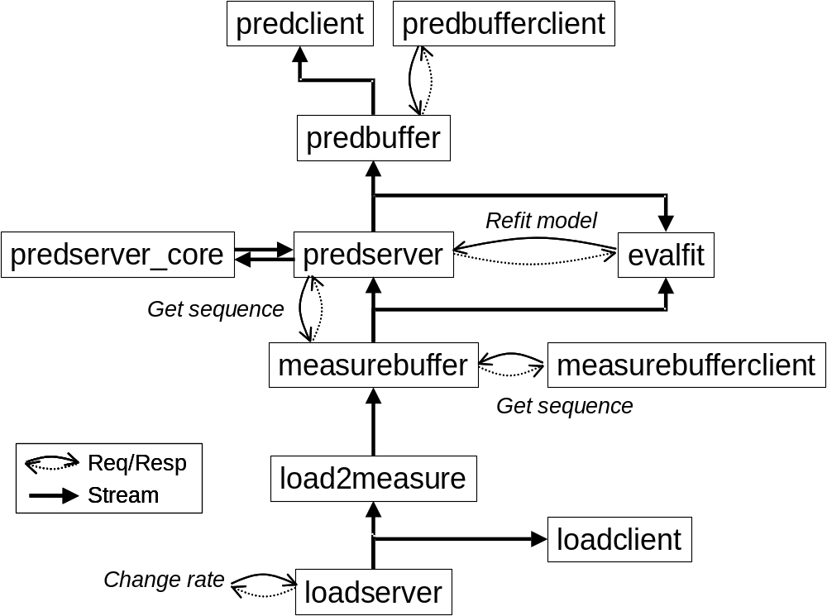
Resource
Prediction
System
Software Configuration Management: “For each of those hosts, find an RPS prediction stream corresponding to a measurement stream from a load sensor on the host”
Compositional Query Over Semistatic Information
Performance Monitoring Streams: “Tell me about instances in which the predicted load on any one of those 4 hosts exceeds the average of their predicted loads by 50%”
Compositional Query Over Dynamic Streams

Slide 8
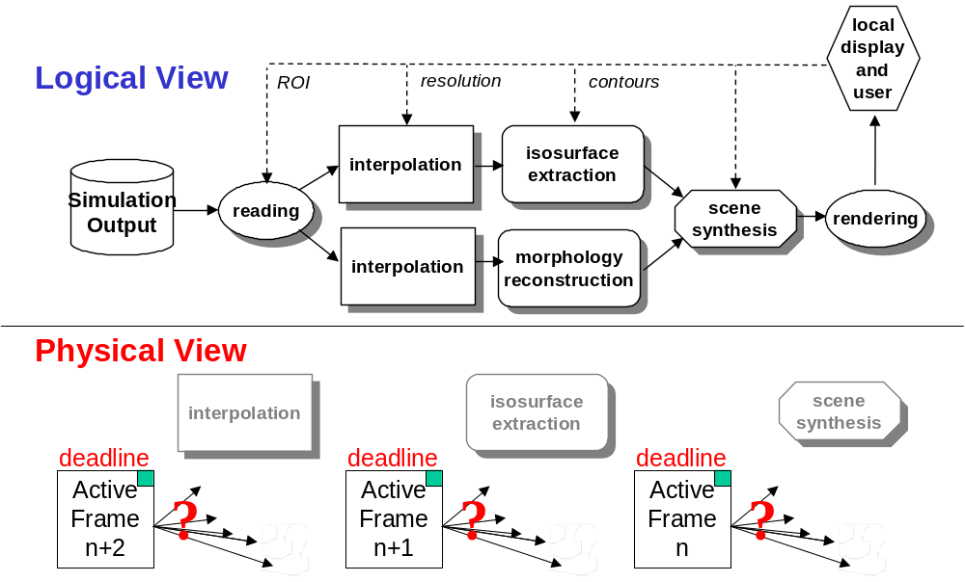
Dv
(and traditional workflow)
Startup: “Find a pool of five hosts each of which have at least a GB of memory for interpolation, a second pool of five different hosts with at least 1 GFLOP/s performance for isosurface extraction, and a third pool of five different hosts with special scene synthesis hardware, where the inter-pool bandwidth is at least 10 MB/s.”
Compositional Query Over Static Information
Adaptation: “What is the host within the isosurface extraction pool which is expected to have the minimum load over the next 10 seconds?” Compositional Query Over Dynamic Streams

Slide 9
Dv as a
Query
“Show me the results of rendering the scene synthesized by combining the results of isosurface extraction and morphology reconstruction over regularly grided data resulting from interpolation of this region of the simulation database”
Compositional Query Describing An Application
No Specific Query Plan is Implied

Slide 10
Grid Schedulers
Similar needs, more flexibility
But these abstractions are important
  GridSearcher [Schopf]
    Compositional Queries over MDS

Slide 11
Supporting Compositional Queries
Set operations -> Relational Algebra -> RDBMS
ANSI SQL
Time-bounded Non-deterministic queries

Slide 12
Type Hierarchies

Slide 13
Query Example (RPSDB)

Slide 14
Schemas and Indices

Slide 15
Non-deterministic Time-bounded Queries

Slide 16
Data Stream Support

Slide 17
Distributed Operation

Slide 18
Interaction with other GIS and Grid Performance Systems

Slide 19
Fast Updates and Freshness

Slide 20
Performance Evaluation

Slide 21
Tensions to explore
RDBMS versus distributed data and decentralized administration and multiple security domains
RDBMS versus expensive queries
Power versus usability (SQL)

Slide 22
Prototype System(s)
RPSDB
dQUOB

Slide 23
Unification

Slide 24
ACID?

Slide 25
Conclusions
Come join us

