Slide 1
ILC Control System Topics
John Carwardine and Frank Lenkszus
Contributions from: N. Arnold, B. Chase, D. Gurd, S. Simrock

Slide 2
Some control system topics
Integrated control system
Remote access
Timing & synchronization
Machine protection
Beam feedback systems
Relational databases
Control system reliability
Standards

Slide 3
Aspects of an integrated control system
Provide a common toolkit for implementing applications in a consistent way across the entire facility.
Meet the needs of different types of user, including operators, system engineers, physicists, …
Operator interface for facility control & monitoring
Automation, sequencing, “slow” feedback
Data acquisition for physics
Archiving, retrieval, and analysis of machine data
Physics modeling and simulation
Save/restore of machine state
Alarm management
Mode control

Slide 4

Control System “Standard Model”
Workstation-based Applications & Tools
(CA Clients)
EPICS Channel Access
IOC
IOC
CAS
IOC
Input-Output Controllers
(I/O to equipment, real-time applications)
(CA Servers)
CAS
IOC
Commercial Instruments
Custom Chassis/Panels
PLCs
Machine Interlocks via PLCs, relays, logic
Technical Equipment

Slide 5
Scalability of existing control systems
The ILC will have 10x more technical systems and I/O points than any existing facility.
Quantity of data that must be collected & archived
  Network bandwidth issue.
  Global data management issue.
Network traffic and effect on clients & servers
  Broadcast approach to client-server interactions does not scale well (name-servers or gateways needed instead)
  Badly-behaved network attached devices.

Slide 6
Some control system trends
Increasing use and availability of network attached devices
  Embedding controls interfaces into individual devices, eg one controls interface per bpm.
  Almost everything now comes with an Ethernet port and either custom software or an embedded web server.
  Increasing expectation of Plug & Play convenience.
  Streaming video distribution.
Increasing use of commercial software packages, eg Matlab, IDL, LabView, etc
  Control system toolkit should provide seemless integration.

Slide 7
A network management strategy
At the control system level, maintain single layer network to minimize latencies (“Standard Model”).
At the network level, manage geographically using smart switches with global backbone.
Utilize separate, parallel (and redundant) networks
  “Clean” network for the main control system.
  “Dirty” network for plug/play network attached devices.
  Streaming video network.
  Dedicated network(s) for synchronous data (eg feedback apps).
  Gateways to isolate general users from critical networks.
I&C group needs to establish allowable network protocols, and determine what can be hooked up to each network.

Slide 8
Integrated control system
Remote access
Timing & synchronization
Machine protection
Beam feedback systems
Relational databases
Control system reliability
Standards

Slide 9
Remote access
It is clear that experimenter tele-presence and remote collaboration will be an integral part of the ILC.
To what extent should we include remote access and remote operation in the baseline design for the ILC accelerator?

Slide 10
Integrated control system
Remote access
Timing & synchronization
Machine protection
Beam feedback systems
Relational databases
Control system reliability
Standards

Slide 11
Timing & Synchronization
RF Master Oscillator distribution
Timing fiducials, triggers, event generation
Real-time data link
Must be considered as an integrated system
  Responsibilities & interfaces with other ILC working groups?
What signals are required, and with what precision/resolution?
Reliability and availability
  Single point of failure: redundant system?
  Built-in diagnostics

Slide 12
Distributed RF references
Required precision and the scale of ILC are major challenges.
Globally distributed references
  RF Master Oscillator: 1300MHz
    Active phase stabilization
  Sync pulses: 5Hz
    Must be phased to account for propagation delays.
  Star distributed to local timing reference generators
Locally derived references
  Damping ring RF (eg 650MHz)
  PC gun laser (54MHz?)
  Bunch clock (3MHz)

Slide 13
Grades of timing system precision
All timing triggers derived from RF references.
Pico-second precision is not required for all signals. Take graded approach to reduce cost.
Grades of hardware trigger
  High precision (pico-second): gun, kickers, bpms, detectors, etc
  Medium precision (nano-second): septum, modulators, etc
  Low precision / event system (micro-second)
Software synchronization
  Trigger software events, eg data collection

Slide 14
Integrated control system
Remote access
Timing & synchronization
Machine protection
Beam feedback systems
Relational databases
Control system reliability
Standards

Slide 15
Integrated control system
Remote access
Timing & synchronization
Machine protection
Beam feedback systems
Relational databases
Control system reliability
Standards

Slide 16
Relational databases
Relational databases need to be established as an integral part of the project from an early stage
  Initially will provide common source of parameters and component data for modeling and simulation.
  Later will become a comprehensive database of technical information for the entire facility.
Relational database contents
  Accelerator parameters & components
  Technical equipment and system interconnects
  Control process points

Slide 17
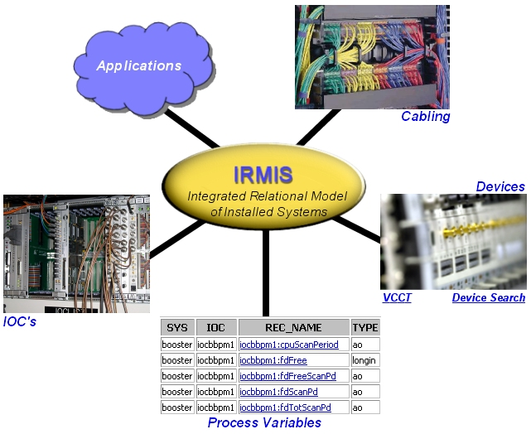
All entities are inter-related …
Physics & machine parameters
Modeling & simulation

Slide 18
Integrated control system
Remote access
Timing & synchronization
Machine protection
Beam feedback systems
Relational databases
Control system reliability
Standards

Slide 19
What do we mean by highly reliable?
Mitigation should depend on the consequence of failure
  Control system failure resulting in loss of beam.
  Control system failure resulting in something bad happening.
Field experience shows that most controls failures are due to power supplies and cooling failures or power cycling.
Only have to be highly reliable during scheduled beam time
  Take advantage of scheduled down time for preventative maintenance and pre-run testing.
  Equipment diagnostics can help detect and prevent impending failures. Diagnostics need to be built in.

Slide 20
What do we mean by redundant systems?
Hot spares that can be remotely swapped in when something fails to reduce beam downtime.
Automatic fail-over to prevent downtime or equipment failure
  How fast? Bump-less? At the I/O point level?
  Implies the failure can be detected in a suitable timeframe.
Hot spares could be maintained in an active state (but not attached) to ensure they are functional when needed.

Slide 21
Closing remarks
We are in a new era of building large-scale facilities through international collaborations of many institutions.
The control system must work with (and for) everyone.
It is important that we have agreement on responsibilities and interfaces between working groups.
The project will benefit tremendously from early setup of relational databases for accelerator and technical data.
Establishing and enforcing facility-wide controls & network protocols for all equipment will be essential.

