Slide 1
Session 2
Technology Developments in Hazard Mapping and Modeling
Ute J. Dymon, Professor
Nancy L. Winter, PhD
Kent State University

Slide 2
DEFINITIONS
Technology – in emergency management is defined as tools that aid in processing information and in decision making to decrease negative results of a disaster.
Infrastructure technology - includes the systems that facilitate the implementation of technology such as networks, communications, the internet and remote sensing.

Slide 3
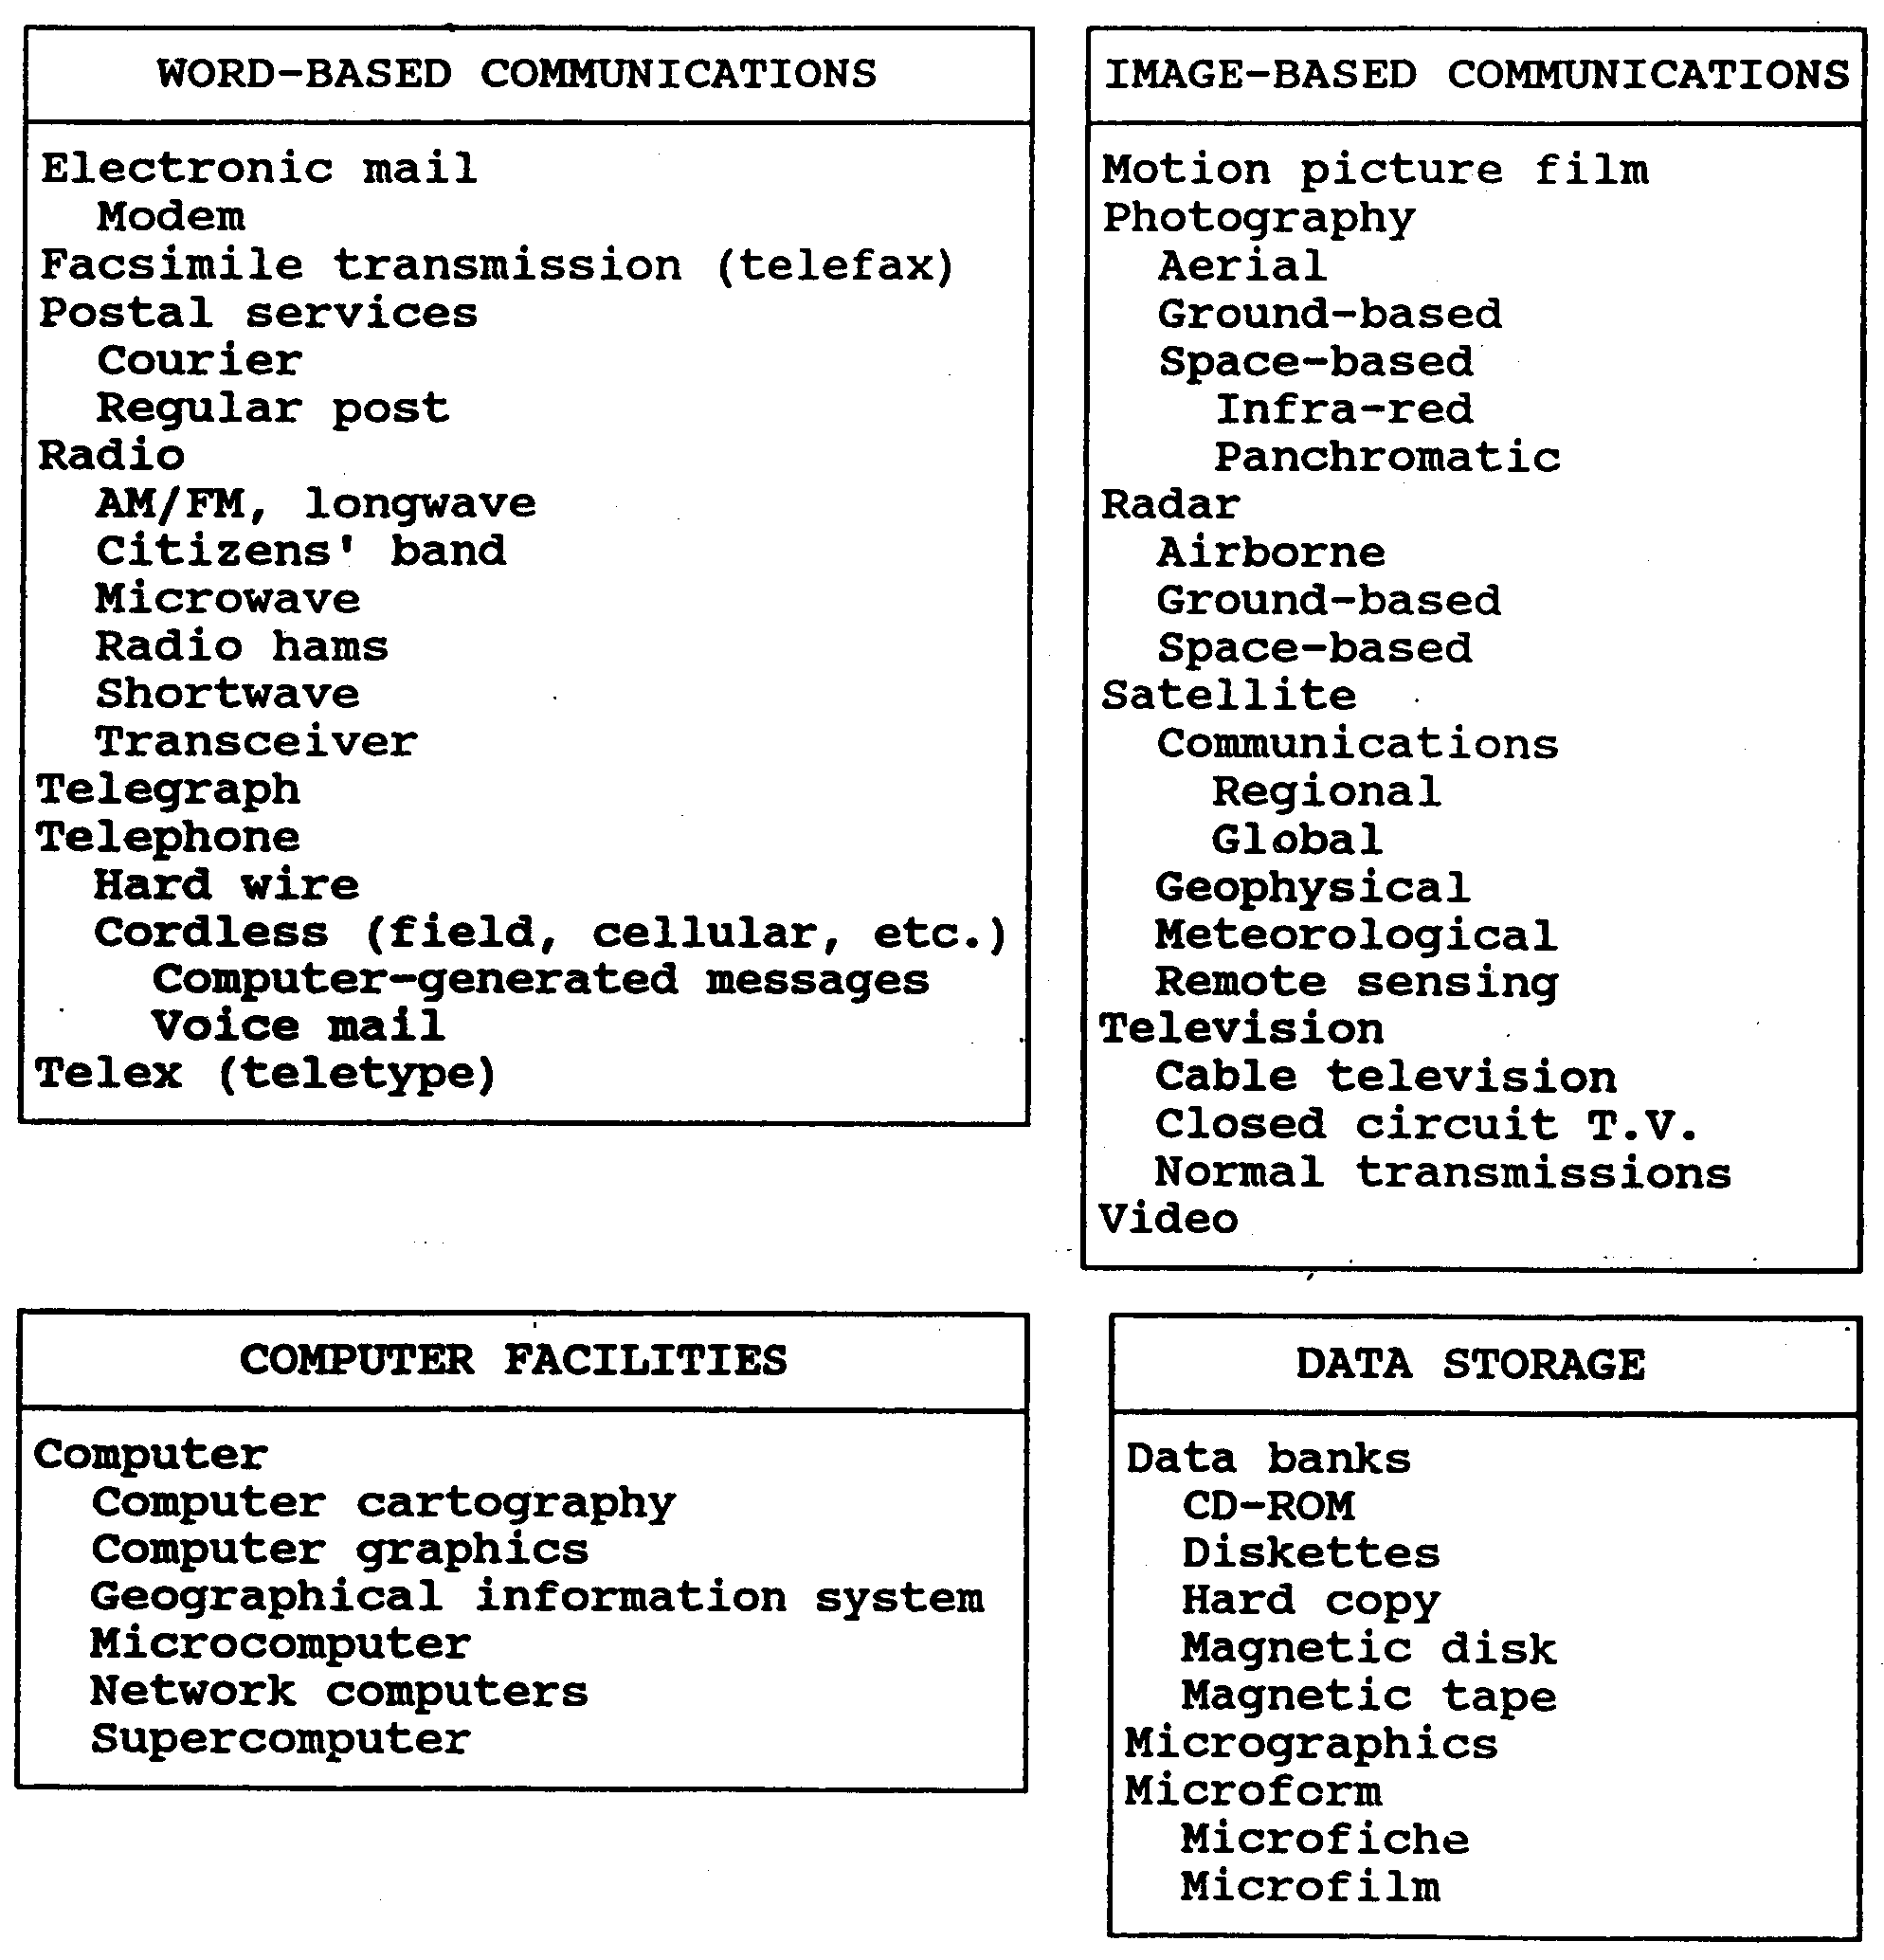
LIST OF INFORMATION TECHNOLOGY RESOURCES
(Alexander, David. 1991. Advanced Information Networks for Management and Decision Making in Real-Time for Natural and Technological Disasters. From a speech given May 9, 1991 at a Conference on Safety and Technological Innovations, Turin, Italy.)

Slide 4
COMPUTER TECHNOLOGY TIMELINE Before PCs Became Commonplace
(Selections from - http://www.maxmon.com/timeline.htm)
1943-1946 First general purpose electronic computer - ENIVAC
1948-1951 First commercial computer – UNIVAC
Circa 1950 Maurice Karnaugh invents Karnaugh Maps (See http://www.maxmon.com/byteinfo.htm)
1958 First integrated circuit (transistors before that
1971 First microprocessor – The 4004
1974 Intel introduces the first true general-purpose microprocessor
1975 Microsoft founded by Bill Gates and Paul Allen
1979 Visicalc Spreadsheet
1981 First IBM PC
  PCs WITH GIS DID NOT BECOME COMMONPLACE UNTIL THE 1990’s
  BEFORE THE 1990s, WHAT CHARACTERIZED THE COMPUTERS GENERALLY APPLIED IN EMERGENCY MANAGEMENT?
  (They were gigantic mainframes used mostly at the federal level for modeling.)

Slide 5
A GIS: The Leading Emergency
Management Mapping and Modeling Tool
“Mapping workhorse of any emergency scene”
  Each Environmental Protection Agency (EPA) region in the U.S. develops its own plan for implementation of GIS for emergency management.
  Federal agencies have developed applications and data that are available to state and local governments to support all stages of disaster planning.
  GIS technology also includes commercially available off-the-shelf (COTS) GIS mapping and modeling tools. (For information about these programs see websites listed at the end of this Session.)

Slide 6
GIS DEFINITIONS
MOST GENERAL DEFINITION: Viewing data about the earth from a geographic perspective.
MORE DETAILED DEFINITION: Since geography tells us what is on Earth and how humans use the planet, this enormous amount of data needs to be organized (systematized).
GIS helps us observe and analyze data about Earth from a geographic perspective which means connecting data to a given location and also dividing it into subject matter layers that can be used to show relationships.

Slide 7
TECHNICAL DEFINITION FOR A GIS
The Environmental Systems Research Institute (ESRI) of Redlands, California, states, “A GIS manages, analyzes and displays geographic knowledge which is represented using one of the following series of information sets:
    maps and globes
    geographic data sets
    processing and work flow models
    data models
    metadata.”
(http://www.gis.com/whatisgis/overview.html).

Slide 8
TWO MAJOR EMERGENCY MANAGEMENT FUNCTIONS OF GIS
Mapping
Relational Analysis

Slide 9
DEFINITION FOR RELATIONAL ANALYSIS
Relational analysis, originally termed map overlay, literally means the super-imposition of one map upon another to determine the features of a given site.
Map overlay, one of the first real uses of GIS, defines the relationships between layers of spatial data.
  Today, in the use of relational databases, relational analysis shows the relationship between attributes (a numeric, text or image data field in a relational database that describes a spatial feature such as a point, line, node, area, or cell.)
  SQL (Structured Query Language) is designed for relational databases.

Slide 10
SQL – STRUCTURED QUERY LANGUAGE
SQL (Structured Query Language) is a data query language designed for relational databases.
Commercial GIS programs such as Oracle, Informix, DB2, Access and Microsoft SQL Server have adopted the language to access data in a database that uses SQL.
The query method of SQL uses a graphic such as a circle, a box, or a polygon to select map features. It processes these map features based on their spatial relationships to other features.
  Example:
    During a chemical accident, the contaminated zone is identified then circles are drawn to select areas that show individuals who require special assistance during an evacuation mainly because they are not able to walk.
    The location of persons with special needs for evacuation are thus identified in order for them to receive assistance.

Slide 11
DEFINITION FOR DIRECT SENSING
Environmental data gathered through direct contact with the physical environment.
The two major real-time emergency management support systems based on direct sensing are:
  the USGS river gauging system that monitors streamflow
  the National Weather Service weather station reporting system

Slide 12
EMWIN: the Emergency Managers Weather Information Network
EMWIN supplies emergency managers with NWS warnings, watches, forecasts, and other products at no recurring cost and disseminates a basic data stream.
EMWIN provides a live stream of weather information through three methods: radio, internet and satellite.

Slide 13
DEFINITION FOR REMOTE SENSING
Remote sensing means recording imagery or data and information from a distance.
  Examples:
    Photography
    Satellite sensors tuned to various bands of the electromagnetic spectrum.

Slide 14
IMPORTANCE OF REMOTE SENSING BY SATELLITE
Satellite remote sensing is the largest single source of digital spatial data for mapping.

Slide 15
MAJOR SATELLITES
TIROS I – first U.S. weather satellite
GOES – Geostationary Operational
Environmental Satellite
POES – Polar Orbiting Environmental Satellite
LANDSAT (also called Thematic Mapper) – has produced millions of images
SPOT – French
SATELLITE IMAGRY FROM RADARSAT SATELLITES – Canadian

Slide 16
LOWER ALTITUDE PLATFORMS
Airplanes
Balloons

Slide 17
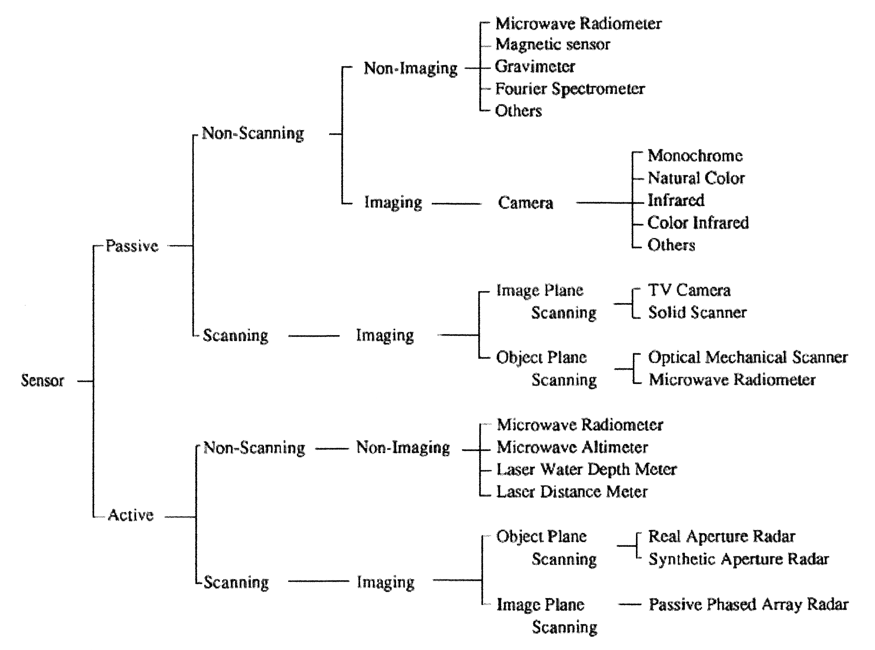
Classification of Sensor http://www.profc.udec.cl/~gabriel/tutoriales/rsnote/cp2/2-1-1.gif

Slide 18
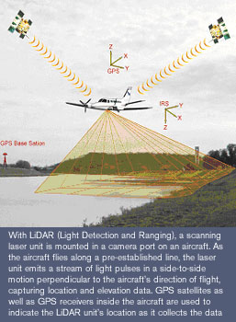
LIDAR TECHNOLOGY DIAGRAM
http://www.woolpert.com/asp/articles/New_LIDAR_Technology.asp

Slide 19
LIDAR IS A COMBINATION OF LASERS AND GPS
Laser beams are sent to the earth’s surface in a sweeping pattern. Data points bounce back to the airplane.
GPS satellites outside the plane and a GPS receiver inside the plane record the location of each point of returning data.

Slide 20
NATIONAL FLOOD INSURANCE PROGRAM
Congress passed the National Flood Insurance Program in 1968 to help reduce the economic and social costs of flood losses.
The program is a joint venture between local communities and the federal government.
Flood insurance is sold in communities that agree to manage their floodplains so that no additional flood-prone structures are built on them.
A National Flood Insurance Program Coordinator assists both local governments and lenders, realtors and insurance agents through education, technical assistance and oversight to meet the requirements of the program.

Slide 21
Process Used to Produce FIRMs
FEMA conducts flood insurance studies (FISs) based on hydrologic and hydraulic investigations of flood risks.
This risk data distinguishes floodplain areas.
Based on this risk data, FEMA produces flood insurance rate maps (FIRMs) that reveal the spatial extent of special flood hazard areas (SFHAs) and other conditions as part of a flood risk assessment.
Insurance requirements and floodplain management of the NFIP are based on these SFHAs

Slide 22
RESULTS OF NFIP MAPPING
All U.S. communities with flood risks have had FIRMS published.
Approximately 20,400 communities nationwide have had flood risk assessments requiring the publication of over 80,000 individual FIRM panels at a cost of over $900 million.
Each year, FEMA distributes 6 to 8 million FIRMS to users and updates several thousand.
Over 2.5 million flood insurance policies have been written covering property worth over $200 billion nationwide.
    (FEMA. 1999. Pine, John C. Technology and Emergency Management. Instructor Guide, Emergency Management Institute, Louisiana State University.)

Slide 23
STORM SURGE MODEL
A storm surge is an out-of-the-ordinary local rise in sea level from a tropical cyclone or other intense storm.
Its height is calculated by subtracting the elevation of the normal or astronomical tide from that of the observed storm tide.

Slide 24
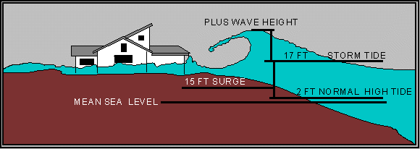
Storm Surge Diagram
http://www.floridadisaster.org/bpr/Response/Plans/Nathaz/hurricanes/

Slide 25
EXAMPLES OF SURGE HEIGHTS OF POWERFUL HURRICANES
25 feet - Hurricane Camille in Mississippi
20 feet – Hurricane Hugo in 1989 in South
Carolina
16 feet - Hurricane Andrew in 1992 in
Florida

Slide 26
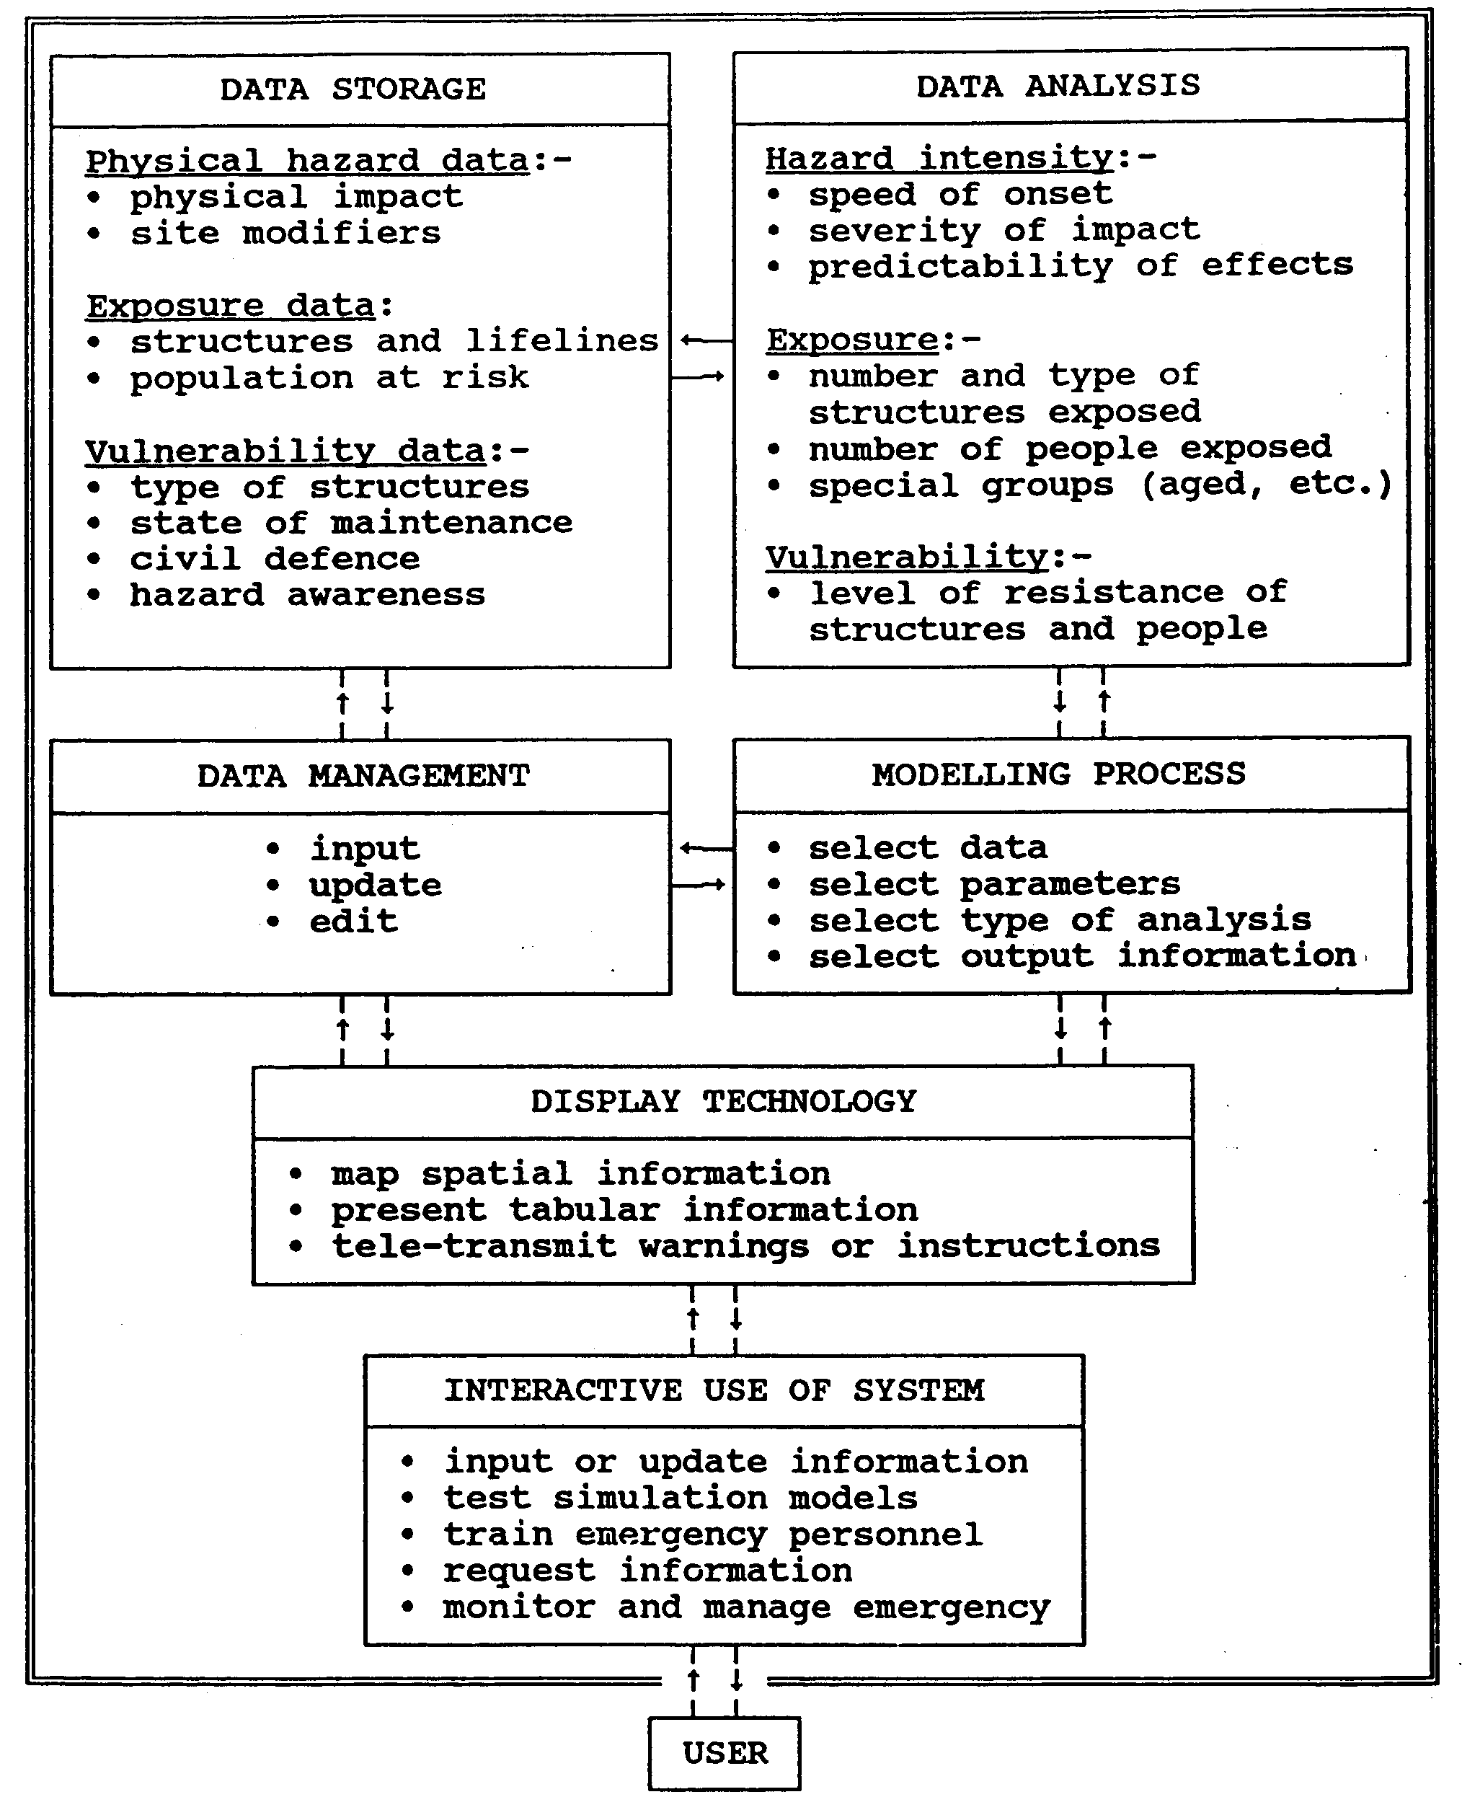
DECISION SUPPORT SYSTEM FOR HAZARD MITIGATION
(Alexander, David. 1991. Advanced Information Networks for Management and Decision Making in Real-Time for Natural and Technological Disasters. From a speech given May 9, 1991 at a Conference on Safety and Technological Innovations, Turin, Italy.)

Slide 27
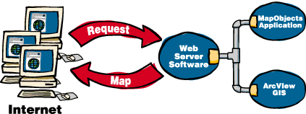
MAP SERVER

Slide 28
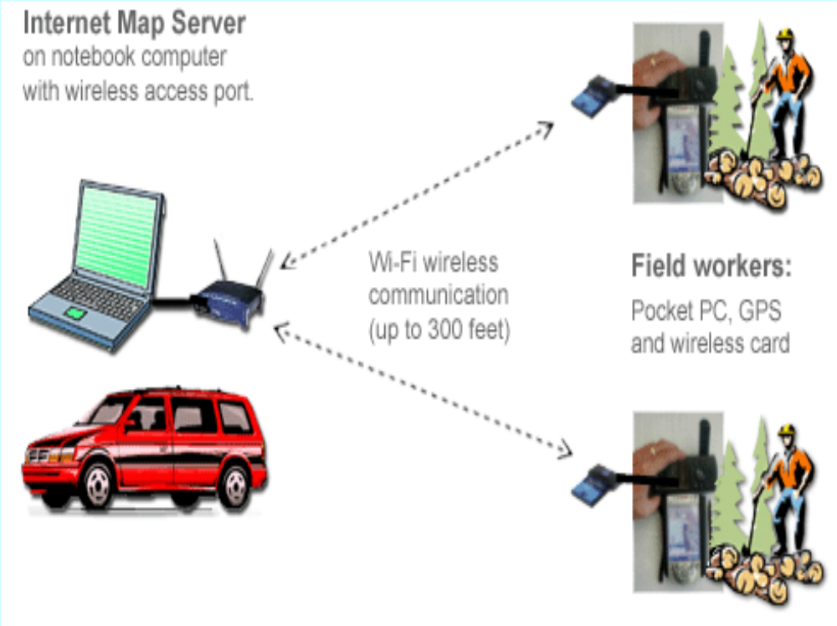
Mobile GIS/GPS

