Slide 1
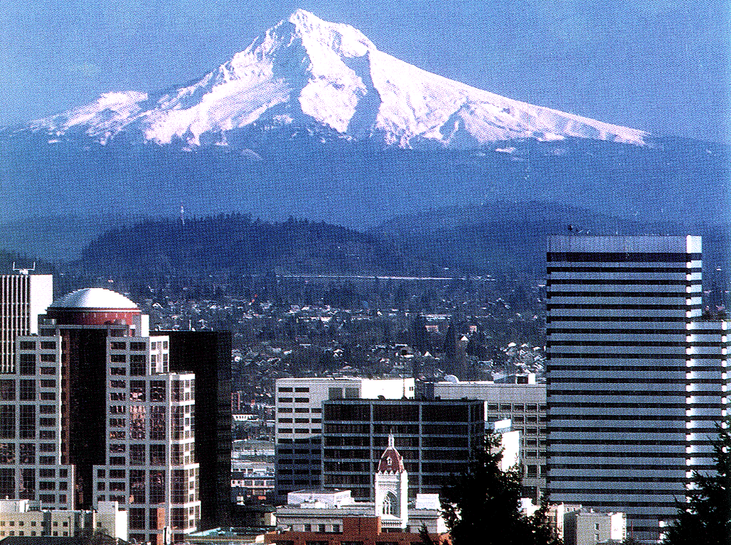
Enterprise Information Strategies
Oregon’s DataMart Solutions
Don Lew - State of Oregon, State Controller’s Div.
IMA - Tri-Cities Washington Chapter
December 6, 2000

Slide 2
Statewide Information Sources
Accounting - Relational Statewide Accounting & Reporting System (R*STARS)
Payroll - Oregon State Payroll System (OSPS)
Budget - Automated Budget Information System (ABIS)
Purchasing - Advanced Purchasing Information Control System (ADPICS)

Slide 3
R*STARS - A short history
R*STARS is Oregon’s Statewide Accounting System
System was implemented March 17, 1995
Operates on legacy computer system
Data is stored in DB2 relational database in several hundred tables
Emphasis: OLTP (On Line Transaction Processing)

Slide 4
System Strengths
Statewide systems collect data effectively & efficiently
R*STARS produces preformatted, standard reports
Reports offer several “special selects” that provide a limited degree of flexibility

Slide 5
System Weaknesses
Standard reports are still not flexible enough - they do not meet a significant percentage of agency needs
Agency-specific production reports cannot be produced
Does not address the need for unique, limited, ad-hoc reports
Information is difficult to extract and use

Slide 6
Initial Solutions:
Mainframe Query Tools
Nomad Qlist
Easytrieve IQ
Direct access to mainframe databases
Required a high level of technical expertise
Required high level of knowledge of the complex database structures

Slide 7
Disadvantages of the mainframe tools
Data was difficult to get to
R*STARS data is designed for efficient On Line Transaction Processing, not ad hoc retrieval and reporting
Data access tools were too technical and difficult to learn

Slide 8
What did we really want?
Data in accessible form
Easy to use access tools
OLAP (On Line Analytical Processing) capability
Broad access to the data

Slide 9
Accessibility Requirements
Ease of use
Cross platform capability in the query tool (PC’s & Mac’s)
Ad Hoc/Analytical capabilities
Standard, customizable accounting reports
Decision Support/Executive Information
Capability to export data to other desktop tools

Slide 10
Our solution:
Statewide DataMarts
DataMarts - Targeted databases containing statewide information
  Accounting DataMart
  Payroll DataMart
  Budget Information DataMart

Slide 11

SCD Accounting DataMart
Accounting data first loaded in April 1997
The DataMart flows from the Statewide Financial Management System (SFMS) - Oregon’s central accounting system.
Contents - Summary and Detail from March 1995 to the present
Frequency of updates - once a week

Slide 12
Information Protocols
Data is extracted and loaded into a Sun Ultra 6000 “mini-computer”
Agencies connect through statewide wide area network (TCP/IP)
Connection protocol - ODBC
Database - IBM DB2 (UDB)

Slide 13
Contents of the Accounting DataMart
5 Financial Tables
  Accounting Transaction Detail
  2 General Ledger Summary Tables
  Receipt Summary
  Document Tracking Summary
30 Descriptive Tables
  Account Names, Agency Names, etc.

Slide 14
User Acceptance
This was our top priority
Task force reviewed data & selected specific tables
Summary tables were straightforward
  GL Summary, GL Detail, etc.
Detail table was ‘de-normalized’ to make it usable
  Accounting Event

Slide 15
Data Validation
Critical for usability of data
  Users
  Auditors
Validation conducted each week
  DataMart compared to mainframe
  Record count
  Hash totals for key financial records

Slide 16

Some Statistics
Size - 92 Gigabytes
Accounting detail - about 70 million rows
Summary tables - up to 21 million rows.
Contains data for all state agencies

Slide 17

DataMart Users
Agency Accountants
Agency Budget Analysts
Central Agencies
  State Controller’s Division
  State Division of Audits
  Legislative Fiscal Office

Slide 18
Query & Reporting
What software can be used?
  Any ODBC compliant software
  M/S Access
  Lotus 1-2-3
  ACL
Our preferred query & reporting tool is the Brio Enterprise suite.

Slide 19
Security & Training
User access based on RACF UserID
Two levels of training
  Orientation to learn about the data
  Customized training in BrioQuery

Slide 20
Information Control & Usage
User agencies have control over their own information (through read-only files)
Extraction of information is easier and cheaper than mainframe reports
Agencies create customized reports
Automatic report scheduling & distribution
  Via e-mail
  Via internet

Slide 21
Types of Reports
Monthly Financial Reporting:
  Detail Expenditures
  Trial Balances
Budget Comparison Reporting
  Actual to Budget
  Remaining Budget
Ad Hoc & Specialty Reporting

Slide 22
Report Production
Agencies produce their own Queries and reports.
Agencies share reports
Brio Repository is available for agencies

Slide 23
Report Distribution
Agencies produce reports & distribute manually
Brio Broadcast Server
Brio OnDemand Server

Slide 24
Some examples - how one agency uses the DataMart
Department of Human Services
State Office for
Services to Children
and Families (SOSCF)

Slide 25
SOSCF
Sources of Data
Statewide
  Accounting DataMart (SFMS/R*STARS)
  Payroll DataMart
  (OSPS)
Agency Specific
  IIS DataMart
  TRACS DataMart
  AFCARS Data
  Adoptions Data
  Other Local Databases

Slide 26
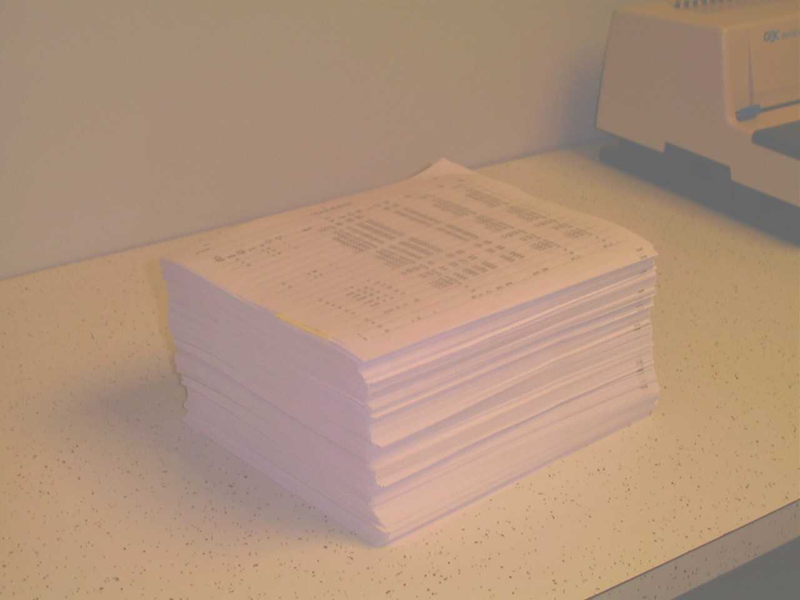
Division Goals in using a new query and reporting system.
  Replacement of inflexible, bulky paper reports.

Slide 27
Division Goals in using a new query and reporting system.
  Provide Branch, Region and Program specific information to Budget Managers at all levels of the organization.
  Improve the timeliness of Budget information being provided to managers in support of fiscal and program decision making.
  Provide Branch Review teams and internal auditors with transaction level information specific to a branch, or activity, or program

Slide 28
SOSCF Reports
From Statewide data sources
  Expenditure & Budget reports
    Agency-wide
    Region specific
    Branch specific
    Statewide field expenditures
  Payroll reports
From Agency Specific data sources
  IIS DataMart - Adoptions & Safe Families Act reports
  SOSCF also merges data from different data sources (IIS & TRACS)

Slide 29
Questions???
Don Lew, Accounting Analyst
State Controller’s Division
(503) 373-7277 ext. 283
Donald.E.LEW@state.or.us

