Slide 1

XMDR Prototype Progress Report
  John McCarthy and Karlo Berket
  XMDR Project Meeting
  January 23, 2007
  Faculty Club
  University of California
  Berkeley
Notes:
Karlo Berket joined LBL’s XMDR Project group as a part time programmer in January 2006
He comes to us from the Cybersecurity and Network :& Distributed Systems Research Group at LBNL,
which continues to occupy and pay for the other half of his working hours

Slide 2
XML Prototype Progress Outline
Semi-automated UML to OWL translation of ISO/IEC11179 working draft 4
Revised architecture & module diagrams
Content (re)loaded to date & planned
Coping with scale (Omega ontology, continued)
Demonstrate revised XMDR Prototype (2007.01.19)
  Integrated text and inference queries & results
  XMDR portal -- software, data & documentation
Next steps & major challenges
Notes:
Prepared this with Larry in mind as the architype for primary audience
Tell story about painful upgrade from T23 to T43
Analogy to upgrading 11179 to include more formal semantic information
We’ve been hearing about inference from Frank for a number of years (Prolog, etc.)
Problem that had a silver lining
Karlo machine crashed, so he had to re-install—did it on xmdr server and revised recipe

Slide 3
11179-ed2 used UML to specify metamodel, but only via human database designers
ISO/IEC 11179 ed3
Metamodel (in UML)
human translation
11179
Relational
Schema
Registry Content
Relational
Database
Notes:
In the future, XML schema may be able to enforce most of the constraints from OWL, RDF, and XML automatically
Can create regular XML Schema from Relax-NG specs using TRANG

Slide 4
XSLT scripts used to generate
OWL from ISO11179 WD4 UML specs
Needed quicker prototype updates from 11179 draft specs
Current automation tools did not work
  tools use UML2, but 11179 spec was in UML1.x
  but even UML 2 from Poseidon 3.2.1-0 did not work
    unsuccessful loading UML2 XMDR into TopBraid & Sandpiper
    UML2 not as yet as interchangable as hoped (more from Elisa on Thurs)
Created XSLT script(s) for converting UML to OWL
  Current version of scripts do not (yet)…
    Separate packages into separate namespaces
    Create owl:disjointWith properties
    Translate OCL rules/restrictions
    (e.g., registered item is either an administered item or an attached item)
Notes:
UML 2 from Poseidon may have failed either due to Poseidon or to non-compliant XMDR specs

Slide 5
XMI from 11179-ed3 UML is transformed to RDF/OWL for XML metamodel specification
ABSTRACT
STEP
UML modeling
& editing
Transformation
to OWL
OWL ontology
display, editing
& validation
UML interchange
Logic index
Reasoner
Human compare / hand editing
XMDR OPEN
SOURCE TOOLS
XSLT
scripts
Poseidon
Protege
Swoop
Jena
Pellet
FILES
(AND TYPES)
XMDR
Metamodel
(UML)
XMDR
Metamodel
(XMI)
XMDR
Metamodel
(preliminary
RDF/OWL)
XMDR
Metamodel
(final
RDF/OWL)
XMDR
Metamodel
asserted
logic index
XMDR
Metamodel
inferred
logic index
POSSIBLE
ALTERNATE
TOOLS
Rational Rose?
Others?
Sandpiper Visual Ontology Modeler?

Slide 6
OLD XMDR Prototype Architecture Diagram & Implemented Modules
External
Interface
Registry
RegistryStore
Java
WritableRegistryStore
Subversion
MetadataValidator
XML Schema (for XML)
Jena (for RDF)
Protégé & Swoop (for OWL)
RetrievalIndex
MappingEngine (defer)
FullTextIndex
LogicBasedIndex
Lucene
Jena, [Sesame?]
Authentication Service (defer)
Ontology Editor
11179 OWL Ontology
Protege
Notes:
Tools in smaller different font &
Lines around boxes for print version
Black print on pastel blocks
Show Protégé creating ontology used to define storage
Evaluated OWI KS and Racer but they had performance and other issues (see data in prior presentation)
Paid version of Saxon may be able to do schema-driven transformations
Karlo says mapping between concept systems could be done by loading additional OWL files
Mapping happens at 2 levels: between different instances of same OWL class; and between dif instances within a class (e.g., Data Elements)

Slide 7
XMDR Prototype Modular Architecture
Metadata Sources
concept systems,
data elements
USERS
Web Browsers…..Client
Software
Content Loading &
Transformation
Human User Interface
Application Program Interface
Validation
(XML Schema)
Authentication Service
Metamodel specs
(UML & Editing)
Mapping
Engine
Search & Inference Queries
XMDR data model
& exchange format
XML, RDF, OWL
Reasoner
Text Search
Registry Store (Subversion)
XMDR metamodel
(OWL & xml schema)
standard XMDR files
standard XMDR files
Inferred
LogicIndex
Asserted
LogicIndex
Full Text
Index
standard XMDR files
standard XMDR files
Notes:
Don’t print very well??
Perhaps a third slide could suggest some criteria for software selections: Open Source vs. commercial, functionality, performance, scalability, cost, maintenance, availability, Operating System dependencies, ....
--The software modules that are crosshatched (because they are deferred), seem to be a bit lost to me. I understand you are trying to keep the slide from being too busy. Perhaps on slide one, "XMDR Modular Architecture", as above, you could put in the black rounded rectangle borders. This would show each module distinctly. By leaving out the software selections on this slide, it would be less busy. Then slide two could be as is. Or you might try using dashed black borders around the deferred modules to see if that would not be too busy.
REST= “Representational State Transfer” term coined by Roy Fielding in his Ph.D. dissertation [1] to describe an architecture style of networked systems
http://www.xfront.com/REST-Web-Services.html http://roy.gbiv.com/pubs/dissertation/rest_arch_style.htm 2000 UC Irvine
Why REST? Why is it not SOAP? Much simpler [need slide to address this]
Need to show where it is RDF, OWL,

Slide 8
XMDR Prototype Modular Architecture: with current open source software selections
Metadata Sources
concept systems,
data elements
USERS
Web Browsers…..Client
Software
XMDR Prototype Architecture REST Style
Content Loading &
Transformation
(Lexgrid & custom)
Human User Interface
(XML pages & javascript)
Application Program Interface (REST)
Validation
(XML Schema)
Authentication Service
Metamodel specs
(UML & Editing)
(Poseidon, Protege)
Mapping
Engine
Search & Inference Queries (Jena, SPARQL)
XMDR data model
& exchange format
XML, RDF, OWL
Reasoner
(Pellet)
Text Search
(Lucene)
Registry Store (Subversion)
XMDR metamodel
(OWL & xml schema)
standard XMDR files
standard XMDR files
Inferred
LogicIndex
Asserted
LogicIndex
Full Text
Index
standard XMDR files
standard XMDR files
Notes:
Don’t print very well??
Bruce suggestions:
Perhaps a third slide could suggest some criteria for software selections: Open Source vs. commercial, functionality, performance, scalability, cost, maintenance, availability, Operating System dependencies, ....
REST= “Representational State Transfer” term coined by Roy Fielding in his Ph.D. dissertation [1] to describe an architecture style of networked systems
http://www.xfront.com/REST-Web-Services.html http://roy.gbiv.com/pubs/dissertation/rest_arch_style.htm 2000 UC Irvine
Why REST? Why is it not SOAP? Much simpler [need slide to address this]
Need to show where it is RDF, OWL,

Slide 9
Criteria for XMDR Prototype software selctions
Open Source (vs. commercial)
Functionality
Performance
Scalability
Modularity (ability to combine with other software)
Cost
Availability
Operating System dependencies
Notes:
Perhaps a third slide could suggest some criteria for software selections: Open Source vs. commercial, functionality, performance, scalability, cost, maintenance, availability, Operating System dependencies, ....

Slide 10
Content loading, with XMDR metamodel used for inferred indexing and validation
CONTENT
TRANSFORMATION
VALIDATION
REGISTRY INFORMATION
INDEXING
Subversion
Reasoner
(Pellet)
Inferred
LogicIndex
Terminology A
XMDR Files A
Terminology B
Lexgrid
XMDR Files B
Thesaurus C
XMDR Files C
Terminology D
XMDR
metamodel
In XML
schema
XMDR Files D
Search &
Inference
Framework
(Jena)
Assesed
LogicIndex
Data Element
Source E
XSLT
script E
XMDR Files E
Terminology
Source F
XSLT
script F
XMDR Files F
Ontology
Source G
XSLT
script G
XMDR Files G
Text
Indexing
(Lucene)
Full Text
LogicIndex
External
Source H
XSLT
script G
XMDR Files H (virtual)
From OWL
Notes:
NEED to explain what Lexgrid is

Slide 11
Example concept system content currently loaded into XMDR Prototype
via Lexgrid
National Biological Information Infrastructure biodiversity
NCI Thesaurus_06.02d health concepts system
GEMET 2001.0 Multilingual Environmental Thesaurus
ISO4217_1981 currency codes
ISO3166_V-10 country codes (only 2 letter codes)
Mouse_1.32 anatomy
Defense Technology Information Center 1.0 Thesaurus
Portions of EPA controlled vocabulary
SIC and NAICS industrial classification codes
via special purpose scripts
Omega ontology
Notes:
Show relative size of each

Slide 12
Additional Metadata Content planned for XMDR Prototype
Current 11179 Data Element Registries
caDSR (full NCI Cancer Data Standards Registry)
EDR (EPA Environmental Data Registry)
Candidate Additions to Concept Systems and Ontologies
NASA SWEET (Semantic Web Earth & Environmental Terminologies)
IETF RFC 3066 Language Codes
USGS Geographic Names Information System
Getty Thesaurus of Geographic Names
I.T.I.S. - Integrated Taxonomic Information System
Foundational Model of Anatomy
EPA Chemical Substance Registry
GO (Gene Ontology), ….Agrovoc, …and possibly others
Notes:
Main criteria are
wide range of substantive fields of interest
different types of data structures, complexity, and other types of challenges

Slide 13
Omega Ontology illustrates challenges of loading large, complex new content
Omega is a “terminological ontology”
reorganization & synthesis of WordNet & Mikrokosmos
adds higher level ontology to organize multiple ontologies
Initial mapping and loading of Omega needs to be refined
Entity relationships conform to Concept_System figure
Entity ->Attribute conforms to Classification_Scheme figure
Omega Attributes mapped to ISO/IEC11179 ed3 Facets
  (ignoring Omega datatype field)
Required a week to process and load Omega Ontology
4 million files, so ~250,000/24 hrs
Notes:
Frank says someone at ICSI working on combining WordNet with upper level ontology (maybe SUMO)

Slide 14
NCI Thesaurus is also challenging
148,110 files of input data
  One per each concept, link, relation and relation role
Number of asserted files are 14x larger (2,149,974)
Number of inferred files are 35x larger (5,305,344)
Size increases 1 to 2 orders of magnitude
Notes:
Ask Karlo about 148,110 files of input data (one per concept?)

Slide 15
XMDR Prototype approach has evolved to overcome semantic web limitations
Semantic web premised on getting lots of pieces and then inferring from them – not retrieving from large databases
  Reasoners require that working set is in memory
XMDR content differs from this paradigm (lots of content)
  Inference at run-time infeasible
  Inference across all content infeasible
Latest XMDR software performs reasoning at load time
  Have to re-load all data if rules change
  But no more memory issues at run-time
  Analogous to materialized views in relational database technology
Latest XMDR software does reasoning on parts of content
  Portions 40K-100K asserted triples
  Limits reasoning

Slide 16
Future Possibilities
Commercial triple stores claim to scale better
  allegrograph/racer
  Ontology Works/Objectivity)
Reasoners that don’t need everything in memory?
Reasoners that can work with incremental changes (next version of Pellet will support this)
Assert everything in generating XMDR content -- leave mapping module to deal with reasoning

Slide 17
Current coverage of 11179 classes in XMDR prototype system
Concept Systems e.g., NBII, NCI Thesaurus
Classification Schemes e.g., CDISC Codelists
Conceptual Domains e.g., Countries of the World
Characteristics e.g., Examined, Analyzed
Object Classes e.g., Participant, Finding
Data Element Concepts e.g., Country Label
Data Elements e.g., Country Name
Value Domains e.g., countries of the world
For number of instances of each, see
xmdr.lbl.gov/xmdr/coverage.jsp
Concepts e.g., River outflow
Relations e.g., IsA, PartOf, broader, Allele_Has_Activity
Links
Organizations e.g., EPA
Units of Measure e.g., seconds, ml/min, …
Notes:
KARLO will show page in app that shows this from http://xmdr.lbl.gov/xmdr/coverage.jsp
NOTE: our intention is to have at least one example item for each type of Identified Item in the new 11179 metamodel
-- includes classes, associations, and relations

Slide 18
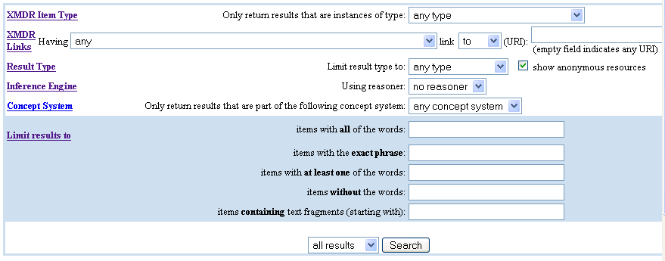
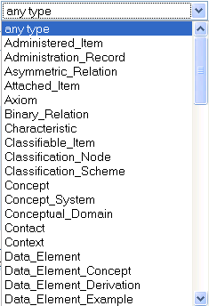
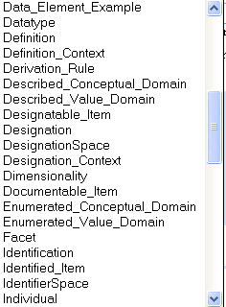
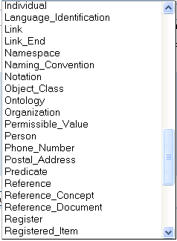
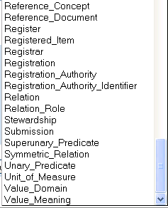
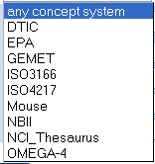
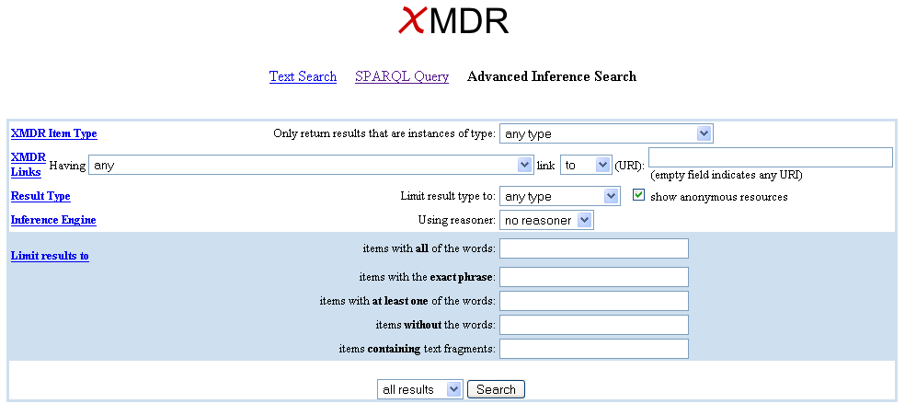
web interface combines inference
& text queries xmdr.lbl.gov/xmdr/
or from
resources (URIs) or literals (values)
or pellet
new feature
or pre-set number of instances (10,20,30…50)
Notes:
Use diff color for annotations!
Frank asks What kinds of inference? Transitive, simple boolean, more general first order logic
Do we allow user-specified predicates? Or just what is in the model?
NEED NEW INTERFACE
In the future, will be able to choose multiple items from pick lists
If you choose number of results to display, it won’t display how many are retrieved in total at the top because it starts as soon as results come back
Will keep text search because it is Lucene only – simple, ala google
Concept with text -- Same with text search Administrered Item Water contamination
XMDR Item Type
In general, XMDR Item Types are names of types of metadata items of interest. In particular, they are class names taken from the OWL specification of the XMDR metamodel, which is based on the ISO/IEC 11179 Part 3 Version 2 metamodel and very similar (but not always identical) to the proposed ISO/IEC 11179 Part 3 Edition 3 metamodel.
XMDR Links
These are properties from the XMDR metamodel, i.e., names of associations and/or attributes of the classes from the metamodel (XMDR Item Types).
The direction of the link, i.e., to or from choice, indicates whether search results should include entities which link to or from the specified target (selected attribute or relationship)
Result Type
This specifies whether to return resources (specified by URIs -- e.g. web addresses) or literals (text strings, numbers, etc.) or both.
The anonymous resources checkbox indicates whether or not to return information about blank (unnamed) RDF nodes as part of the search results.
Inference Engine
What type of inference engine to use in conjunction with the queries. No reasoner means just return exact matches for the query. The various inference engines allow one to return various implied results, e.g., the result of performing a transitive closure on specified types of links.
Limit results to
Further restricts search results on the basis of their text contents.

Slide 19
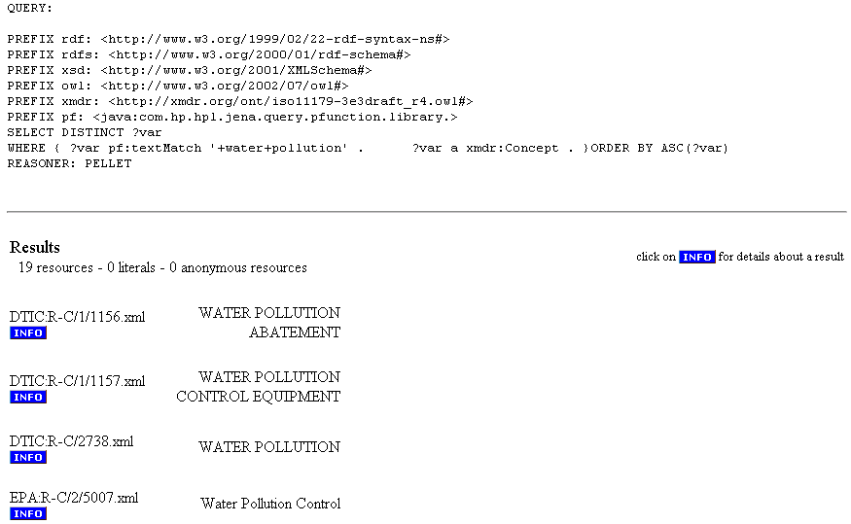
Inference query results
URI prefixes
SRARQL Query
Number of Concept (or subclasses) Items/Files Found
file identifier, with prefix
designated item sign(s) for each item/file
show detailed information
See relevant part of XMDR metamodel diagram
What other summary information should we show for each item/file?
Notes:
INFO link shows detailed information about the item (including inferred info -- shown on next slide)

Slide 20
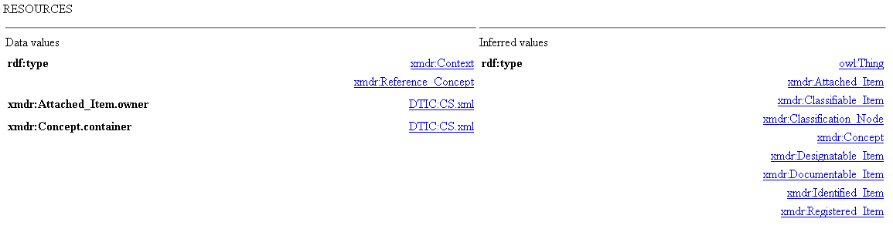
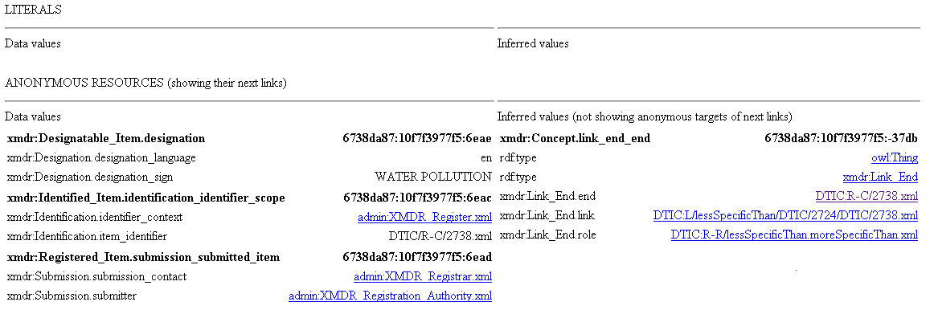
“Info” shows details about items with asserted info at left
See relevant parts of metamodel diagram
URI – item/file ID
Links
Designation.Sign
Pages divided into two sections –
stored data at the left ……and inferred data on right
tags on left
values on right
actual data rather than links
items that are neither identified or registered
another anonymous node
non-bold shows attributes of bold items
more on next page!
Notes:
KARLO: REPLACE

Slide 21
Inferred information in right half
URI – item/file ID
Links
Designation.Sign
Pages divided into two sections –
stored data at the left ……and inferred data on right
How can we improve the content & format
of this detailed data for each item?
more on next page!
non-bold shows attributes of bold items
Notes:
KARLO: REPLACE

Slide 22
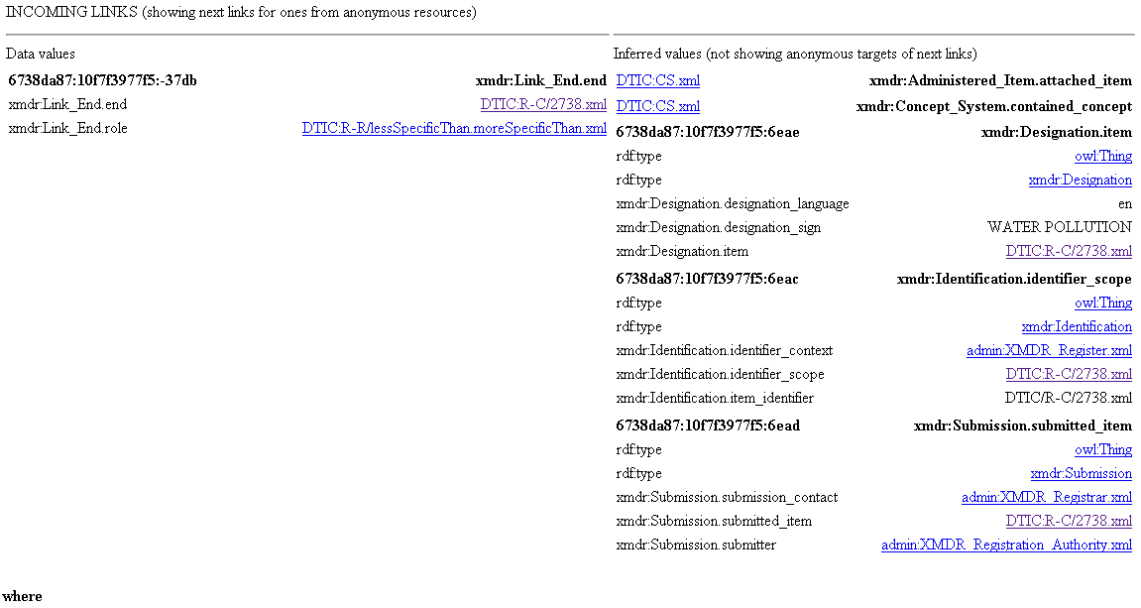
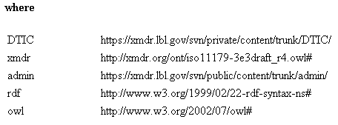
Info detail incoming links with inferred information on the right
Legend of Prefixes
Notes:
KARLO: yes, replace (if showing new version)

Slide 23
Item detail ends with incoming links and legend of prefixes
Legend of Prefixes
Notes:
KARLO: yes, replace (if showing new version)

Slide 24
Demo & Discuss XMDR
List of Concept_System instances in prototype
“River outflow” Reference_Concept from NBII
“UseFor” Relation_Role from NBII
Broader relations (from interface example)
Any other requests
Notes:
KARLO: REPLACE IF SHOWING NEW VERSION

Slide 25
Notable features of XMDR Advanced Inference Search
You don’t have to know SPARQL
  but you can see the generated SPARQL query
  Each search component has pop-up help screen
Choice of reasoners
  None, Pellet
Can restrict search to target object type
  e.g., concept system, data element, concept, value domain, etc.
Can restrict search by object attributes or links
  e.g., administrativeStatus, designation, etc.
Combines XMDR text search (via Jena)
  phrases, words (all, at least one, without), strings
Simple output summary & control
  Result count, specify number displayed per screen
  Show results as web addresses, literals, or both
Restrict search by Concept System (new)
Notes:
KARLO has updated object type and attribute names to current specification

Slide 26
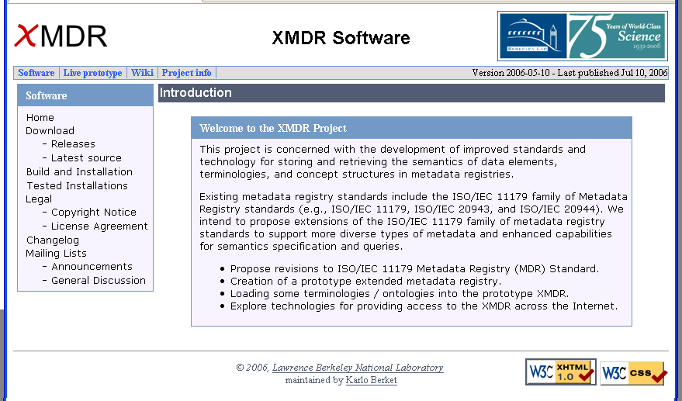
XMDR Prototype Web Site has downloadable code & content
http://xmdr.lbl.gov/
Note tabs for other sections!
Notes:
KARLO: MAY NEED NEW SCREENSHOT

Slide 27
New XMDR checkpoint release includes several improvements
Uses new XMDR ontology based on iso11179 part 3 edition 3 working draft 4
Improved memory footprint
Improved mixed searches (logic & text)
Improved times for Advanced Inference Search
Core functionality now distinct from 11179 model
New option to constrain search to a particular concept system in Advanced Inference Search
http://xmdr.lbl.gov/software/releases.html

Slide 28
Next priorities for XMDR Prototype are currently under discussion
Add more metadata
  fully populate all aspects of 11179 metamodel
  especially for example 11179 data registries, i.e. caDSR, EPA-EDR
  other content that stretches the current model (like Omega)
Improve tools & procedures for input data mapping/loading
  More extensive integration of Lexgrid features
Extend XMDR System Features
  try using Lexgrid for other functionality beyond data loading
    e.g., Ontology Lifecycle Management – versions & semantic drift
  experiment with other User Interface options
    Exhibit from MIT-Sesame project
    BioPortal
  transitive closure queries within specified number of arcs
  let users select multiple items from interface pick lists
  Investigate microformats (http://microformats.org/about/ )
Notes:
SEE NSF Milestones

Slide 29
Technical Challenges and Issues for XMDR Implementation Testbed
Complexity
  Representation of relations
  Omega ontology has raised a number of issues
  how to provide extensibility for unknown future complexities?
Scalability & performance
  Currently includes [number] objects & [number] RDF triples
  maybe indexing and/or distributed registries will help?
Model Evolution
  we eventually hope to generate directly from UML
External metadata sources, ontologies, terminologies
Mapping (e.g. between concept systems, to data elements)
Harmonize with ODM, MMF, Common Logic, Web Services
Notes:
NEED NUMBERS ABOVE

Slide 30
Thanks & Acknowledgements
Bruce Bargmeyer, Principal Investigator
Frank Olken, Theory & Model Development
Harold Solbrig, Lexgrid, Model Development, etc!
L8 and SC 32/WG 2 Standards Committees
Major XMDR Project Sponsors and Collaborators
  National Science Foundation (Grant #0637122)
  U.S. Environmental Protection Agency
  Department of Defense
  National Cancer Institute
  U.S. Geological Survey
  And others!

Slide 31
Contact Information
XMDR Project
  http://xmdr.org/
Bruce Bargmeyer, Principle Investigator
  BEBargmeyer@lbl.gov
Karlo Berket, Systems Design & Programming
  KBerket@lbl.gov
John McCarthy, Information Systems Consultant
  JLMcCarthy@lbl.gov

Slide 32
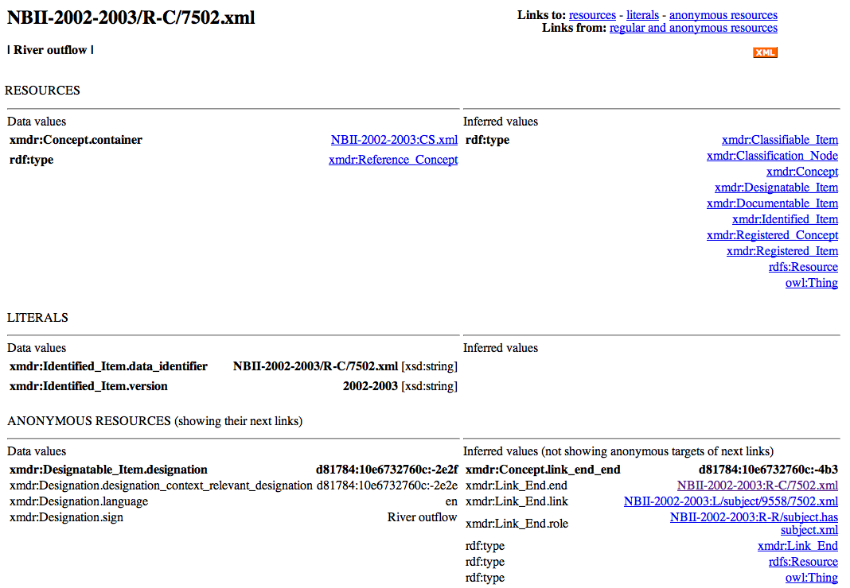
*Info shows details about items (including inferred info)
See relevant parts of metamodel diagram
URI – item/file ID
Links
Designation.Sign
Page divided into two sections – stored data on left & inferred data on right
tag on left with value on right
tag on left with value on right
NBII Concept System
How can we improve the content and format of this detailed data for each item?
actual data rather than links
Designation.Sign
items that are neither identified or registered
another anonymous node
non-bold shows attributes of bold items
more on next page!
Notes:
KARLO: REPLACE

Slide 33
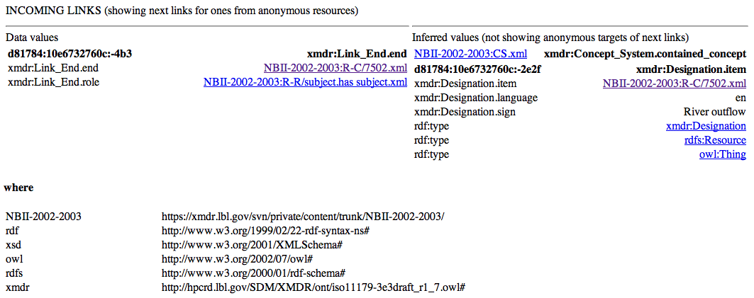
*Continuation of Item detail
stored data on left & inferred data on right
nodes
arrows
Legend of Prefixes
Notes:
KARLO: yes, replace (if showing new version)

Slide 34
DEFER XMDR Prototype example: dual purpose rdf/xml file (extract) for one GEMET term
<Reference_Concept xmlns:rdf="http://www.w3.org/1999/02/22-rdf-syntax-ns#"
xmlns="http://hpcrd.lbl.gov/SDM/XMDR/ont/iso11179-3e3draft_r1_7.owl#"
xml:base="http://xmdr.lbl.gov/xmdr2/data/OMEGA-4/R-C/50010/1451.xml"
rdf:about="">
<Identified_Item.data_identifier rdf:datatype="http://www.w3.org/2001/XMLSchema#string">OMEGA-4/R-C/50010/1451.xml</Identified_Item.data_identifier>
<Identified_Item.version rdf:datatype="http://www.w3.org/2001/XMLSchema#string">4</Identified_Item.version>
<Identified_Item.identification_source rdf:resource="http://xmdr.lbl.gov/xmdr2/data/OMEGA-4/N/5001.xml"/>
<Designatable_Item.designation rdf:parseType="Resource">
<Designation.sign rdf:datatype="http://www.w3.org/2001/XMLSchema#string">table tennis</Designation.sign>
<Designation.designation_context_relevant_designation rdf:parseType="Resource">
<Designation_Context.scope rdf:resource="http://xmdr.lbl.gov/xmdr2/data/OMEGA-4/C-1.xml"/>
</Designation.designation_context_relevant_designation>
</Designatable_Item.designation>
<Concept.container rdf:resource="http://xmdr.lbl.gov/xmdr2/data/OMEGA-4/CS.xml"/>
</Reference_Concept>
Karlo show new version
Annotate parts that
illustrate RDF & OWL
28
Notes:
KARLO suggests we try showing more compact representation of triples (using N3 or similar tool)
Perhaps in addition to the full blown XMDR RDF/XML format such as above
Is this possible now Karlo?
Concept is shorthand in xmdr name
Property is RDF type subject
Subject property object
Xml serialization
Class name for tag is shorthand for property

