Slide 1

XMDR Prototype Overview
  John McCarthy and Karlo Berket
  International Ecoinformatics Technical Collaboration
  October, 2006
  Faculty Club
  University of California
  Berkeley
1
Notes:
Karlo Berket joined LBL’s XMDR Project group as a part time programmer in January 2006
He comes to us from the Cybersecurity and Network :& Distributed Systems Research Group at LBNL,
which continues to occupy and pay for the other half of his working hours

Slide 2
XML Prototype Overview Outline
Review XMDR Prototype motivation & goals
Describe architecture & modular implementation
Summarize content loaded to date & planned
Demonstrate current XMDR Prototype (v.1 & 2)
  Text Search and Inference queries & results
  XMDR portal for software, data & documentation
Discuss next steps & major challenges
2
Notes:
Prepared this with Larry in mind as the architype for primary audience
Tell story about painful upgrade from T23 to T43
Analogy to upgrading 11179 to include more formal semantic information
We’ve been hearing about inference from Frank for a number of years (Prolog, etc.)
Problem that had a silver lining
Karlo machine crashed, so he had to re-install—did it on xmdr server and revised recipe

Slide 3
Goals of the open source XMDR prototype implementation testbed
Demonstrate feasibility & utility of proposed revisions to ISO/IEC 11179
Provide open-source reference implementation with XMDR capabilities
  Determine the necessary features to leverage semantic interoperability between ‘concept’ systems and ‘data elements’
  e.g., for ontology lifecycle management & harmonization
Explore benefits of representing XMDR content using emerging semantic technologies (e.g., RDF, OWL, CL, …)
  integrate open source tools to create, maintain, deploy XMDR standards
  test capabilities and performance of candidate tools
Assemble semantic metadata with different structures from diverse sources to test various semantic technologies
  terminologies, thesauri, ontologies, …
  From health, environment, geography, …
Help identify ways to resolve registration & harmonization issues for different metadata standards, including ODM & MMF
10

Slide 4
How does the XMDR prototype seek to overcome 11179-ed2 limitations?
Add more rigorous & formal specification for
  Concepts and concept systems (ontologies)
  Relationships between metamodel components
  Continuing evolution toward increasing granularity & details
Use concepts to unify different types of metadata
  and axioms for conceptual & structural relationships
Support more powerful software tools
  for richer text searching beyond relational technology
  for inference queries based on structural metadata
Build interfaces to aid searching & navigation
  hide complexities of inference queries
  combine text searching and inference
Bridge the realms of concepts & data artifacts
  More explicit connections to & use of other metadata standards
6

Slide 5
How does XMDR Prototype differ from current 11179 technology?
Evolutionary aspects
  Finer-grained, more formal metadata
    e.g., distinct attributes for measurement units
    rather than just part of textual description
  Machine inference complements text searching
Revolutionary aspects
  Use of formal ontologies, logic, and inference
    to specify 11179 metamodel
    to store, search, retrieve and display metadata
  Logic engines & machine reasoning
Now implementing 2nd generation prototype
  after past year’s experience with version 1
  reloading and adding to example contents
12
Notes:
Many years ago, I remember Frank Olken asserting how we needed
to store complete and detailed schema information in
graph databases so we could use logic programming to do
Automatic inferencing in order to search and navigate
Large and complex universes of metadata.
At the time, it seemed pretty esoteric, academic, and impractical.
But in the meantime logic programming and inference technology
Has matured, computing capabilities have grown substantially,
and our metadata challenges have grown as well.
And now I’m finally beginning to understand Frank’s prophetic vision
As something we can now implement in practical ways in order
To dramatically improve the capabilities and potential of metadata registries.

Slide 6
XMDR Prototype Architecture: Initial Implemented Modules
External
Interface
Registry
RegistryStore
Java
WritableRegistryStore
Subversion
MetadataValidator
XML Schema (for XML)
Jena (for RDF)
Protégé & Swoop (for OWL)
RetrievalIndex
MappingEngine (defer)
FullTextIndex
LogicBasedIndex
Lucene
Jena, [Sesame?]
Authentication Service (defer)
Ontology Editor
11179 OWL Ontology
Protege
11
Notes:
Tools in smaller different font &
Lines around boxes for print version
Black print on pastel blocks
Show Protégé creating ontology used to define storage
Evaluated OWI KS and Racer but they had performance and other issues (see data in prior presentation)
Paid version of Saxon may be able to do schema-driven transformations
Karlo says mapping between concept systems could be done by loading additional OWL files
Mapping happens at 2 levels: between different instances of same OWL class; and between dif instances within a class (e.g., Data Elements)

Slide 7
As XMDR uses UML for 11179 metamodel, XMDR adds XML (schema), RDF & OWL
11179
Relational
Schema
Relational
Metadata
UML11179
Metamodel
Dotted lines indicate steps that are done by hand (i.e., not automated)
11179 UML Specification (proposed ed3) (Poseidon xmi file)
Scripts (plus some hand editing (may use commercial tools in the future)
OWL XMDR Ontology & annotations Types & Cardinalities
RDF Spec Triples: binary labeled relationships
XMDR XML Objects Files
XMDR XML Schema
What things go in own files? Which property direction stored? Sequential ordering of properties
16
Notes:
In the future, XML schema may be able to enforce most of the constraints from OWL, RDF, and XML automatically
Can create regular XML Schema from Relax-NG specs using TRANG

Slide 8
Used UML to generate
OWL statements
Current automation tools did not work
  tools use UML2, but current 11179 spec is UML1.x
  but even UML 2 from Poseidon did not work
  tried TopBraid (Knublauch), Sandpiper
Created script(s) for converting UML to OWL
  Tested with XMI output from Poseidon 3.2.1-0
  Quicker updating of prototype from 11179 draft spec
  Current version of scripts do not
    Translate datatypes
    Separate packages into separate namespaces
    Create owl:disjointWith properties
    Translate OCL rules/restrictions
      (e.g., registered is either an administered item or an attached item)
[new]
Notes:
UML 2 from Poseidon may have failed either due to Poseidon or to non-compliant XMDR specs

Slide 9
Different ontologies help support XMDR prototype at different levels
11179 classes, properties & relations
OWL Ontology of 11179 Metamodel
Metamodel Level
Data Element Metadata
Concepts & Terms
Data Element 3
11179 Registry Level
Data Element 2
SWEET Ontologies
SWEET
& Other Ontologies
SWEET Ontologies
Data Element 1
Application Software Level
Database A
Database B
15
Notes:
$$ Might want to invert the order and put Application Software Level at the top

Slide 10
*Diverse XMDR example content being re-loaded via lexgrid, scripts, and XSLT
Concept System A
Original Source A
Harold Solbrig
(Mayo,Apelon)
XSLT
script
A Concepts
Lexgrid Source A
A Relationships
Concept System B
Input script
XSLT
script
Concept System C
Original Source B
Std XML Source B
B Concepts
Input script
XSLT
script
Concept System D
Original Source B
Std XML Source B
B Concepts
Input script
XSLT
script
B Relationships
Original Source B
Std XML Source B
D Concepts
B Relationships
D Relationships
XSLT scripts updated to work with new XMDR specification
17
Notes:
KARLO: the loaded content will need to be modified (depends on version using for demo)

Slide 11
Example concept system content is being reloaded into XMDR Prototype
via Lexgrid
NBII_2002-2003 biodiversity
NCI_Thesaurus_06.02d health
GEMET_2001.0 Multilingual Environmental Thesaurus
ISO4217_1981 currency codes
ISO3166_V-10 country codes
Mouse_1.32 anatomy
DTIC_1.0 Department of Defense
via special purpose scripts
Omega ontology
NASA SWEET-earthrealm extract
caDSR (released data elements from “web site” file)
18

Slide 12
Additional Metadata Content planned for XMDR Prototype
Current 11179 Data Element Registries
EDR (EPA Environmental Data Registry)
caDSR (full NCI Cancer Data Standards Registry)
Possible Candidate Concept Systems and Ontologies
IETF RFC 3066 Language Codes
USGS Geographic Names Information System
Getty Thesaurus of Geographic Names
I.T.I.S. - Integrated Taxonomic Information System
Adult Mouse Anatomy
Foundational Model of Anatomy
NASA SWEET (Semantic Web Earth & Environmental Terminologies)
EPA Chemical Substance Registry
GO (Gene Ontology), ….Agrovoc, …and possibly others
19
Notes:
Main criteria are
wide range of substantive fields of interest
different types of data structures, complexity, and other types of challenges

Slide 13
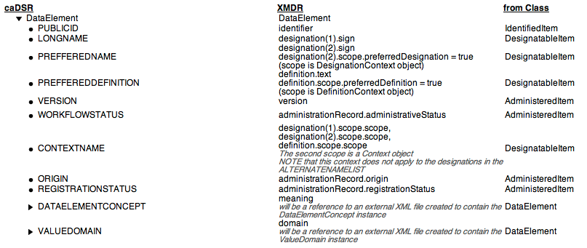
caDSR illustrates mapping of metadata into XMDR prototype
See active outline at http://xmdr.lbl.gov/mappings/cde-xmdr-mapping/
Both it and the above are from earlier mappings, but show how it is done
20
Notes:
KARLO: there is a new one on-line (there will be a newer one by demo); the URL is now http://xmdr.lbl.gov/mappings/cde-xmdr-mapping/ ; there is also a mapping for omega and lexgrid (both need to be updated) accessible from http://xmdr.lbl.gov/mappings/
WILL ADD NEW PICTURE OVER WEEKEND

Slide 14
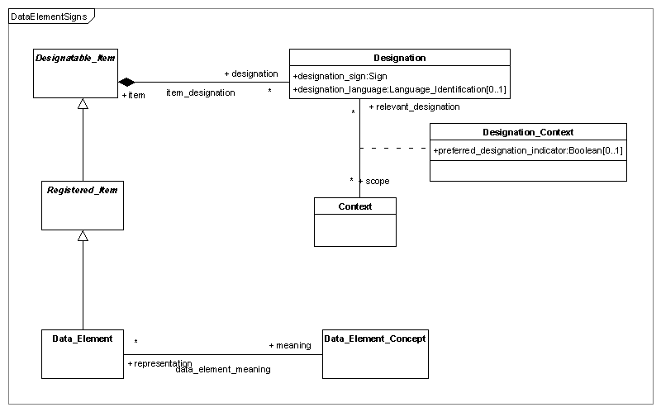
Extract from draft 11179 ed 3 metamodel UML diagram

Slide 15
Omega Ontology illustrates challenges of how to load complex new content
Omega is a “terminological ontology”
reorganization & synthesis of WordNet & Mikrokosmos
adds higher level ontology to organize multiple ontologies
somewhat mysterious files (o4, wnvfrm, d, efrm, pfrm, tfrm)
Initial loading of Omega was as follows:
Entity relationships conform to Concept_System figure
Entity ->Attribute conforms to Classification_Scheme figure
Omega Attributes map to 11179 ed3 Facets
  with two extensions to current draft 11179 ed3 proposal
    Each facet may have a datatype and description
    There may be multiple instances of a facet type
This initial mapping needs further discussion!
21
Notes:
Karlo may want to edit this

Slide 16
*XMDR prototype contains an XML file for each 11179 Identified Item
3 Concept Systems e.g., NBII, NCI Thesaurus (3)
51 Classification Schemes e.g., CDISC Codelists (51)
86 Conceptual Domains e.g., Countries of the World (86)
2,244 Characteristics e.g., Examined, Analyzed (2244)
1,735 Object Classes e.g., Participant, Finding (1735)
4,417 Data Element Concepts e.g., Country Label (4417)
5,987 Data Elements e.g., Country Name (5987)
3,118 Value Domains e.g., countries of the world (3118)
87,907 Concepts e.g., River outflow
96 Relations e.g., broader, Allele_Has_Activity
128,377 Links
0 Organizations e.g., EPA
14 Units of Measure e.g., %, ml/min, seconds
22
Notes:
KARLO SAYS it will take a day to write a script to get the numbers automatically from the prototype
(competing priority with loading data and text search)
We will only put numbers where we have at least one of that type of item
NOTE: our intention is to have at least one example item for each type of Identified Item in the new 11179 metamodel
-- includes classes, associations, and relations

Slide 17
Each 11179 Identified Item in XMDR (e.g., object, concept, data element) is
Logically stored as a separate XMDR file/document
In Subversion code management system
  with files stored in Subversion’s database
  in order to help support versioning and access control
Compliant with three complementary standards:
  XML (document constraints)
  RDF (graph constraints)
  OWL ontology (11179 draft ed3 constraints)
…and will in the future be
Validated against a 11179 XMDR XML Schema
  generated mostly automatically from 11179 UML2 specs
  to automatically enforce XML, RDF, and OWL constraints
24

Slide 18
What happens to xmdr files before they can be used for text searching or inference?
NCI Thesaurus
Concept System A
A Concepts
A Relations
xmdr
files
A Concepts
A Relations
EPA Data Registry
Registry B
B Data Elements
B Relations
& other sources
[all xmdr files]
[each system (A,B,…etc) loaded individually]
Inference queries (Jena)
Lucene
Jena
Text queries (Lucene)
Model A
Model B
XMDR Ontology…etc
Lucene indexes
Union of all models
Search/Query results are sets of tuples with URIs for xmdr files pictured above or substructures within files
23
Notes:
In the future, we may want to invert the vertical ordering of objects in this slide

Slide 19
XMDR XML schema can add several important benefits…
Schema specifies what is required as well as what is legal
Divides metadata into files conforming to XML schema
Normalizes data (ala’ relational “one fact in one place”)
Facilitates XSLT transformations by reducing degrees of freedom to a canonical encoding within the RDF standard
Relax NG can be used to create XMDR prototype schema
RNG validator can enforce many OWL ontology constraints
TRang can automatically translate into XML schema syntax
25
Notes:
KARLO: - none of this actually exists as far as I know; if leave should talk about in abstract

Slide 20
RDF provides complementary benefits on top of XML
All the advantages of XML plus …
RDF provides more explicit semantics than XML
Users can employ a growing set of RDF tools
    e.g., SPARQL query language, SWRL rule language, Jena inference
More powerful retrieval capabilities
  Using many different RDF graph query tools
RDF’s graph data model supports inference
  e.g., inclusion of subsumed sub-classes
Results can be either
  tuples (ala relational tables)
  XML/RDF graphs (being developed for W3C’s SPARQL)
Facilitates integrated use and management of multiple related concepts within different concept systems
26

Slide 21
OWL ontology specification adds richer semantics atop RDF & XML
All the advantages of XML & RDF plus…
RNG validator enforces many OWL ontology constraints
Classes and subclasses (is-a relationships)
Union classes
Inverses
Same-as, same-property-as, same-class-as
Restriction classes (restrict range, cardinality, etc. of property based on type of subject)
…and tools for creation, editing, visualization, and management (Protégé & plug-ins)
27

Slide 22
*XMDR Prototype example: dual purpose rdf/xml file (extract) for one GEMET term
<Reference_Concept xmlns:rdf="http://www.w3.org/1999/02/22-rdf-syntax-ns#"
xmlns="http://hpcrd.lbl.gov/SDM/XMDR/ont/iso11179-3e3draft_r1_7.owl#"
xml:base="http://xmdr.lbl.gov/xmdr2/data/OMEGA-4/R-C/50010/1451.xml"
rdf:about="">
<Identified_Item.data_identifier rdf:datatype="http://www.w3.org/2001/XMLSchema#string">OMEGA-4/R-C/50010/1451.xml</Identified_Item.data_identifier>
<Identified_Item.version rdf:datatype="http://www.w3.org/2001/XMLSchema#string">4</Identified_Item.version>
<Identified_Item.identification_source rdf:resource="http://xmdr.lbl.gov/xmdr2/data/OMEGA-4/N/5001.xml"/>
<Designatable_Item.designation rdf:parseType="Resource">
<Designation.sign rdf:datatype="http://www.w3.org/2001/XMLSchema#string">table tennis</Designation.sign>
<Designation.designation_context_relevant_designation rdf:parseType="Resource">
<Designation_Context.scope rdf:resource="http://xmdr.lbl.gov/xmdr2/data/OMEGA-4/C-1.xml"/>
</Designation.designation_context_relevant_designation>
</Designatable_Item.designation>
<Concept.container rdf:resource="http://xmdr.lbl.gov/xmdr2/data/OMEGA-4/CS.xml"/>
</Reference_Concept>
Karlo show new version
Annotate parts that
illustrate RDF & OWL
28
Notes:
HIDE for Huntsville; Karlo hopes to have replacement ready by Ecoterm the next week
KARLO suggests we try showing more compact representation of triples (using N3 or similar tool)
Perhaps in addition to the full blown XMDR RDF/XML format such as above
Concept is shorthand in xmdr name
Property is RDF type subject
Subject property object
Xml serialization
Class name for tag is shorthand for property

Slide 23
*XMDR RDF graph query facilities complement text query capabilities
Underlying SPARQL has SQL-like structured queries
  e.g., SELECT ?x WHERE (?x rdf:type xmdr:Concept_System)
Can span items that are only indirectly connected
  e.g., data elements associated with a conceptual domain
  inferred inverses (e.g., xmdr:Relation.member/xmdr:Link.relation)
Some depend on relations in concept system
Expand queries to subsumed classes in hierarchy
  e.g., all cities within state and states within countries
Transitivity
  e.g., all subclasses subsumed by a higher order class
  e.g., all superclasses (ancestors) of a particular class
Others depend on SPARQL capabilities
Least common ancestor (minimal generalization)
  e.g., closest subsuming concept for 2 concepts
Siblings
  e.g., other airport codes comparable to “SFO”
29
Notes:
KARLO: not sure if it can do all of that (maybe we should mention SPARQL instead) -- this is something Frank would probably know better

Slide 24
Reasoners use OWL ontologies to augment RDF graph queries
RDF Query
(rdql/nrdql/SPARQL)
Reasoners
Jena
(knows RDF & OWL)
(main memory)
result set
Includes tuples
with subclasses,
inverses, etc.
Several choices
OWL 11179 Metamodel Ontology
11179 metadata (xml/rdf/owl files)
OWL built-in rules
Jena is
a Java framework for building Semantic Web applications;
a rule-based inference engine;
a programmatic environment for RDF, RDFS & OWL;
open source – originally from HP Labs Semantic Web Programme.
available at http://jena.sourceforge.net/
30
Notes:
KARLO: update URLs (just have one that points to the project page -- http://jena.sourceforge.net/ )

Slide 25
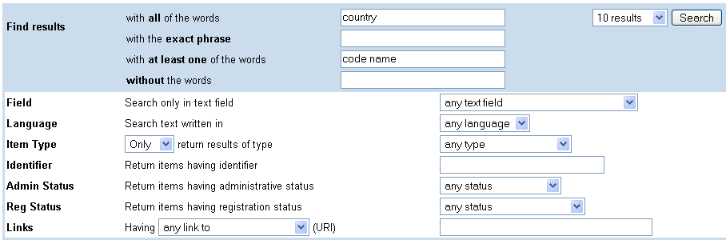
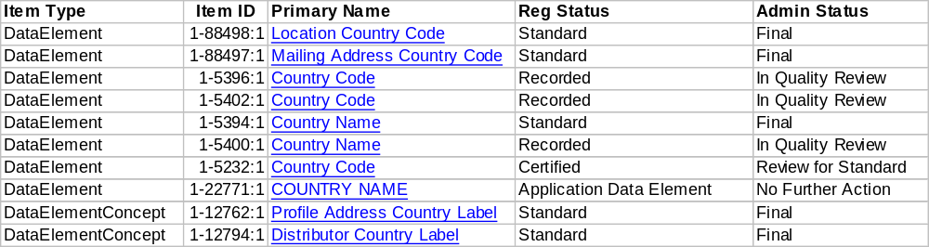
*XMDR Advanced text search interface
(not yet in new version of prototype)
xmdr.lbl.gov/xmdr/
Search for "any:(+country +(code name))"
More Results>>
XMDR Web Interface 0.4, LBNL
31
Notes:
This one is for the old version if you are demoing it.

Slide 26
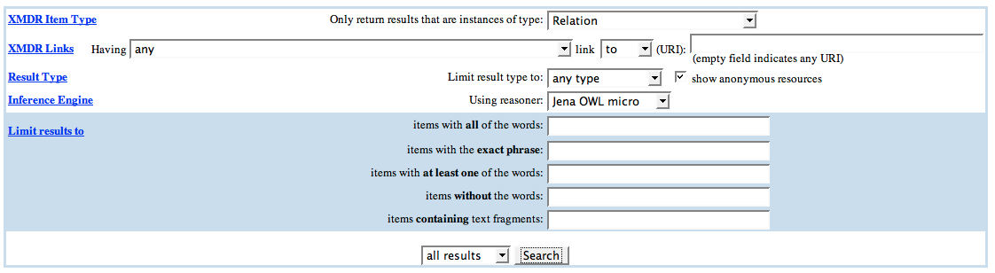
*Web interface for inference queries http://xmdr.lbl.gov/xmdr2/
Reference_Concept
NBII
32
Notes:
KARLO: yes, replace (if showing new version)

Slide 27
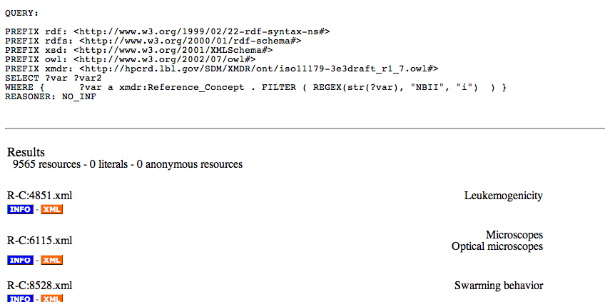
*Inference query results
33
Notes:
XML link shows the XML representation of the data item (shown back in slide 15)
INFO link shows detailed information about the item (including inferred info -- shown on next slide)

Slide 28
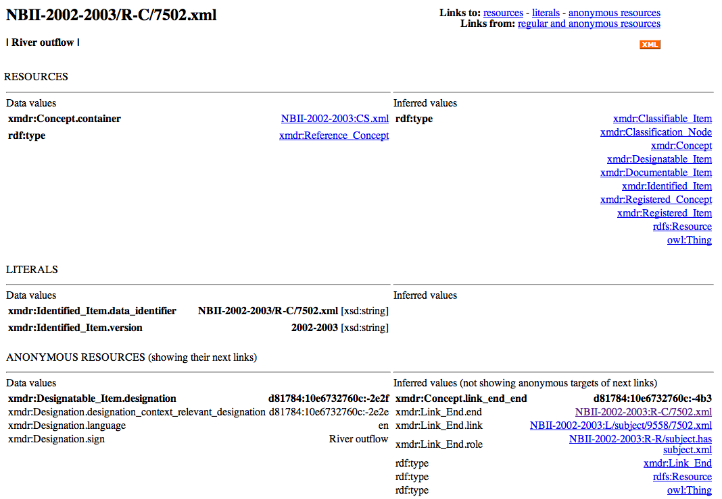
*Info shows details about items (including inferred info)
38
Notes:
KARLO: REPLACE

Slide 29
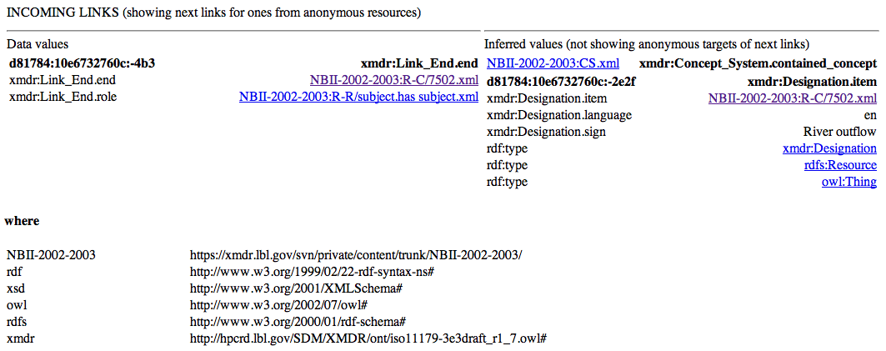
*Info about incoming links as well
34
Notes:
KARLO: yes, replace (if showing new version)

Slide 30
Extract from draft 11179 ed 3 metamodel UML diagram

Slide 31
*Demo & Discuss XMDR
List of 3 Concept_System items now in the prototype:
http://xmdr.lbl.gov/xmdr2/mixed/results.jsp?itemtype=Concept_System&linktype=&linkdirection=to&link=&field=any&anonymous=true&inftype=NO_INF&all=&exact=&any=&not=&frag=&maxresults=0
“River outflow” Reference_Concept from NBII:
  http://erdos.lbl.gov/xmdr/display.jsp?item=https://xmdr.lbl.gov/svn/private/content/trunk/NBII-2002-2003/R-C/7502.xml
“useFor” Relation_Role from NBII:
  http://xmdr.lbl.gov/xmdr2/mixed/display_new.jsp?item=http://xmdr.lbl.gov/xmdr2/data/NBII-2002-2003/R-R/useFor.xml
37
Notes:
KARLO: REPLACE IF SHOWING NEW VERSION

Slide 32
Notable features of XMDR Advanced Inference Search
You don’t have to know SPARQL
  but you can see the generated SPARQL query
  Each search component has pop-up help screen
Choice of reasoners
  None, Jena OWL micro, Jena RDFS default
Can restrict search to target object type
  e.g., concept system, data element, concept, value domain, etc.
Can restrict search by object attributes or links
  e.g., administrativeStatus, designation, etc.
Combines some elements of XMDR text search
  phrases, words (all, at least one, without), strings
Simple output summary & control
  Result count, specify number displayed per screen
  Show results as web addresses, literals, or both
35
Notes:
KARLO has updated object type and attribute names to current specification

Slide 33
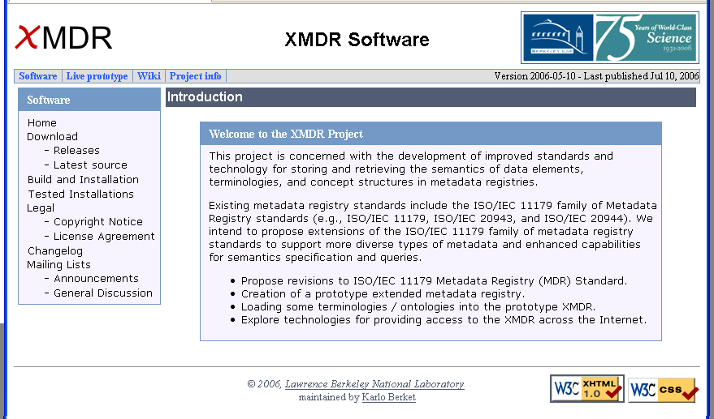
XMDR Prototype Web Site has downloadable code & content
Demo http://xmdr.lbl.gov/software/
40
Notes:
KARLO: MAY NEED NEW SCREENSHOT

Slide 34
Next priorities for XMDR Prototype are currently under discussion
Update XMDR metamodel & data to reflect 11179 revisions
  revised UML model, figures & text submitted to editor Ray Gates
  Karlo revising prototype model & XML schema to reflect revisions
  Prototype experience is helping inform model revisions
  explore more general ways to handle evolving model revisions
    e.g., generate schemas from axiomitized ontologies
Add more metadata
  especially for example 11179 registries, i.e. EPA-EDR, caDSR
  Other content that stretches the current model (e.g., Omega)
Improve tools & procedures for input data mapping/loading
  reduce need for a new script for each new dataset
Extend XMDR System Features
  experiment more with Longwell for faceted metadata
  references to externally maintained independent metadata
  explore possibilities for multiple & distributed registry databases
  selective transitive closure queries for (1) exact match;(2) nodes above or below current node; or(3) within specified number of arcs
  Ontology Lifecycle Management – versions & semantic drift
  Integrate management of semantics, data, and content
41
Notes:
Will improve appearance on XMDR

Slide 35
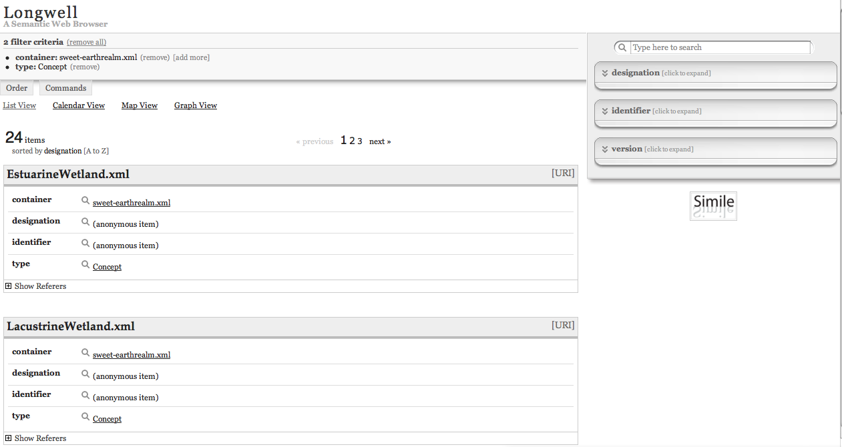
MIT’s Longwell Project may be a good user interface for faceted metadata
39
Notes:
KARLO: nothing new to report here (make note last experimented in July)

Slide 36
Technical Challenges and Issues for XMDR Implementation Testbed
Complexity
  Representation of relations
  XML + RDF + OWL is a lot
  Omega ontology raised a number of issues
  how to provide extensibility for unknown future complexities?
Scalability & performance
  Currently includes [number] objects & [number] RDF triples
  maybe indexing and/or distributed registries will help?
Model Evolution
  may be able to generate directly from UML?
RDF Issues
  RDF queries yield tuples, not RDF objects (W3C addressing this)
  RDF tools won’t create XMDR files (add wrapper constraints?)
External metadata sources, ontologies, terminologies
Harmonize with ODM, MMF, Common Logic, Web Services
45
Notes:
NEED NUMBERS ABOVE

Slide 37
Thanks & Acknowledgements
Bruce Bargmeyer, Principal Investigator
Kevin Keck, Initial Designer & Implementor
Frank Olken, Theory & Model Development
Harold Solbrig, Lexgrid, Model Development, etc!
L8 and SC 32/WG 2 Standards Committees
Major XMDR Project Sponsors and Collaborators
  U.S. Environmental Protection Agency
  Department of Defense
  National Cancer Institute
  U.S. Geological Survey
  And others!

Slide 38
Introduction to the XMDR Project: selected overview documents
www.xmdr.org/
hpcrd.lbl.gov/SDM/XMDR/overview.html (link from xmdr.org)
hpcrd.lbl.gov/SDM/XMDR/presentations/XMDR_Elevator_ Summary_rough_draft.ppt (overview)
xmdr.lbl.gov/xmdr/ (prototype system)
hpcrd.lbl.gov/SDM/XMDR/arch/index.html (architecture)
erdos.lbl.gov/mediawiki/index.php/Main_Page (project wiki)
hpcrd.lbl.gov/SDM/XMDR/presentations/ (esp recent ones)
hpcrd.lbl.gov/SDM/XMDR/presentations/XMDR-Prototype-Status-Oct-2005.ppt (status report)
51

Slide 39
Other Topics? Extra Slides below here
This is the end of the presentation
Slides following this one can be
  folded back into the mainline presentation,
  Held in reserve if questions arise they can help
  Dropped altogether
47

Slide 40
Review: why do we need metadata registries and how are they used?
Design (design time)
  Databases, XML Schemas & related applications
  Data engineering & documentation
  Concepts, Terminologies, Taxonomies, Ontologies
Data Integration & Administration (design + run time)
  Combine information from diverse sources
  Discover hidden relationships between data
  Link concepts and data
Support interactive uses (run time)
  Data entry forms, output explanation
  Data navigation & warehousing, federated queries
Semantic Services & Computing (design + run time)
  MDR metadata interchange & semantic grids
  Ground concepts found in RDF statements & ontologies
3
Notes:
Cait says this is lot of info to put in simple pictures!

Slide 41
Evolution of metadata technology
From unstructured natural language text metadata to structured metadata
  multi-faceted classification schemes
  explicit modeling and characterization of relationships
  graph based metamodels to aid comprehension and searching
  formal ontologies (description logic et al.)
  support for inference
AND from human consumption to machine processing for
  detailed query/search
  inference (e.g., transitive search, subsumption testing, etc.),
  units conversion,
  query processing in federated database systems
Two new key technologies
  Graph databases (e.g., RDF) facilitate visualization & machine processing
  Description logic (e.g., OWL) for more precise semantics & machine reasoning
    which carry out graph searches according to stored formal rules
7

Slide 42
What are major limitations of current registry technology and standards?
Natural language descriptions are too limited
  imprecise and fuzzy, even for human users
  computer software cannot process unambiguously
  does not help identify what is known and not known
  require too much intervention by expensive humans
Weak integration of concepts with data artifacts
  relationships not well-specified
Lack of scalability
  for multiple terminologies & myriad databases
Limited relationships with other standards
  e.g., terminologies, ontologies, OMG, etc.
  formal axioms to specify relationships, etc.
5

Slide 43
What are the primary functional goals of the XMDR Prototype system?
Enhance capabilities to capture and retrieve semantics of information artifacts (e.g., data elements and value domains) in metadata registries using terminologies, taxonomies, ontologies, etc. …
Improve representation of relationships between data (e.g., objects, data elements & domains) and concept structures (ontologies, taxonomies, thesauri, terminologies, …)
Register complex semantic metadata (concept structures, terminologies) in more formal, systematic ways (e.g., description logic) to facilitate machine processing for
  creating and managing names, definitions, terms, etc.
  linking together data elements, etc. across multiple systems
  discovering relationships among data elements & terms
8

Slide 44
Advanced 11179 E3 Use Scenario
A User is concerned about a specific type of cancer
Wants to discover any documents on the web (reliable and unreliable sources) about the disease, causes, treatment, victims, and researchers
Wants to link concepts and individuals found in text to metadata and data in databases (where metadata/data relate to the concepts/individuals)
Wants to find relevant information where the terms used for the concepts vary: by regions, disciplines, scientific nomenclature, vernacular usage, language, and names of individuals.
Want to find information that is related through generalization and specialization and other relationships.
Note: No assumption of federation or central control over data and text generation. However, well managed concept systems and metadata (e.g., data definitions) help.
9

Slide 45
Role of terminologies and ontologies in metadata registries
Sources for concepts, concept definitions, object classes, properties, value meanings, external references
Terminologies as classification schemes (e.g., taxonomies)
Ontologies to specify semantic relationships
  is-a, part-of, instance-of, …
  inheritance permits more compact definitions
  semantic pathways for indexing
  facilitates searching subclasses & inverses
Frameworks for integration of multiple schemas …
Help connect metadata entities via shared terms
  via automatic indexing of metadata words
  via text values from specific metadata elements
14

Slide 46
Tools
User-friendly interface for RDF inference queries
Something like EDR UI with link labels & inverse references
RDF normalizer into XMDR format (to work with RDF tools)
-----------
Form interface for registration & uploading metadata?
Registry access services, query facilities, etc.
Handling multiple registries within single registry server
Extraction, Translation & Loading (ETL) metadata
aggregation operators for derived tables (statistical/OLAP)
XBRL support for tables, etc.
49

Slide 47
XMDR helps manage concepts in conjuntion with data elements
In general, we want to register any concept based graph structure comprised of nodes, relationships, and possibly axioms
  possibly including millions of concepts, millions of terms, and millions of relationships (maybe billions).
We want to link the concepts (e.g., research organization w, person x, disease y, location z) to data and text, even when we may only have a probabilistic notion of w, x, y, and z.
50

Slide 48
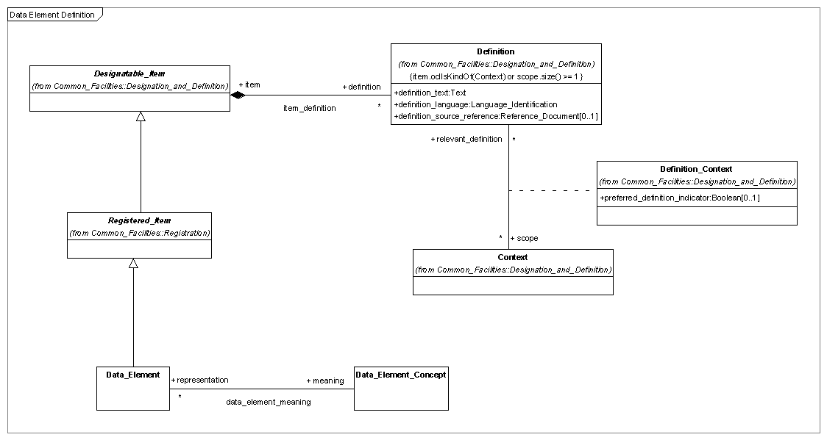
Definition

Slide 49
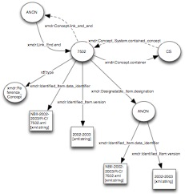
RDF Example

