Slide 1
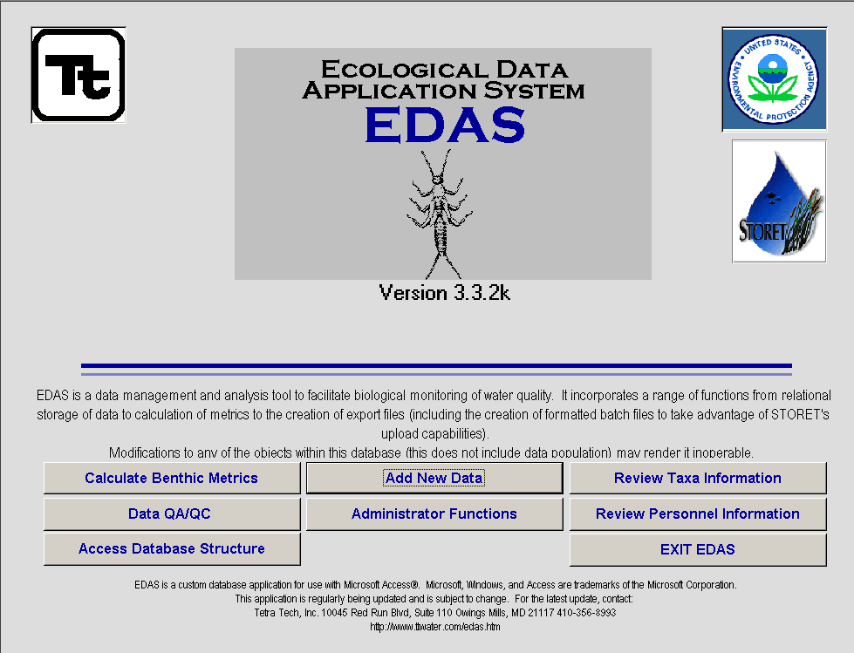
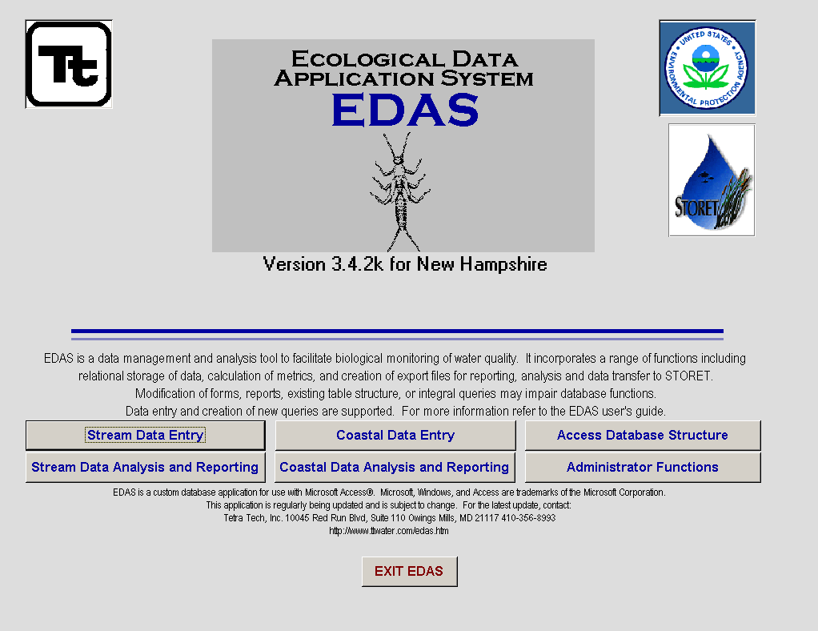

Slide 2

The Ecological Data Application System (EDAS) for biological data analysis and data upload to
STORET
Jeffrey S. White
Erik W. Leppo
Tetra Tech, Inc.
Ecological Sciences
IT services
Tetra Tech, Inc.

Slide 3
What is EDAS
EDAS is an data management and analysis tool to facilitate the biological monitoring and assessment of water quality data.

Slide 4
EDAS Features:
Relational database
Data entry forms
Data import capabilities
Metric calculations
Reporting capabilities
Data export capabilities

Slide 5
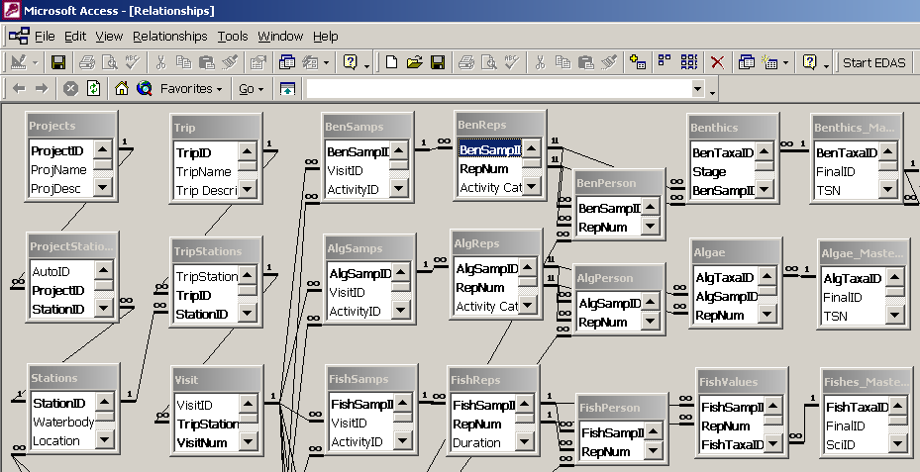
EDAS is a Relational Database

Slide 6
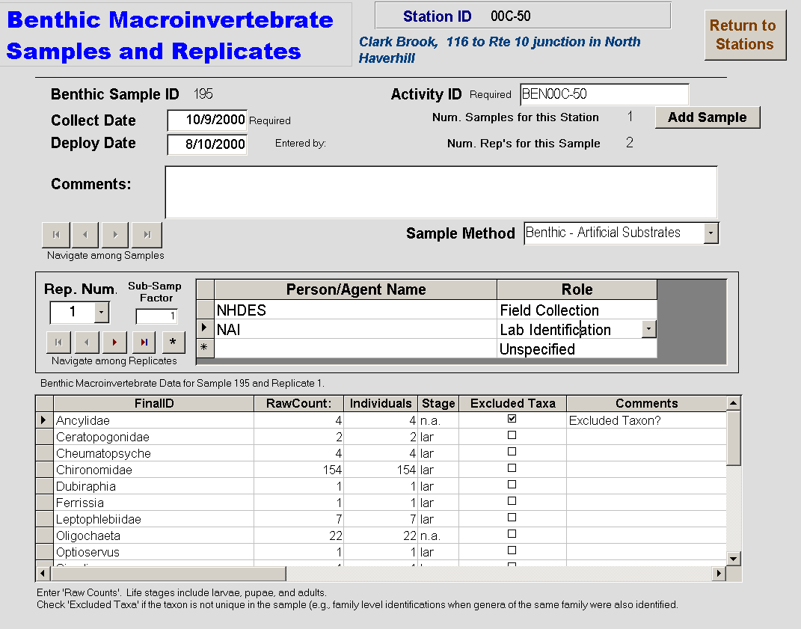
Data Entry

Slide 7
Ecological Data Types
Metadata for Programs, Projects, Station, Samples, Replicates, Personnel, and Methods
Taxonomic census data for Benthic Macroinvertebrates, Fish, and Periphyton
Water Quality
Habitat Assessments
Physical Characteristics
  Pebble Counts
  Cross-sections

Slide 8
EDAS analytical features
Analytical Capability Enhancements
A hands-on approach to index development.
  Selection menu for a full range of metrics.
  Selection of candidate metrics with export options.
  Ability to maintain and update constants based on standard best values.
  Ability to collapse taxa samples.

Slide 9
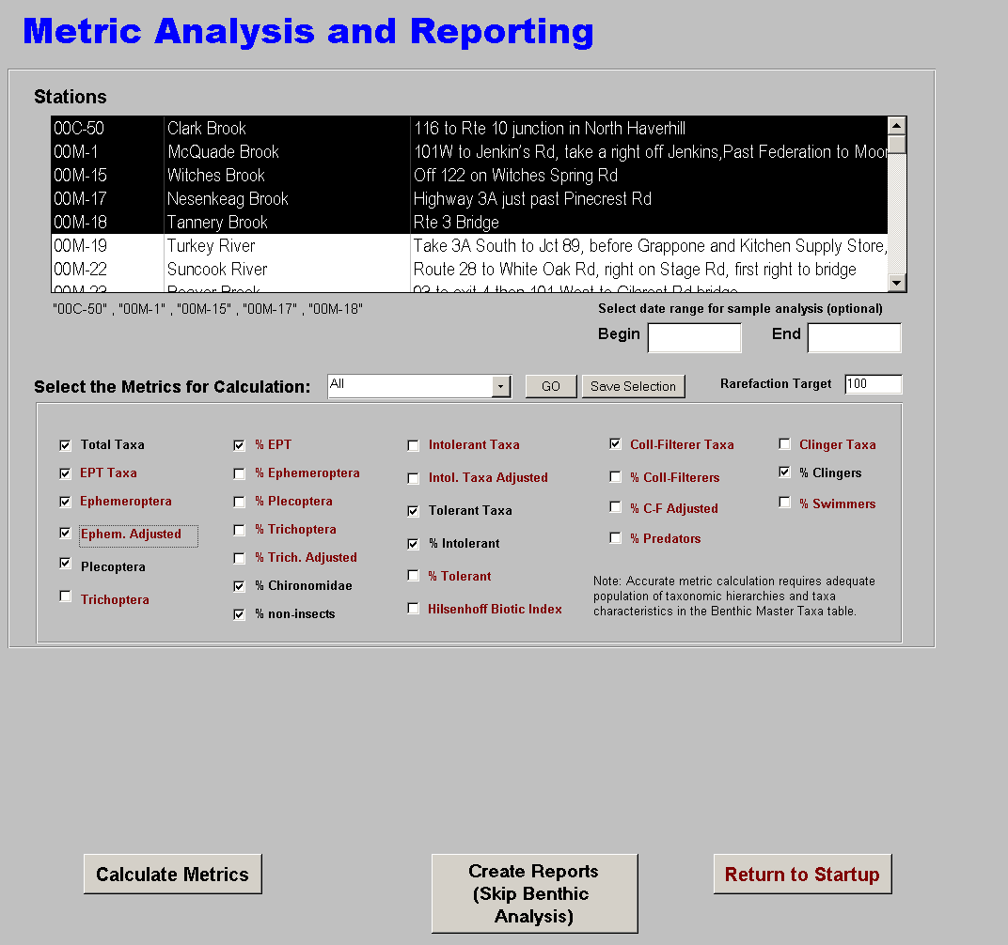
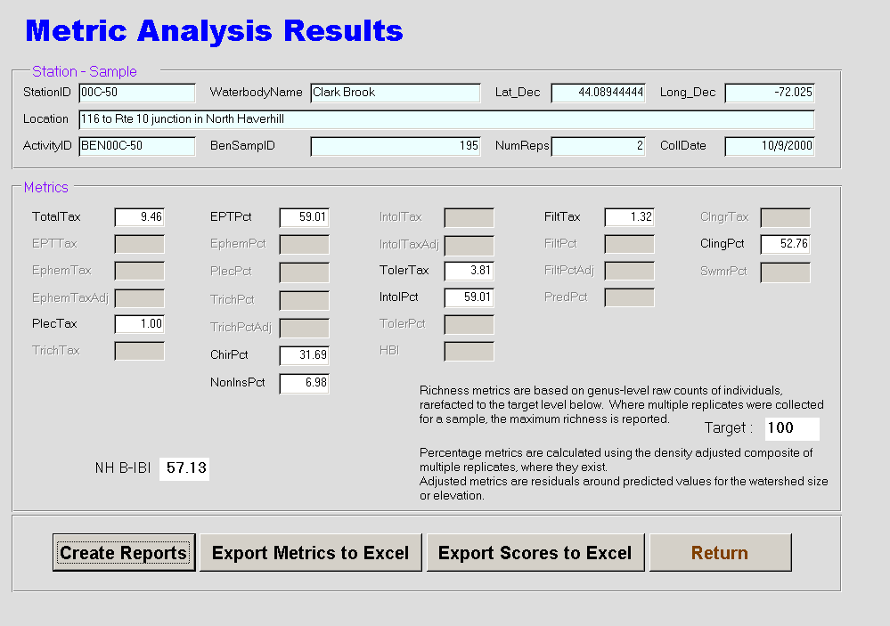
Metric Calculations

Slide 10
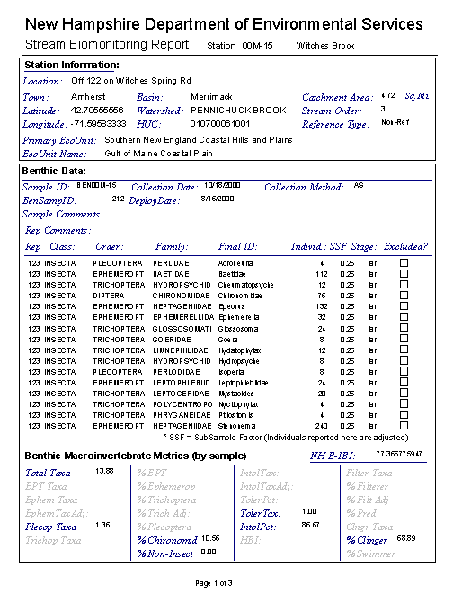
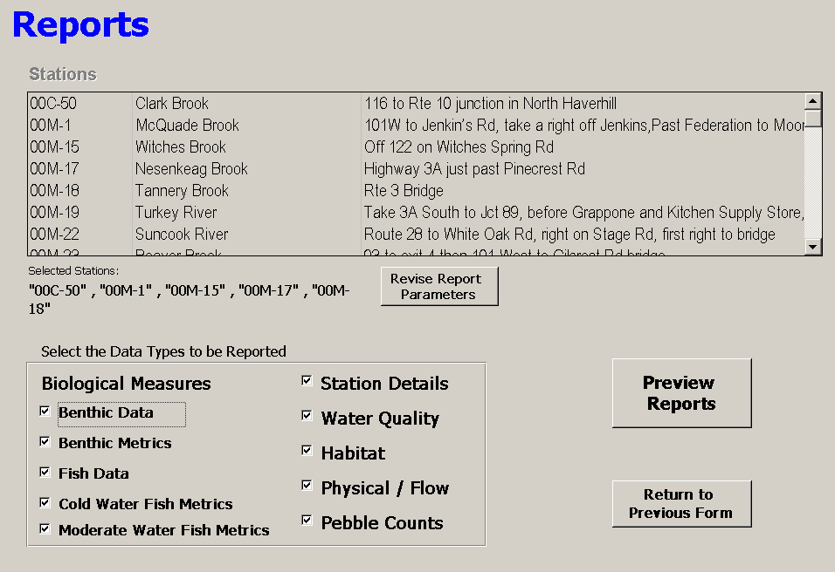
Reporting Back

Slide 11
EDAS and STORET
EDAS incorporates STORET conventions and codes for sample types, methods, etc.
Data can be prepared in EDAS, exported as a text file and imported to STORET using SIM.
EDAS currently supports data transfer for stations, benthic macroinvertebrates, and water quality data.

Slide 12
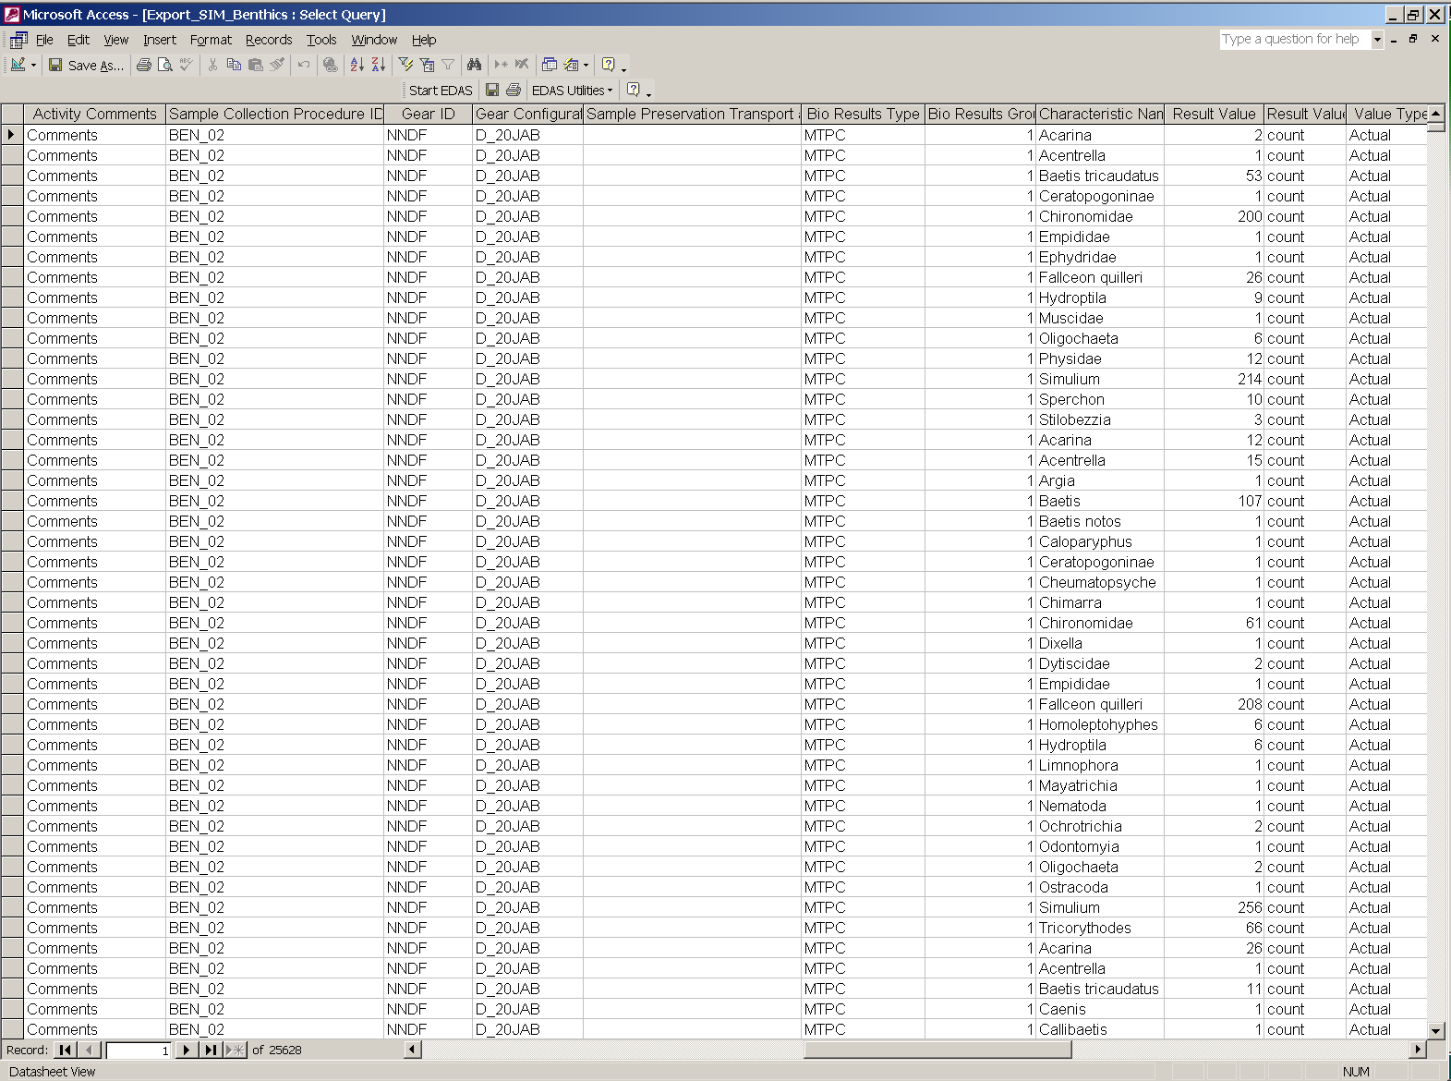
Export for SIM

Slide 13
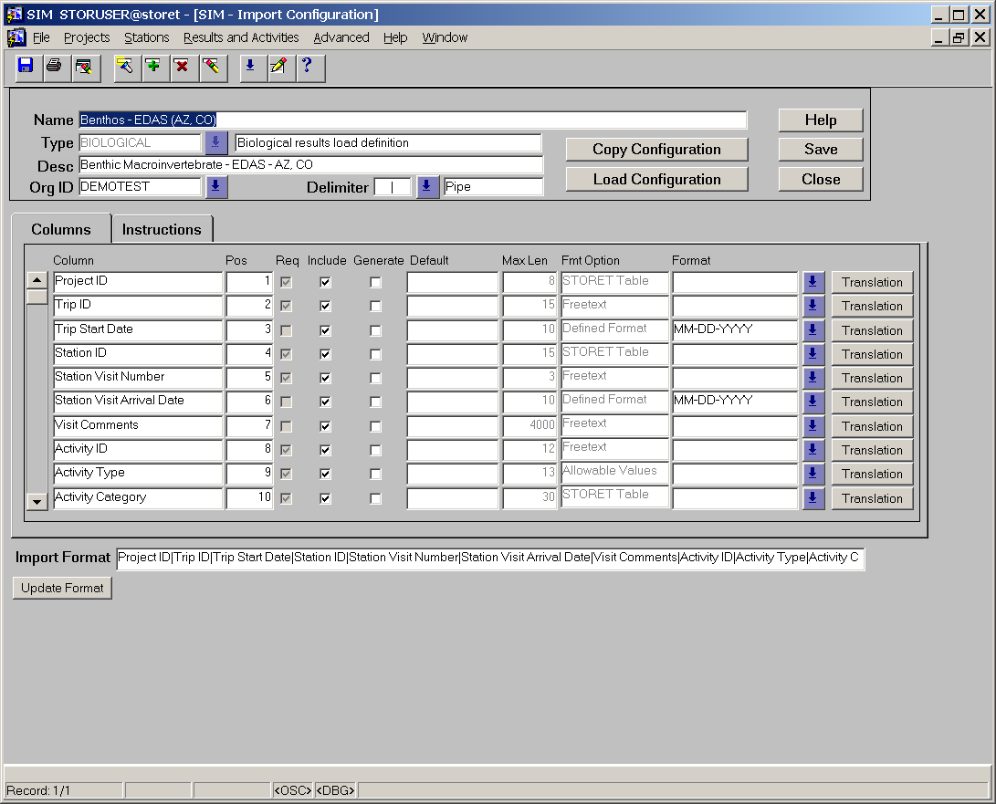
SIM Profile

Slide 14
EDAS SIM compatible file export
Actual Demonstration

Slide 15
EDAS future features
ODBC
  EDAS (Access) ODBC connection to a local instance of STORET.
An Oracle version of EDAS
  EDAS as a user / schema within STORET.
  A database link to STORET.
  A web-enabled version of EDAS.

Slide 16
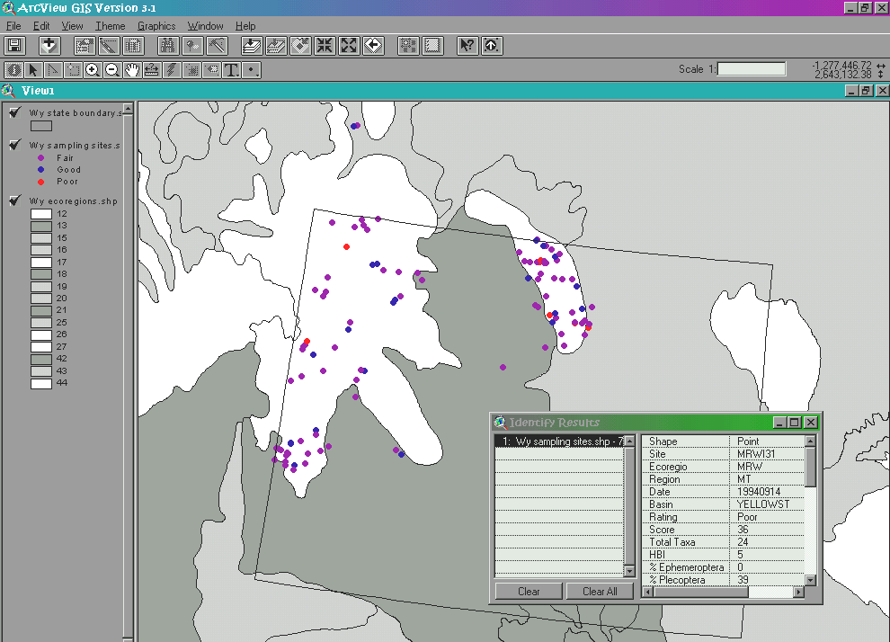
Interactive Maps
Displaying your EDAS data with GIS

Slide 17
End

