Slide 1
SNS Application Development Environment
CVS
Tom Nepsee
March 17, 2003

Slide 2
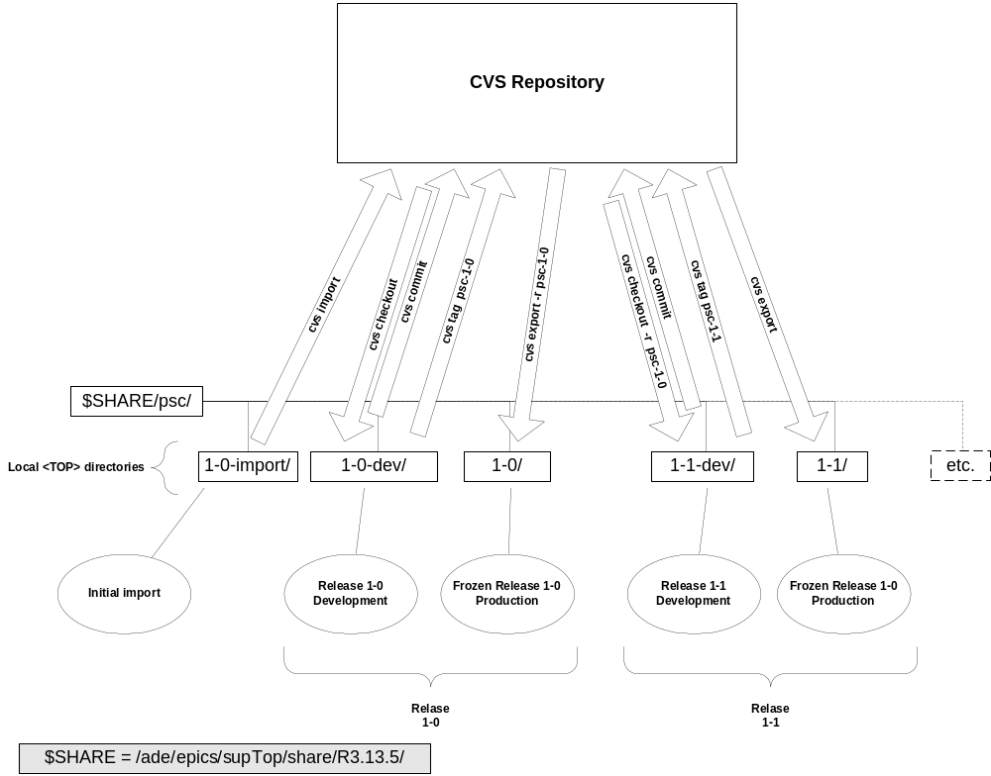
SNS ADE
CVS Release Cycle

Slide 3
Power Supply Controls
Configuration Data Flow
One IOC
Relational DB
Client App
CONFIG
FILE
QUERY
IOC DB
Flat File in ASCII Encoded
CSV Format
Extracts data for each PS

Slide 4
Power Supply Controls
Database Tables
IOC/PSC/PSI
  List of power supply names with IOCs
PS Model Data
  Operating parameters for each PS type
IOC Locations
  Location
Controls Cabinets
  Location and power requirements
IOC Records
  Describes EPICS records used by IOC

Slide 5
Power Supply Controls
Database Query
Query Selects Configuration Parameters for a specific IOC
SELECT
[PS to IOC Map].[PS Name], [PS to IOCMap].[PSC Number],
[PS to IOC Map].[PSI Number], [PS Models].[Max Current],
[PS Models].[Max Voltage], [PS Models].[Polarity]
FROM
[PS Models] INNER JOIN ([PS to IOC Map] INNER JOIN [PS ID]
ON[PS to IOC Map].[PS Name]=[PS ID].[PS Name])
ON [PS Models].[Model]=[PS ID].[Model]
WHERE ((([PS to IOC Map]![IOC Name])="ICS_Ctl:IOC_7"));

Slide 6
Power Supply Controls
Config File Format
PS
Name
PSC Number
PSC
Channel
Max
Current
Max
Voltage
Polarity
Mode
Ring_PS:DCVB7,0,0,20.00,35.00,Bipolar
Ring_PS:DCVB9,0,1,20.00,35.00,Bipolar
Ring_PS:DCVC1,0,2,20.00,35.00,Bipolar
Ring_PS:DCVC10,0,3,20.00,35.00,Bipolar
Ring_PS:DCVC13,0,4,20.00,35.00,Bipolar
Ring_PS:DCVC3,0,5,20.00,35.00,Bipolar
Ring_PS:DCVC5,1,0,20.00,35.00,Bipolar
Ring_PS:DCVC7,1,1,20.00,35.00,Bipolar
Ring_PS:DCVC9,1,2,20.00,35.00,Bipolar
Ring_PS:DCVD1,1,3,20.00,35.00,Bipolar
Ring_PS:DCVD10,1,4,20.00,35.00,Bipolar

Slide 7
Summary
An automated method is used for building power supply IOC software with information from a relational database.

