Slide 1


High Energy Physics:
What do we want from the TeraGrid?
Jennifer Schopf
Argonne National Laboratory
jms@mcs.anl.gov
www.griphyn.org www.ivdgl.org
GriPhyN and iVDGL are supported by the National Science Foundation
(with matching funds from member institutions)
Notes:
Will show many slides quickly – some to give you a chance to refer back to them.

Slide 2
HEP today:
US-CMS testbed
Wisconsin
Fermilab
Caltech
UCSD
Florida

Slide 3
Overview
Quick overview of HEP grids
Thoughts on what we need
  What capabilities and services do we need to use the TeraGrid?
  How can we move from our experiment testbeds to including the TeraGrid?
Thoughts on what we can give you

Slide 4
High Energy Physics and Grids
GriPhyN
  CS research focusing on virtual data, request planning
Virtual Data Toolkit
  Delivery vehicle for GriPhyN research results
  Built on top of NMI core
iVDGL
  Laboratory for large-scale deployment and validation
Grid Laboratory Uniform Environment
  Link from VDT-based grids to EDG-based grids
Particle Physics Data Grid
  Grid-enable six HENP experiments

Slide 5
GriPhyN Approach
Virtual Data
  Tracking the derivation of experiment data with high fidelity
  Transparency with respect to location
  and materialization
Automated grid request planning
  Advanced, policy driven scheduling
Funded by NSF (2000-2005)
  $11.9M (NSF) + $1.6M (matching)
  40+instiutions, 2/3 CS and 1/3 Physics
Applying CS research to ATLAS, CMS, LIGO, SDSS
Outreach – planting seeds
Notes:
Virtual data started with cache-like semantics, transparency wrt location
These ideas led to transparency wrt materialization driven by desire to explore performance benfits of this degree of freedom
We quickly realized that many other benofits derived from this approach:

Slide 6
Overview of Project
GriPhyN basics
  $11.9M (NSF) + $1.6M (matching)
  5 Year effort, started October 2000
  4 frontier physics experiments:
  ATLAS, CMS, LIGO, SDSS
  Over 40 active participants
GriPhyN funded primarily as an IT research project
  2/3 CS + 1/3 physics

Slide 7
GriPhyN Institutions
  U Florida
  U Chicago
  Boston U
  Caltech
  U Wisconsin, Madison
  USC/ISI
  Harvard
  Indiana
  Johns Hopkins
  Northwestern
  U Texas, Brownsville
  U Wisconsin, Milwaukee
  UC Berkeley
  UC San Diego
  San Diego Supercomputer Center
  Lawrence Berkeley Lab
  Argonne
  Fermilab
  Brookhaven

Slide 8
Virtual Data
Track all data assets
Accurately record how they were derived
Encapsulate the transformations that produce new data objects
Interact with the grid in terms of requests for data derivations
Goal for this year:
  Local Virtual Data Catalog Structures (relational)
  Catalog manipulation language (VDL)
  Linkage to application metadata

Slide 9
Virtual Data Research Timetable
Year 2:
  Local Virtual Data Catalog Structures (relational)
  Catalog manipulation language (VDL)
  Linkage to application metadata
Year 3: Handling multi-modal virtual data
  Distributed virtual data catalogs (based on RLS)
  Advanced transformation signatures
  Flat, objects, OODBs, relational
  Cross-modal depdendency tracking
Year 4: Knowledge representation
  Ontologies; data generation paradigms
  Fuzzy dependencies and data equivalence
Year 5: Enhance Scalability and Manageability

Slide 10
Planner Decision Making
policy
Status
planner
Job Profile
Predictions
Records
Accounting
Job Usage
Records
info
Job Profiling
Data
Planner considers:
  Grid resource status: state, load
  Job (user/group) resource consumption history
  Job profiles (resources over time) and prediction information

Slide 11
Virtual Data Toolkit (VDT)
Set of software to support the research and experiments in GriPhyN
Fundamental grid software
  Condor, GDMP, Globus
  Future releases based on NMI
  Easy packaging and configuration scripts
Virtual Data Software
  Currently under development
Version 1.1 available now
  Globus 2.0 beta, GDMP 3.0, Condor 6.3.1, Condor-G 6.3.2, ClassAds 0.9.2

Slide 12
VDT Timeline
VDT 1.2 Late-April 2002
  Replace Globus 2 beta with Globus 2.0 final
  May include tools for installing Certificate Authority signing policies.
VDT 1.3 Mid-May 2002
  Use NSF Middleware Initiative software release (including Globus 2.0 final)
  New tools for simplifying configuration
VDT 2.0 Summer 2002
  Early releases of virtual data tools (Virtual Data System and Virtual Data Language)
VDT 3.0 2003
  Globus 3.0, Condor 6.x, GDMP X, VDL X...

Slide 13
iVDGL: A Global Grid Laboratory
“We propose to create, operate and evaluate, over a
sustained period of time, an international research
laboratory for data-intensive science.”
From NSF proposal, 2001
International Virtual-Data Grid Laboratory
  A global Grid laboratory (US, Europe, Asia, South America, …)
  A place to conduct Data Grid tests “at scale”
  A mechanism to create common Grid infrastructure
  A laboratory for other disciplines to perform Data Grid tests
  A focus of outreach efforts to small institutions
U.S. part funded by NSF (2001-2006)
  $13.7M (NSF) + $2M (matching), 17+ US sites

Slide 14
iVDGL Components
Computing resources
  2 Tier1 laboratory sites (funded elsewhere)
  7 Tier2 university sites ⇒ software integration
  3 Tier3 university sites ⇒ outreach effort
Networks
  USA (TeraGrid, Internet2, ESNET), Europe (Géant, …)
  Transatlantic (DataTAG), Transpacific, AMPATH?, …
Grid Operations Center (GOC)
  Joint work with TeraGrid on GOC development
Computer Science support teams
  Support, test, upgrade GriPhyN Virtual Data Toolkit
Education and Outreach
Coordination, management

Slide 15
iVDGL Components (cont.)
High level of coordination with DataTAG
  Transatlantic research network (2.5 Gb/s) connecting EU & US
Current partners
  TeraGrid, EU DataGrid, EU projects, Japan, Australia
Experiments/labs requesting participation
  ALICE, CMS-HI, D0, BaBar, BTEV, PDC (Sweden)

Slide 16
Initial US iVDGL Participants
  U Florida CMS
  Caltech CMS, LIGO
  UC San Diego CMS, CS
  Indiana U ATLAS, GOC
  Boston U ATLAS
  U Wisconsin, Milwaukee LIGO
  Penn State LIGO
  Johns Hopkins SDSS, NVO
  U Chicago/Argonne CS
  U Southern California CS
  U Wisconsin, Madison CS
  Salish Kootenai Outreach, LIGO
  Hampton U Outreach, ATLAS
  U Texas, Brownsville Outreach, LIGO
  Fermilab CMS, SDSS, NVO
  Brookhaven ATLAS
  Argonne Lab ATLAS, CS
Tier2 / Software
CS support
Tier3 / Outreach
Tier1 / Labs
(funded elsewhere)

Slide 17
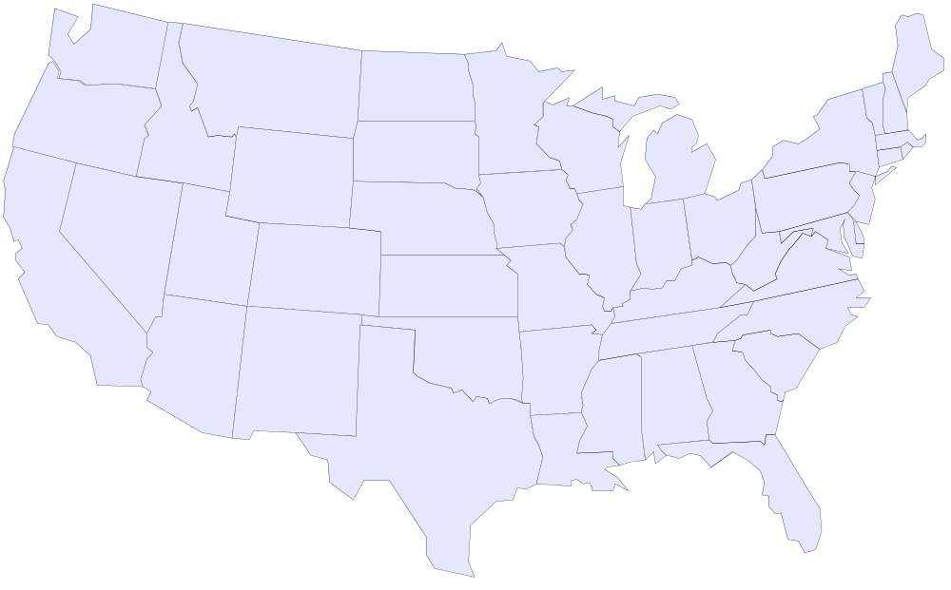
Initial US-iVDGL Data Grid
SKC
BU
Wisconsin
PSU
BNL
Fermilab
Indiana
JHU
Hampton
Caltech
UCSD
Florida
Brownsville
Tier1
Other sites to be added in 2002
Proto-Tier2
Tier3 university

Slide 18
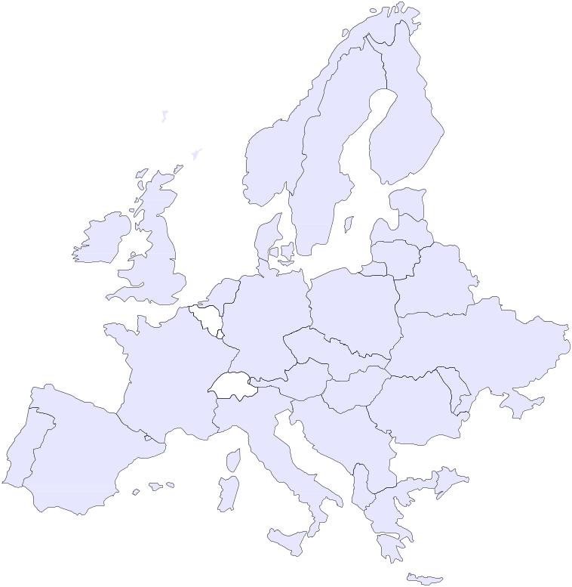
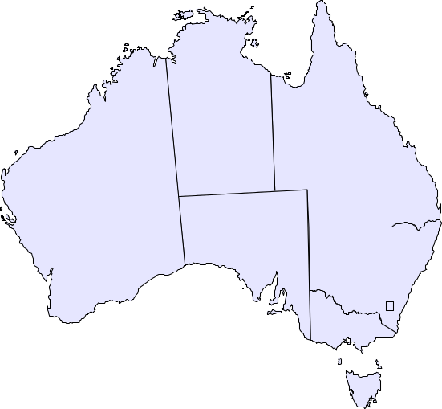
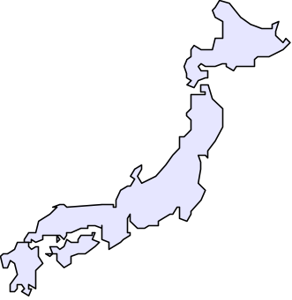
iVDGL Map (2002-2003)
Surfnet
DataTAG
Later
Brazil
Chile?
Pakistan
Russia
China
Tier0/1 facility
Tier2 facility
Tier3 facility
10 Gbps link
2.5 Gbps link
622 Mbps link
Other link

Slide 19
GLUE
Grid Laboratory Uniform Env’t
Interoperability between US physics grid projects(iVDGL, GriPhyN, PPDG) and EU physics grid projects (EDG, DataTAG, etc.)
Phase 1:
  Authentication infrastructure (GSI, CA’s, RA’s)
  Information infrastructure (MDS, Schema)
Phase 2:
  Data movement infrastructure (GridFTP, GDMP)
  Community Authorization Services
Phase 3:
  Computational service infrastructure (job management, logging, accounting)

Slide 20
How can we move to including the TeraGrid?
Connect HEP community to PACI resources and infrastructure – many good reasons to do this
  HEP collaborations link ~100 university groups with DOE laboratories
  Good step towards building national cyberinfrastructure
TeraGrid could give us Tier-1 capacity in 2003, not 2007 (as currently planned)
  Explore Tier 1-Tier 2 connectivity
  Validate LHC computing model (distributed, hierarchical data centers)
  Early look at user access and analysis patterns, data movement, workload
  Support large scale Monte Carlo simulations (Data Challenges)

Slide 21
What capabilities and services do we need to use the TeraGrid?
Interoperability
  authentication, information infrastructure, data and job management
HEP use case categories:
  “Production”: large scale Monte Carlo simulations
  “Analysis”: iterative processing of disk-resident collections
What are you thinking about in terms of policy issues
  Guarantees? Dedicated time?

Slide 22
Thoughts on what we can give you
Monitoring services used with our testbeds
A Scheduler/Planner
Infrastructure thoughts on international issues like authorization, interoperability
Software and environment packaging tools (such as PACMAN) may facilitate easy, clean use of the TeraGrid
Thousands of hungry users!

Slide 23
Contacts
GriPhyN
  http://www.griphyn.org
Virtual Data Toolkit
  http://www.lsc-group.phys.uwm.edu/vdt/
iVDGL
  http://www.ivdgl.org
GLUE
  http://www.hicb.org/glue/glue.htm

