Slide 1
eGovernment Working Group Meeting
Chris Niedermayer, USDA eGovernment Executive

Slide 2
Agenda
Welcome
Guest Speaker: NASS Electronic Data Reporting
EITIRB Update
HR Online/Enterprise HR Update
GPEA Update
General Discussion/Q&A
Next Steps and Wrap-up
Notes:
High energy Welcome.
Get jazzed.
Good things are happening:
EITIRB meeting tomorrow for 30 minutes exclusively on eGov
EC and I will be meeting with DS ideally this week as well but may slip to next week
Relatively positive feedback from OMB based on our efforts – only Yellow
Thanks for efforts to date. Time to roll up sleeves again.

Slide 3
EGWG Briefing Topics
Past Briefings:
  Universal Telecommunications Network (UTN) — February 13
  Export.gov (Presidential Initiative) — February 20
  eEligibility (Presidential Initiative) — February 27
  Geospatial One Stop (Presidential Initiative) — March 13
  Integrated Acquisition System (eProcurement) — March 13
  Capital Planning and Investments (CPIC) — March 27
  eTraining (Presidential Initiative) — April 9
  eLoans (Presidential Initiative) — April 24
  Smart Choice Candidate Business Cases — May 8 – June 19
  Service Center eForms Demo — July 10
  USA Services (Presidential Initiative) and GPEA/Paperwork Reduction Act — July 19
  GovBenefits.gov Update/Demo and Lessons Learned — August 21
Today’s Briefing:
  NASS Electronic Data Reporting
Planned Briefings:
  Additional USDA-related Presidential Initiatives
  Cyber Security
  Enterprise Architecture

Slide 4
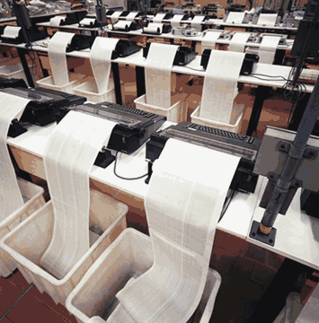

Guest Speaker
Question Repository System
Meeting GPEA:
Getting Your Documents on the Web the Easy Way

Slide 5
What’s The Story?
NASS conducts surveys
Compile statistical reports based on survey results
Hundreds of base survey instruments
Multiple variations of single base instrument
Each instrument is a paper document

Slide 6
What’s The Story?
GPEA requires our instruments be available via the web
Currently manage 400+ Word Perfect Documents
Changes handled by complex WP macro library
Hard to work with, not complete, scattered
Macro author long gone

Slide 7
Requirements
Word processing interface
Easy to use/reuse objects
End result must run on LCD client
Relational data base functionality
Ability to collect data via web
Instruments must be easy to build, modify
Lots of value (cheap)

Slide 8
The Solution
Not a technical problem
Welded a word processor and a relational database (Word, Sybase)
A little box of magic in between
So flexible, front end and/or backend can be replaced with out major effort

Slide 9
How It Works
Documents created in MS Word
Word Document is saved to the repository along with appropriate metadata
Producer logs into USDA web page
Web server ‘knows’ where to look for survey documents
Serves up web document directly from database repository

Slide 10
How It Works
Producer answers questions
Server collects data and results are stored in Repository
Data readily available to be processed, sent other places
All in a nice, neat, simple client package that you already know how to use

Slide 11
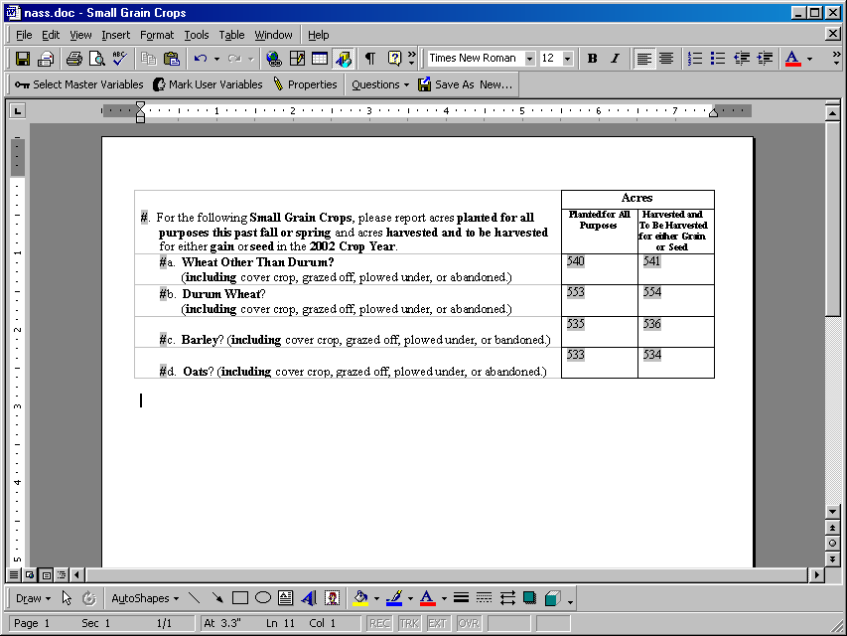
Sample Question and Meta Data

Slide 12
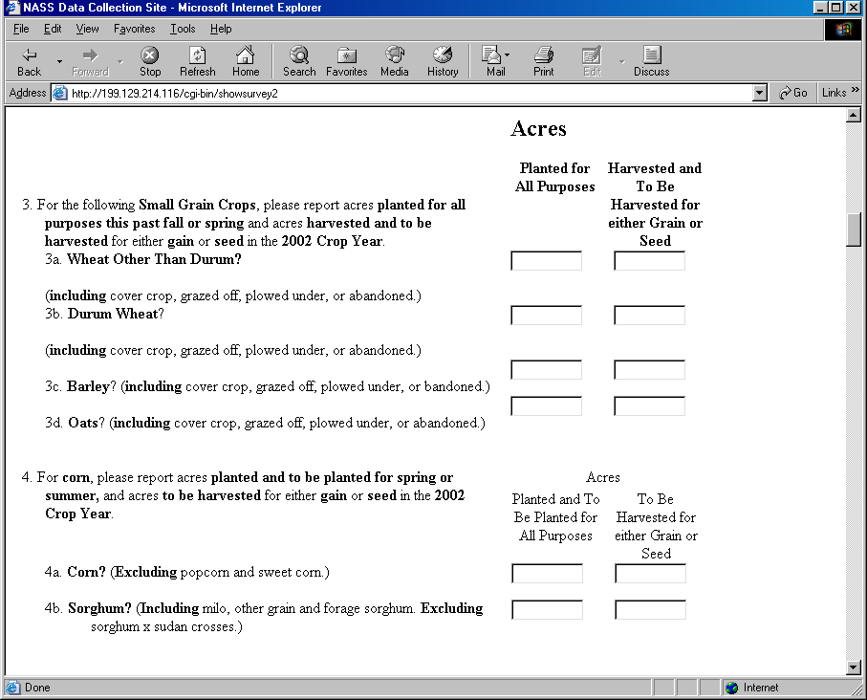
How It’s Rendered on the Web

Slide 13
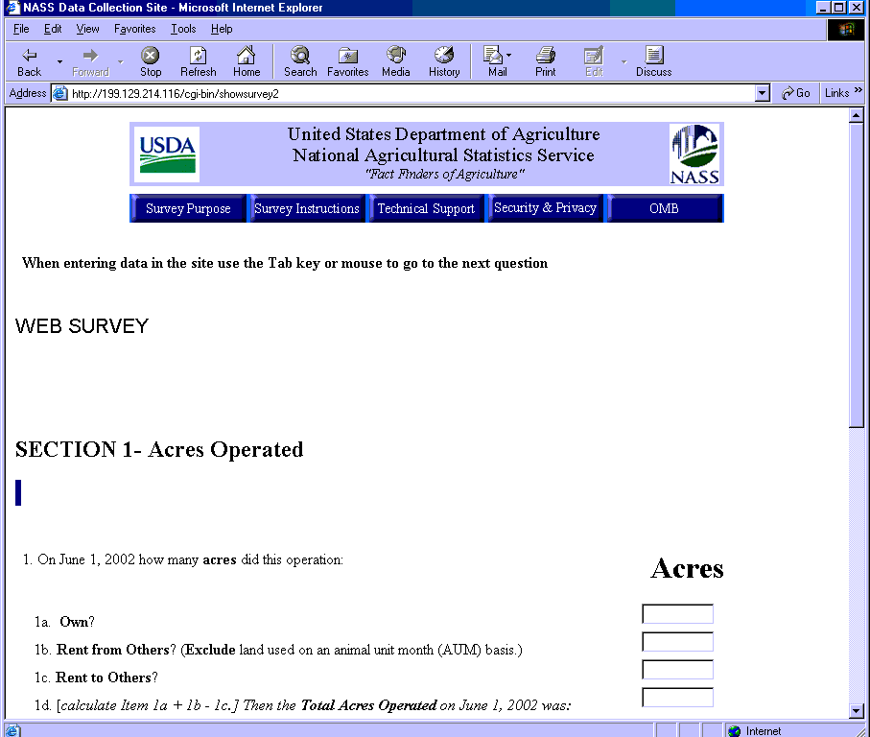
Example of Web Survey

Slide 14
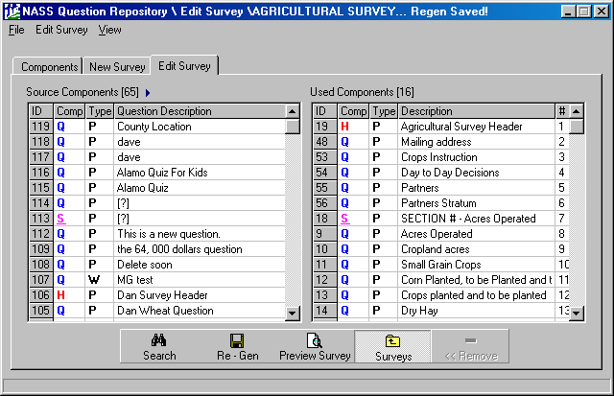
QRS New Survey

Slide 15
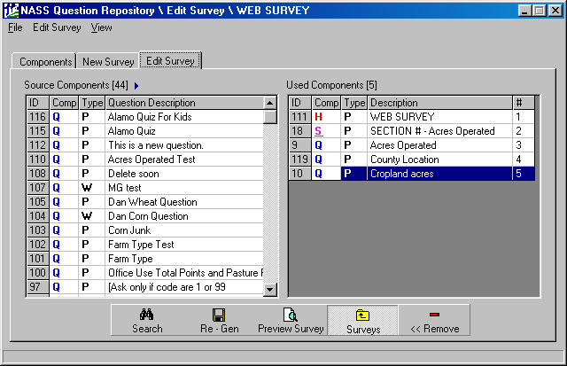
Building a Web Survey

Slide 16
What’s Next?
On-line, context-sensitive help
Additional data collection functionality
Advanced web rendering features
Interface to WebCAAF (Service Center Authentication)
Section 508 Compliance Validation

Slide 17
What’s In It For You
Easy way to deploy documents to the web little/no extra work – cut/paste!
Ability to collect data from web form if necessary
Store native document, RTF, HTML, XML, PDF, image….

Slide 18
What’s In It For You
Don’t like Word? Use Word Perfect, FrontPage, Open Office
Don’t like HTML? Fine! Use XML, PDF
Don’t like Sybase – great! Use Oracle, SQL Server, any modern relational database

Slide 19
Bottom Line
You have the opportunity to deploy all your documents to the web in an easy, simple to use tool, that your staff already knows how to use
The resulting documents can be rendered over the simplest client configurations
Prototype completed in 8 weeks

Slide 20
Questions
Contact Information:
Bob Hocutt
Office of the Administrator
Director of eGovernment Programs
USDA/NASS
202-690-2990
bob_hocutt@nass.usda.gov

Slide 21
Agenda
Welcome
Guest Speaker: NASS Electronic Data Reporting
EITIRB Update
HR Online/Enterprise HR Update
GPEA Update
General Discussion/Q&A
Next Steps and Wrap-up
Notes:
High energy Welcome.
Get jazzed.
Good things are happening:
EITIRB meeting tomorrow for 30 minutes exclusively on eGov
EC and I will be meeting with DS ideally this week as well but may slip to next week
Relatively positive feedback from OMB based on our efforts – only Yellow
Thanks for efforts to date. Time to roll up sleeves again.

Slide 22
EITIRB Update
The Executive Information Technology Investment Review Board (EITIRB) met on August 21st to review USDA’s major investments and the overall information technology portfolio.
  Agencies had submitted investment review packages to OCIO
  OCIO reviewed and scored, and the Executive Work Group made recommendations on each investment
  At the meeting, the board unanimously approved the recommendations of the Executive Work Group
Although the Smart Choices were approved to progress to the Select phase at the July board meeting, the EITIRB again blessed them (as a component of the major investment portfolio).
  Smart Choice business case teams are now kicking off the effort to meet Select Phase requirements.
The EITIRB’s decisions will now be forwarded to OMB for their review and, ideally, inclusion into the President’s budget.

Slide 23
EITIRB Update
EITIRB members expressed a strong desire to move from investment reviews to more active, continuous portfolio management
  The EITIRB will now meet quarterly to enable more active management.
  Enhanced portfolio management will include:
    More closely reviewing investments to ensure they align with USDA’s strategic direction,
    Ensuring projects are on track to deliver expected benefits at projected cost, and
    Studying all steady-state systems to ensure they still efficiently fulfill their mission.
  The Board will take a more holistic view of the portfolio, focusing on how the entire set of investments integrates and serves the Department in addition to reviewing individual projects.

Slide 24
Agenda
Welcome
Guest Speaker: NASS Electronic Data Reporting
EITIRB Update
HR Online/Enterprise HR Update
GPEA Update
General Discussion/Q&A
Next Steps and Wrap-up
Notes:
High energy Welcome.
Get jazzed.
Good things are happening:
EITIRB meeting tomorrow for 30 minutes exclusively on eGov
EC and I will be meeting with DS ideally this week as well but may slip to next week
Relatively positive feedback from OMB based on our efforts – only Yellow
Thanks for efforts to date. Time to roll up sleeves again.

Slide 25


HR Update
Enterprise HR Integration/ HR Online
Joe Colantuoni
Office of HR Management

Slide 26
Agenda
Welcome
Guest Speaker: NASS Electronic Data Reporting
EITIRB Update
HR Online/Enterprise HR Update
GPEA Update
General Discussion/Q&A
Next Steps and Wrap-up
Notes:
High energy Welcome.
Get jazzed.
Good things are happening:
EITIRB meeting tomorrow for 30 minutes exclusively on eGov
EC and I will be meeting with DS ideally this week as well but may slip to next week
Relatively positive feedback from OMB based on our efforts – only Yellow
Thanks for efforts to date. Time to roll up sleeves again.

Slide 27
GPEA Timeline
July 18:
eGovernment Team Kickoff Meeting
August 5:
Agency Kickoff Meeting
August 30:
Draft Agency Responses Due
September 23:
Final Report Due to OMB
July
August
September
October
August 1:
Follow-up eGovernment Team Meeting
August 5-21:
Initial One-on-One Agency Meetings
September 6:
Final Agency Responses Due with Agency Head Memos
October:
Launch Phase II (Information Value Chain)

Slide 28
GPEA 2002 Progress Report Status
President’s Management Agenda
USDA
eGovernment
Program
Government
Paperwork
Elimination
Act
Freedom
to E-FILE
Act
As of today, draft GPEA progress reports submitted by 11 agencies (with 7 still outstanding
eGovernment Program providing one-on-one review of all drafts.
Final reports with accompanying memo from your Agency Head are due Friday, September 6th.
OCIO is compiling final report and strategic memo for a single Departmental submission.

Slide 29
Agenda
Welcome
Guest Speaker: NASS Electronic Data Reporting
EITIRB Update
HR Online/Enterprise HR Update
GPEA Update
General Discussion/Q&A
Next Steps and Wrap-up
Notes:
High energy Welcome.
Get jazzed.
Good things are happening:
EITIRB meeting tomorrow for 30 minutes exclusively on eGov
EC and I will be meeting with DS ideally this week as well but may slip to next week
Relatively positive feedback from OMB based on our efforts – only Yellow
Thanks for efforts to date. Time to roll up sleeves again.

Slide 30

Questions and Answers/General Discussion

Slide 31
Agenda
Welcome
Guest Speaker: NASS Electronic Data Reporting
EITIRB Update
HR Online/Enterprise HR Update
GPEA Update
General Discussion/Q&A
Next Steps and Wrap-up
Notes:
High energy Welcome.
Get jazzed.
Good things are happening:
EITIRB meeting tomorrow for 30 minutes exclusively on eGov
EC and I will be meeting with DS ideally this week as well but may slip to next week
Relatively positive feedback from OMB based on our efforts – only Yellow
Thanks for efforts to date. Time to roll up sleeves again.

Slide 32
Next Steps
We are planning general agency eGovernment updates for an upcoming EGWG meeting.
  We will send out a brief template shortly.
Final agency GPEA spreadsheets and memos are due to OCIO this Friday, September 6th.
‘All Hands’ meeting for business case participants (originally scheduled for tomorrow) is being rescheduled.
We continue to welcome your suggestions about additions to the eGovernment Web site.
Next EGWG meeting will be Wednesday, September 18, at 11am in room 108-A.

