Slide 1


Introduction to Grid Monitoring
Stratos Efstathiadis
BNL
ITD – STAR PPDG

Slide 2
Introduction to Grid Monitoring
Grid Monitoring
  Monitoring in distributed systems
  Grid Monitoring Architecture (GMA)
  Grid Monitoring Systems
Monitoring and Discovery System (MDS)
  Components
  Hierarchical structure
  Clients
A Short Introduction to JINI
MonALISA

Slide 3
Monitoring
Several kind of monitoring:
Monitoring of the Resource (facility)
Network Monitoring
Job Monitoring ( status of jobs)
…
I’ll talk mostly about Monitoring of the Resource.

Slide 4
Monitoring
The process of dynamic collection, interpretation and presentation of information about hardware and software systems
Why do we need monitoring?
Debugging purposes
Resource Utilization
Performance Evaluation
Security
Management Decisions
Accounting

Slide 5
Monitoring Distributed Systems
The challenges of monitoring Distributed Systems:
(from monitoring tools to monitoring systems)
No single point of observation
No central point of monitoring information
Diverse Hardware and Software Systems
Different policies and decision making mechanisms
Network monitoring is very important
Larger monitoring data sets
Security

Slide 6
Grid Monitoring
Characteristics for Grid Monitoring:
Scalable
Dynamic
Robust
Flexible
Should be integrated with other Grid Technologies and middleware (security infrastructure, resource brokers, schedulers, ...)
Must Perform

Slide 7
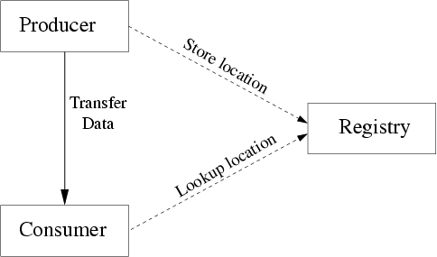
Grid Monitoring Architecture

Slide 8
Grid Monitoring Systems
R-GMA
Relational GMA http://www.r-gma.org
Monitoring and Discovery System (MDS)
http://www.globus.org/mds
MonALISA
Monitoring Agents in a Large Integrated Services Architecture
http://monalisa.cacr.caltech.edu

Slide 9
Monitoring Tools
NetLogger
Networked Application Logger
http://www-didc.lbl.gov/NetLogger
Network Weather Service
http://nws.cs.ucsb.edu/
Ganglia
http://ganglia.sourceforge.net
Nagios
http://www.nagios.org

Slide 10
R-GMA
R-GMA is used in the European Data Grid Project
Based on a Relational Data Model (uses Individual RDBMS and SQL statements to provide the functionality outlined in GMA)
Uses Java Servlets (tomcat). Moving to Web Services
Can be used as a replacement to MDS (tools are provided to invoke MDS Info Providers)
Nagios is used for graphs and notification
Clients: R-GMA Browser (Java Graphical display Tool), command line tool (Python) and an API for programmatic access.

Slide 11
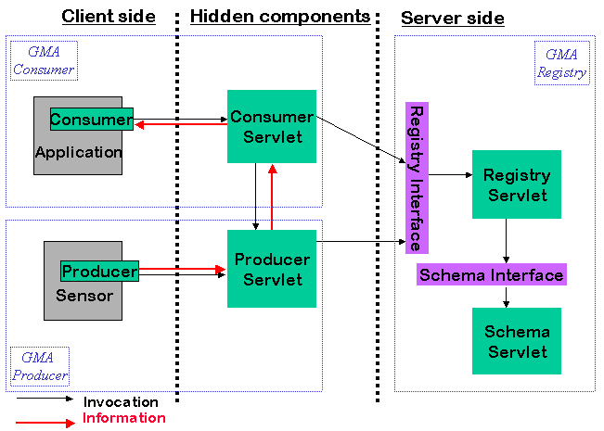
R-GMA

Slide 12
MDS - Overview
http://www.globus.org/mds
MDS provides directory services for Grids using the Globus Toolkit.
Provides a mechanism for publishing and discovering resource stats and configuration info
Based on OpenLDAP
Decentralized and Scalable
Security provided by combining GSI (Grid Security Infrastructure) with OpenLDAP ACLs

Slide 13
MDS - Components
Information Providers
GRIS (Grid Resource Information Service)
GIIS (Grid Index Information Service)
Clients

Slide 14
MDS – Information Providers
Provide resource info to GRIS.
Three Types of Information Providers
Core Information Providers
GRAM Reporters
Custom Information Providers
The provided info must be in a format that GRIS understands.

Slide 15
MDS – GRIS
GRIS runs on each resource and provides resource specific info.
GRIS invokes Info Providers to collect Resource data.
Each GRIS supports multiple Info Providers
Data gets cached for a period of time (Cachettl parameter)
GRIS registers with one or more GIIS to form a hierarchy.

Slide 16
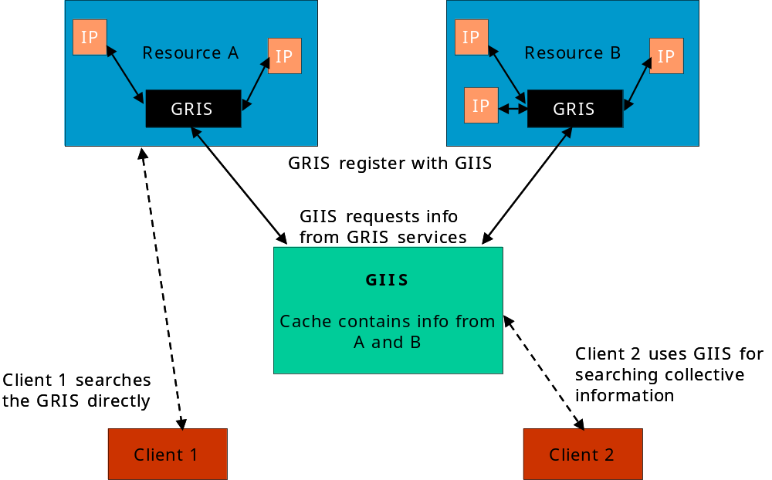
MDS – GIIS

Slide 17
MDS – Hierarchical GIIS
Registrar configuration (GIIS)
Every Registrar (GIIS) determines whether to accept incoming registration requests (grid-info-site-policy.conf )
Registrant (GRIS/GIIS)
Every Registrant determines which GIIS’s will register to (grid-info-resource-register.conf) and which providers will be available to send data to the GIIS’s this GRIS is registered (grid-info-resource-ldif.conf).
regperiod:
How often this GRIS will send a message to GIIS announcing its existence
ttl:
How long the registration info will be good for, before assuming that this GRIS is no longer available (typically ttl=2xregperiod)
cachettl:
How long info from this GRIS will be kept in cache.
bindmethod:
What method will be used for mutual authentication

Slide 18
MDS – Clients
MDS data can be accessed with a wide range of utilities:
Command Line Tools:
grid-info-search: a grid enabled ldapsearch
Programmatically:
LDAP Client API for Java, Python and Perl
Java uses the JNDI package for accessing LDAP directories.
Java CoG uses it.
Various LDAP/Web Browsers
The Grid technology Repository is a good place to look for MDS info providers and clients. http://gtr.globus.org

Slide 19
GLUE Schema
GLUE: Grid Laboratory for a Uniform Environment
Goal: To provide interoperability between US and European Physics Grid Projects
GLUE Schema: A common Schema used in describing and monitoring Grid Resources. The major components are: Computing Element (CE) a Storage Element (SE) and a Network Element (NE).
Glue Schema can be implemented in LDAP, XML,SQL
An MDS implementation of the GLUE Schema includes modified core Info Provider, modified GRAM Reporter and a Ganglia Interface for Cluster Info.

Slide 20
MDS3
GT3 is an OGSI implementation.
A Grid Service is a Web Service + extra concepts and mechanisms defined by OGSI.
A key concept, as far as monitoring is concerned, is the serviceData.
serviceData is a structured collection of information that is associated with an instance of a Grid Service. Basically, is an in XML representation of its internal state.
Each serviceData is composed of servicaDataElements
The status of a host is exposed as an SDE. This is similar to GRIS functionality in MDS2

Slide 21
MDS3
MDS3 supports both push and pull mechanisms to retrieve serviceData
Pull mechanism: findServiceData operation (required by OGSI; send one query and gets one response)
OGSI supports a query type: queryByServiceNames
GT3 supports a query type that uses XPath (and working in supporting other query languages such as XQuery and XSLT)
Push mechanism: subscribe to receive notification about serviceData (optional)

Slide 22
MDS3
The OGSI query type queryByServiceDataNames (and subscribeByServiceDataNames) both take SDEs as arguments.
They are pretty inefficient though, in that they return entire Service Data Elements (which could by a large chunk of data).
Globus defines a query type based on XPath. The input query takes a list of SDEs and an XPath Query. The output is the result of evaluating the XPath query against a set os SDEs.

Slide 23
MDS3 -- XPath
The primary purpose of XPath is to address parts of an XML document.
XPath views an XML document as a tree made up of nodes. XPath is a language for picking nodes and sets of nodes out of this tree.
XPath uses a compact, non-XML syntax to facilitate use of XPath within URIs and XML attribute values. The Syntax is similar to filesystem addressing.

Slide 24
XPath Query Example
//Host[@Name=“dc-user.isi.edu”]/ProcessorLoad
First selects only the Host Elements
From that subset, selects only those elements that Name=“dc-user.isi.edu”
And finally from that subset, select only the ProcessorLoad Elements
Output:
<ProcessorLoad Last1Min="00" Last5Min="00" Last15Min="00“ />

Slide 25
<Cluster Name="pygar.isi.edu" UniqueID="pygar.isi.edu">
<SubCluster Name="pygar.isi.edu" UniqueID="pygar.isi.edu">
<Host Name="pygar.isi.edu" UniqueID="pygar.isi.edu">
<Processor
Vendor=" GenuineIntel" Model=" Intel(R) XEON(TM) CPU 2" Version="15.2.4"
ClockSpeed="2193" CacheL2="512"/>
<MainMemory VirtualSize="2047" RAMSize="1004" RAMAvailable="119" VirtualAvailable="1716" />
<OperatingSystem Name="Linux" Release="2.4.7-10" Version="#1 Thu Sep 6 17:27:27 EDT 2001" />
<FileSystem Name="/“ Size="23510" AvailableSpace="650" Root="/" Type="unavailable" ReadOnly="false“ />
<NetworkAdapter Name="eth0" IPAddress="128.9.72.46" InboundIP="True" OutboundIP="True" MTU="1500"/>
<ProcessorLoad Last1Min="00" Last5Min="00" Last15Min="00“ />
</Host>
</SubCluster>
</Cluster>

Slide 26
MDS3
In addition to findServiceData, OGSI provides additional support for handling service data:
Support for Xindice: an XML database for persistant XML service data; You may reboot your services and service data can still be there.
Aggregator mechanism: acts as a notification sink. Takes service data from notifications and republishes under one service data. So, you can perform queries under this service data instead of having to query each individual service data.
Provider mechanism: plug in your Java or Unix scripts service data providers. Similar to MDS2 Info Providers.

Slide 27
MDS3
Putting together the functionality described in the previous slide you get something similar to MDS2 GIIS:
Gather serviceData from other grid services
Publish collection as one service
Clients can query the index in the same way as they can query any other service data.

Slide 28
A Short Introduction to JINI
Jini network technology is an open software architecture that enables the creation of network-centric solutions which are highly adaptive to change.

Slide 29
A Short Introduction to JINI
JINI: A set of APIs and Network protocols that can help build and deploy distributed applications that are organized as federations of services.
Federation: a set of equal peers. There is no central controlling authority.
Instead of a central authority, JINI provides a mechanism for clients and services to find each other: Lookup Service

Slide 30
A Short Introduction to JINI
The Discovery protocol: Clients and Service Providers use the discovery protocol to find a Lookup Service
Once a Lookup Service has been located a ServiceRegistrar object is the first object that is sent over to the Service that registers or to the Client that searches for a service.
Two major methods in the ServiceRegistar register() and lookup()

Slide 31
A Short Introduction to JINI
Once the service provider has located a Lookup Service will create a ServiceItem object that will pass it as an argument to the register() method of ServiceRegistar.
package net.jini.core.lookup;
public Class ServiceItem {
public ServiceID serviceID;
public java.lang.Object service;
public Entry[] attributeSets;
public ServiceItem(ServiceID serviceID, java.lang.Object service, Entry[] attrSets);
}

Slide 32
A Short Introduction to JINI
Once the client has located a Lookup Service will create a ServiceTemplate object that will pass it as an argument to a lookup() method of ServiceRegistar.
package net.jini.core.lookup;
public Class ServiceTemplate {
public ServiceID serviceID;
public java.lang.Class[] serviceTypes;
public Entry[] attributeSetTemplates;
ServiceTemplate(ServiceID serviceID,
java.lang.Class[] serviceTypes,
Entry[] attrSetTemplates);
}

Slide 33
A Short Introduction to JINI
The Client looks for an object of a Class that implements a known Interface.
What gets in return is either a Service object that will enable the client to implement the service locally or a service proxy that will invoke the service remotely (over RMI).
JINI raises the level of abstraction of distributed systems programming from the Network protocol level to the object interface level.

Slide 34

http://monalisa.cacr.caltech.edu/

Slide 35
MonALISA
Design Considerations
A distributed monitoring service based on JINI/JAVA and WSDL/SOAP technologies that provides monitoring information from large and distributed systems to “higher level services” that require such information.
It is truly dynamic:
  Discover all the “Farm Units” that make up a Group/Community
  Provide a notification mechanism to propagate configuration changes
  Provide a Lease mechanism.
It can integrate existing monitoring tools to collect parameters describing computational nodes, applications and network performance.

Slide 36
MonALISA
  It Provides:
  Single farm values and details for each node that makes up the farm.
  Network parameters, connectivity values and traffic information.
  Real time data for subscribed listeners
  Historical data
  SNMP support and interfaces with other tools: Ganglia, MRTG, LSF, PBS, user defined scripts
  Active filters to process the data and provide customized information to other services.
  Dynamic proxies (WSDL) so that clients can access the data in a flexible way.
  Authentication and a secure GUI to configure and administer the monitoring service.
  Global monitoring repositories for a group/community.
  Access to the monitoring information from mobile phones using WAP.

Slide 37
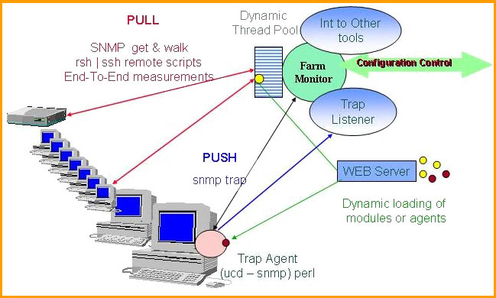
MonALISA
Data Collection

Slide 38
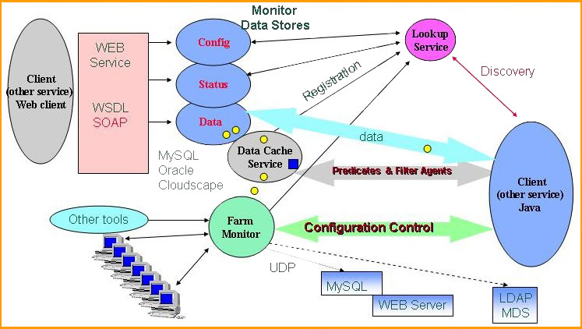
MonALISA
The Service System

Slide 39
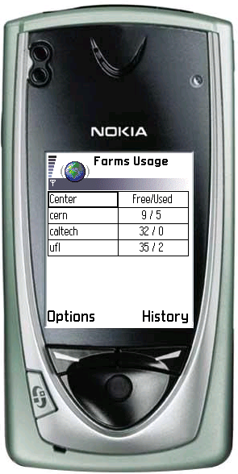


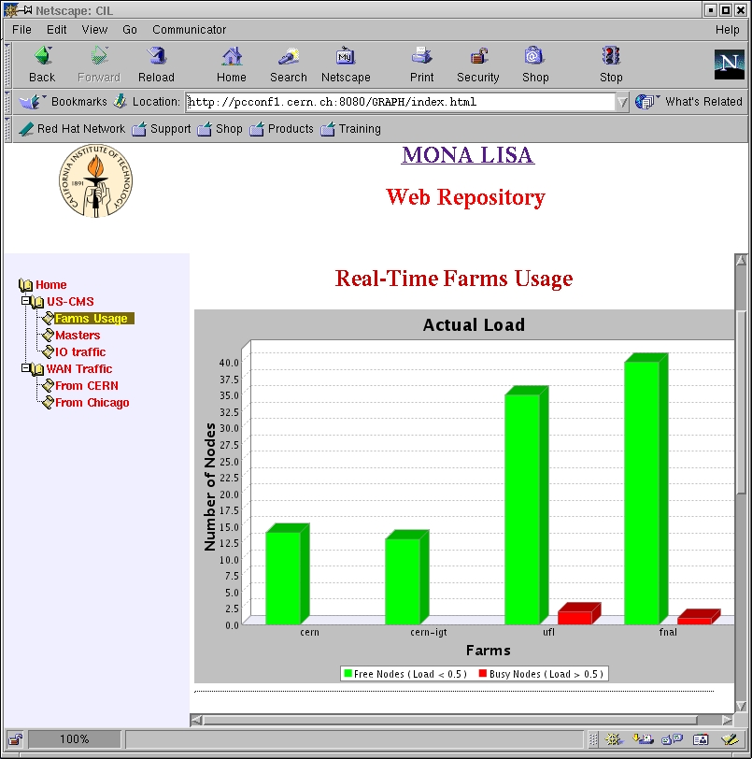
Repositories
Lookup
Service
MySQL
IDB
MonaLisa
Service
Discovery
WAP
Filter Agents / Data
TOMCAT
JSP/servelts
Pseudo Client
WEB
Filter Agents / Data
MySQL
MySQL
IDB
MonaLisa
Service
Lookup
Service

Slide 40
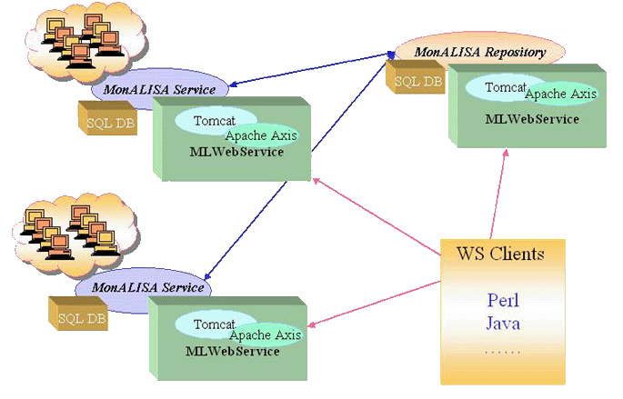
Web Services

Slide 41
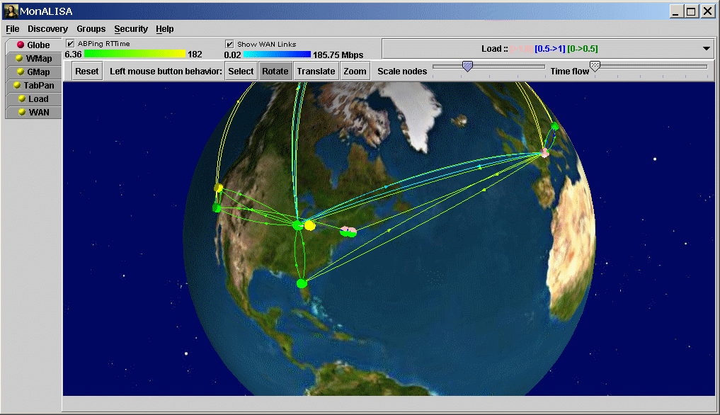
Global Client

Slide 42
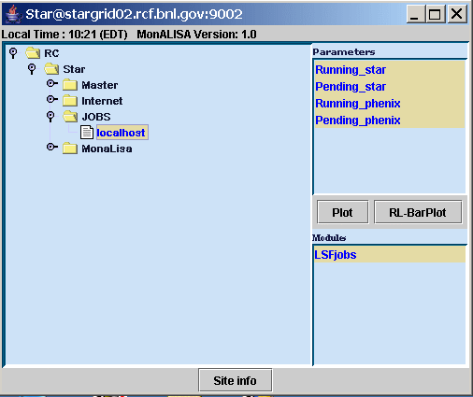
Regional Center GUI Client

Slide 43
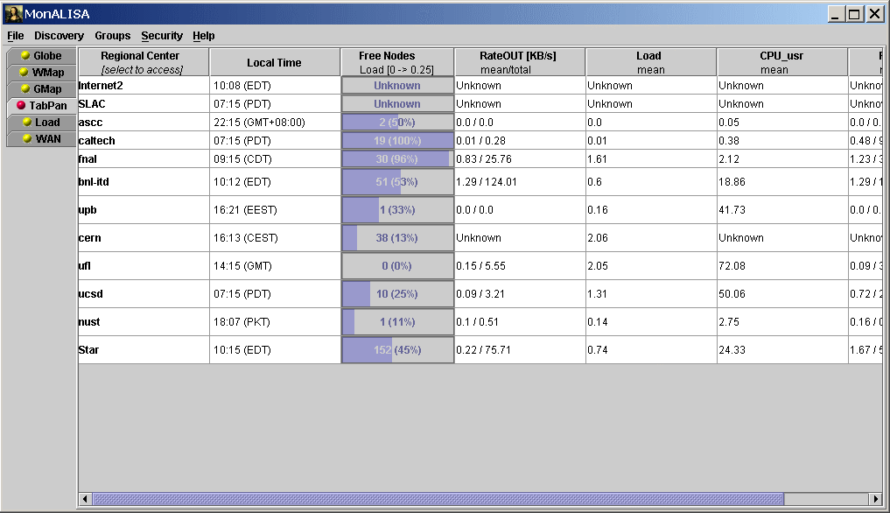
Global Views – Filter Agents

Slide 44
MonALISA
Deployed two MonALISA Services: one in ITD (for testing and learning purposes) and one for STAR (about a month ago). Another one will soon be deployed in PDSF.
Documentation: http://www.star.bnl.gov/STAR/comp/Grid/Monitoring/
Developed custom Monitoring Modules (LSFjobs).
Comparison of monitored values between MDS and MonALISA
Setup a STAR Group in the Lookup Services.
Started looking into setting up a private Lookup service to be used exclusively for STAR (firewall issues).
Setting up a Web Repository for STAR is under way. It exists but it needs to be reconfigured.
Looking into possible secure access to monitored values.

Slide 45
