Slide 1

Transformation
Market Disruption
Inspiration
Instigation
Innovation
THE POWER OF TOGETHER

Slide 2
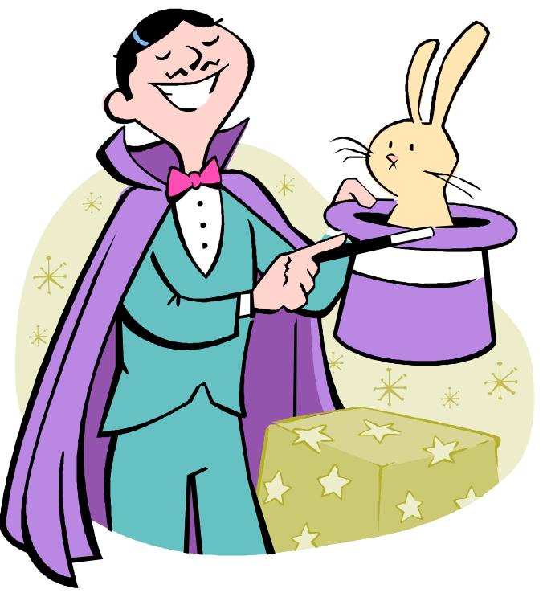
MAGIC
SHOW
Notes:
Rabbit graphic

Slide 3
From Burgers…
Innovation got me press
  3 patents
  Chaired the innovation team for McDonald’s
  Involved in every innovation with McDonald’s in the last 10 years
  The mentality had to change
Press got me in “The World is Flat”
  NYT, WSJ, AP, Bloomberg, USA Today
THE POWER OF TOGETHER

Slide 4
To Bankers
Lead to America’s Family
  Necessity is the mother of invention
    Fortune off the backs of them
Employer based model
  Tremendous traction
Sticky surface is CAPITALIZATION

Slide 5
To the Working Poor
9 reasons

Slide 6
9 reasons
1-5 – kids
6. Pancakes for dinner
7. Fortune on the backs of them
8. Nothing American about working hard and being poor

Slide 7
#9
"This same road has opened for all Americans a new era of progress and hope. It has led to a new civil rights bill, and it will, I am convinced, be widened and lengthened into a superhighway of justice as Negro and White men in increasing numbers create alliances to overcome their common problems.
THE POWER OF TOGETHER

Slide 8
American dream scorecard 1970-2003
Poverty / child poverty / dist of wealth
Average net assets / readiness for retirement /econ. mobility
grad rates / achievement test scores
college matriculation compared to others
college completion by income
health ins/ 2 parent families / asthma / obesity
parent in prison and violent crime
ANYONE happy with this progress
THE POWER OF TOGETHER

Slide 9
How to
Harness innovation, technology and entrepreneurial spirit to
Inspire
Instigate
Innovate
And ultimately GRADUALLY Transform the nation
THE POWER OF TOGETHER

Slide 10
THE POWER OF TOGETHER
4X more expensive
to be poor
8.7% of all US families (slightly less than 10 million families) do not have a checking or savings account

Slide 11
Payday Costs
Current Costs Yearly (24 Pay Periods)
Cab Fare $54.00 (Could get a ride)
Lunch for Kids $10.20 (Without feeding the kids)
Check Cashing $20.25 $486.00
Money Orders $3.95 $94.80
Money Wire $16.99 $407.76
P/U Money Wire $25.00 $600.00
Total Yearly Cost: $3,129 total $1558 in fees
AND She spent THE ENTIRE DAY
THE POWER OF TOGETHER
Notes:
Play the Andrea story

Slide 12
The steps to transformation
Innovation
Done!
Instigation
Inspiration
THE POWER OF TOGETHER

Slide 13
Disruptive Innovation
Clay Christensen
Introduce a New value Proposition
  New Market (Kodak Camera / Xerox / E-bay)
Key – Bring Consumption to Non consumers
  Bring banking to the un-banked
This new model will use these principles
THE POWER OF TOGETHER
Notes:
Take Clay’s book – Seeing What’s Next

Slide 14
LEVERING THE MARKETPLACE
Inspiration
Instigation
Innovation
THE POWER OF TOGETHER
Notes:
Couldn’t buy dinner for my kids
Didn’t have $ on me
Lots of guests shared desire!
Industry experts – Said never
Customer – Said now
The moral of the story – the customer ALWAYS gets what they want
Will you be the one giving it to them?
INSTIGATION
What’s out there
Don’t always reinvent the wheel
I took two existing items and married them
Tip edit
NDC - Bob
Full service software
Hardware
Omron – Bruce
“Instigated” them into solution
INNOVATION
Anyone can do it!
I was in a 25k restaurant manager position
Flippin burgers
500k and 5 prototypes later
Combine
McPlastic – There u have it
2 patents and over a decade later
McD 95%+ others over 70%
Restaurants accept
1 of my stores –over 100,000 tcs /yr

Slide 15
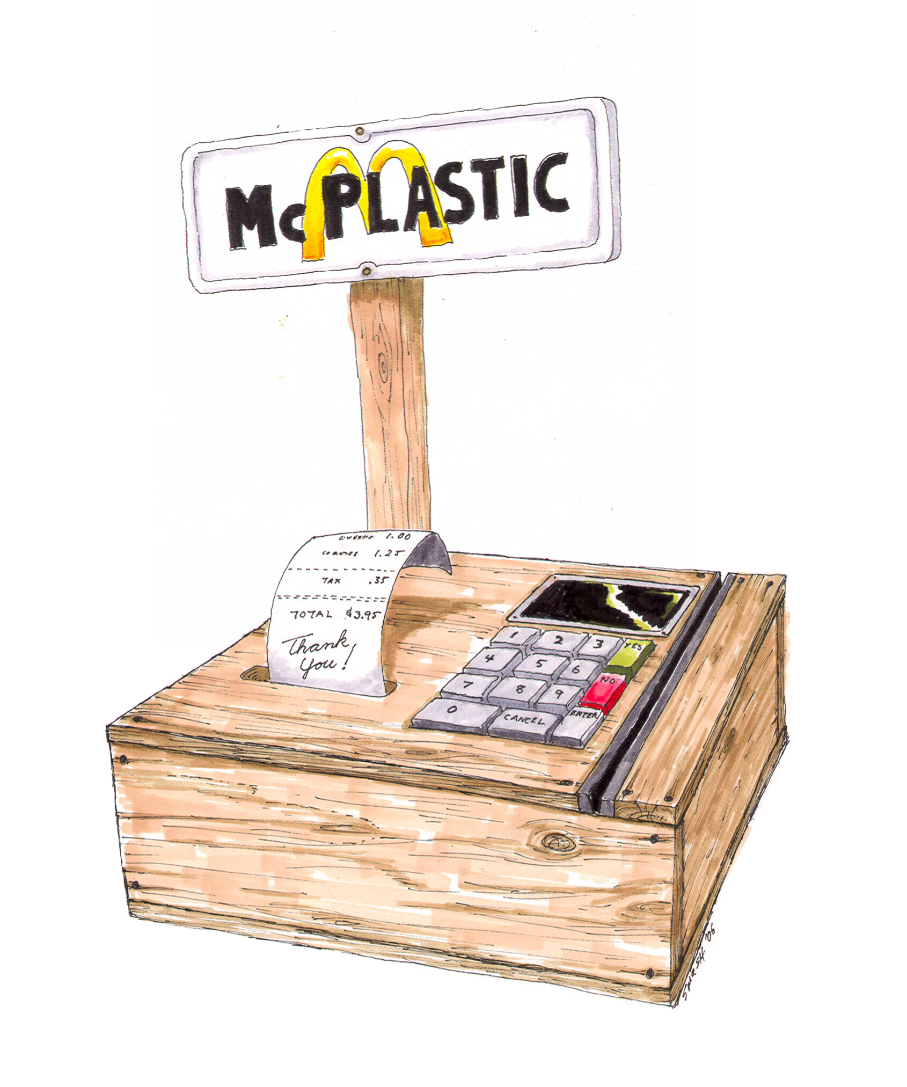
McPlastic
An example 15 years in the making
What CAN
Happen!
THE POWER OF TOGETHER
Notes:
Credit acceptance in QSR
2 Patents Feb 15 1994
Cute little box
Industry Transformation

Slide 16
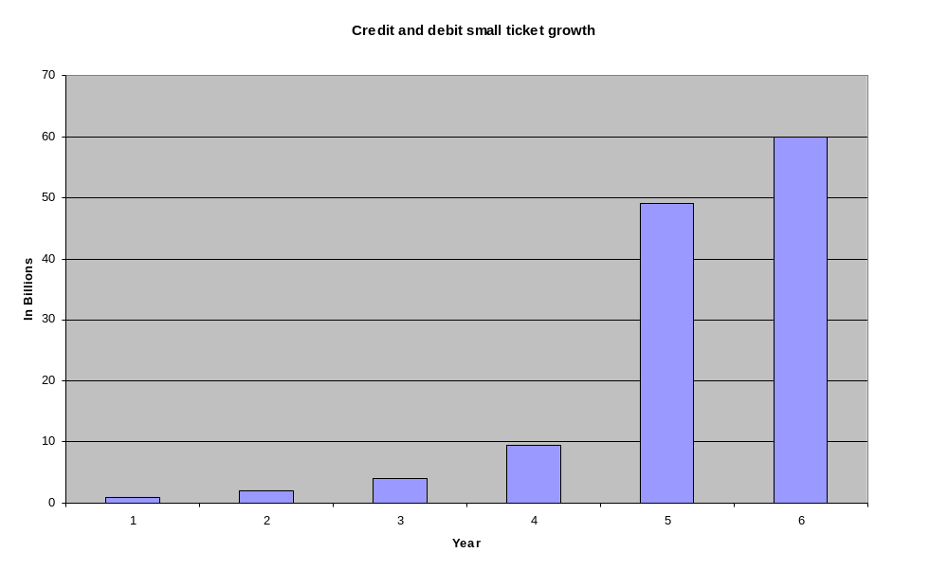
Explosive Transformation
Notes:
Card Acceptance
93,000 QSR’s in US
McD 95% accept
1 of my stores –over 100,000 tcs /yr
Less than 1b in 97
10b in 03
13.7b in 04
Nearly 20b Today!

Slide 17
Transformation Thru
Innovation
EZ Bank
THE POWER OF TOGETHER

Slide 18
EZ Bank
Inspiration
  No one wants the unbanked - Clay
  MLK Nobel Peace Speech – Anybody happy?
Instigation – what’s out there
  Companies with employees
  Cash – Deposits
  AF
  Technology
Innovation – EZ Bank
THE POWER OF TOGETHER
Notes:
Instigation
Speak about tools, inspire employees to the BIGG vision
They buy in and solve the challenges

Slide 19
Companies
McDonald’s
  AUV – $2.1mm per location
  14,000 US Locations
  All A real estate
  Over 650,000 hourly staff
  $86,661,157 average DAILY Deposit
  No need for a local Bank
WalMart
  AUV - $97 million
  3,189 US locations
  Not A real estate
  Over 1.5 million hourly staff
  $852,157,000 average DAILY deposit
  No need for a local Bank
Why not use these deposits for a day?
THE POWER OF TOGETHER
Notes:
Add Walmart

Slide 20

Technology
Similar to V-Com
in 7-11 stores – fees a fraction of the cost
Entry level bank
NO BANKING PARADIGM
Located where they are
Scalable cost
THE POWER OF TOGETHER

Slide 21
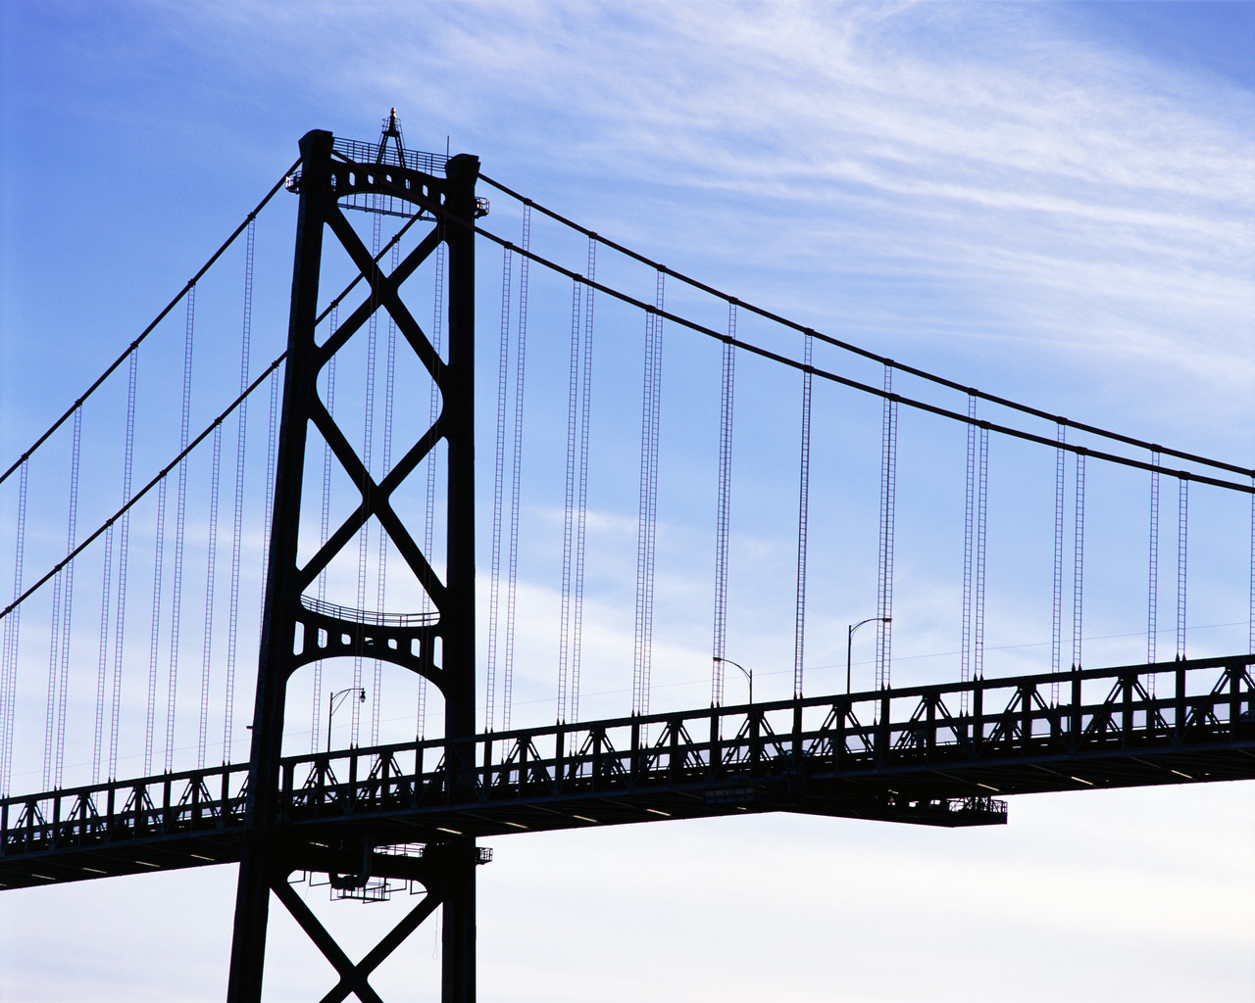


Bridging the Gap
The Coalition
TRUST
THE POWER OF TOGETHER
Banked
Un-Banked

Slide 22
Long-term EZ Bank Model
AMFAM manages the relationship between the employer and the bank
AMFAM helps the employees with counseling, loan programs, and other AACTS
Once the employee becomes “bankable” we help transition the employee to a traditional local banking partner
THE POWER OF TOGETHER

Slide 23
Payday After EZ Bank
Gas for Vehicle $5.00
Kiosk Fee $1.50
Bills $2.50
Overseas Transfer $1.50
$10.50 x 24 Pay Periods = $250
Fees = $130
(A difference of up to $2,999 annually)
THE POWER OF TOGETHER

Slide 24
A
THE POWER OF TOGETHER
dvocacy
Partner to Success
Hard Work - Education - Relationships
Notes:
The Box You Got
Celebrity Partners
Daryl Simmons, Mike Minter, Fisher DeBerry
Giving Voice to the Unheard
Helps to scale nationally

Slide 25
A
THE POWER OF TOGETHER
ssociation
Connect to Success
Hard Work - Education - Relationships
Notes:
GRAMEEN Model
Leverage Community
Business 2 Business
Existing Resources
Connecting the Dots
Helping to Bridge the gap for hard working Americans
Networking in small groups
Rides
Childcare
Shift coverage
The tech aspect
Cell phone use for bill paying, etc.

Slide 26
C
THE POWER OF TOGETHER
apitalization
Access to Success
Hard Work - Education - Relationships
Notes:
Access to resources
Financial Literacy
Available in English and Spanish
Interactive Counseling program in person and online
Low Interest Loans for:
Lines of Credit
Car Loans
Consolidation Loans

Slide 27
T
THE POWER OF TOGETHER
ransportation
Transport to Success
Hard Work - Education - Relationships

Slide 28
S
THE POWER OF TOGETHER
cholarship
Teach to Success
Hard Work - Education - Relationships
Notes:
Access to Education
GED, ESL
Tech Training, Community College
Mentoring
Financial and Family Stability

Slide 29
Why AMFAM works
THE POWER OF TOGETHER
Notes:
Our employer based relationship works because
We speak “employer”
We understand their needs
We have 100 years of operations experience
We introduce a “community based” model for the employer

Slide 30
Back to the beginning
Notes:
Table Analogy
Another meeting?
Will you remember this meeting?

Slide 31
Questions?
THE POWER OF TOGETHER

Slide 32
Content Plus
Website – i3cms.com / Theboxyougot.com
Steve Bigari – “The Box You Got”
  Theboxyougot.com
Clayton M. Christensen – “Seeing What’s Next”
Thomas L Friedman – “The World is Flat”
  Footnotes
ETA 2005 Annual Meeting and Expo. (Mar 05) Fast Food Solutions on a Fast Track: An Industry Update on QSR. By Gary Holmes (Sr VP First Data Bank) and
Paul Bazylak (VP of Merchant Relations, Visa USA)
Visa Takes Bite Out of Small Ticket Payments (Sep 06). By Dori Busell and Emily Collins, Visa USA
2004 Survey of Consumer Finances
www.mcdonalds.com
www.walmart.com
Notes:
Footnotes
Walmart
# of unbanked

