Slide 1


Outcome Study for the Evaluation of the Modular Grants Program
May 2005
Prepared by Westat under Contract # GS-23F-8144H

Slide 2
Background on the Modular Grant Application Process
June 1, 1999 NIH initiated the modular grant application process
Intent was to reinforce the grant-in-aid philosophy of supporting research (as opposed to the contract mentality of “buying” research)

Slide 3
Goals of the Modular Grant Application Process
Goals:
  Focus the efforts of peer reviewers, principal investigators, institutional officials, and NIH staff on the science of the applications (rather than on the itemized budget)
  Reduce administrative burden for all stakeholders and simplify the grant administration process
  Accommodate principal investigators’ need for flexibility

Slide 4
History of the Modular Grant Application Process Evaluation
Nov 2001 – Modular Evaluation Workgroup developed a report on guidelines for the evaluation of the modular process
Feb 2002 – Peer Review Oversight Group (PROG) approved report; Phase I Feasibility Study funds made available
April 2003 – Phase I feasibility study began
Jan/Feb 2004 – PROG members review Phase I results and approve survey instruments
March 2004 – Phase I presentation at EPMC meeting, requesting feedback on surveys
April 2004 – Phase II outcome evaluation study began
May 2005 – Phase II presentation and materials delivered to NIH

Slide 5
Phase II Outcome Study Purpose
Overall purpose
  Determine if the modular grants application process met its intended long-term program goals
  Determine if stakeholders understand the modular grant application process

Slide 6
Phase II Outcome Study Activities
Developed and tested five web surveys
Administered web surveys
Conducted quantitative and qualitative data analysis
Produced slide presentations, executive summary, summary reports, methodology report, quantitative and qualitative results, data files

Slide 7
Samples: Census Groups
Used a census for two stakeholder groups
  NIH Scientific Review Administrators (N=372)
    CSR and Non-CSR Scientific Review Administrators in NIH Health Scientist Administrator (HSA) database as of August 2004
  Institutions (Institutional Officials) (N=327)
    Institutions that applied for 10 or more modular grants, excluding foreign institutions (but including Canada); used National Council for University Research Administrators (NCURA) database or institution web site to find highest ranking person (e.g., Director of Office of Sponsored Research); gave highest ranking person option to let another staff member more knowledgeable take the survey

Slide 8
Samples: Non-census Groups
Used a systematic random sample for three stakeholder groups
  Principal investigators
    Principal investigators that had submitted a modular grant application between September 1999 and March 2004
  Peer reviewers
    NIH Peer reviewers serving as of December 2003 and those who had rotated off during the previous 2 years
  NIH program and grants management staff
    Program staff in NIH Health Scientist Administrator (HSA) database as of August 2004
    Grants management officers and grants management specialists listed in Grants Management Advisory Committee (GMAC) Directory
Oversampled non-census groups to account for:
  60% response rate
  15% “bounce back” (undeliverable) emails for non-NIH employees

Slide 9
Sample Sizes
Stakeholder Group | Population Size | Sample Size (# of surveys administered)
Principal Investigators | 31,180 | 1,676
Peer Reviewers | 2,836 | 753
Scientific Review Administrators | 372 | 372
Program and Grants Management Staff | 1,213 | 488
Institutional Officials | 327 | 327

Slide 10
Data Collection Schedule: Fall 2004
Pre-notification Letter Mailed
Reminder Email #2
Telephone Prompting
Survey Notification Email
Reminder Email #1
SRAs Sept. 15 Sept. 20 Sept. 30 Oct. 8 Oct. 18
PRs, PGMS, IOs Sept. 22 Sept. 28 Oct. 8 Oct. 18 Oct. 28
PIs Sept. 27 Oct. 5 Oct. 15 Oct. 25 Nov. 4

Slide 11
Final Sample Sizes and Response Rates
Stakeholder Group | Final Sample Size* | Completed Surveys | Response Rate
Institutional Officials | 288 | 227 | 78.8%
Peer Reviewers | 671 | 497 | 74.1%
Scientific Review Administrators | 285 | 209 | 73.3%
Program and Grants Management Staff | 355 | 247 | 69.6%
Principal Investigators (PIs) | 1,439 | 949 | 65.9%
PIs – Recipients of Modular Grants | 879 | 644 | 73.3%
PIs – Unfunded Applicants | 560 | 305 | 54.5%
*Includes only eligible respondents

Slide 12
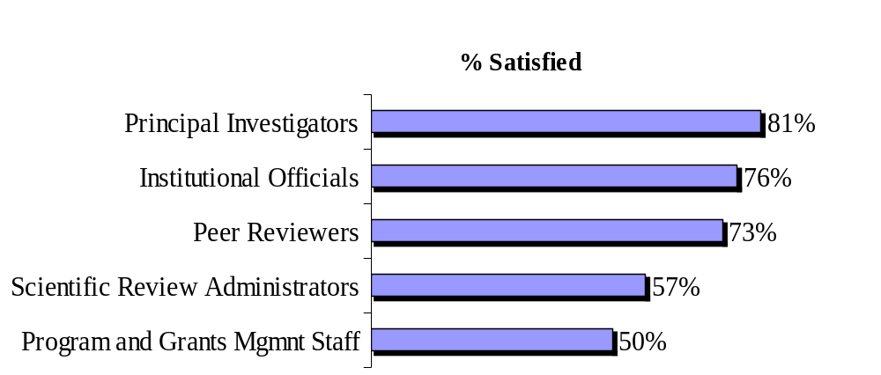
Overall Satisfaction with Modular Grants
Overall, how satisfied are you with the modular grant application process?

Slide 13
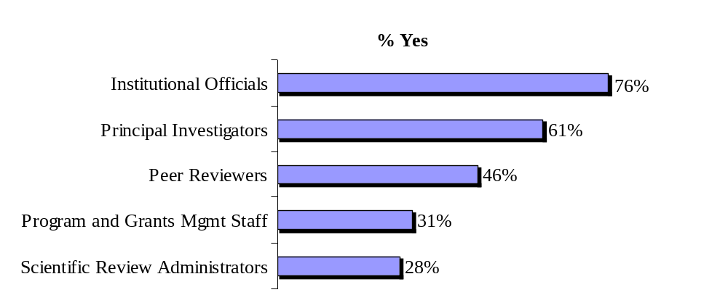
Raising the Modular Grant Limit
Would you prefer the modular grant limit be higher
than $250,000?

Slide 14
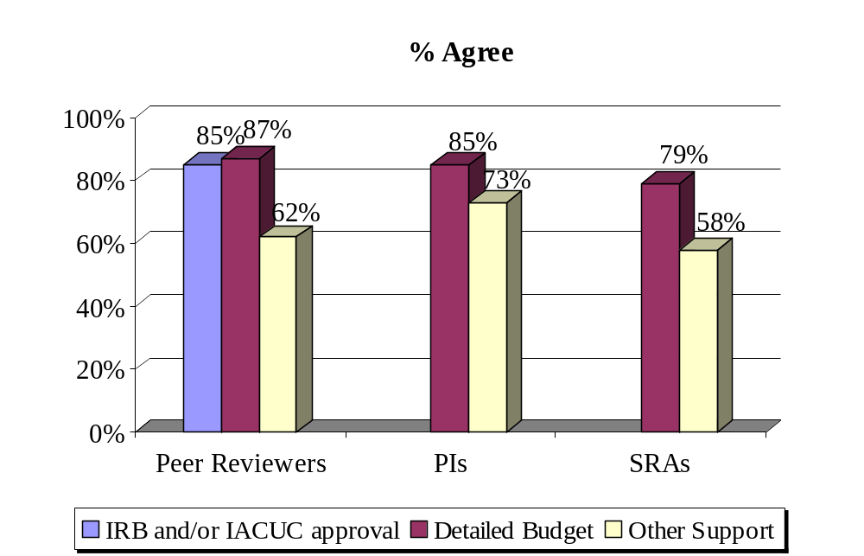
Assessing Scientific Merit
I/Peer reviewers can assess the scientific merit of a modular grant application without…

Slide 15
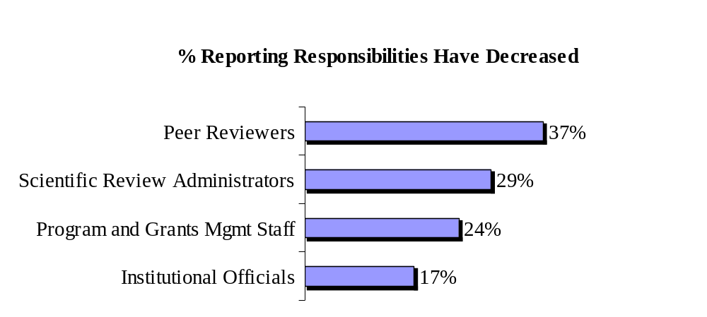
Changes in Job Responsibility
Due to Modular Grants
As a direct result of the modular grant application process, my responsibilities have decreased

Slide 16
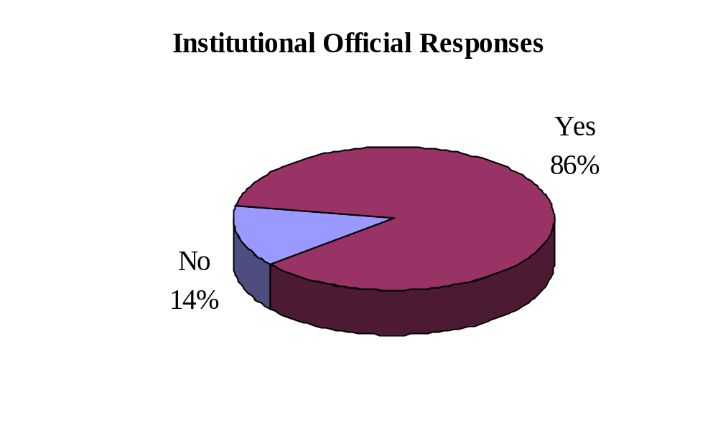
Institutions Require Detailed Budgets
Does your office or any other office at your university/research center require principal investigators to submit detailed budgets for review even if they are applying for an NIH modular grant?

Slide 17
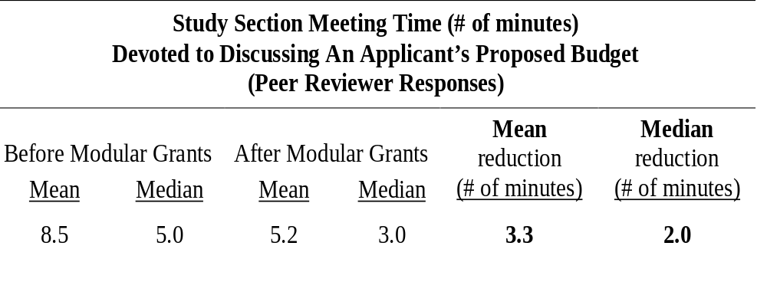
Study Section Meeting Time
On average, how much study section meeting time was devoted to discussing an applicant’s proposed budget before and after the implementation of the modular grant application process?

Slide 18
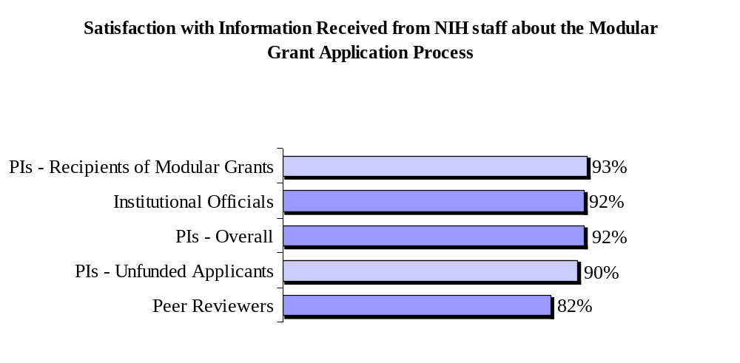
Satisfaction with Information Received from NIH Staff

Slide 19
Best and Least Understood Features of the Modular Grant Application Process
Best understood features:
  All forms for modular grant applications are available on the NIH web site
  Biographical sketches need to be prepared for all key personnel
  Individual salary information is not required for personnel
Least understood features:
  Total consortium/contractual costs need to be estimated for each year, rounded to the nearest $1,000
  Modular grant awards are eligible for administrative supplements (i.e., noncompeting supplemental funding)

Slide 20
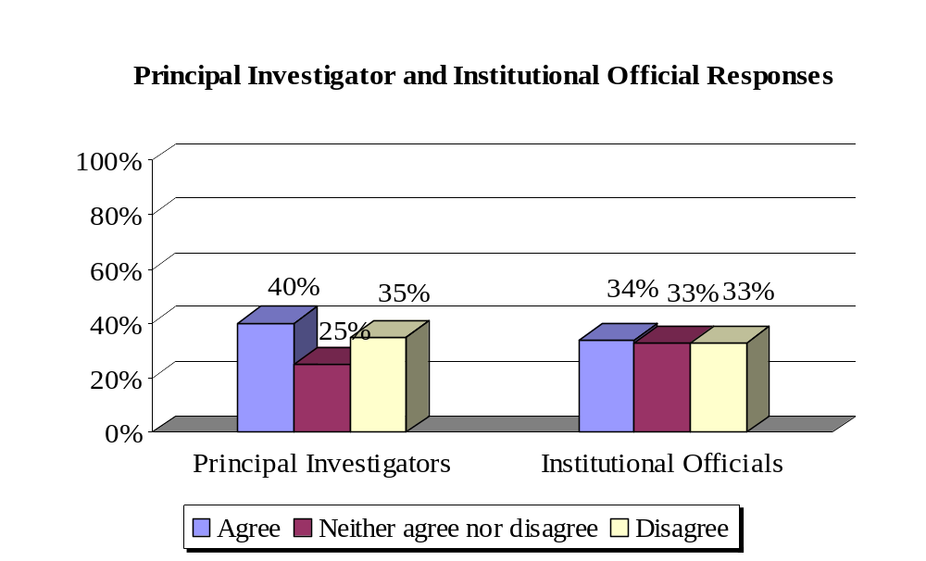
Perception of Funding Likelihood for Modular Compared to Nonmodular Grant Applications
I think/PIs believe a modular grant is more likely to be funded than a nonmodular grant

Slide 21
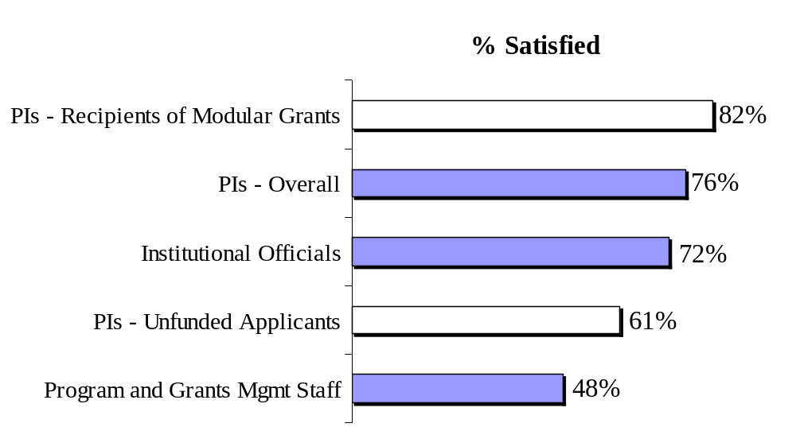
Overall Satisfaction with Just-in-Time
Overall, how satisfied are you with Just-in-Time?*
*Just-in-Time survey items were not included on peer reviewer or scientific review administrator surveys

Slide 22
Conclusions
Modular grant application process...
  is generally well received in the extramural community, somewhat less well received by NIH staff
  has achieved the goals of…
    reducing administrative burden (most for peer reviewers and scientific review administrators than others)
    focusing peer reviewers on the scientific content of the application
  has resulted in less study section meeting time devoted to budget discussions
Peer review can be performed well without a detailed budget or IRB/IACUC approval
Extramural community is very satisfied with the information provided on the modular grant application process by NIH staff

Slide 23
Conclusions and Recommendations for Modular Grant Application Process
While the modular grant application process solved some problems, it created others
  Principal investigators required to prepare two budgets
    Practices used to reduce burden of two budgets could be shared among institutional officials and/or learned and disseminated by NIH
  Peer reviewers less able to conduct a good assessment without “Other Support” pages
    Consider re-implementing “Other Support” pages or obtaining similar information at time of application submission
Lack of understanding and misconceptions about some aspects of the modular grant application process
  Use Phase II findings as a guide to developing more targeted on-line training and educational modules

Slide 24
Conclusions and Recommendations for Just-in-Time
Just-in-Time is better received by extramural community than by NIH staff
Procedures for requesting and receiving materials are problematic
  Assign one contact person for working with principal investigators and institutional officials to get Just-in-Time materials in
  Request materials from only one point person (PI? IO?) at an institution
  Routinely test NIH “Commons” electronic submission and receipt functioning
  Develop better document tracking system for materials that are received
Too many people are notified that they may receive an award
  Consider decreasing cutoff percentage
Turnaround time for applicants to submit materials is too short
  Consider notifying applicants earlier and/or providing them with more time when possible

Slide 25
On the Modular Grant Outcome Evaluation Web Site
Introduction/Background
Methodology
Surveys
Results
  Overview
  Highlight
  Specific Topics
  Main Themes from Open-Ended Comments
  All Open-Ended Comments
  All Survey Responses

