Slide 1
NOISE WORKSHOP
History and Use of EPA’s Hearing Protector Labeling Regulation
Alice H. Suter, Ph.D.
March 27, 2003

Slide 2
Who Uses What:
Europe
  SNR (Single Number Rating)
  HML (High, Middle, Low)
Canada and Australia
  Class System
United States
  NRR

Slide 3
How the NRR’s Use Causes Problems
Bigger is Better Mentality
NRR is Gospel
Failure to Match the NRR to TWA
NRR Overestimates Attenuation
Discourages Tailoring to Individual Needs

Slide 4
Modifications to the NRR
OSHA’s Compliance Policy
  Derating by 50 % when assessing the relative effectiveness of hearing protectors and engineering controls
  OSHA Technical Manual mentions NRR(SF)for informational purposes
NIOSH Criteria Document Recommendation
  Earmuffs NRR minus 25%
  Foam Earplugs NRR minus 50%
  All Other Earplugs NRR minus 70%
Some Employers

Slide 5
Noise Control Act of 1972
Congressional Declaration of U.S. Policy
  “to promote an environment for all Americans free from noise that jeopardizes their health or welfare. To that end, it is the purpose of the Act to establish a means for effective coordination of Federal research and activities in noise control, to authorize the establishment of Federal noise emission standards for products distributed in commerce, and to provide information to the public respecting the noise emission and noise reduction characteristics of such products.”

Slide 6
Noise Control Act - Section 8
Gives EPA the Responsibility to Regulate the Labeling of:
  Products Emitting Noise
  Products Reducing Noise

Slide 7
Noise Control Act - Section 8
(a) The EPA Administrator must designate any product or class of products which:
  1. Emits noise capable of adversely affecting the public health or welfare, or
  2. Is sold wholly or in part on the basis of its effectiveness in reducing noise.

Slide 8
Noise Control Act - Section 8
(b) For each product or class of products EPA shall require that notice be given to the prospective user of the level of noise the product emits, or of its effectiveness in reducing noise. The regulation must specify:
  1. Whether such notice shall be affixed to the product or to the outside of its container (or both), at the time of its sale to the ultimate purchaser, or whether such notice shall be given to the prospective user in some other manner,
  2. The form of the notice,
  3. The methods and units of measurement to be used.

Slide 9
Rationale for Labeling Hearing Protectors
Section 6 of the Noise Control Act mandates regulations for major sources of noise
Too many noisy new products would take too long to regulate
Technical and economic feasibility problems
Need to protect against noise of in-use products

Slide 10
Background Leading up to the Regulation
ANSI Z24.22-1957
ANSI S3.19-1974
NIOSH Methods #1, #2, and #3
  Subtracting 2 SDs “should rarely overestimate the degree of protection”

Slide 11
EPA-1979 Hearing Protector Labeling Requirements - Subpart B
211.204 Information content of primary label
  Includes requirements for primary label size, print and color, label location and type, and supporting information.
211.205 Special claims and exceptions
211.206 Methods for measurement of sound attenuation
  Real ear method in ANSI S3.19-1974 (as modified in this section)
211.207 Computation of the noise reduction rating (NRR)
211.208 Export provisions
211.209 Maintenance of records and submittal of information
211.210 Labeling verification requirements
211.211 Compliance with labeling requirements
211.212 Compliance audit testing

Slide 12
OSHA’s Hearing Conservation Amendment
Appendix G (1981) now Appendix B (1983)
  Noise Reduction Rating
  NIOSH #1, #2, or #3
Using the NRR to estimate the A-weighted level under the ear protector:
  C-weighted TWA – NRR
  A-weighted TWA - (NRR-7)

Slide 13
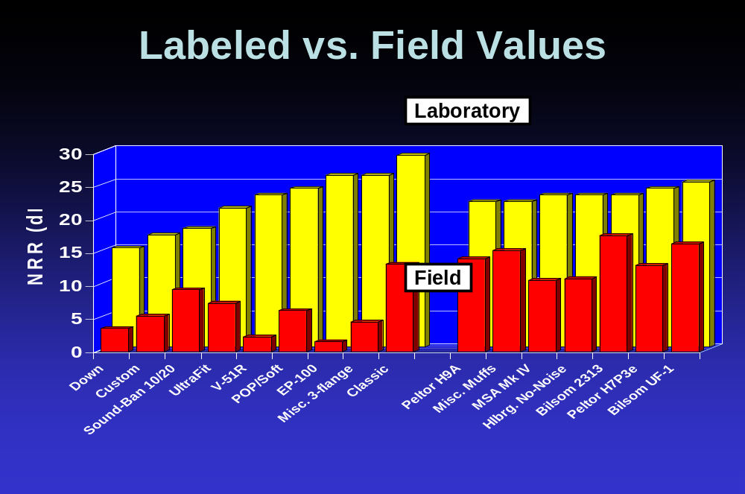

Slide 14
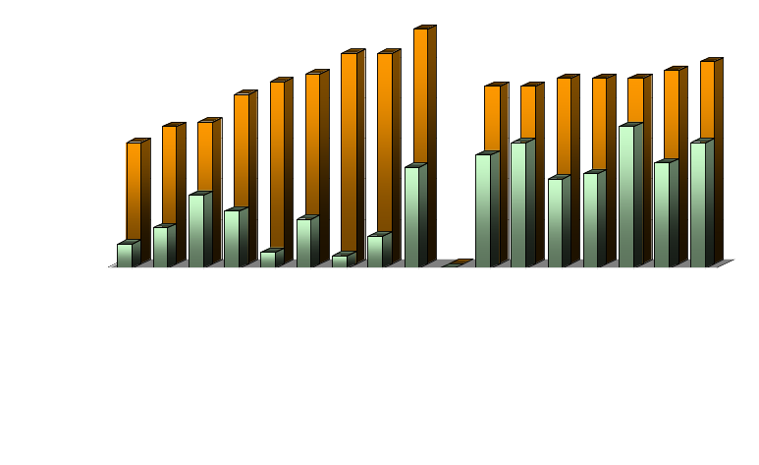
Labeled vs. Field Values
Laboratory
Field

Slide 15
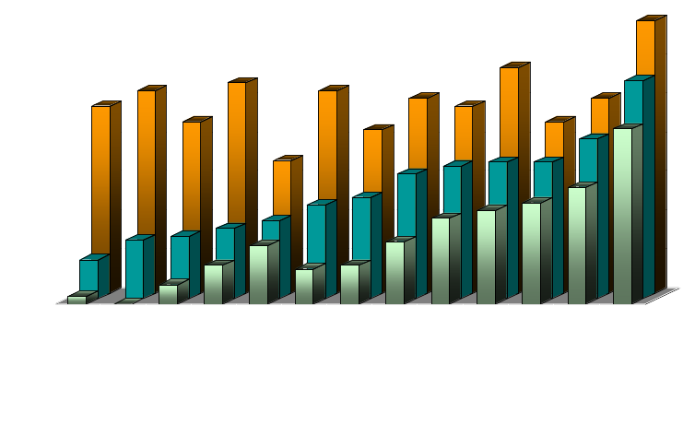
Predicted vs. Field Values
Laboratory
Method B
Field

Slide 16
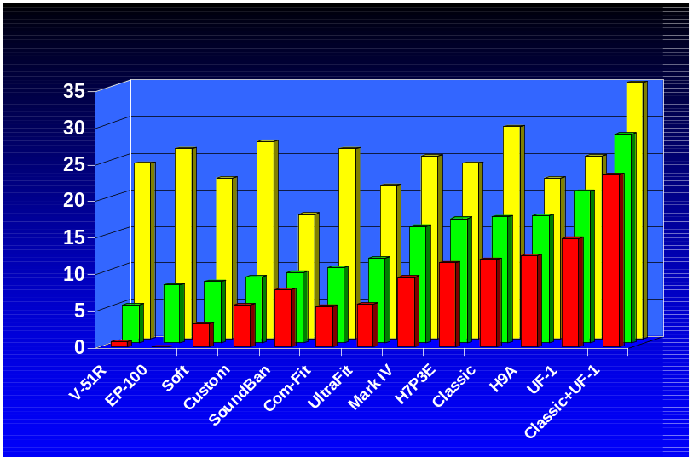
Predicted vs. Field Values
Label Test
Method B
NRR (dB)
Field

Slide 17
NHCA Task Force HPD Effectiveness
AAOHN, Barbara Panhorst
AAO-HNS, Robert Dobie
ACOEM, Tom Markham
AIHA, Dennis Driscoll
ASA, Jim Patterson
ASHA, Rena Glaser
CAOHC, Rena Glaser
ISEA, Jeff Birkner
NHCA, Larry Royster
NSC, Jill Niland
EPA, Ken Feith
MAA, Doug Ohlin
MSHA, Leonard Marraccini
NIOSH, John Franks
OSHA, Deborah Gabry
WG10, Charles Nixon
WG11, Elliott Berger
WG12, Julia Royster
WG35, Ed Toothman

Slide 18
HPD Task Force’s Mission
Guidelines for labeling hearing protection devices
Recommendations for educational materials that should be provided
General guidelines for hearing protector selection and use

Slide 19
Administrative Issues
Use Method B from ANSI 12.6-1997
Test facilities meet NVLAP requirements
Retesting at least every 10 years but not more often than every 5 years

Slide 20
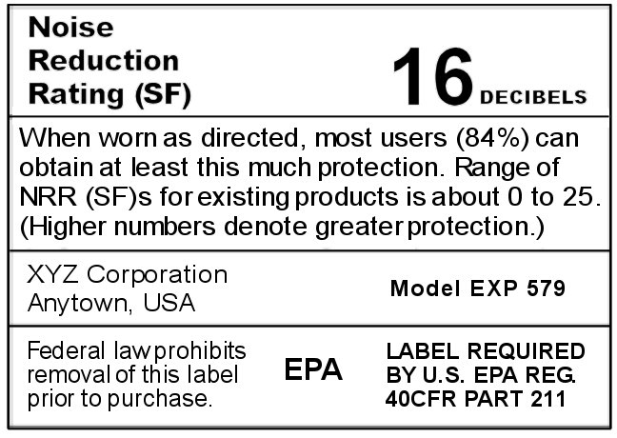
Proposed Primary Label

Slide 21
Secondary Label Format
Instructions for use
This section may contain unlimited text and pictures at the discretion of the manufacturer.

Slide 22
Secondary Label Format
Selecting Hearing Protectors
The most critical consideration in selecting and dispensing a hearing protector is the ability of the wearer to achieve a comfortable noise-blocking seal which can be consistently maintained during all noise exposures.

Slide 23
Secondary Label Format
Additional Issues
Hearing protector’s noise reduction
Wearer’s daily equivalent noise exposure
Variations in noise level
User preference
Communication needs
Hearing ability
Compatibility with other safety equipment
Wearer’s physical limitations
Climate and other working conditions
Replacement, care and use requirements

Slide 24
Secondary Label Format
Attenuation Values
Test Frequency (Hz) | 125 | 250 | 500 | 1000 | 2000 | 4000 | 8000 | H | M | L | NRR(SF)
Mean Attenuation (dB) | 17.9 | 19.0 | 21.0 | 24.7 | 29.9 | 35.6 | 34.6 | 25 | 18 | 14 | 16
Standard Deviation (dB) | 7.3 | 6.3 | 7.3 | 6.4 | 5.3 | 5.0 | 5.4

Slide 25
Secondary Label Format
How to Use NRR(SF)
The NRR(SF) may be subtracted from an A-weighted sound level or TWA
1. For example, the noise level is 92 dBA.
2. The NRR(SF) is 16 dB.
Most users (84%) should be protected to a level of 76 dBA.
Tip: A better estimate of the protected level can be obtained by adding 5 dB to the NRR(SF) and subtracting it from a measurement made using C- instead of A-weighting.

Slide 26
Secondary Label Format
Applicability
FAILURE TO FIT THIS HEARING PROTECTOR ACCORDING TO INSTRUCTIONS WILL REDUCE ITS EFFECTIVENESS. When used as directed, this hearing protector is expected to provide between 16 and 30 dB of noise reduction for about 66% of the users. Of those remaining, 17% will be likely to obtain less than 16 dB of protection, and the other 17% will be likely to obtain more than 30 dB.
Differences between hearing protector ratings of less than 3 dB are not important.

Slide 27
Secondary Label Format
Estimating Noise Reduction for Individual Users
The labeled values of noise reduction are based on laboratory tests. It is not possible to use these data to reliably predict levels of protection achieved by a given individual in a particular environment. To ensure protection, those wearing hearing protectors for occupational exposures must be enrolled in a hearing conservation program. Non-occupational users should have hearing evaluations by an audiologist, qualified physician, or other qualified professional, on a regular basis.

Slide 28
Secondary Label Format
Impulse Noise
Although hearing protectors are useful for protection from impulsive noise, the noise reduction measurements are based on tests in continuous noise and may not be an accurate indicator of the device’s performance for impulsive sounds, such as gunfire.

Slide 29
Secondary Label Format
Additional Information
For additional information, call NIOSH at 800-35-NIOSH to obtain document 9X-XXX (www.cdc.gov/niosh), or contact the EPA at phone/address (www.epa.gov).

Slide 30
Summary
Current NRR is not useful to purchasers and users of hearing protectors
Modifications to NRR vary and are less than ideal
EPA developed its hearing protector regulation with the idea that the NRR would be beneficial information for hearing protector users
NIOSH believed that the two standard deviation adjustment would prevent overestimates
OSHA cast the NRR in concrete
Field studies provided a wake-up call
NHCA Task Force responded, made recommendations
Something needs to change.....

