Slide 1
Notes:
1
NOTES:

Slide 2
Agenda
Basic Foundations
Types of Variable Programs
Getting Ready
Elements of the Programs
Current Usage
Closing

Slide 3
Variable Pay
Variable pay refers to compensation that is received in addition to the base pay. The amount received may be linked directly to individual, team, division and/or organization performance, and is determined (typically) by a variety of measures important to the organization.
It may be known in advance (incentive) or as an after the fact reinforcer (bonus).
Payment can be made in many forms; cash, stock, time, and even 4T’s.

Slide 4
Why Variable Pay Compensation?
Reinforces Cultural Change
Aligns Pay with Results
Suppresses Entitlement Mentality
Encourages Employees ‘Stakeholdership’
Communicates Values to Employees
Focuses Employees’ Activities
Can “Buy” Security

Slide 5
Variable pay is part of a larger reward strategy
Intrinsic
Job Content
- “Buy in” of results
- Level of responsibility
- Meaningful work
- Feedback
Career
- Growth
- Development
- Opportunities
- Security
Environment
- Culture
- Balance work/life
- Relationships
Direct Financial
- Base Salary
-Variable pay
- short-term/long-term
- Support programs
Indirect Financial
- Benefits
- Awards
- Support programs
Extrinsic

Slide 6
Value Exchange Theory Requires A Balance - No program proves this more than variable pay!
Energy
Benefits
Career
Loyalty
Value Add
Job
Effort
Compensation
Opportunity
Time
Commitment
Employee Gives Employer Gives
Notes:
NOTES:

Slide 7
Two Primary Theories
Reinforcement
Behaviors occur due to experience in reinforcement and objective measurement of value of past rewards
Looking back
Expectancy
Adjusts behaviors due to anticipation and subjective weighing of future rewards
Looking out
Bonus only
Incentives

Slide 8
You have to ask yourself do you really believe this chart?
Low
Performance
High
High
Overpaying
Who designed this?!
Ideal
Worth the investment
Pay Out
Underachieving
Something is not working
Unstable
Value Exchange Issue
Low

Slide 9
‘Type’ of variable pay
Team-Based
Variable Programs
Base Programs
Team Incentives
Venture
Systems
General
Increase
Profit Sharing
Success
Sharing
COLA
Gainsharing
Time Based
Reward
Platform
MBO
Competency
Based
Lump Sum
Payments
Skill Based
Individual-
Based
Perf. Based
Commissions
& Piece Rates
Market Based
Market Based
Individual
Incentives
Individual
Incentives

Slide 10
They can be ‘lumped’ together
Spot Awards - Bonus
Calendar Based Incentive
Event Based Incentive
Long Term Incentive (greater than one year)
Notes:
NOTES:

Slide 11
Strategy of Design
“Gain” sharing - Upside only
Risk - Downside only
Balanced risk and reward - Downside risk and upside opportunity

Slide 12
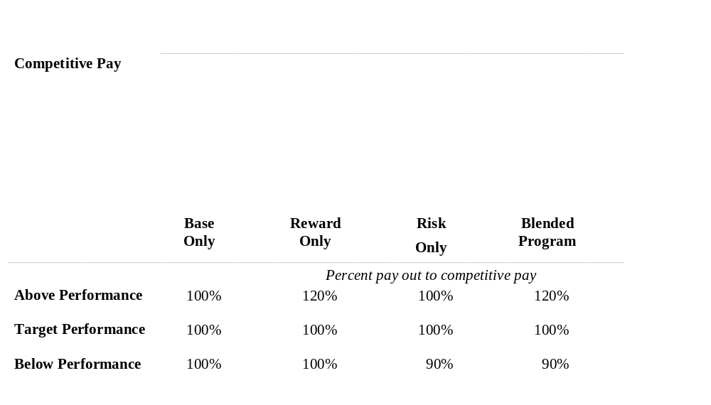
Strategy of Plan
Base
Incentive

Slide 13
Process Overview
Assessment
Design
Phases
Implementation
Evaluation
Time Line

Slide 14
Assessment
Why are you moving to a variable plan?
What are the core objectives?
Can the employees impact the objectives?
Is the organization ready for variable pay?
  What level of trust is there?
  What level of communication exists?
  Can you measure objectives?
Who is the champion of the program?
How committed to change are the Sr Leaders?
Is this the right time?
Notes:
NOTES:

Slide 15
Design Elements
1. Intent
2. Eligibility
3. Participation
4. Performance Criteria-Measurements
5. Goals within Measurements
6. Funding
7. Pay Outs & Timing
8 Benefits Impact
9. Administration
10. Evaluation - Plan Success
Notes:
NOTES:

Slide 16
1. Intent of Program
Understanding the intent of the plan has two objectives:
1. Makes you think
2. Communicates to employees
What is the purpose of the plan?
What are we trying to do?
The plan is designed to motivate and unite key leaders by providing a pay system which allows them to share in the financial success of the organization.
Notes:
NOTES:

Slide 17
2. Eligibility
Who is eligible for the program?
  Sr. Leaders
  Managers
  Professionals
  Hourly/Non-exempt
Is there a required employment time frame?
Individuals on Leave? Performance?
Notes:
NOTES:

Slide 18
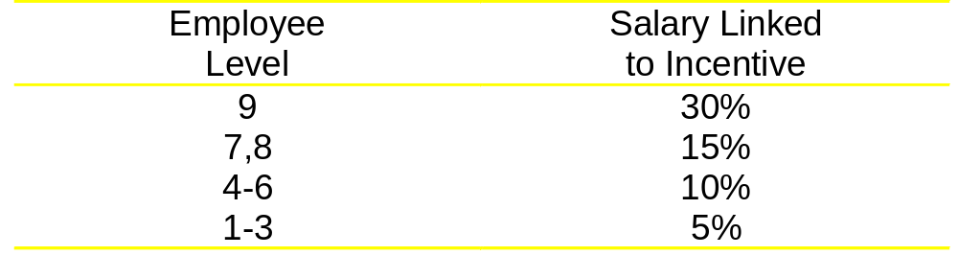
3. Participation
Is the plan designed so that all collect or only a portion?
Do they participate in the same amounts?
Will differences create barriers to team work?
Example of a leveled plan
Notes:
NOTES:

Slide 19
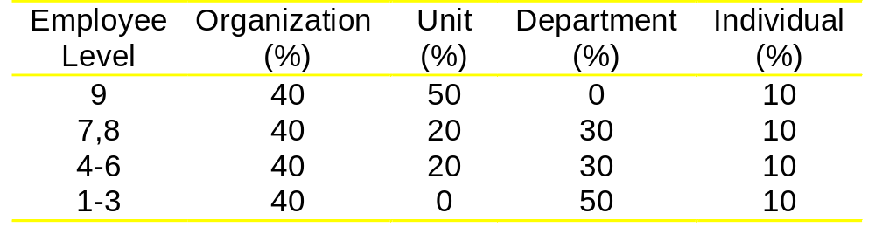
4.Performance Criteria
What are the measures to be?
  Financial, Objectives, Satisfaction, and a million more
At what level will we measure?
  Organization, Unit, Department, Individual or combo?
Can you have different measures at different levels?
Notes:
NOTES:

Slide 20
4.Performance Criteria - a few words
Don’t have more than 3-5 core measures.
If you say you want team work - then measure the team NOT the individual
If you have sub-measures make sure they are related
Ensure that you can get the information on the measures
Ensure that employees can have some impact on them
Notes:
NOTES:

Slide 21
5. Metric/Goals within Measures
Circuit Breaker
  A performance level that turns all measures off.
Threshold
  The minimum performance level at which you would pay out on a variable pay program.
    Typically 80-85% of target preference
    Last years performance
  Question - can different groups, organizations, have different thresholds?
Targeted performance
  The performance level that you expect to be achieved and at which level you would pay the targeted variable amount.
Notes:
NOTES:

Slide 22
5. Metric/Goals within Measures
Over-target (above plan) Performance
  Payments in excess of the targeted payment for performance in excess of the established metric/goal
  Can you have some measures with opportunity for over achievement and others not?
  Do you change the ‘ramp’ with over achievement?
  Do you have a cap?
What if a major change occurs in mid year to change the goals?
Notes:
NOTES:

Slide 23
A few words on the Metrics
Keep it Smart!
Significant but Simple
Measurable
Attainable
Responsible
Timely

Slide 24
6. Funding
Where is the $$$$ to come from to fund the program?
  New money? Increase in Performance? Current Compensation?
Is a ‘pool’ created for distribution?
How do you plan to ‘get it’ in current compensation?
  Increase Offset?
  Cut in current compensation
  “Cash-flow” movement
Notes:
NOTES:

Slide 25
Cash Flow Example
Current base only = $100
Cash Flow”
Base equals = $90
Day One payment = $10 (advancing the payment)
Next Day One Base = $90
Next Day One is based on performance = $0 to $20

Slide 26
7. Pay Outs
When are the measures to be taken?
  Quarterly, Annually, On an event?,
Are the pay out calculations
  Straight line
  Ramped up
    Stepped up
    Interpolated
What is the payout?
  Cash, Stock, something else?
Is it a percentage of salary, or grade? Or is it a set dollar figure?
Notes:
NOTES:

Slide 27
8 & 9 Benefits, and Administration
Must the employee be employed? When?
  At end of measurement or payment date?
What about LOA’s?
What about Death?
Are new hires or transfers eligible?
Must transfers be in their ‘group’ plan?
How does the pay out impact:
  Benefits? - Pensions, Life Insurance
  Future increases?
Notes:
NOTES:

Slide 28
10. Plan Evaluation
How do you know it is working?
Set up evaluation criteria in your plan document!
When will you evaluate the program?
Every day of the year!
What if the program is a mess in mid year?
  Remember many courts see this as a contract!
Notes:
NOTES:

Slide 29
A few words on implementation
Variable pay is a strong communication tool.
You must consider all the communication needs
  The roll out
  The measures
  The performance.
You should document the entire plan in a plan document.
Notes:
NOTES:

Slide 30
Short-Term Variable Pay: Usage
Median base rate for incentive $30,000 - 72.8%
Most effective plans have 3-5 measures
Most effective plans link to business
  66% strong linkage
  23% moderate linkage
  11% little linkage
At risk component growing
  19% FY95
  28% FY97
  50% >FY99
  82% Planned >FY2001 (but I think some of this is just talk)
Most plans find it difficult to put $ on gains
  42% can measure impact in $’s
  58% can not measure impact in $’s

Slide 31
A few other facts
Impact on Base Pay (Transition)
  Addition to current pay 76%
  Pay replacement 7%
  Future Increase Replacement 15%
  “Cash Flow” model 2%
Distribution to peer members
  Same Size Awards 76%
  Different Size Awards 24%
Distribution amounts
  Same dollar amount 56%
  Percent of Base Pay 44%
Notes:
NOTES:

Slide 32
Summary: Risks
Changes behavior
Outcomes are not always desired
Will impact company culture
Poorly designed programs can be expensive
Loss of trust by employees
Watch out for the non-exempt issues!

Slide 33
Basic Rules To Remember
People want to do the best they possibly can for both social and personal “approval”
People act in ways that get rewarded and avoid those that don’t
Lastly -
  The Good News is that incentive systems work.
  The Bad News is that incentive systems work!

