Slide 1

Discussion Questions of Polymorphism in ANDAs
Ken Morris
Industrial and Physical Pharmacy
Purdue University

Slide 2
Questions for the SAB
Do the proposed decision trees adequately address the key polymorph issues (stability and bioavailability) that should be considered in FDA's regulatory assessment on an ANDA?
Decision Tree#1. Are there other issues with respect to characterization of polymorphic forms that FDA should consider?
Decision Tree #3 addresses the necessity of having a polymorph spec for drug product when using the most stable or previously used form:
  Please comment on methods, approaches, and challenges for establishing specification for polymorphs in drug products. Also, in your experience, how often would you anticipate that such a specification necessary?
What additional considerations, if any, should be addressed on the issue of manufacture-ability or "process-ability" when different polymorph forms are present?

Slide 3
Decision Trees in My Opinion
Represent a huge mentality advance over “check list” approach
Encourages inclusion of proper scientific processes
Removes incentive for “testing into compliance”
Allows the industrial scientist to logically develop appropriate tests
Facilitates rationale risk assessment by regulatory and management
Levels the playing field for Generic companies by allowing the establishment of reasonable expectations based on the science

Slide 4
Do the proposed decision trees adequately address the key polymorph issues …
Decision Tree#1. Are there other issues with respect to characterization of polymorphic forms that FDA should consider?
In the context of sameness including amorphous, solvates (stoichiometric and variable), adducts, etc.. under the umbrella of polymorphs: questions/caveats.
#1
START
If polymorphs are not known or no monograph is available, do they have to be screened for? If so, this should be in the table.
The solubility determination of meta-stable forms must be scrutinized for conversion artifact.
Are there
known polymorphs
with different apparent
solubility?
YES
Are
all known
polymorphs highly
soluble?
NO
Decision Tree # 2

Slide 5
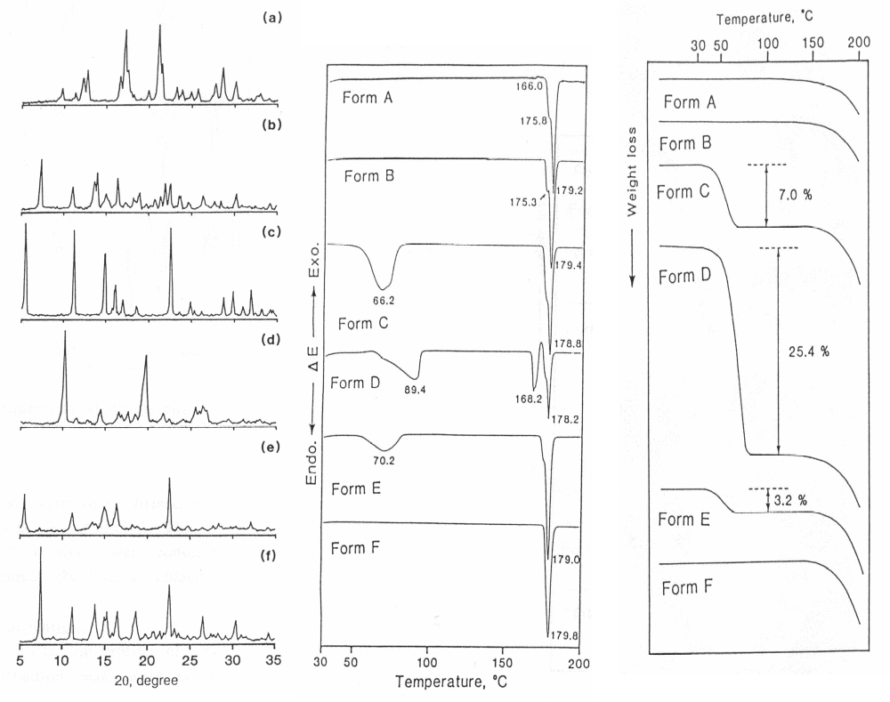
MP as an ID test for all of the forms under polymorphs is often problematic: it must be carried out and analyzed carefully to avoid confusion if it is to be the only test.
Decision Tree # 1
#2
Is there a
polymorphic specification
in the USP? (e.g.,
melting point)
NO
YES
Is the USP
polymorphic specification
adequate?
NO
Set new polymorphic
acceptance criteria for
drug substance
YES
Set the same polymorphic
acceptance criteria for
drug substance as the USP
Decision Tree # 3
More revealing yet common tests may be much less ambiguous and require similar resources
Matsuda et.a.

Slide 6
#2
Decision Tree # 1
Tighter specs may have to be negotiated with changing suppliers.
Includes differences in impurity profiles
Final crystallization and drying conditions
Is there a
polymorphic specification
in the USP? (e.g.,
melting point)
NO
YES
Is the USP
polymorphic specification
adequate?
NO
Set new polymorphic
acceptance criteria for
drug substance
YES
Set the same polymorphic
acceptance criteria for
drug substance as the USP
Decision Tree # 3
1) Different
polymorphic form
2) Allow to establish
tight specification

Slide 7
Levels of Difficulty: Reasonable Expectation in Characterization of Polymorphs
Routine
  Identification and quantitation of mixed phases in API
    XRD, DSC, IR, NIR
  Identification of “high” levels of mixed phase in Product
Difficult (sometimes unreasonable on a case by case basis)
  Quantitation of trace amounts of phases in API/product
    Synchrotron
    Raman mapping
    Advanced PXRD
  Quantitation of phases in Drug Product
    Particularly amorphous
Cutting Edge
  Prediction of crystal structures from powder XRD patterns

Slide 8
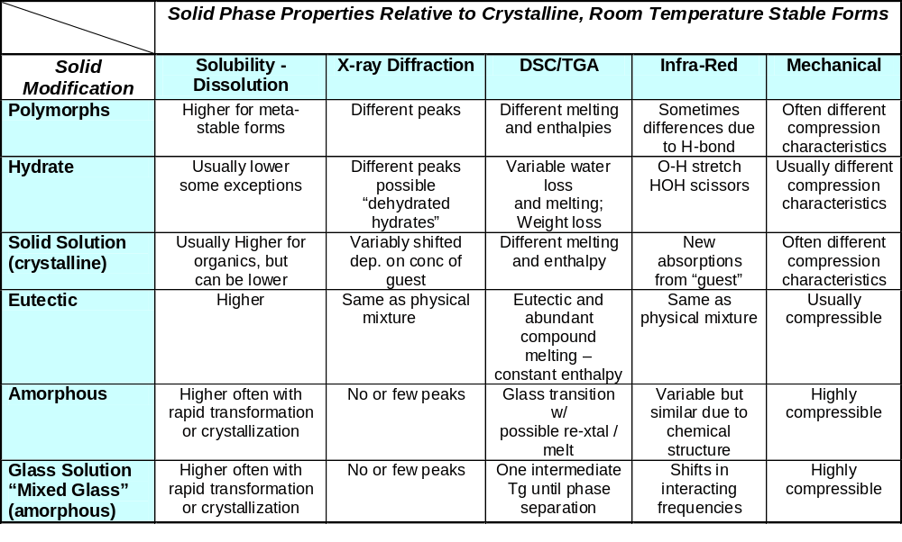
What to Expect from the Different Solid Phases

Slide 9
#3
Dissolution testing may often be correlated to KNOWN transformations.
Given a demonstrated liability, should the statistics be improved?
Are other techniques less resource intensive than dissolution allowing better statistics with less incremental investment?
Previous Slide
Does
the drug product
dissolution testing
provide adequate controls if
the polymorphic ratio
changes?
NO
Set acceptance criteria for the
drug product using other
approaches, such as solid
characterization method
END
“Dissolution testing can frequently detect potential conversion of polymorphs. In rare cases, solid characterization methods have to be used.”

Slide 10
“In general, there should not be a concern if
1) The most stable polymorphic form is used or
2) The form is used in a previously commercialized product”
#3
Here we need caveats for point 2 around amorphous and hydrated “polymorphs”.
  Amorphous forms may have been stabilized by unique formulation/processing strategies not easily reproduced and should include a cautionary statement.
  Hydrates may be easily altered in subsequent processing
  There should be a recognition of the possible need to “build in” in product characterization for meta-stable forms subjected to processing conditions producing conditions conducive to transformation

Slide 11
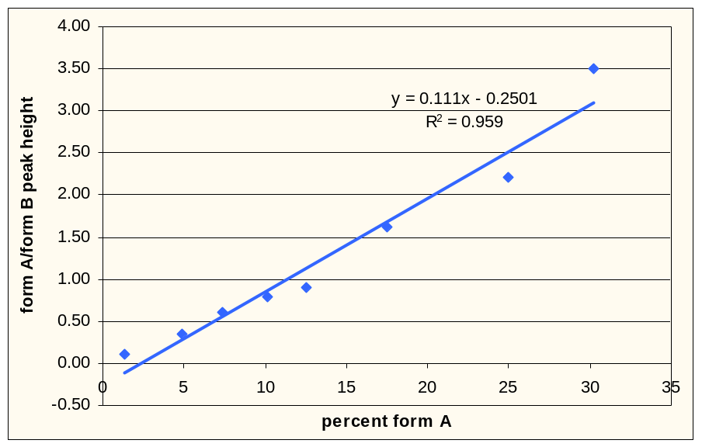
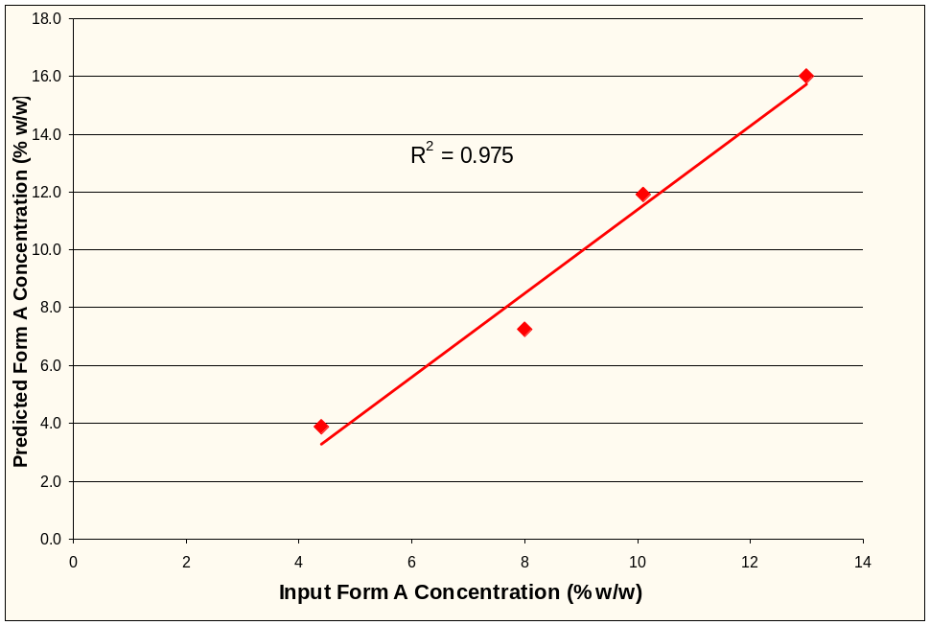
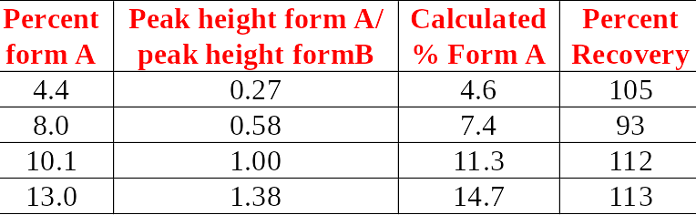
C. Approaches, and challenges for establishing specification for polymorphs in drug products. Also, in your experience, how often would you anticipate that such a specification necessary? (I’d say only occasionally to the last part)
Calibration
PXRD method
  Range 3-30 % form A
  Method RSD 5%
  Good percent recovery
Validation
Newman and Bugay

Slide 12
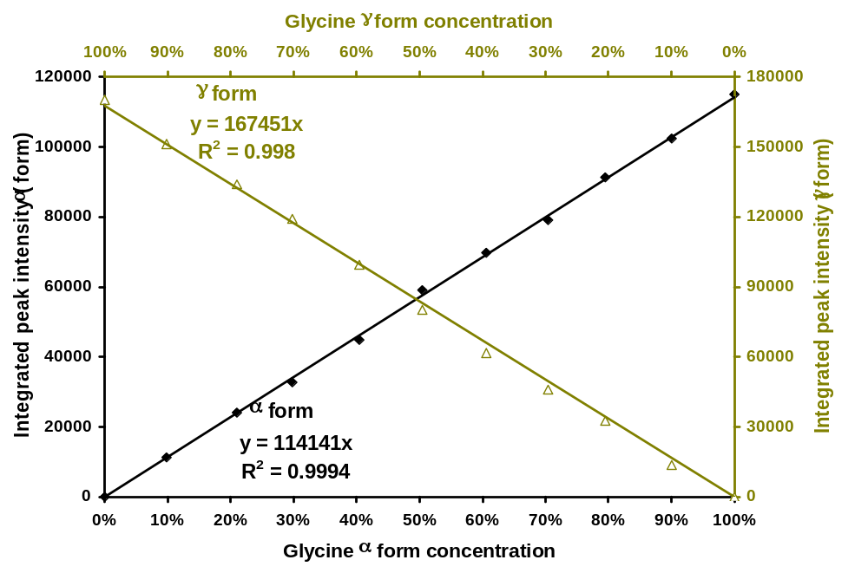
Calibration Curves of Glycine Compacts
Calculated detection limit: 0.5 % wt (γ form), 0.8 % wt (α form)
Cao and Morris (in press, JPharm Biomed Anal.)

Slide 13
Questions for the SAB
What additional considerations, if any, should be addressed on the issue of manufacture-ability or "process-ability" when different polymorph forms are present?
Subject of ongoing research (Minnesota, Purdue, Companies)
Issues should be addressed when potential is identified in formulation/process development. This could be acknowledged in charts.
  Maybe valuable as background for companies in subsequent trouble shooting

