Slide 1
Washington Group International
Sarbanes-Oxley Implementation
Brian R. Thomas
Waste Treatment Plant
Business Services Manager
December 12, 2006

Slide 2
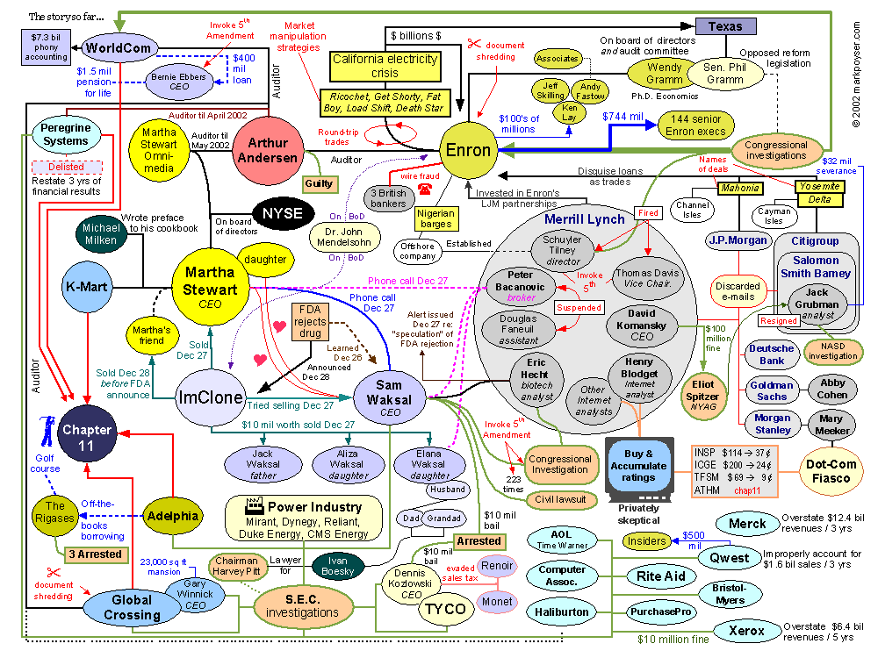
What is SOX?

Slide 3
Sarbanes-Oxley Act of 2002
Signed into law by President Bush in July 2002
  Named after its Congressional sponsors
    Senator Paul Sarbanes (D-MD)
    Congressman Michael Oxley (R- OH)
  Fundamental changes
    Independent auditing firms
      Significantly limited in what they can do on consulting side for its audit clients
      Audit engagements will no longer be a loss-leader
      Significantly higher fees for audit engagements
    Publicly-traded companies
    Criminal liability for CEO’s & CFO’s
  Response to financial scandals
    Enron, WorldCom, Adelphia, HealthSouth, others
  Restore investor confidence in publicly-traded companies
Notes:
Independent auditing firms
Public Company Accounting Oversight Board
Regulates; inspects; disciplinary proceedings
Now required to issue 2 audit opinions
Financial statements
Internal controls over financial reporting
Eliminated ability for auditors to provide consulting services to their audit clients

Slide 4
Background
No significant law changes since 2002
Intense industry and lobbyist pressure on Congress and SEC to reduce requirements of Section 404
  Very costly
  Penalizes small businesses
  Discourages listing on U.S. stock exchanges
2005 was second year of compliance for Washington Group
  Internal controls documented and tested
  Included every business unit, numerous projects and many corporate functions
    Financial Compliance department created to accomplish task

Slide 5
2006 Update
Further focusing/reduction of control activities
  Top-down; risk-based
  Reduced over 50% for 2005
  Additional reductions for 2006
Project SOX checklist
  Controls performed at project level
  Tested at BU level & project level
Process-level control activities
  80 percent of revenue & contract earnings as measured at year-end

Slide 6
Regulatory & Compliance Update
Year 2 SOX reports from companies
  Useful to identify, document, test controls
  More top-down & risk-based
    But not to the extent expected
  Fewer key controls
  More discipline in corporate accounting practices
  Improved investor confidence
  44%* say financial statements more reliable
  33%* say Section 404 helped them to prevent or detect fraud
*Financial Executives International (FEI) March 2006 Survey

Slide 7
Regulatory & Compliance Update
Year 2 SOX report from companies
  85%* say Section 404 costs exceed benefits
  Average costs declined 16%*
  Average compliance cost- $3.8 million*
  Duplication of effort for internal & external audit
  Testing of IT controls particularly checklist oriented (not risk-based)
*Financial Executives International (FEI) March 2006 Survey

Slide 8
Costs & Benefits
Year one implementation (2004) was expensive
  Average compliance cost was $1.9 million per billion of revenue*
Year two costs expected to be less
  Most companies expect to spend less
    Due to regulatory guidance after year one
*For companies with annual revenues less than $5 billion. Source: AMR SOX Spending Survey, 11/04, Controllers’ Leadership Roundtable research.

Slide 9
Costs & Benefits
Positive impact on overall corporate governance
Encourages management to set the “tone at the top” – walk the talk
Reinforcement that managers at all levels are responsible for internal control
Provides a platform to hold individuals accountable for noncompliance
Reduces the risk of material misstatements of financial reports
Provides an opportunity to review the company’s processes related to financial reporting
  Enhance efficiency; increase standardization; reduce errors

Slide 10
Costs and Benefits
Companies have found they didn’t always know what they thought they knew
Investors, creditors, & other stakeholders
  Higher confidence (higher stock price, lower costs of borrowing)
  More reliable financial statements
  More informed and vigilant Board of Directors and audit committee
  More timely and better management decisions

Slide 11
Audit Committee of Board of Directors
Must be independent of company
Has a mechanism to receive confidential and anonymous complaints
Directly manages the activities and compensation of the independent auditors
At least one member must be a “financial expert”
Holds management accountable for resolving significant deficiencies and material weaknesses in internal controls
Washington Group internal audit function reports directly to audit committee

Slide 12
Principal Executive Officers
For each quarterly & annual financial report, the CEO & CFO must certify that
  It is complete, accurate, transparent
  Internal controls over financial reporting have been established and maintained
  Effectiveness of internal controls within the past 90 days has been evaluated
  There is adequacy of disclosures to the audit committee
    Significant deficiencies & material weaknesses in internal controls
    Fraud involving management (any amount)
  There is adequacy of disclosures to the public
    All material weaknesses in internal controls over financial reporting

Slide 13
Summary - Project-level SOX Requirements
Perform SOX project control activities monthly or quarterly
Perform quarterly self-assessment of effectiveness of SOX control activities
Assist Corporate Audit in performing their audit work (mid-year and at year-end)
New projects
  Prepare initial process narratives
  Augment existing procedures where needed to obtain compliance
  As the project progresses, do items 1. through 3. above
Included are projects that comprise 80% of Company’s revenues and gross profits.

Slide 14
Quarterly Controls Self-assessments
“Process owners” perform quarterly self-assessments of SOX control activities
  Business managers at large projects, business units & corporate functions (about 50 in all)
  Process narratives – review & update, as needed
    At WTP:
      Added six SOX processes
      Added “Project CEO/CFO” sign-offs to four periodic financial support documents
  Control activities – perform inquiries, observations or other procedures to determine whether SOX control activities are being performed as designed
  Deficiencies – remediation for existing, identify & report any new
  Survey – complete & certify as to adequacy of SOX control activities
  Sign-off – OpenPages SOX Express application

Slide 15
Regulatory & Compliance Update
Restatements to correct financial statement - errors*
  Total of 1,200 for 2005
  Nearly double the rate of 2004
  1 for every 12 U.S.-listed companies
  Of the 1200, 640 reported material weaknesses** in internal control
    Most companies that did not report material weaknesses were smaller companies that did not have SOX audits
*Excludes GAAP-to-GAAP changes or adoption of new accounting principles
**A deficiency in internal controls that creates a “more than remote likelihood” that a material misstatement in the financial statements will go undetected

Slide 16
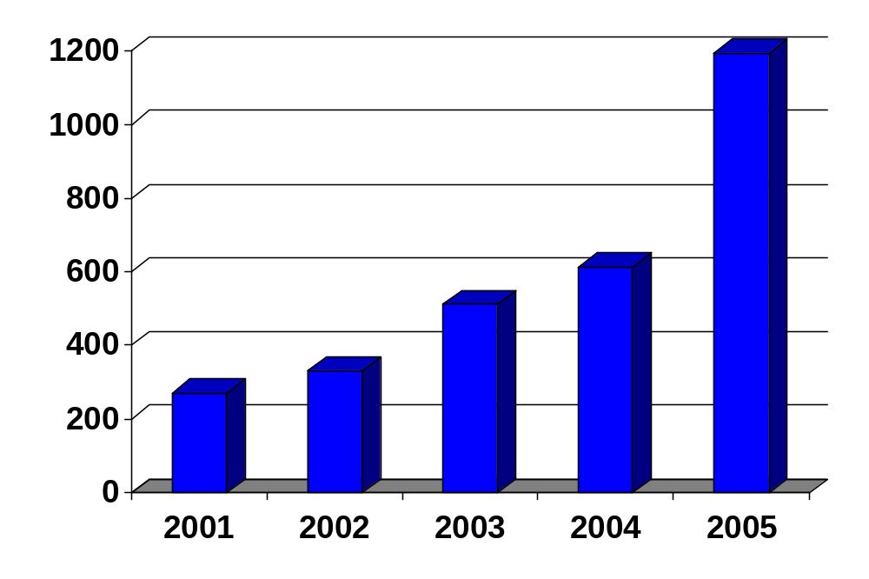
Restatements – U.S. Public Companies
Companies have found they didn’t always know what they thought they knew.

Slide 17
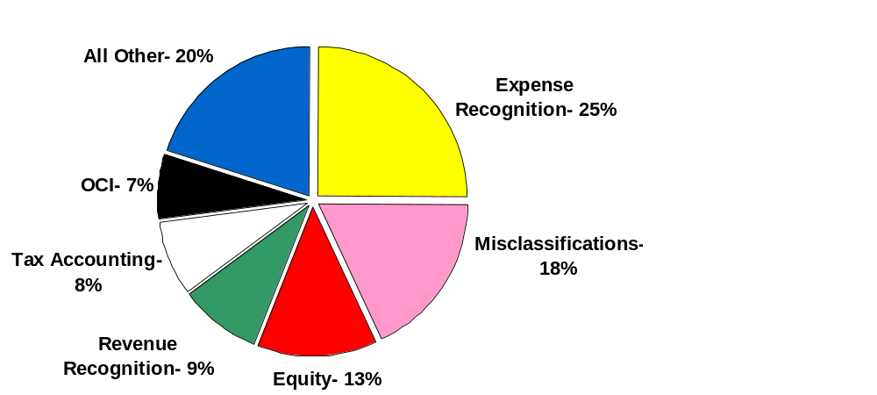
Top 6 Restatement Areas - 2005

Slide 18
Summary
Stay the path of reducing the cost of compliance
Sustainability of SOX
  Move from project (one shot deal) mentality to a process (this is life as we know it) mentality
Remediate deficiencies in internal controls
Don’t expect any regulatory changes in the near-term
  Recent rash of options-backdating cases won’t help

Slide 19
Summary (continued)
Look for opportunities to focus & automate control activities
  Risk-based
  Top-down approach
  Systems work flow & imbedded controls
  Less transaction-level testing
Our goal: no financial restatements
Resource – AICPA.org website link:
“Sarbanes-Oxley Implementation Central”
“State Issues Related to the Sarbanes-Oxley Act”

