Slide 1
Pity the Poor Peta-Flops Programmer
But not too much!
Dr. Richard Loft
Computational Science Section
Scientific Computing Division
National Center for Atmospheric Research
Boulder, CO USA
November 18, 2003

Slide 2


The Demand for Petaflops:
High Cost of Climate Science Goals
Climate scientists project a need for 150x more computing power of the next 5 years.
Doubling horizontal resolution increases computational cost eightfold.
Many additional constituents will be advected.
New physics: computational cost of CAM/CCM, holding resolution constant, has increased 4x since 1996. More coming…
Future: introducing super-parameterizations of moist processes would increase physics costs dramatically (another x120).

Slide 3
Observed IBM Cluster Efficiencies
System | Application efficiency (% of peak)
bluesk8 | 4.1%
bluesk32 | 4.5%
blackforest | 5.7%
Newer systems are less efficient.
Larger nodes are more efficient.
Max sustained performance: ~450 GFlops

Slide 4
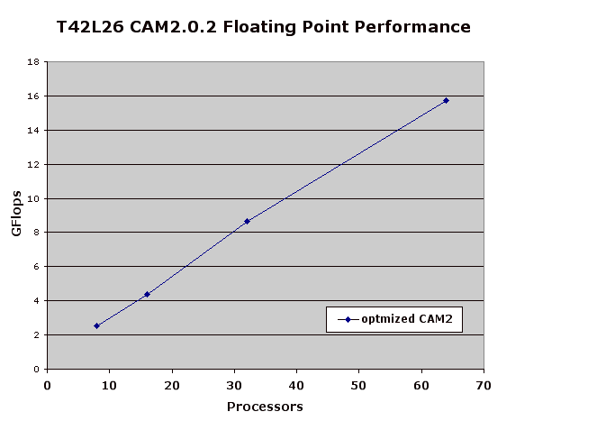

Slide 5
Towards Scalable Climate Models
Current dynamical core limits scalability
  Based on global transpositions
New core based on spectral elements
  Scales better (local exchanges)
  More efficient (~16% of peak on RISC)
  Runs on 1000’s of pe’s at 2/3º resolution
  Cache, thread, message optimizations
  Classic “heroic” effort with current tools.
  Sustained PFlops: only a factor of 2000 to go!

Slide 6
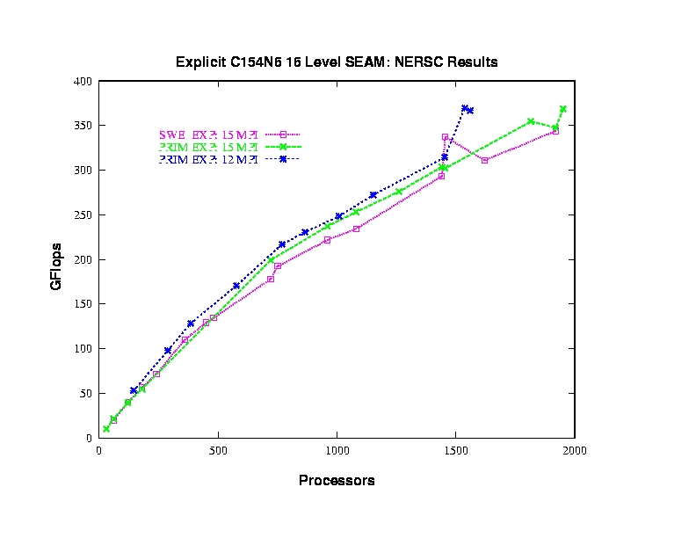

Slide 7
What are the Biggest Challenges you foresee in using Petaflops architectures?
Petaflops Diagnosis:
Complexity Complex
Architectural angst
Performance Anxiety
Memory Latency Syndrome (MLS)
Bisected Bandwidth
Reduction disorder
Data Storage/Analysis paralysis

Slide 8
Complexity Complex
Systems are getting more complex
  Processor (CMP, SMT, etc)
  Depth of memory heirarchies
Applications are getting more complex
  Application heirarchies
  Adaptive/dynamical algorithms
People are dumb/smart as ever

Slide 9
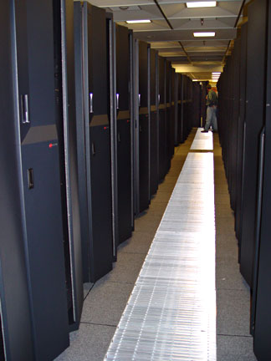
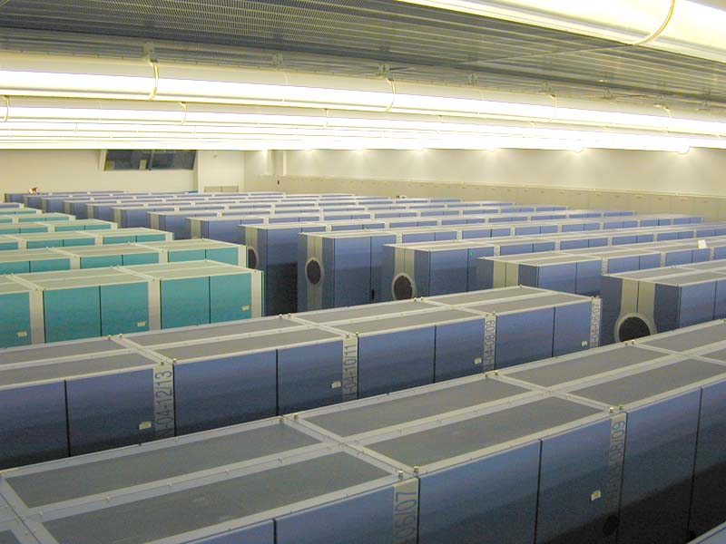
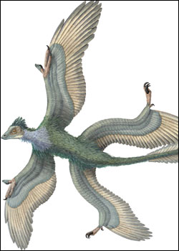
Architectural angst:What will it look like?
RISC?
MUTANT?
VECTOR?

Slide 10
More Architectural Angst
Assume the worst - you’ll be right!
COTS hardware
MPI library
“print” statement

Slide 11

More Architectural Angst
Code does not turn on a dime.
  Rewriting models takes about 5 years
  Changing algorithms about 10 years
  Both are disruptive to science
  Both cost $$$
Automation: Are we reaching the limits of the human programmer?
  Source translation
  Source generation
  Algorithm selection

Slide 12
Performance Anxiety
Lose the peak Flops mentality.
Some metrics I’d like to see:
  Local memory bandwidth of system
    Aggregate of parallel Streams.
  Local memory latency
    Random index chase.
  System bisection bandwidth
    All to all transpose (MB/s/proc)
  System-wide Latency
    global reduction of short vector.
    global barrier synchronization.

Slide 13
Data Paralysis
Data Storage/Analysis/Visualization
  Storage costs $$$ :
  Tools for analyzing data will break!
  Sharing data difficult (LAN/Grid/Fedex)
  Just compute on fly. Well, exploring data sets and discovering new things is part of science. Computing on the fly is only good if you already know the signal you are looking for.

Slide 14
What do Programming Models Need to provide you to exploit Pflops Architectures productively?
The programming model should abstract away irrelevant architectural details without abstracting away performance.
Too much arcane and ephemeral knowledge is required to get at performance: this applies to the system administration, user environment, language-compiler interactions, and to run-time libraries.
It should be easy to get correct and reproducible answers. Little in current paradigms to encourage this.
It should be easier to diagnose what is going on.

Slide 15
What do Programming Models Need to provide you to exploit Pflops Architectures productively? (cont)
The programming model needs to provide a clear performance API for both local and non-local operations.
The parallel abstraction must not be too restrictive. In this respect, HPF was bad.
  Allow for asynchronous communication.
  Quasi-regular grids (icosahedra/cube topologies)
  Transpositions/regriddings
  Unstructured/adaptive grids
  Parallel I/O Model
Should be a full functioning OO language.

Slide 16
What do Programming Models Need to provide you to exploit Pflops Architectures productively? (cont)
Whole business of HPC languages seems trapped at the academic threshold.
Needs to be a substantial developer/user community, perhaps captive, from the beginning.
Linux open source model for domain specific languages?
The programming model needs to persist. Algorithmic improvements, changes to production models are decadal processes, much longer than a CS PhD thesis (hopefully).

Slide 17
What constructs or abstractions would make it easier for you to map your applications on PFlops architectures?
OK we have local memory hierarchies, can we build smart software/hardware to deal with them?
Fine grained thread/relaxed coherency model is interesting.
Efficient and flexible grid constructs.

Slide 18
Which code would you rather write?
n8 = n - MODULO(n,8)
do j=1,n,8
s0=y(j)
s1=y(j+1)
s2=y(j+2)
s3=y(j+3)
s4=y(j+4)
s5=y(j+5)
s6=y(j+6)
s7=y(j+7)
do i=1,n
s0 = s0 + x(i)*a(i,j )
s1 = s1 + x(i)*a(i,j+1)
s2 = s2 + x(i)*a(i,j+2)
s3 = s3 + x(i)*a(i,j+3)
s4 = s4 + x(i)*a(i,j+4)
s5 = s5 + x(i)*a(i,j+5)
s6 = s6 + x(i)*a(i,j+6)
s7 = s7 + x(i)*a(i,j+7)
end do
y(j) = s0
y(j+1) = s1
y(j+2) = s2
y(j+3) = s3
y(j+4) = s4
y(j+5) = s5
y(j+6) = s6
y(j+7) = s7
end do
do j=n8+1,n
y(j) = y(j) + x(i)*a(i,j)
end do
do j=1,n
do i=1,n
y(j) = y(j) + x(i)*a(i,j)
end do
end do

Slide 19
At which point in the maturity of a new programming language would you be willing to try a new promising model?
At the very beginning.
At the very end.
The ugly middle’s the part to avoid!
Seriously, in my experience these partnerships are hard to get funded.
NCAR has tried with ZPL and EARTH.

