Slide 1
Spallation Neutron Source
SNS – Key Lessons Learned
Les Price
OECM Workshop
November, 2006

Slide 2
Spallation Neutron Source
World’s most powerful neutron science facility (x 10)
User Facility: ~2000 guest scientists per year (by ~2012)
Pulsed proton beam from Linac/Ring creates neutrons by spallation reaction with a heavy metal target
Partnership of 6 laboratories under direction of SNS Project Office in Oak Ridge
Level 0 Baseline Objectives
1 Mw proton beam on target……….Exceeded
Completion in June 2006……………May 2006
Total Project Cost = $1,411.7M……~$5 M under

Slide 3
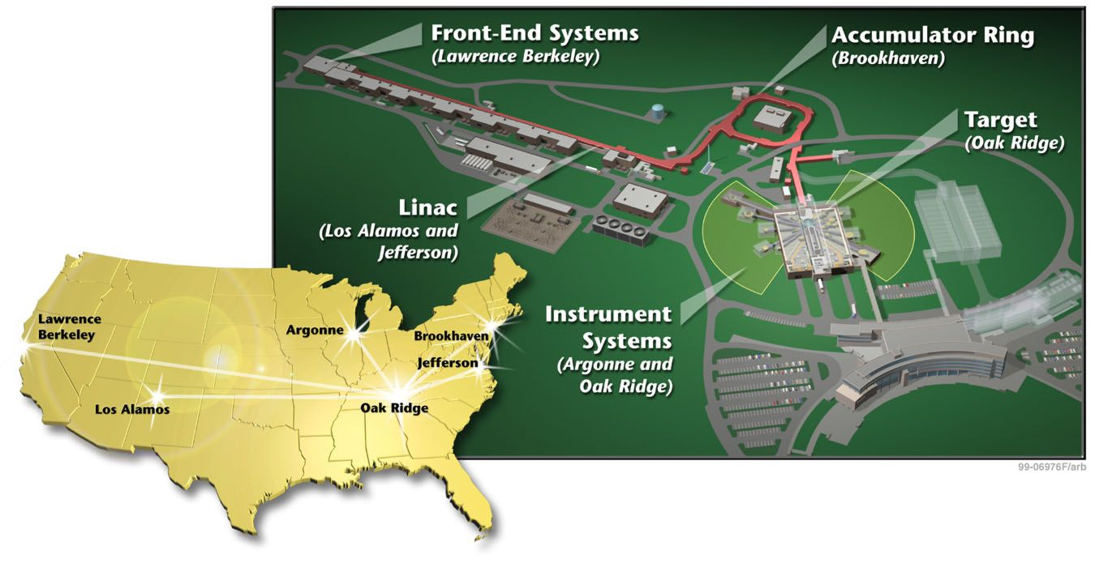
Spallation Neutron Source Partnership

Slide 4
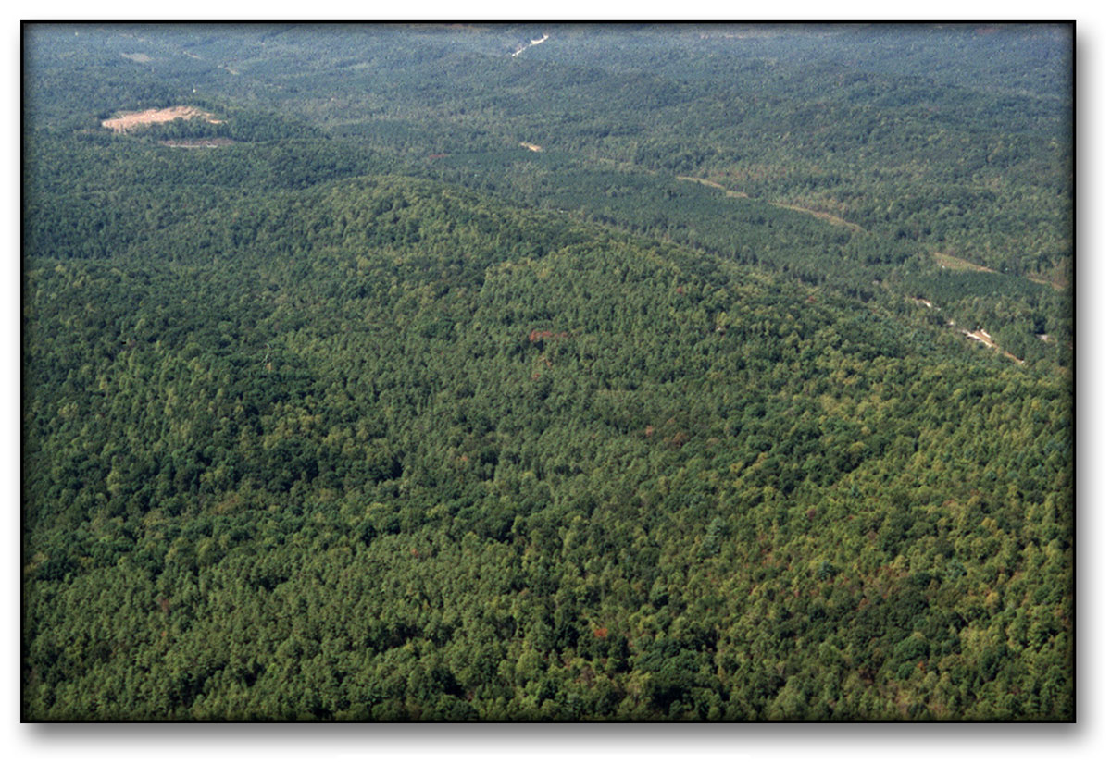
SNS site - 1999

Slide 5
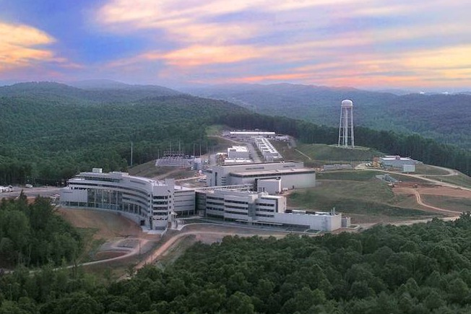
SNS complete - May 2006

Slide 6
SC Project Management Principles
Strong laboratory management team
  Partnership with DOE
  Technically qualified for the project
  Highly motivated as the future user
  Strong institutional support
  With authority to make decisions!
Shared vision between DOE and lab
  What is to be built and why
  Realistic cost and schedule baselines
Emphasis from the beginning on a rigorous safety culture
Regular, disciplined peer review process on all aspects of project, i.e. Lehman reviews and Advisory Committees
  Incorporates lessons learned from other projects
  “Peer pressure” is strong motivator
  Reflects SC lab sense of “family”
  Tool for managing risks and vulnerabilities

Slide 7
Not a PMBOK Project
Typical Construction Project: “Build This”
Well defined and bounded scope, i.e. “design to scope”
CDR is basis for Level 0 baseline and detailed design
Little/no R&D or operations in project scope (TEC~TPC)
Limited interest by program organization in project execution
Project organization goes away after completion

Slide 8
Science Projects – “Most Bang for the Buck”
Meet essential requirements, then maximize science capability within TPC and schedule, i.e. “modified design to cost”
CDR establishes reasonableness of Level 0 baseline; point of departure for further optimization; benchmark for success
R&D and operations (commissioning) are important drivers
SC and science community involved throughout project
Decisions driven by long term vision; expect future upgrades
Project organization evolves into operating organization

Slide 9
Other Key Lessons Learned
Mission Need and Strong Program Support were Critical
  High cost projects will always be challenged
  Science community support of SNS never wavered
  Political support never wavered
  DOE-SC support never wavered
Lab Management Team Must Have Project Mentality
  Appropriate experience for the job
  Success in building the mission need doesn’t ensure success in execution
  A new execution team will revisit concepts and planning

Slide 10
Other Key Lessons Learned …con’t
Managing Project Execution is not Rocket Science
  Mostly Project Management 101
  Plan carefully, build a strong team, anticipate problems, manage changes proactively, stay on top of the details,….
  Keep your eye on the ball (EAC, risk)
  Use the tools of the trade…with judgment
  Drive schedule, Drive schedule, Drive schedule
Multilab Partnerships Add Another Dimension
  Lead Laboratory must have clout
  Management at each lab must make commitment and accept institutional ownership and accountability
  Lead Laboratory must have the technical expertise to be strong systems integrator
  Start-up and roll-off are critical times

Slide 11
Other Key Lessons Learned – con’t
Planning for operations and commissioning/pre-operations should take place early
  Needed to establish cost estimates within TPC
  Needed to communicate “vision” and recruit staff
Long-range upgrade strategy should be established between DOE and Lab
  Enough detail to guide design decisions
  Facilitate future scope enhancements

