Slide 1
OSCAR SECURITY
Neil Gorsuch
NCSA

Slide 2
The Futility of Security
Even extreme measures don’t always work
Cases in point:
  Airport security
  Recent openssh security hole
CERT security incidents
  (each may involve a single machine to hundreds of machines)
Year
1990
1991
1992
1993
1994
1995
1996
1997
1998
1999*
Incidents
252
406
773
1,334
2,340
2,412
2,573
2,134
3,734
9,859
Year
2000
Q1-Q3, 2001
Incidents
21,756
34,754

Slide 3
OSCAR Security Difficulties
Wide range of security hardening requirements
  Some clusters have all nodes directly connected to internet
  Some already behind massive firewalls
Every cluster machine needs hardening in some cases
Widely varying cluster network topologies
Clusters usually have many network services
Clusters usually have many users
Clusters often need to be accessible from the internet
Clusters are prime targets for hackers:
  Powerful computing engines
  Large temporary data storage
  Fast network for launching denial of service attacks

Slide 4
The Loose Security Environment/Model
In political terms, the FAR LEFT:
All cluster nodes accessible from the internet
No firewalls between the cluster and the internet
Little or no packet filtering
No high ports filtered from the internet
All network services allowed
  (what, you mean RedHat isn’t secure out of the box?)
The technical name for this type of environment is a

Slide 5
The Loose Security Environment/Model
In political terms, the FAR LEFT:
All cluster nodes accessible from the internet
No firewalls between the cluster and the internet
Little or no packet filtering
No high ports filtered from the internet
All network services allowed
  (what, you mean RedHat isn’t secure out of the box?)
The technical name for this type of environment is a
“target rich environment”

Slide 6
The Loose Security Environment/Model
In political terms, the FAR LEFT:
All cluster nodes accessible from the internet
No firewalls between the cluster and the internet
Little or no packet filtering
No high ports filtered from the internet
All network services allowed
  (what, you mean RedHat isn’t secure out of the box?)
The technical name for this type of environment is a
“target rich environment” or “script kiddies playground”

Slide 7
The Strict Security Model (FAR RIGHT)
Very strict cluster/border firewall
  No packet forwarding, all services must use proxies
  Sometimes, secure login services such as ssh not allowed
    (because they can’t log conversations)
Access outside the firewall to the cluster impaired
File transfer difficulties
  The technical term for this is

Slide 8
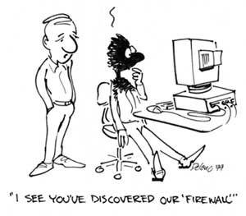
The Strict Security Model (FAR RIGHT)
Very strict cluster/border firewall
  No packet forwarding, all services must use proxies
  Sometimes, secure login services such as ssh not allowed
    (because they can’t log conversations)
Access outside the firewall to the cluster impaired
File transfer difficulties
  The technical term for this is
  “work impairment”
“Big Brother” mentality
  (logs of all your actions)

Slide 9
OSCAR Security Plans
Machine based packet filtering for exposed nodes
  (yes/no during wizard, and a configuration GUI)
TCPwrapping
  (yes/no during wizard, and a configuration GUI)
Network services control GUI
Sandboxes around servers if wanted
  (ftp, http, DNS, NTP, etc.)
Examination of logs for hacking attempts
Tripwire if wanted
IDS if wanted

Slide 10
Security is an Onion (Layers)
Router packet filtering (outside of OSCAR’s scope)
Source route verification (OSCAR 1.?)
Machine packet filtering (OSCAR 1.?)
  At externally connected nodes if cluster has private subnet
  On all cluster nodes if no private subnet
  Hard to set up unless special tools available
  Easy to mess up and leave security holes without special tools
TCPwrappers (OSCAR 1.?)
  Conditionally block access by service/source address
  Some services bypass this in some distributions
Server application sandboxes (OSCAR 1.?)
Application configuration (OSCAR 1.?)
  Some applications can be set to conditionally block access
Users cannot log into compute/batch nodes (OSCAR 1.?)
Intrusion Detection Services (OSCAR 1.?)
  Tripwire, others, some sniff network packets

Slide 11
Source Route Verification
When turned on for an interface, prevents packets from being accepted on that interface that are impossible (such as packets claiming to come from 127.0.0.1 arriving on a NIC)
Martians are packets that are dropped by source route verification
Planned to be in OSCAR 1.3/1.4 as part of pfilter

Slide 12
Packet filtering
Examines each network packet, looking at:
  Source address abd destination addresses
  Network interface
  Protocol type (TCP UDP ICMP) and destination port
  Other parameters depending on type
Each packet is either:
  Passed
  Dropped (nasty, makes port scanning more difficult, and makes harmless wrong connection attempts take a long time to timeout)
  Rejected (normal network protocol for packet that can’t be accepted)
Two types of packet filters are stateless and stateful
Planned to be in OSCAR 1.3/1.4 as part of pfilter

Slide 13
Blocking Outside Access To Services
Best way to tighten security
  (most network break-ins through service security holes)
Difficult way to tighten security
  (different distributions turn on/off services different ways)
  (different services conditionally block access different ways)
TCPwrappers can block/filter most services
  /etc/hosts.allow and /etc/hosts.deny

Slide 14
Best Security Return on Invested Time
Packet filtering
  Does the work of most of the other security layers
  Hard to set up
  Easy to mess up
  Some network services require special connection tracking modules not all of which are written yet
What is needed:
  A good way to generate packet filtering rulesets that is:
  Easy to use
  Shields the user from packet filtering details
  (a packet filtering compiler)

Slide 15
pfilter – a Packet Filter Compiler
Configured by either:
  An easy to understand text configuration file, or …
  a configuration GUI (both hide details of packet filtering)
Default setup:
  Incoming packets/connections that are not explicitly allowed are dropped/rejected
  Any outside network service can be accessed/used from within the machine with no proxies
  Incoming ICMP packets blocked except for:
    Destination unreachable and redirect packets for errors
    OSCAR defaults will allow pinging and tracrouting within cluster
Controlled by chkconfig/service start stop restart status
No compiled binaries, same RPM for all platforms

Slide 16
pfilter on a Multiple NIC Machine
Automatically determines which is the protected internal interface by looking for RFC 1918 private addresses
By default:
  Allows machines on the internal/protected interface to access any outside network service
  Hides machines on the internal interface from the outside
  Uses IP masquerading for all connections from the inside
Allows internal hosts to have some services be accessible from the outside using translated address/ports. These hosts can appear to respond to a separate external address than the one that pfilter is running on. This allows hosts on a private subnet behind the firewall/pfilter machine to not have to be tightened down, security-wise, while still allowing access to them from the outside.

Slide 17
Main Parts of a pfilter Configuration File
This opens/closes services on the pfilter machine:
OPEN/CLOSE [protocol(s)] service(s) port(s) \
[from source(s)] [to destination(s)] [on interface(s)]
This allows hidden hosts on a private subnet to appear to be outside the firewall machine with selected services on the hosts being accessible from outside:
ALIAS external_address hidden_address [protocol(s)] \ service(s) port(s) [from source(s)] [on interface(s)]
This is how to set network interface attributes:
filtered|unfiltered|protected|unprotected interface(s)

Slide 18
pfilter Ruleset Generation
Ruleset generation is done when started/restarted
Generates “glue” rules that (if appropriate):
  Turn on IP masquerading and packet forwarding
  Generate pseudo interfaces for aliased hosts
  Add routing table entries for aliased hosts
  Logs bad packets various ways
  Uses modprobe commands to pull in kernel modules
  Turn on source route verification and martian logging
  Turn off BOOTP packet forwarding
  Allow packets that are part of a tracked connection through
Allows/blocks specified connections

Slide 19
pfilter Efficiency
A 3 line configuration file required to:
  Allow ssh logins to a machine
  Allow ssh logins to one of it’s internal hidden hosts
  Allow terminal services logins to another hidden host
produces a good level security 192 line ruleset file

Slide 20
pfilter, A Work in Progress
Version 1 is in use:
  on largest NCSA cluster
  in various NCSA X-in-a-box products
Open sourced (GNU license)
Resides on sourceforge
Version 2 is in testing stages

Slide 21
pfilter Version 2
Currently being tested
New features:
  Network services defined in text files, extensible by user
  Services can include shell script fragments for OPEN/CLOSE
  Macros in configuration and service definitions
  Support for iptables/ipchains/ipfilter through macros
  Conditional “compilation” in configuration and services
  Named constants/defines in configuration and services

Slide 22
pfilter Future Versions
GUI (webmin based)
TCPwrappers <> pfilter synchronization
System logs analysis for hacking attempts reporting

Slide 23
For pfilter Information
Contact me at:
  ngorsuch@ncsa.uiuc.edu
pfilter project page
  http://pfilter.sourceforge.net/

Slide 24
The Perfect Firewall for OSCAR 2.0
A firewall was found that:
  Does more than filter packets
  Completely blocks all unwanted intrusions through it
  Lets exactly what the user wants through it
  Rock – solid
  Proven technology
I’m still trying to integrate it into OSCAR, but here is an advance look at it before it’s deployment:

Slide 25
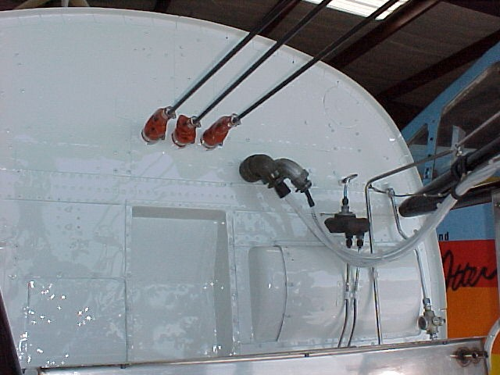
The PERFECT Firewall

Slide 26
Private Subnet Cluster Topology
Only head(login)/administration nodes on outside network
Head(login)/administration nodes have dual NICs
  One to outside network, other to private cluster network
Compute/storage nodes on private network
Compute/storage nodes access outside network through the head/login/administration nodes
Compute/storage nodes are NAT’ed/IP masqueraded
More difficult to allow access to compute nodes from outside
  (too bad about CACTUS)
Better security for entire cluster
Relaxed security concerns on compute/storage nodes
Throughput problems from compute/storage to outside
  (probably not usable for medium or larger clusters)

Slide 27
Public Network Cluster Topology
Simpler to set up
Allows direct access to compute nodes from outside
  (can be UN-filtered to specific nodes from specific network addresses via job control language when needed - CACTUS)
Worse overall cluster security
ALL cluster nodes need packet filtering and/or security tightening
ALL cluster nodes are potential targets
Better network throughput
Large clusters probably need to be set up this way

Slide 28
Stateless Packet Filtering
Linux kernels prior to 2.4
Controlled by the ipchains program
Examines each packet on it’s own to pass/drop/reject
Does not keep track of running connections
Because of this, high ports usually have to be left unblocked
FTP is a big problem under stateless packet filtering
Typical stateless ruleset 5 times larger than for stateful
Much less security than stateful packet filtering
Fortune 500 example

Slide 29
Stateful Packet Filtering
Linux kernels 2.4 and later
Controlled by the iptables program
Keeps track of active connections, examines each packet based on their place in a connection
Can easily block ALL ports except the ones needed to connect to services
Can conditionally unblock other ports based on their appropriateness in an active connection
Rulesets can be very simple and still allow good security

Slide 30
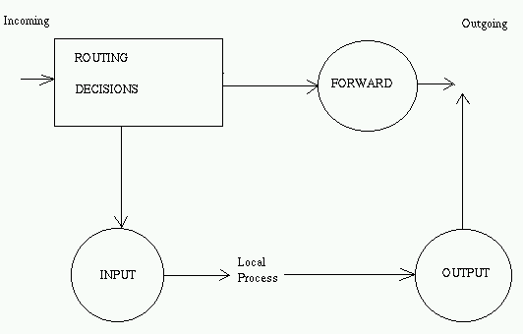
Linux kernel >=2.4 / iptables Filtering
Pre-defined
filtering:
Integrated connection tracking / stateful filtering / NAT
New conditional packet matching: MAC Address, limits to prevent log overflows, user id, packet length, packet strings, time of day, service classifications

Slide 31
Login Services
telnet
  Most send names/passwords over network un-encrypted
  Newer kerberized versions avoid this and are acceptable
rlogin
  Names/passwords over network uncrypted (unless user .rhosts files allowed)
  Anything rlogin can do, ssh can do better
ssh
  Encrypted connections
  Kerberized versions available
  Openssh has excellent track record
  Allows tunneled X connections (X ports can be blocked)

Slide 32
File Transfer Services
tftp
  Simpler version of FTP
  Security Nightmare
ftp
  Widely used
  Most send names/passwords over network un-encrypted
  Server security holes found frequently
  Nightmare for stateless packet filtering
  Better to force users to passive mode ftp from within cluster
scp
  Encrypted connections
  Kerberized versions available

Slide 33
FTP Active Mode
Sequence:
  Client program contacts server on TCP port 21
  Client picks TCP port 1024-65535 on client for the server to connect to
  Server connects back to the client chosen port coming from TCP port 20
Active mode FTP clients on the inside of a firewall should only be allowed to access the outside if:
  the firewall has stateful packet filtering so that it can selectively open higher TCP ports based on current FTP connections.
Active mode FTP servers inside a firewall are not a problem for either stateless or stateful packet filter.

Slide 34
FTP Passive Mode
Sequence:
  Client program contacts server on TCP port 21
  Server picks an unused TCP port 1024-65535 and tells the client the port number
  Client opens connection to picked TCP port on server
Clients outside a firewall should only be allowed to access FTP servers inside the firewall in passive mode if:
  the firewall has stateful packet filtering so that it can selectively open higher TCP ports based on current FTP connections.
Clients inside a firewall can access outside servers in passive mode without any problems for stateless or stateful packet filtering.

Slide 35
Remote Windowing
X
  The standard for Linux/Unix
  Serious security holes
  Don’t allow it through a firewall unless tunneled inside ssh
  Linux/Unix/Windoze clients available
Windoze Terminal Services
  Too bad it’s not usable for Linux, because it’s encrypted, compressed, detachable, and caches bitmaps
VNC http://www.uk.research.att.com/vnc/index.html
  Stateless (reconnect sessions from anywhere)
  Sharable (sharing of window sessions)
  Encrypted passwords, un-encrypted stream (tunnel via ssh)
  Servers/clients for Unix/Linux/Windoze/MAC/X

