Slide 1
Facing the Media
A Course To Prepare CDC Spokespersons for Crisis and Emergency Situations

Slide 2
Introduction and Understanding a Crisis

Slide 3
Learning Objectives
Communicate the importance of the spokesperson and his or her roles and responsibilities during a crisis or emergency.
Provide the opportunity to practice message delivery in a realistic, high-pressure, on-camera training situation, and receive individualized feedback on performance.
Notes:
Note to Instructor(s):
This is a short four slide section on the learning objectives and purpose of the course.
Run this slide and the next for 5 and 25 seconds respectively.

Slide 4
Training Agenda
Morning
On-camera
press-conference training
Understanding a crisis
Your role as a spokesperson
Afternoon
Message development
Individual on-camera training
  Scenario
  5-minute interviews

Slide 5
Role of Emergency Risk Communication
Provide the public with information to make the best possible decisions within nearly impossible time constraints and to accept the imperfect nature of choice.
Use all the potential channels of dissemination to get messages out:
  Media
  Others

Slide 6
Reactions of the General Public During a Crisis
Decisionmaking is different:
  People simplify.
  They cling to current beliefs.
  They remember what they have seen or experienced before.
  First messages and messengers carry more weight.
  Perception becomes reality.
In “fight or flight” moments of an emergency, more information leads to decreased anxiety.

Slide 7
How People Behave, Feel, and Think
People:
Seldom panic
Undergo denial
Experience fear, anxiety, confusion, and dread
Feel hopeless or helpless
Rehearse vicariously
  People now “experience” local crises and mentally rehearse recommended courses of action (e.g., worried well).
Notes:
Note to Instructor(s):
This is a short four slide section on the learning objectives and purpose of the course.
Run this slide and the next for 5 and 25 seconds respectively.

Slide 8
Risk Acceptance
Dying by falling coconut or dying by shark
Natural vs. man-made
Fairly vs. unfairly distributed
Familiar vs. exotic
Controlled by self vs. outside control of self
Affecting adults vs. affecting children

Slide 9
Post 9/11 Suspicion
Most incidences will be suspect for
bioterrorism:
Outbreak of a rare disease
Seasonal disease at the wrong time
Unusual age distribution
Unusual clinical symptoms
Unusual epidemiologic features
Outbreak in a region normally not seen

Slide 10
Risk Communication Principles for Emergencies
Don’t overreassure.
A high estimate of harm modified downward is more acceptable than a low estimate of harm modified upward.
“It’s possible that tens of thousands could be afflicted before this is over,
but right now only 100 are sick.”

Slide 11
Risk Communication Principles for Emergencies
State continued concern before stating reassuring updates.
“Although we’re not out of the woods yet, we have seen a declining number of cases each day this week.”

Slide 12
Risk Communication Principles for Emergencies
Confidence vs. uncertainty.
Express the uncertainty of the situation and confident belief in the “process” to fix it, and address public safety concerns.
“It must be awful to hear we can’t answer that question right now, but here’s what we are doing to find out . . .”

Slide 13
Risk Communication Principles for Emergencies
Give people things to do. Anxiety is reduced
by action and a restored sense of control.
Symbolic behaviors
Preparatory behaviors
Contingent “if, then” behaviors
Three-part action plan:
  Must do X
  Should do Y
  Can do Z

Slide 14
Risk Communication Principles for Emergencies
Allow people the right to feel fear.
Don’t pretend that they’re not afraid, and don’t tell them that they shouldn’t be. Acknowledge the fear, and give contextual information.
“We’re all frightened by this, but here’s what we know . . .”

Slide 15
Risk Communication Principles for Emergencies
Ask more of people.
Ask people to bear the risk and work towards solutions with you.
“We don’t know if this is the last case, but right now it’s important for all of us to continue on with our lives . . .”

Slide 16
Disasters Are Media Events
Need the media to be there.
Tell the public about important protective actions.
Know how to reach their audiences and what their audiences need.
Respect the immediacy of their needs for information.
A sensational story will create a pack mentality.

Slide 17
Media Genres
Broadcast—TV and radio are the news sources of most people during a crisis:
  Deadline driven.
  Pressure of visual needs, needs action.
  Live or taped interviews.
  Tight deadlines mean little time for verification.
  Radio gives an audio sense of “being there.”
TV crawlers mean news is out immediately.

Slide 18
Media Genres
Print—Newspapers and magazines require sometimes hours instead of minutes to file:
  Reporters are more likely to verify information and to call other sources.
  Many will file early for online editions.
Internet—It has speeded up everything and has changed how reporters get information; instant news can be picked up by anyone.

Slide 19
Media Myths During a Crisis
Experienced reporters will be assigned
to give a balanced coverage.
News does not set up daily for crisis coverage.
Newsroom sends who is around and available first, then gets its experts on it.
A sensational story rarely stops for balance.

Slide 20
Media Myths During a Crisis
The media will take the time to
understand what we are going through.
Deadline pressures mean that they will believe and go with almost any information.
Beat competition, pressure of a
24-hour news cycle.
Facts get sorted out later.

Slide 21
Media Myths During a Crisis
The story will be better if we avoid
talking to the media until we have all
the facts together.
The media won’t wait.
They’ll use what they get and put it on the air.
They’ll be there again when the information is updated.

Slide 22
Media Myths During a Crisis
Reporters verify facts and work just as
they do during regular assignments,
only faster.
Reporters go with what they have at the time.
They come back later for new breaking information.
They move on to the next aspect of the crisis.

Slide 23
Media Myths During a Crisis
News will play it exactly as I say it.
No matter how factual your statements are, they will be filtered through a reporter’s understanding.
When under crisis deadlines, reporters won’t spend a lot of time going through complex information for background.
Reporters look for good sound bites and quotes.

Slide 24
What the Public Asks First
Are my family and I safe?
What have you found that may affect me?
What can I do to protect myself and my family?
Who caused this?
Can you fix it?

Slide 25
What the Media Ask First
What happened?
Who is in charge?
Has this been contained?
Are the victims being helped?
What can we expect?
What should we do?
Why did this happen?
Did you have forewarning?

Slide 26
What the Media Now Surely Ask in a Health Crisis
Is this bioterrorism?
Could this be bioterrorism?
Are you investigating this situation as possible bioterrorism?
Is the FBI involved in this investigation?
When will you be able to tell us whether or not this situation is bioterrorism?

Slide 27
The Spokesperson’s Role
Embody the organization, e.g., “CDC exists to make people safer and healthier. Personnel have history of going in harm’s way to detect disease and prevent its spread. It is humble in going where asked. It has credibility as disease detectives and as a source of sound advice.”
Be trustworthy, credible, empathetic, and committed.
Be human.
Deliver the important messages!

Slide 28
Communicating in a Crisis Is Different
Empathy
What you are doing to solve the problem and actions for people to take
Facts and fast, credible information
Process for managing the problem and for providing more information
Limit intake of information (People remember about three bits.)

Slide 29
So How Do We Initially Communicate in a Crisis?
Simply
Timely
Accurately
Repeatedly
Credibly
Consistently

Slide 30
Your Role as a Spokesperson

Slide 31
Effective Spokespeople Are Not Born; They Are Made
It’s not “acting natural.”
Strong spokespeople have knowledge, skills, and practice.

Slide 32
“A journalist is the lookout on the bridge of the ship of state. He notes the passing sail, the little things of interest that dot the horizon in fine weather. . . . He peers through the fog and storm to give warning of dangers ahead. . . . He is there to watch over the safety and welfare of the people who trust him.”
—Joseph Pulitzer

Slide 33
“They’re liars by instinct. They’re cowards by nature. They’re yellow journalists. They’re unbelievable. They’re irresponsible. . . . They’re reprehensible. They don’t have a patriotic impulse in the hand that writes the garbage they bring. They stink like a mackerel.”
—Al Binder
Campaign Manager

Slide 34
Understanding the Media
The news media want:
  Access to experts and information.
  Stories with audience appeal.
  To beat their competitors.
  Professional recognition.

Slide 35
Spokesperson Goals
Educate target audiences
Accurate coverage
Fair treatment

Slide 36
Spokesperson Offerings
Information
Credibility

Slide 37
A Formula for Failure
Not responding quickly
Being unprepared
Waffling a question
Interrupting a reporter on deadline

Slide 38
Media Presentation

Slide 39
The Elements of an Effective Presentation
Preparation
Practice
Performance

Slide 40
Preparation
Message
Environment
Target audience
Tailoring the presentation

Slide 41
Preparation
The message:
  Develop key message points.
  Personalize or localize.
  Prepare a Q & A.

Slide 42
Preparation
The environment:
  Ground rules
  Interviewer style
  Program format
  Physical layout

Slide 43
Basic Ground Rules
Set limits on format and time.
Agree on location.
Establish topics/subjects.
Include no new documents or reports.
Ask who else will be or has been interviewed.

Slide 44
Preparation
The audiences:
  Media audience
  Target audience

Slide 45
Preparation
Tailor the presentation:
  Consider the medium.
  Respect the ground rules.
  Focus on format.
  Use visuals.

Slide 46
Media Presentation

Slide 47
Practice
Rehearse your message.
Practice Q & A.
Sharpen your style.

Slide 48
Practice
Rehearsal:
  Rehearse with a colleague.
  Emphasize your message points.
  Localize or personalize.
  Speak to the public.
  Avoid jargon, acronyms, and statistics.

Slide 49
Practice
The Q & A
  Use the answer formula:
    A conclusion
    An explanation/transition
    Your core message
  Prepare to say “I don’t know.”

Slide 50
Practice
Presentation style:
  Stress brevity.
  Keep eye contact.
  Do not use notes.
  Speak in common terms.
  Maintain a good posture.

Slide 51
Performance
During an interview:
  Focus on your message points.
  Listen.
  Look directly at the interviewer.
  Speak in common terms.

Slide 52
Performance
During an interview:
  Avoid unnecessary gestures.
  Never repeat or introduce a negative.
  Don’t be afraid to say “I don’t know.”
  Stay cool.
  Record your performance.

Slide 53
Performance
Interview followup:
  Request a tape of your interview.
  Send a followup letter.
  Provide information.
  Critique yourself.

Slide 54
Telephone Interview Tips
Know who is on the other end of the line.
Ask whether you are being recorded.
Ask when and where the information will be used.
Spell out difficult names and technical terms and phrases.
Limit the time available for the interview.
Be certain to ask for feedback from reporters to ensure that they have understood your points.

Slide 55
Radio Interview Tips
A live interview is very different from a taped interview.
Watch out for verbal pauses—
“Uh,” “Um,” and “You know.”
Radio will not be as in-depth as print.
Be careful not to repeat the negatives in a reporter’s question.

Slide 56
Coping With Sticky Situations
The interviewer expects you to comment on issues beyond your expertise.
  Inform the interviewer that you are only prepared to answer questions related to
  your expertise as a spokesperson.
  Transition into key message points.
  If the interviewer persists, say “I’m sorry;
  I’m unable to answer your question.”
  Stick to the substance of your message.

Slide 57
Coping With Sticky Situations
The interviewer is unprepared and asks irrelevant questions.
  Take control by reaffirming your expertise.
  Stress your key message points, feeding him questions about your topic.
  Involve the interviewer by asking questions about his experiences and concerns.

Slide 58
Coping With Sticky Situations
The interviewer/guest keeps interrupting you in midsentence.
  When it happens again, say “I will be happy to respond to your comment, but first let me finish with mine.”
  Be pleasant, but insist on your right to give complete responses.
  Do not interrupt a questioner!

Slide 59
Coping With Sticky Situations
The interviewer is particularly antagonistic and asks one hostile question after another.
  Do not become combative. Maintain your enthusiasm.
  Do not repeat a negative question.
  Remember, you are well prepared and rehearsed.
  Answer questions with a brief response,
  then transition to a key message point.

Slide 60
Coping With Sticky Situations
During a taped interview, the reporter keeps raising his voice higher and higher.
  Don’t respond by raising your voice.
  Each time the reporter raises his voice, lower yours.
  Remain calm, and stick to your message.

Slide 61
Coping With Sticky Situations
A reporter puts down his microphone and says, “Let’s go off the record”:
  Never go off the record with a reporter.
  Assume that anything you say in the presence of a reporter will be quoted.
  Assume that anything you say in the presence of a reporter’s equipment will be quoted.

Slide 62
Coping With Sticky Situations
The interviewer wants you to respond to questions with yes or no answers.
  Do not fall for this technique.
  If a one-word answer will not do justice to your topic, say that there is not enough time for a proper answer to the question.
  Offer to provide an answer in writing.

Slide 63
Coping With Sticky Situations
An interviewer attempts to elicit your endorsement of a legislative proposal or program related to your issue.
  Be pleasant, but inform the reporter that your purpose is to provide information, not to make judgments.
  Stress your key message points.
  Develop a transition to get back to your subject.

Slide 64
Coping With Sticky Situations
You are asked a question that you don’t know the answer to.
  Say “I don’t know.”
  Offer to find the answer.
  Never attempt to respond to a question that you don’t know the answer to. Your credibility will be jeopardized!

Slide 65
Coping With Trick Questions
The interviewer starts questions with hostile or inaccurate comments. This is called the loaded preface.
  Don’t allow the loaded preface to stand unchallenged. Either correct the comment or state “I would have to verify that; I’m not sure it is correct.”
  Quickly dispute the interviewer’s comments, and explain why. Then, respond to the question posed, using the answer formula.

Slide 66
Coping With Trick Questions
The interviewer poses an either/or question, and you don’t agree with either option.
  Don’t fall for this old trick.
  If you don’t agree with either option, your answer must be “neither.”
  After you’ve responded correctly, explain your response, then develop a transition.

Slide 67
Coping With Trick Questions
You’ve answered fully, but the interviewer stares at you as if you should say more. Don’t. This is called the pregnant pause.
  Keep your eye contact, and ask him or her for another question.
  If the interviewer continues to use this technique, launch into a transition, and deliver your key message points.

Slide 68
Suggested Transitions
“What I think you are really
asking is…”
“The overall issue is…”
“What’s important to
remember is…”
“It’s our policy not to discuss (x), but what I can say is…”

Slide 69
Ten Rules for a Successful Interview
Be yourself.
Know your message.
Stick to your expertise.
Don’t be afraid to say “I don’t know.”
Avoid jargon, acronyms, and statistics.

Slide 70
Ten Rules for a Successful Interview
Be brief and to the point.
Personalize your answers.
Never repeat or introduce a negative.
Answer questions with:
  A conclusion
  An explanation/transition
  Your core message
Maintain eye contact.

Slide 71
Message Development

Slide 72
Messages
The public will judge your message by its content, messenger, and method of delivery.

Slide 73
Key Elements To
Build Trust
Expressed empathy
Competence
Honesty
Commitment
Accountability

Slide 74
Perception Is Reality
Competence and humanness are key.
How you look means as much as what you say.
  Impact of any message:
    40% nonverbal
    40% voice
    20% what you say
Build trust by repeating your core messages and by looking competent and human.

Slide 75
Accuracy of Information
__________
Speed of Release
CREDIBILITY
Successful Communication
+
=
Empathy
+
Openness
TRUST

Slide 76
Constructing Crisis Messages
Express empathy.
Simply inform the public about risks.
Establish organization/spokesperson credibility.
Provide emergency courses of action.
Commit to communicate with the public and stakeholders.
Reputations are made or broken here.

Slide 77
Sound Bites Rule!
Words, phrases, 7–9 seconds, about 30 words
  Make them your most core message
  Brackets for story background
  Punchy
  Persuasive
  Plain language
  Memorable

Slide 78
Message Development Do’s
State the who, what, where, when, and why.
Be clear, concise, and focused.
Show relevance.
Give action steps in positives (e.g., in case of a fire, use the stairs).
Provide sound bites (7–9 seconds,
30 words).

Slide 79
Message Development Don’ts
Don’t:
Use jargon (“outbreak” instead of “epidemic”).
Be judgmental.
Make promises that can’t be kept.
Use humor.
Make more than three main points.

Slide 80
Risk Communication Principles for Emergencies
Don’t overreassure.
State continued concern before stating reassuring updates.
Express uncertainty, but also express confidence in the process to fix the problem.
Give people things to do.
Allow people the right to feel fear.

Slide 81
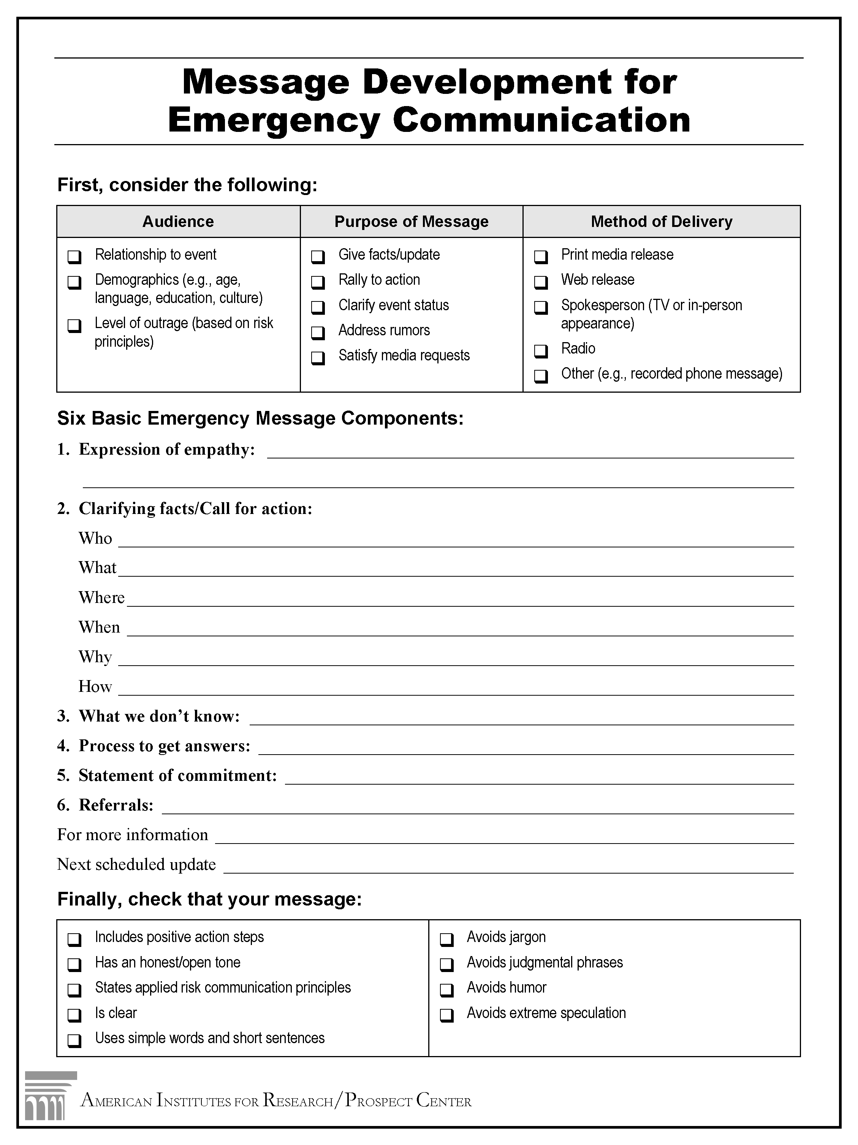
Message Development Template

