Slide 1


Natural Gas
Conveyance and Rates
Barbara Mariner-Volpe
February 2001
Bangladesh Ministry of Energy and Mineral Resources
barbara.marinervolpe@eia.doe.gov

Slide 2
Scope of Presentation
Natural gas transportation market
Competition vs. market power
Rate structures
  Cost-of-service
  Performance based rates

Slide 3
Evolution of the U.S.
Natural Gas Industry
Era of Development: 1910 - 1950
Era of Regulation: 1950 - 1970’s
Era of Market Inefficiency: late 1970’s - mid 1980’s
Era of Adjustment/Restructuring/Deregulation:
late 1980’s - 2000

Slide 4
Era of Market Inefficiency: Late 1970’s - Mid 1980’s
Market signals not transmitted - prices not market driven
Curtailments, followed by market restrictions
Growing perception of supply scarcity, then supply “bubble”
Disincentives to efficiency improvements

Slide 5
The Paradigm for the Gas Market Has Changed
Pre Restructuring Paradigm:
  heavy regulation
  efficiency not rewarded
Post Restructuring Paradigm:
  principles of competition and choice, while recognizing a continuing, although greatly reduced role for regulation

Slide 6
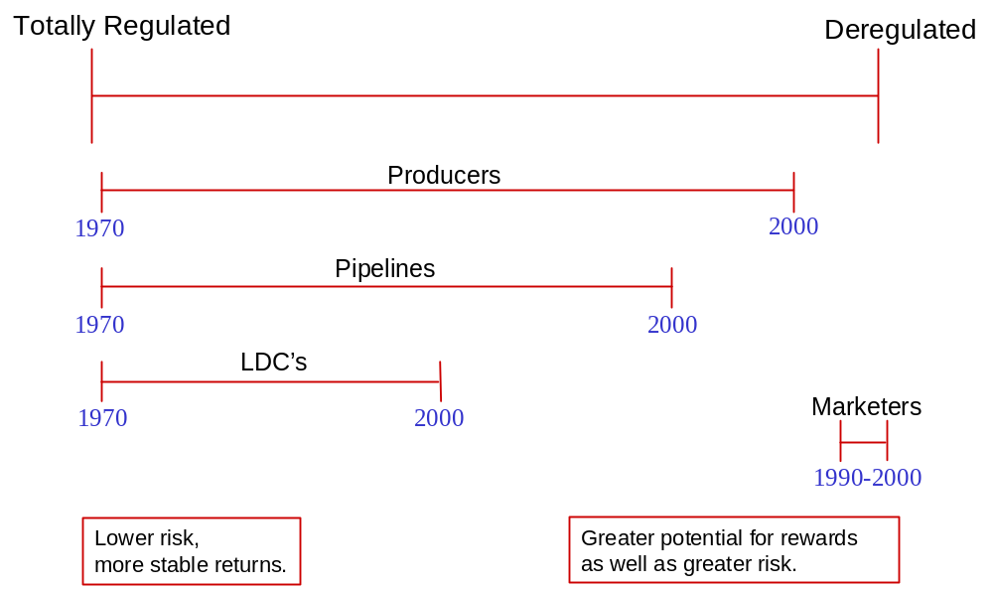
Regulatory - Market Continuum Within the U.S. Natural Gas Industry

Slide 7
Regulations/Laws Affect the Production/Supply Segment of the Gas Industry
State
  Conservation Laws - well spacing, mineral rights, environmental impact, production rates, draining
Federal
  Environmental Protection Agency (EPA) - emissions
  U.S. Department of Energy - authorizes import/exports, Strategic Petroleum Reserve
  Bureau of Land Management, Minerals Management Service - leasing
Other
  U.S. Coast Guard, U.S Dept. of Transportation, Natural Gas Act, Energy Policy Act, Laws affecting access to wilderness areas and offshore

Slide 8
Regulations/Laws Affect Natural Gas Pipeline Companies
State
  Regulate intrastate pipeline companies
Federal
  Federal Energy Regulatory Commission (FERC) regulates interstate pipeline rates, construction and certain operations
  U.S. Department of Transportation - pipeline safety, inspections
  EPA - emissions
  Treasury Department

Slide 9
Regulations/Laws Affect Local Distribution Companies
State
  Regulate local utility rates, certain operations, siting, construction, emissions
Federal
  Environmental regulations - emissions, ground water impact
Local Jurisdictions
  Regulate municipal utilities rates and operations

Slide 10
Federal Energy Regulatory Commission
Independent regulatory agency that regulates aspects of the electric, natural gas and oil pipeline and nonfederal hydropower industries.
Ensures that rates, terms and conditions of service are just and reasonable
Authorizes construction of natural gas pipeline facilities
Ensures hydropower licensing, admin. and safety actions are consistent with the public interest.

Slide 11
Federal Agencies Affect the
U.S. Gas Market
Department of Interior
        Bureau of Land Management
        Minerals Management Service
        Bureau of Indian Affairs
        U.S. Geologic Survey
        Forest Service
        Office of Fossil Energy
Department of Agriculture
Department of Energy
Department of Commerce
Department of Treasury
Environmental Protection Agency

Slide 12
Regulatory Developments
Federal
  Order 637 - certain price caps on transportation removed
State
  Unbundling programs stalled in some areas
  Evaluating programs and impacts
  Issues: reliability, consumer prices, standards

Slide 13
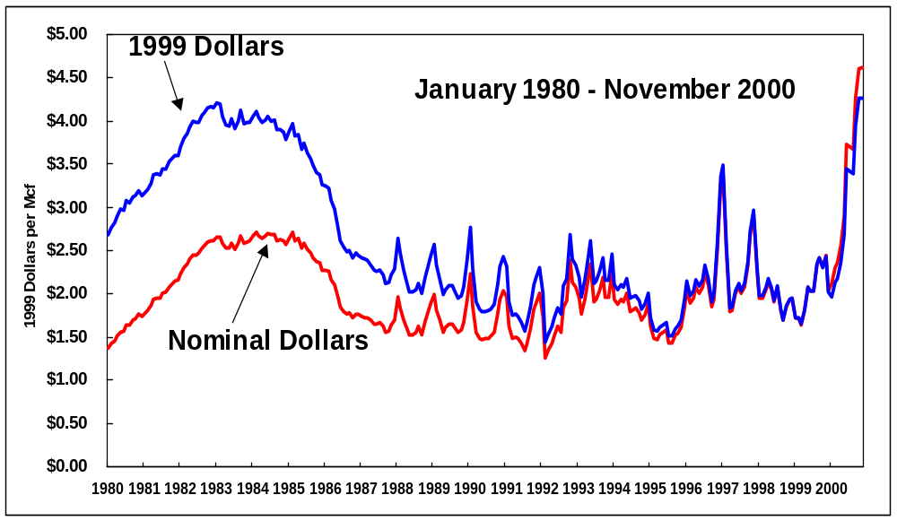
Average Monthly Wellhead Prices Currently Exceed the Highest Level Over the Past 20 Years

Slide 14
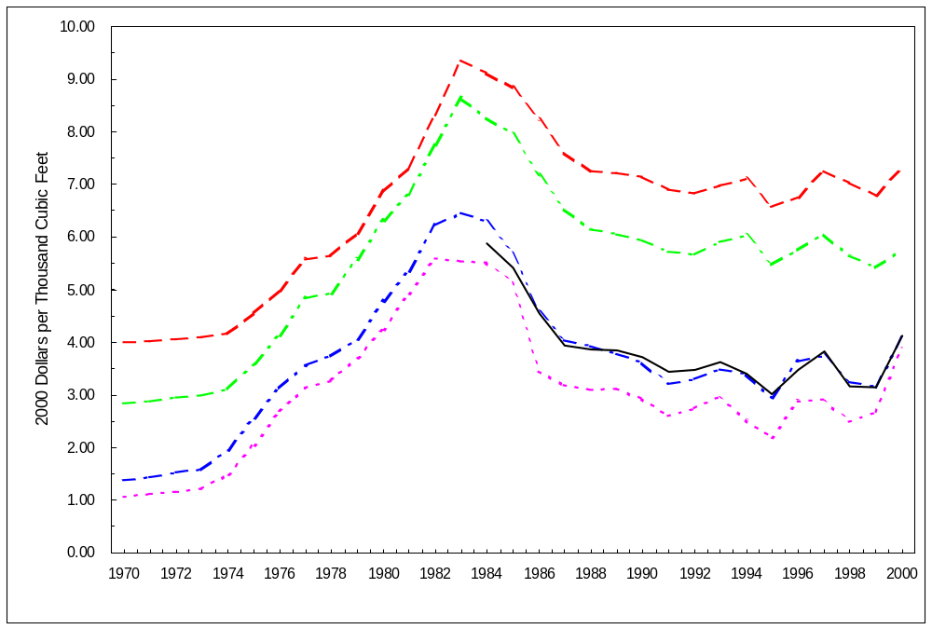
Average Annual Consumer Prices for 2000 Have Not Risen to the High’s of the 1970’s
Residential
On-System
Industrial
Commercial
Electric
Utility
Citygate
Wellhead

Slide 15
Purpose of Regulated Rates
Protect captured consumers from monopoly pricing
Promote public welfare
Promote national policy objectives
Balance cost incurrence with cost assignment among classes of customers
Provide opportunity for reasonable profit to utility

Slide 16
Transportation Rates

Slide 17
The Ratemaking Process
1. Cost of service determination
2. Cost functionalization
3. Cost classification
4. Cost allocation
5. Rate design

Slide 18
Transportation Rates:
Postage Stamp vs. Mileage
Postage Stamp Rate - Flat rate for transportation service without regard to the distance the gas is moved
Mileage-Based Rate - Rate designed to reflect the distance involved in transporting the gas
Notes:
Add following text to another slide on rate structures

Slide 19
Structure of Transportation Tariffs in the U.S. - Two Part Rates
Part 1 - Reservation Fee or Demand Charge - paid to reserve the right to have service. Cost depends on the amount and quality of service. Firm or guaranteed service requires a premium over non-firm service.
Part 2 - Usage or Commodity Charge - a charge based on the use of the service (typically calculated on a per unit basis).

Slide 20
U.S. Pipeline Rates Have Had Varying Allocations of Fixed Costs to the Tariff Components
METHOD ALLOCATION OF FIXED COSTS
United 25% Reservation Charge 75% Commodity Charge
Seaboard 50% Reservation Charge 50% Commodity Charge
Modified Fixed-Variable All in Reservation Charge except return on equity and associated taxes
Straight Fixed-Variable All fixed costs in the Reservation Charge
In all cases, above the variable charges are allocated to the Commodity Charge

Slide 21
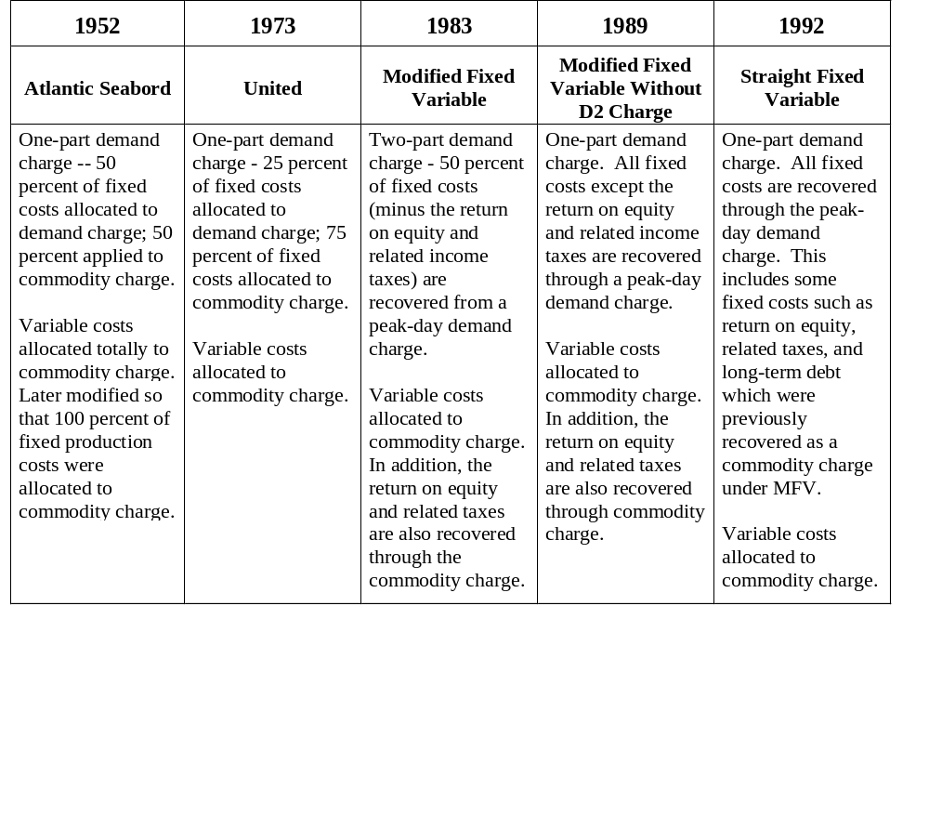
Chronology of Major Trends in U.S.
Rate Design Description

Slide 22
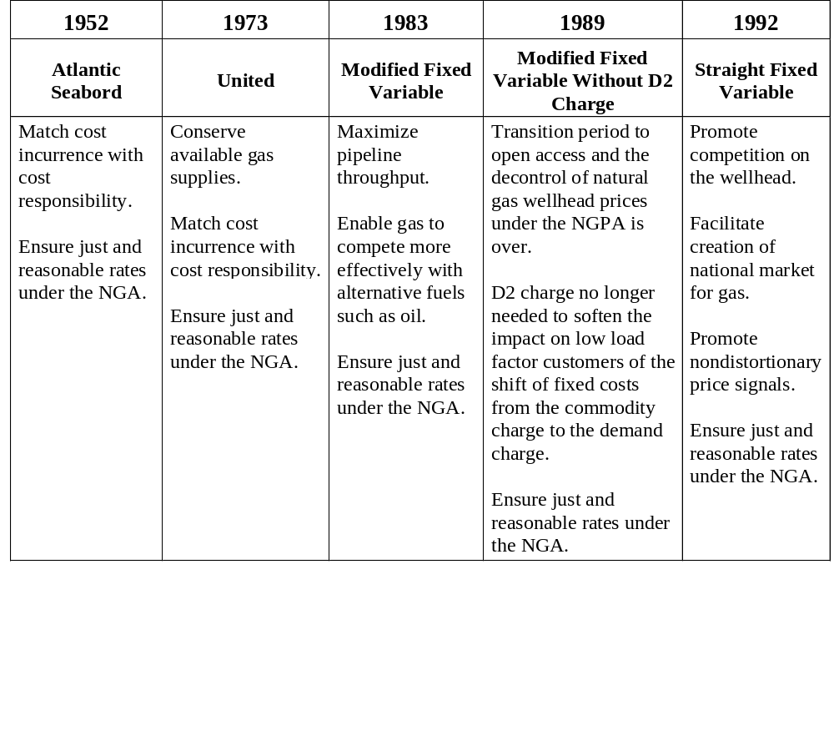
Chronology of Major Trends in U.S.
Rate Design Policy Rationale

Slide 23
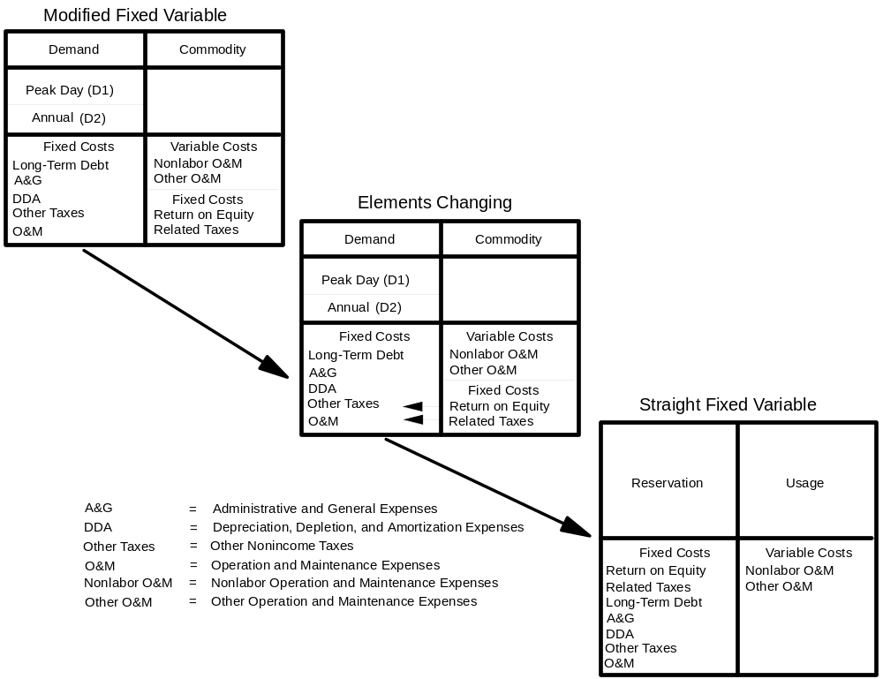
Rate Design Changed With Restructuring:
Modified to Straight Fixed Variable

Slide 24
Cost of Service Regulation
Some argue leads to a "cost plus" mentality and little/no incentive for efficiency gains or cost reductions

Slide 25
Do Cost Of Service Rates Provide Any Incentives to Minimize Costs?
Answer: Yes, some.
Providers under cost of service pricing are allowed to keep all of the revenue that exceeds total cost of service between rate cases.
However, similarly providers may not collect additional funds to make up for revenue short-fall.
The longer the time period between rate cases, the greater the incentive to reduce costs.
Notes:
CHECK WITH MICHAEL TITA ON THIS ONE -- IS THERE A RECONCILIATION AT THE TIME OF THE NEXT RATE CASE? SO THE ONLY BENEFIT IS THE TIME?USE OF THE OVERRECOVERY BETWEEN RATE CASES

Slide 26
Some Rate Structures Are More Competitive Than Others
Less
Competitive
Rates
More
Competitive
Rates
Cost of Service
(Max Rates)
Cost of Service
Bounded Rates
(Max, Min)
Performance Based (Incentive) Rate
Market
Based
Rates
Fixed Price

Slide 27
How Does Incentive Regulation Differ From Cost of Service Regulation?
Answer? Fosters long-term efficiency by:
Separating rates from the underlying cost of service
Lengthening the period between “rate cases” (when rates are revised)
Sharing the benefits of cost savings between consumers and stock holders on a current basis

Slide 28
Examples of Incentive Rate Mechanisms
Automatic Rate Adjustment Mechanisms
Performance Targets
Flexible Pricing
Benefit Sharing

Slide 29
Automatic Rate Adjustment Mechanisms
Rates are indexed and change automatically to correspond to changes in an index approved by the regulatory agency
Would extend the interval between rate cases and permit greater flexibility in intermediate price changes

Slide 30
Performance Targets
A company would be allowed to keep a portion of the savings if it exceeds its target, or it would have to absorb a portion of the losses if it fails to achieve the target
Performance targets could be set for almost any cost – interest, salaries, operation and maintenance, and taxes

Slide 31
Flexible Pricing
Allows different prices for different situations
An example of flexible pricing is selective discounting

Slide 32
Benefit Sharing
Benefit sharing allows both the company and the customer to benefit from incentive rates, by sharing cost savings
Bonuses can reward companies for serving customers well. For example, the allowed rate of return could rise or fall depending on how well the company improves service or cuts prices.

Slide 33
Incentive Regulation
Opportunities for reward may be offset by a symmetrical downside risk
  rewards service providers that reduce costs, expand services and streamline operations
  penalizes service providers that fail to achieve efficiencies

Slide 34
Criteria to Consider When Evaluating Incentive Rate Proposals
Rates Should Be:
  Prospective
  Voluntary
  Understandable by all parties
  Demonstrate incentives to improve service quality

Slide 35
In Addition, Incentive Rates Should Also...
Include performance benchmarks that do not rely on measurements that are ambiguous or subject to manipulation
Include mechanisms to ensure that reduction in costs and/or increases in operating efficiency are shared with customers

Slide 36
Negotiated Rates and
Services
Recent option for transmission service
Cost-based recourse rates must be available
Allows buyers and sellers to negotiate on non-price terms
Improves the attractiveness of long-term contracts
Provides an incentive to innovate new services while minimizing risk
Downside - may allow exercise of market power

Slide 37
Recourse Service
A viable alternative to negotiated service
The purpose of recourse service is to act as a check against market power by the service provider

Slide 38
Possible Checks Against the Exercise of Market Power with Negotiated Rates and Services
If the following conditions are Not violated
No undue discrimination or Preference
No degradation of the quality of existing services
No impairment of tradability (customization versus standardization)
No significant reduction in competition
No unwanted tying arrangements (e.g. to other services)
Transparency of negotiated transactions (possibly designate services as non-negotiable, negotiable and potentially negotiable)

Slide 39
Why Do Some Service Providers Charge Penalties?
U.S. Pipelines can ensure reliability through penalty and operation flow order (OFO) tariffs that levy severe penalties for shipper imbalances and overruns
To: maintain operational integrity
DOWNSIDE - some argue that
  pipelines can manipulate penalties to their benefit
  customers (e.g. shippers) can take advantage of arbitrage opportunities between differences in penalty structure of competing providers.
May be considered a revenue stream. Should penalty money be credited to those who were in balance

Slide 40
Auction v. Bilateral Contracting
U.S. Regulators have considered a "universal" auction of all-available short-term (<1 year), interstate pipeline capacity.
It has been suggested that bilateral contracting not be precluded - as it allows terms that meet the tailored, unique needs of individual buyers and sellers. A standardized auction contract would not be able to do this.

Slide 41
Is a Competitive Market Preferable?
YES
Because competition can discipline markets more quickly and effectively than can regulation
Because cost of service regulation imposes significant costs on all participants in the market (including regulators) - costs of preparing, litigating, deciding rate cases

Slide 42
A Competitive Market...
Allows consumers and service providers to make individual decisions about managing and allocating risks and associated costs.
Can benefit informed customers who may choose the terms and prices that best meet their needs.

Slide 43
Goals of Competition
Minimize costs
Maximizing economic efficiency needs to be balanced by considerations of the effects of competition on supply security, environmental policy and social equity.
Tradeoffs between lower prices and supply security

Slide 44
ADD-On Pricing Versus
Netback Pricing
Add-on Pricing:
Wellhead (regulated) price
+ Pipeline mark-up
+ Local Distribution Co. mark-up
= Sales Price to Consumer
Netback Pricing:
Price of Consumer’s Competing fuel
+ Distributor transportation charges
+ Pipeline transportation charge
= Netback price at the wellhead

Slide 45
Under What Circumstances are Market-
Based Rates Appropriate for
Service Providers?
Answer: According to federal regulators in the U.S., they are appropriate when a market is sufficiently competitive that it precludes exercise of market power.

Slide 46
What Are the Signs of a “Sufficiently” Competitive Market?
Competitive Markets generally possess one or more of the following characteristics:
Many buyers and sellers
Many product options
Relative ease of entry and exit
Risk, on the part of the service provider, of losing money if they do no operate efficiently

Slide 47
Market Power
Ability of a single company or a group of companies to increase and sustain a price that is measurably above the competitive market price. (may also relate to non-price elements such as burdensome terms and conditions of service that effectively obstruct competition)
Difficult to detect/measure (at times)
The absence of market power is a competitive market
Often associated with size and market share of the firm.

Slide 48
Types of Market Power
Horizontal - cases where the company has little competition for the same type of services or has competition only from affiliates which may be favored
Vertical - cases where a company can favor itself or an affiliate for complementary services e.g. local distribution company favoring its marketing affiliate.

Slide 49
To Avoid Market Power
Eliminate Barriers to (reasonable) Market entry/exit - level playing field
Monitoring of regulated and unregulated affiliates to prevent cross-subsidies
Easily accessible information on market choices

Slide 50
Some Elements to Consider in Developing A Framework to Detect Market Power
Define relevant markets:
  Identify good alternatives to the company’s product
  Identify sellers of good alternatives in the same geographic area
Measure firm size and market concentration
  Evaluate market share
  Estimate market concentration
Evaluate other factors
  Are there externalities that might limit market power?

Slide 51
Detecting Market Power
Depends on the availability of reliable data
Herfindahl-Hirschman Index (HHI) - equals the sum of the squared market shares
Lerner Index (or similar series) - premium of price over marginal cost. Equals the markup of price over marginal cost as a percentage of price.

Slide 52
To Allow Competitive Markets to Develop and Function Effectively
Actions May Be Needed That:
Foster choices that serve the public interest
Promote system efficiencies
Reduce regulatory uncertainty
Support development and commercialization of technologies that reduce costs and increase choices available to consumers

Slide 53
What is the Key to Attracting New Markets and Retaining Existing Markets?
Answer: Greater flexibility in service and products and prices
Some examples of flexibility in the U.S. gas market:
  development of market hubs
  secondary market for trading capacity rights
  introduction of new services
  commoditization of capacity (e.g. more flexible receipt and delivery points)

