Slide 1
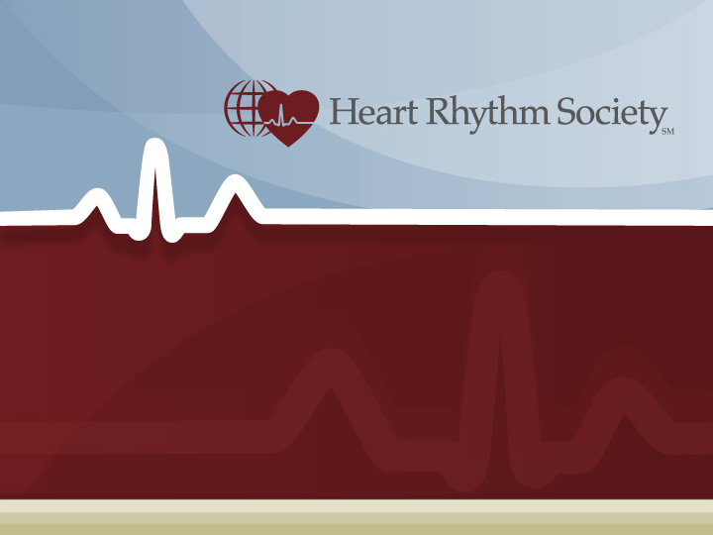
Risk-Benefit Communication: FDA Viewpoint
Megan Moynahan
Chief, Pacing Defibrillators and Leads Branch
Food and Drug Administration

Slide 2
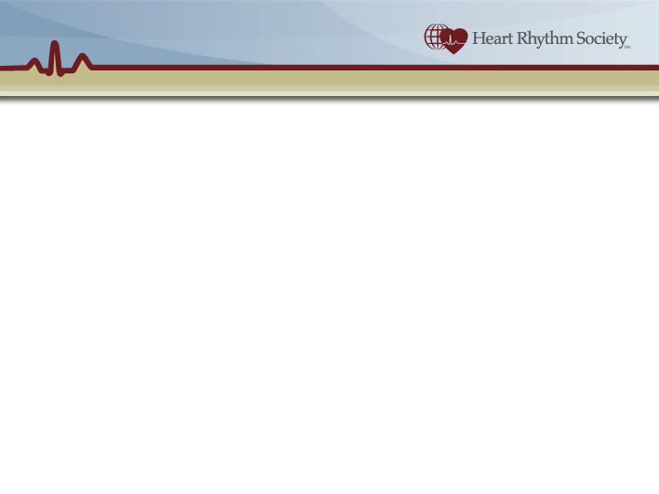
RISK – BENEFIT COMMUNICATION
Scope of this presentation
  Public communication
  Device performance in post-market period
➔ RECALL COMMUNICATIONS
“Dear Doctor” letters

Slide 3
RECALL COMMUNICATION
Firms are required to notify the public about recalled products [21 CFR 7.49]
A weekly Enforcement Report is published by FDA [http://www.fda.gov/opacom/Enforce.html]
During a recall, patients and physicians need balanced information about a device’s performance.
➔ Recall Notifications are not designed to convey balanced information about device performance.

Slide 4
REQUIRED ELEMENTS OF RECALL NOTIFICATION
Identification of the product (model, serial numbers).
Explanation of the reason of the recall
Hazard involved.
Instructions on what to do with the recalled product (e.g., “return explanted devices or unopened devices to the firm”).
A means for the physician to communicate back to the company whether they have the recalled product.

Slide 5
Discussion Point 1a.
A balanced view of device performance – one that includes both risks and benefits – must come from sources other than recall notifications.

Slide 6
OTHER ELEMENTS OF RECALL NOTIFICATION
Other elements in public notifications [derived from “Health Hazard Evaluation”]
  Description of deaths a/o injuries that have already occurred;
  Discussion of existing conditions that could contribute to the hazard;
  Assessment of the hazard to various segments of the population (children, elderly);
  Degree of severity of injury;
  Likelihood of occurrence of the hazard;
  Immediate or long-range consequences of the hazard.

Slide 7
HEALTH HAZARD EVALUATION
HHE – designed to help FDA classify the recall.
Not intended to be used to make “practice of medicine” decisions about individual patients.
!!
“Recall” does not equate to “explant”;
“Class I recall” does not equate to “explant”
!!

Slide 8
RECALL NOTIFICATION
A recommendations sections is often included
  How to tell if a patient’s device has failed or not (if such a test is available);
  What to do for those patients whose devices have already failed.

Slide 9
Discussion Point 1c.
As they are currently drafted, recall communications do not adequately inform physicians what to do for patients whose at-risk devices have not failed.

Slide 10
PACEMAKERS AND ICDS ARE UNIQUE
Pacemakers and ICDs are life-saving
  Catastrophic failure is more causally related to patient death than other devices;
  HHE more often skewed to Class I even if probability of failure is very low because of the potential for death as an outcome.

Slide 11
PACEMAKERS AND ICDS ARE UNIQUE
Pacemakers and ICDs are permanent implants
  Advantage: Easier to calculate patient exposure (1-to-1 relationship between products in service and patients exposed)
  Disadvantage: The need to consider explantation as a possible action

Slide 12
PACEMAKERS AND ICDS ARE UNIQUE
Pacemakers and ICDs are “active” implants (e.g., they include electronic and computer-like circuitry)
  Disadvantage: Huge source of potential “failure” modes
  Disadvantage: Software doesn’t fail “deterministically” like physical component failure and therefore can’t be predicted.
  Advantage: Errors in software can be easily fixed with reprogramming.

Slide 13
PACEMAKERS AND ICDS ARE UNIQUE
Component failure ≠ catastrophic device failure ≠ patient death.
  Disadvantage: Difficult to predict catastrophic device failure given rates of component or software failure
  Advantage: These devices rarely fail catastrophically.
Physician response to PM and ICD recalls is limited:
  Explant, reprogram, or “watch-and-wait”.

Slide 14
Discussion Point #1b.
Pacemakers and ICDs have unique characteristics that shape the recall process and should shape the content of recall notifications, rather than just relying on the required elements of those notifications.

Slide 15
Discussion Points - Recap
A balanced view of device performance – one that includes both risks and benefits – must come from sources other than recall notifications.
Pacemakers and ICDs have unique characteristics that shape the recall process and should shape the content of recall notifications, rather than just relying on the required elements of those notifications.
As they are currently drafted, recall communications do not adequately inform physicians what to do for patients whose at-risk devices have not failed.

