Slide 1
Up-Front Phase II Windows in
Children with Cancer
Victor M. Santana, M.D.

Slide 2
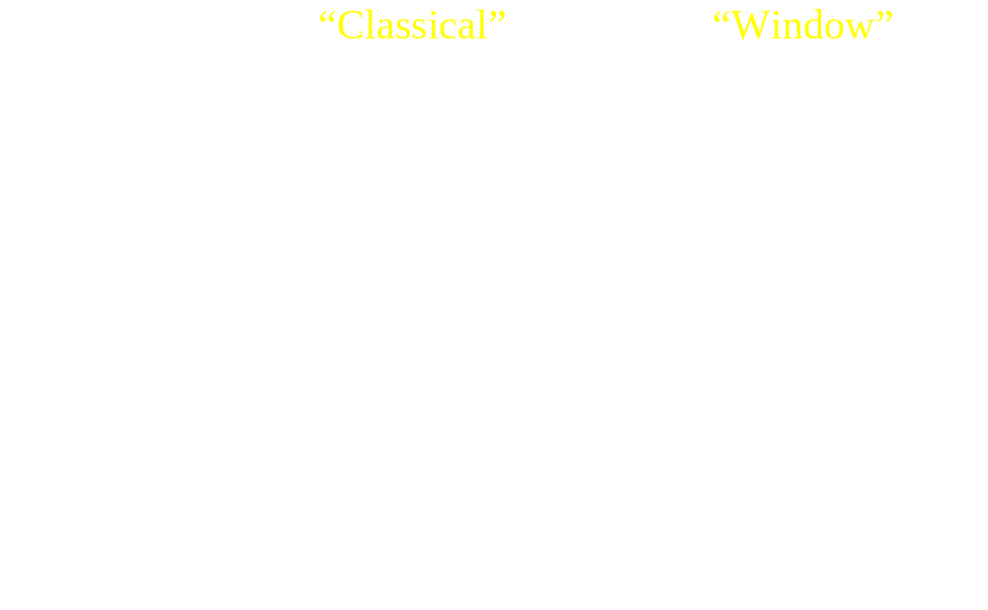
Phase II Study Designs

Slide 3
Therapeutic Intent
● Window study are design to provide effective therapy
● Assessment of risks and benefits should consider that:
    – the phase II window is part of the complete protocol
    – “standard therapy” in pediatric oncology is usually an investigational trial

Slide 4
Scientific Validity of Phase II Windows
● Classical Phase II trials
  – often underestimate the activity of new agents
  – may overestimate the toxicity of new agents
● Phase II windows most accurately assess antitumor activity

Slide 5
Impact: Classic Phase II Trials
● Identify agents that improve outcome
  – All-trans retinoic acid in APML
  – Ifosfamide/etoposide in Ewing family
● Problems in pediatrics include:
– slow, often inadequate accrual
    – agents with modest activity moved into front-line therapy

Slide 6
Not all agents active in classic phase II trials improve survival
● Ependymoma (vs radiotherapy alone)
  – CCNU, vincristine (40 vs 44% survival, NS)
  – CCNU, vincristine plus procarbazine (44 vs 35%
  survival, NS)
● Rhabdomyosarcoma (multimodality therapy)
  – cisplatin; IRS regimen 35 and 36 (NS)
● Metastatic Ewing sarcoma
    – ifosfamide/etoposide (NS - intergroup)
    – 5-FU(NS-IESS 1 and 2)

Slide 7
Too early to judge impact of window phase II studies
Long developmental cycle
● Ifosfamide window trials: osteosarcoma
  – SJCRH OS-86 (6/1986 - 12/1991)
  – POG 8759 (6/1987 - 10/1990)
● Intergroup prospective randomized trial of ifosfamide in osteosarcoma (PG9357)
  – activated 12/1993, closed 11/97
● Intergroup trial of irinotecan in rhabdomyosarcoma
– activated 9/99; still accruing

Slide 8
Patient Benefits: Phase II Windows
● Prompt tumor response, often with non-cross resistant agent
    – Topotecan and Irinotecan in RMS
    – Topotecan in NBL
● Improved outcome
    – Ifosfamide/etoposide window in metastatic RMS
● Decreased toxicity
    – Ifosfamide/carboplatin in osteosarcoma

Slide 9
Phase II Windows: Agent selection
● Use predictive preclinical models (e.g. xenografts)
● Prioritization of agents
    – novel mechanisms of action
    – analogues of known effective agents with improved toxicity profile

Slide 10
Phase II Windows: Patient selection
● Higher risk of ultimate treatment failure
● Careful assessment of risk:benefit
    – preclinical scientific rationale for agent selection
    – prior experience with agent
    – agent toxicity profile

Slide 11
Phase II Windows: Consent
● Enrollment is voluntary
● Consent must be informed and carefully obtained
● By federal rules, discretion is “lodged primarily with the parents and the local IRBs.”

Slide 12
Phase II Windows: Summary
● Scientifically justified
● Ethically acceptable
● An effective mechanism to identify active agents,
within the overall new agent development program
● Too early to judge overall impact on treatment outcome

Slide 13
Consensus meeting July 22, 1997
Points to Consider
● Risk and Benefits
● Informed Consent

Slide 14
Risks and Benefits
  – risk of tumor progression
  – additional unique toxicities
  – jeopardizing future therapy
  – benefit of early response/incorporation into
  subsequent treatment
  – duration of participation must be as short as possible

Slide 15
Informed Consent
  – clear identification/separation from the main treatment/study
  – option not to participate in the “window” component
  – explantation of how “window” treatment differs from subsequent therapy
  – risks of delaying therapy or eligibility for future therapies

Slide 16
Informed Consent
  – impart on quality of life (additional procedures, extending duration of therapy)
  – pre-clinical/clinical data supporting the use of the agent(s)
  – treatment alternatives
  – provision for assent or refusal

