Slide 1
Night Navigation
Developed as part of the National Emergency Services Curriculum Project

Slide 2
What’s Different?
Typically teams move much slower
Why?
  Vision impaired
    Seeing Black and White Mostly
  Simply not comfortable
Is there a solution?
  Not total, but workable
Notes:
Teams need to be especially careful in working at night. There are obvious limitations.

Slide 3
What do we do?
Wear reflective vests
Use Red Lens in Flashlight
Avoid especially dangerous areas
Only send experienced personnel to the field at night
Wait until daytime if necessary - Use the Night for planning and crew rest
Notes:
There are several things that you can do to help yourself though.

Slide 4
Why use a red lens?
As light decreases, the sensing tasks are passed over from the cones to the rods of the eyes.
The sensitivity of the rods involves a pigment called visual purple (rhodopsin) which is bleached in bright light and takes time to re-constitute
Because the rods are less sensitive to red light, we use red lenses in our lights to keep our limited night vision

Slide 5
Why else should we use a red lens?
It takes on average 40+ minutes to regain your night vision
Younger people tend to adapt quicker than adults to the dark

Slide 6
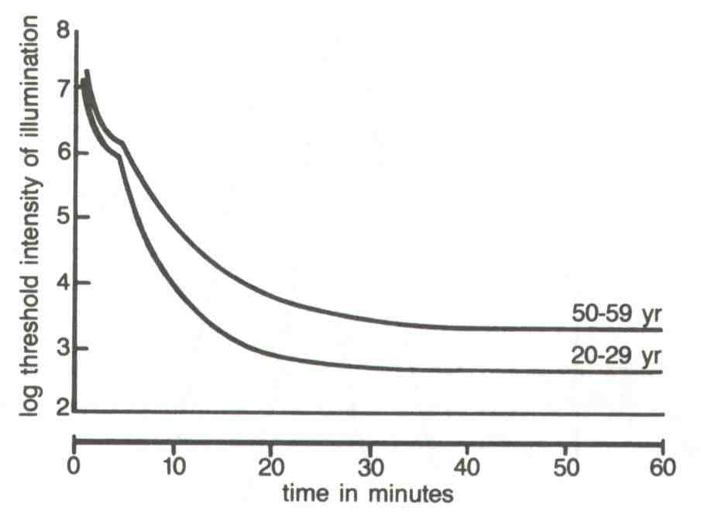

Slide 7
Be careful out there!

