Slide 1



How we use MPI to perform scalable parallel molecular dynamics
Next-generation scalable applications: When MPI-only is not enough
June 3, 2008
Paul S. Crozier
Sandia National Labs
Sandia is a multiprogram laboratory operated by Sandia Corporation, a Lockheed Martin Company,
for the United States Department of Energy under contract DE-AC04-94AL85000.

Slide 2
Molecular dynamics on parallel supercomputers
  Why MD begs to be run on parallel supercomputers:
    Very popular method
    Lots of useful information produced
    Fundamentally limited by: force field accuracy and compute power (hardware/software)
  Where’s the expensive part?
    Force calculations
    Neighborhood list creation
    Long-range electrostatics (if needed)

Slide 3
Our MD codes
miniMD: http://software.sandia.gov/mantevo/packages.html
part of Mantevo project
currently in licensing process (LGPL)
intended to be extremely simple parallel MD code that enables rapid portability and rewriting for use on novel architechtures
LAMMPS: http://lammps.sandia.gov
( Large-scale Atomic/Molecular Massively Parallel Simulator )

Slide 4
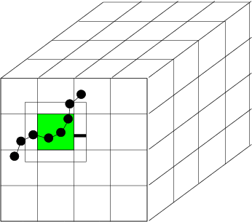
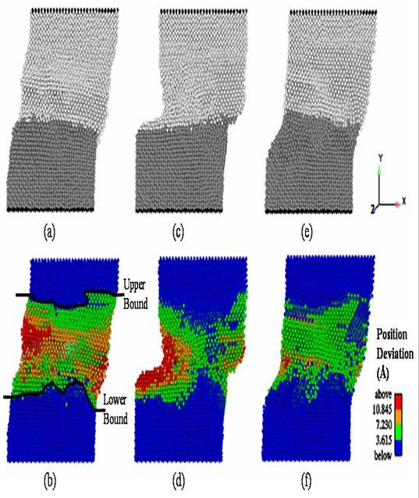
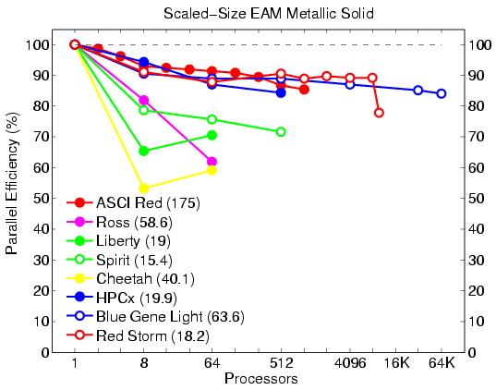
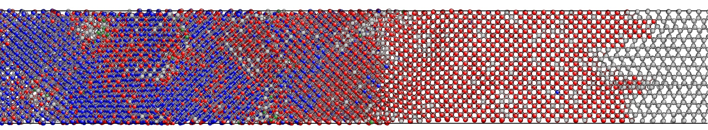
LAMMPS
(Large-scale Atomic/Molecular Massively Parallel Simulator)
Steve Plimpton, Aidan Thompson, Paul Crozier
lammps.sandia.gov
Classical MD code.
Open source, highly portable C++.
Freely available for download under GPL.
Easy to download, install, and run.
Well documented.
Easy to modify or extend with new features and functionality.
Active user’s e-mail list with over 300 subscribers.
Since Sept. 2004: over 20k downloads, grown from 53 to 125 kloc.
Spatial-decomposition of simulation domain for parallelism.
Energy minimization via conjugate-gradient relaxation.
Radiation damage and two temperature model (TTM) simulations.
Atomistic, mesoscale, and coarse-grain simulations.
Variety of potentials (including many-body and coarse-grain).
Variety of boundary conditions, constraints, etc.

Slide 5
LAMMPS development areas
Timescale & spatial scale
Force fields
Features
Faster MD
Auto generation
Informatics traj analysis
On a single processor
FF parameter data base
NPT for non-orthogonal boxes
In parallel, or with load balancing
Biological & organics
User-requested features
novel architectures, or N/P < 1
Solid materials
Accelerated MD
Electrons & plasmas
Temperature accelerated dynamics
Chemical reactions
Parallel replica dynamics
ReaxFF
Forward flux sampling
Bond making/swapping/breaking
Multiscale simulation
Functional forms
Couple to quantum
Charge equilibration
Couple to fluid solvers
Long-range dipole-dipole interactions
Couple to KMC
Allow user-defined FF formulas
Coarse graining
Aspherical particles
Aggregation
Rigidification
Peridynamics

Slide 6
Possible parallel decompositions
Atom: each processor owns a fixed subset of atoms.
requires all-to-all communication
Force: each processor owns a fixed subset of interatomic forces.
scales as O(N/sqrt(P))
Spatial: each processor owns a fixed spatial region.
scales as O(N/P)
Hybrid: typically a combination of spatial and force decompositions.
Other?
S. J. Plimpton, Fast Parallel Algorithms for Short-Range Molecular Dynamics, J Comp Phys, 117, 1-19 (1995).

Slide 7
Parallelism via Spatial-Decomposition
Physical domain divided into 3d boxes, one per processor
Each processor computes forces on atoms in its box
  using info from nearby procs
Atoms "carry along" molecular topology
  as they migrate to new procs
Communication via
  nearest-neighbor 6-way stencil
Optimal N/P scaling for MD,
  so long as load-balanced
Computation scales as N/P
Communication scales as N/P
  for large problems (or better or worse)
Memory scales as N/P

Slide 8
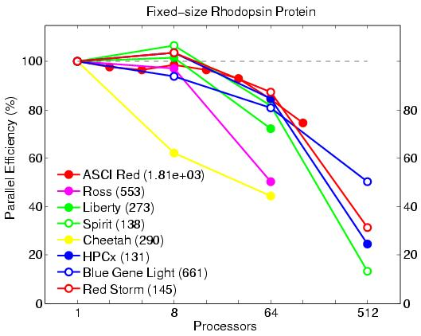
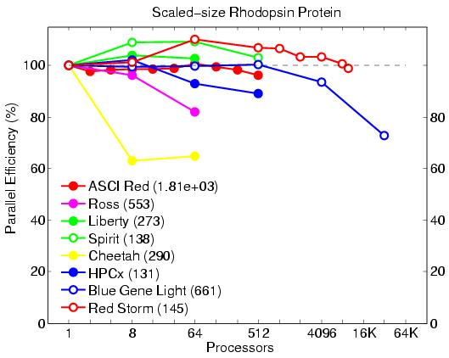
Parallel Performance
Fixed-size (32K atoms) and scaled-size (32K atoms/proc) parallel efficiencies
Protein (rhodopsin) in solvated lipid bilayer
Billions of atoms on 64K procs of Blue Gene or Red Storm
Opteron processor speed: 4.5E-5 sec/atom/step
  (12x for metal, 25x for LJ)

Slide 9
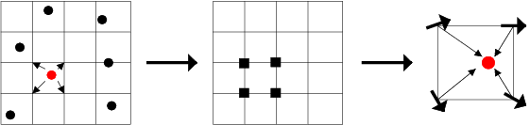
Particle-mesh Methods for Coulombics
Coulomb interactions fall off as 1/r so require long-range for accuracy
Particle-mesh methods:
  partition into short-range and long-range contributions
  short-range via direct pairwise interactions
  long-range:
  interpolate atomic charge to 3d mesh
  solve Poisson's equation on mesh (4 FFTs)
  interpolate E-fields back to atoms
FFTs scale as NlogN if cutoff is held fixed

Slide 10
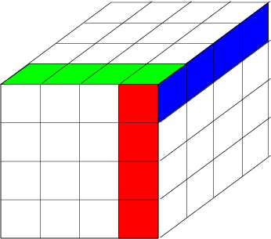
Parallel FFTs
3d FFT is 3 sets of 1d FFTs
  in parallel, 3d grid is distributed across procs
  perform 1d FFTs on-processor
  native library or FFTW (www.fftw.org)
  1d FFTs, transpose, 1d FFTs, transpose, ...
  "transpose” = data transfer
  transfer of entire grid is costly
FFTs for PPPM can scale poorly
  on large # of procs and on clusters
Good news: Cost of PPPM is only ~2x more than 8-10 Angstrom cutoff

Slide 11

Could we do better with non-traditional hardware, or something other than MPI?
Alternative hardware:
Multicore
GPGPUs
Vector machine
Non-MPI message passing:
OpenMP
Special-purpose message passing
Other suggestions?

Slide 12
Comments on morning discussion
We really want strong scaling --- get out longer on the time axis.
  Rather simulate a membrane protein for ms than a whole cell for a ns.
  We want an MD algorithm that performs well on N < P.
  LAMMPS’s spatial decomposition breaks down for N < P.
  We’ll need a new parallel MD algorithm for speedup along the time axis for problems where N < P.
We’ve looked at OpenMP vs MPI and see no advantage on LAMMPS as it stands right now.
Many in the MD community now looking at doing MD on “novel architechtures” --- GPUs, multicore mahcines, etc.
“Canned” particle pusher middleware seems difficult. Needs many different options and flavors.

Slide 13
How we use MPI to perform scalable parallel molecular dynamics
MPI Applications: How We Use MPI
Tuesday, June 3, 1:45-3:00 pm
Paul S. Crozier
Sandia National Labs
Sandia is a multiprogram laboratory operated by Sandia Corporation, a Lockheed Martin Company,
for the United States Department of Energy under contract DE-AC04-94AL85000.

