Slide 1
Rapid and Accurate Spoken Term Detection
David R. H. Miller
BBN Technolgies
14 December 2006

Slide 2
Overview of Talk
BBN English system description
Evaluation results
Development experiments
BBN explored STD across languages, but with limited evaluation resources we chose to field systems only in CTS for each language.

Slide 3
BBN Evaluation Team
Core Team
Chia-lin Kao
Owen Kimball
Michael Kleber
David Miller
Additional assistance
Thomas Colthurst
Herb Gish
Steve Lowe
Rich Schwartz

Slide 4
BBN System Overview
audio
search
terms
ATWV cost
parameters
Byblos STT
lattices
phonetic-
transcripts
indexer
detector
index
decider
scored
detection
lists
final output
with YES/NO
decisions
indexing
searching
Notes:
Walk through the 4 yellow boxes of the slide, noting inputs and outputs.
The Speech-to-text box was the only part of the system that was pre-existing. Indexer, detector, and decider are new technology.
Now I’ll talk about each in turn

Slide 5
BBN System Overview: STT
audio
search
terms
ATWV cost
parameters
Byblos STT
lattices
phonetic-
transcripts
indexer
detector
index
decider
scored
detection
lists
final output
with YES/NO
decisions
Notes:
Walk through the 4 yellow boxes of the slide, noting inputs and outputs.
The Speech-to-text box was the only part of the system that was pre-existing. Indexer, detector, and decider are new technology.

Slide 6
Primary STT configuration
STT generates a lattice of hypotheses and a phonetic transcript for each input audio file.
2300-hour EARS RT04 CTS acoustic model training corpus
946M words language model training
14.9% WER on Std.Dev06 CTS data
Notes:
Fairly basic research system. No system combination, no fancy LM’s.
AM training: Switchboard, Callhome, Fisher
LM Training: AM transcripts, UW web data, BN data, CNN&PBS archives
StdDev06 = Fisher subset of EARS Eval03
15.5% WER on EARS Dev04.
14.9 WER on Eval03 Fisher subset
These error rates using .glm based scoring. Exact orthography is 0.5 worse.
Operated at 44xRT – there

Slide 7
Primary STT English Architechture
Segmentation
+
Feature
Extraction
System described in detail in B. Zhang, et al. “Discriminatively trained region dependent feature transforms for speech recognition”. Proc. ICASSP 2006, Toulouse, France.
Waveform
RDLT Features
Fw SI STM AM,
bigram LM
Bw SI SCTM AM,
approx.trigram LM
Forward-
Backward
Decoding
Forward-
Backward
Decoding
Fw HLDA-SAT STM AM,
bigram LM
Bw HLDA-SAT SCTM AM,
approx.trigram LM
Trigram Lattice
Trigram Lattice
SI crossword
SCTM AM,
trigram LM
Lattice
Rescoring
Lattice
Rescoring
HLDA-SAT
crossword SCTM
AM, trigram LM
N-best Hypothesis
Speaker
Adaptation
Adaptation
Parameters
Final Lattice
Final 1-best
Notes:
Actually, slight differences from Bing Z system. Slight difference in LM training with hyphenated words
Fairly basic research system. No system combination, no fancy LM’s.
FW-BW-RESC : Adapt : FW-BW-RESC
Automatic segmentation
VTLN, PLP Analysis, RDLT on 15frame super vectors --> 60 dimension.
STM forward pass, SCTM backward with approx 3-gram, SCTM x-word 3-gram lattice rescore.
Three pass decode, adapt all three models from N-best, full re-decode.
FW: 139k pdfs, 245 cbks, 504 Gauss/cbk
Triphone AM, nonx
BW: 126k pdfs, 6500 cbks, 127 Gauss/cbk
quinphone AM, nonx
RESC: 224k pdfs, 7000 cbks, 127 Gauss/cbk
Gauss/cbk is an average
Adaptation is from Nbest list

Slide 8
BBN System Overview: Indexer
audio
search
terms
ATWV cost
parameters
Byblos STT
lattices
phonetic-
transcripts
indexer
detector
index
decider
scored
detection
lists
final output
with YES/NO
decisions
Notes:
Walk through the 4 yellow boxes of the slide, noting inputs and outputs.
The Speech-to-text box was the only part of the system that was pre-existing. Indexer, detector, and decider are new technology.

Slide 9
Indexer
Indexer precomputes single-word detection records from lattices.
  Stores as hashed sorted lists for fast lookup.
Computes fraction of likelihood that flows over each arc.
  Uses forward-backward algorithm.
  Optimistic posterior: ignores possibility true word is missing from lattice.
Clusters detections with same word, close times, summing their scores
WHICH [a=-205 l=-5]
CAT [a=-170 l=-2]
IS [a=-18 l=-2]
THAT [a=-92 l=-3]
WITCH [a=-203 l=-4]
A [a=-12 l=-2]
CUT [a=-175 l=-3]
WITCH [a=-200 l=-4]
Notes:
Note existence of AM/LM overall scale knobs.
Variation of Word Consensus Networks
No global linear time scaffold.

Slide 10
Index Structure
CAT
file9: b=39.1 d=0.3 p=0.83
file9: b=39.1 d=0.3 p=0.83
file9: b=39.1 d=0.3 p=0.83
file9: b=39.1 d=0.3 p=0.83
…
…
WITCH
file9: b=39.1 d=0.3 p=0.83
file9: b=39.1 d=0.3 p=0.83
file9: b=39.1 d=0.3 p=0.83
WHICH
file3: b=25.2 d=0.1 p=0.77
file5: b=173.8 d=0.2 p=0.52
phonetic
transcripts
file5: b=173.8 d=0.2 p=0.52
file5: b=173.8 d=0.2 p=0.52
file5: b=173.8 d=0.2 p=0.52
file5: b=173.8 d=0.2 p=0.52
file5: b=173.8 d=0.2 p=0.52
Notes:
Each detection has a file reference, a begin time, a duration, and a score.
Bundles 1-best phone transcript (from Byblos lattice rescoring) into the index separately for OOV searches.

Slide 11
BBN System Overview: Detector
audio
search
terms
ATWV cost
parameters
Byblos STT
lattices
phonetic-
transcripts
indexer
detector
index
decider
scored
detection
lists
final output
with YES/NO
decisions
Notes:
Walk through the 4 yellow boxes of the slide, noting inputs and outputs.
The Speech-to-text box was the only part of the system that was pre-existing. Indexer, detector, and decider are new technology.

Slide 12
Detector
candidates for term “bombing”
Audio File | Begin | Duration | Score
fsh_60262_exA | 83.1 | 0.23 | 0.93
fsh_61228_exA | 29.7 | 0.18 | 0.85
fsh_60844_exA | 101.5 | 0.28 | 0.47
fsh_60650_exA | 2.71 | 0.30 | 0.13
fsh_61228_exA | 55.9 | 0.21 | 0.01
Detector generates a sorted, scored list of candidate detection records for each search term supplied.
For single-word IV terms, performs trivial retrieval from index.
For multi-word IV terms, looks for acceptable sequences of single-word detections
  Component detections must satisfy adjacency timing constraints
  Assigns minimum component score to the multi-word detection.
OOV not a significant factor in English CTS – see Levantine talk.
Notes:
No English Eval terms were both OOV and in the reference
We’ll talk about our OOV logic in Levantine
Note that our levantine OOV number is .364, better than our levantine IV number of 0.345
Not a significant factor for English Dev CTS (<1.5% OOV).
Term declared OOV if any word is OOV.

Slide 13
BBN System Overview: Decider
audio
search
terms
ATWV cost
parameters
Byblos STT
lattices
phonetic-
transcripts
indexer
detector
index
decider
scored
detection
lists
final output
with YES/NO
decisions

Slide 14
Decider
candidates for term “bombing”
Audio File | Begin | Duration | Score | YES/NO
fsh_60262_exA | 83.1 | 0.23 | 0.93 | ?
fsh_61228_exA | 29.7 | 0.18 | 0.85 | ?
fsh_60844_exA | 101.5 | 0.28 | 0.47 | ?
fsh_60650_exA | 2.71 | 0.30 | 0.13 | ?
fsh_61228_exA | 55.9 | 0.21 | 0.01 | ?
Decider picks and applies a score threshold for each list to make YES/NO decisions.
  Processes each list of candidates independently
  Processes all detection records in a list jointly
  Aims to maximize ATWV metric

Slide 15
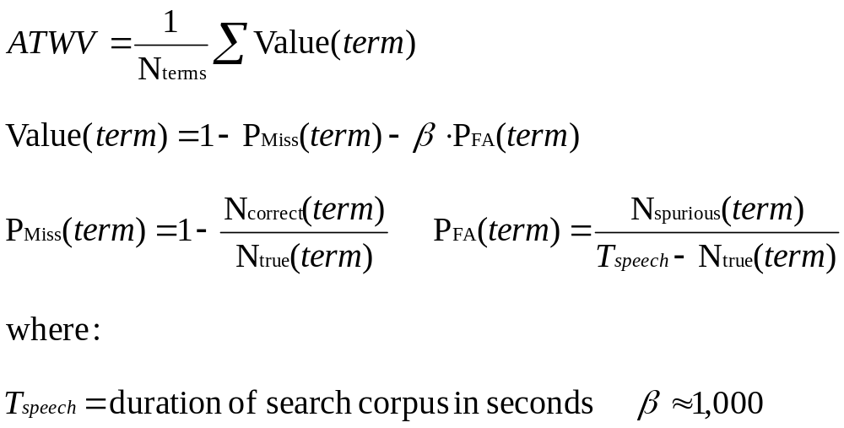
Primary Evaluation Metric
“Actual Term Weighted Value” is primary metric
Notes:
Those of us working in the eval know this quite well.
With apologies to them, wanted to review this for the rest of the audience.
Define Ncorrect, Ntrue, Nspurious.
N_terms is number of terms occuring once or more in the reference.
Otherwise Ntrue =0 causes division by 0 errors.

Slide 16
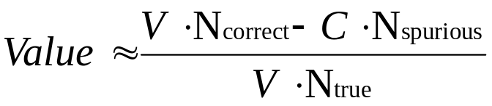
Understanding ATWV
Perfect ATWV = 1.0
Mute detector has ATWV = 0.0
Negative ATWV is possible.
Motivated by application-based costs:
All search terms are weighted equally
False alarm cost is almost constant, but miss cost varies by term.
  Missing an instance of a rare term is expensive.
  Missing an instance of a frequent term cheap.
Notes:
Refer to next slide for cheap/expensive reasoning.

Slide 17
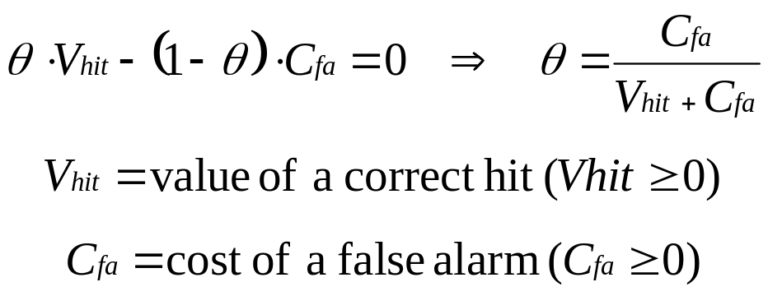
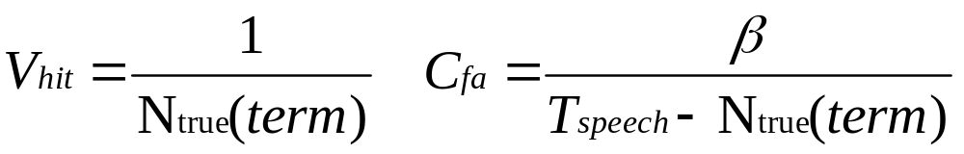
Decider Theory
Given unbiased, independent posterior probabilities on detections and known constant value/cost on outcome, optimal decision threshold θ satisfies
In ATWV metric, if N_{true}(term) > 0
Notes:
You start down the list of detections and declare YES whenever your expected to have postitive contribution to ATWV by doing so.
Expected impact = 0 is cutoff.
Vhit and Cfa are only constant within a term. So need per-term thresholding for optimal ATWV
Point out Ntrue has big effect on V, little effect on C

Slide 18
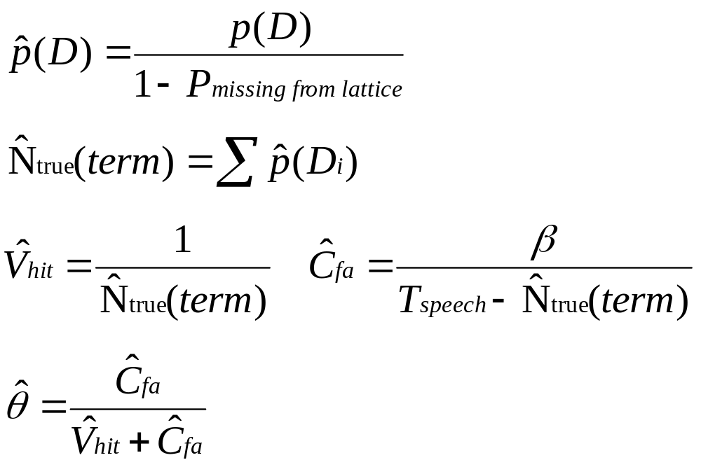
Decider Approximations
N_{true}(term) unknown, and detection scores biased.
For each term, estimate from detections D_{i}:
Notes:
Start by adjusting for p(D) biases
P(D) is really estimate of P(D) given truth is in lattice at that time.
Scale by 1/(1-Pmissing from lattice)
fixed constant, optimized on Dev set

Slide 19
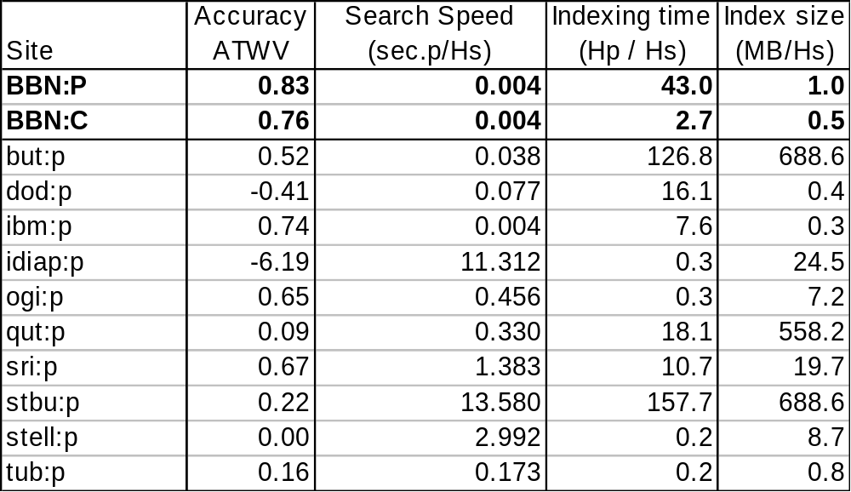
2006 STD Evaluation English Results
English CTS Results
Notes:
Note Indexing time on P and C different. Using “1xRT” STT system.
There’s a bug in the BBN speed/size numbers as reported by NIST on 1207.
Here they are all scaled up by 8/3 since we only processed CTS audio.
Search speed a little misleading in precision:
Our Linux system clock we were using had resolution only up to 0.01 sec

Slide 20
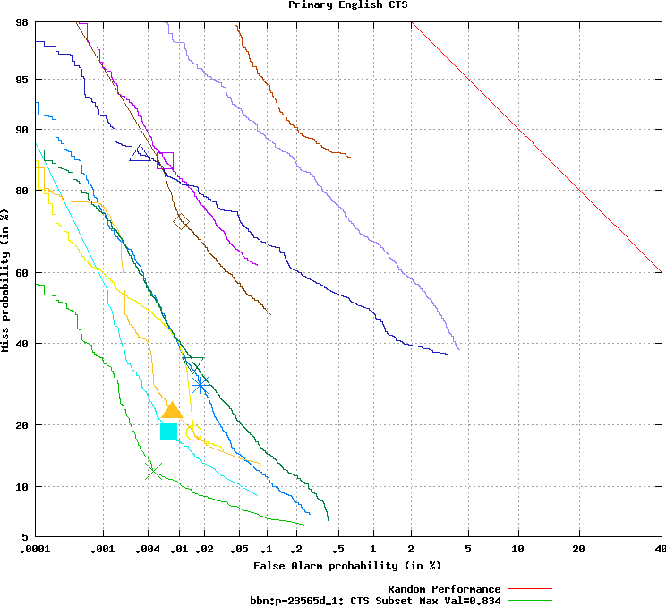
NIST English DET curves
Notes:
Pooled over all terms
Normalized raw scores after computing θ so that θ=1 for each term.
Note no line represents optimal ATWV point since cost of Miss is not constant

Slide 21
Effect of STT Error Rate
STT WER has strong effect on ATWV:
System | WER | Dev06 ATWV | DryRun06 ATWV
BBN primary | 18.0 | 0.786 | 0.766
BBN contrast | 15.5 | 0.847 | 0.852
Loss of 2.5 WER caused ATWV to drop 0.6-0.9
  Magnified effect because changes in lattice word posteriors don’t show up in WER
WER affected by scoring conventions.
  Contraction, hyphenation normalization
  Rigorous match definition for this eval causes WER to increase by 0.5
Notes:
Mention what Dev06 and DryRun06 are
Story 15 report
Byblos 370hr 1xRT WER=24.7 Dev ATWV=? DryRun06 ATWV=?
WERs quoted here are about 0.5 worse than on old evals
current scoring is less forgiving on contractions

Slide 22
Importance of Lattice Output
Search lattices is more accurate than searching 1-best transcripts
 | Dev06 |  | DryRun06
 | 1-best | lattices | 1-best | lattices
primary | 0.787 | 0.847 | 0.735 | 0.852
contrast | 0.740 | 0.786 | 0.704 | 0.766
Lattice searching reduces P_{miss}
  8-fold increase in number of candidate detections from STT
Improves estimate of N_{true} for decisions
  Holds P_{FA} down
Notes:
32,917 words in 1-best transcripts
259,266 detection clusters in lattices

Slide 23
Effect of Multi-word Detection Logic
Exact detection of multi-word search terms is possible:
  Store full lattice
  Search for words on adjacent edges
  Use fw-bw to get true posterior probability
Approximate multi-word detection:
  Store only individual words, forget topology
  Search for words ordered & close in time
  Pr(phrase) = min Pr(words in phrase)
Effect of Approximate Multi-word Detection
Search time | Index size | ATWV
decreased by 99.5% | decreased by 97% | increased by 0.01
Notes:
factor of 200 on speed
factor of 36 on size

Slide 24
BBN STD Summary
Accurate detection (83% of perfect ATWV)
Fast search time
Small index size
Configurable indexing speed
  Fast index speed maintains good accuracy.
Encapsulated decision logic
  Easy to tailor for cost metrics other than ATWV

Slide 25
Contrast STT configuration
2300hrs/800hrs/1500hrs AM training data (complementary MPE).
Same LM training data as primary system
Somewhat smaller model than primary
18.1 % WER on Std.Dev06 CTS data
  compared to 14.9% for primary
Notes:
RT04 forward model disappeared.
Ran at about 3xRT
We used FW STM model from primary system
FW: 139k pdfs, 245 cbks, 504 Gauss/cbk
BW: 78k pdfs, 6500 cbks, 127 Gauss/cbk
RESC: 224k pdfs, 7000 ckbs, 52 Gauss/cbk

Slide 26
Contrast STT English Architechture
Segmentation
+
Feature
Extraction
Architechture same as S. Matsoukas et al “The 2004 BBN 1xRT Recognition Systems for English Broadcast News and Conversational Telephone Speech”
  Proc. Interspeech 2005, Lisboa, Portugal.
Waveform
Cepstra + Energy
Fw SI STM AM,
bigram LM
Bw SI SCTM AM,
approx.trigram LM
Forward-
Backward
Decoding
Cepstra + Energy
1-best Hypothesis
Trigram Lattice
Speaker
Adaptation
Adaptation Parameters
HLDA-SAT
crossword SCTM
AM, trigram LM
Lattice
Rescoring
Final Result

