Slide 1
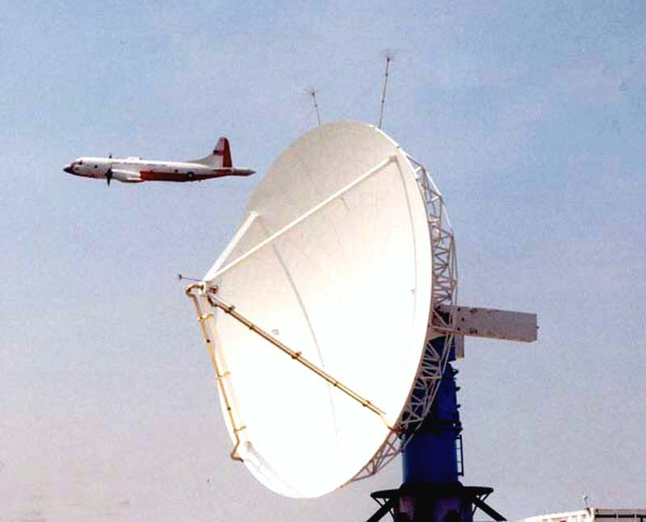
NEXRAD Technical Advisory Committee
AP Clutter Mitigation Scheme
Cathy Kessinger
Scott Ellis
Joe VanAndel
Norman, OK
19 November 2002

Slide 2
AP Clutter Mitigation Scheme
Objective -- automatic detection and suppression of AP clutter to improve hydrology and aviation products for the WSR-88D
Approach
  Separate AP clutter from precipitation (Radar Echo Classifier)
  Compensate precipitation reflectivity (Z-Comp)
  Define AP-affected areas on Clutter Filter Control map
  Clutter filter specification and control

Slide 3
AP Clutter Mitigation Scheme
REC and Z-Comp
  Open Radar Product Generator (ORPG)
  REC AP detection algorithm deployed Build 2
  ORPG Build 5:
    REC precipitation detection algorithm
  ORPG Build 6:
    Reflectivity compensation
    Automated clutter filter control
Eventual implementation in Open Radar Data Acquisition (ORDA)
  Spectral processing techniques

Slide 4
AP Clutter Mitigation Scheme
Tested on WSR-88D and NCAR S-Pol data
  S-Pol provides polarimetric truth
    Particle identification algorithm
    Independent, objective truth
    Real-time statistical scoring of REC

Slide 5
AP Clutter Mitigation Scheme
Real-time implementations on S-Pol
  STEPS, Jun-Jul 2000
    REC
  IMPROVE 1, Jan-Feb 2001
    REC and Z-Comp
  IMPROVE 2, Nov-Dec 2001
    REC and Z-Comp
    Confidence fields and statistical scoring
  IHOP_2002, Oklahoma, May-June 2002
    Continued confidence testing
    ZVW-Comp

Slide 6
Schematic of AP Clutter Mitigation Scheme
Base Data
Radar Echo Classifier
AP Clutter
Detection
Precipitation
Detection
Background Map Augmentation
Clutter Filter Control
and Specification
Reflectivity
Compensation

Slide 7
Radar Echo Classifier (REC)
Data fusion system that uses “fuzzy logic”
Has three algorithms
  AP Detection Algorithm (APDA)
  Precipitation Detection Algorithm (PDA)
  Clear Air (bugs) Detection Algorithm (CADA)
Working on confidence algorithms
New algorithms
  Sea clutter detection
  Stratiform/convective precipitation partition, in progress
  Detection of small regions of clutter, in progress

Slide 8
Reflectivity Compensation (Z-Comp)
Methodology
  Create compensation table assuming a Gaussian spectra with known clutter filter characteristics
  Use filtered V, W to get compensation value from table
  Maximum 15 dB compensation allowed

Slide 9
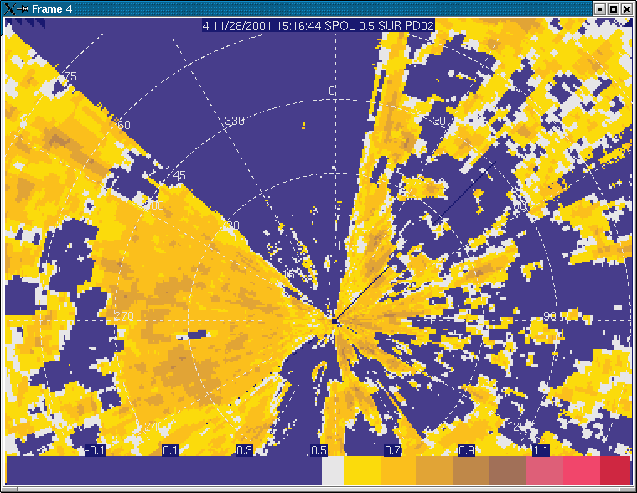
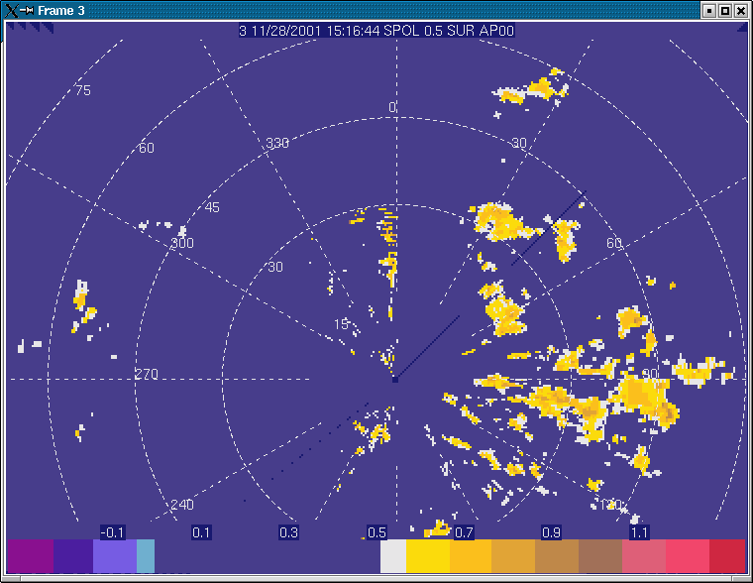
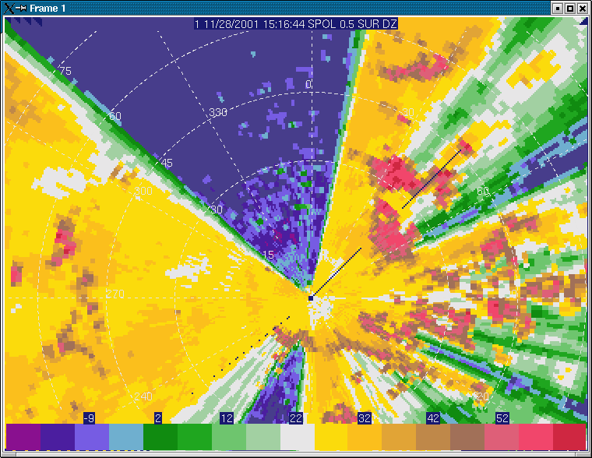
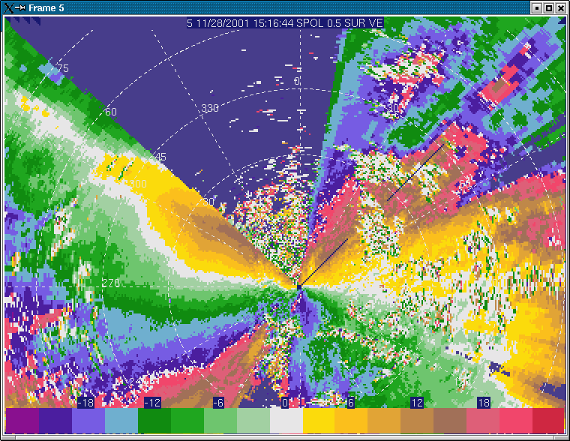
IMPROVE II Case
Precipitation Detection Algorithm
AP Detection Algorithm
Radial velocity
Reflectivity
REC results
S-Pol located in high terrain near Sweet Home, Oregon
0.5 deg

Slide 10

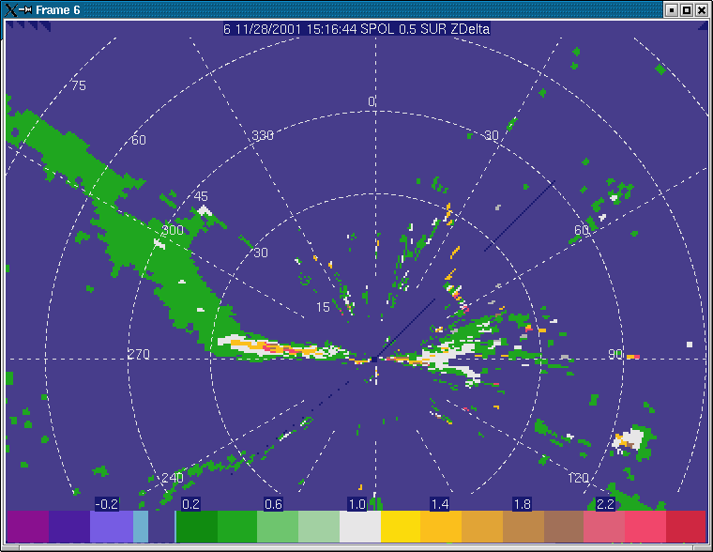
Reflectivity Compensation
Compensated Reflectivity
Reflectivity
Reflectivity Difference (dB)
Reflectivity compensation results

Slide 11
Schematic of AP Clutter Mitigation Scheme
Base Data
Radar Echo Classifier
AP Clutter
Detection
Precipitation
Detection
Background Map Augmentation
Clutter Filter Control
and Specification
Reflectivity
Compensation

Slide 12
WSR-88D Clutter Filter Control
Two methods to specify clutter filters
  Gate-by-gate background map
    Stationary targets
    Can be edited
  User-specified CFC shapes
    Defined by azimuth and range limits
    Maximum of 15 shapes
    Can be edited
APDA products defined on background map
  Manual override, initially

Slide 13
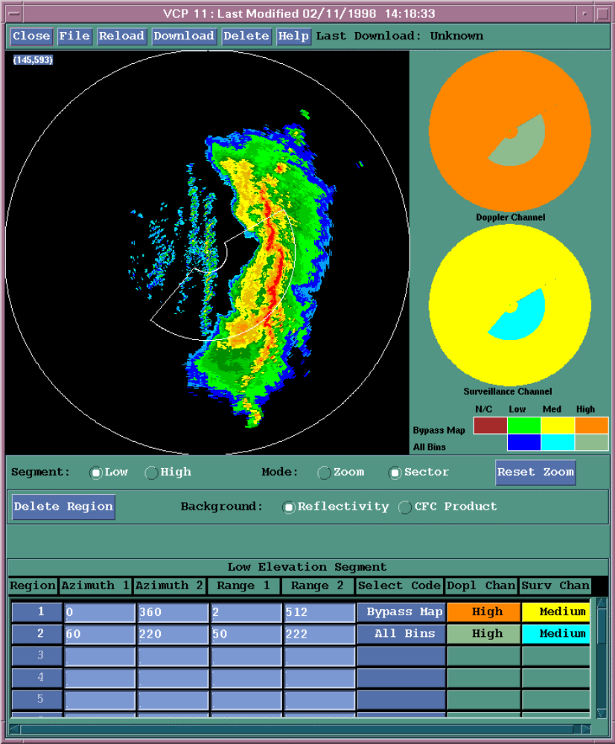
ORPG Clutter Filter Control (CFC) Panel
AP detection products
will augment this map
Precipitation
Echo
Medium
APDA Products
Low
Clutter
Echoes

Slide 14
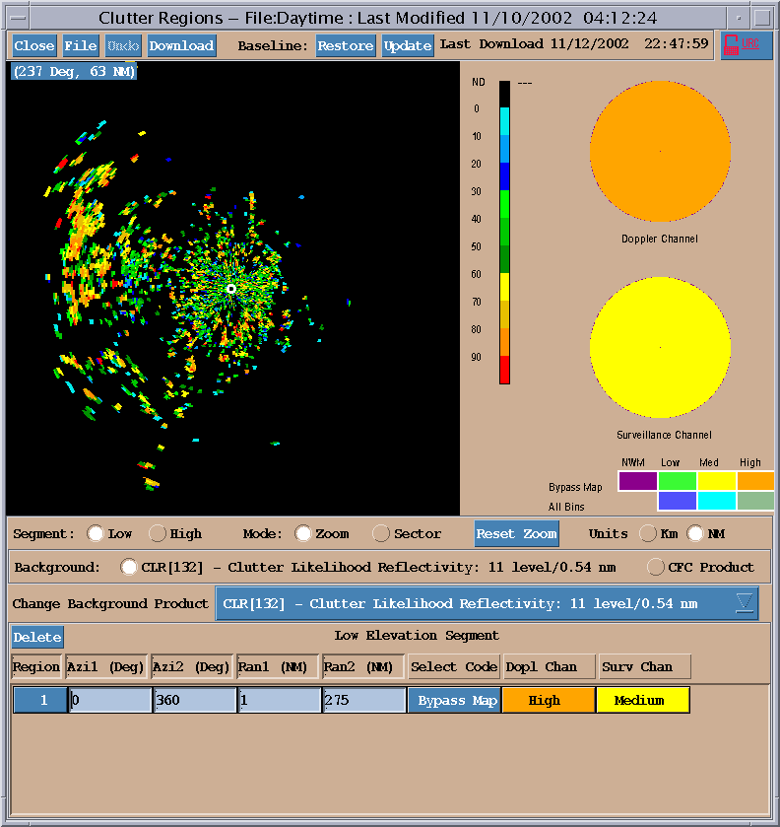
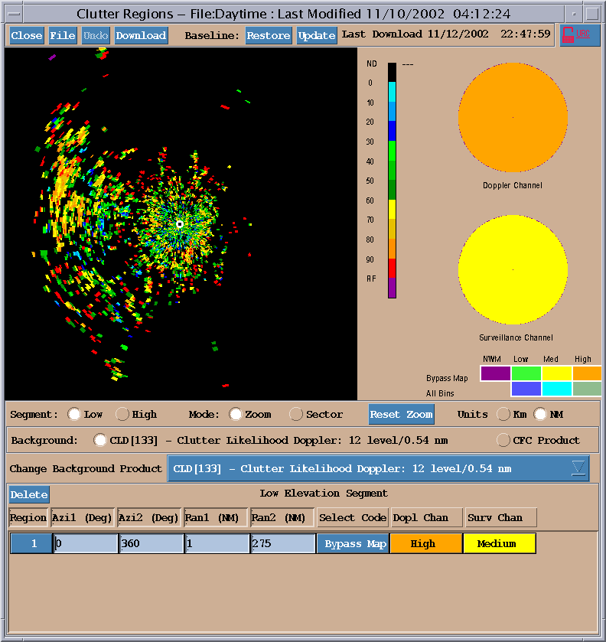
REC in ORPG Build 2
AP detection algorithm
installed in ORPG
build 2 during Sept/Oct
Accessed through the
clutter filter control
Panel
Two resolutions:
Doppler
Surveillance
Example is from
Denver KFTG
Surveillance resolution
Doppler resolution

Slide 15
netCDF files
Validating implemented AP algorithm
  Requires a common data format
  netCDF
The netCDF format code exchanged with
  ROC
  NWS Headquarters
Exchanged a few files with ROC

Slide 16
Clutter Filter
Control
APDA products
augment background
map
When filters applied,
AP clutter removed
At expiration time,
filters disabled
If AP remains, new
detection product
generated
APDA
Product
Clutter
removed
Volume 1
Volume 2
Volume 3
Volume 4

Slide 17
ORPG Builds 5, 6
Build 5
  REC precipitation detection algorithm
Build 6
  Reflectivity compensation algorithm
  Automated clutter filtering

Slide 18
IHOP Deployment
S-Pol near Beaver, OK from May-June
Ran REC and ZVW-Compensation during operations
  About 10 days
  Several good cases of AP clutter
  Good rain events
Collaborated with RAP to run the Configurable, Interactive Data Display (CIDD) program
  Reformatters to convert from DORADE to Mdv format
  Movie loops
  Geographical information on display
  Could access other data sets (GOES, metar, etc)
  Very useful during operations

Slide 19
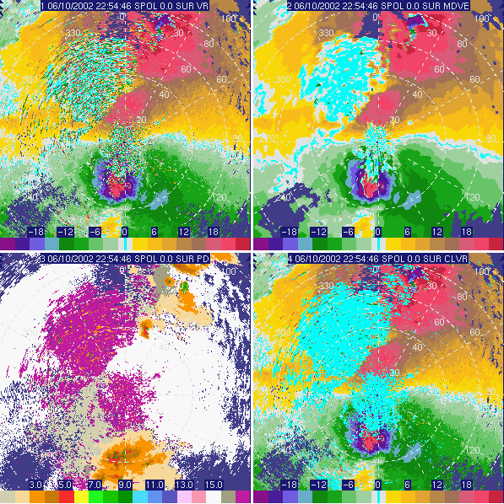
REC Improvements at IHOP
Added clutter velocity field
  Use PID output
  Clutter category used to set radial velocity to zero
Useful to retain small regions of clutter
  REC algorithms use median radial velocity because S-Pol clutter is non-zero
Will be used to make new REC algorithm for small clutter regions
Radial velocity
Median radial velocity
PID
Clutter velocity

Slide 20
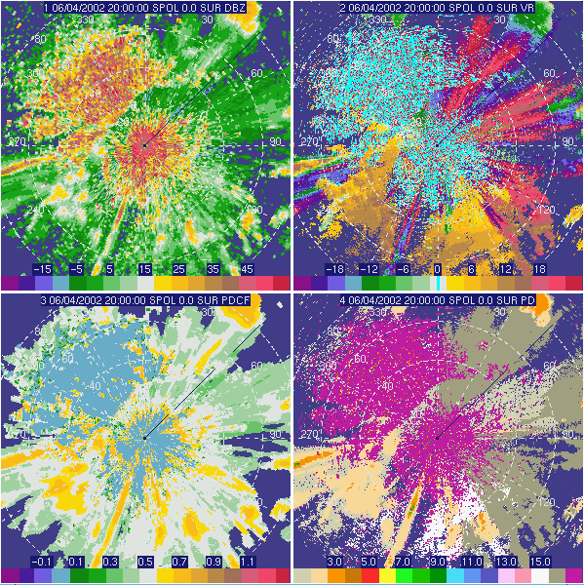
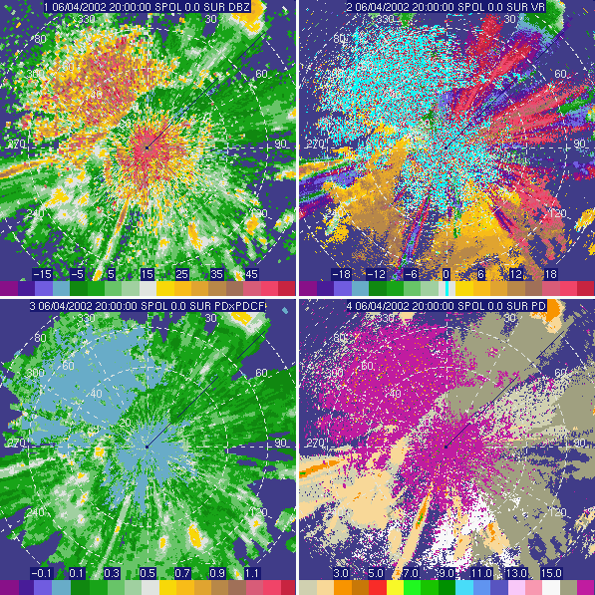
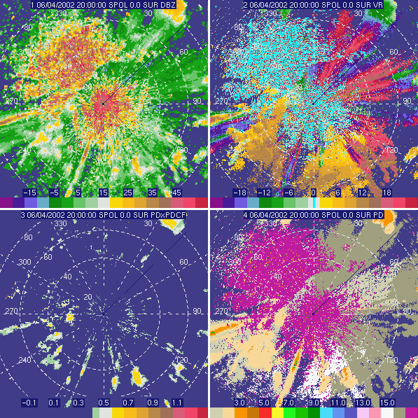
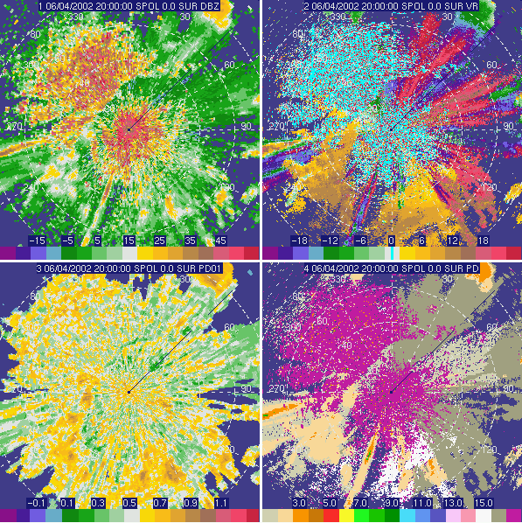
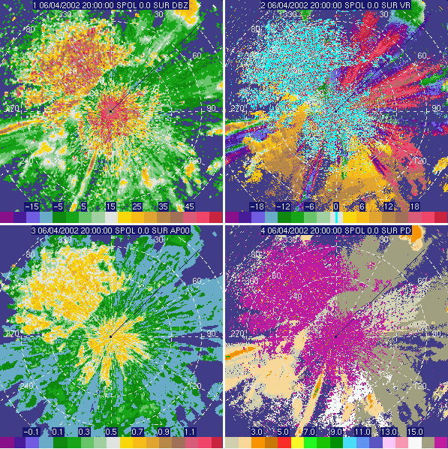
REC Improvements at IHOP
Reflectivity
Radial Velocity
Continued testing confidence algorithms
Confidence can improve the PDA algorithm
Needs more work
PDA*Conf, thresh=0.4
PDA*Confidence
PDA Confidence
PDA
APDA
PID

Slide 21
Sea Clutter Detection Algorithm
SCDA developed under separate funding
  NCAR/RAP
Deployed on civilian United Arab Emirates (UAE) Enterprise radars
  3 radars in network, more are planned
  Membership functions are still being tuned
  AP detection algorithm also deployed
SCDA is not yet implemented within ATD REC

Slide 22
Sea Clutter Detection Algorithm
Feature fields
  3 variables for vertical variation of reflectivity
  2 variables for horizontal variation of reflectivity
  Median spectrum width
  Standard deviation of the radial velocity
Local area or gate-to-gate difference

Slide 23
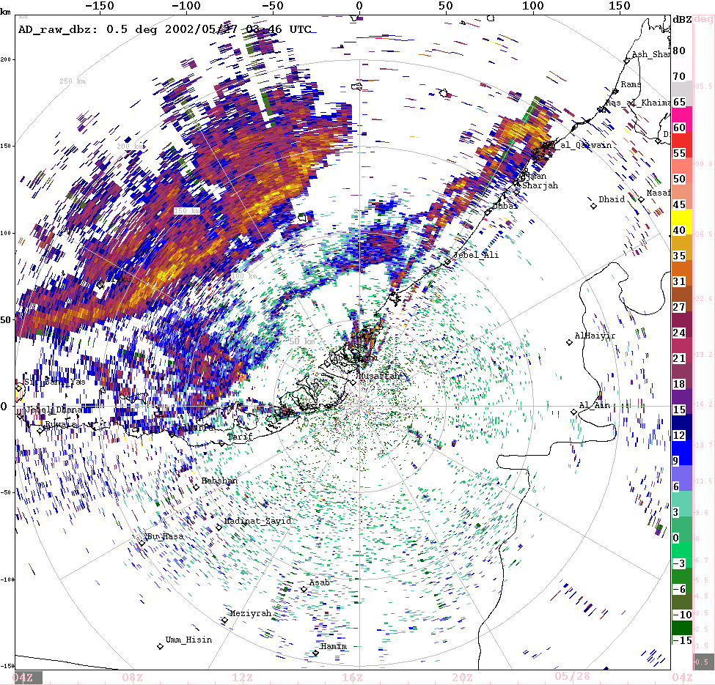
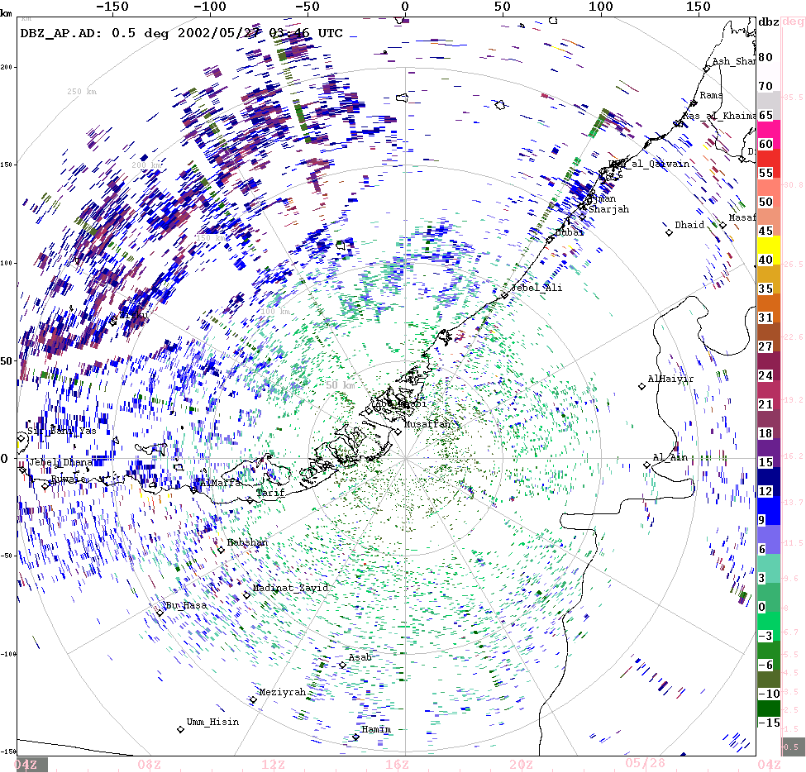
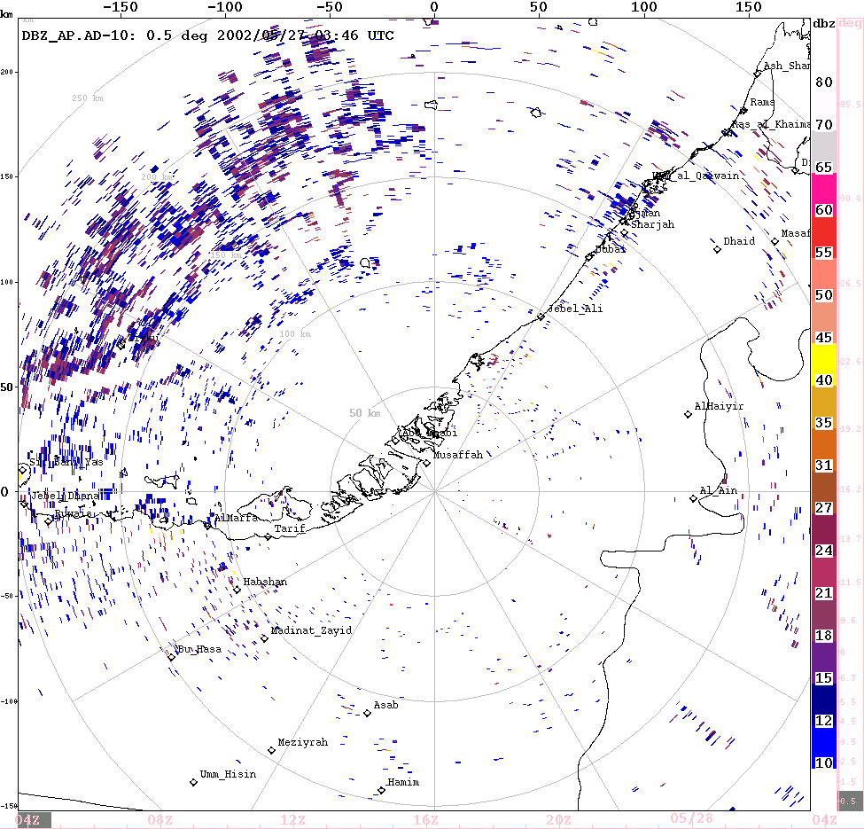
UAE
Radar Data Quality
Only APDA and SCDA are deployed
Original reflectivity
field
Sea clutter and AP clutter residue
Reflectivity removed by APDA and SCDA
Applying a 10 dBZ minimum contour to the reflectivity color table

Slide 24
Spectral Domain Processing
Thinking about how to combine the REC with spectral domain processing techniques
  New variables will be available
    Ratio of filtered power to total power
  On-the-fly processing with ability to re-process regions with clutter

Slide 25
Summary
AP detection algorithm deployed in ORPG
  ORPG clutter filter control panel
  AWIPS (after next build)
PDA, Z-Comp and automated clutter filter control planned for ORPG Builds 5 and 6
New REC algorithms
  Sea clutter algorithm
  Convective/stratiform partition
  AP detection for small regions

