Slide 1




The Early Detection Research Network
Pre-submission Meeting
November 3rd, 2004
Jacob Kagan, M.Sc., Ph.D.
Cancer Biomarkers Research Group
Division of Cancer Prevention
National Cancer Institute

Slide 2



The NCI Challenge
“To eliminate the suffering and death due to cancer by 2015”
Andrew C. von Eschenbach, M.D., the NCI Director

Slide 3
NCI’s Areas of Strategic Focus
Strategic Development of Cancer Interventions (including identification of new targets)
Molecular Epidemiology
Integrated Cancer Biology
Early Detection, Prevention, Prediction
Integrated Clinical Trials Systems
Other Health Disparities
Bioinformatics
Re-Engineering the Intramural Program
http://www.cancer.gov

Slide 4
Early Detection Research Network (EDRN)
http://www.cancer.gov/edrn

Slide 5
Early Detection Research Network
Background
Proposed By:
Early Detection Implementation Group (Jan.- Aug., 1998)
Approach Supported by:
  Colon Cancer Progress Review Group (2001)
  Lung Cancer Progress Review Group (2002)
  Stomach and Esophageal Cancer Progress Review Group (2002)
  Pancreatic Cancer Progress Review Group (2002)
  Kidney and Bladder Cancer Progress Review Group (2002)
  Gynecologic Cancer Progress Review Group (2002)

Slide 6
Early Detection Research Network
Supporting Laboratories/Centers Across the Country: 32 funded laboratories and centers: approximately 120 participating institutions; approximately 300 investigators
Washington (2)
Illinois (1)
New York (1)
Michigan (2)
Massachusetts (2)
Connecticut (1)
Pennsylvania (2)
Maryland (7)
Virginia (1)
California (2)
N. Carolina (1)
Georgia (1)
Nebraska (1)
Florida (1)
Colorado (1)
Alabama (1)
Texas (5)
Note: Number in parenthesis indicates the number of awardees
6b

Slide 7
Early Detection Research Network (EDRN)
Goals of the Network
Develop and Test Promising Biomarkers and Technologies
for Early Detection and Risk Assessment
Validate Promising Biomarkers for Detection, Early
Detection and Prognosis of Cancer
Promote Collaboration between Academia
and Industry to Accelerate the Development and
Application of New Biomarkers
Promote Rapid Dissemination of Information on
Biomarkers and Validated Biomarkers

Slide 8


Early Detection Research Network
Supporting a Multidisciplinary Approach for
Biomarkers Development
Tissue Markers
Serum Markers
Gene specific
Mutation
Functional Genomics
(Proteomics)
Tissue
Markers
Expression Profiles
Body Fluids Markers
Molecular Signatures
Cancer Prevention

Slide 9
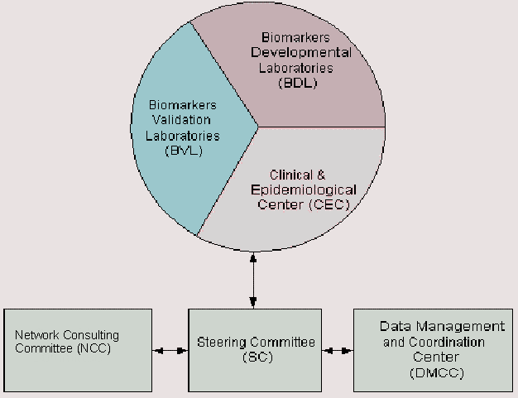
Early Detection Research Network
3 laboratories
NIST, UCLA and UAB
18 laboratories
8 Centers
+ CDCP
2 centers
FHCRC and JPL
Chair: Bernard Levin
Chair: David Sidransky

Slide 10
EDRN Committees
Steering Committee
Composed of all EDRN members and NCI coordinator
Scientific management and oversight of Network activities
Monitors DMCC activities
Meets twice a year
Executive Committee
Composed of EDRN Chair, Co-Chair, Chairs of EDRN
collaborative groups and NCI coordinator
Approves collaborative studies, validation studies,
associate members, supplements, other funding decisions
Meets monthly
Network Consulting Committee
Non-EDRN members
Advise EDRN to meet its goal
Meets every two years

Slide 11

Collaboration
  Collaborative Groups Play a Major Role in Facilitating
  Collaborations
  - Breast and Gynecologic Cancers
  - Colon and other Gastrointestinal Cancers
  - Lung and Upper Aerodigestive Cancers
  - Prostate and Other Urologic Cancers
  Collaborations are Abound: Several Collaborations
  with Clinical Programs/Trial Community in Progress
- SPORE and CGN (Ovarian Markers)
- CARET (Proteomics)
- PCPT (Prostate)
- Ob/Gyn Oncology Group and International
Gynecologic Cancer Inter-group

Slide 12

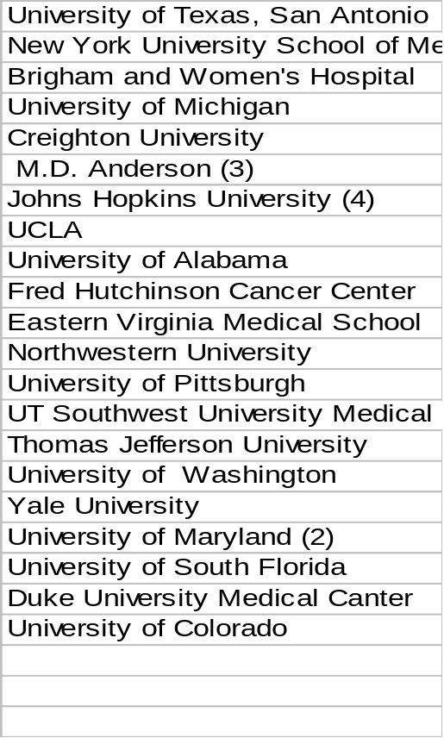
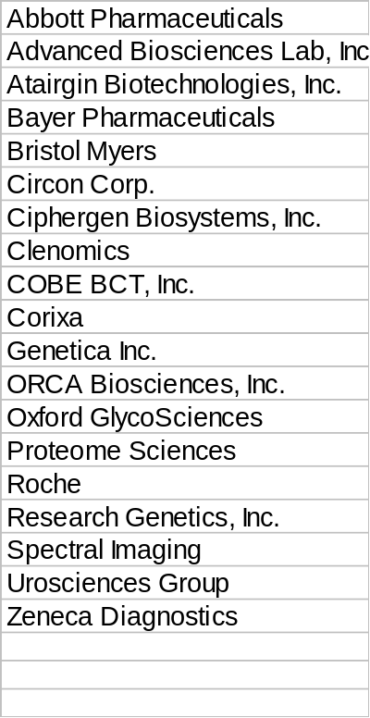
Public Private Partnership
Early Detection Research Network
Bioinformatics/
Resources
Industry
Academia
EDRN
Basic
Science
Clinical
Government
National Cancer Institute
Centers for Disease Control and Prevention
National Institute of Standards and Technology
Jet Propulsion Laboratory
Food and Drug Administration
Pacific Northwest National Laboratories (DOE)

Slide 13
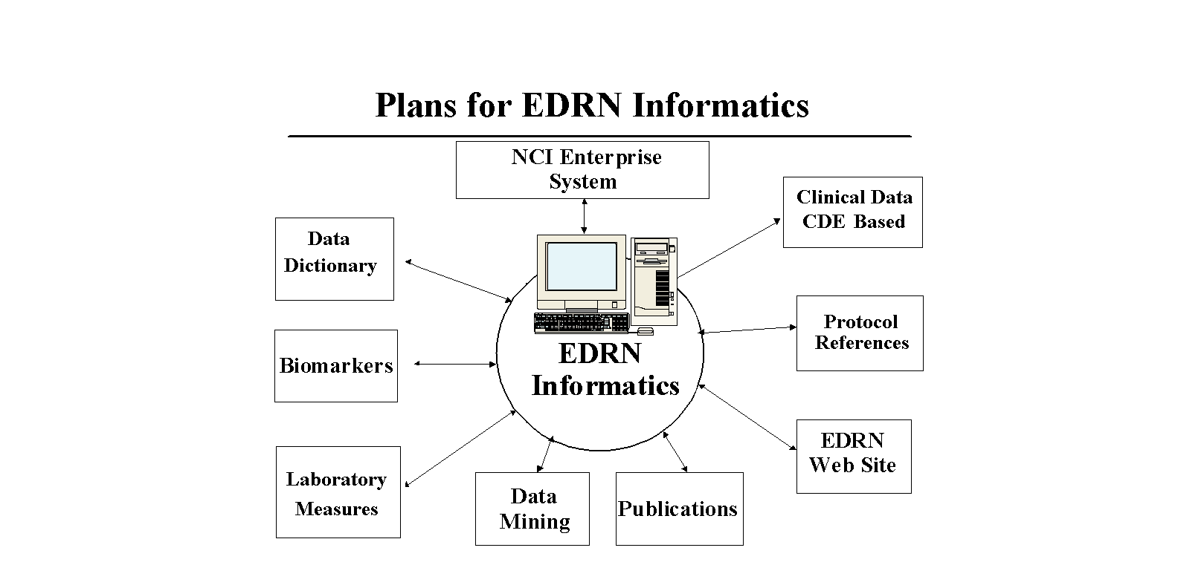
EDRN Informatics

Slide 14
BUILDING INFORMATICS
EDRN Developed:
Common Data Elements, Statistical and Computational Tools, and other decision support tools
EDRN Research Network Exchange “ ERNE” to connect sites with biorepositories and other clinical databases (Virtual Warehouse)
Web-based Portal for sharing data, exchanging data, and depositing data on specimens, protocols, IRB, etc.

Slide 15
Common Data Elements
Provide a common “language” for the specification of data terms and values
  Critical to normalizing data capture
  Critical to data sharing
  Critical to search and retrieval
EDRN CDE examples include
  Standards for epidemiological data sets
  Standards for bio-specimen data sets
EDRN Working Groups developing new CDEs

Slide 16

EDRN Resource Network Exchange Tool
Build a national data sharing infrastructure to support
collaboration in biomedical research for EDRN
As of September 2003
University of Michigan /GLNE (CEC)
Fred Hutchinson Cancer Research Center, Seattle (DMCC)
Creighton University (CEC)
Brigham and women
Hospital, (CEC)
Boston, MA
University of Colorado (BDL)
NYU (CEC)
University of
Pittsburgh (BDL)
UT Health Science Center, San Antonio, TX (CEC)
Moffitt Cancer Center, Tampa (BDL)
M. D. Anderson (CEC)
Huston, TX

Slide 17
Rollout of EDRN Informatics Infrastructure
Product Server
Moffitt
Specimen
Database
EDRN Secure Website
Product Server
UT, San Antonio
Specimen
Database
User
query
Web server
search.jsp
QueryClient
Product Server
Creighton Univ
Specimen
Database
Product Server
Univ of Colorado
Specimen
Database
EDRN Profile
Server
Product Server
Univ of Pittsburgh
Specimen
Database
Product Server
GLNE
Specimen
Database
EDRN CDE Mapping Database
DMCC – Fred Hutchinson Cancer Research Center
EDRN Resource Network Exchange

Slide 18
DEFINITION
Biological Marker (Biomarker)
A characteristic that is objectively measured and evaluated as an indicator of normal biologic processes, pathogenic processes, or pharmacologic responses to a therapeutic intervention.
Source: Biomarker Definitions Working Group - 1998

Slide 19
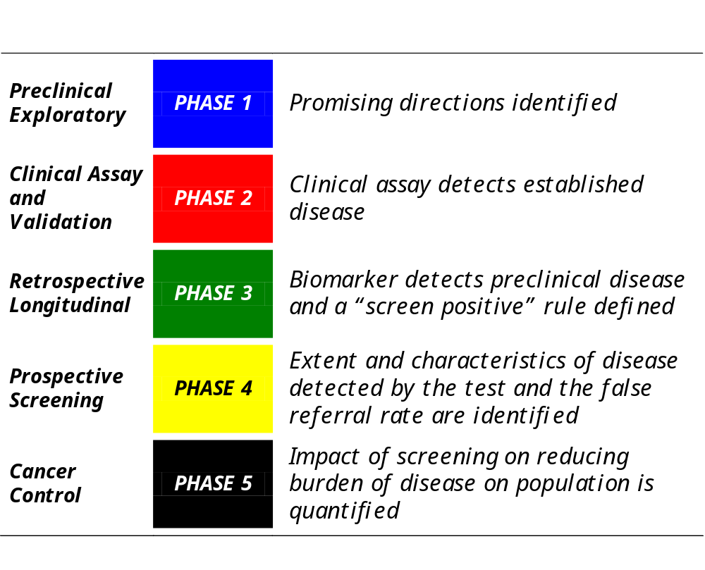
Phases of Biomarker Development and Validation
Pepe, SM. J Natl Cancer Inst. 2001 Jul 18;93(14):1054-61.

Slide 20
VALIDATION STRATEGY
BRLs
Industry
BDLs
Biomarker Discovery
Samples
Lab : BDLs
Clinical: CECs
(Protocol Driven)
Characterization
(Phases 1 & 2)
False Positive Rate
False Negative Rate
Cross-sectional
Study
Lab: BRL (High
throughout CLIA Q/A, Q/C)
More Stringent Threshold for Specificity and Sensitivity
Clinical: CEC
Longitudinal
Study
Statistically Derived Panels of Biomarkers

Slide 21
EDRN Validation Studies
The EDRN mandate is to validate markers for:
Detection and Early Detection
Prognostic markers
Risk assessment
EDRM and Non-EDRN members may submit applications to validate markers

Slide 22
EDRN Biomarker Validation Studies
Multi-institutional Studies
Protein profiling of prostate cancer using
SELDI/MALDI MS
Detection of early recurrence of bladder cancer
based on detection of Microsatellite Instability (MSA)
in urine exfoliated cells
3. Serum Biomarkers for Hepatocelluar Carcinoma

Slide 23
Communicating with the Scientific Community
EDRN Websites, Workshops, Working Group Meetings
Symposia such as the Gordon Research Conference on New Frontiers in Cancer Detection and Diagnosis, January 16-21, 2005 Santa Ynez Valley Marriott Buellton, CA
Member Liaisons for relevant professional societies appointed
Collaborative opportunities published in major journals
Associate Members
Scientific publications
Interaction and collaboration with other NCI programs (e.g., SPORE, PLCP)

Slide 24
SUMMARY: AN INVESTIGATOR-DRIVEN
NETWORK
EDRN IS:
Interactive and driven by strong science
Based on vibrant and efficient collaborations
Inclusive (Associate Members and outside collaborations)
Dynamic, flexible funding structure
Unique infrastructure with resources for translational research

