Slide 1

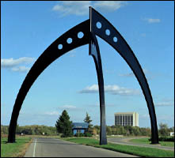
Implications of Direct Dark Matter Experiments for
MSSM Higgs Searches at the Tevatron
Dan Hooper
Particle Astrophysics Center
Fermi National Laboratory
dhooper@fnal.gov
Pheno 06 Symposium University of Wisconsin May 15, 2006

Slide 2

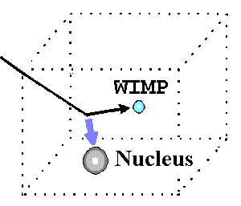
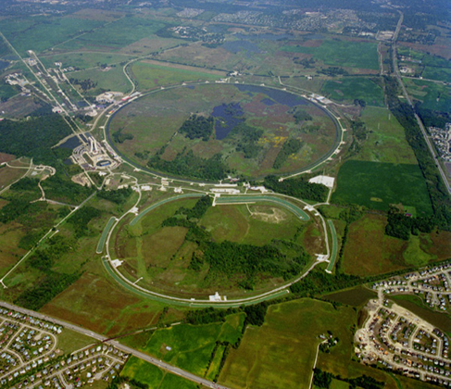
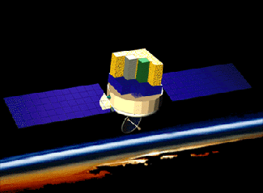
How To Search For Supersymmetry and Neutralino Dark Matter
Direct Detection
Indirect Detection
Colliders

Slide 3
Direct Dark Matter Detection
Underground experiments hope to detect recoils of dark matter particles elastically scattering off of their detectors
Prospects depend on the neutralino’s elastic scattering cross section with nuclei
Leading experiments include CDMS (Minnesota), Edelweiss (France), and Zeplin (UK)

Slide 4
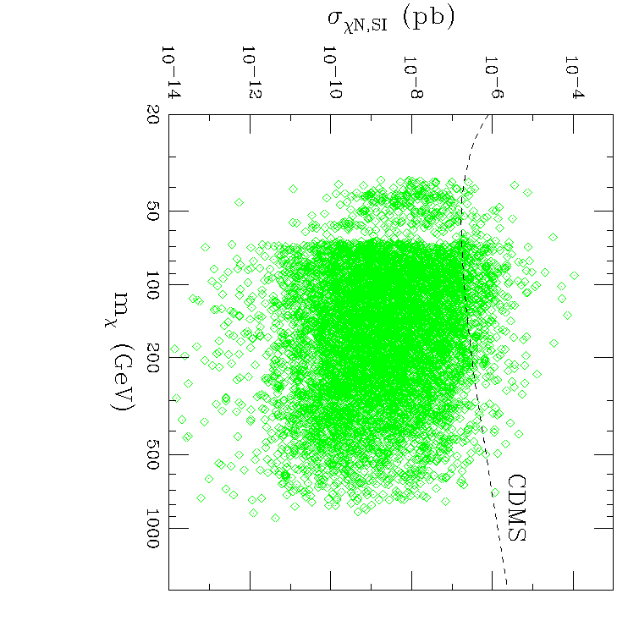
Direct Dark Matter Detection
Elastic scattering can occur through Higgs and squark exchange diagrams:
χ
χ
χ
χ
~
q
h,H
q
q
q
q
SUSY Models
Cross section depends on numerous SUSY parameters: neutralino mass and composition, tanβ, squark masses and mixings, Higgs masses and mixings

Slide 5
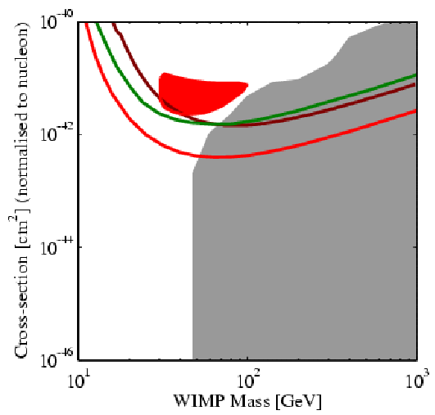
Direct Dark Matter Detection
Current Status
Zeplin, Edelweiss
DAMA
CDMS
Supersymmetric
Models

Slide 6
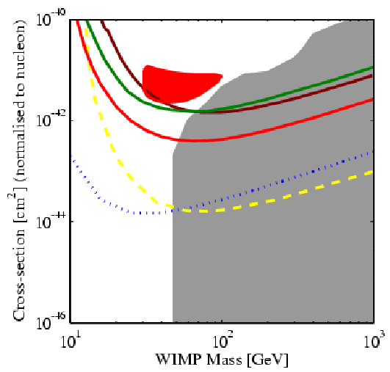
Direct Dark Matter Detection
Near-Future Prospects
Zeplin, Edelweiss
DAMA
CDMS
Supersymmetric
Models
CDMS, Edelweiss Projections

Slide 7
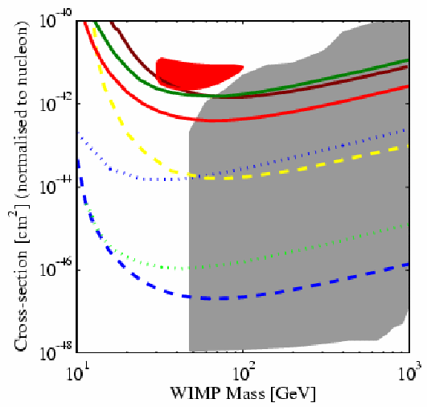
Direct Dark Matter Detection
Long-Term Prospects
Zeplin, Edelweiss
DAMA
CDMS
Supersymmetric
Models
Super-CDMS, Zeplin-Max

Slide 8
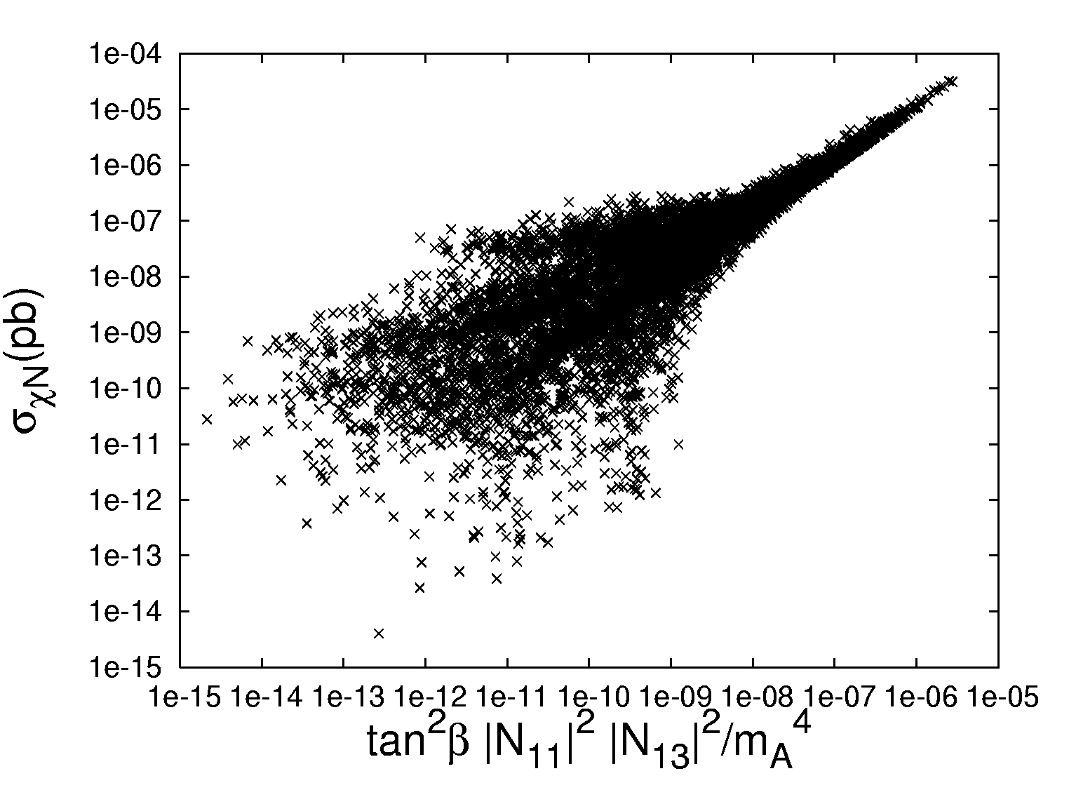
Direct Dark Matter Detection
What does direct detection tell us?
Models with large cross sections are dominated by Higgs exchange, couplings to b, s quarks
Squark exchange contribution substantial only below ~10⁻⁸ pb
Leads to correlation between neutralino composition, tan β, m_{A} and the elastic scattering rate
Direct detection searches depend on the quantity:
|N₁₁|² |N₁₃|² tan²β / m_{A}⁴
A. Taylor, Hooper, in preparation

Slide 9
Searches For Heavy MSSM Higgs at the Tevatron
Heavy (A/H) MSSM higgs searches at the Tevatron/LHC are most sensitive for models with small m_{A} and large tanβ
p p → A/H X→ τ⁺ τ⁻ X p p → A/H bb→ bb bb

Slide 10
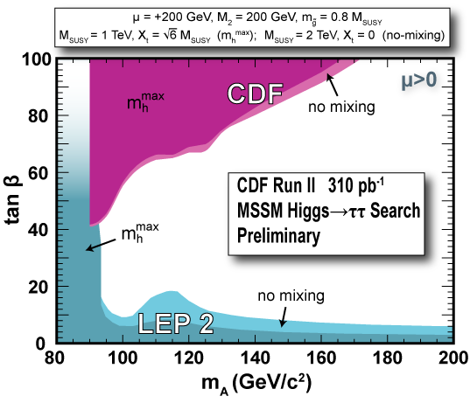
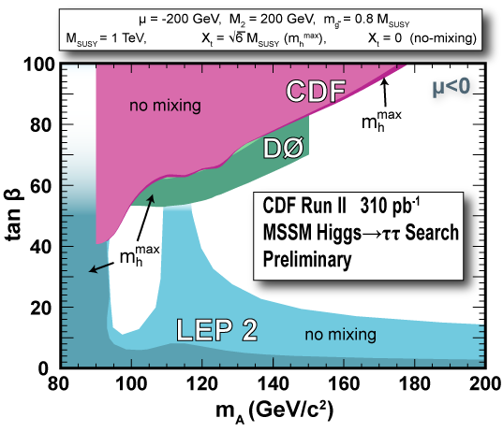
Searches For Heavy MSSM Higgs at the Tevatron
Current Limits

Slide 11
Searches For Heavy MSSM Higgs at the Tevatron
Projected Reach

Slide 12
Searches For Heavy MSSM Higgs at the Tevatron
Projected Reach
Both depend on tanβ, m_{A}

Slide 13
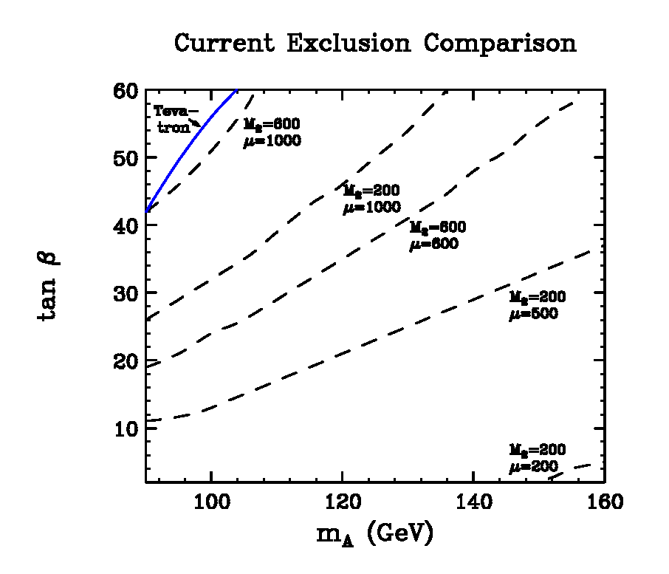
Direct Detection and Collider Searches
Current CDMS Limit
For a wide range of M₂ and μ, much stronger current limits on tanβ, m_{A} from CDMS than from the Tevatron
M. Carena, Hooper, P. Skands, hep-ph/0603180

Slide 14
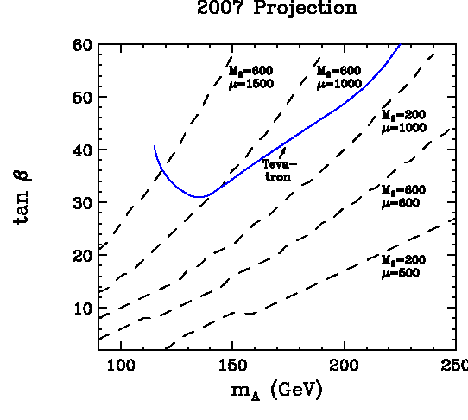
Direct Detection and Collider Searches
3σ discovery reach, 4 fb⁻¹
Projected 2007 CDMS Limit (assuming no detection)
Limits from CDMS imply heavy Higgs (H/A) is beyond the reach of the Tevatron, unless LSP has a very small higgsino fraction (μ>>M₂)
M. Carena, Hooper, P. Skands, hep-ph/0603180

Slide 15
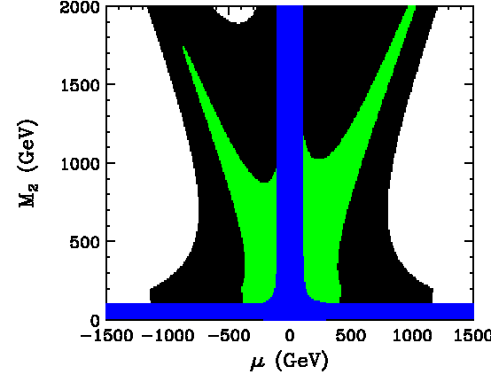
Direct Detection and Collider Searches
Constrained heavy Higgs (A/H) discovery potential at the Tevatron (4 pb⁻¹)
H/A discovery (3σ) not possible given current CDMS limits
H/A discovery (3σ) not possible given projected 2007 CDMS limits (assuming no detection)
M. Carena, Hooper, P. Skands, hep-ph/0603180

Slide 16
Caveats
Our Results depend on the following assumptions:
The LSP is a neutralino
R-parity is conserved
GUT relations for M₁, M₂ (LSP not mostly wino)
No large CP-violating phase of μ (can reduce elastic scattering)
Local dark matter (neutralino) density of ~0.3 GeV/cm³
Standard dark matter velocity distribution (no tidal steams, etc.)

Slide 17
Interplay Between Collider and Astrophysics Experiments
Despite the efforts of a few, most of the collider and astrophysics communities are largely unaware of each others’ contributions
Astrophysics and collider experiments are highly complementary and should be used to assist each other

Slide 18
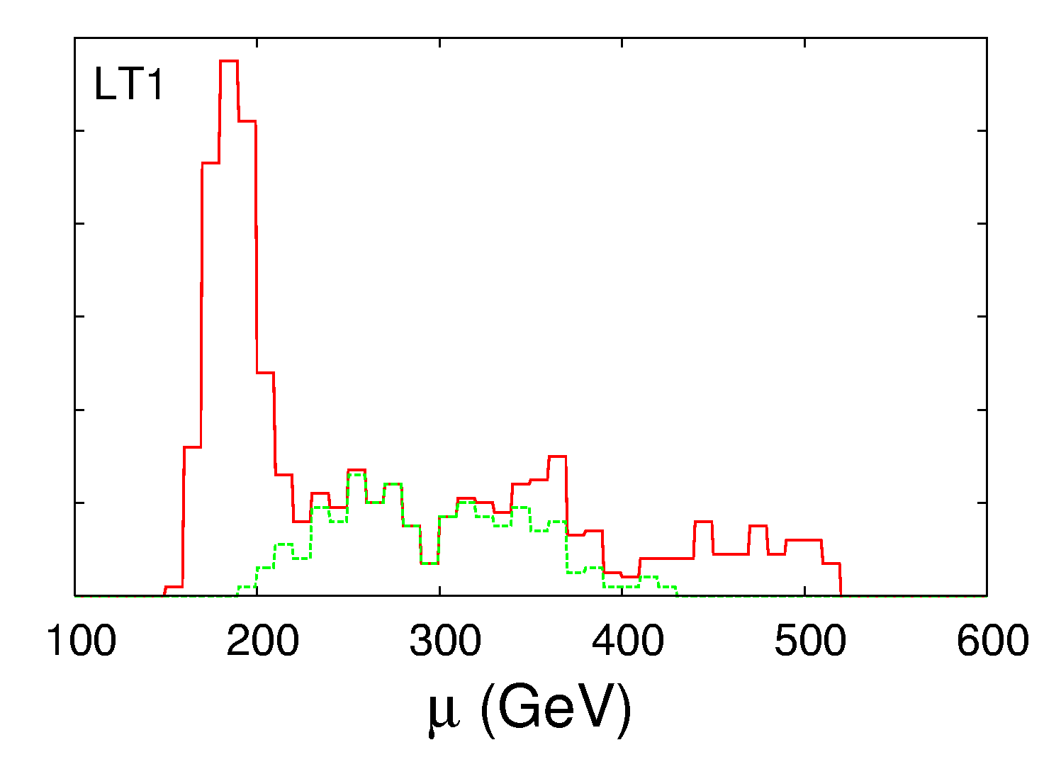
Putting It All Together
LHC+Relic Density
Actual Value
+CDMS
(Hooper, A. Taylor, In preparation)

Slide 19
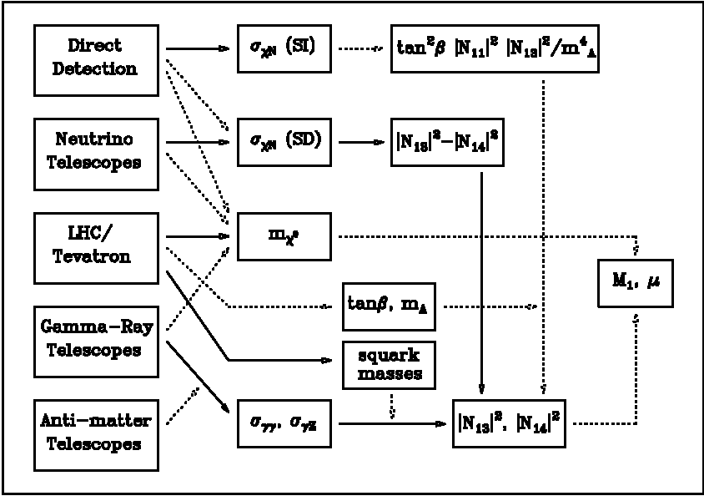
Putting It All Together

Slide 20
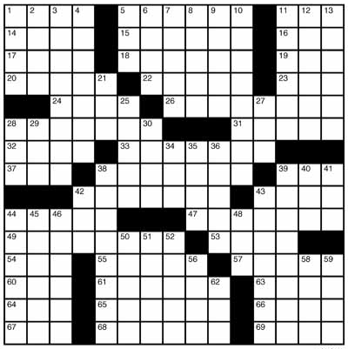
ANTA
CMS
DZERO
ZEPLIN
A T L S
RES
H E S
I C E C U B E
D M S
CDF
VERITAS
M A G I C
GLAST
A
I C E
P
M E L A
M S

Slide 21
ANTA
CMS
DZERO
ZEPLIN
A T L S
RES
H E S
I C E C U B E
D M S
CDF
VERITAS
M A G I C
GLAST
A
I C E
P
M E L A
M S
Let’s use all of the tools we have to solve the puzzle of supersymmetry!

