Slide 1
Detection of Earth in the Presence of Stellar noise
Joseph Catanzarite and Michael Shao,
Jet Propulsion Laboratory,
and
Nicholas Law,
Caltech Astronomy Department
03 January 2008

Slide 2
Overview
We apply a dynamic starspot model to estimate the impact of starspot noise on the detection of Earth via astrometric and radial velocity techniques.
We find that for the Earth-Sun system, starspots
  do not appreciably interfere with astrometric detection.
  impose severe requirements on the number of measurements and duration of an observing campaign needed for radial velocity detection.

Slide 3
Dynamic starspot model
Assumptions
  All of the Sun’s visible flux variation is due to dark starspots.
  On average there are three starspots of equal area on the Sun’s surface at any time.
  The birth of starspots is a Poisson process in time.
Adjustable parameters:
  Lognormal distribution of starspot lifetimes (2 parameters)
  Starspot area (1 parameter)
Model includes effects of
  Area projection and limb-darkening
  Systematic latitude drift with solar cycle “Maunder Butterfly pattern”
  Inclination of stellar rotation axis with respect to the line of sight.
Each starspot is specified by its creation date, lifetime, latitude, and area.
Each starspot is propagated in time as the star rotates.
Drive the total daily starspot area with the 30-year record of sunspot numbers, that overlaps the space-based TSI (total solar irradiance) record.
Tune the model parameters to approximately match the Sun’s observed flux variations.

Slide 4
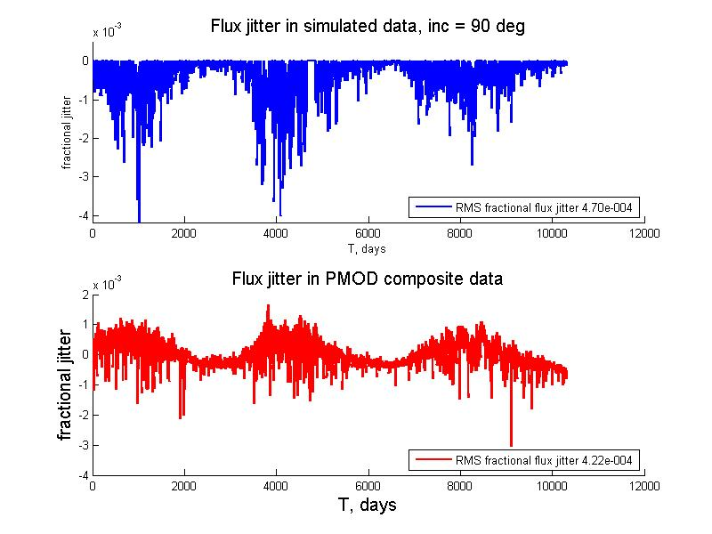
Flux jitter in the time domain
Simulation
RMS = 4.7x10⁻⁴
Observation
RMS = 4.2x10⁻⁴

Slide 5
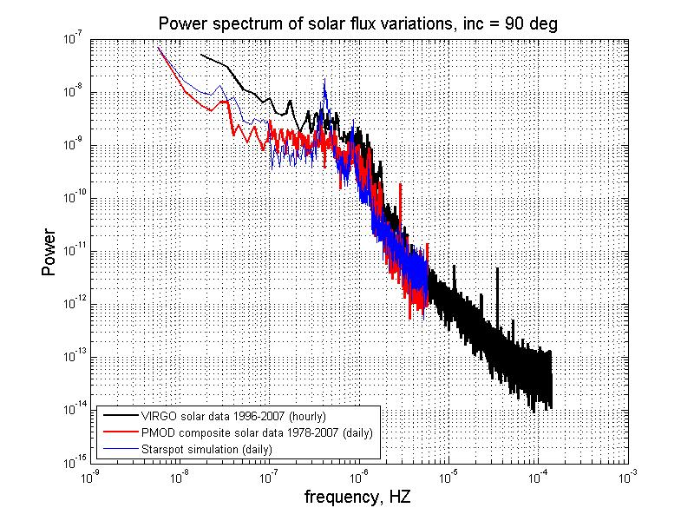
Flux jitter in the frequency domain
The simulation matches the observational data fairly well.

Slide 6
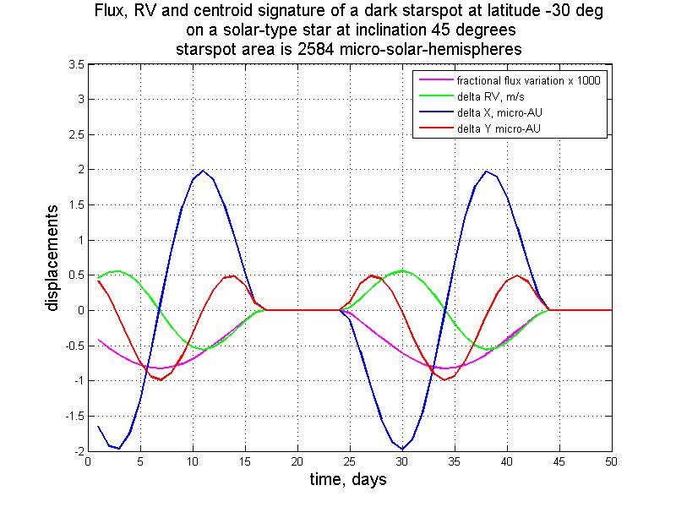
Starspots cause systematic variation of stellar flux, astrometric centroid and RV
The effect depends on inclination and latitude.
In the tangent plane: X is along the direction of the line of nodes, Y is along the projected direction of the star’s rotation axis.
In general, the jitter in the X centroid and RV are zero-mean, but the jitter in the Y centroid is not.
The bias in the Y centroid is worst for the case of 45° inclination.
Typical starspot lifetimes* are about a week so (roughly speaking) starspot noise
  Is correlated for measurements separated by less than a week.
  Is independent for measurements separated by over a week.
*The starspot represented in the figure above is persistent, for the purpose of illustration only.

Slide 7
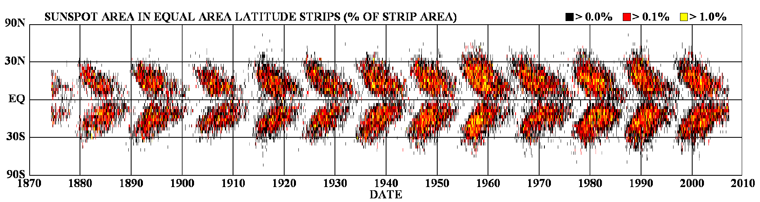
Maunder Butterfly Pattern
An 11-year sunspot cycle is included in the simulation.
Sunspots occur at higher latitudes at the beginning of the cycle.
As the cycle progresses sunspots become more likely to appear at lower latitudes.

Slide 8
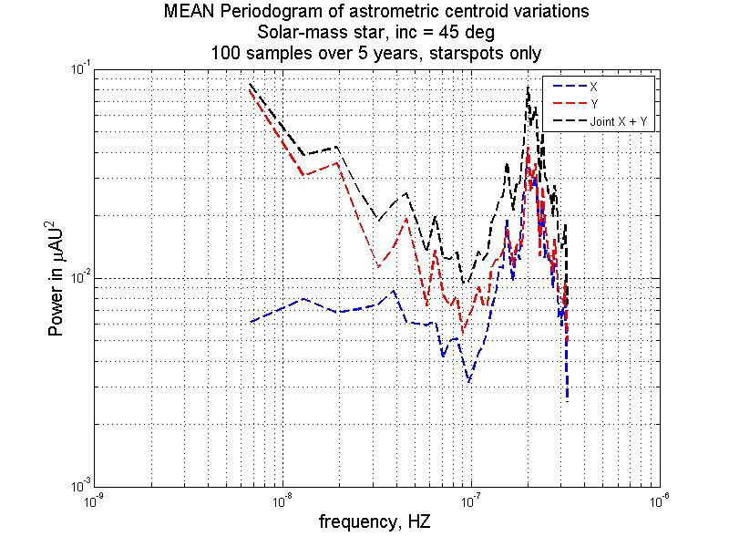
Power spectrum of centroid jitter due to starspots, 45° inclination
Mean of 80 periodograms sampled 100 times over 5 years, as in a typical observing campaign.
Captures noise in the astrometric centroid as a function of frequency; it is between 0.5 & 2 μAU per measurement.
At a 1 year period, it’s about 0.7 μAU per measurement.
1 year
X jitter spectrum is fairly flat for periods longer than a few months.
Y jitter increases at longer periods, due to starspot cycle systematics; but this is offset by the planet signal, which increases by about the same factor.

Slide 9
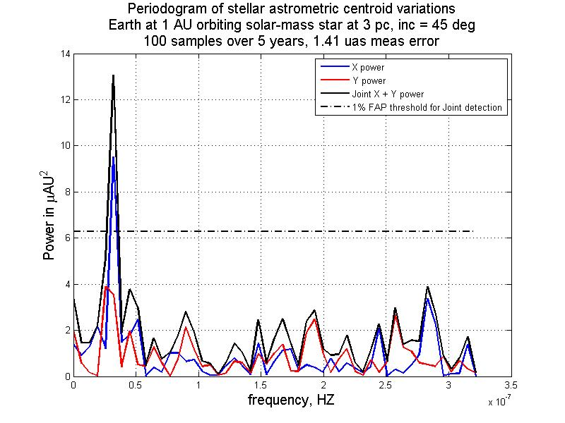
Astrometric detection of Earth at 3 pc in sunspot noise, 45° inclination
Earth’s signal is 3 μAU
Starspot noise is 0.7 μAU
per measurement.
Instrument noise is 3 μAU
per measurement, at 3 pc.
Instrument noise floor
  SIM PlanetQuest:
    0.025 μas, or
    0.075 μAU at 3 pc
  SIM PlanetQuest Light:
    0.038 μas, or
    0.113 μAU at 3 pc
SNR = 3*sqrt(100)/4.2 ~ 7
At distances of 3 pc and beyond, instrument noise dominates starspot noise, so that
  Starspot noise doesn’t interfere with astrometric detection of Earth (see periodogram, above).
  Even correlated starspot noise is generally not problematic: the noise average for groups of 10 or so measurements taken within a week is well above the starspot noise.
SIM PlanetQuest (or SIM PlanetQuest Light) could detect a 0.3 Earth mass planet in the habitable zone at 3 pc, with the 1000 measurements allowed by the noise floor.

Slide 10
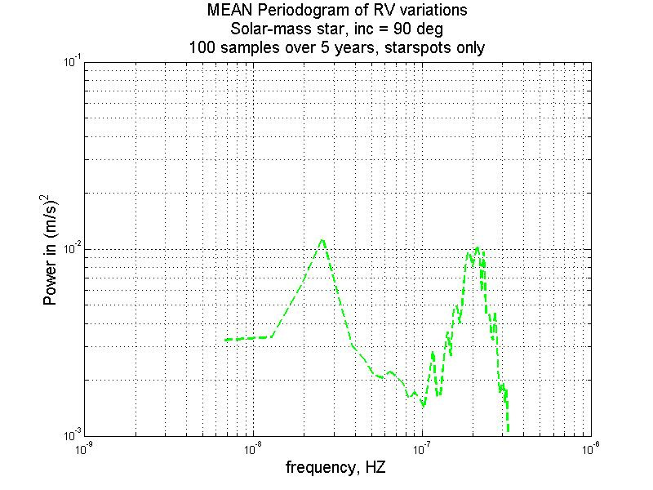
Power spectrum of RV jitter due to starspots, 90° inclination (edge-on)
Mean of 80 periodograms sampled 100 times over 5 years, as in a typical observing campaign.
Captures RV jitter due to starspots as a function of frequency: it’s between 0.3 and 0.7 m/sec per measurement.
At 1 year period, RV jitter is 0.6 m/sec per measurement
1 year
Starspot noise is comparable to typical instrument noise of 1 m/sec.
RV signal of Earth is 0.09 m/sec, much smaller than starspot and instrument noise.
If the noise were to average down like root N, it would take over 8000 independent measurements at a precision of 1 m/sec to detect Earth with the same SNR (~7) as for astrometric detection.
But adjacent measurements would need to be spaced a week apart, otherwise their noise would be correlated, they would not be independent, and so could not not average down to below 0.6 m/sec

Slide 11
Conclusion
Astrometric starspot noise
  Is small compared to Earth’s astrometric signature.
  Is small compared to SIM PQ & PQ-light’s instrument noise.
  Doesn’t interfere with astrometric detection of Earth.
On the other hand, RV starspot noise correlations make RV detection of Earth extremely difficult.
  Requires over 2000 measurements even at precision of 0 m/s.
  Sampling rate must be lower than 1 per week to avoid correlations.
  Such an observing campaign would take over 40 years.

Slide 12
Ongoing work
We are currently extending this study to estimate the effect of starspots on the detection of potentially habitable planets around all the stars in the SIM target list. We will
  Use existing space-based photometric time series from WIRE, MOST, and Hipparcos to study the flux variability of other main-sequence stars.
  Exploit connections among flux variability, chromospheric activity (from Ca II H&K indices), age and rotation rate to extend our starspot model to other spectroscopic types on the main sequence.

