Slide 1
Update on HIV Testing
[A Very Fast]

Slide 2
Message
There are numbers of tests
They should be used in combination (strategies)
Combinations must be consistent

Slide 3

Laboratory Tests
diagnosis of infection
  acute, recent, established or late stage disease
prognostic markers
monitoring of ARV therapies
  immunological and virological markers
  toxicities
diagnosis of opportunistic infections
drug resistance testing

Slide 4
‘typical’ primary HIV-1 infection
symptoms
symptoms
HIV proviral DNA
HIV antibodies
‘window’
period
HIV viral load
HIV-1 p24 antigen
0 1 2 3 4 5 6 / 2 4 6 8 10
1° infection
weeks
years
Time following infection

Slide 5
HIV Assays: Methodologies
FOR THE DIAGNOSIS (DETECTION) & MANAGEMENT OF HIV
Virus Detection & Quantification
RNA
modified Ag
Viral Culture,
phenotyping
EIA
Simple, rapid tests Immunoblots
Incident assays
Antibody
Antigen
Detection
ARV Resistance – genotyping
ARV Sensitivity
CD4+
DNA
(RNA)
DIAGNOSIS
MANAGEMENT
Notes:
HIV Assays - Methodologies and Utilisation:
The diagnosis of HIV infection usually rests on the identification of specific antibody to HIV in plasma or serum. To identify positively the presence of anti-HIV, two assays using different technology and different antigen preparations, should be used.
The detection of HIV infection by antibody tests is an indirect confirmation of infection.
There has been a change in test usage with the introduction of molecular-based tests.
The emphasis in using anti-HIV tests has been somewhat eclipsed by the news around tests that quantify viral load. Viral load estimations are used to gauge prognosis and to monitor therapy.
Other tests monitor the status of immune function indirectly but these are used widely in HIV management.

Slide 6
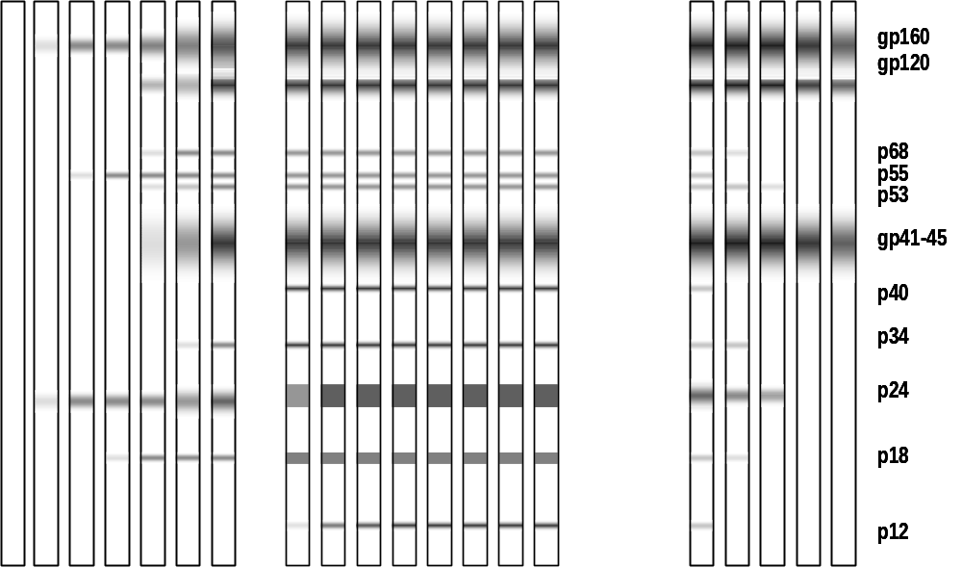
Spectrum
of anti-HIV
testing
early
recent / established
advanced
DNA PCR
RNA PCR
p24 Ag
3rd gen ELISA
1st gen ELISA
Detuned ELISA
1wk 2wk 3wk 2mo 6mo 1yr 2yr 3yr +8yr

Slide 7
HIV Testing -
Direct Detection of Virus
HIV p24 antigen– serology
  - In isolation or Ab/Ag Combo test
  - Diagnosis of primary infection viraemia
Virus culture / isolation
Nucleic acid detection - (NAT)
  Clinical uses
  Proviral DNA vs. plasma RNA(viral load)
  resolution of inconclusive serology / neonatal
  subtyping
  drug resistance monitoring

Slide 8
Principle of Immunoassays
ANTI-HUMAN IMMUNOGLOBULIN WITH DETECTOR
SAMPLE ANTIBODY
ANTIGEN
SOLID PHASE
Notes:
Principles of Immunoassay:
There is a general basic construction format of immunoassays which include:
An antigen which is used to capture any sample antibody, attached to a solid phase, be it a well on a microtitre plate or a gelatin particle, bead or membrane.
The anchored antigen is incubated with the sample so that an antigen-antibody reaction occurs.
In PA assays bound antibody causes particle agglutination.
In EIAs a wash step removes the serum or plasma and leaves only bound antibody. A conjugate which is usually anti-human immunoglobulin labelled with enzymes or fluorochromes which will subsequently bring about a reaction that will result in a colour change. After a wash step to remove excessive conjugate a substrate on which the enzyme reacts or by which the fluorochrome is activated, the colour change is read in a spectrophotometer.
Newer machine-based assays may use variations on the system diagrammed above.

Slide 9
Available Assays
EIAs including
  rapid, simple
  particle agglutination,
  dot/blot
  Western blot
  Antigen & Ab/Ag
  Incidence assays
Direct Virus Detection
Notes:
Available Assays:
There is a large range of assays available, especially for anti-HIV screening and HIV-diagnosis.
In considering the most suitable assay for a given testing strategy there will be a number of considerations including:
suitability of assay format
antigens used
characteristics of the assay
skills of the technical staff, etc.

Slide 10
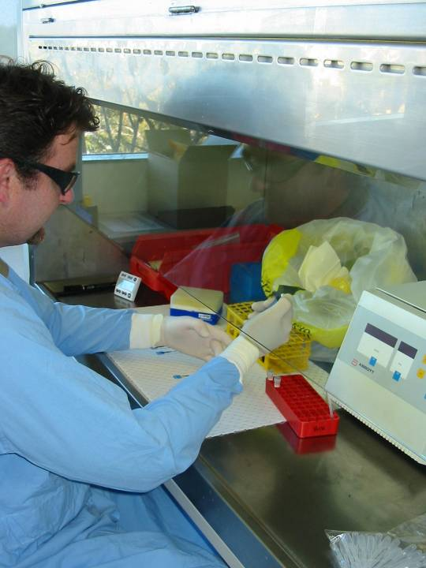

Slide 11
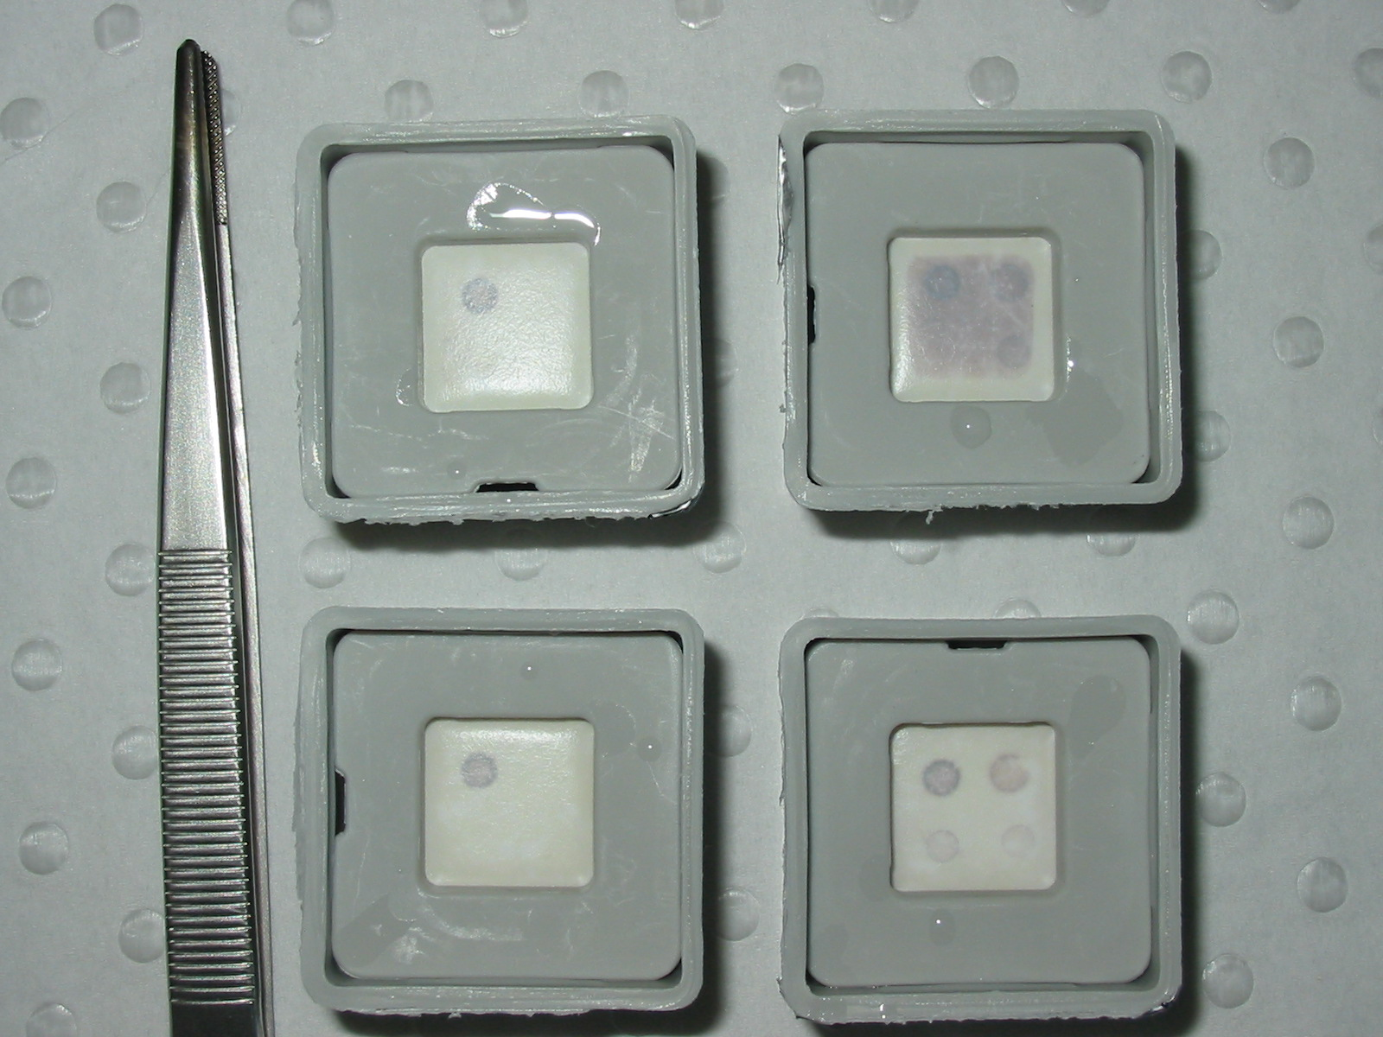

Slide 12
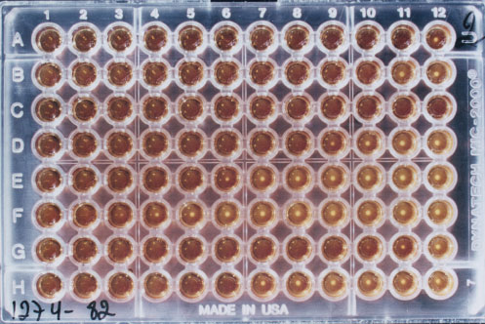
Particle Agglutination

Slide 13
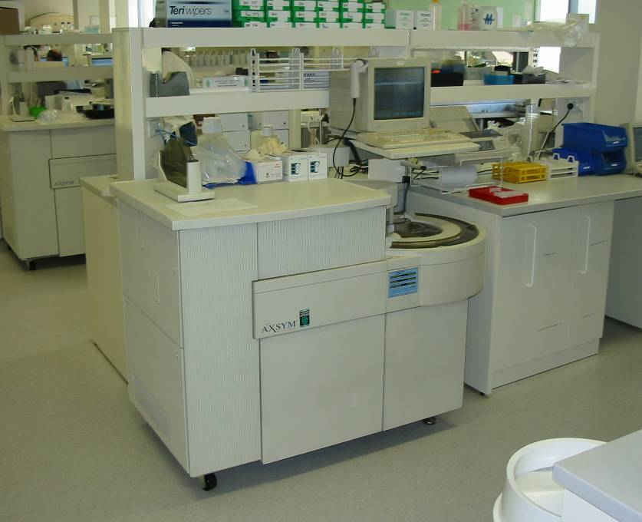

Slide 14
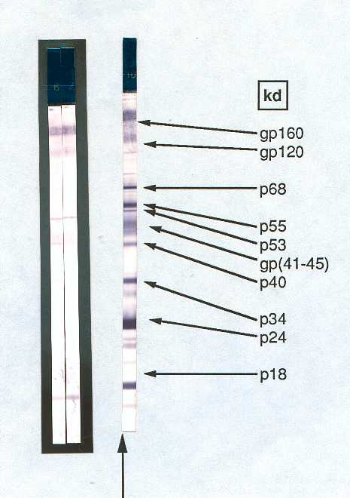
Western Blot
Expensive – $ 80 - 100
technically more difficult
visual interpretation
lack standardisation
  - performance
  - interpretation
  - indeterminate reactions – resolution of ??
‘Gold Standard’ for confirmation

Slide 15
Antibody testing limitations
Difficulties in interpretation
Limitations - ‘window period’
antibodies appear within 3-4 weeks
  Direct detection – HIV p24 antigen or DNA/RNA (NAT) – pre-antibody
  Combo test = earlier detection
Primary infection + therapy = delayed antibody response

Slide 16
Ag/Ab Combo tests
Ab & Ag
Detection of Ag & Ab in a single test
utility in primary infection – pre-seroconversion ‘window period’
Incident populations – ‘at risk’
Blood bank
Automated platforms available
Ag & Ab

Slide 17
Issues with Combo Assays
Testing strategies
False reactivity rates
Confirmation strategies
Replacement of other assays
(especially in the USA)
Cost
Legal issues

Slide 18
Conclusions
HIV-1/2 Ag/Ab combo assays perform well
Differences in limit of detection of Ag
  (140 - <25 pg/mL)
May shorten window period by 3-5 days
  PHI detection without indication
Issues associated with introduction
  Strategies and confirmatory algorithms
ARV therapy effects seroconversion events

Slide 19
What about simple assays?

Slide 20
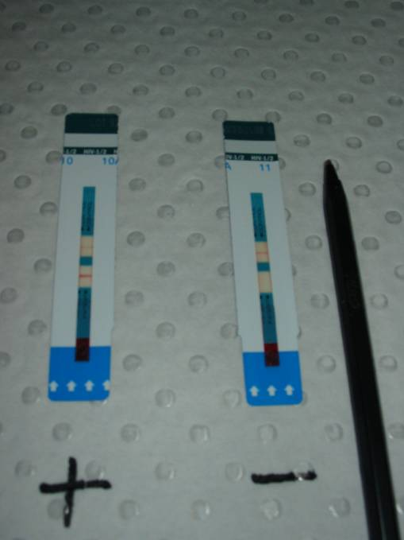
HIV Determine test
Detect HIV-1 & HIV-2
Cannot differentiate
Procedural control – anti Hu IgG
Whole blood or serum/plasma
Widely available
No additional reagents required
Room temperature storage
15 minutes to result

Slide 21
BioRad HIV-1/2 Multispot
Detects HIV-1 and HIV-2
Will differentiate 1 and 2
Procedural control – anti-Hu IgG
Serum / plasma only
Additional reagents (included)
Requires refrigerated storage
‘Immunoconcentration’ principle
15 minutes to result

Slide 22
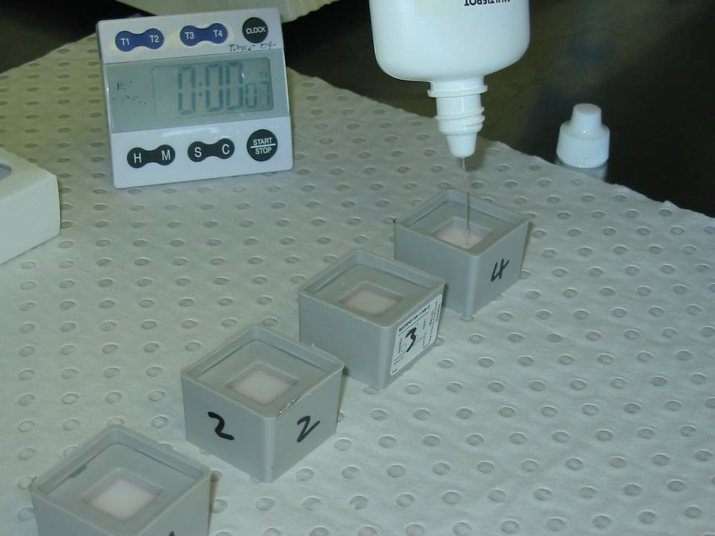

Slide 23
WHO Recommended Strategies
Strategy I Test all samples with one EIA
Strategy II Strategy I with all reactives retested in a more specific test with different principle and/or antigen.
Strategy III Strategy II with reactives tested in a third test differing from the first two tests.
Notes:
WHO Recommended Strategies:
Because of the cost of supplemental testing WHO has devised and recommended alternative testing strategies. These strategies are designed to avoid the use of the costly and poorly standardised Western Blot.
The strategies rest entirely on assays that may be conducted by screening laboratories.
It is emphasised that tests must be carefully selected. Each test used in the strategy should employ a different principle and different antigen preparation.
The strategy selected also depends on the prevalence of HIV infection within the population being tested. The predictive values of the strategies will change with the prevalence.

Slide 24
WHO Recommended Testing Strategies
Transfusion safety
Surveillance
Diagnosis
Risk factors
No risk factors
Strategy I
>10% I
<10% II
Strategy II
>10% II
<10% III
Notes:
WHO Recommended Testing Strategy 2
The strategies are recommended by their prospective use and depending on the prevalence of the population being tested. Furthermore if the test strategy is being used to achieve diagnoses, risk factors will be taken into account.
These alternative testing strategies have been used to advantage in numbers of countries.

Slide 25
Testing Strategies
AIM: To develop the logic used in establishing the use of HIV tests (testing strategies)
Notes:
Developing Testing Strategies:
To develop testing strategies effectively you should know:-
the prevalence of the infection being detected
the incidence of the infection
the characteristics of tests used in testing your population
that a supply of the tests to be used will be constant over time
the interactive properties of the tests
the requirements of the clinical staff that use the laboratory
All these parameters need to be available and understood for a testing strategy to be developed so that the predictive values of the strategies will be understood.

Slide 26
Objectives of Testing Strategies
To achieve the correct diagnosis in the most efficient manner
To maintain consistency in testing
To know the predictive value of the testing process
To develop baseline data for assessing changes
To deliver useful results
Notes:
Objectives Of Testing Strategies:
Achieving the correct diagnosis
In a fully developed testing strategy, the limitations of any tests and of the testing process are understood.
Tests are used appropriately.
There are supporting data against which ongoing performance may be measured.
Consistency
Laboratory performance can only be tracked if the testing process is consistent
Laboratory staff and doctors alike understand results reported with consistent test usage.
Laboratory records can be maintained with consistency.
Strategies are based on data therefore the predictive value of the testing process is known.
The limitations of the testing process may be defined.
If any changes in tests or testing occur, the changes will be understood in the context of the strategy.

Slide 27
Aims in Developing HIV Testing Strategies
To arrive at the correct sero-diagnosis
To minimise total testing; thus cost
Minimise samples classed as indeterminate or dual reactors
Detect HIV-1 negative but HIV-2 positive
Follow likely seroconverters (HIV-1 or -2)
Notes:
Aims in Developing HIV Testing Strategies:
To arrive at a correct sero-diagnosis
Characteristics of the tests need to be understood.
The sequence in which the tests are to be used have to be understood by laboratory personnel and health care workers alike.
The deficiencies of the strategies must be understood.
Minimising total testing
Developing strategies generates data that will enable laboratories to achieve the correct diagnosis in the most efficient manner. Therefore, total testing is minimised.
If different tests are continually introduced into testing there is confusion about what aberrant test results might mean, and no consistent means of resolving these. Therefore further testing and confusion is generated. This can be costly.
CONTINUED ON NEXT PAGE

Slide 28
Screening Assays
  Are used to detect antibody-- specific or nonspecific
  Are designed to handle large numbers of samples with rapid throughput
  Must be high performance
  Should include a full range of HIV antigens
Notes:
Screening or First Line Tests:
Screening assays usually detect antibody.
Because the assays are geared to detecting any antibody that resembles the target antibody they demonstrate false reactivity that cannot be ignored.
The most commonly used screening assays are enzyme immunoassays (EIAs) and particle agglutination(PA) assays. In many countries the blood service laboratories are using fully automated micro-particle immunoassays.
The assays are designed so that large sample numbers can be processed in short time frames.
The use of screening assays has almost eliminated the transmission of HIV, HCV and HBV through blood transfusion when the assays are used correctly.
This has been possible because most screening assays are highly sensitive (designed to detect all positive sera).
Screening assays are the assays used initially in diagnostic testing strategies.

Slide 29
Ab + Ag AbAg
Notes:
The Basis of Immunoassay reactions:
All immunoassays are based on an equilibrium between the binding of an antibody with an antigen.
Perfect Immunoassays:
To create a perfect immunoassay there would be a single, totally specific interaction, which was 100% sensitive in detecting the particular antibody and 100% specific to the analyte in question

Slide 30
Ab +Ag
AbAg
Ab +Ag
AbAg
Ab +Ag
AbAg
Ab +Ag
AbAg
Ab +Ag
AbAg
Ab +Ag
AbAg
Ab +Ag
AbAg
Ab +Ag
AbAg
Notes:
There Is No Perfect Assay!
Because humans generate a repertoire of antibodies to many proteins there is always some degree of overlap and false reactivity can occurs in 0.1 to 2 or 3% of the population for any given assay.
On the other hand sometimes antibody is of low level or low concentration and therefore is not detected.
When 100% sensitivity and specificity are quoted for an assay - the reported evaluation has not incorporated sufficient samples (always look for Confidence Intervals).
Therefore where a result is sensitive such as for the diagnosis of HIV, the result must be as close to a100% accurate as possible. Because this is not possible using a single test multiple tests must be used in sequence to arrive at a diagnosis that is as close to 100% as possible. The careful development of testing strategy will enable this.

Slide 31
Serological Testing Strategy
SCREENING TEST, highly sensitive
NEG
REACTIVE
SUPPLEMENTAL TEST, highly sensitive & higher specificity
POS
NEG
IND
ADDITIONAL
TESTS
NEG
POS
IND
Notes:
A Reference Laboratory Testing Strategy:
In a reference laboratory tests additional to the normal screening and first supplemental test used in diagnostic laboratories, may be performed to decipher complex reactivity in samples that may be referred from other laboratories.
“Supplemental tests” used could include other EIA’s, p24, immunoassays, commercial Western Blots and molecular methods.
As a reference laboratory we aim to minimise the need for follow up of samples.
It should be realised that most samples will never enter this complex type of strategy. Most samples will not go beyond the first screen.

Slide 32
HIV Testing Strategy
HIV1/2 SCREEN
SCREENING
NEG
REACTIVE
POS
HIV-1 WB
NEG
IND
NEG
SUPPLEMENTAL
ADDITIONAL
TESTS
POS
IND
POINT OF REPORTING
Notes:
Principles involved in a Testing Strategy:
Testing strategies are set up according to the characteristics of the tests.
The screening test is a highly sensitive test which identifies anything that resembles the target.
Supplemental testing sorts out true from false reactivity - tests should therefore be:
highly sensitive
of different configuration
use different capture targets

Slide 33
Supplemental Assays
  Range of assays that further define sero-status
  High Performance (higher specificity)
Notes:
Supplemental assays - Definition:
Supplemental assays are those that further define the sero-status.
To distinguish true from falser reactivity supplemental assays are necessarily of high specificity.

Slide 34
The Use of Screening Assays
Define samples as negative for a given analyte
Enable high throughput
Notes:
The Use Of Screening Assays:
Screening assays are used in both blood bank and diagnostic programs to exclude negative samples from any further testing in the testing strategy.
Because of the very high negative predictive value of screening tests, the first test in screening programs can use the specimen as a single sample and if it is negative no further testing need occur.

Slide 35
Assay Selection depends on:
laboratory infrastructure
access to reference laboratory
desired characteristics of the test
equipment
performance time
shelf life and stability of reagents
price
technical skills of personnel
support (technical, kit supply, etc)
Notes:
Assay Selection:
The assay selected in strategy development will depend on a large number of factors.
These factors will be different for every country or region.
An advantage of collaborations between regions is that each may utilise aspects of others testing strategies for unusual situations.

Slide 36
Predictive Values
Positive Predictive Values:
The likelihood of a sample identified as a reactive by a test being truly POSITIVE for the analyte used as the basis of the test.
True Positives
PPV
=
X 100%
True Positives + False Reactives
Notes:
Predictive Values:
Understanding predictive values is the key to understanding the predictability of a strategy’s effectiveness.
The predictive values of the same strategy in different areas will be different because of factors such as
the prevalence of HIV in the community
the characteristics of the tests being used
the rate of false reactivity.
Low Prevalence : True Positives < False Reactives
High Prevalence: True Positives > False Reactives
Therefore the same tests and strategies used in different areas will not give the same predictive values. Thus it is important that each testing network understand what its individual predictive values are.

Slide 37
Predictive Values
Negative Predictive Values:
The likelihood that a sample identified as a non-reactive by a test is truly NEGATIVE for the analyte used as the basis of the test.
True Negatives
X 100%
NPV
=
True Negatives + False Negatives
Notes:
Predictive Values Continued:
Negative predictive values are much higher than positive predictive values because of the way of tests are constructed.
Antibody tests are geared to recognise antibody. (The tests can be thought of as hypersensitive therefore, the number of false negatives is usually very low.)

Slide 38
Negative Predictive Value
Non-reactive test, prevalence 2%
Sensitivity
%
60 70 80 90 95 98 99
99.17 99.38 99.59 99.79 99.90 99.96 99.98
99.17 99.38 99.59 99.79 99.90 99.96 99.98
99.17 99.38 99.59 99.79 99.90 99.96 99.98
60
70
90
Specificity
Notes:
Negative Predictive Values:
Because assays are constructed to pick up antibody that even vaguely resembles anti-HIV antibody, the negative predictive value of tests is very high, even for tests with relatively low sensitivity and specificity.
This explains why it is possible to screen using a single sample.
It is notable that most samples screened will fall into the negative category. This means that if samples are screened appropriately with a high sensitivity test the chances of a false negative are very low.

Slide 39
Positive Predictive Value
Reactive test, prevalence 2%
Sensitivity
%
60 70 80 90 95 98 99
60
70
80
90
95
98
99
4.95 4.95
6.49 6.49
9.43 9.43 9.43
17.24 17.24 17.24 17.24 17.24 17.24 17.24
29.41 29.41 29.41 29.41 29.41 29.41 29.41
51.02 51.02 51.02 51.02 51.02 51.02 51.02
67.57 67.57 67.57 67.57 67.57 67.57 67.57
Specificity
Notes:
Positive Predictive Value:
The positive predictive value depends on the prevalence of the measured analyte in the community being tested as well as the false reactivity of the tests i.e. test specificity.
The positive predictive value is the ratio of true reactivity to the sum of and true false reactivity and therefore predicts the likelihood of a reactive test being a true positive.
It is notable that for tests with high sensitivity that if the specificity is low the predictive value falls precipitously. This is particularly true of populations where the true prevalence is low.
In developing a testing strategy, laboratories need to have a clear understanding of what the positive predictive value of tests are. Furthermore it is extremely important to be able to communicate to the public and to the health care workers and the public the importance of predictive values. How many times have we all heard that the test is 100% sensitive therefore the performance is perfect!

Slide 40
Cross reactivity
3SD
2SD
1SD
Frequency
X
X
1
2
3
Cut-off value
Notes:
The Cutoff Value:
Cutoff values are set by manufacturers by examining wide populations - both negative and positive for the analyte.
If the cutoff value is move the predictive value of the test will change.
Cutoff values should never be altered unless a full evaluation has been undertaken.

Slide 41
Positive Predictive Value
Assays used separately
Prevalence
0.2%
2.0%
20.0%
Assay 1
Sens 99.0%
Spec 99.5%
PPV
28.4%
80.2%
98.0%
Assay 2
Sens 99.0%
Spec 99.9%
PPV
66.4%
95.3%
99.6%
Notes:
Positive Predictive Values Of Strategies:
If an assay of high sensitivity and specificity is used in a low prevalence population its predictive value will be low but in a high prevalence population it will be much higher.
Even if the sensitivity and specificity of an assay approach 100% (as is the case in assay 2 above) the predictive value may still be quite low for low prevalence populations.

Slide 42
Positive Predictive Value
Assays used sequentially
Prevalence
0.2%
2.0%
20.0%
Assay 1
Sens 99.0%
Spec 99.5%
PPV
28.4%
80.2%
98.0%
Assay 2
Sens 99.0%
Spec 99.9%
PPV
99.75%
99.97%
99.99%
Notes:
Positive Predictive Values (2):
If assays are used in sequence as in assay 1 and assay 2 in the example above, the predictive value, even at low prevalence, is enhanced considerably.
It is the use of assays in sequence that makes strategy development essential in populations of low prevalence.

Slide 43
PPV vs Prevalence
Assay 1 Assay 2 Assays 1+2
(in sequence)
Sensitivity 99.0% 99.0%
Specificity 99.5% 99.9%
Prevalence
PPV
PPV
PPV
0.2%
2.0%
20.0%
28.4%
66.4%
99.75%
80.2%
80.2%
99.97%
98.0%
99.6%
99.99%

Slide 44
Why Follow a Strategy?

Slide 45
The Importance of Maintaining a Strategy
Consistency of laboratory records
Consistency of results
Clarity of results to doctors
Maintaining data base to assess performances
Avoiding common false reactivity
Avoiding technical errors
Reducing costs
Notes:
The Importance of Maintaining a Strategy:.
Consistency of Laboratory Records
The records can be set up consistently and therefore data will be in better order
If a strategy is carefully followed, laboratory records will be more easily maintained. Log books or computer records can be consistent.
Consistency of results
If a strategy is followed the results will be more consistent because technical staff will be more familiar with assays and procedures.
The staff will become more familiar with interpretation procedures.
Similarly, the clarity of reported results will be consistent and easier to understand. Therefore better diagnoses will be given to patients.
Databases will be more useful if tests are used consistently. Any difficulties with the strategy may be assessed from data that are carefully maintained.
If assays are changed over the course of time it may become evident that there is common false reactivity among samples. This will only be detected if a strategy is followed and a database maintained.
Consistency of data and results will lead ultimately to the reduction in costs as will a reduction or avoidance of technical errors. In the previous example of developing HTLV strategies the reduction in the number of referrals and indeterminate results would only have been possible if the strategy had been maintained for a sufficient period of time to analyse the results.

Slide 46
WHO Recommended Strategies
Strategy I Test all samples with one EIA
Strategy II Strategy I with all reactives retested in a more specific test with different principle and/or antigen.
Strategy III Strategy II with reactives tested in a third test differing from the first two tests.
Notes:
WHO Recommended Strategies:
Because of the cost of supplemental testing WHO has devised and recommended alternative testing strategies. These strategies are designed to avoid the use of the costly and poorly standardised Western Blot.
The strategies rest entirely on assays that may be conducted by screening laboratories.
It is emphasised that tests must be carefully selected. Each test used in the strategy should employ a different principle and different antigen preparation.
The strategy selected also depends on the prevalence of HIV infection within the population being tested. The predictive values of the strategies will change with the prevalence.

Slide 47
WHO Recommended Testing Strategies
Transfusion safety
Surveillance
Diagnosis
Risk factors
No risk factors
Strategy I
>10% I
<10% II
Strategy II
>10% II
<10% III
Notes:
WHO Recommended Testing Strategy 2
The strategies are recommended by their prospective use and depending on the prevalence of the population being tested. Furthermore if the test strategy is being used to achieve diagnoses, risk factors will be taken into account.
These alternative testing strategies have been used to advantage in numbers of countries.

Slide 48
WHO Guidelines
Other possibilities
strategy for confirmation
  combination of affordable & simple assays
  different test principles
  different antigen preparations
two or three ELISAs or rapid tests
diagnosis confirmed by second sample
detection of virus (PCR)
antigen detection (limited lab.facilities)
Always use a QC sample

Slide 49
Cost of HIV Testing
comparative costs (AUD$)
ELISA (Ab only) - $2 per test
EIA (Ab/Ag combo) - $3.50
rapid test - $10-20 per test
Western blot $80 - 100
p24 antigen $30
PCR - qualitative $80 - 100
PCR - quantitative (viral load) $90 – 150*
DNA sequencing (resistance) $400 – 700

Slide 50
Summary of Testing Strategies
-
Screening test x1
NEG
Eliminates laboratory error
R
-
Screening test x2
-
NEG
RR or R-
+
-
POS
Supplemental test
NEG
Other tests

Slide 51
Message
There are numbers of tests
They should be used in combination (strategies)
Combinations must be consistent

