Slide 1
Mosaicking to Improve Gust Front Detection and Forecasting
Justin D. Shaw
MIT Lincoln Laboratory – Weather Sensing
28 May 2003
Notes:
1
1

Slide 2
Outline
Introduction
  Background
  Motivation
Gust Front Mosaic Strategy
  MIGFA Interest images
  Mosaic Algorithm Development Strategy
Performance
Summary

Slide 3
Motivation
Terminal ATC safety enhancement and delay reduction
  wind shear alerts based on detections/extrapolated positions
  wind shift forecasting
Convective weather forecasting
  boundary intersections – triggering mechanisms
Tornado forecasting

Slide 4
Importance of Multiple Radar
Gust Front Detection and Integration
Many terminal areas (e.g., DFW, NY, Chicago, Miami, Washington) have overlapping radar coverage at low altitudes
  Machine Intelligent Gust Front Algorithm (MIGFA) currently operating on TDWR, ITWS, ASR-9 WSP and will be used on NEXRAD shortly
DFW experience shows detection and tracking of gust fronts
can be significantly improved by integrating gust front information from multiple radars
Gust Front TRACON Map (GFTMAP) is current gust front mosaic algorithm for ITWS:
  Utilizes a-priori rule grid to select which radar’s gust front product output is to be displayed at each location
  “Slice and dice” product-based approach
  Poor performance noted. May select “wrong” radar for given gust front geometry
New Gust Front Mosaic (GFMosaic) algorithm utilizes MIGFA-like evidence fusion approach

Slide 5
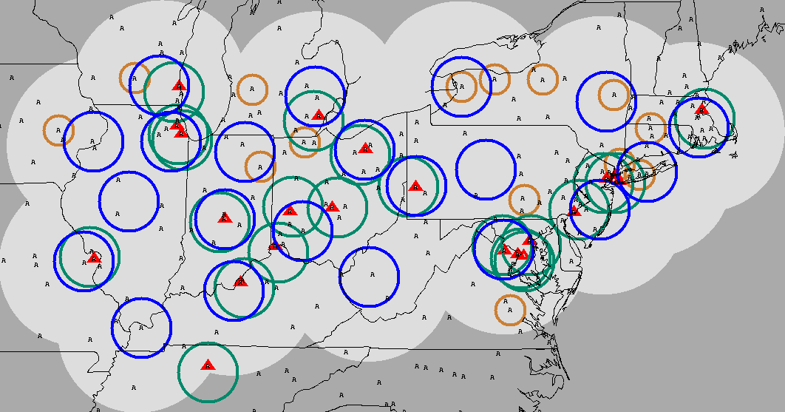
Boundary Layer Winds Coverage
= ITWS Airport
= TDWR (80 km)
A = ASOS Stations
= ASR-9 (40 km)
= NEXRAD (80 km)

Slide 6
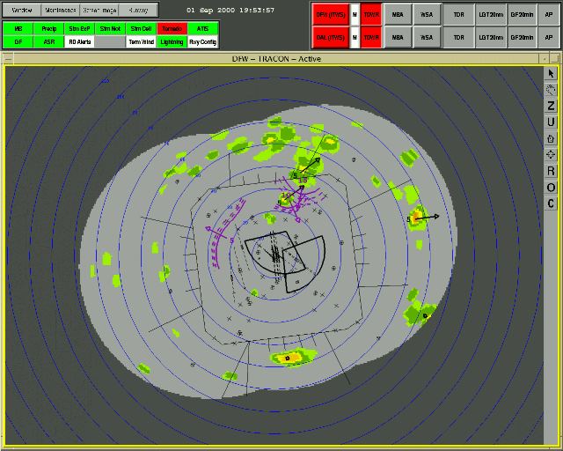
ITWS Gust Front Product

Slide 7
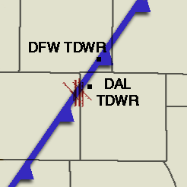
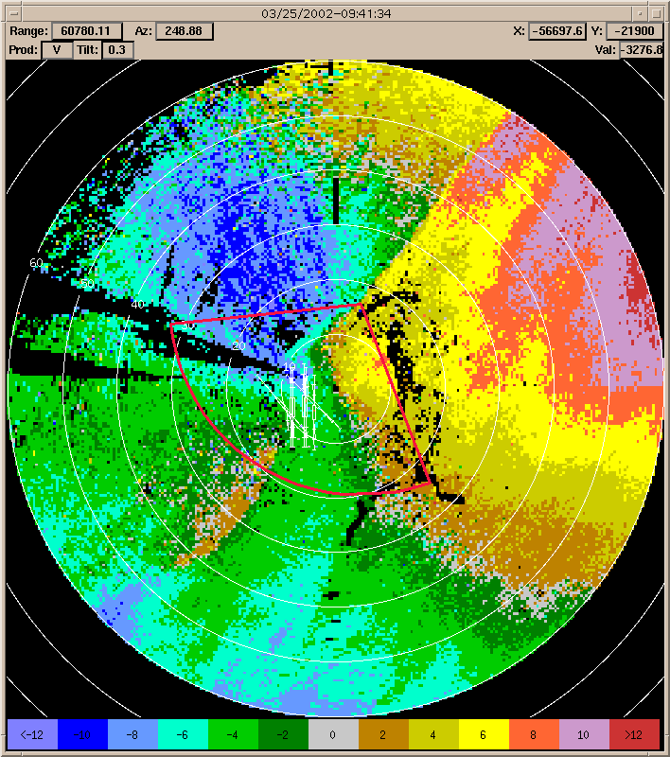
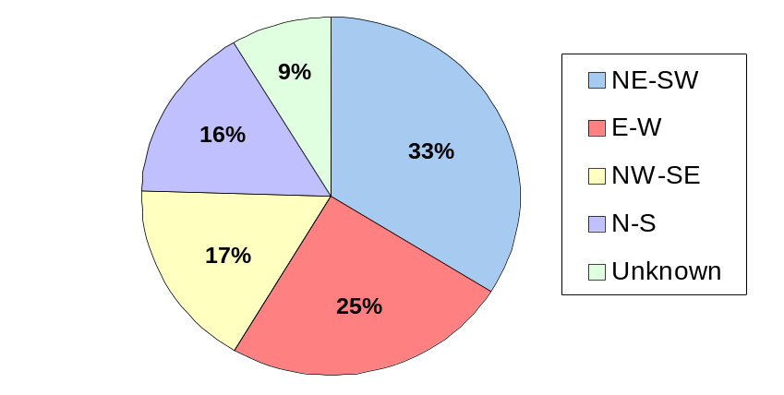
DFW Gust Front Detection Challenge
Doppler velocity convergence signature vanishes as front becomes radially aligned
High percentage of gust fronts at DFW have NE-SW orientation
  DFW radar has poor viewing angle
March 25, 2002
DFW
AIRPORT
Cold Front
DFW Gust Front Categorization (1999-2002)
Cold Front

Slide 8
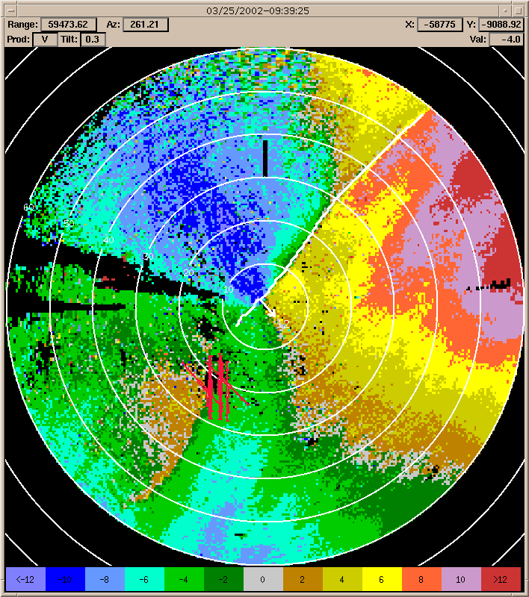
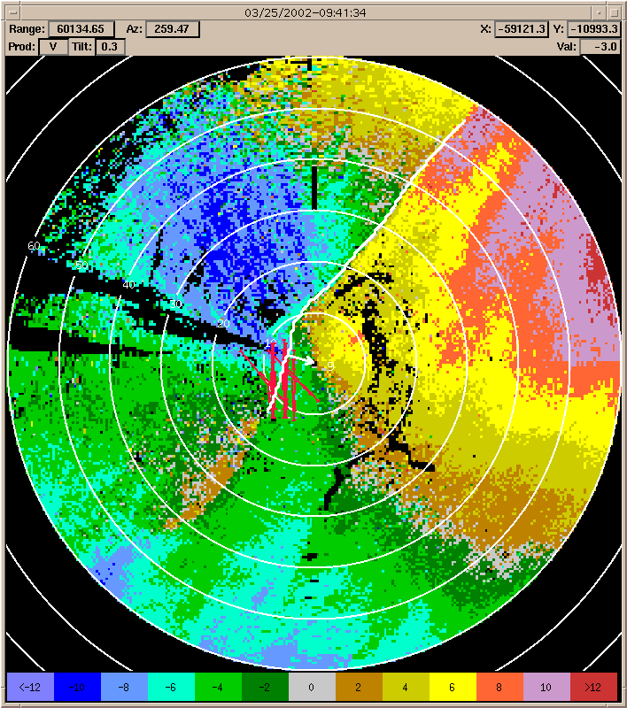
MIGFA Detection Comparison
DFW TDWR Velocity & MIGFA Detections
DAL TDWR Velocity & MIGFA Detections
Improved gust front detection over DFW when using data from DAL TDWR

Slide 9
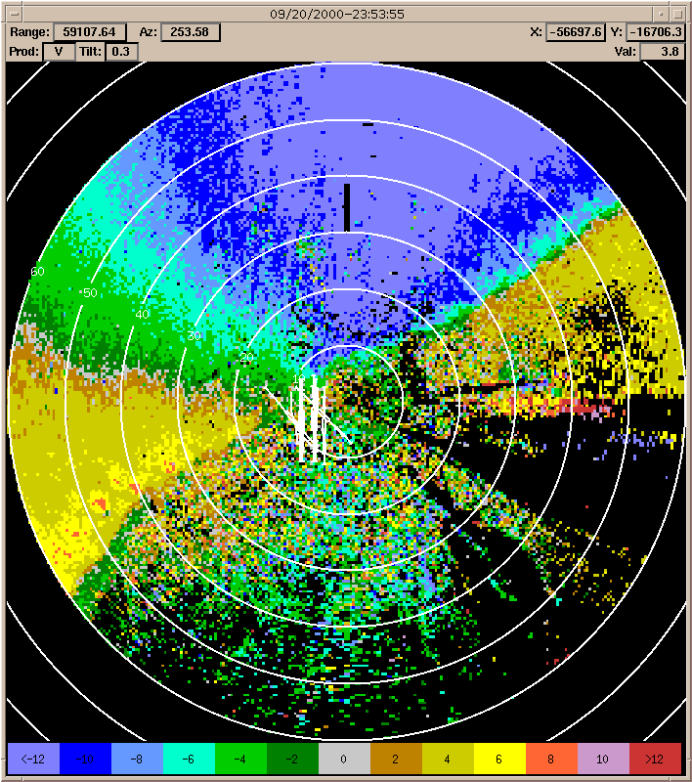
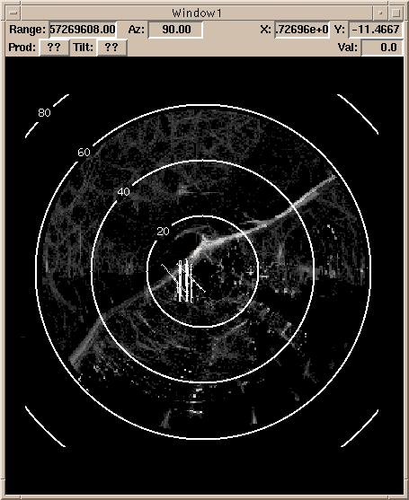
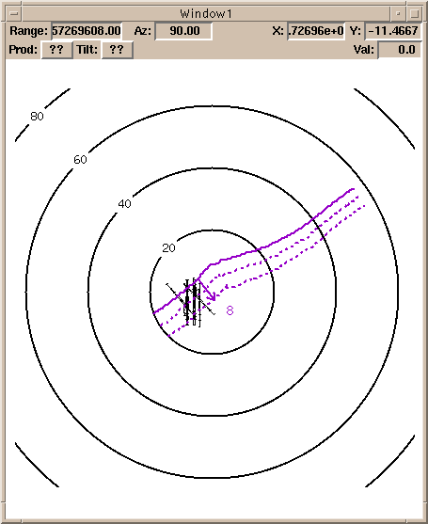
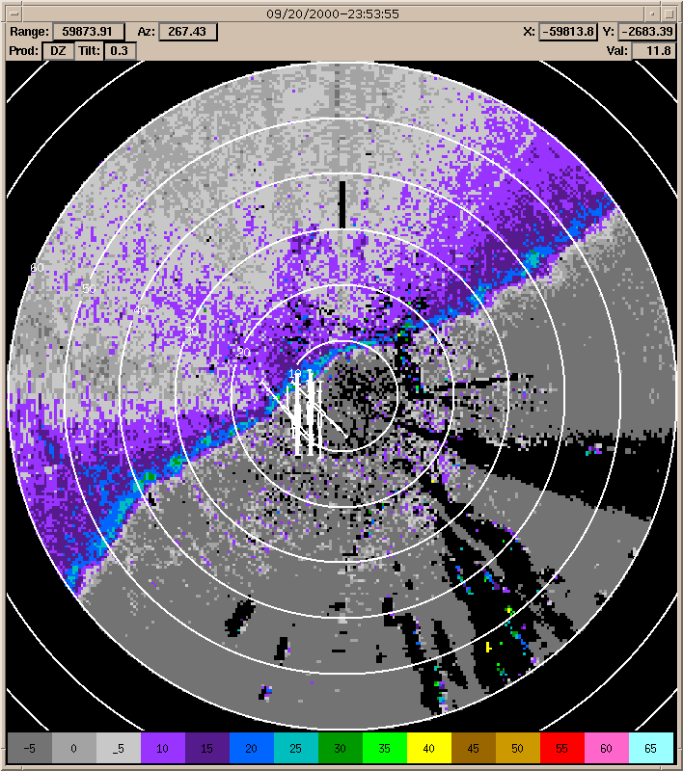
MIGFA Gust Front Extraction Approach
DAL TDWR Velocity
MIGFA Combined Interest
MIGFA Detections
DAL TDWR Reflectivity
Combined interest image represents consensus of pattern matching evidence
Gust fronts are extracted from regions of high interest

Slide 10
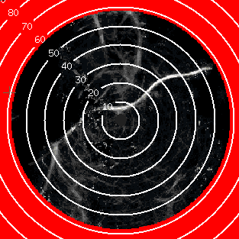
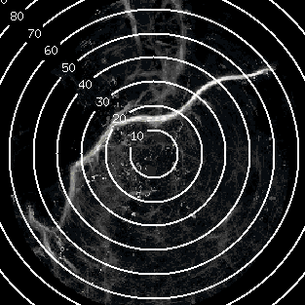
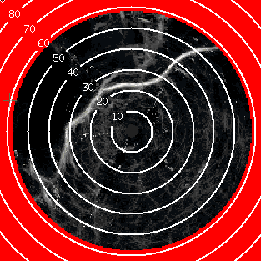
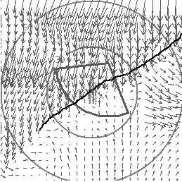
GFMosaic Processing Approach
Interest
MIGFA #1
Interest Mosaic
GFMosaic
GF
Detections,
Predictions
Extract
Track
Wind
Analysis
Interest
MIGFA #2
Terminal Winds
Preferred inputs: Intermediate data from operating
MIGFAs (interest, shear, velocity images)
  Alternative inputs: Images may be fabricated from final MIGFA detection product data
Fused evidence may be stronger than individual interest => better detection potential than individual MIGFAs
Gust fronts are re-extracted and tracked from fused evidence using MIGFA library routines (software re-use)
Optional input of ITWS Terminal Winds product for improved gust front wind analysis

Slide 11
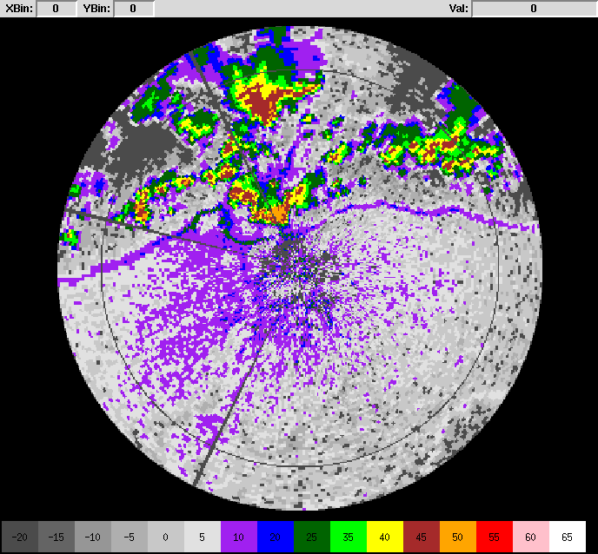
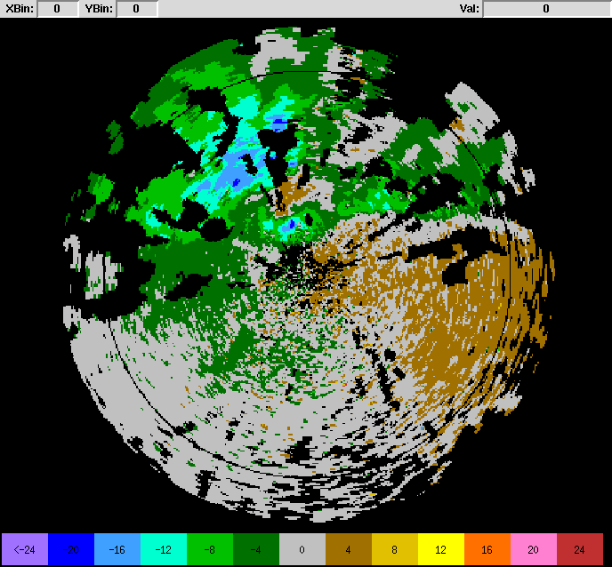
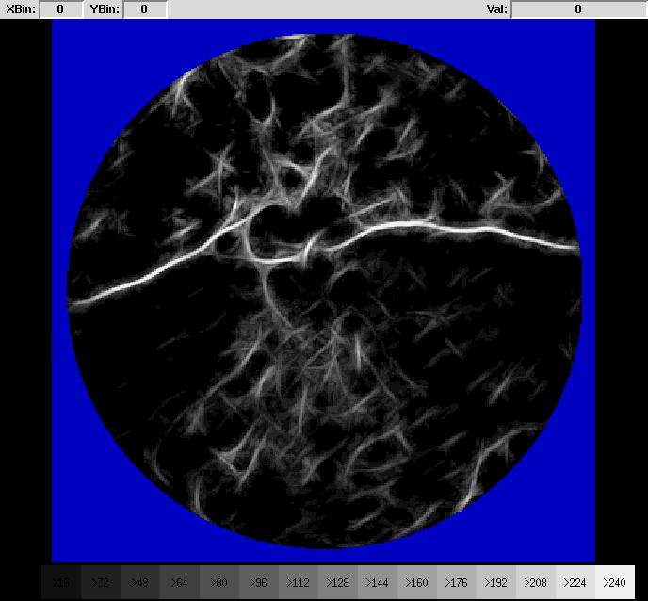
NEXRAD MIGFA Interest Map
NEXRAD Reflectivity
NEXRAD Velocity
NEXRAD Interest Map
Interest map generated from NEXRAD MIGFA can be merged with TDWR MIGFA interest

Slide 12
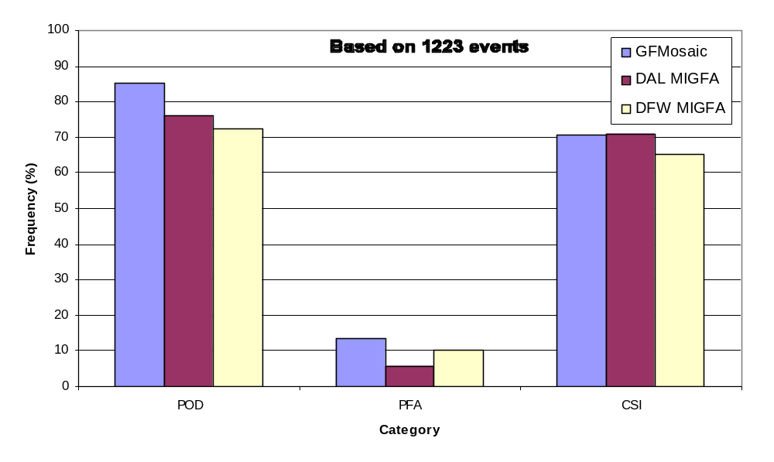
DFW Gust Front Mosaic Performance Statistics
Intermediate data-level fusion by GFMosaic shows improved POD compared to MIGFA
Work continues to reduce PFA for GFMosaic

Slide 13
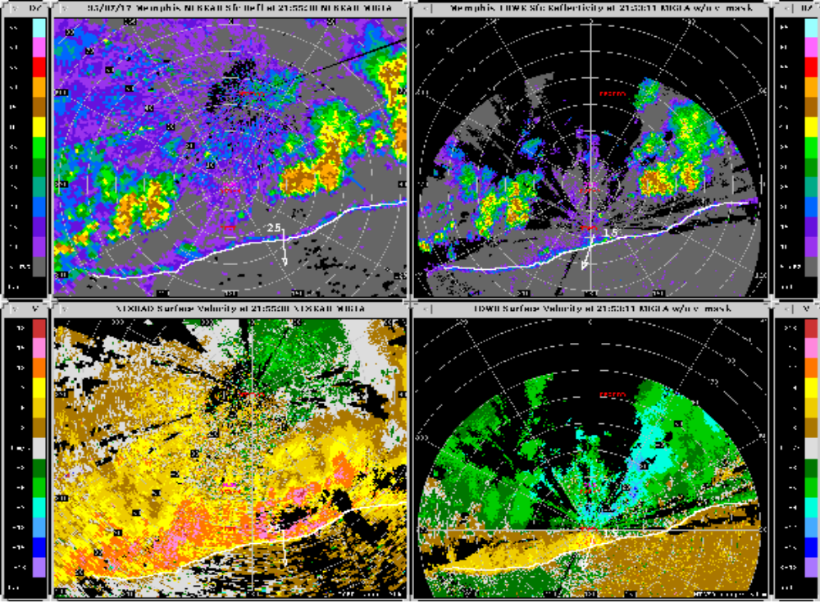
Comparison of NEXRAD and TDWR MIGFA
17 July 1995
NEXRAD
TDWR
NEXRAD
TDWR
NEXRAD
TDWR
NEXRAD MIGFA performs as well as TDWR MIGFA on this case

Slide 14
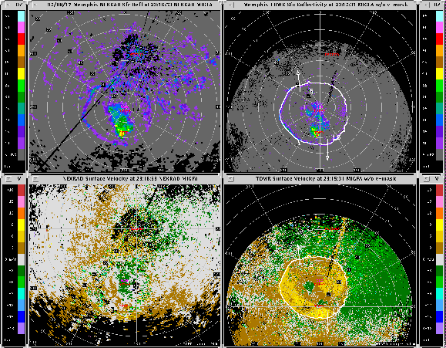
Comparison of NEXRAD and TDWR MIGFA
17 August 1995
NEXRAD
TDWR
MIGFA does excellent job
  detecting full ring gustfront
  estimating winds behind gustfront
NEXRAD clutter prevents detection of solid convergence signature

Slide 15
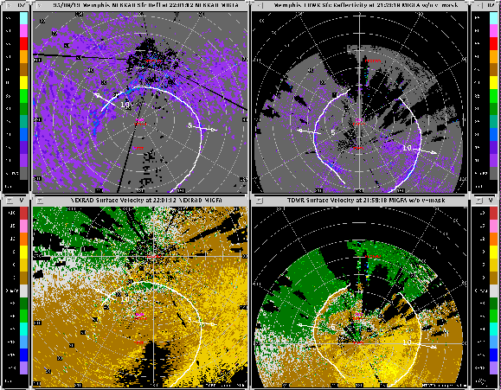
Comparison of NEXRAD and TDWR MIGFA
19 August 1995
NEXRAD
TDWR
MIGFA detects gustfront well even with vague and noisy data signatures
TDWR misses part due to second trip contamination
Combination of radars would achieve better detection

Slide 16
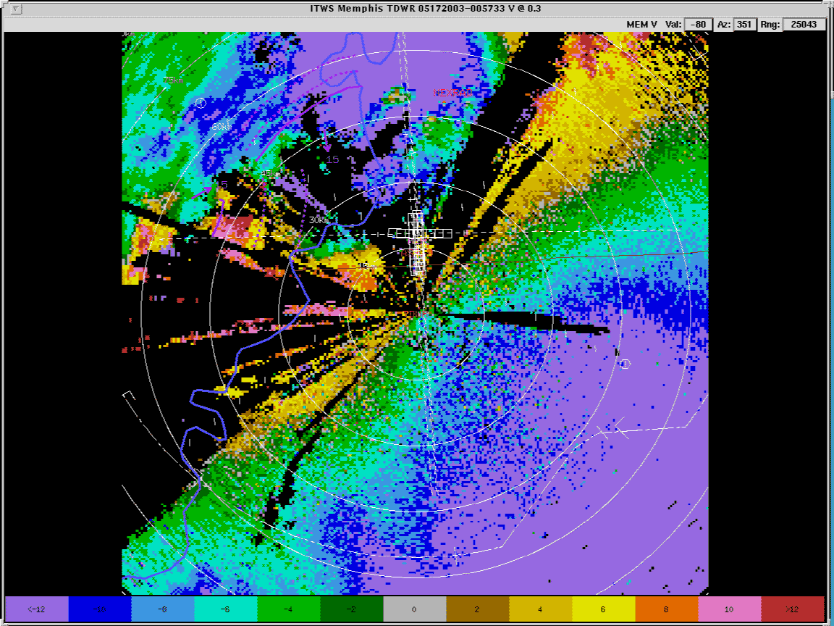
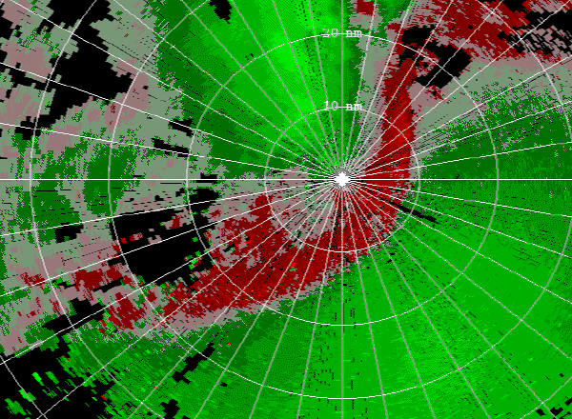
MEM GF CASE (NEXRAD vs. TDWR)
16 May 2003
NEXRAD
TDWR
TDWR
NEXRAD
Range folding obscures GF in TDWR data over airport

Slide 17
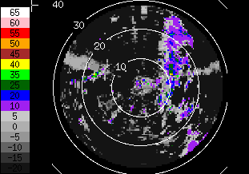
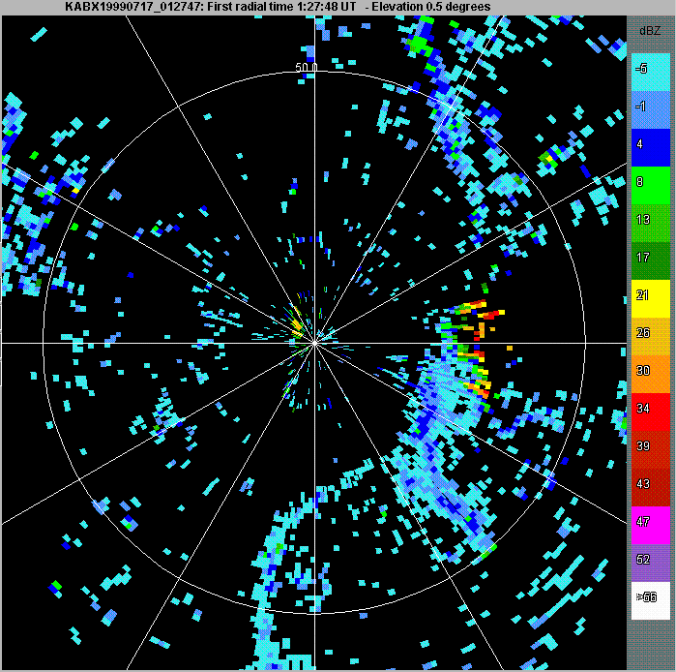
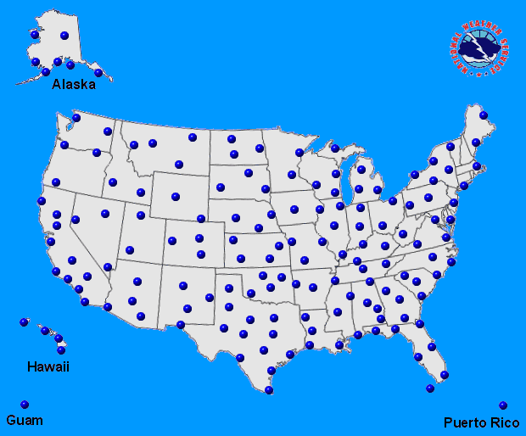
Proposed Use of NEXRAD to Augment
ASR-9 WSP Gust Front Detection
July 17, 1999 01:27:47 GMT
50
Clutter
25
Gust fronts
ASR-9
ABQ ASR-9 WSP
KABX NEXRAD
ASR-9 has difficulty detecting weak gust
front signatures, especially in dry
environments
NEXRAD gust front product could be
integrated with WSP detections to improve
performance

Slide 18
Summary
Many large TRACONS have overlapping radar coverage, including NEXRAD
Radial alignment of gust fronts with respect to single radar can cause significant detection degradation
  Gust front detection is improved by utilizing data from additional radars having different viewing angles
New GFMosaic algorithm effectively fuses intermediate gust front evidence maps from operational gust front algorithms (MIGFAs)
  Testing ongoing at DFW. Summer, 2003 tests targeted for NY ITWS site
NEXRAD gust front coverage will likely provide significant performance benefit for several FAA systems (ITWS,
ASR-9 WSP, MIAWS)

