Slide 1
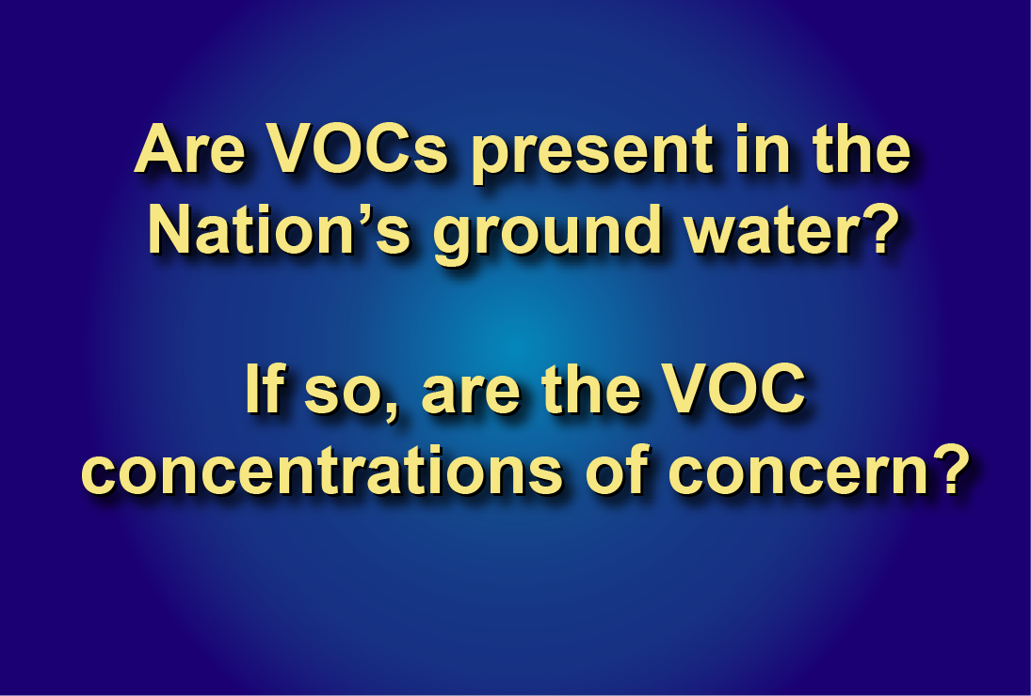
slide 1
Notes:
circular.2BRIEFING.04.21.06.ppt

Slide 2
Water-supply system
Ambient
ground
water
Drinking
water
Treatment
Water
captured
by supply
wells
slide 2

Slide 3
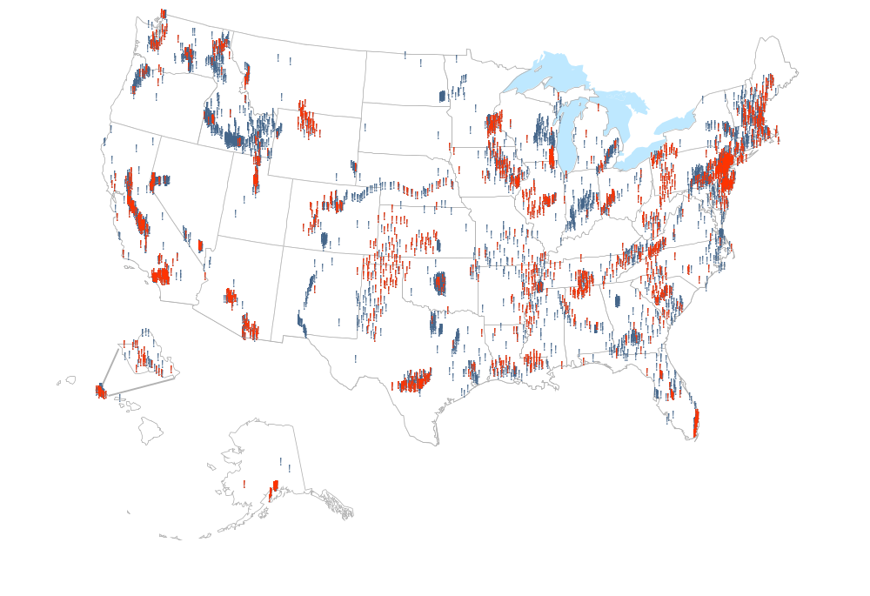
Oahu
Hawaii
Alaska
No VOC Detection
VOC Detection
slide 3
Notes:
Findings: VOCs were detected in aquifers throughout the Nation.
Conclusions: Many of the Nation’s aquifers are vulnerable to VOC contamination.

Slide 4
VOC concentrations in aquifers
Detected,
above 1 ppb
Not
detected
Detected,
below 1 ppb
slide 4
Notes:
Finding: Most aquifer samples had no VOCs detected or the concentration was below 1 part-per-billion (ppb)
Conclusion: Few aquifer samples have VOC concentrations that may affect the potability of ground water for drinking water

Slide 5
Chloroform was the most frequently detected VOC in aquifer samples
Chloroform
PCE
MTBE
TCE
Toluene
0
2
4
6
8
DETECTION FREQUENCY, IN PERCENT
slide 5
Notes:
Assessment level of 0.2 micrograms per liter
Conclusion: Recycled water with a history of chlorination is an important source of chloroform (and other THMs) for aquifers.

Slide 6
PCE and TCE were also frequently detected in aquifer samples
Chloroform
PCE
MTBE
TCE
Toluene
0
2
4
6
8
DETECTION FREQUENCY, IN PERCENT
slide 6

Slide 7
MTBE was the third most frequently detected VOC in aquifer samples
Chloroform
PCE
MTBE
TCE
Toluene
0
2
4
6
8
DETECTION FREQUENCY, IN PERCENT
slide 7

Slide 8
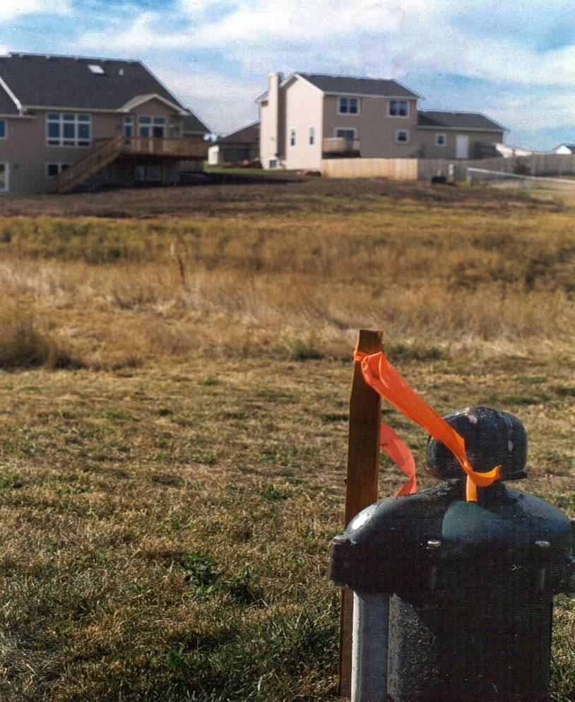
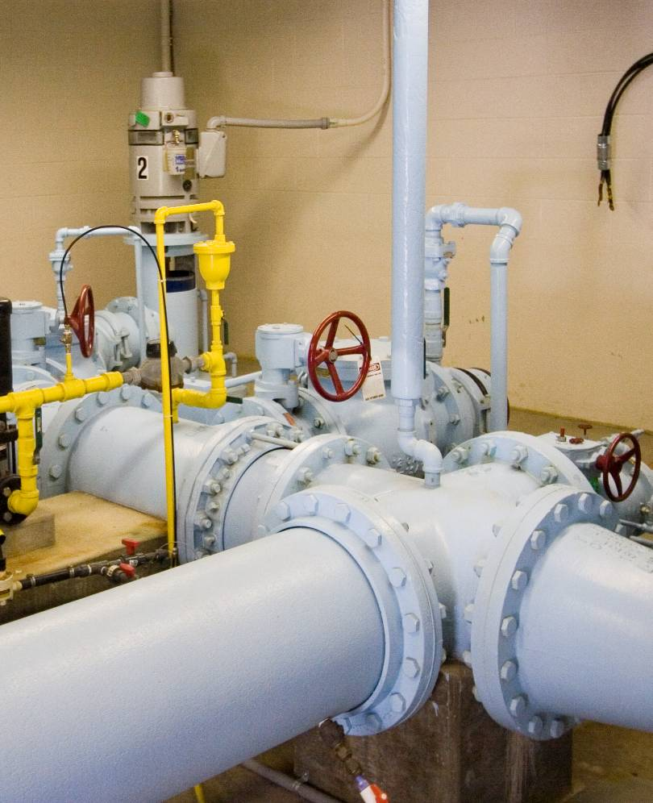
Domestic wells
Public wells
and
slide 8

Slide 9
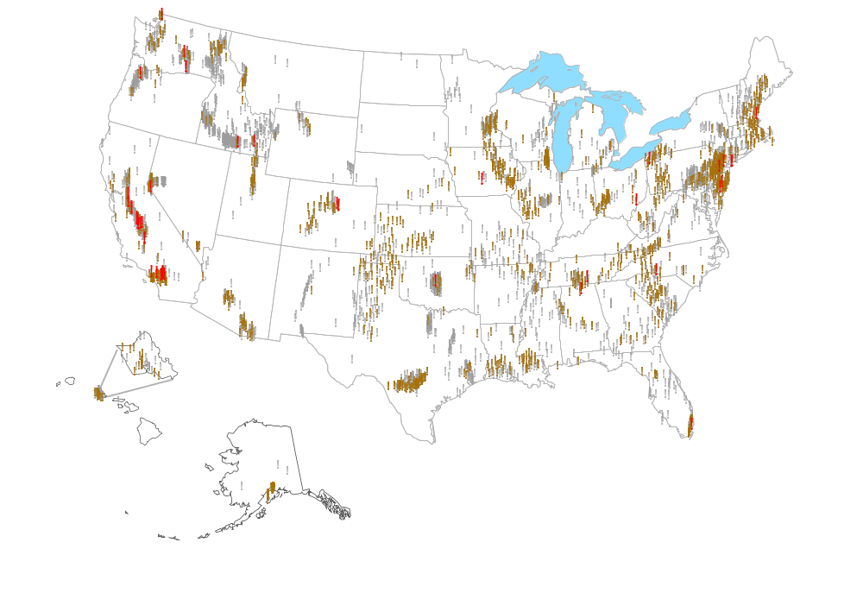
Oahu
Hawaii
Alaska
Concentration less than MCL or HBSL
Concentration greater than MCL
No VOC Detection
slide 9

Slide 10
concentrations greater than MCLs
Domestic
wells
concentrations below MCLs and HBSLs
Public
wells
0
5
10
15
20
25
30
DETECTION FREQUENCY, IN PERCENT
slide 10

Slide 11
VOCs with concentrations greater than MCLs
Well type
Group
Compound
Domestic
Public
DBCP X
1,2-Dichloropropane X
EDB X
Fumigants
TCE X X
PCE X X
Methylene chloride X
Solvents
Chemical
production
1,1-Dichloroethene X X
Vinyl chloride X
slide 11
Notes:
VOCs found at concentration(s) of potential human-health concern (compounds listed by decreasing number of concentrations of potential concern).
Finding: Only 8 compounds had concentrations of potential human-health concern.
Conclusion: Most VOC concentrations are not anticipated to cause adverse human-health effects.

Slide 12
THMs in domestic and public wells
Chloroform
Bromodichloromethane
Dibromochloromethane
Domestic
Public
Bromoform
0
2
4
6
8
10
12
DETECTION FREQUENCY, IN PERCENT
slide 12
Notes:
Assessment level of 0.2 micrograms per liter.
Finding: Chloroform and other trihalomethanes (THMs) were more frequently detected in public wells.
Conclusion: Anthropogenic sources of the THMs in public wells should be examined further.

Slide 13
Summary
Widespread occurrence of VOCs
Concentrations seldom of
potential concern
Large number of vulnerable aquifers
slide 13

