Slide 1

Applications of a Pixellated Detection System to Digital Mammography
Valeria Rosso
Dipartimento di Fisica, Universita’ di Pisa and Sezione INFN Pisa, Italy
^{valeria.rosso@pi.infn.it}

Slide 2
Outline
The detection system, which the Pisa group is working with, consists of a single photon counting chip [G.Bisogni, et al., SPIE 1998 San Diego], bump bonded to a semiconductor detector: the hybrid approach allows to change either the thickness of the detector or the semiconductor type.
Most important advantages of such system, with respect to a traditional X-rays film/screen device, are the wider linear dynamic range (10⁴ -10⁵) and the higher performance in terms of MTF and DQE [S.R.Amendolia et al., Nucl Instr Meth, A461,(2001) 389-392]. Besides the single photon counting architecture allows the detection of image contrasts lower than 3%, that is relevant for mammographic applications [S.R.Amendolia et al., IEEE Trans Nucl Science, 47(4), (2000), 1478-1482].
The detection system
300 μm Silicon detector
Photon Counting Chip
X-ray images of details of an accreditation phantom
  Standard mammographic tube
  RMI 156
Hybrid images of some details using the dual-energy technique

Slide 3
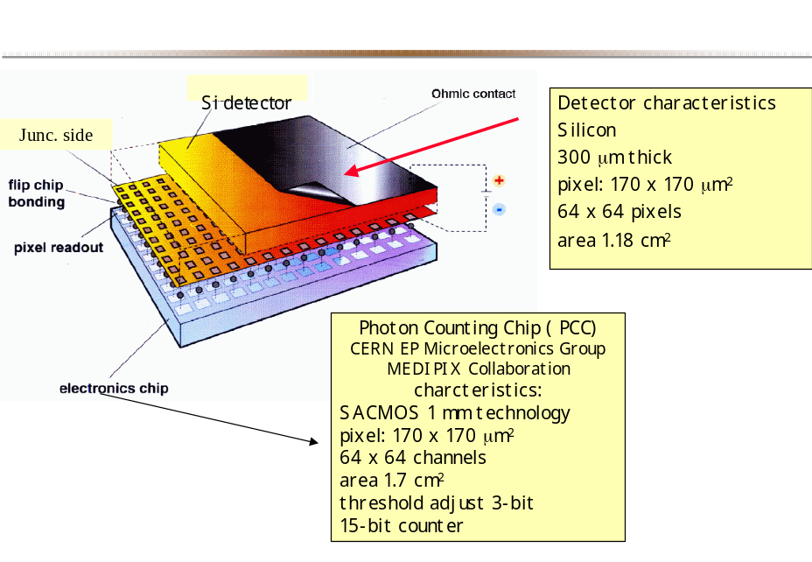
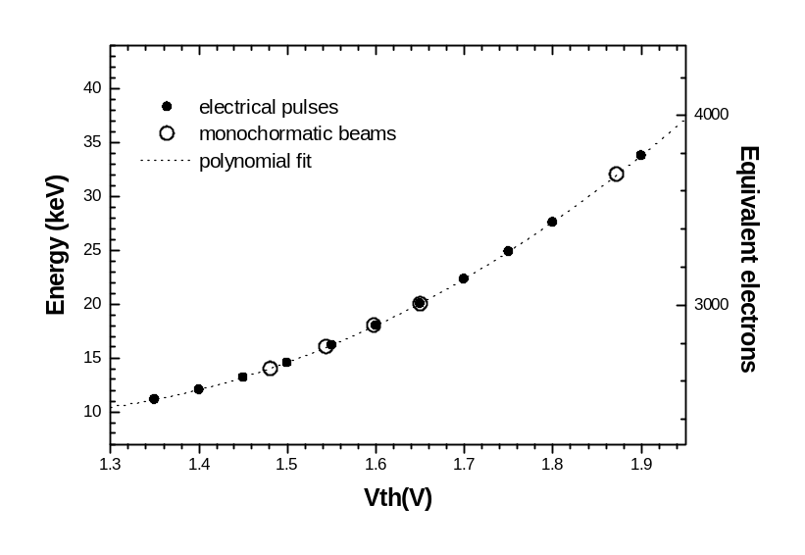
The chip is an array of 64x64 asynchronous read-out channels, each one equipped with a low noise charge preamplifier, a latched comparator, a digital shaper and a 15 bits counter.
An energy threshold, common to the 4096 pixels, can be externally selected by means of an external bias voltage V_{th}; in addition, the threshold of each pixel can be finely adjusted. The preamplifier circuit has an input test sensitive to electrical pulses injected through a calibration capacity (C_{test} = 22 fF).
Calibration curve
Calibration measurements
To optimize the working point of our detection system, a set of calibration measurements is performed. These tests are carried out by sending voltage pulses through the test input of each channel.
After the fine threshold tuning among the 4096 channels we obtained a total threshold spread of σ_{tot} = 350 e⁻. To make an absolute calibration of the threshold, the silicon detector has been exposed to monochromatic beams whose energy ranges from 14 to 32 keV.

Slide 4
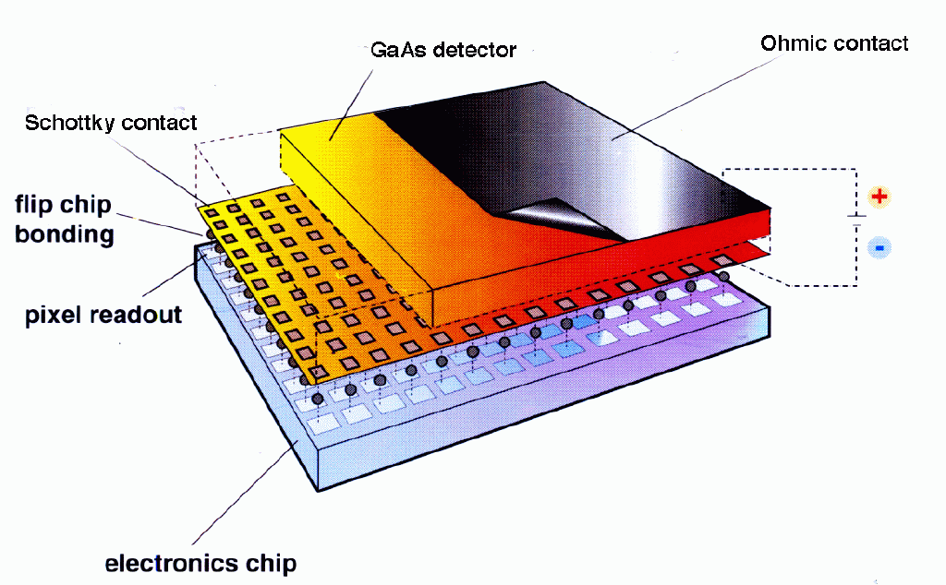
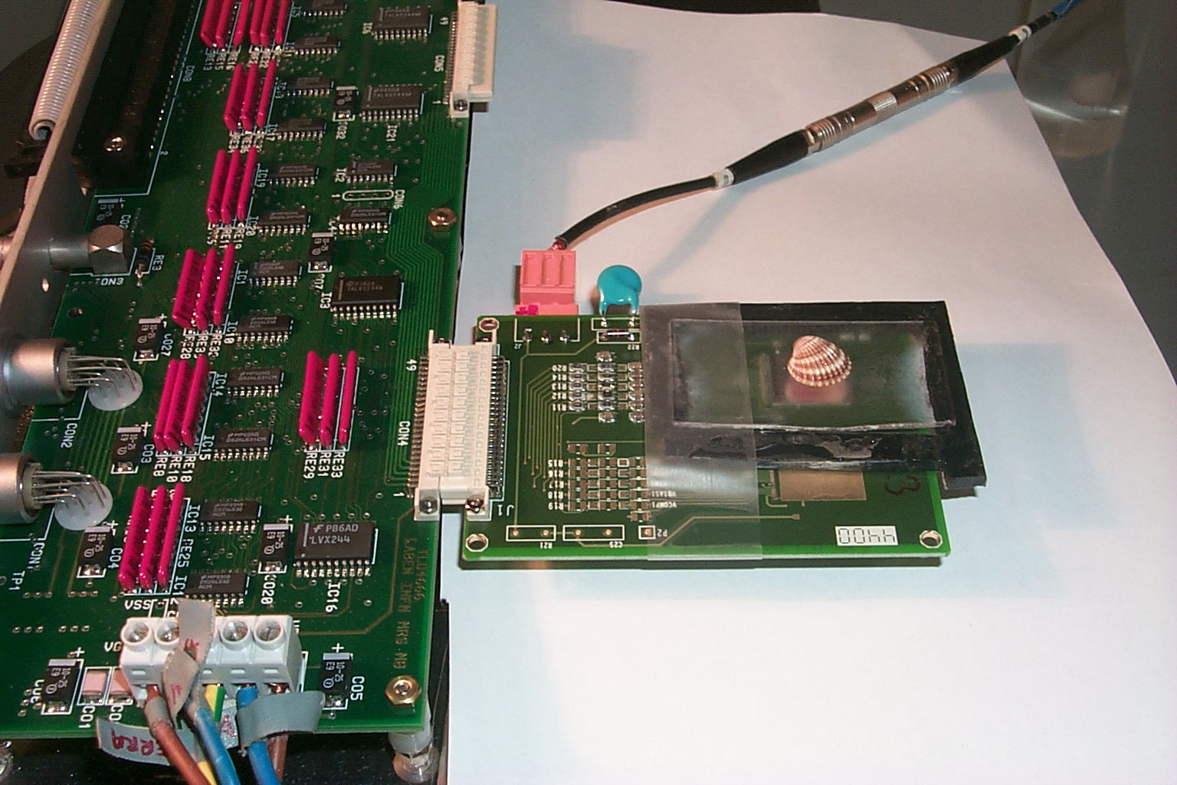
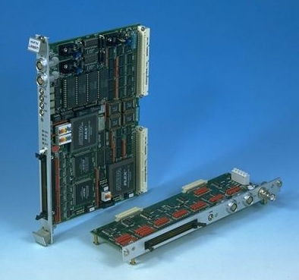
The system
VME board
Mother board

Slide 5
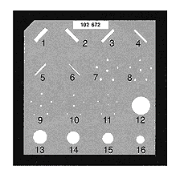
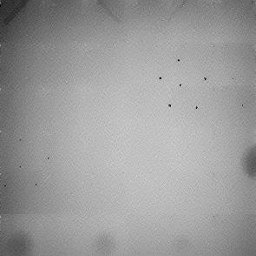
Projection radiographic image of the RMI 156 phantom
To realize a partial image of the RMI 156 mammographic phantom with our detection system ( active area ~ 1 cm²) was necessary to perform a scan: 36 images were acquired one after the other and then the total image was built
Inside the phantom there are: six different size nylon fibers simulate fibrous structures (from 1 to 6), five groups of simulated micro-calcifications (from 7 to 11) and five different sizes tumor-like masses are included in the wax insert (from 12 to 16)
X-ray source:
mammographic tube
(Mo -Mo) @ 30 kVp
Dose = 4 mGy
300 μm Si detec.
(scan 6x6)
8 cm
6 cm

Slide 6
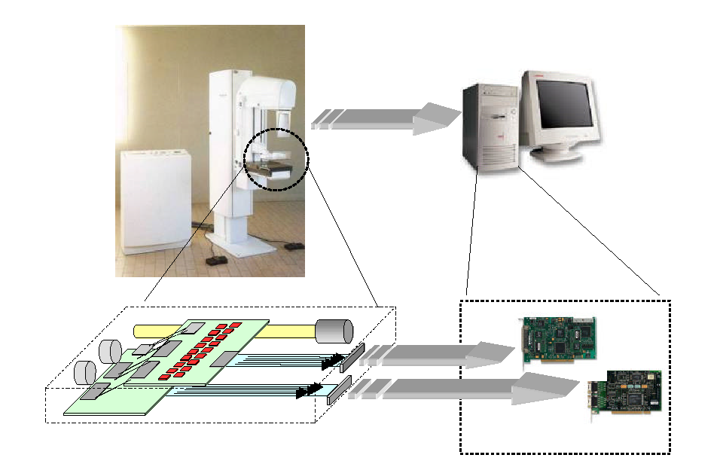
Integrated Mammographic Imaging project
Funded by the Ministry for University and Scientific Research of Italy
Research:
INFN and University Physics Departments of Pisa, Ferrara, Roma, Napoli
Industries:
Laben (electronics), AleniaMarconiSystems (detectors, bump-bonding), CAEN (electronics), Pol.Hi.Tech.(scintillators), Gilardoni (X-rays)
18 detection systems based on 200 μm GaAs detectors
Web site: http://imamint.df.unipi.it

Slide 7
Dual energy basis decomposition techniques
R.E.Alvarez and A. Makovski ( Phys. Med. Biol. 5, 733,1976) and L.A. Lehmann, R.E.Alvarez and A. Makovski ( Med. Phys. 8, 659,1981) presented a technique that using the μ(E) dependence, is able to identify unknown materials and cancel the contrast between couples of materials.
To apply the technique we:
need two images at different energies: we worked with two radioactive sources ¹⁰⁹Cd <X-ray> = 22.5 keV as low energy beam E_{L} and ¹²⁵I < X-ray> = 27.7 keV as high energy beam E_{H}.
decompose and project the images: using the high and low energy images we calculate the log attenuation and then we decompose the images on the basis set (we considered as basis materials wax and PMMA); varying the projection angle between 0° and 90°, we have obtained 90 hybrid images, and among them the most interesting are those in which one can see the contrast cancellation for different pairs of materials: from this angle one can determine the Z of the radiographed materials
Phantom
X-ray sources
Images

Slide 8
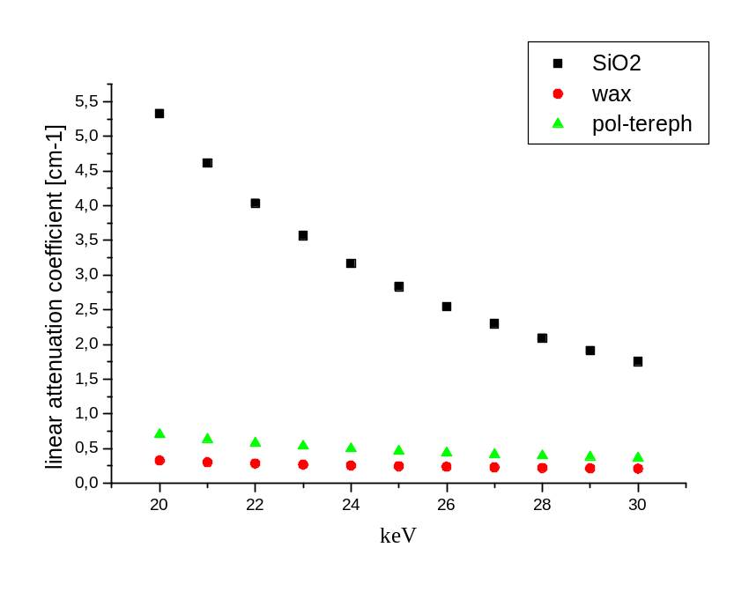
Phantom
≅700 μm
Ø 2.5 cm
8mm
2mm
SiO₂
Polyethylene-Terephtalate
Wax
The difference in % between water and polyethylene-terephtalate [μH₂O-μPT)/ μH₂O] is < 10% in the 20-30 keV range.
The difference between SiO₂ and calcium hydroxyapathite is greater

Slide 9
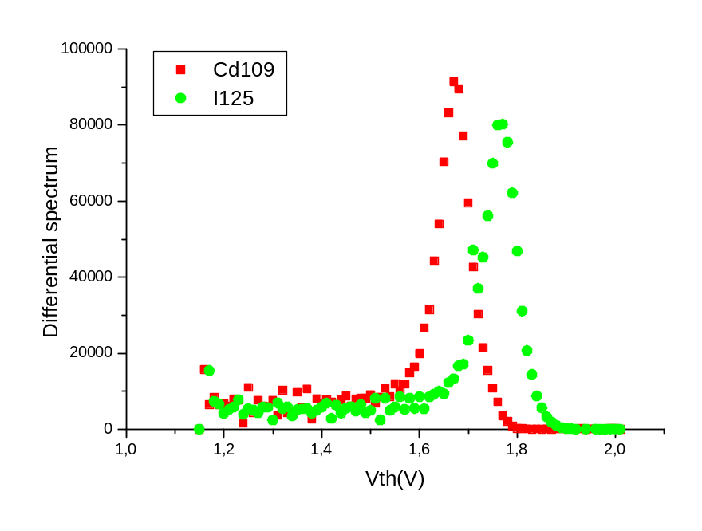
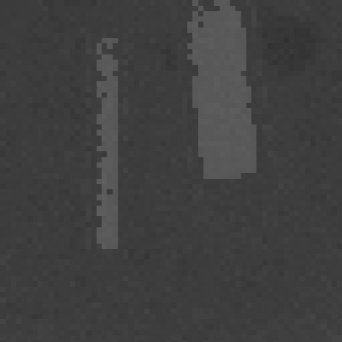
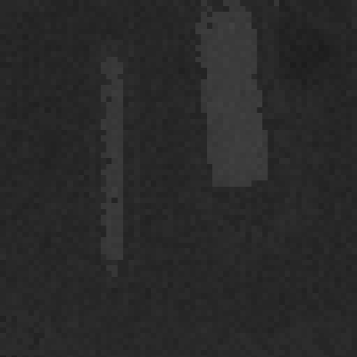
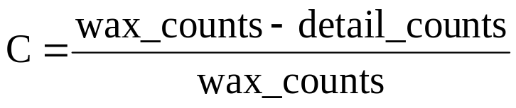
X-ray sources
<¹⁰⁹Cd X-ray> = 22.5 keV
<¹²⁵I X-ray> = 27.7 keV
@ 22.5 keV @ 27.7 keV
Contrast: SiO₂-wax (19.0+0.2)% (9.9+0.3)%
Contrast: PT-wax (19.6+0.2)% (12.1+0.3)%
¹⁰⁹Cd image
¹²⁵I image
The dose in air for the ¹²⁵I image was 0.3 mGy; while the one for the ¹⁰⁹Cd image was 0.4mGy

Slide 10
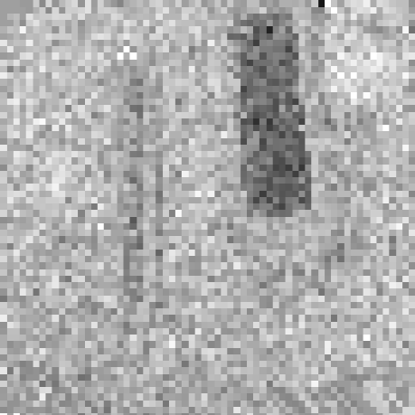
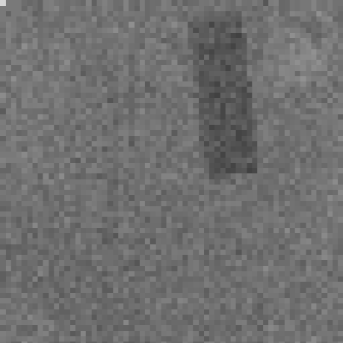
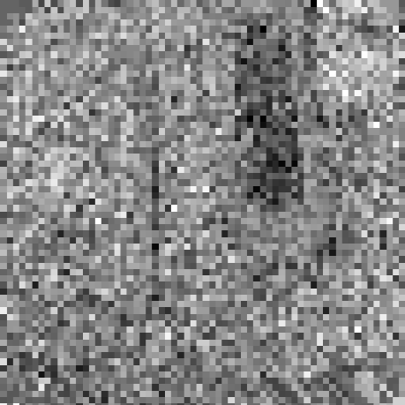
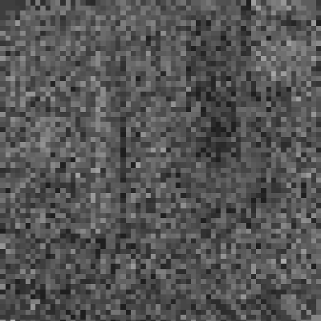
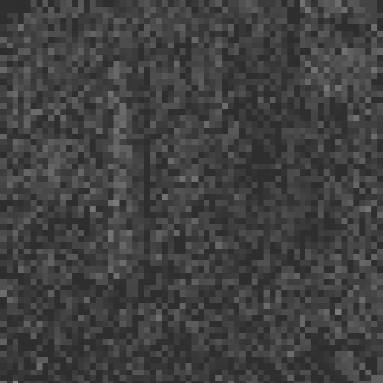
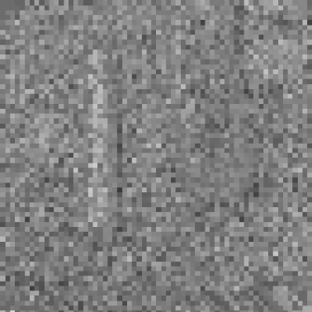
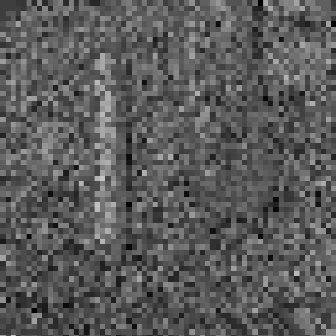
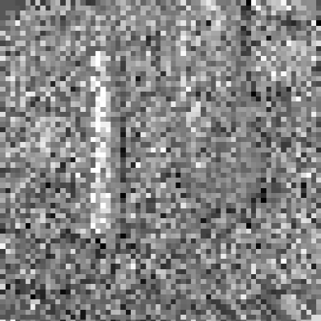
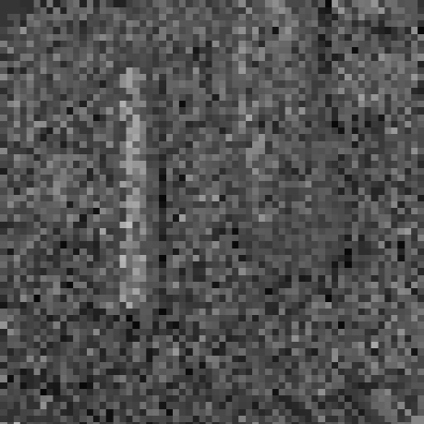
40º 42º 44º
¹⁰⁹Cd image
¹²⁵I image
log. atten.
decomp. on basis
project
52º 54º 56º

Slide 11
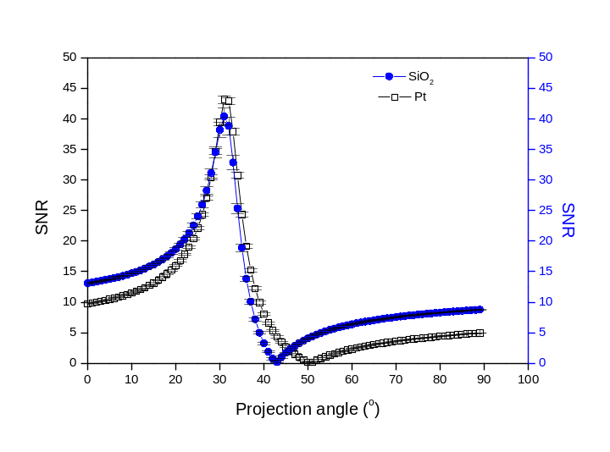
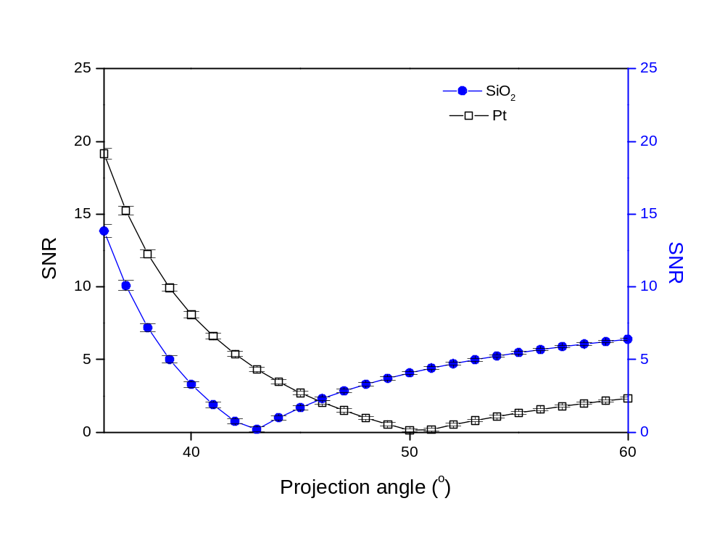
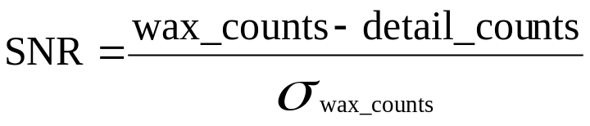
@ 22 keV
SNRSiO₂=36.7+0.3
SNRPT=39.1+0.1
@ 27 keV
SNRSiO₂=17.0+0.2
SNRPT=21.9+0.1.

Slide 12
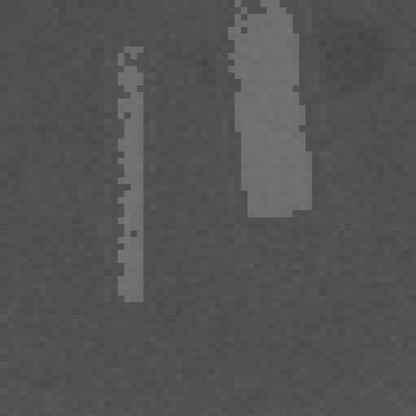
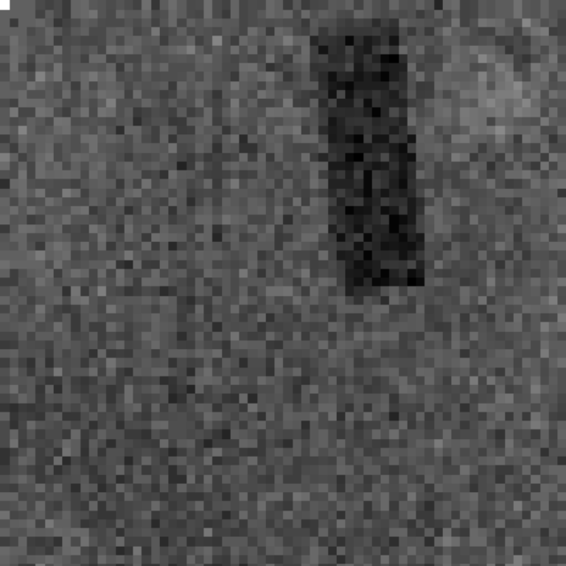
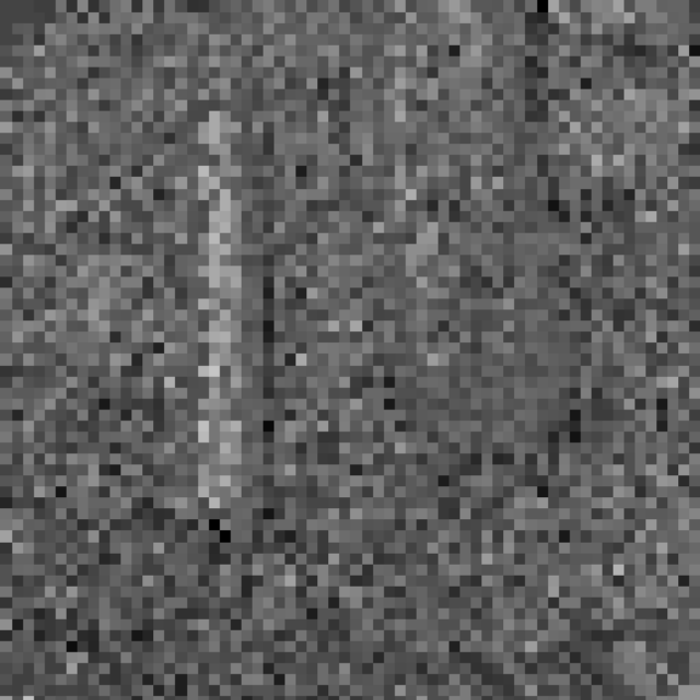
44^{O}
52^{O}
C between wax and SiO₂ is cancelled
C between wax and polymethyl-terephtalate is cancelled
Knowing the materials of the phantom details it’s possible to evaluate the theoretical projection angles for the cancellation of C between SiO₂ and wax: 41^{O}, and for the cancellation of C between PT and wax: 47^{O}

Slide 13
Conclusions
The detection system is useful for its use in digital mammography: we have obtained good results in terms of C and MTF
The prototype for the ImaMInt project will be ready in June 2003 for validation tests.
The Dual Energy technique can improve the specificity of the projection mammography, bringing information about the different composition of the radiographed details. It may also enhance the contrast for certain detail removing any materials from the image.
Using this detection system in conjunction with standard polychromatic beam we have shown that the dose was reduced; using monochromatic X-rays the dose can be further reduced . We hope to achieve still better results using GaAs detectors.

