Slide 1
Effect of Symbology Location and Format on Attentional Deployment on a Cockpit Display of Traffic Information
Walter W. Johnson, NASA Ames Research Center
Min-Ju Liao, National Research Council
Stephen Tse, San Jose State University

Slide 2
Introduction
  Free Flight seeks to give real-time flight path control to the flight deck. This requires the flight crew to have ongoing traffic situation awareness, including
    Traffic location
    Potential collisions
  This requires advanced Cockpit Displays of Traffic Information (CDTIs) that support
    Intermittent monitoring
    At-a-glance extraction of critical information

Slide 3
Introduction (cont.)
  CDTI design will therefore need to
    Accommodate inherent biases in how attention is deployed across a CDTI
    Direct attention to important elements or areas of a CDTI

Slide 4
Background
Egeth & Yantis (1997) posited 3 issues in the selection/control in visual attention:
  top down or bottom up nature of attentional control
  spatially or object oriented basis of attentional control
  the time course of attention
Previous research relevant to these issues, and to CDTI design
  Kee, Jung, and Chung (1992) examined search time in a 54° wide x 43° high region. They found isoresponse time contours that were related primarily to range from a visual fixation point at display center.

Slide 5
Background (cont)
Previous Research (cont)
  Wolfe, O’Neil, and Bennett (1998) examined search times in a 16° x 16° region with a center fixation, and found faster responses to upper visual field targets.
  Delzell, Johnson, and Liao (1998) used a task requiring recall of CDTI contents, and found isoprobability recall contours that were related primarily to range from an Ownship symbol at the bottom of the display.
  Fisher and Tan (1989), Philipsen (1993), and others, have investigated brightness highlighting using structured alphanumeric stimulus arrays, and found that relative brightness effects are probably top down.

Slide 6
Research Goals
The first goal of the present research was to use visual search tasks to determine the spatio-temporal distribution of attention on a baseline CDTI. This task differs from the previously cited work of Kee et. al. in the following ways:
  CDTI symbology (Ownship, range rings, and compass arc)
  Absence of any instructed fixation point
  A smaller display (search region (13.1° high x 16.6° wide)
  Two types of search tasks defined the target in terms of:
    An associated numeric altitude tag
    A colliding course with Ownship
  .

Slide 7
Research Goals (cont)
A second goal of the present research was to test for bottom-up effects of brightness highlighting on attentional deployment. This extends previous highlighting research to the case of randomly scattered stimuli.

Slide 8
Method
CDTI Display:
  Ownship flying at FL350,
  Traffic aircraft, plus associated altitude tags, flying between FL310 and FL390
Tasks
  Collision Detection Task: Participant must find the one aircraft, out of nine shown, on a colliding trajectory.
  Altitude Detection Task: Participant must find the one aircraft, out of nine shown, with an altitude tag indicating an odd numbered flight level (all other aircraft at even numbered flight levels).
  Collision Evaluation Task: Participant must evaluate whether a single aircraft on the CDTI is on a colliding trajectory.

Slide 9
Method (cont)
Manipulations
  Target Location: Target appearing in one of nine equally sized regions on the CDTI.
  Symbol Brightness: In both detection tasks, three symbol brightness conditions were used.
    1) all aircraft were bright
    2) all aircraft were dim
    3) heterogeneous condition: half aircraft bright, and half aircraft dim.
Measures: Response accuracy and response time.
Participants: Eight University Students.

Slide 10
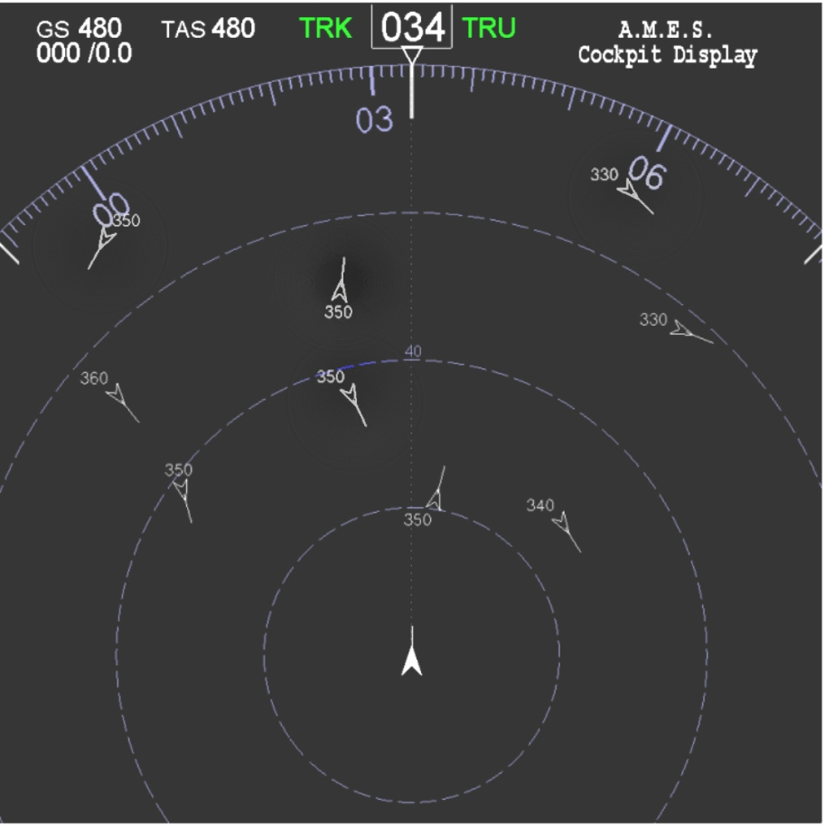
Sample Trial – Heterogeneous Presentation

Slide 11
Data Analysis
Two within subject ANOVAs analyzed data…
1) in which the highlighting was homogeneous (i.e., all bright or all dim)
2) in which the highlighting was heterogeneous (i.e., half bright, half dim)
Independent Variables Tested:
1) Task (collision vs. altitude detection)
2) Target Location
3) Target Brightness

Slide 12
Results
  No direct relationship between errors and RT:
    Average error rates for Collision Evaluation, Collision Detection, and Altitude Detection were 3.4%, 2.94%, and 1.96%, respectively.
  In the nine target collision search task
    RT was never influenced by target brightness (p > .05).
    There was a lateral x vertical display location interaction (p < .01) with best performance near Ownship and display center

Slide 13
Results (cont)
In the nine target altitude search task
  RT was never influenced by target brightness (p > .05).
  There was a lateral x vertical display location interaction (p < .01) with best performance toward the left and center of the display
In the one target collision evaluation task
  RT was related to lateral display position (p < .01)

Slide 14
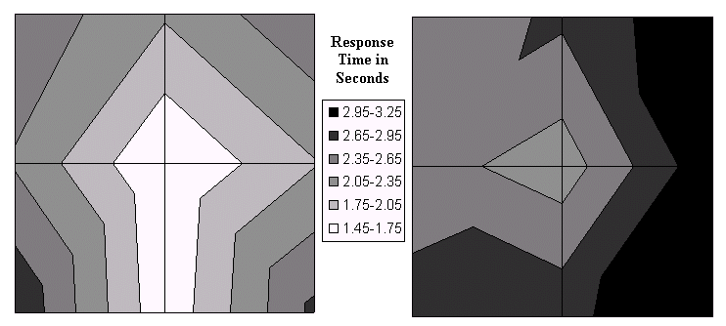
Detection Time Results
Collision Detection Time
Altitude Detection Time
Lateral x Vertical Display Location Interaction (p < .01) for both Collision and Altitude Detection Time

Slide 15
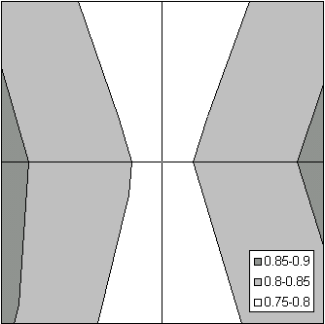
Collision Evaluation Time
Significant Effect of Lateral Display Location (p < .01)
Faster Evaluation Times for aircraft nearer vertical midline of display
Small overall effect
Evaluation Time
(seconds)
Display Surface Contour Plot

Slide 16
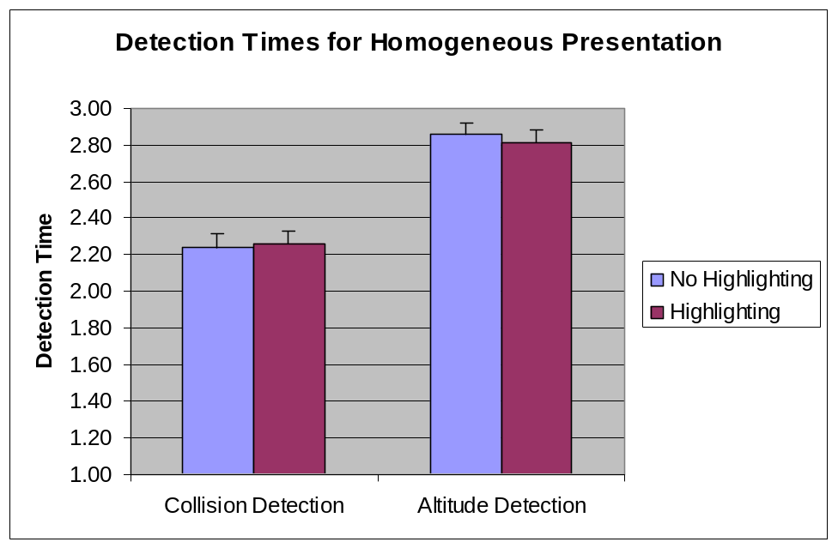
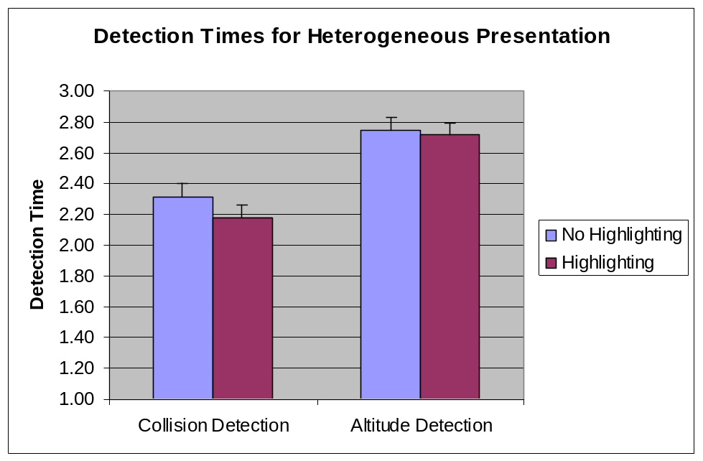
Highlighting Results
No Significant Effects of Highlighting on Detection Time (p > 0.05)
Equal detection times when presented homogeneously
Equal detection times when presented heterogeneously

Slide 17
Discussion
Participants had attentional biases to different locations, and these biases were different depending on the task.
  The bias revealed in the Collision Detection Task is somewhat similar to that found by Delzell, Johnson, & Liao (1998), but shows a greater focus on the center of the display.
  The left-right bias in the Altitude Detection Task suggests that a natural left to right reading tendency may be influencing performance.
Brightness highlighting had little effect which suggests a top-down (goal-directed) process.

Slide 18
Future Research
To determine the bottom-up effects of highlighting:
  Testing different types of highlighting modes.
  Evaluating how the number or proportion of highlighted items affects attention.

