Slide 1
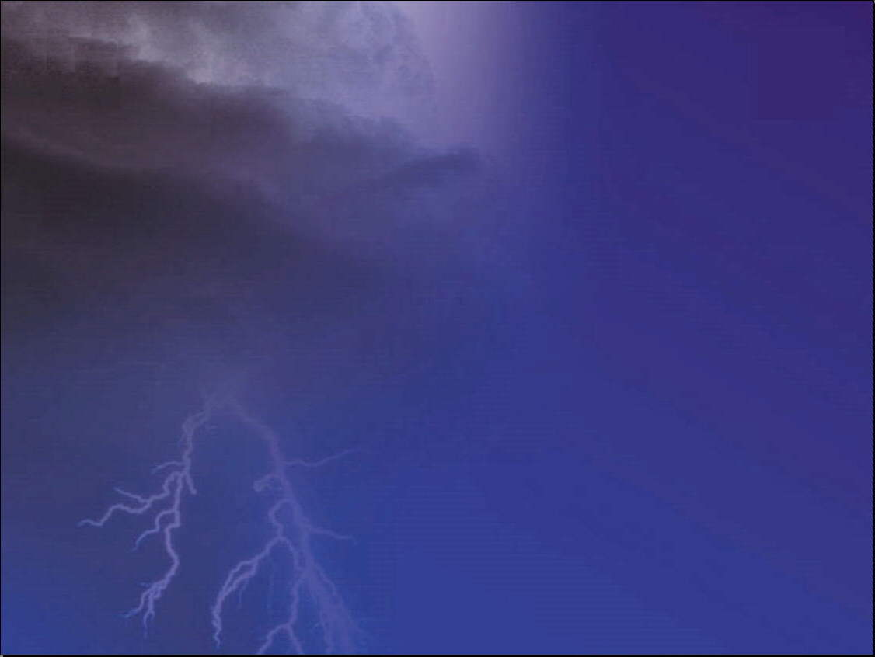
Tornado Detection & Limitations*
April 2004 Media Workshop
David Craft
Weather Forecaster
*This briefing covers the major limitations common to all Doppler weather radars
Notes:
This briefing describes limitations of detecting tornadoes common to all Doppler weather radars, be they owned and operated by news media, research institutions, or the National Weather Service (NWS).

Slide 2
Overview
Background
Doppler Radar Limitations
Examples
Other Tornado Detection Capabilities
Prepare & React Appropriately
Bottom Line
References

Slide 3
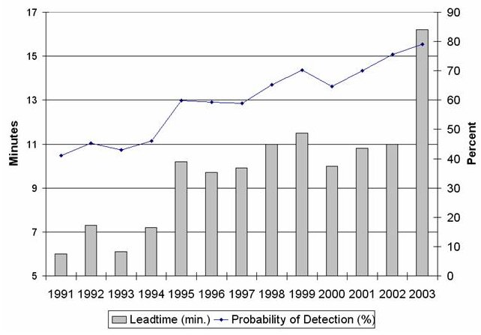
National Average Lead Times &
Probability of Detection
WSR-88D network installed early 1990s
  Doppler technology
  Greater sensitivity
  Improved volume scanning & computer processing
Training advancements
  Improved local training on Doppler radars & storm structure/evolution
  Four-week course in residence
Significant improvement in the last 10 years
Notes:
WSR-88D Advancements
- Doppler technology
- Greater sensitivity
- Improved volume scanning
- Computer processing of primary data into useful derived data and products
Training Advancements (radar use and storm structure/evolution)
- Intensive 4-week course in residence
- Local training programs
NWS Weather Event Simulator
- Recently deployed to field offices
- Replays data from an archived event
- Simulates technological, scientific, and human facotr (fatigue, stress) challenges
- Allows forecasters to gain experience and expertise w/o actually working an event and w/o impacting operations

Slide 4
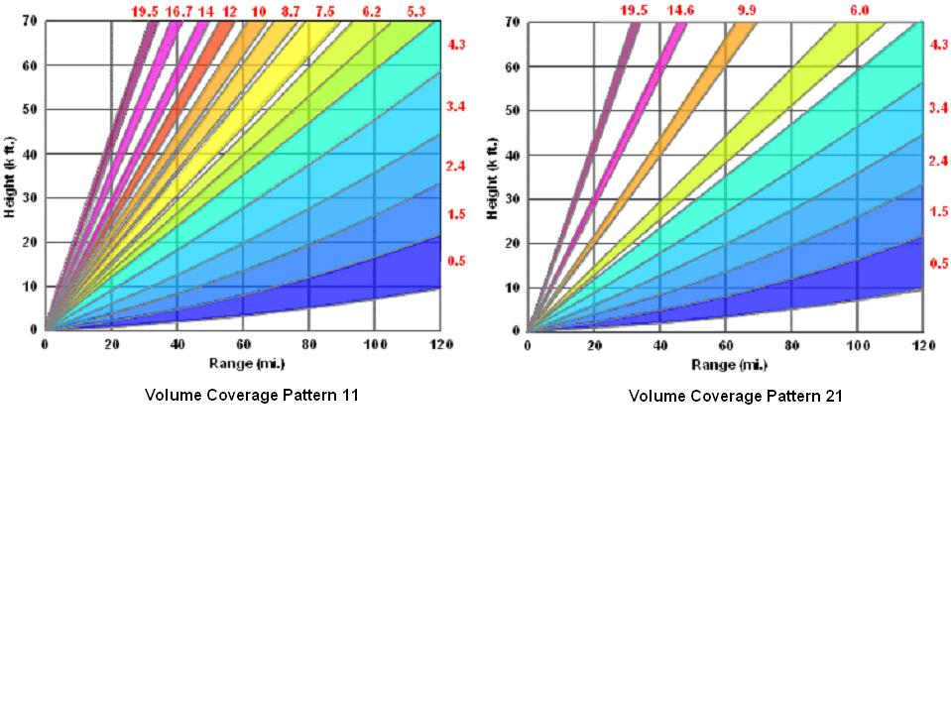
Weather Radar Basics
Doppler radars obtain data by:
  Transmitting electromagnetic energy in brief pulses at specific angles
  Energy returns from precipitation, cloud droplets, mountains, etc.
  Doppler measures strength of return and the component of object motion toward and away from the radar
(NWS, 2003)
Angles used by the WSR-88D
Notes:
To obtain data
- Transmit electromagnetic energy in brief pulses at specific angles
- Energy returns from precip, cloud droplets, mountains, buildings, etc.
- Doppler measures strength of return and object motion toward/away from radar
Let’s look at data from a supercell near Clovis

Slide 5
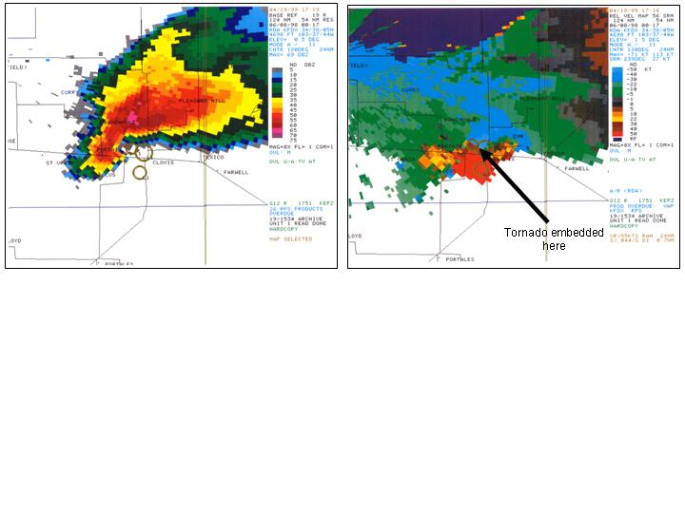
Weather Radar Basics
Technically, radar shows larger shear zones, not the actual tornado
Base reflectivity shows hook echo due to precipitation thrown out of/around rotating updraft core
Storm relative velocity
  Speed of wind toward (cool colors) and away (warm colors) from radar
  The stronger, tighter, & deeper (more than one elevation angle) the rotation, the greater the likelihood a tornado is present
  Time continuity is also important (more than one volume scan)
Base Reflectivity
Storm Relative
Velocity
Supercell Thunderstorm
Notes:
Reflectivity image may show hook echo due to precip thrown out of/around rotating updraft core
Velocity image shows speed at which wind carrying particles moves toward/away from radar
- The stronger, tighter, and deeper the rotation, the greater the likelihood a tornado is present
- Time continuity is also important
- Technically, radar shows larger shear zones, not the actual tornado

Slide 6
Supercell Tornadoes
Occur during a supercell thunderstorm’s mature stage
Preceded by strong mid-level [15-25,000 feet (ft)] rotation (where radars have a better view)
In NM, occur mostly along eastern border with TX during May, June, and July
WSR-88Ds earned excellent reputation with these
Supercell thunderstorms produce the majority of NM’s confirmed tornadoes each year, but not all of them
Notes:
AKA: land spouts, gustnadoes, or spin-ups
Rarely exceed F2 intensity
- May cause damage, injuries, or even deaths.
- Lets take a look at two common formation mechanisms in New Mexico

Slide 7
Non-Supercell Tornadoes
A.K.A. landspout, gustnado, or spin-up
Probably more frequent in Western U.S.
Often unseen or unreported
Form early in thunderstorm lifecycle, sometimes before lightning strikes
May form rapidly near surface then extend upward
May form simultaneously at low and mid levels
Shallow and/or narrow (rarely exceed F-2 intensity)
Larger atmospheric circulations usually cause these to dissipate in only a few minutes
Notes:
AKA: land spouts, gustnadoes, or spin-ups
Rarely exceed F2 intensity
- May cause damage, injuries, or even deaths.
- Lets take a look at two common formation mechanisms in New Mexico

Slide 8
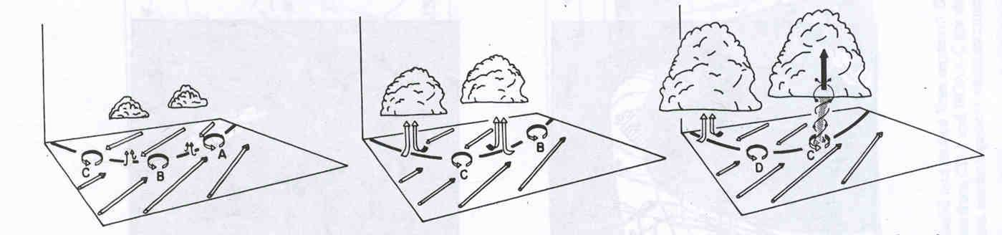
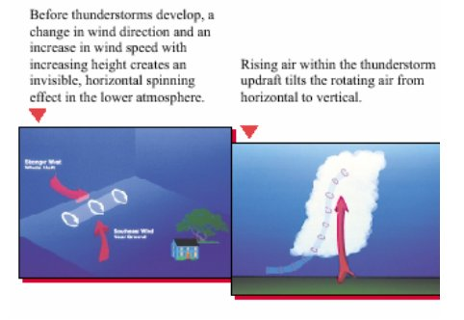
Spin-Up Tornado Formation
Cause 1: small and shallow circulations along surface convergence zone, stretched upward by strong updraft
(Wakimoto et. al., 1988)
Cause 2: horizontal vorticity roll downwind of mountains, tilted to vertical when crossed by a strong updraft
(NOAA, 1999)
Notes:
Shearing instabilities
- Rapidly growing cumulus (Cu) or cumulonimbus (Cb) moves over small near-surface circulation along a boundary
- Tornado forms rapidly near the surface then extends upward as the updraft below the cloud stretches and tightens the circulation by pulling it upward
- Similar stretching can occur when a cumulus or cumulonimbus moves over a dust devil.
Vertically tilted horizontal vorticity
- Cu or Cb moves over horizontal roll (east of mountains) and tilts into vertical
- Tornado may form at low levels or simultaneously at low and mid levels
Now that you understand some basic information about how Doppler weather radars sample the atmosphere and about the types of tornadoes we see out west, let’s examine radar tornado detection limitations more closely

Slide 9
Doppler Radar Limitations
All Doppler radars have difficulty detecting circulations...
Too far from radar
  Beam broadening
  Overshooting
Too close to radar
Blocked from radar view
Dissipate too quickly
Notes:
- These limitations are common to all weather radars

Slide 10
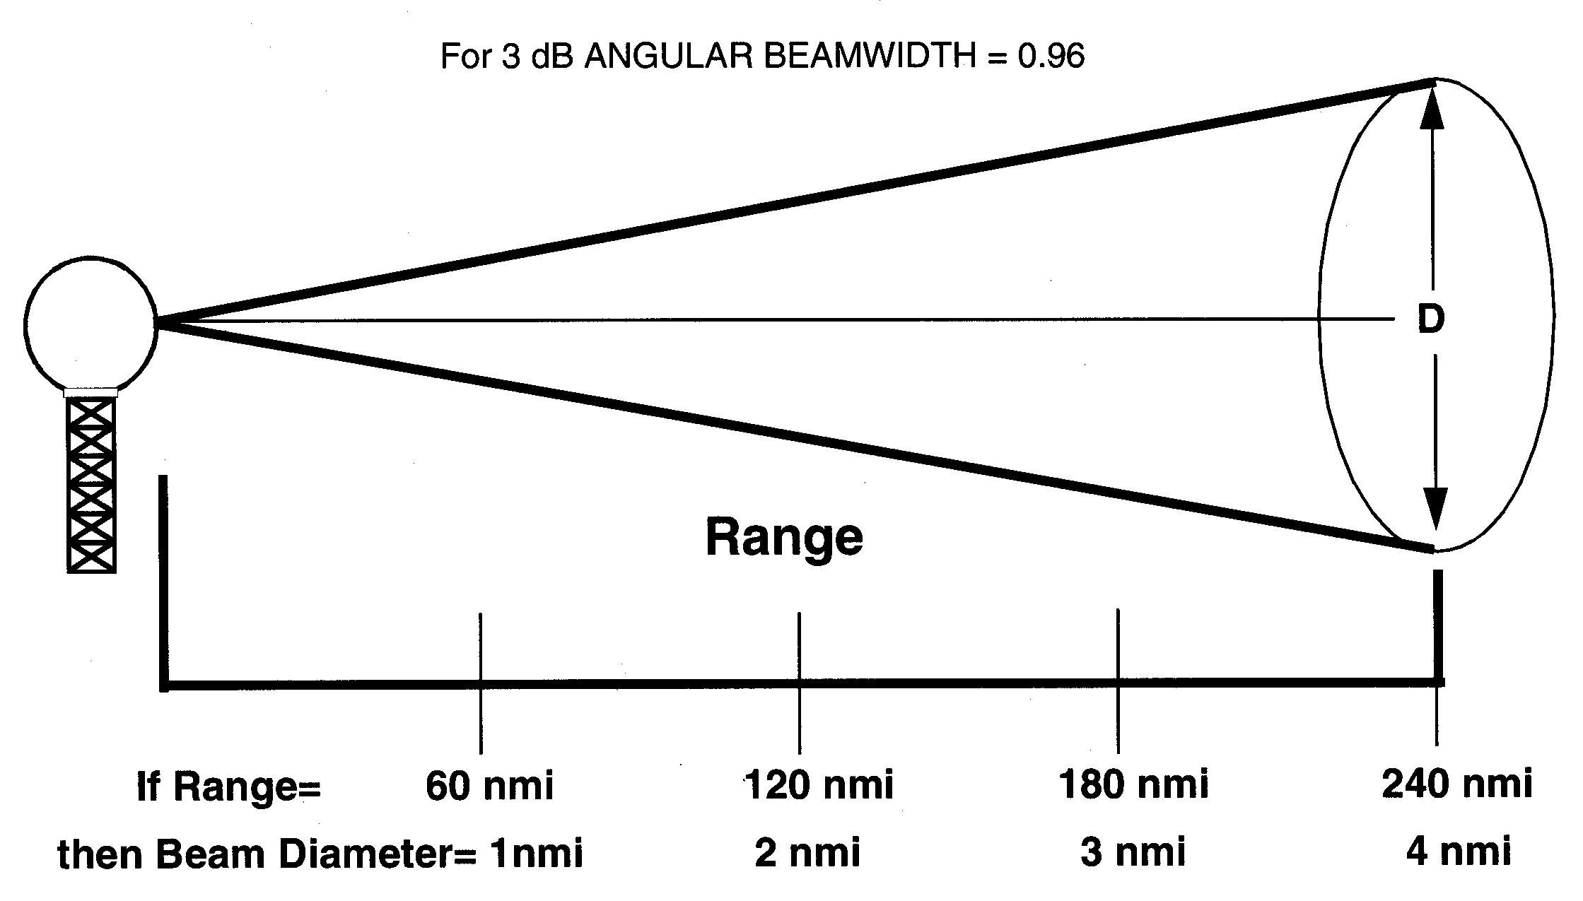
Limitation 1:
Too Far From the Radar
Beam grows too large compared to size of the circulation
  Large # of slow wind returns outside tornado outweigh small # of fast wind returns within
  Averaged away/toward velocities too small to represent a threat
Effective detection range depends on circulation size; effective detection range < 63 statute miles (sm) for the WSR-88D (WSR-88D Operational Support Facility, 1997)
For very small tornadoes, or radars with larger beam diameters, the range shrinks even shorter
Cause 1: Beam Broadening
(WSR-88D Operational Support Facility, 1998)
Notes:
Beam grows too large compared to the size of the circulation
- Large number of slow wind returns from outside the tornado outweigh the relatively small number of fast wind returns from inside the tornado
- Averaged away/toward velocities too small to represent a threat
Thus, w/ any radar, beam broadening limits the range of confident tornado detection. Effective range depends on the size of the circulation.
Example
- WSR-88D’s 0.96 degree angular beam width helps it resolve smaller features
- Practical range of tornado detection still limited to around 55 nm (63.3 sm)
- For very small tornadoes, the range shrinks even shorter

Slide 11
Limitation 1:
Too Far From the Radar
Beams rise above low-level circulations because beams travel away from the radar at an angle
Many NM spin-ups only extend up to about 3,000 ft
Overshot by center of lowest beam at 40 sm from radar
Overshot by center of second lowest beam at 29 sm, so spin-ups may only be detectable out to 29 sm (WSR-88D Operational Support Facility, 1997)
New scan strategy coming
  Adds 3 new angles at lowest levels
  Better vertical display of low-level storm structure
Cause 2: Overshooting
(NWS, 2003)
Angles used by the WSR-88D
Notes:
To obtain data
- Transmit electromagnetic energy in brief pulses at specific angles
- Energy returns from precip, cloud droplets, mountains, buildings, etc.
- Doppler measures strength of return and object motion toward/away from radar
Let’s look at data from a supercell near Clovis

Slide 12
Limitation 2:
Too Close to the Radar
Cone of Silence
Doppler radars don’t sample the atmosphere directly above them
Radars cannot detect circulations that move into the cone of silence
WSR-88D’s cone prevents detection of mid-level circulations within about 11.5 sm of the radar
Neighboring radar beams overshoot the low levels and the lower portion of the mid levels over both the Albuquerque and Cannon AFB radars
(NWS, 2003)
Angles used by the WSR-88D
Notes:
Weather Radars don’t sample the atmosphere directly above them
Circulations that move into the cone of silence cannot be detected
Example
- WSR-88D’s cone inhibits searches for mid level circulations w/ in 10 nm (11.5 sm) of the radar
- Unfortunately, neighboring radar beams overshoot the low levels and the lower portion of the mid levels of the atmosphere above KABX and KFDX

Slide 13
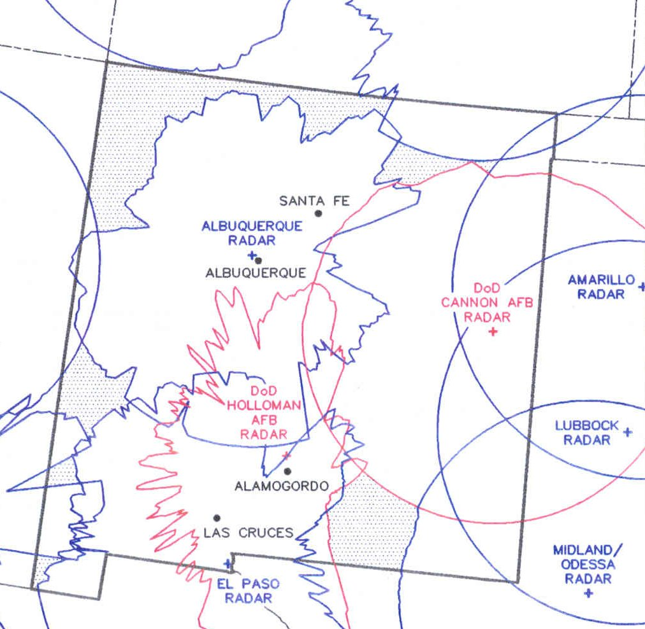
Limitation 3:
Blocked From View
Mountains can shield low-level circulations from view
If not for mountains, we’d see perfect circles of coverage like those in TX
Since lower elevation angles intercept more terrain, coverage decreases below 10,000 ft
Since higher elevation angles intercept less terrain, coverage improves above 10,000 ft
When implemented, the new scan strategy will slightly improve detection capabilities by increasing sampling of the atmosphere just beyond and above mountain tops
Radar Coverage at 10,000 Ft
Notes:
Mountains can shield low level circulations from view
For example
- If not for mountains, we’d see perfect circles of coverage around each radar
- Since lower elevation angles intercept more terrain, there is less coverage below 10,000 ft
-- Better coverage exists above 10,000 ft, except for the area within the cone of silence
- NWS’s new scanning strategy will improve the detection capabilities of radars by increasing the sampling of the atmosphere just beyond and above mountain tops.

Slide 14
Limitation 4:
Dissipate Too Quickly
Many spin-ups may last only a few minutes
Complete atmosphere scan may take 5 or 6 minutes
Forecaster analysis of images and dissemination of a tornado warning takes extra time
Even when detected, spin-ups frequently dissipate before a warning can reach people
New scan strategies will shrink scans to 4.1 minutes
Notes:
Forecaster analysis of images and dissemination of a tornado warning takes extra time
Although these four weather-radar limitations are separate phenomena, they can work together to prevent forecasters from detecting a tornado. Let’s look at a couple examples, then we’ll discuss the NWS’s other tornado detection capabilities and the actions people should take to mitigate New Mexico’s tornado threat.

Slide 15
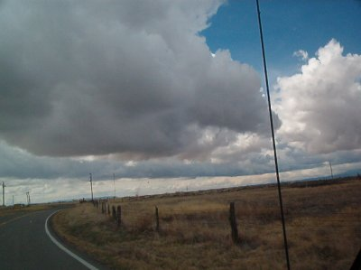
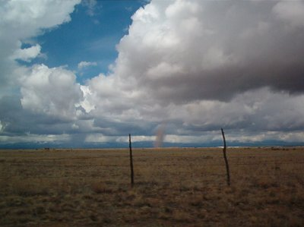
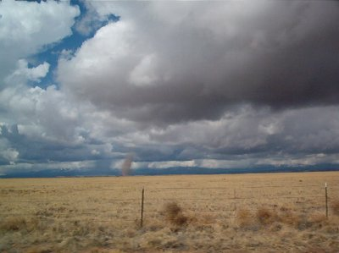
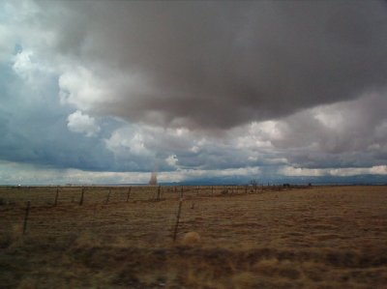
Example 1:
Spin-Up Below Cumulus Cloud
Photo 1
Photo 2
Photo 3
Photo 4
March 2003, Torrance County, east of Manzano mtns.
Not detected by forecasters for 3 reasons
  Too far: 63 sm from Albuquerque radar and 128 sm from Cannon AFB radar
  Manzanos blocked the lowest 1 1/2 beams from Albuquerque radar; radar sampled no lower than 6,000 ft above spin-up
  No rain or thunderstorm activity on this day. Forecasters use the prominent returns from rain, hail and thunderstorm outflow boundaries to identify possible tornado locations.
Notes:
March 2003, Torrance County, east of Manzano Mountains
Not detected by forecasters for 3 reasons
- Too far away for its size: 63 miles from KABX, 128 miles from KFDX
- Manzanos blocked lowest 1 ½ beams from KABX; radar sampled no lower than 6K ft above spin-up
- No rain, hail or thunderstorm activity on this day. Forecasters use the prominent returns of rain shafts, hail shafts and outflow boundaries to help identify updrafts and other favored areas for tornado formation.

Slide 16
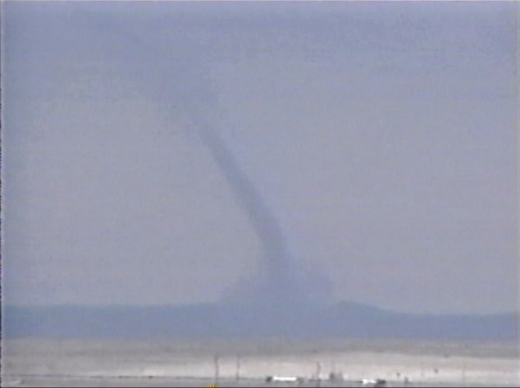
Example 2:
Spin-Up Below Thunderstorm
May 2003, near Willard in Torrance County, east of Manzanos
Storms nearly stationary this day
Forecasters issued a severe thunderstorm warning about 40 minutes before this photo; this spin-up may have developed along the earlier storm’s outflow boundary
59 sm from Albuquerque radar; this tornado may have been big enough to detect
Manzanos blocked lowest 1 1/2 beams from Albuquerque radar; radar sampled no lower than about 5,000 feet above this spin-up
Notes:
May 2003, near Willard in West Central Torrance County, east of Manzanos
Not detected, but forecasters did issue a severe thunderstorm warning nearby 40 minutes before photo. Storms were nearly stationary on this day.
- No strong and sizeable mid level rotation
- At 59 sm from KABX, may have been large enough compared to beam diameter for detection
- Manzanos blocked lowest 1 ½ beams from KABX; radar sampled no lower than around 5K or 6K feet above spin-up
Fully aware of the limitations of weather radars, NWSFO ABQ uses a variety of other means to detect and warn for tornadoes. I’ll close our discussion of tornado detection limitations with a brief explanation of these other means, and give you some ideas how to prepare and respond appropriately to the tornado threat.

Slide 17
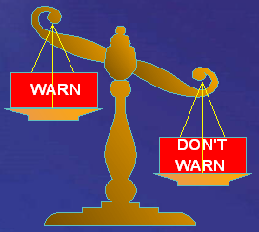
Other Tornado Detection Capabilities
Storm Prediction Center guidance
Weather models
Satellites, profilers, soundings, upper-air data, surface obs
Storm spotters
News media, law enforcement and public reports
Research collaboration
  Testing new scan strategy
  Will help confirm sonar’s ability to detect tornadoes
Notes:
Research collaboration
- Currently operationally testing new scanning strategies on KABX
- Will soon help confirm sonar’s ability to detect tornadoes

Slide 18
Prepare & React Appropriately
FEMA’s tornado safety tips brochure: www.fema.gov/hazards/tornadoes/tornadof.shtm
Watch for small tornadoes early with all thunderstorms; remember our first spin-up example
Useful NOAA forecasts
  U.S. hazards assessment
  Severe weather outlook, mesoscale discussions, watches
  Hazardous weather outlook & warnings
Use NOAA weather radios
Report tornadoes to NWS, if safely possible
Notes:
Remember our first spin-up example: brief but dangerous tornado-like circulations can occur without any other signs of a thunderstorm
We will always need spotter, news media and public reports, because they may provide ground truth information that wouldn’t otherwise be available

Slide 19
Bottom Line
WSR-88D’s do a good job at what they’re designed to do: detect strong mid-level circulations
All weather radars have limitations
Small tornadoes frequently exploit these limitations in New Mexico
NWS forecasters use all available resources to overcome tornado detection limitations
Weatherwise media & public can prepare for this dangerous threat and react appropriately when tornadoes strike
Notes:
Future technology
- Polarimetric radars (dual-polarization radars)
Most weather radars, such as the WSR-88D, transmit radio wave pulses that have a horizontal orientation. Polarimetric radars, transmit radio wave pulses that have both horizontal and vertical orientations. The horizontal pulses essentially give a measure of the horizontal dimension of cloud (cloud water and cloud ice) and precipitation (snow, ice pellets, hail, and rain) particles while the vertical pulses essentially give a measure of the vertical dimension. Since the power returned to the radar is a complicated function of each particles size, shape, and ice density, this additional information results in improved estimates of rain and snow rates, better detection of large hail location in summer storms, and improved identification of rain/snow transition regions in winter storms. Engineers at the National Severe Storms Laboratory are currently working to develop a polarimetric NEXRAD Doppler radar. Polarimetric technology should be available for installation into the national radar network in 5-10 years.
- Phased array radars
-- Uses multiple beams and frequencies to reduce scans to 1 minute
-- more detail of lowest elevations
-- allows observation of rapidly changing low-level wind flow

Slide 20
References
NOAA, 1999: Thunderstorms…tornadoes…lightning… nature’s most violent storms. A preparedness guide. NOAA/PA #99050, ARC 1122, 16 pp. Cited 2004. [Available online at http://www.nws.noaa.gov/om/brochures/ttl.pdf].
NWS, cited 2003: NWS radar FAQs page. [Available online at http://weather.noaa.gov/radar/radarinfo/radarinfo.html].
Wakimoto, R.M., and Wilson, J.W., 1988: Non-supercell tornadoes. Mon. Wea. Rev., 117, 1113-1140.
WSR-88D Operational Support Facility, May 1997: WSR-88D operations course student guide. Version 9704.
WSR-88D Operational Support Facility and Titan Systems Group, July 1998: WSR-88D Principal User Processor Operator Handbook. Volume II, Applications Terminal, Software Version 10.0, 267 pp.

Slide 21
Tornado Detection & Limitations*
April 2004 Media Workshop
Questions for David Craft?
David.Craft@noaa.gov
*Limitations common to all Doppler weather radars

