Slide 1




The Early Detection Research Network:
Biomarker Developmental Laboratories (BDL)
RFA-CA-05-023
Pre-submission Meeting
November 3rd, 2004
Jacob Kagan, M.Sc., Ph.D.
Cancer Biomarkers Research Group
Division of Cancer Prevention
National Cancer Institute

Slide 2
The information presented in following
slides is a general overview. Applicants
must consult RFA CA-05-23 for detailed
information on the scope of this RFA,
application procedures, and review
criteria

Slide 3
BDL RFA-CA-05-023
This RFA is a reissue of RFA-04-006, which was published in the NIH Guide on September 22, 2003
The purpose is to invite new and competing renewal cooperative agreement and NIH intramural applications to continue the national Network that has the responsibility for development evaluation and validation of biomarkers for earlier cancer detection and risk assessment
The RFA is available at: http://grants1.nih.gov/grants/guide/rfa-files/RFA-CA-05-023.html

Slide 4
Receipt and Review Schedule
Letter of Intent Receipt Date: November 22, 2004
Application Receipt Date: December 20, 2004
Peer Review Date: March 2005
Council Review: June, 2005
Earliest Anticipated Start Date: July 1, 2005

Slide 5
Mechanism of Support
Cooperative Agreement award mechanisms (U01)
The Principal Investigators retain the primary responsibility for planning, directing, and executing the proposed projects
NIH Program Coordinator is substantially involved as a Partner with the Principal Investigators

Slide 6
Definition
Biological Marker (Biomarker)
A characteristic that is objectively measured and evaluated as an indicator of normal biologic processes, pathogenic processes, or pharmacologic responses to a therapeutic intervention.
Source: Biomarker Definitions Working Group - 1998

Slide 7
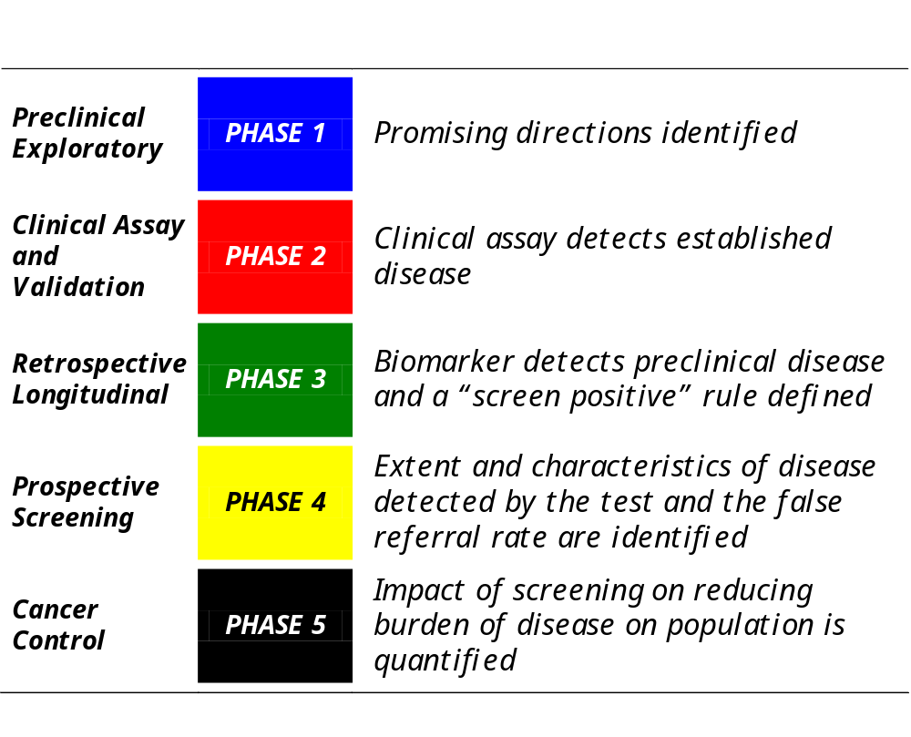
Goals
Early Detection Research Network
Phases of Biomarker Development and Validation
Pepe, SM. J Natl Cancer Inst. 2001 Jul 18;93(14):1054-61.

Slide 8
Phase II and Phase III Studies
The EDRN is primarily focusing on Phases II and III
Phase II: studies to determine the capacity of biomarkers to distinguish between people with cancer and those without.
Phase III: studies to assess the capacity of a biomarker to detect preclinical disease by testing the marker against tissues collected longitudinally from research cohorts.

Slide 9
The Primary Roles of the Biomarker Developmental Laboratory – BDL
The primary roles of the Biomarker Developmental
Laboratory (BDL), within the Early Detection Research
Network (EDRN), are to develop and validate biomarkers
for early cancer detection and or risk assessment; and to
move discoveries form the laboratories to patient or
population research setting or to move observations
from patients setting back to the laboratory.

Slide 10
Biomarker Developmental Laboratory – BDL
The BDL may also develop relevant technologies and assays for biomarker detection, and analytical tools for the evaluation of biomarkers. A Major components of this process are to standardize assays and to develop methods of analytic quality control.

Slide 11
The Biomarker Developmental Laboratory –
BDL Continued..
Among other, the laboratory should have knowledge and practical experience with Standard Operating Procedures (SOPs) and in evaluation of the accuracy, precision reproducibility and performance characteristics (e.g., sensitivity and specificity and positive and negative predictive values of tests in multi-center settings)

Slide 12
Two Ways to Participate in EDRN Collaborative Studies
Participate in collaborative network validation studies
Participate in analytical validation studies as requested by the SC

Slide 13
Submitting an Application
Use the standard PHS 398 forms
The research plan (sections A to D) should be
replaced with the following sections:
The Applicant
Major objectives and experience
Specialized or unique facilities; Cores;
Institutional and Private sector resources that might be used support the project
Ongoing Grant Support;
The roles of key personnel, collaborators, consultants

Slide 14
Submitting an Application
2) Scope of Research
For competing renewal applicants, section 2 should also have a description of the goals of the previous grant and include the scientific progress form the previous project period. Indicate the status of developed markers according to the biomarker developmental phases (Pepe et. al., 2001).

Slide 15
Submitting an Application continued ..
For all applicants, depending on the composition and structure of the group, this section may be organized as distinct projects or as one integrated plan; in either case, the page limitation is the same.
Define the major research questions and apportunities related to objectives of EDRN that their group effort proposes to undertake.
Applicants should describe the approaches to be taken by the group in the aggregate or as inter-dependent projects, and should describe the rationale for approaches to be used or planned for development.
Highlight how the diverse expertise of the group contributes to innovation, and flexibility to redirect research when scientific progress warrants it; ability to anticipate new directions, based on their individual experience; and ability to contribute to the Network collective effort.

Slide 16
Submitting an Application continued ..
3. Collaborations
For competing renewal applications, applicants should describe their participation in the EDRN activities, and the contributions in terms of collaborations within, and outside the Network in meeting the EDRN missions (see EDRN Second Report, http://www3.cancer.gov/prevention/cbrg/edrn/edrn_report2002.pdf, Metrics for Programmatic Evaluation). Also they are required to list all approved collaborative studies by the EDRN Executive Committee. Letter of approval or the minutes of the EDRN Executive Committee indicating the approval should included in Appendix.

Slide 17
Submitting an Application continued ..
For new applications, applicants should describe the experience of their group in collaborative programs and activities with academic and industry partners.
Examples:
demonstrated evidence of collaborative projects and publications
demonstrated evidence of collaborative funding; and
sharing of data and resources, e.g., specimens, technology, research protocols.
The collaborative requirements are integral to EDRN activities and applications will be judged for their scientific merits of the collaborative study, not just the individual study.

Slide 18
Submitting an Application continued ..
In Section 3, applicants must include their specific plans for responding to the "Cooperative Agreement Terms and Conditions of Award" section.
State their willingness to collaborate and share data freely with the other EDRN components
To participate in planning and attending workshops and symposia
To serve on the SC and be bound by its decisions
To be able and willing to share data and research resources with each other and the NCI.

Slide 19
Submitting an Application continued ..
At the end of Section 3, applicants must append a letter from the applicant institution describing how that institution intends to meet the NIH policies for sharing of data or why data sharing is not possible. In this regard, attention is drawn to the NIH Final Statement on Sharing Research Data (http://grants.nih.gov/grants/policy/data_sharing/index.htm and http://grants.nih.gov/grants/guide/notice-files/NOT-OD-03-032.html), which was published in the NIH Guide on February 26, 2003.

Slide 20
Budget
Administrative costs
Travel expenses: PI and one senior investigator to attend two EDRN Steering Committee meetings and one workshop or symposia per year
May include salary support for the PI’s administrative staff
Collaborative Study
When you join an EDRN collaborative study, funds will be allocated from EDRN core funds to cover costs. Upon EDRN SC approval core fund may be also used to cover analytical validation of biomarkers, assay development and refinement, data management, etc.

Slide 21
Budget
Set aside 20% of Annual budget for EDRN Validation and other Collaborative Studies
The competing renewal applicant should set aside funds from the first year onward
The new applicant should set aside funds after the first year onward for Network collaborative studies.
The use of these set-aside funds will be restricted and must be reviewed and approved by the Steering Committee and then recommended to, and approved by the NCI for release from the individual U01 awards

Slide 22
Budget
3) Budget for Data Collection on relevant common data elements (CDEs)
4) Research Budget - as for R01 grants

Slide 23
Review Criteria
Significance
To what extent are the specific aims integrated to address the proposed goals?
The proposed research should reflect the urgency of scientific needs in the area of biomarker-based diagnostics possible only through a consortium or a network approach
Does the proposal uniquely discuss challenges and issues relevant to cancer detection and screening?
How would the proposed research complement or augment existing detection systems or methodologies?

Slide 24
Review Criteria
Does the research plan fit the EDRN- established phases of biomarker development for early detection of cancer?
Indicate the potential of moving biomarkers to Phase II or Phase III in the next five years
What is the potential impact of these studies, if successful?

Slide 25
Review Criteria continue…
2. Approach
Has the applicant clearly defined their objective, hypothesis and scientific plan?
Is the study design, methods, and analyses adequately developed and appropriate to address the specific aims?
Discuss potential pitfalls and alternative strategies
Adequate sample size and statistical methods
Are biomarkers characterized by parameters, such as sensitivity, specificity, and predictive value?

Slide 26
Review Criteria continue…
Discuss how you intend to minimize biases and reproducibility issues in the proposed study design?
Does the applicant have demonstratable evidence for bringing biomarkers to Phase II or Phase III?
Are the chosen approaches suitable for the development of biomarkers/reagents in other cancers?
Is the proposed approach or technology adaptable, or has the potential to analyze large samples in population setting for screening purposes?

Slide 27
Review Criteria continue…
3. Innovation
Is the project original and innovative?
Does the proposed project challenge existing paradigms or clinical practice?
Does the project develop or employ novel concepts, approaches, methodologies, tools, or technologies for this area?
Will the approaches advance the field of biomarkers/reagents development in the context of cancer detection and risk assessment?

Slide 28
Review Criteria continue…
4. Investigators
Does the principle investigator, the key personnel and the collaborators have appropriate training and experience to execute the project.
Does the PI have track record of publishing papers relevant to cancer detection and risk assessment?
Have the investigators establish a collaboration/s or teamed with a consultant to complement and enhance their expertise?
How will this team of investigators contribute their unique skills to assist the Network in the development and validation of Biomarkers?

Slide 29
Review Criteria continue…
5. Environment
Access to required human specimens, e.g. tissues, biological fluids, archived materials, normal controls, pathology reports etc.
Does the scientific environment in which the work will be done contribute to the probability of success?
Evidence of institutional support
Has the applicant adequately addressed his/her institutional patent policy

Slide 30
Review Criteria continue…
6. Additional Review Criteria
6.1. Collaborative Strengths and Interactions
Are there adequate plans for effective collaboration with the other EDRN components (DMCC, BDL, CEVC, SC) and NCI?
Do the investigators state their willingness to abide by the priories and policies agreed upon by the SC for collaborative studies?
Plans for the set up of sound communication procedures among the EDRN collaborators
Are plans for collaborations provided for individual research objectives?
state your willingness to collaborate and share information

Slide 31
Review Criteria continue…
6.3. Protection of Human Subjects form research risk
6.4. Inclusion of women, minorities and children in research
6.5. Care and use of vertebrate animals in research
6.6. Sharing Research Data
Applicants must include a data sharing plan in their application. The reasonableness of the data sharing plan or the rationale for not sharing research data will be assessed by the reviewers. However, reviewers will not factor the proposed data sharing plan into the determination of scientific merit or priority score.

Slide 32
Review Criteria continued..
6.7. Budget
Does the budget reflect that applicant understands the requirements of managing a BDL in the Network enterprise?
Is the commitment of effort appropriate to the scope of the project, and are the resources and environment adequate to support the project?

Slide 33
Review Criteria continued..
For competing renewal applications, applicants will be also evaluated on their performance of EDRN validation and developmental studies, and their overall contribution to collaborations within, and outside the Network in meeting the EDRN missions (see EDRN Second Report,
http://www3.cancer.gov/prevention/cbrg/edrn/edrn_report2002.pdf, Metrics for Programmatic Evaluation).

Slide 34
Award Criteria
Scientific merit (as determined by the peer review)
Availability of funds
Programmatic Priorities

