Slide 1

Optical Entanglement and
Single-Photon Detection
Alexander Sergienko
Quantum Imaging Laboratory
Department of Electrical & Computer Engineering
Department of Physics
Photonics Center
Boston University
AlexSerg@bu.edu
http://people.bu.edu/alexserg ; http://www.bu.edu/qil

Slide 2




Incorporating QKD into the Internet
Building the DARPA Quantum Network
Copyright © 2001 by BBN Technologies.
All Rights Reserved.
Harvard
University

Slide 3
Entangled source point-to-point link
(heterogeneous composite schematic)
fiber or free-space transmission
ALICE
near IR
or
telecom IR
Single-photon or number sensitive
continuous
or
pulsed
phase or polarization qubits
BOB
Generation
Propagation
Detection

Slide 4
Entangled State Generation
Non-collinear Type-II SPDC
to Bob
Laser
Aperture
NLC
(χ⁽²⁾)
top view
to Alice
Dichroic
Mirror
Bob’s
photon beam
Alice’s
photon beam
Polarization
Entanglement

Slide 5
Entangled Source point-to-point link
Femto SPDC
ALICE
      Femto
      Output
      Fast PIN for Trigger
Micro Mirror
      Shutter
      Optical Trigger System
BOB
      SPCM
      BS in Fiber
      PBS in Fiber
      λ/2 in Fiber
      PBS in Fiber
      Trigger

Slide 6
Implementation of Quantum Hardware for
Secure Key Distribution (Quantum Cryptography)
Weak Coherent States
Good
LASER
  OA
Correlated Two-Photon State
Better («0» removed)
LASER
  SPDC
“click”
“no click”
Correlated Two-Photon State
With photon number detection
Better
(«0» and «2» removed)
LASER
  SPDC
2
  PNR
  P
1
0

Slide 7
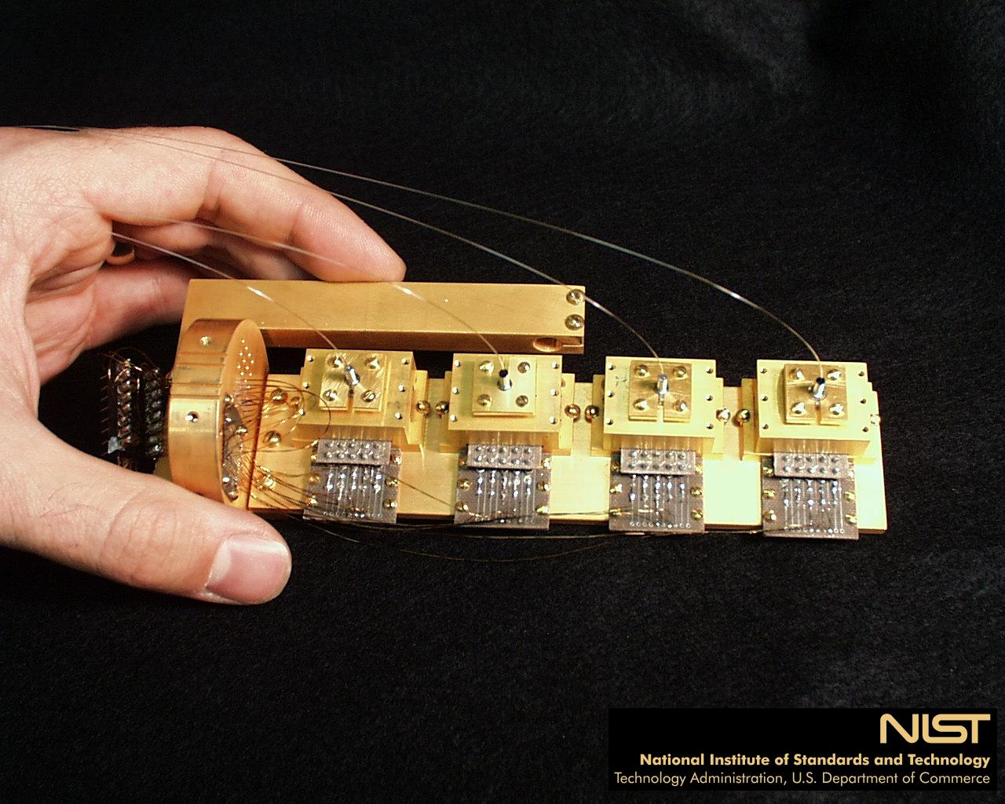
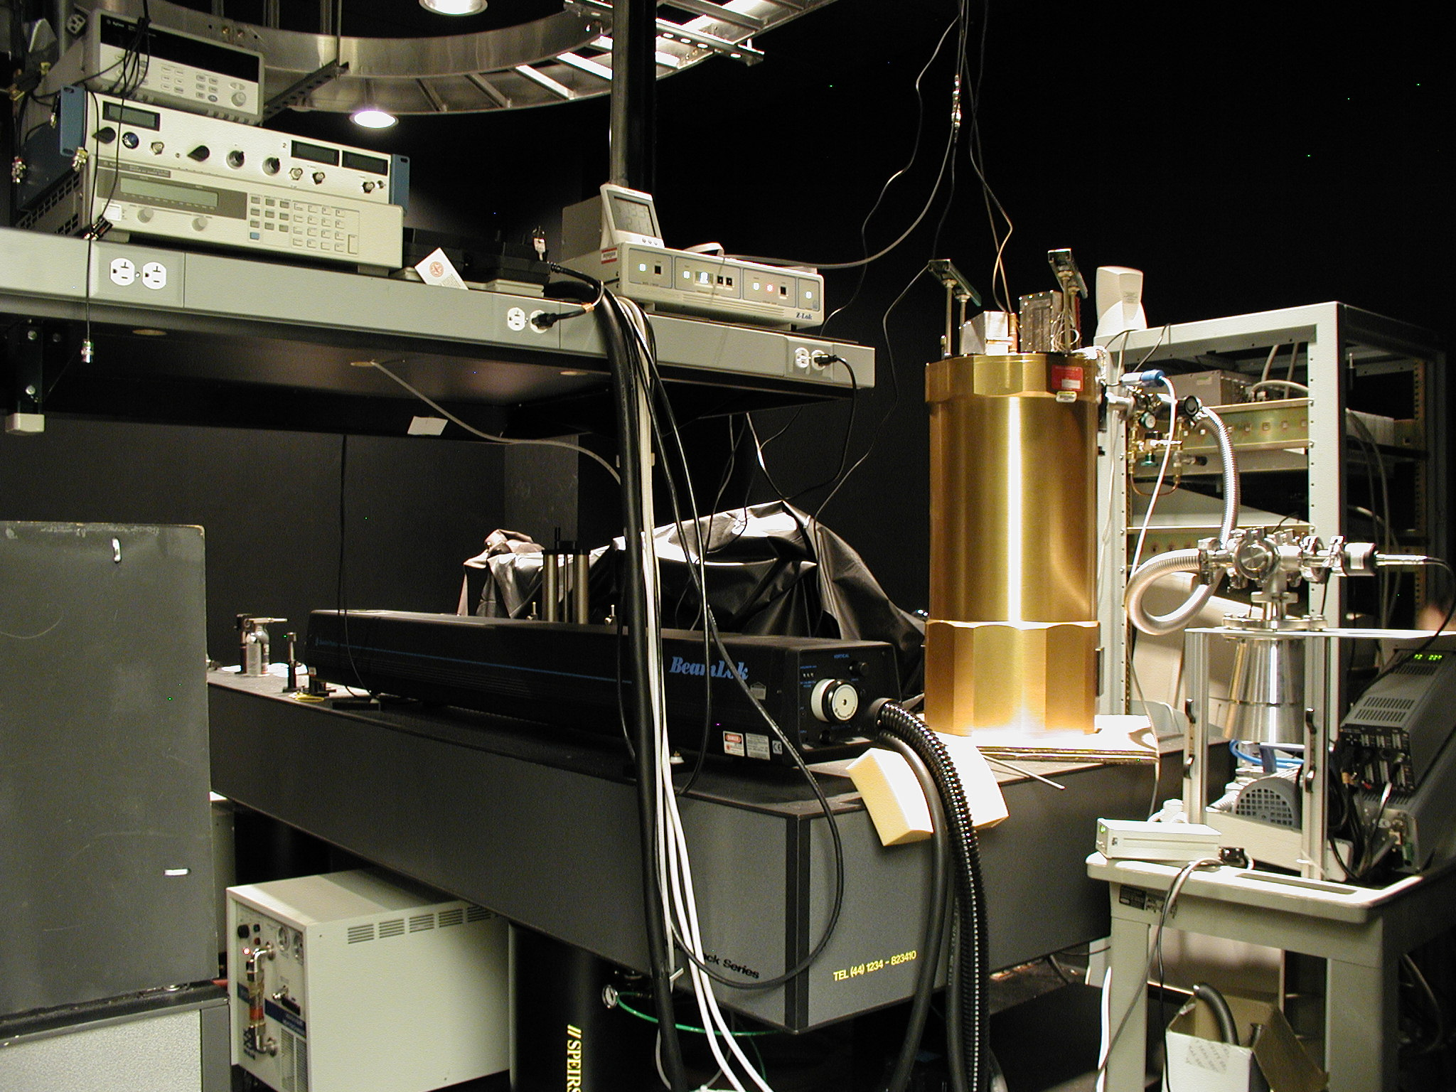
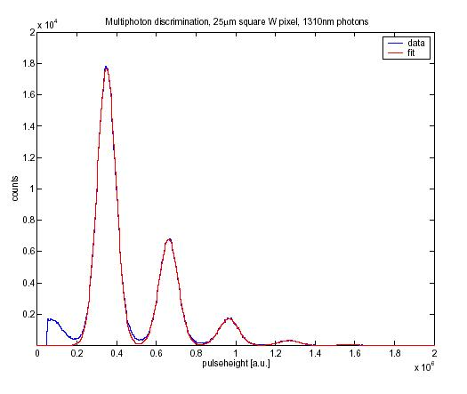
NIST (Boulder) Photon-Number Resolving Detector at BU

Slide 8
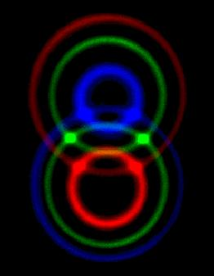
Post-selection and Entanglement
χ⁽²⁾ crystal
UV laser
|ψ>_{SPDC} ∼ | H >| V >
Type - II
(polarization)
Rc
~L_{crystal}
δt
polarization
analyzers
C
δt
|ψ>_{SPDC} ∼ | H >| V > − | V >| H > + | H V >| 0> − | 0>| V H >

Slide 9
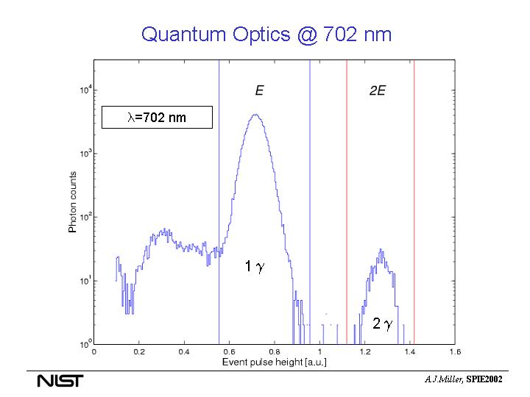
1 γ
2 γ

Slide 10
cw LASER (351.1 nm)
DICHROIC
MIRROR
COUNTING
ELECTRONICS
BBO
1.5 mm
TYPE-II
PNR
DETECTOR
B
RELATIVE
DELAY
τ
POLARIZATION
ANALYZERS
A
FILTER
RG 630
APERTURE
2 mm
BEAM
SPLITTER
PNR
DETECTOR

Slide 13


Role of detection time and detection area
in multi-photon excitation processes
H_{Aj} (x_{A},q;ω)
x_{A}
χ⁽²⁾(z)
x_{B}
H_{Bj} (x_{B},q;ω)
Generation
Propagation
Detection

